Slide 1
Strategies for Employers to Increase Self-Identification of Veterans and People w/ Disabilities
Fast-Track Strategies for Military Engagement: Unlocking the Potential of Military Talent in Your Organization

Slide 2
Who is rob and why is he here?
Eradicate underemployment within the military-connected community
Rob Arndt
Founder & CEO
Marine Veteran
Rob@BufferSprings.com
veterans
by
for
with
is proud to be a

Slide 3
Who is ?
Tailored Plans
Develop customized affirmative action plans for protected veterans
Ensure compliance & maintain thorough record-keeping
Customized Training
Provide comprehensive VEVRAA & Section 503 compliance training
Foster a deep understanding of equal employment opportunities within your team
At BufferSprings, we are dedicated to eradicating underemployment within the military-connected community. We partner with smart employers to help them become “Military-Effective” organizations, ensuring all hands are on deck for success.
As a strategic partner, we develop competitive and VEVRAA-compliant talent programs, aimed at building a robust military-connected community within your organization and enhancing your employer brand.
Strategic Outreach
Attract top-tier protected veterans
Utilize diverse recruitment sources & veteran associations
Benchmark Setting
Help partners exceed industry standards for hiring & inclusion
Establish new benchmarks for success
Data-Driven Decisions
Leverage data analytics to inform &enhance strategies
Continuously refine & optimize recruitment & retention efforts
veterans
by
for
with

Slide 4
who owns a pair of Crocs?
who Here owns a pair of

Slide 5
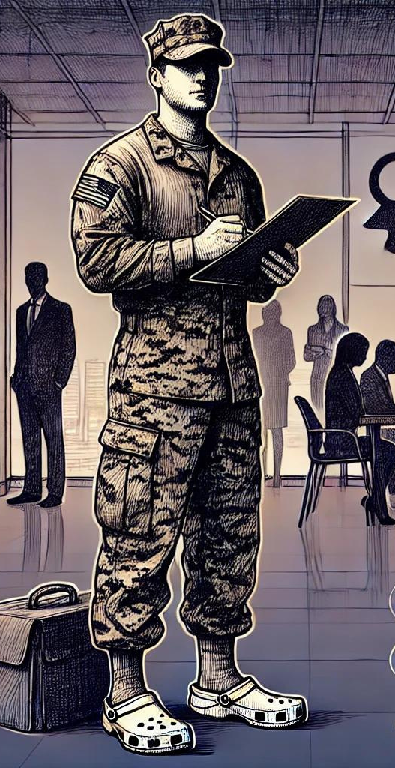
who here owns a pair of
Priority Hiring Programs: Dedicated recruitment and promotion initiatives.
Tailored Support: Specialized career counseling and mentorship.
Training Opportunities: Exclusive skill enhancement and leadership development.
Financial Incentives: Signing bonuses, relocation assistance, and retention bonuses.
Flexible Policies: Remote work, flexible hours, and necessary accommodations.
Employee Resource Groups (ERGs): Networking and support platforms.
Recognition Programs: Awards celebrating achievements and contributions.
Healthcare Benefits: Comprehensive coverage including mental health and wellness.
Educational Assistance: Tuition reimbursement and scholarships.
Transparent Benefits Communication: Clear information on available support.
Partnerships: Collaboration with Croc-friendly organizations.
Accessible Technology: Tools enabling effective job performance.

Slide 6
Session Goals
Understand the importance of self-identification.
Learn actionable strategies to encourage self-identification.
Foster a culture of authenticity and inclusion.
Ensure compliance with OFCCP’s VEVRAA & Section 503.

Slide 7
Understanding the Premise
Explanation of self-identification:
Voluntary disclosure of veteran, military spouse, and/or disability status.
Importance for individuals:
Access to tailored support, career development, & community.
Importance for employers:
Understanding workforce demographics, enhancing diversity & inclusion.

Slide 8
The Employer's Perspective
Why Self-Identification Matters for Employers
Understanding Workforce Demographics:
Enhancing diversity & inclusion.
Leveraging unique skills & experiences of military-connected employees.
VEVRAA & 503 Compliance:
How self-identification supports compliance & its benefits.

Slide 9
Self-Identification in the Employment Process
Application Stage
Encourage self-identification during the application process to understand the talent pool.
Onboarding
Reiterate self-identification during onboarding to ensure new hires feel supported & included.
Ongoing Updates
Implement regular check-ins & updates to maintain accurate data & continue support throughout employees' tenure.

Slide 10
the military & Disability perspective
Common hesitations:
Fear of discrimination
Privacy concerns
Uncertainty about the benefits
Positive impact on career opportunities & personal growth?

Slide 11
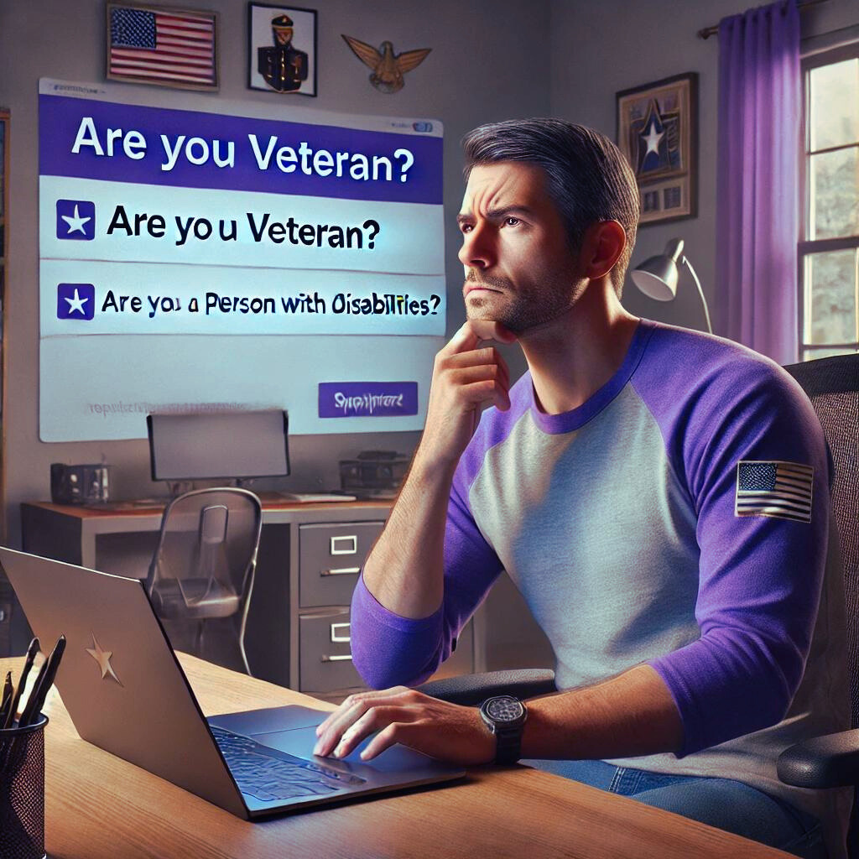
the experience matters

Slide 12
Self-Identification in the Employment Process (2)
Self-Identification in the Employment Process
Application Stage
Onboarding
Ongoing Updates

Slide 13
Bridging the Gap
Importance of creating a culture of authenticity.
Celebrating differences as strengths.
Building trust & transparency.
Meeting Halfway & Creating a “Military-Effective” Culture of Authenticity and Inclusiveness.
Strategies for fostering an authentic workplace culture.

Slide 14
wiifm?
employer
vet - milspouse - IWD
Diverse Talent Pool:
Access broad skills & experiences.
Tailored Support:
Access specialized career counseling & mentorship.
Reputation & Compliance:
Enhance image & meet diversity regulations.
Career Advancement:
Clear pathways for skill development & promotion.
Priority Hiring:
Dedicated recruitment for veterans, milspouses, & IWDs.
Flexible Policies:
Enjoy remote work, flexible hours, & accommodations.
Leadership Development:
Strengthen leadership pipeline with diverse perspectives.
Sense of Belonging:
Join a respectful, supportive workplace community.
Workplace Culture:
Foster an inclusive environment that values diversity.
Comprehensive Benefits:
Robust healthcare, wellness programs, & education & support.
Engagement & Retention:
Increase morale & loyalty in an inclusive environment.
Impactful Roles:
Roles leveraging military experience to make meaningful contributions.

Slide 15
Progression & Advancement Paths
Cross-functional Opportunities
Career Progression Discussions
Advanced Education Support
Mentorship & Coaching Programs
Recognition & Rewards
Continuous Learning & Development
Basic Training & Orientation
Technical Training
Leadership Pathways
Certification Programs

Slide 16
strategies for engagement
community
erg
Activating Stakeholders for Success
mentors
battle buddies

Slide 17
Moving Beyond Lip Service
Concrete steps to move beyond superficial support.
Establishing meaningful programs & policies.
Measuring impact & continuous improvement.

Slide 18
Action Planning & Wrap-Up
Personalized Action Plans
Floor is now open for questions & final thoughts.
Key takeaways:
Understanding the importance of self-identification.
Implementing actionable strategies.
Fostering a culture of authenticity and inclusion.
Consider the experience for all stakeholders in the process.

Slide 19
Supporting Your Mission
As you build the most military-effective talent program known to mankind, know that we have your back and take the word "partner" seriously.
We will provide you with exceptional tools and training, including this free Guide to “Hiring Veterans the Smart Way.”
This comprehensive guide is filled with valuable information on Federal Contractor requirements, military culture insights, and strategies for hiring and retaining veterans and military spouses.
Enjoy! And don’t forget to share with your battle-buddies building this program with you.
It takes a village!

Slide 20
Together we can make systemic & lasting change
for marching with us!!
ROB ARNDT
Founder & CEO
Marine Corps Veteran
Rob@BufferSprings.com
veterans
by
for
with
is proud to be a

