Slide 1
Key Communication Strategies for Engaging in the Interactive Process
AskJAN.org
JAN is a service of the U.S. Department of Labor’s Office of Disability Employment Policy/ODEP.

Slide 2
National Disability Employment Awareness Month (NDEAM) October 2024
NDEAM celebrates the contributions of America’s workers with disabilities and showcases supportive, inclusive employment policies and practices that benefit employers and employees.
DOL.gov/NDEAM

Slide 3
Training Overview
Key Communication Strategies for Engaging in the Interactive Process
Successful employment outcomes achieved through the interactive accommodation process hinge on effective communication among all parties involved. This Job Accommodation Network (JAN) training emphasizes the significance of constructive dialogue and collaborative exploration to find reasonable workplace accommodation solutions that meet the diverse needs of workers with disabilities. Participants will receive key strategies for facilitating accommodation discussions and learn about JAN services and resources designed to support the interactive process.
60 minutes

Slide 4
Job Accommodation Network (JAN)
A national, free consulting service that was established in 1983
The leading source of expert and confidential guidance on workplace accommodations
A service of the U.S. Department of Labor’s Office of Disability Employment Policy (ODEP)

Slide 5
Why provide workplace accommodations?
Reasonable accommodations play a role in elevating the productivity of all employees and can help employers:
Attract good employees in times of labor shortages
Hire employees who are adaptable, flexible, and capable
Retain an experienced workforce
Meet legal obligations under Title I of the Americans with Disabilities Act (ADA) or similar laws, when applicable

Slide 6
Accommodations: Low Cost, High Impact
JAN survey results indicate that accommodations are typically no or low cost and positively impact the workplace
Low Cost, High Impact Report

Slide 7
“Reasonable” Accommodation
A modification or adjustment to a job or work environment that permits an applicant or employee with a disability to participate in the hiring process, perform the essential job functions, or enjoy equal benefits and privileges of employment—Title I of the Americans with Disabilities Act (ADA)
Reasonable means “feasible” or “plausible”—possible to provide without undue hardship
Undue hardship—an action requiring significant difficulty or expense (high threshold)
Must be effective—enables applicant to compete or employee to perform essential functions
Enforcement Guidance on Reasonable Accommodation and Undue Hardship under the ADA (EEOC)

Slide 8
When must an accommodation be provided?
When a covered employer is aware that a person with a disability needs one to apply for a job, perform a job, or enjoy equal benefits and privileges of employment—unless it would cause undue hardship for the employer
Request for accommodation typically triggers the interactive process
Generally, the individual with a disability must inform the employer that an accommodation is needed—employer is not expected to guess
Request can be stated or written in plain language and need not mention the "ADA" or “reasonable accommodation”

Slide 9
What is an accommodation request?
Any request by an applicant or employee for an adjustment or change for a reason related to a health condition/disability is an accommodation request
“I am neurodiverse and need interview questions in advance.”
“I'm having difficulty concentrating because of the side effects of medication.”
“My wheelchair won’t fit under my desk.”
Healthcare provider’s note requests 3 months of leave for medical treatment
“I need to go to counseling appointments and want to flex my schedule.”
Recognizing an Accommodation Request

Slide 10
Unsure if it’s an accommodation request?
Facilitate a collaborative dialogue:
“How can I help?”
“What do you need to be successful?”
“I want to clarify what you’re asking for and why it’s needed, so I can find out what we can do to help.”
Mother May I? Must I? Should I?
How Can I Help?

Slide 11
Accommodation Request Strategies
Decide how to request (e.g., face-to-face, email, formal letter, etc.)
Decide who to ask (e.g., supervisor, human resources)
Explain why an accommodation is needed and offer accommodation ideas
Follow-up on the request as needed
When requested by the employer, provide necessary medical information
Requesting and Negotiating a Reasonable Accommodation
How to Request an Accommodation: Accommodation Form Letter
Sample Language for Accommodation Request Letters

Slide 12
Sample Accommodation Request: Mental Health
Dear [insert employer’s name here]:
I have been having medical issues that have affected my mood, sleep schedule, concentration, and focus. I would like to request accommodations so that I might be able to perform my job effectively before my performance starts to suffer.
Workplace distractions interfere with my concentration and focus so I would like to try noise cancelling headphones to minimize sound distractions. In addition, having a list of what I might need to do for the workday/week could also help me keep track of my work.
Please let me know if you need additional information or would like to discuss additional ideas. Would you please let me know in the next week?
Thank you for considering my request.

Slide 13
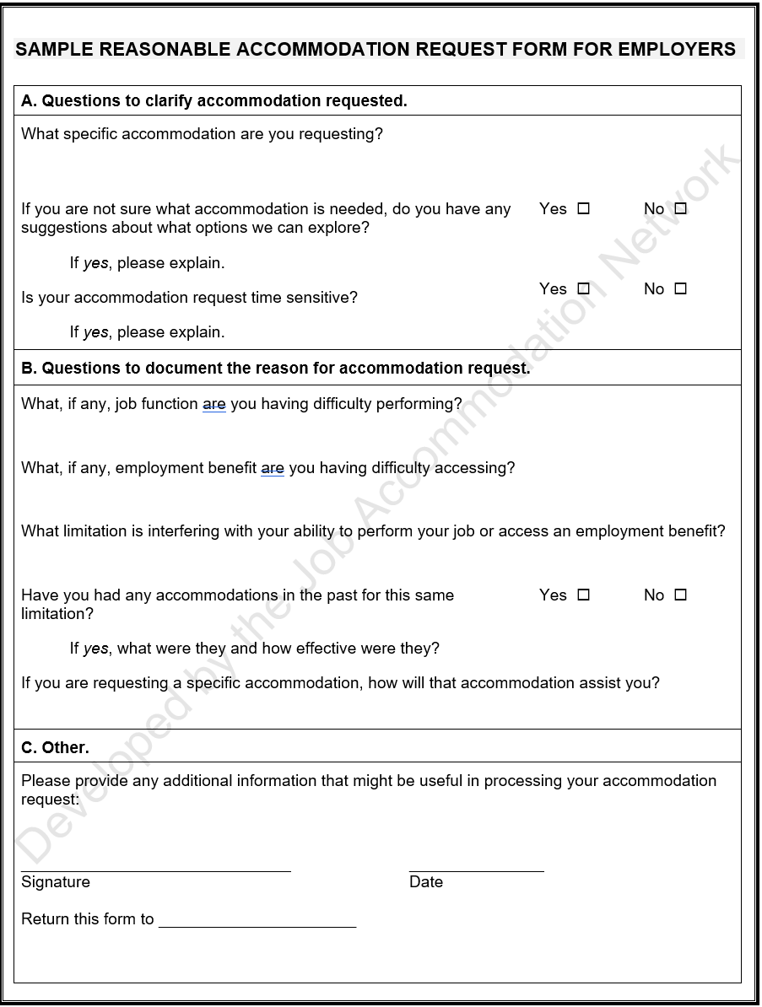
Sample Reasonable Accommodation Request Form for the Hiring Process Sample Reasonable Accommodation Request Form for Employers (shown here)

Slide 14
Accommodation Process Considerations
Create an inclusive and welcoming workplace where people feel comfortable asking for what they need to do their best work
Develop, implement, and communicate reasonable accommodation policies and procedures—keep policies flexible, simple, and transparent, and make it easy to request and receive accommodations
Train people leaders on inclusion, workplace personalization, and effective ways to meet accommodation requests
Five Practical Tips for Providing and Maintaining Effective Job Accommodations

Slide 15
What does the “interactive process” entail?
When an accommodation is not obvious, an appropriate accommodation is best determined through a flexible, interactive process:
Analyze the job to determine its purpose and essential functions
Consult with the individual to ascertain the job-related limitations imposed by the disability and how those limitations can be accommodated
Collaboratively identify potential accommodations and assess their effectiveness
Consider the preference of the individual and select and implement the accommodation that is most appropriate for both parties

Slide 16
Is a formal interactive process required?
No. A formal process is not required, and may be unnecessary, depending on the circumstances
When possible, begin with an informal process to clarify what the individual needs and identify the appropriate reasonable accommodation

Slide 17
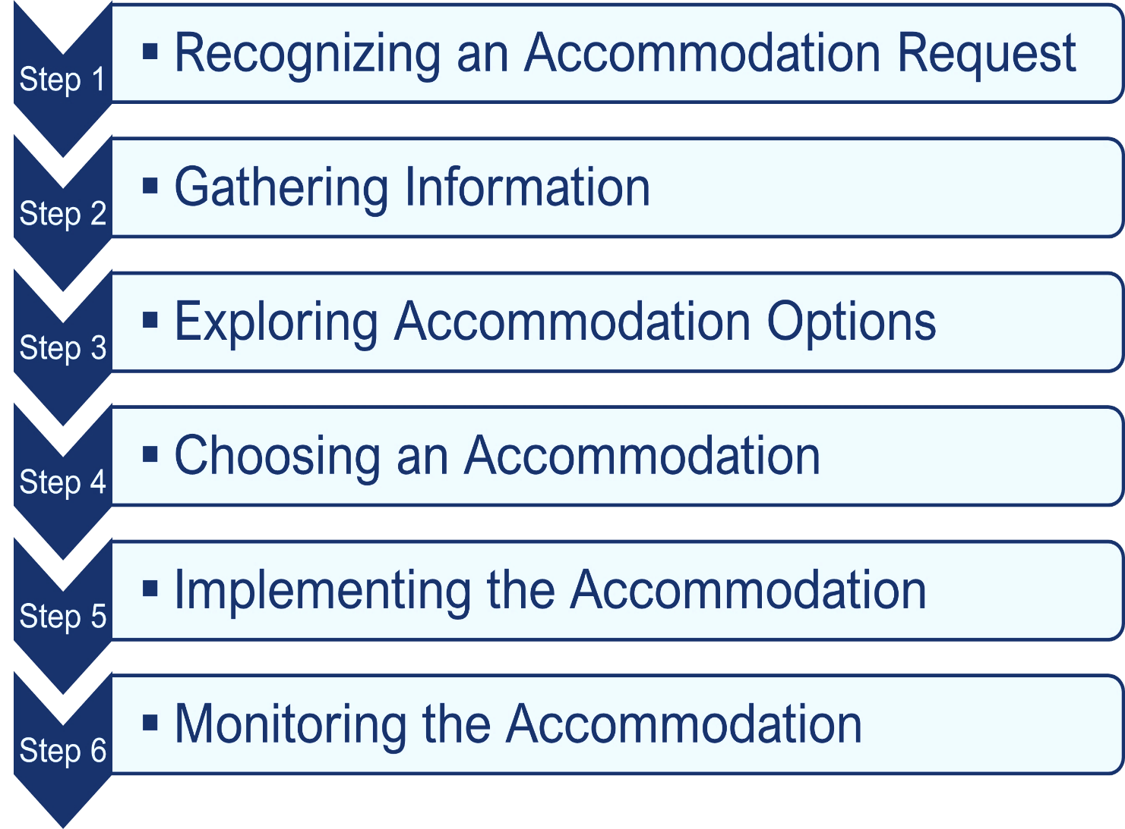
Sample Interactive Process A process for collaboratively identifying accommodation solutions AskJAN.org A to Z By Topic: Interactive Process
Notes:
The Job Accommodation Network (JAN) offers practical guidance and strategies to help employers and individuals with disabilities engage in the interactive process. The interactive process is simply the ongoing collaborative dialogue between these parties. This dialogue is meant to:
• Identify the information necessary to provide a reasonable and effective accommodation, and
• Establish good faith in the effort to solve a workplace issue, create an inclusive environment, advance the goals of the ADA, and increase employment opportunities for qualified people with disabilities.
JAN’s 6-step interactive process, is a sample framework but is not the only way to engage in the interactive process. Employers are free to develop and implement policies and procedures that suit their organization. Every accommodation process is unique but many follow steps such as:
Acting when an accommodation request is recognized
Gathering information to better understand the accommodation need
Collaboratively exploring, choosing, and implementing accommodations, and
Monitoring accommodations for effectiveness.
Our team at the Job Accommodation Network (JAN) works with everyone involved in the accommodation process—employers, workers, friends and family, legal representatives, and medical providers. The situations we encounter and the solutions we help develop vary widely, even among individuals with the same disability or employers in the same industry. There is no accommodation solution that fits every situation.
Let’s explore these accommodation process steps in greater detail…
Next slide

Slide 18
Build a Collaborative Dialogue
Effective communication requires all parties to listen actively to each other, seek common ground, and show mutual respect
Discuss specific aspects of the job that may be difficult
Focus on job functions rather than the health condition
Identify specific accommodations that might be needed
Encourage all parties to suggest possible solutions
Give the employee an opportunity to share relevant information without disclosing detailed medical information

Slide 19
Ask Yourself What is Known
Before requesting health-related information, consider whether:
The request is covered under current policy or practice
The health condition or need for accommodation is known, obvious, or already documented
An effective, reasonable accommodation can be provided without obtaining medical documentation
Medical Inquiry in Response to an Accommodation Request and Sample Form
Sample Limited Medical Documentation Form
A Flexible Approach to ADA Medical Documentation

Slide 20
Guide the Conversation
Questions to Consider:
Can you tell me about the challenges you're facing in your current role?
How does your health condition affect your ability to perform certain job tasks?
Is there anything you’d like to share about your health condition that would help us better understand your accommodation needs?

Slide 21
Clarify Accommodation Needs
Provide clarity on the accommodation needed
Connect the request to job performance
Share previous experience with the accommodation(s) to inform decision making

Slide 22
Explore Accommodation Options
Demonstrate a willingness to find a solution that works for both parties
Invite the employee to share their accommodation ideas
Recognize the potential positive effect of workplace personalization
Consult internal and external resources, such as ergonomic and information technology specialists, vocational rehabilitation services, rehabilitation engineers, assistive technology projects, disability-related organizations, and JAN

Slide 23
Explore Accommodation Options (2)
Questions to Consider:
What specific accommodations are you requesting?
How do you think the requested accommodation will help you perform your job duties?
Have you tried any accommodations in the past that were helpful, or not helpful?

Slide 24
Explore Accommodation Options (3)
Questions to Consider (cont’d):
What tools, changes, or supports do you believe will help you perform your job more effectively?
Are you aware of any external resources or specialists who might help us understand how best to accommodate your needs?

Slide 25
Explore Accommodation Options (4)
Questions to Consider (cont’d):
Are there any workplace changes that would be helpful in minimizing the impact of your health condition?
Are you open to discussing alternative accommodations if the one requested is not feasible?

Slide 26
Common Accommodations
Making existing facilities accessible and useable
Job restructuring
Flexible or modified work schedules
Modifying policies
Acquiring or modifying equipment
Telework
Providing a qualified reader, interpreter, job coach
Access for service or emotional support animal
Reassignment to a vacant position
Leave

Slide 27
Explore Accommodations A to Z at AskJAN.org

Slide 28
Find Scenarios Using the “Situations and Solutions Finder”
Situations and Solutions Finder
28

Slide 29
Workplace Personalization, Flexibility, and High-Impact Changes
Tailor the work environment to individual preferences and needs to enhance efficiency and productivity
Allow employees to work remotely or have flexible hours, when possible
Make small, high-impact changes like providing ergonomic chairs and standing desks, or adjusting lighting

Slide 30
Choose Accommodations
Employer may choose among effective accommodation solutions
Choose the accommodation the employee prefers, when possible
Consider a trial period when it’s not clear whether the accommodation will work
Consider temporary accommodations
Temporary or Trial Accommodations and Sample Form

Slide 31
Choose Accommodations (2)
Communicate approval or denial
Draft a written agreement with the employee
Documentation is recommended and is a vital way to demonstrate engagement in the interactive process
Sample Accommodation Approval Form
Sample Accommodation Denial Form
Sample Temporary/Trial Accommodation Approval Form

Slide 32
Communicate About Ineffective Accommodations
Inform the employer that the alternative accommodation isn’t effective—useful to do this in writing
Explain why the alternative accommodation isn’t effective
Ask that the original accommodation be reconsidered, if reasonable
How to Inform an Employer That an Accommodation is Not Effective and Sample Letter

Slide 33
Implement Accommodations
Inform essential personnel about the accommodation(s), when necessary
Maintain confidentiality of personal health and accommodation information
Ensure all necessary steps are taken to implement the accommodation
Establish a point of contact responsible for monitoring the accommodation

Slide 34
Monitor Accommodations
Make it clear that the accommodation may be reviewed and adjusted if needed
How can we support you in evaluating the effectiveness of the accommodation once it’s in place?
Create an open line for future communication and adjustments
Would you like regular check-ins to ensure the accommodation continues to meet your needs?

Slide 35
Communication is Key
Collaborate to find solutions that benefit everyone
Be open and honest about decisions, policies, and other information relevant to the accommodation process
Communicate clearly so that everyone is on the same page
Stay open-minded and be adaptable and creative, because accommodations are never one-size-fits-all
Be open to temporary and trial accommodations
Communication is Key to the Accommodation Process

Slide 36
Interactive Process Conversations
Scenario Examples

Slide 37
Scenario One: Flexible Work Schedule
Manager: “Hi, thanks for meeting with me. I understand you’ve requested a flexible work schedule. Can you help me understand what specific challenges you’re facing that a flexible schedule will help?”
Employee: “I’ve been dealing with anxiety, and some mornings are really tough for me. It makes it hard to get to work on time, which increases my stress. Having flexibility in when I start my day would help me manage better.”
Manager: “I appreciate your openness. Do you think starting later or having a more flexible range of start and end times would help you perform your job better?”
Employee: “Yes, starting an hour later would help a lot. It would give me time to manage my anxiety in the morning without worrying about being late.”

Slide 38
Scenario One (2)
Manager: “That sounds reasonable. Would you need any additional adjustments, such as remote work on particularly difficult days?”
Employee: “Remote work on those days would definitely help, especially when I’m feeling overwhelmed.”
Manager: “Okay. We can work on setting up a later start time and allowing flexibility to work remotely on days when needed. How often do you think you’d need to work from home?”
Employee: “Maybe once or twice a week, depending on how things are going.”

Slide 39
Scenario One (3)
Manager: “All right. We’ll give it a try and see how it works for you. We can also plan to check in periodically to make sure it’s helping and adjust as needed. Does that sound okay?”
Employee: “Yes, that sounds really helpful. Thanks for understanding.”
Manager: “Of course. Let’s set a date in two weeks to review how it’s going.”

Slide 40
Scenario Two: Workplace Access
Manager: “I received your accommodation request. Thank you for bringing this to our attention. Can you tell me more about the challenges you’re facing in navigating the workplace?”
Employee: “Yes, some of the pathways between desks are too narrow for my wheelchair, and the breakroom is on a different floor, which is hard to get to.”
Manager: “That sounds frustrating. Can you tell me which areas specifically are problematic so we can assess them?”
Employee: “Mostly the hallway near the conference rooms and the breakroom area.”

Slide 41
Scenario Two (2)
Manager: “Thank you for sharing that. Are there any other areas you’ve encountered issues?”
Employee: “Not really, but those two are the most important because I use them daily.”
Manager: “Okay. One option we could explore is widening the pathways between desks or rearranging the layout to make it easier to navigate. For the breakroom, how would you feel about relocating it to a more accessible or perhaps offering an alternative option like a mini-fridge near your workstation?”
Employee: “That would be great. I like the idea of the layout adjustment and having a fridge near my desk would help with food access.”

Slide 42
Scenario Two (3)
Manager: “Perfect. I’ll work with facilities to make these adjustments. Would you like us to check in with you to make sure the changes meet your needs?”
Employee: “Yes, that would be helpful. Thanks for addressing this so quickly.”
Manager: “Of course. We’ll stay in touch and make sure everything works for you.”

Slide 43
Scenario 3: Task Organization
Manager: “Thank you for coming in to discuss your accommodation request. You mention needing some help with task management. Can you tell me more about the specific difficulties you’re experiencing?”
Employee: “Sometimes I struggle to keep track of multiple tasks, and I get overwhelmed when there’s a lot going on. It’s hard for me to prioritize what needs to be done first.”
Manager: “That sounds challenging. What type of support do you think would help with managing your workload more effectively?”
Employee: “I think having a clearer structure or checklist would help. Maybe breaking tasks down into smaller steps with reminders would make it easier to stay on track.”

Slide 44
Scenario 3 (2)
Manager: “That makes sense. We could explore using project management tools or creating a daily checklist to help you prioritize. Would having scheduled check-ins to review your progress be helpful?”
Employee: “Yes, definitely. It would keep me more accountable, and having a clear plan would reduce stress.”
Manager: “Great. We can set up a system where tasks are broken down, and I can help you set up reminders in the calendar. Let’s also schedule a weekly check-in to make sure everything is working well for you. Does that sound like a good approach?”
Employee: “Yes, that would really help. Thanks for being supportive.”

Slide 45
Questions?

Slide 46
Ask JAN! We can help.
AskJAN.org
800.526.7234
Live Chat @ AskJAN.org
Email JAN@AskJAN.org
46

Slide 47
Social Media
Job Accommodation Network
Job Accommodation Network
JANatJAN
JANinformation
47

