Slide 1
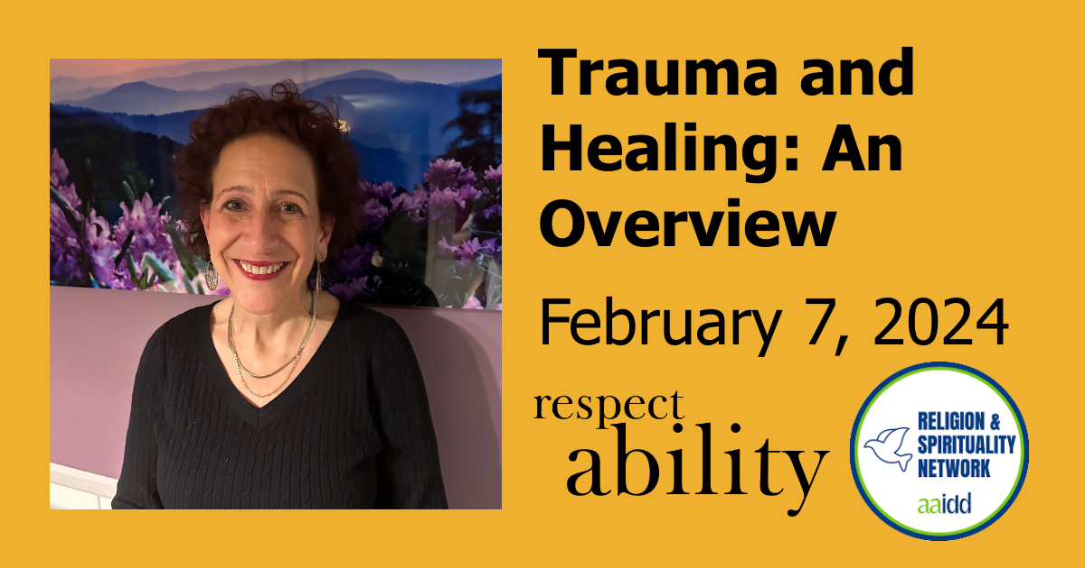
Trauma and Healing: An Overview

Slide 2
Housekeeping Notes
This webinar has ASL interpretation and live CART captioning.
You can pin the ASL interpreter to keep them in view for the entire presentation.
To view the live CART transcript in a separate window, use the link in the chat box.
This webinar is being recorded and will be posted to RespectAbility.org/AAIDD-2024-Series by next week, after open captions are added to the recording.

Slide 3
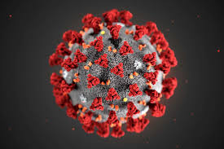
Trauma of Covid

Slide 4
3 Phases of Mental Health Challenges for the People We Support
Phase 1- Fear
Phase 2 - Isolation
Phase 3 – Anxiety

Slide 5
Sources of Trauma for People with Intellectual Disabilities
Sexual Abuse
Physical Abuse
Bullying
Exclusion
Institutionalization
Repeated Foster Care Placements

Slide 6
Sexual Abuse
Bureau of justice – 2018 – People with ID are 7 times more likely to be sexually abused than people without ID
Tomsa Et Al – 2021 – International Literature Review – 1 out of every 3 people with ID suffer sexual abuse in adulthood
Most common was “peer to peer”
Often not reported
Highest in institutional settings

Slide 7
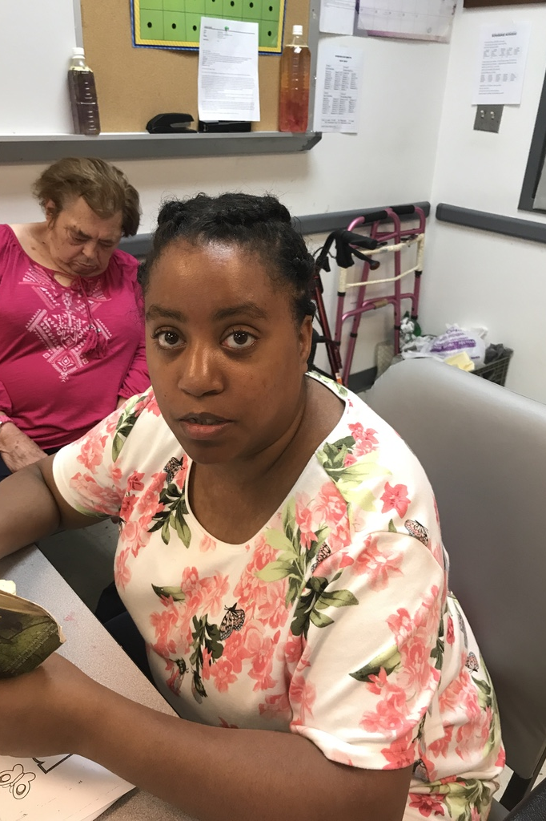
Betrayal Trauma

Slide 8
Big T and Little “t” Traumas
Major Events | Little “t” Trauma
Sexual Abuse | Discrimination
Physical Abuse | Neighborhood Violence
Neglect | Social Exclusion
Negative Events | Exclusion from Family
Grief and Loss | Frequent foster care or group home placements and lack of stability

Slide 9

Bullying

Slide 10
Bucharest Early
Intervention Orphan Study
138 children between 6 and 31 months who were in an orphanage in Bucharest were studied
68 kept in institution
68 placed in a new foster care system – full time paid parenting
Results: After 54 months ( 41/2 years):
Compared to 138 children raised in birth families
Learn More

Slide 11
Results
Issues: | Institution | Foster Care | Biological
Axis 1 Disorders | 55% | 35% | 13%
Emotional Disorders | 49% | 29% | 8%
Behavioral Disorders | 32% | 25% | 6.8%
Intellectual Disability Average IQ Score | 73 | 85 | 110

Slide 12
Children Who Stayed in Institutions - Nathan Fox
Gray matter in brain actually shrunk
Lower brain activity measured by EEG
Impairments in executive functioning
Increased adrenaline levels after 1 year – affects heart, behavior, ability to focus ( looks like ADHD)
Often abnormally small physically
At higher risk for premature deaths
Neglect is more devastating than any other type of abuse

Slide 13
Traumatic Exposures
In-utero drug exposure
In-utero drug/alcohol exposure

Slide 14
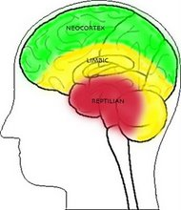
Psychological Trauma –
Past is Present
Neocortex
The rational brain: Intellectual tasks
Limbic
The intermediate brain: Emotions
Brain Stem
The primitive brain: Self preservation, aggression
The Triune Brain

Slide 15
Trauma Responses
Trigger Response: Something happens in the present that reminds the person of the negative past - person goes into fight, flight or freeze mode:
Thinking he/she/they are in Danger!
Trauma
Trigger
Fight
Freeze
Flight
Attachment
Issues

Slide 16
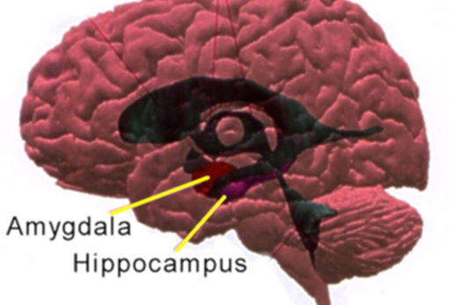
Amygdala and Hippocampus

Slide 17
Sometimes the “Behaviors” we see are really symptoms of
Post-traumatic Stress Disorder

Slide 18
4 Areas of Symptoms of PTSD
1. Re-experiencing (interfering with present to different degrees)
Intrusive Memories
Nightmares
Flashbacks- Person can disconnect from reality and be convinced he or she is being attacked, hurt or threatened due to a memory that becomes present
2. Avoidance
Blunted emotions
Shut down responses
Person can become obsessive about details concerning self and safety
Disconnection and withdrawal

Slide 19
Symptoms of PTSD (Continued)
3. Negative Alterations in Cognition and Mood
Persistent negative-trauma related emotions
ie. fear, horror, anger, guilt and shame
Constricted emotion – inability to express positive emotion
Alienation and withdrawal from others
SHAME
4. Arousal
Easy to startle
Agitated – can lead to property destruction
Periodically Combative
Impulsive
Also associated with reckless or self-destructive behavior

Slide 20

Jordyn Zimmerman

Slide 21
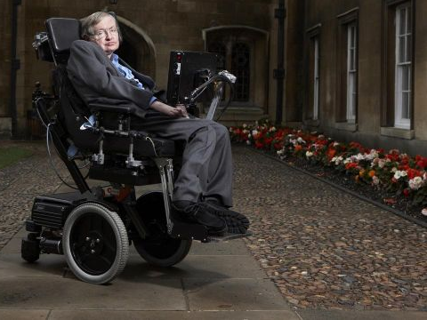
Stephen Hawking Quotes
“The greatest enemy of knowledge is not ignorance, it is the illusion of knowledge.”

Slide 22
Ingredients Necessary for Post traumatic Recovery
Perceived Safety
Empowerment
Connection

Slide 23
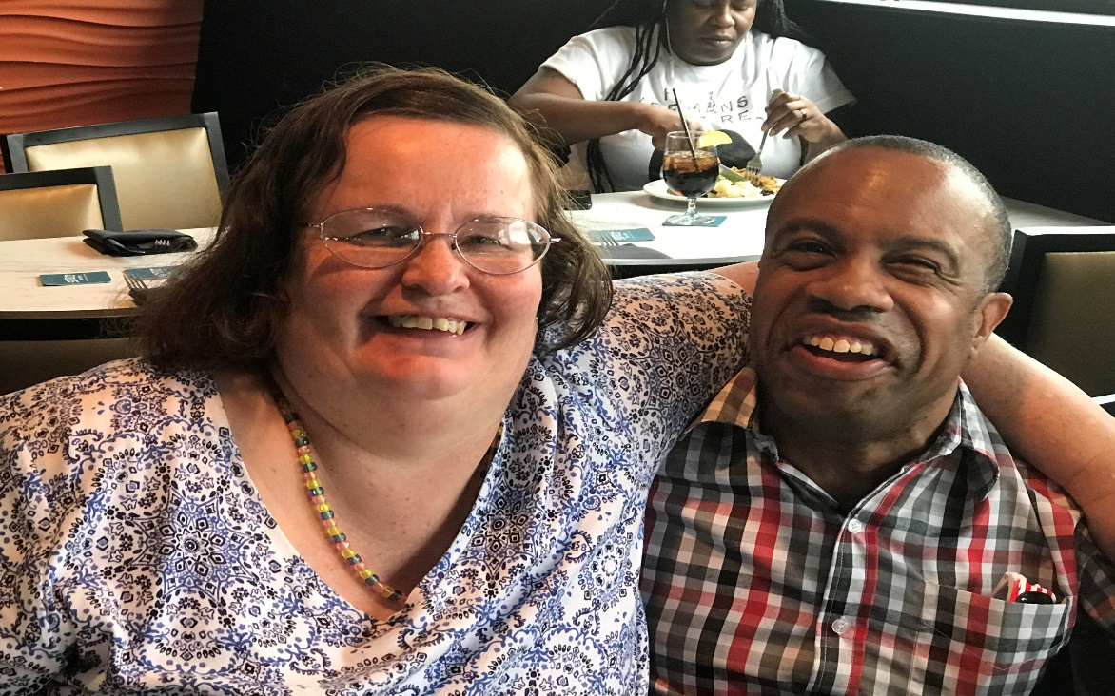
The Healing Power of Relationships

Slide 24
Murthy: Health Risks of Loneliness
Increased Risk of heart disease – 29%
Increased Risk of Dementia – 50%
Increased Risk of Stroke – 32%

Slide 25
Harvard’s Men’s Study
Robert Waldinger, Principal Investigator

Slide 26
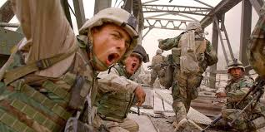
The Iraq PTSD Study

Slide 27

Access To Treatment:
A Human Right
This Photo by Unknown Author is licensed under CC BY-SA

Slide 28
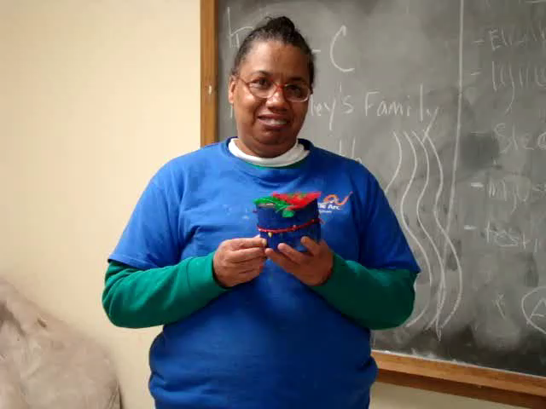
Importance of Treatment:
Grief Work

Slide 29

Who Am I ?

Slide 30
Positive Identity Development
Positive Identity
Who I am
What I do well
Who my friends are
What my preferences are
Where I make a difference
What I am proud of
Negative Identity
NOT the person who gets married
NOT the person who drives
NOT the person who plays on a high school sport team
NOT the person who is popular or liked
Not the cool one

Slide 31
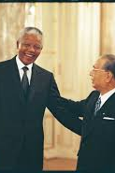
“Ultimately happiness rests on how you establish a solid sense of self or being.”
Daisaku Ikeda

Slide 32
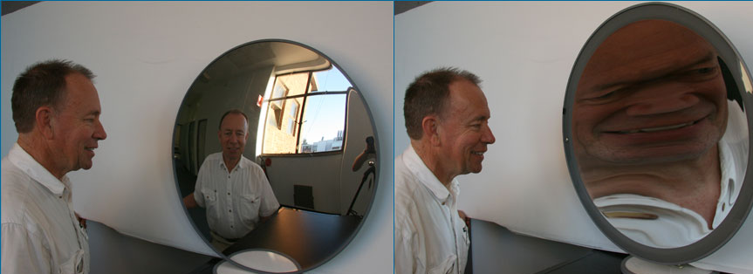
We Can Hold Up Two Possible Mirrors
This Photo by Unknown Author is licensed under CC BY-NC-ND

Slide 33

“There is always light - if only we are brave enough to see it. If only we are brave enough to be it.” – Amanda Gorman

Slide 34

Here and Now

Slide 35

Hope Changes Everything

Slide 36

Healing Happens

Slide 37
References
Bennett, DS, Bendersky, M, and Lewis, M. (2008). Children’s cognitive ability from 4 to 9 years old as a function of prenatal cocaine exposure, environmental risk and maternal verbal intelligence. Developmental Psychology, 44,(4) 919-28.
Chasnoff, IS, Griffith, DR, Freier, C, and Murray, J. Pediatrics 89. Cocaine/Polydrug Use Pregnancy: Two Year Follow-up. (2) 284-9. 1992
Frank, DA, Augustyn, M, Knight, WG, Pell, T and Zukerman, B.( 2001). Growth, development, and behavior in early childhood following prenatal cocaine exposure: a systematic review. Journal of American Medical Association, 285, (12) 1613
Chiriboga, CA. ( 1998) Neurobiological Correlates of Fetal Cocaine Exposure Annals of New York Acadamy of Sciences, 846, 109-125.
Eisenberger, N, Lieberman, M., Williams, K. Does Rejection Hurt? An fMRI Study of Social Exclusion in Science Vol 302, no 5643. Pp290-292. October 2003.
Harvey, K. Trauma – Informed Behavioral Interventions ( 2012) AAIDD Press, Washington.
Harvey, K. Positive Identity Development ( 2009) NADD Press, Kingston.
Herman, J. (1997).Trauma and Recovery. New York: Basic Books.
LeDoux, J. (1996). The Emotional Brain. New York: Simon And Schuster. Chapter 8.
Mercier F, Kwon YC, Douet V Hippocampus/amygdala alterations, loss of heparan sulfates, fractones and ventricle wall reduction in adult BTBR T+ tf/J mice, animal model for autism. 2012 Neuroscience 2 p 208-13.
Seigel, D. (2009). The Mindful Therapist. New York: W.W. Norton and Company. Chapter 10.
Seligman, M. Authentic Happiness. New York: Vintage Books. 2006.

Slide 38
Upcoming Webinars
Celebrating Jewish and Disabled Creativity During JDAIM
Thursday, February 15 at 1:30 p.m. ET
Private Sneak Peek and Conversation: THIRTEEN
Wednesday, February 28 at 4 p.m. ET
How to Talk About Trauma Informed Care, Faith, and Spirituality
Wednesday, March 6 at 2 p.m. ET
Learn More and Register at www.RespectAbility.org/Category/Events

