Slide 1
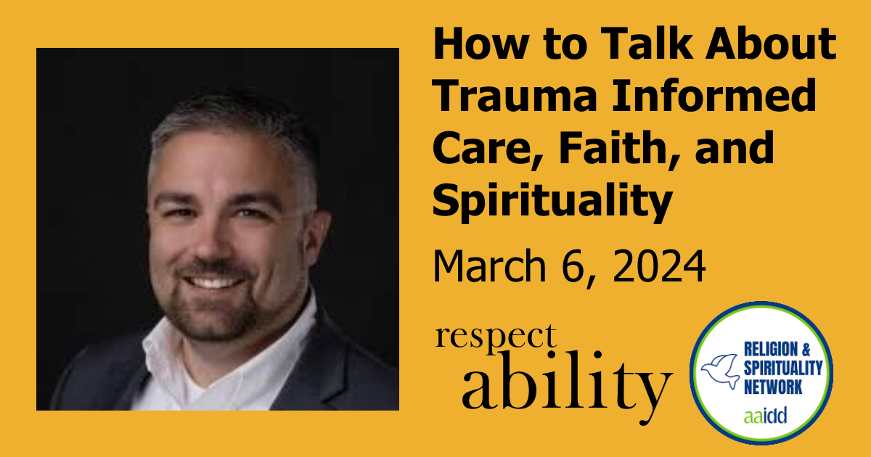
How To Talk About Trauma Informed Care, Faith, and Spirituality

Slide 2
Housekeeping Notes
This webinar has ASL interpretation and live CART captioning.
To view the live CART transcript in a separate window, use the link in the chat box.
This webinar is being recorded and will be posted to RespectAbility.org/AAIDD-2024-Series by next week, after open captions are added to the recording.

Slide 3
Trauma Informed Care, Faith, and Spirituality
John M. Keesler, PhD, LMSW

Slide 4
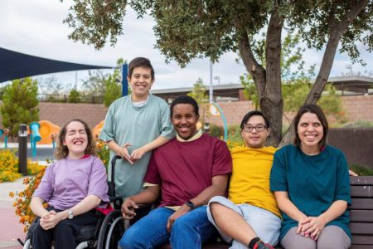

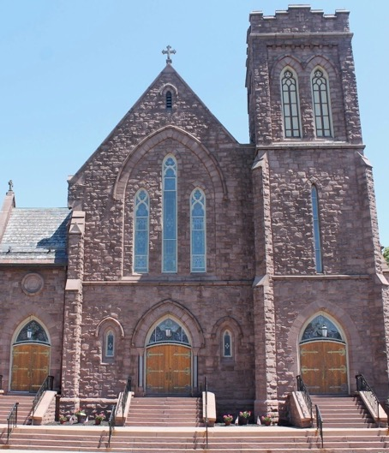
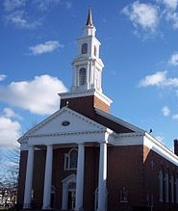
Meet the Presenter
John M. Keesler, PhD, LMSW
Associate Professor
School of Social Work
Indiana University Bloomington
Not the expert but willing to share and begin the conversation
Bias: Catholic/Christian lens

Slide 5

Social Work Perspective
Person-In-Environment
Systems
Practice-Informed Research

Slide 6

Intersection of Past & Present: An Unknown Connection
“Human suffering anywhere concerns men and women everywhere.”

Slide 7
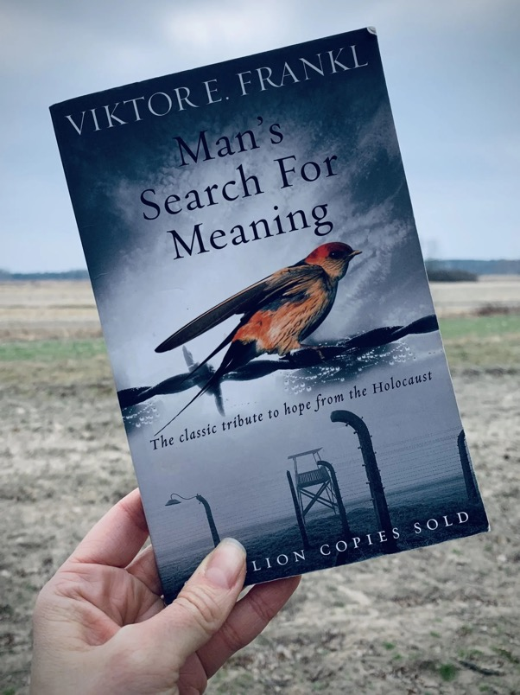
Wisdom to Guide
“…we may also find meaning in life even when confronted with a hopeless situation, when facing a fate that cannot be changed. For what then matters is to bear witness to the uniquely human potential at its best, which is to transform a personal tragedy into a triumph…”
“The more one forgets himself--by giving himself to a cause to serve or another person to love--the more human he is and the more he actualizes himself...”

Slide 8
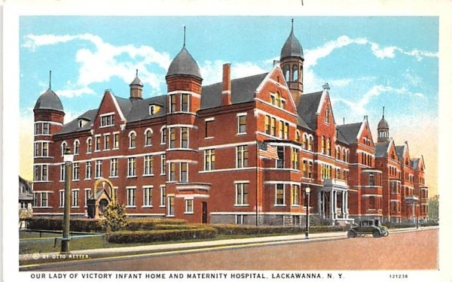

Early Roots
Personal struggle & Prayer
Volunteered as 1:1 classroom aide for child with multiple disabilities in a religious education program
First job – maintenance
Involvement with church ministries
History dating back to 1800s of social services that continue to operate today

Slide 9

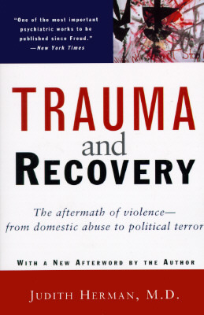
School, Work, & Ministry
A “trauma-influenced” journey
Formal Music Ministry 1995 – 2016
          Choir 1992 – 2022
          Getting through PhD program
Ebb and flow of education as a nontraditional student
          AA, Music; BA, Psychology; MSW; PhD Social Welfare
Concurrent work in IDD services 1999 – 2011
          ~ 2008 Trauma and Recovery

Slide 10
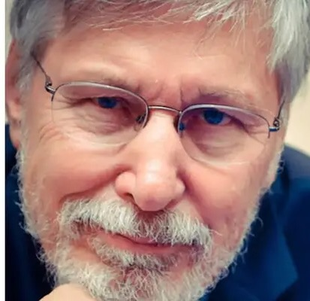
Life Sucks a Good Amount of the Time
We all have jobs and situations that are really unpleasant. But the moment that a situation is over, it’s over. The problem with trauma is that when it’s over, your body continues to relive it.
Bessel van der Kolk, MD

Slide 11

Understanding Trauma: The Foundation
“outside the range of usual human experience”
Trauma results from an event, events, or circumstances an individual experiences as physically or emotionally harmful or threatening, which may have lasting adverse effects on the individual’s functioning and wellbeing (mental, physical, social, emotional, or spiritual).
May be experienced by an individual, a generation, or an entire community or culture.

Slide 12
Symptoms of Trauma
Hypervigilance
              Easily startled/on alert
              Sensitive to environmental cues/changes
Intrusive thoughts/memories/flashbacks
              Nightmares
              Not in the present moment
Avoidance of stimuli associated with trauma
              Disengaged/shutting down
              Combative/refusal to participate
              Running
Negative changes in mood/thoughts
              Depression
              Self as bad
Situation-Response Incongruence
Extreme, unusual or blunted
Irritability, aggression, destruction
“Stuck” in dysfunction/rumination
Physical distress
Headaches, upset stomach, pain
Relational/work problems
Changes in sleep, appetite
Shame/brokenness
Hopelessness/loss of Interest
Defensiveness & hesitation to engage
Loss of faith and/or trust in God

Slide 13
Trauma and IDD
Think broadly about events/circumstances that might be potentially traumatic
Intersectionality of disability, cognitive capacity, developmental stage, supports & resources, demographics, identity/orientation, etc.
Trauma symptoms are like the general population, yet potentially different
        Regression or apparent loss of skills
        Changes in toileting or sleeping
        Sexualized behaviors
        Increased dysregulation and behavioral incidents
However, people with IDD are resilient!

Slide 14
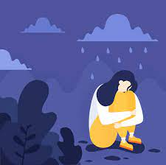
Trauma & Adversity – A Common Bond
People with IDD
  3 – 6 times more likely to be abused/neglected
    65% of kids with IDD and MH experienced at least 1 traumatic event
  Multiple traumas most common
  10% - 40% PTSD
Direct Support Professionals
  30% of DSPs had ≥4 types of ACEs
    34% Emotional Abuse
    32% Mental Illness
    30% Substance abuse
    29% Lack of support
    25% Physical abuse
    21% Sexual abuse
    12% Domestic Violence

Slide 15
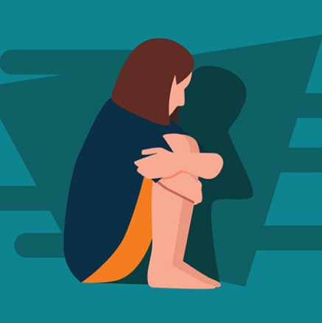
Secondary Traumatic Stress (STS)
Emotional duress by persons having close contact with someone who has experienced trauma (same symptoms as PTSD)
>80% of DSPs support clients with trauma
16% - 21% DSPs had increased levels of STS
      Intrusive thoughts about clients
      Foreshortened future
      Difficulty sleeping/concentrating

Slide 16
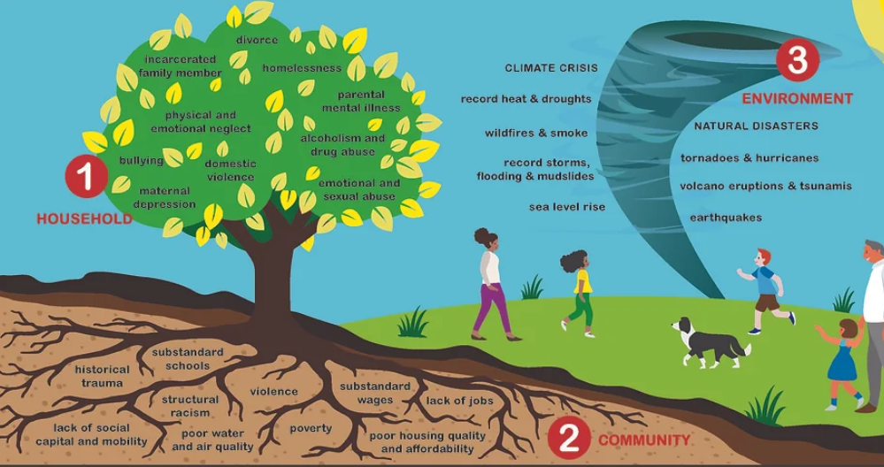
Adversity in a Broader Context

Slide 17

Interdependence & Resilience
We are “interdependent people”
When our relationships are intact, generally, we are good with trauma (resilient)
Foundation of safety is maintained when someone is there for you

Slide 18
Healing the Wounds of Trauma
Trauma | Healing
What is the context for most trauma? Human relationships Caregiving (natural/paid supports) What happens in the immediacy of a traumatic event? Loss of safety Loss of control or sense of agency No choice in the matter – victim | What will it take to heal? Restoring trust in others Physical and psychological safety Predictability Follow-through Having a voice Ability for self-expression (not just words) Being empowered/having a say Having options Engaging with others Healthy Relationships

Slide 19

Defining Spirituality, Religion, & Faith

Slide 20

Spirituality
“a process of life and development”
  Focusing on a search for a sense of meaning, purpose, and wellbeing
  In relationship with oneself, others, creation, and a higher power
  Engaging a sense of transcendence and hope (profound/sacred)

Slide 21

Religion
An organized pattern of values, beliefs, symbols, behaviors, and experiences that involves:
        Spirituality
        A community of followers
        Sharing of traditions over time
        Individual and community support functions that are related to spirituality
Ritual engages the senses and creates structure – lends to different types of expression and predictability

Slide 22
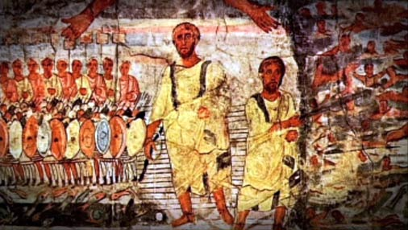
Faith
belief and trust in and loyalty to God
belief in the traditional teachings of a religion

Slide 23

Trauma and Spirituality
Trauma often leads to a need to find meaning; spirituality often provides a system for making meaning
    Why did this happen to me? Why would God allow it?
    Need to reconcile difficult events with beliefs
Spirituality can create a sense of empowerment and in turn increase mental health
Spirituality can help when a positive relationship to one’s beliefs/practices buffer trauma and are a source of comfort
    Forgiveness
    Support from prayer, faith community, relationship with God

Slide 24
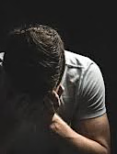
Struggling to Make Meaning
Spiritual struggles may focus on relationship with God, on interpersonal relationships, or on intrapersonal matters (e.g., doubting one’s faith, lacking meaning in life)
Doubts can lead to a decrease in religiosity and to greater distress that can worsen PTSD
Spiritual strain = poorer mental health after trauma

Slide 25

Quote
How can we facilitate deepening a person’s relationship with God when the fabric of that person’s relationality has been rent by the effects of trauma?
(Keefe-Perry & Moon, 2019)

Slide 26
"Trauma-Informed Care 101"
REALIZE
RECOGNIZE
RESPOND
RESIST
REALIZE the pervasive impact of ACEs and trauma
RECOGNIZE the signs of trauma in people served
RESPOND by applying the practices of TIC
RESIST RE-TRAUMATIZATION; avoid making things worse
Different from trauma-specific treatment

Slide 27
Trauma-Informed Care
Trauma-Informed
Care
Safety
Action-Oriented
Past Meets Present
Collaborate
Trust
Restorative
Cultural Sensitivity
Relational
System-Wide
Empower
Choice

Slide 28
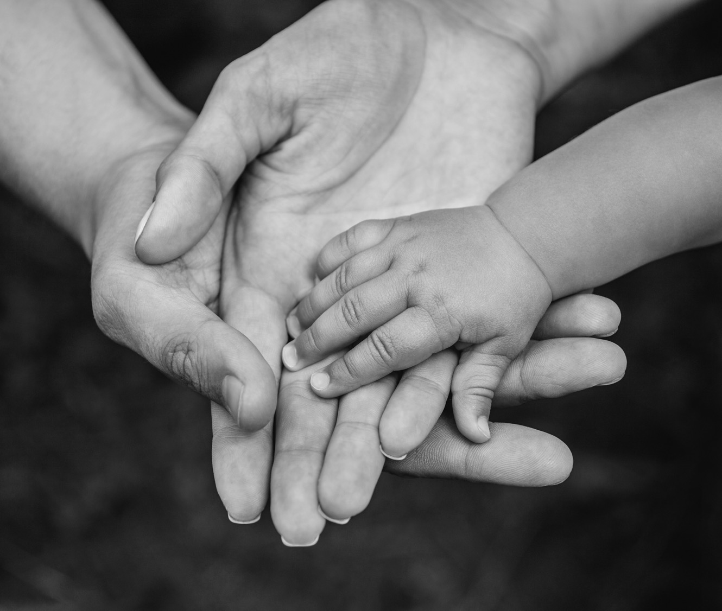
In Action
Exemplifying the Principles of Trauma-Informed Care

Slide 29




What is the overall messaging in your…
Place of worship?
Homilies/sermons?
Religious education programs?
Bible study?

Slide 30
Caution!
Resist temptations to quickly theologize suffering as redemptive
(Keefe-Perry & Moon, 2019)
Remember, for some, faith leaders have been perpetrators
Such meaning-making can create opportunities for growth, it can imply a “no pain, no gain” mentality that trivializes suffering

Slide 31
Application of Trauma-Informed Care
Principle | Individual with IDD | Support Staff
Safety | Is it safe for me to ask questions or to explore beliefs and practices? Is it safe for me to be myself as a person with disability? Are worship services available that consider my sensory needs/sensitivities? Are members of your leadership and/or congregation knowledgeable about people with disabilities and/or trauma? Are there spaces for me to use if I need to calm or relax without having to leave? | Is it safe for me to ask questions or to explore beliefs and practices? Is it safe for me to be present as a support person who may not believe or may not worship as you do?
Choice | Do I have a choice to worship as best as I can according to my abilities? Do I have choices to join different ministries? | Do I have a choice in whether I actively participate in worship or just sit quietly?

Slide 32
Application of Trauma-Informed Care (continued)
Principle | Individual with IDD | Support Staff
Collaboration | Will I be genuinely welcomed as someone with different abilities? Am I engaged in conversations or do others only speak with my staff? Will I be seen as an equal member of the community? | Will you work with me and help me support my client?
Trustworthiness | Will you follow through with what you say you will do? If I talk with you, will you maintain my privacy? | Will you follow through with what you say you will do?
Empowerment | Am I blamed/shamed or seen as a person needing healing? Will I be seen as a passive recipient of charity or as a person with agency? Am I encouraged to actively join others in worship? Are there study groups or opportunities for me to learn about my faith in ways that I can understand and contribute to? Will you assume or will you explore with me my pain and my understanding of my faith? | Will you value and respect my role? Will you refrain from pressuring me to join your congregation? Will you encourage me to do the best I can?

Slide 33
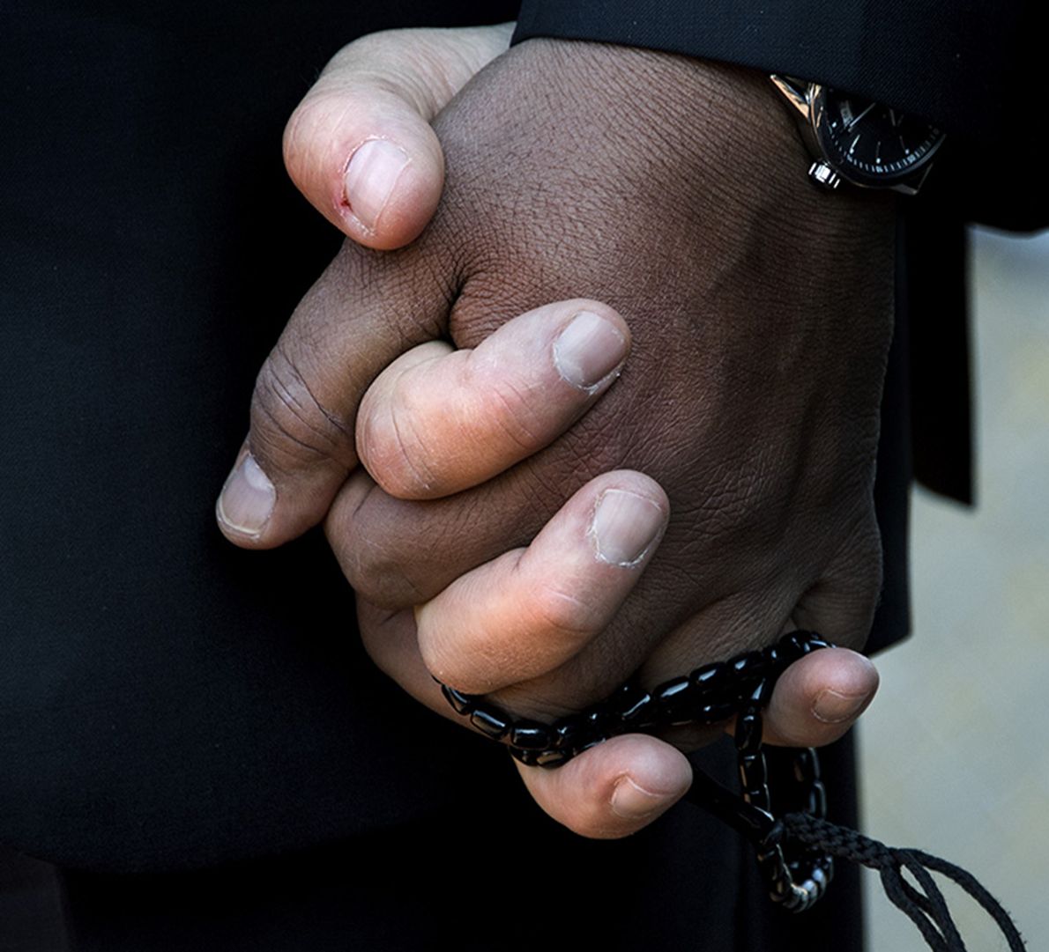
“Physician heal thyself”

Slide 34

Care of Self
  Recognize and respond to the one’s own trauma and the impact of ministry on self
    Grief and loss
    Burnout
    Secondary trauma

Slide 35
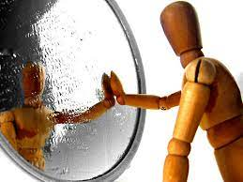
Being self-aware
“It is also essential that pastoral care givers examine their own attitudes, values, and behaviors, boundaries, and limitations…
The pastoral caregiver may encounter a variety of perspectives and interpretations of what happened and the meaning of the experience given by those he or she is attempting to help.
This may conflict with the views and values of the pastoral caregiver and cause ambiguity and a discomfort between the pastoral caregiver and the one needing assistance.” (Streets, 2015)

Slide 36

Being self-aware (continued)
“We can easily identify so closely with those with whom we work that their pain also becomes our pain in addition to whatever burdens we may be carrying ourselves. Just as it is important for the traumatized person to know and be reassured that their total sense of self need not be the trauma they have experienced and to try to imagine having a larger life beyond the trauma, care givers must also have a network of support...” (Streets, 2015)

Slide 37
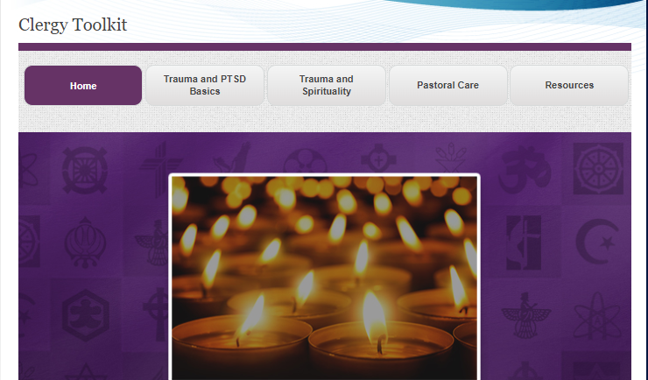
Clergy Toolkit
https://www.ptsd.va.gov/professional/treat/care/toolkits/clergy/index.asp

Slide 38
Upcoming Webinars
Stronger Together: Heritage Christian Services’ Grief Support Team
Wednesday, April 10 at 2 p.m. ET
Equity at the Ballot Box: Registering To Vote and Getting Involved with Political Campaigns
Tuesday, March 12 at 2 p.m. ET
RespectAbility presents: Disney’s Wish – The Making of Dahlia
Tuesday, March 19 at 4 p.m. ET
Learn More and Register at www.RespectAbility.org/Category/Events

