Slide 1
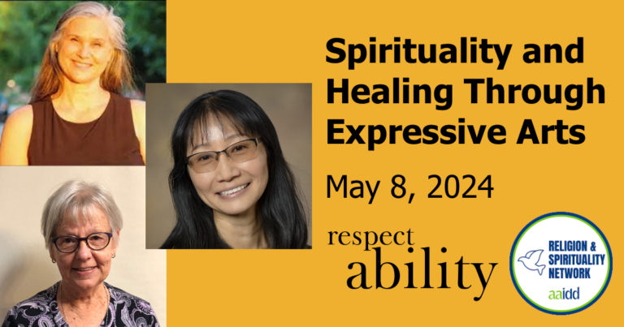
Welcome

Slide 2
Housekeeping Notes
This webinar has ASL interpretation and live CART captioning.
To view the live CART transcript in a separate window, use the link in the chat box.
This webinar is being recorded and will be posted to RespectAbility.org/AAIDD-2024-Series by next week, after open captions are added to the recording.

Slide 3
Spirituality & Healing Through Arts
The American Association on Intellectual and Developmental Disabilities (AAIDD)
Creative Arts Interest Network
Religion and Spirituality Interest Network
RespectAbility

Slide 4
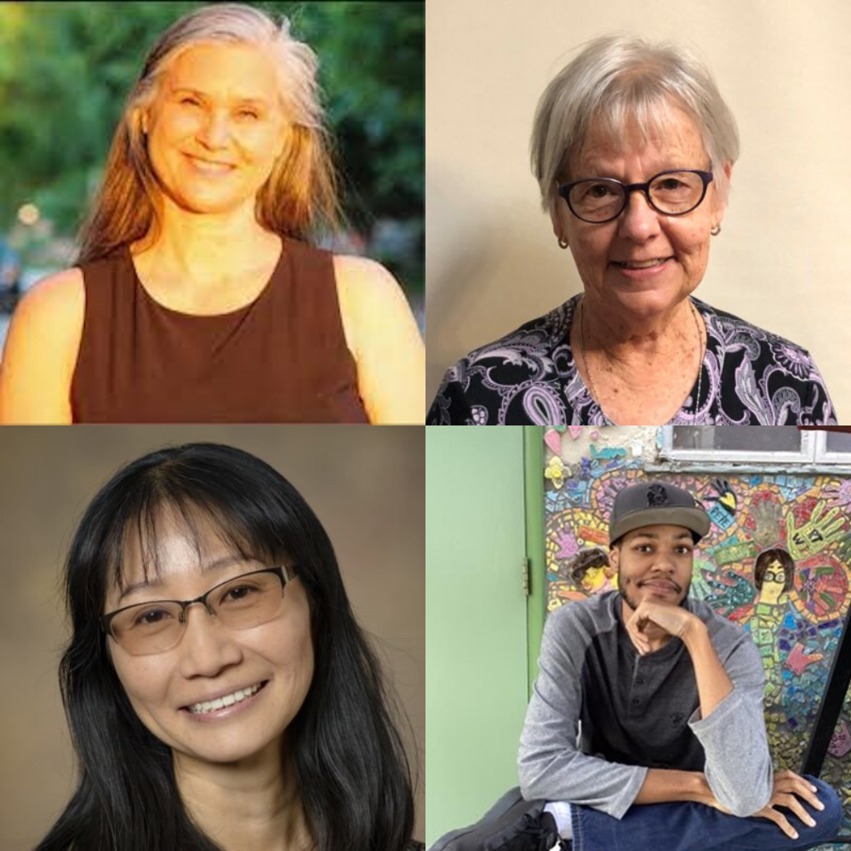
Today’s Speakers
Michelle Thompson
Jeanne Carrigan
Yumi Shirai
Jamelle Texeria

Slide 5

Community and Belonging to Access Spirituality
Home and Community Based Services (HCBS)
Person-centered
Friendships, relationships, and self-determination
(CQL, Personal Outcome Measures, 2024; Lipson, 2019)
Spirituality as a Social Determinant of Health
Improves quality of life for all people, including those with
intellectual and developmental disabilities.
(CQL, Spirituality, 2024; Wedgworth & Cody, 2023)
Spirituality
How people seek a sense of meaning, purpose, connection,
value or transcendence.
(Harvard T. H. Chan. School of Public Health, 2022)

Slide 6
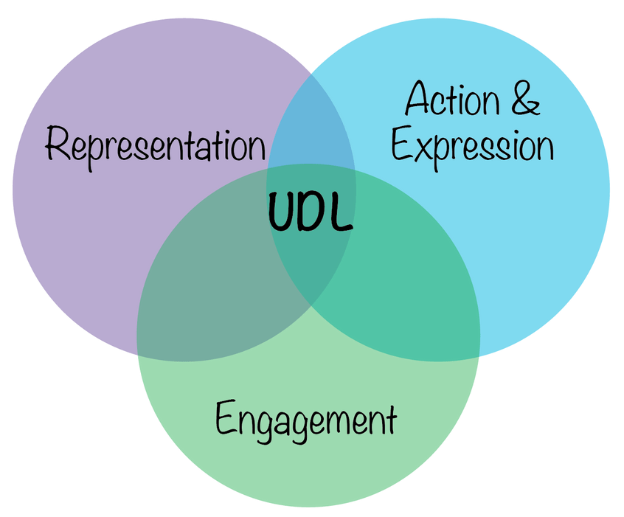
Universal Design for Learning (UDL)
Multiple means of Engagement
Multiple means of Representation
Multiple means of Action and Expression
https://udlguidelines.cast.org/

Slide 7
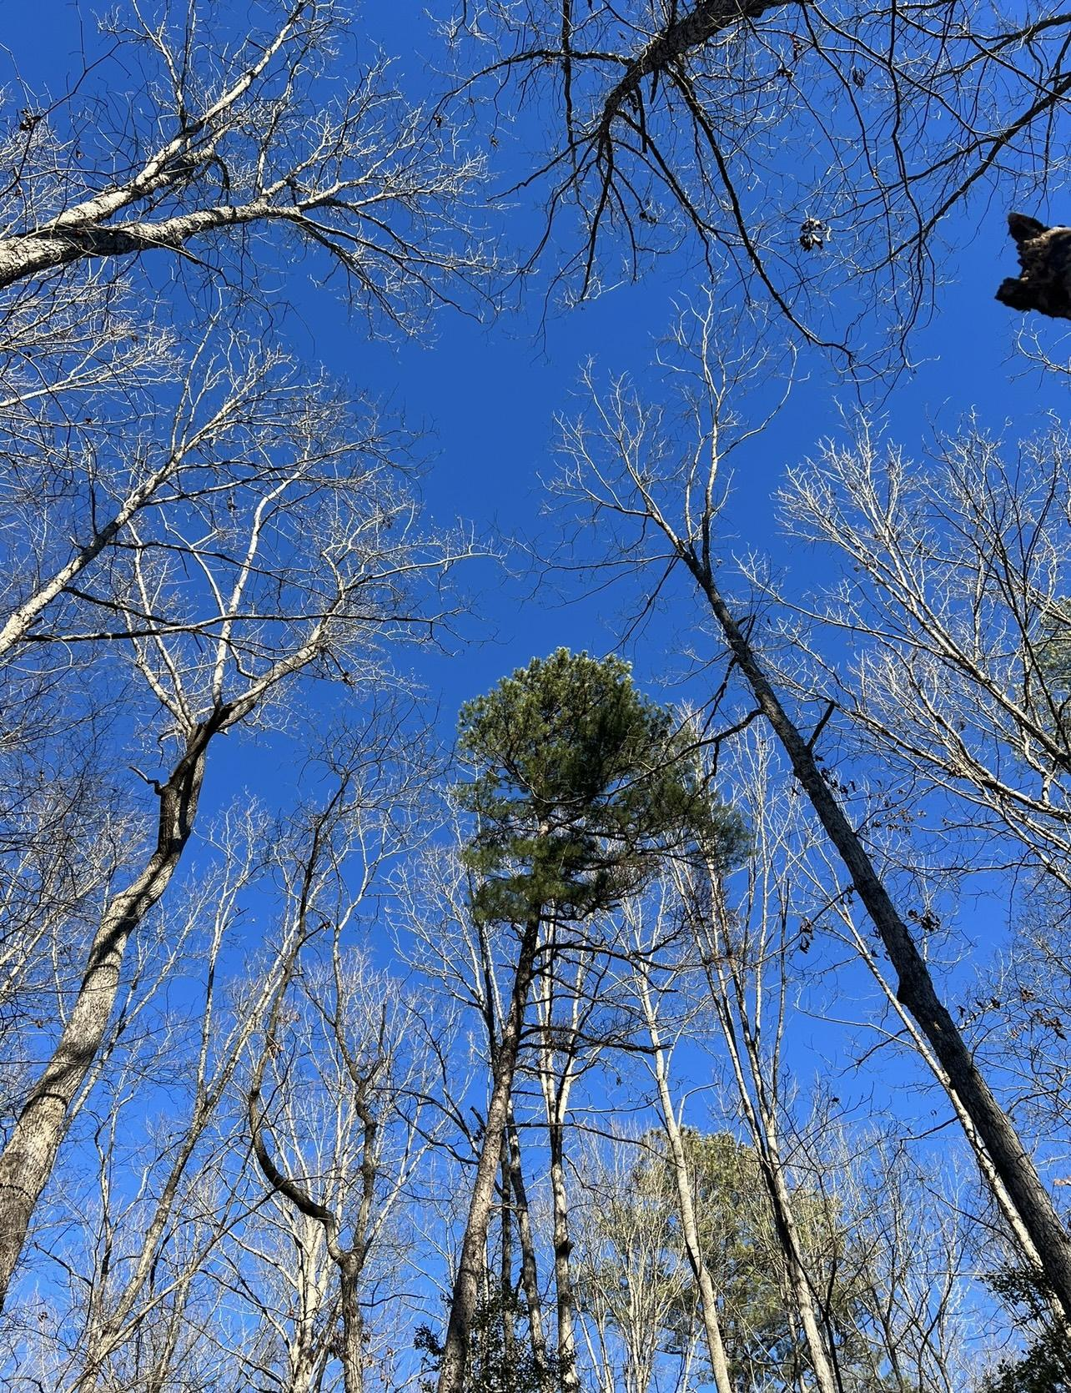
Spirituality

Slide 8
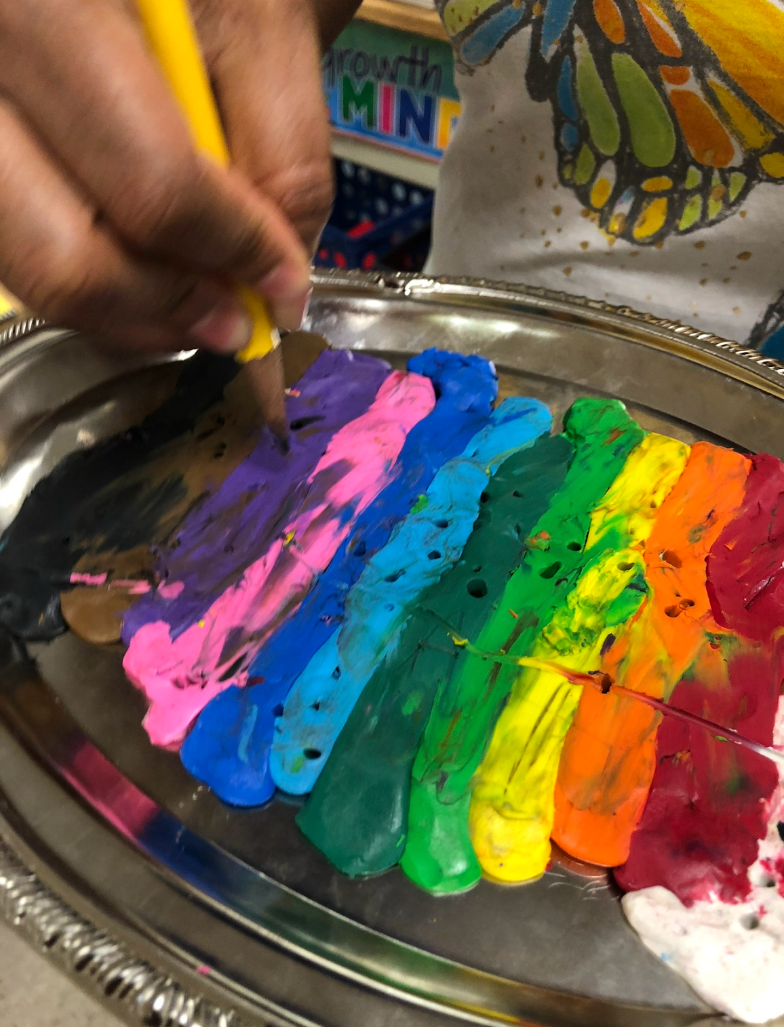
Repetitive Art
…as prayer and access to spirituality

Slide 9
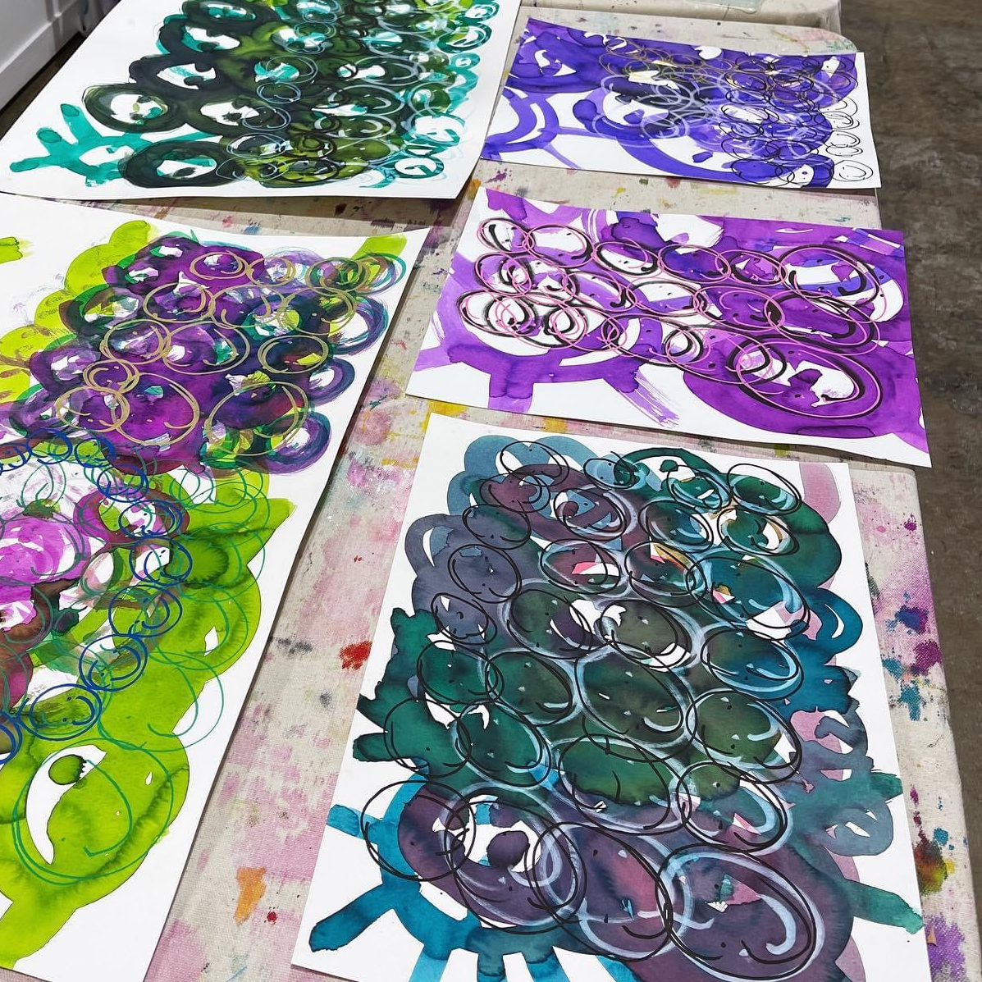
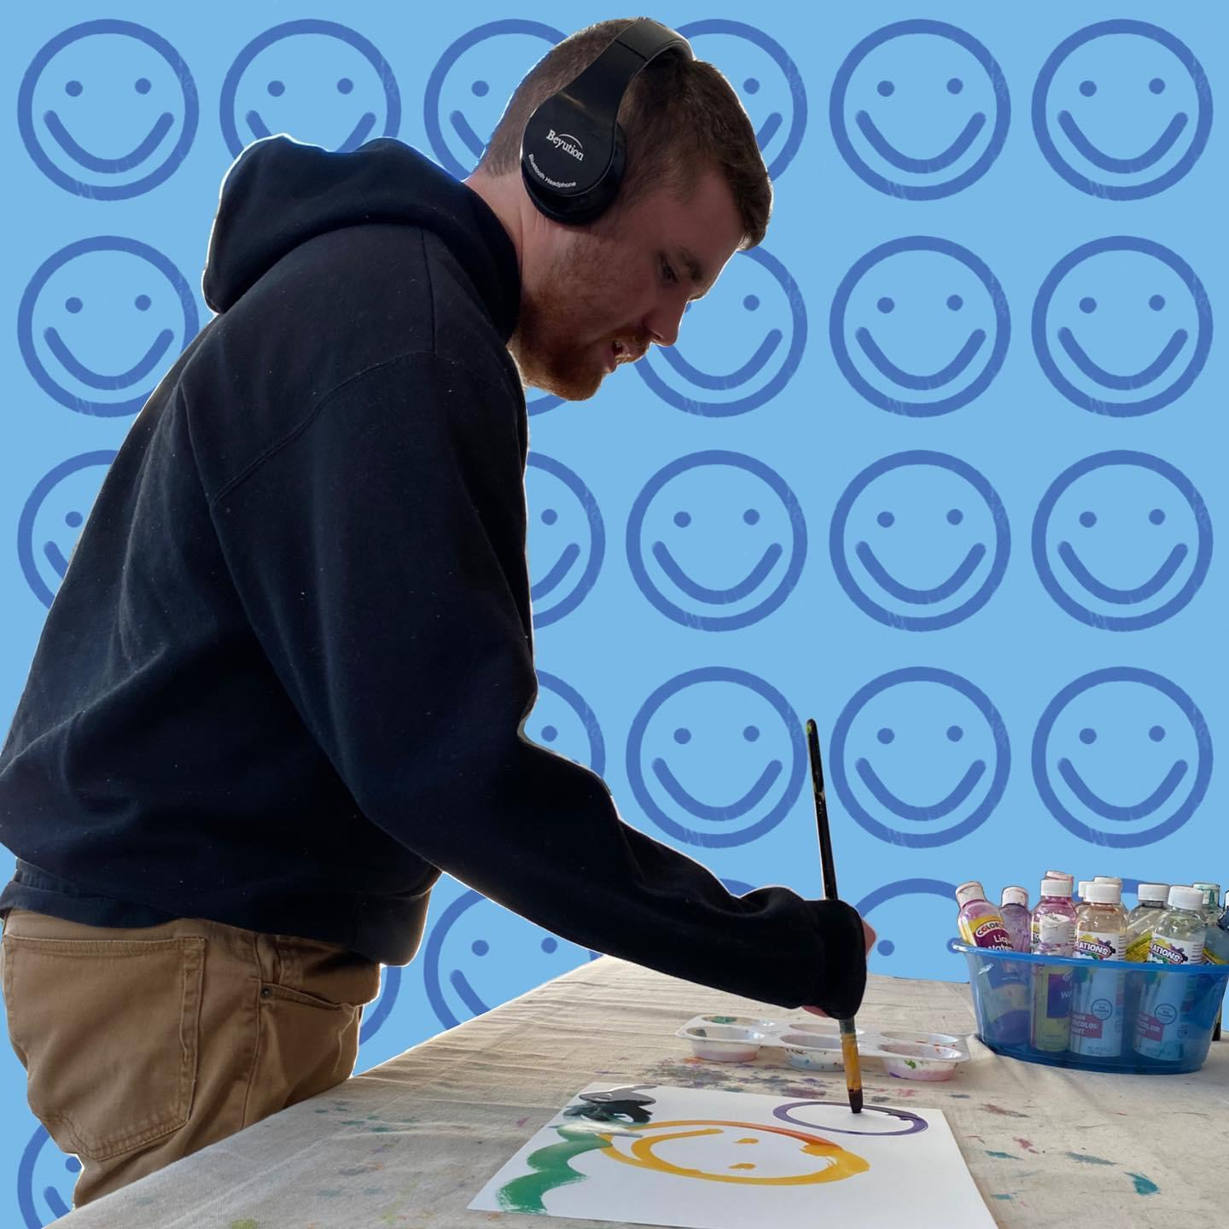
Happiness

Slide 10
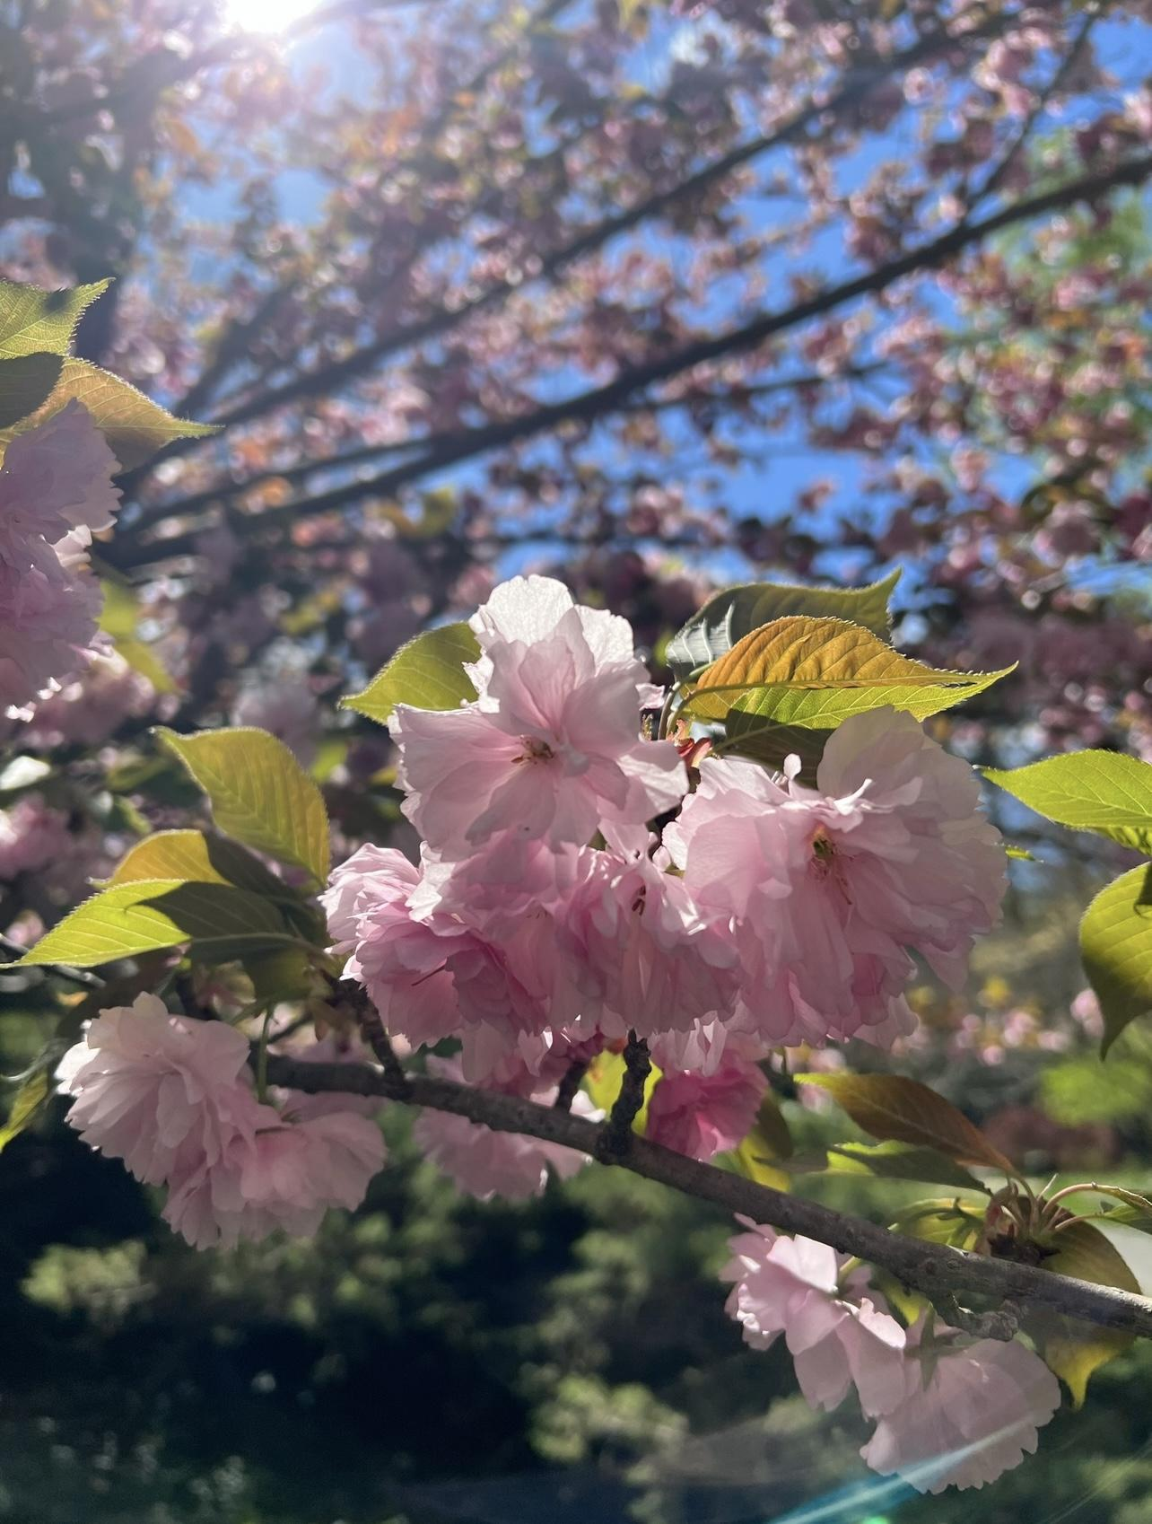
Crafting My Story
Grief Experience of Artists with IDD

Slide 11
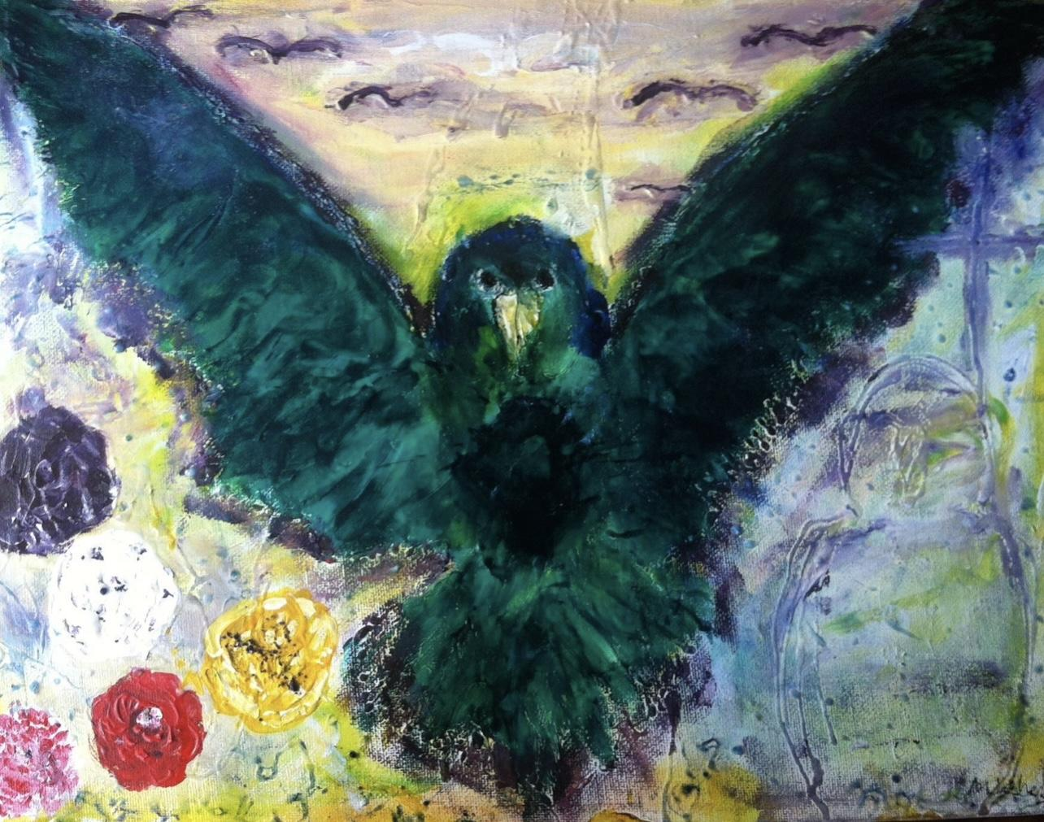
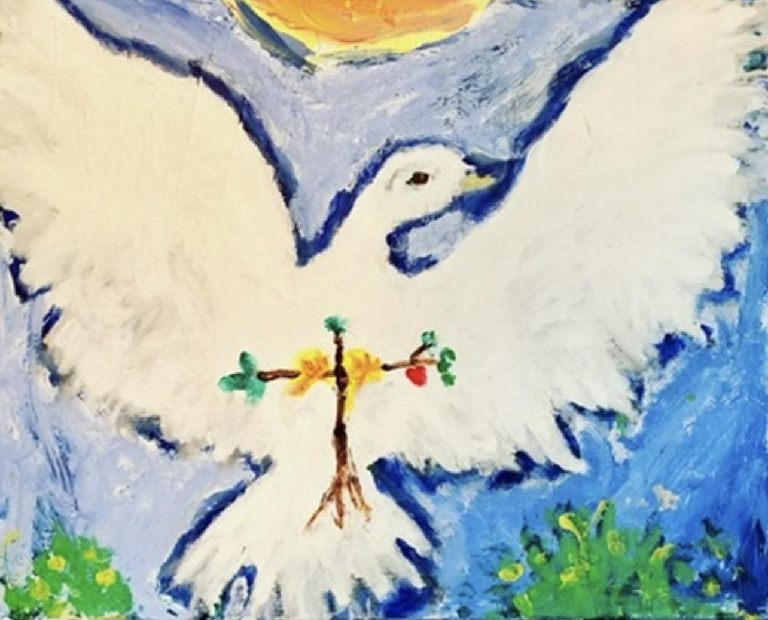
Painting, Connection, and Gifting

Slide 12
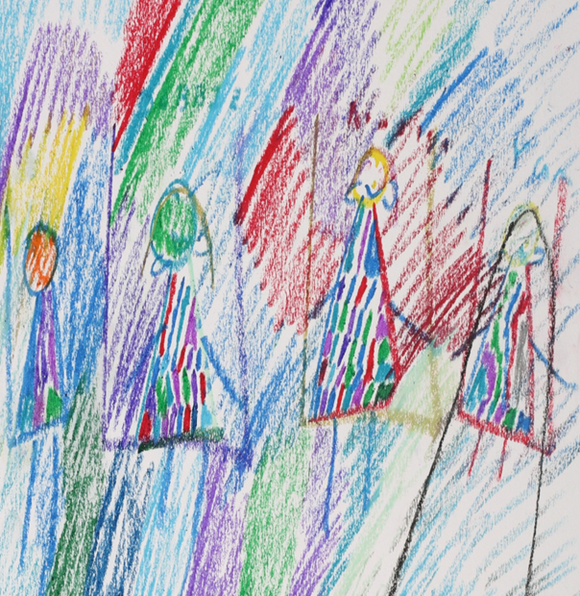
“Casey”
40-year-old had lived with her mother and many cats for most of her life after her parents separated when she was young.
After the loss her mother, moved into a group home, leaving her house and 13 cats behind.
Moved five different residential places over the first year of the loss

Slide 13
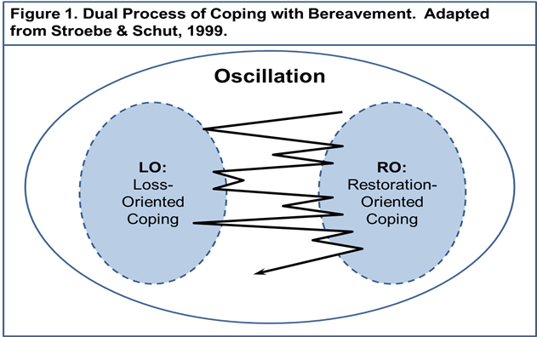
Project Together: A 10-week Expressive Art-Based Peer Bereavement Support Curriculum for Adults with IDD
Multi-Dimensional Loss
Communication Challenges
Through the Lens of the Dual Process Model of Coping with Bereavement
Utilization of expressive arts provides individuals with IDD opportunities to:
express their thoughts and feelings
learn, process, and reflect on their life events and challenges
connect with others to provide and receive support in a group setting
(Carrigan, 1994; Devlin, 2006; Finley, 2013; Segal, 1984)

Slide 14
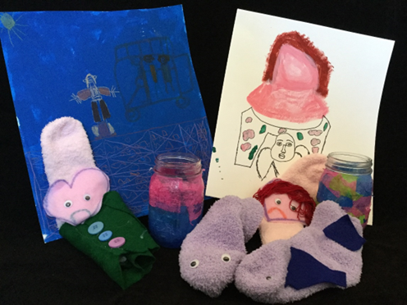
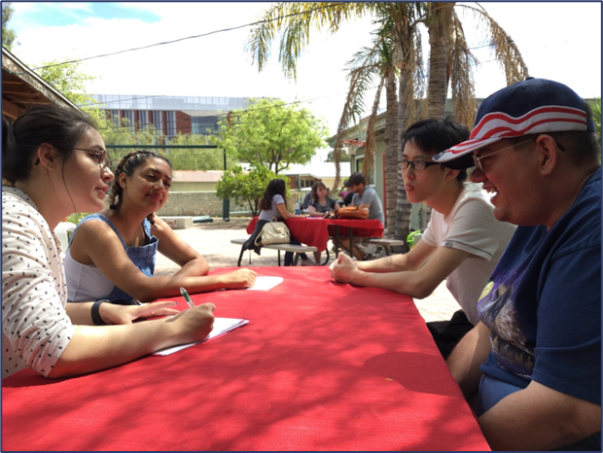
Project Together:
Private and Personal Process
Museum Exhibition:
Public Awareness

Slide 15
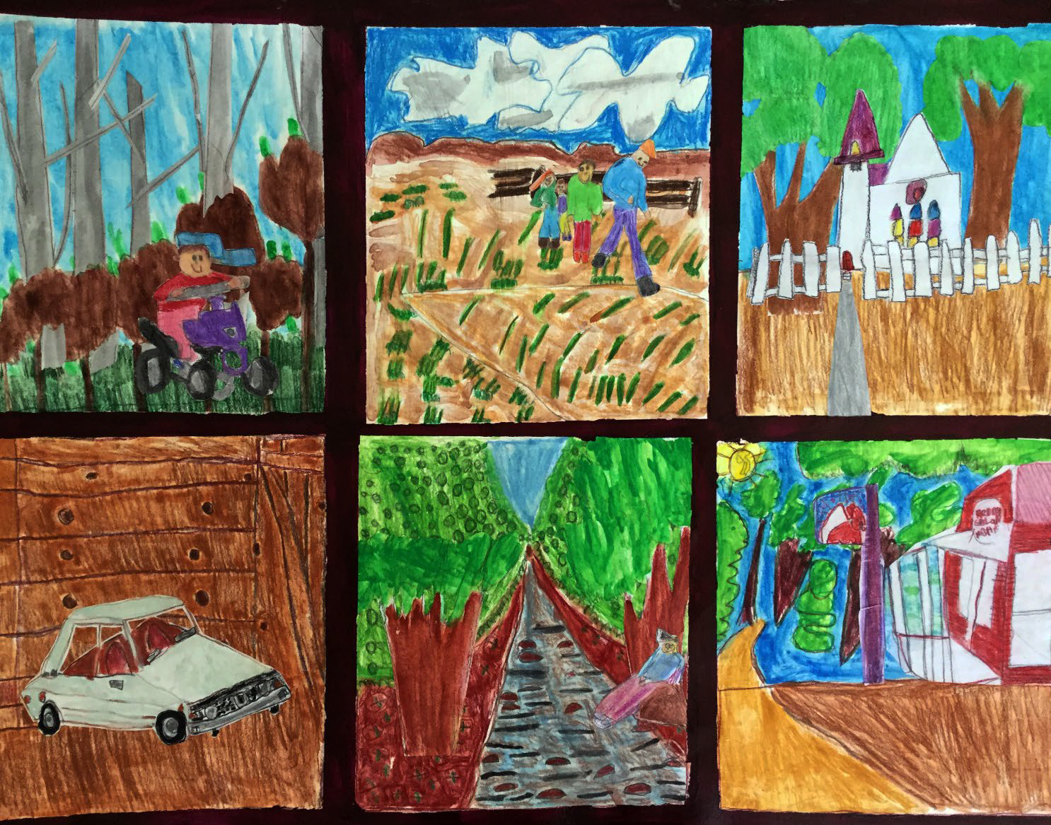
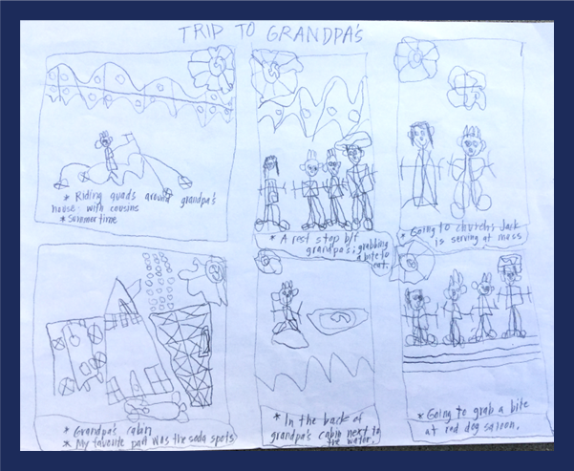
Jack’s Story

Slide 16
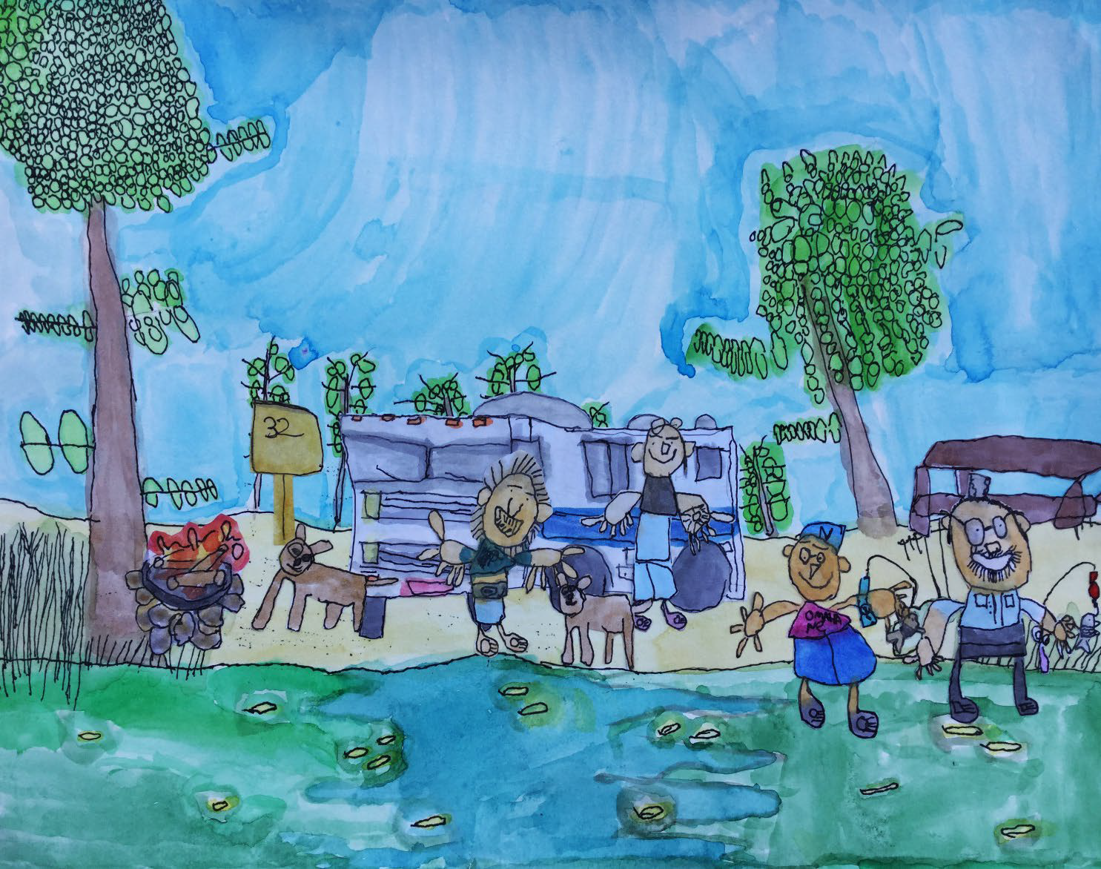
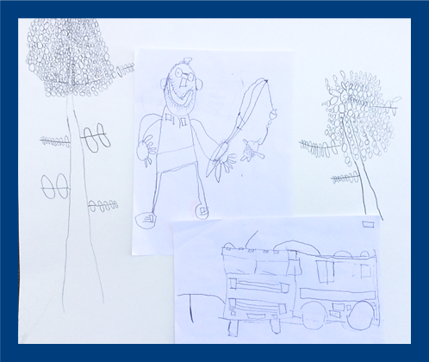
Joey’s Story

Slide 17

Supporters
This project is supported in part by an award from the National Endowment for the Arts, as well as by the Arizona Commission on the Arts and the Molly Lawson Foundation.
Shirai, Y. & DiCindio, C. (2022). Museum as a Mutual Learning Space for Artists and University Students. Canadian Journal of Disability Studies, 11 (3), 32-60. Retrieved from https://cjds.uwaterloo.ca/index.php/cjds/article/view/926

Slide 18

Conclusion
Arts and creative expressions can offer a space by expanding opportunities for connections with nature, repetitive prayer, and one’s spirituality.
Universal Design for Learning (UDL) is a lens we can use to understand how creativity and the arts works as a conduit to connect each person with their own unique experience of spirituality as individual needs of engagement, representation, and action/expression are organically met through creativity, connection, and the arts.

Slide 19
Resources
AAIDD Creative Arts: https://aaiddcreativearts.wordpress.com/
Creating art as an act of prayer: https://open.library.ubc.ca/soa/cIRcle/collections/ubctheses/831/items/1.0054921
Plain Language: Medicaid Services for People with Intellectual or Developmental Disabilities – Evolution of
Addressing Service Needs and Preferences. (2021).
https://systems.aucd.org/docs/publications/policy/PlainLanguageMedicaidServicesforPeoplewithIntellectualorDevelopmentalDisabilities.pdf
Council on Quality and Leadership (CQL). (2024). Spirituality: Definitions, Barriers, and Best Practice.
https://www.c-q-l.org/resources/newsletters/spirituality-definitions-barriers-and-best-practices/
Council on Quality and Leadership (CQL). (2024). Personal Outcome Measures.
https://www.c-q-l.org/tools/personal-outcome-measures/
Harvard T. H. Chan. School of Public Health. (2022). Spirituality linked to better health outcomes, better patient care.
https://www.hsph.harvard.edu/news/press-releases/spirituality-better-health-outcomes-patient-care/
Policy Position Statement:
https://medium.com/christian-citizen/a-regulatory-nudge-toward-supporting-spiritual-lives-of-persons-with-disabilities-f59d7ebee80f
Universal Design for Learning: https://udlguidelines.cast.org/

Slide 20
Caregiver Resources
Advance Planning And End Of Life Decisions - ONEcaregiver Resource CenterMy
Life, My Wishes: Sharing My Journey (workbook)” Lynne Tomasa, Sonoran University Cent:
http://sonoranucedd.fcm.arizona.edu/publications/1275
Talking End of Life with People with Intellectual Disabilities
https://www.caresearch.com.au/tel/tabid/4881/Default.aspx
“Caring at the End of Life” Position Statement of American Association on Intellectual and Developmental
Disabilities
https://aaidd.org/news-policy/policy/position-statements/caring-at-the-end-of-life#.WSYTV-vyvIU
“Let’s Talk About Death.” Down Syndrome Scotland.
https://www.dsscotland.org.uk/wordpress/wp-content/uploads/2016/02/Lets-Talk-about-Death-2012.pdf
“Meeting the End of Life Needs of Older Adults with Intellectual Disabilities” Philip McCallion, Mary
McCarron, Elizabeth Fahey-McCarthy and Kevin Connaire: https://cdn.intechopen.com/pdfs-wm/27625.pdf

Slide 21
References
Carrigan, J. (1994). Paint talk: An adaptive art experience promoting communication and understanding among
students in an integrated classroom. Preventing School Failure: Alternative Education for Children and
Youth, 38(2), 34-37. doi:10.1080/1045988X.1994.9944302
Clute, M. A. (2010). Bereavement interventions for adults with intellectual disabilities: What works? OMEGA —
Journal of Death and Dying, 61(2), 163-177. doi:10.2190/OM.61.2.e
Davies, P., Shanks, B., & Davies, K. (2004). Improving narrative skills in young children with delayed language
development. Educational Review, 56(3), 271-286. doi:10.1080/0013191042000201181
Devlin, B. (2006). The art of healing and knowing in cancer and palliative care. International Journal of Palliative
Nursing, 12(1), 16-19. doi:10.12968/ijpn.2006.12.1.20391
Doka, K. J. (2010). Individuals with intellectual disabilities: Struggling with loss and grief. Washington DC:
American Association on Intellectual and Developmental Disabilities.
Finley, C. (2013). History and programming for people with disabilities. Nashville, TN: Vanderbilt Kennedy Center
for Excellence in Developmental Disabilities.
Gulbenkoglu, H. (2007). Supporting people with disabilities coping with grief and loss. Melbourne, Australia:
Scope (Vic) Ltd.

Slide 22
References (continued)
Hume, K., Regan, T., Megronigle, L., & Rhinehalt, C. (2016). Supporting students with autism spectrum disorder
through grief and loss. TEACHING Exceptional Children, 48(3), 128-136. doi:10.1177/0040059915618196
Lipson, D. (2019). Assessment and Planning Care Measures. https://www.medicaid.gov/media/4301
Segal, R. M. (1984). Helping children express grief through symbolic communication. Social Casework, 65(10),
590-599
Stroebe, M., & Schut, H. (1999). The Dual Process Model of Coping with Bereavement: rational and description.
Death Studies, 23 (3): 197-224.
Stroebe W, Schut H, Stroebe M. Grief work, disclosure and counseling: Do they help the bereaved?. Clinical
Psychology Review. June 2005;25(4):395-414
Wedgeworth, M. & Cody, S. (2023). Spirituality and health outcomes within the context of social determinants of
health. Nursing. 53(11), 41-45. DOI: 10.1097/01.NURSE.0000978888.90787.38
Young, H., Hogg, J., & Garrard, B. (2017). Making sense of bereavement in people with profound intellectual and
multiple disabilities: Carer perspectives. Journal of Applied Research in Intellectual Disabilities, 30(6),
1035-1044. doi:10.1111/jar.12285

Slide 23
Upcoming Events
Disability Representations in the Second Testament
Monday, June 10 at 2 p.m. ET (virtual)
Disability Impact Awards in Washington, D.C.
Thursday, July 11 at 5:30 p.m. ET (in-person)
Learn More and Register at www.RespectAbility.org/Category/Events

Slide 24
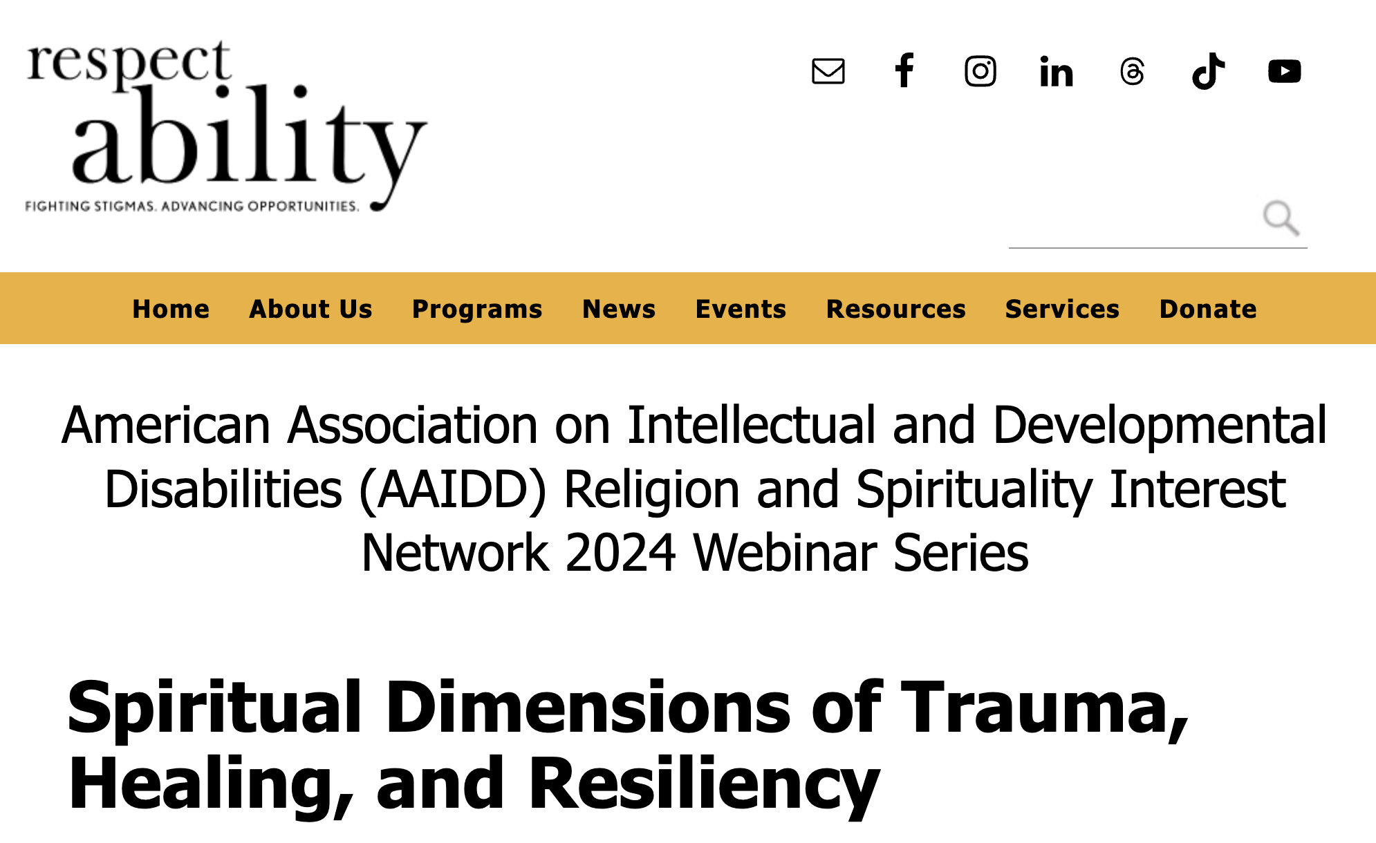
In Case You Missed It
Catch up on this series at
www.RespectAbility.org/aaidd-2024-series/

