Slide 1
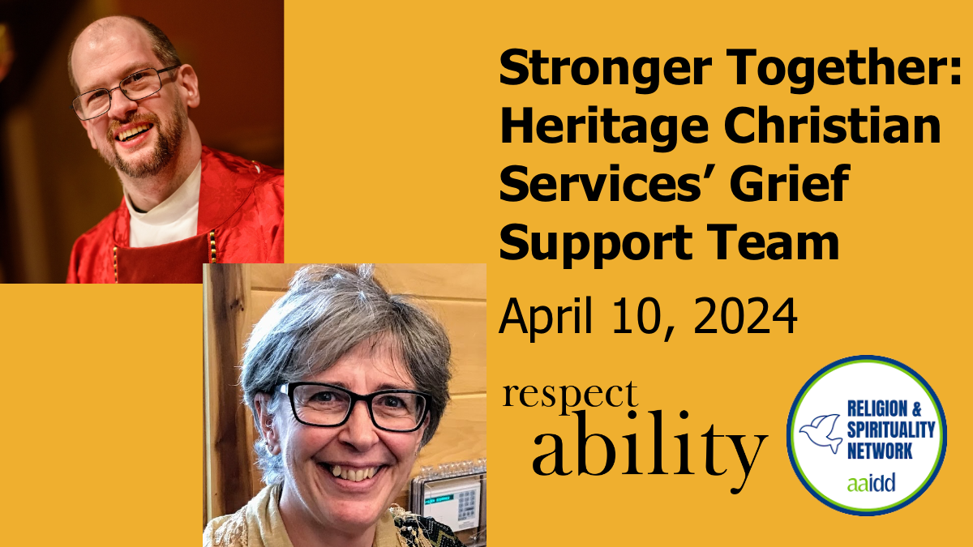
Welcome

Slide 2
Housekeeping Notes
This webinar has ASL interpretation and live CART captioning.
To view the live CART transcript in a separate window, use the link in the chat box.
This webinar is being recorded and will be posted to RespectAbility.org/AAIDD-2024-Series by next week, after open captions are added to the recording.

Slide 3
Stronger Together: Heritage Christian Services Grief Support Team
By Padraic Collins-Bohrer, M.Div. & Lida Merrill, M.Th.

Slide 4
What is Grief?
Grief is the emotion that comes with loss; usually described as “sadness”
  Death of a family member or friend
  Death of a pet
  Support staff leaving
  End of a job
  Diagnosis of a serious illness
  Divorce of close people
  End of a relationship
  Anticipated loss
Grief can last for a few days, many years, or somewhere in between

Slide 5
What is a team?
A team is a group of people who come together to work towards a common goal or to support an on-going project
A Grief Support Team is a group of people who gather to support a grieving person or people
Heritage Christian Services’ Grief Support Team consists of the Faith Community Inclusion team, creative arts therapists, speech therapists, and a behavior support team member

Slide 6
Don’t embark on this journey alone
400+ aging people within the residential program
4,000+ employees
4 Faith Community Inclusion staff (spiritual support staff)
100 sites across Buffalo and Rochester, NY regions
Not enough intense support and after care for those experiencing grief
Join together the Creative Arts, and some clinical team members, the Behavioral Support team, and Faith Community Inclusion (spiritual supports)
The idea orgiginated from the Clinical Arts Team

Slide 7
Why the Grief Support Team?
The need for on-going grief support in our large agency was needed
To support a person as they are ill or preparing to die, and people who are grieving, to be with them as they begin to adjust to their grief or loss.
We support other types of grief
We primarily support people and employees in our residential and day habilitation programs; others as requested
We will assist people to seek external supports or employee EAP programs
Our name indicates the losses we are present to support

Slide 8
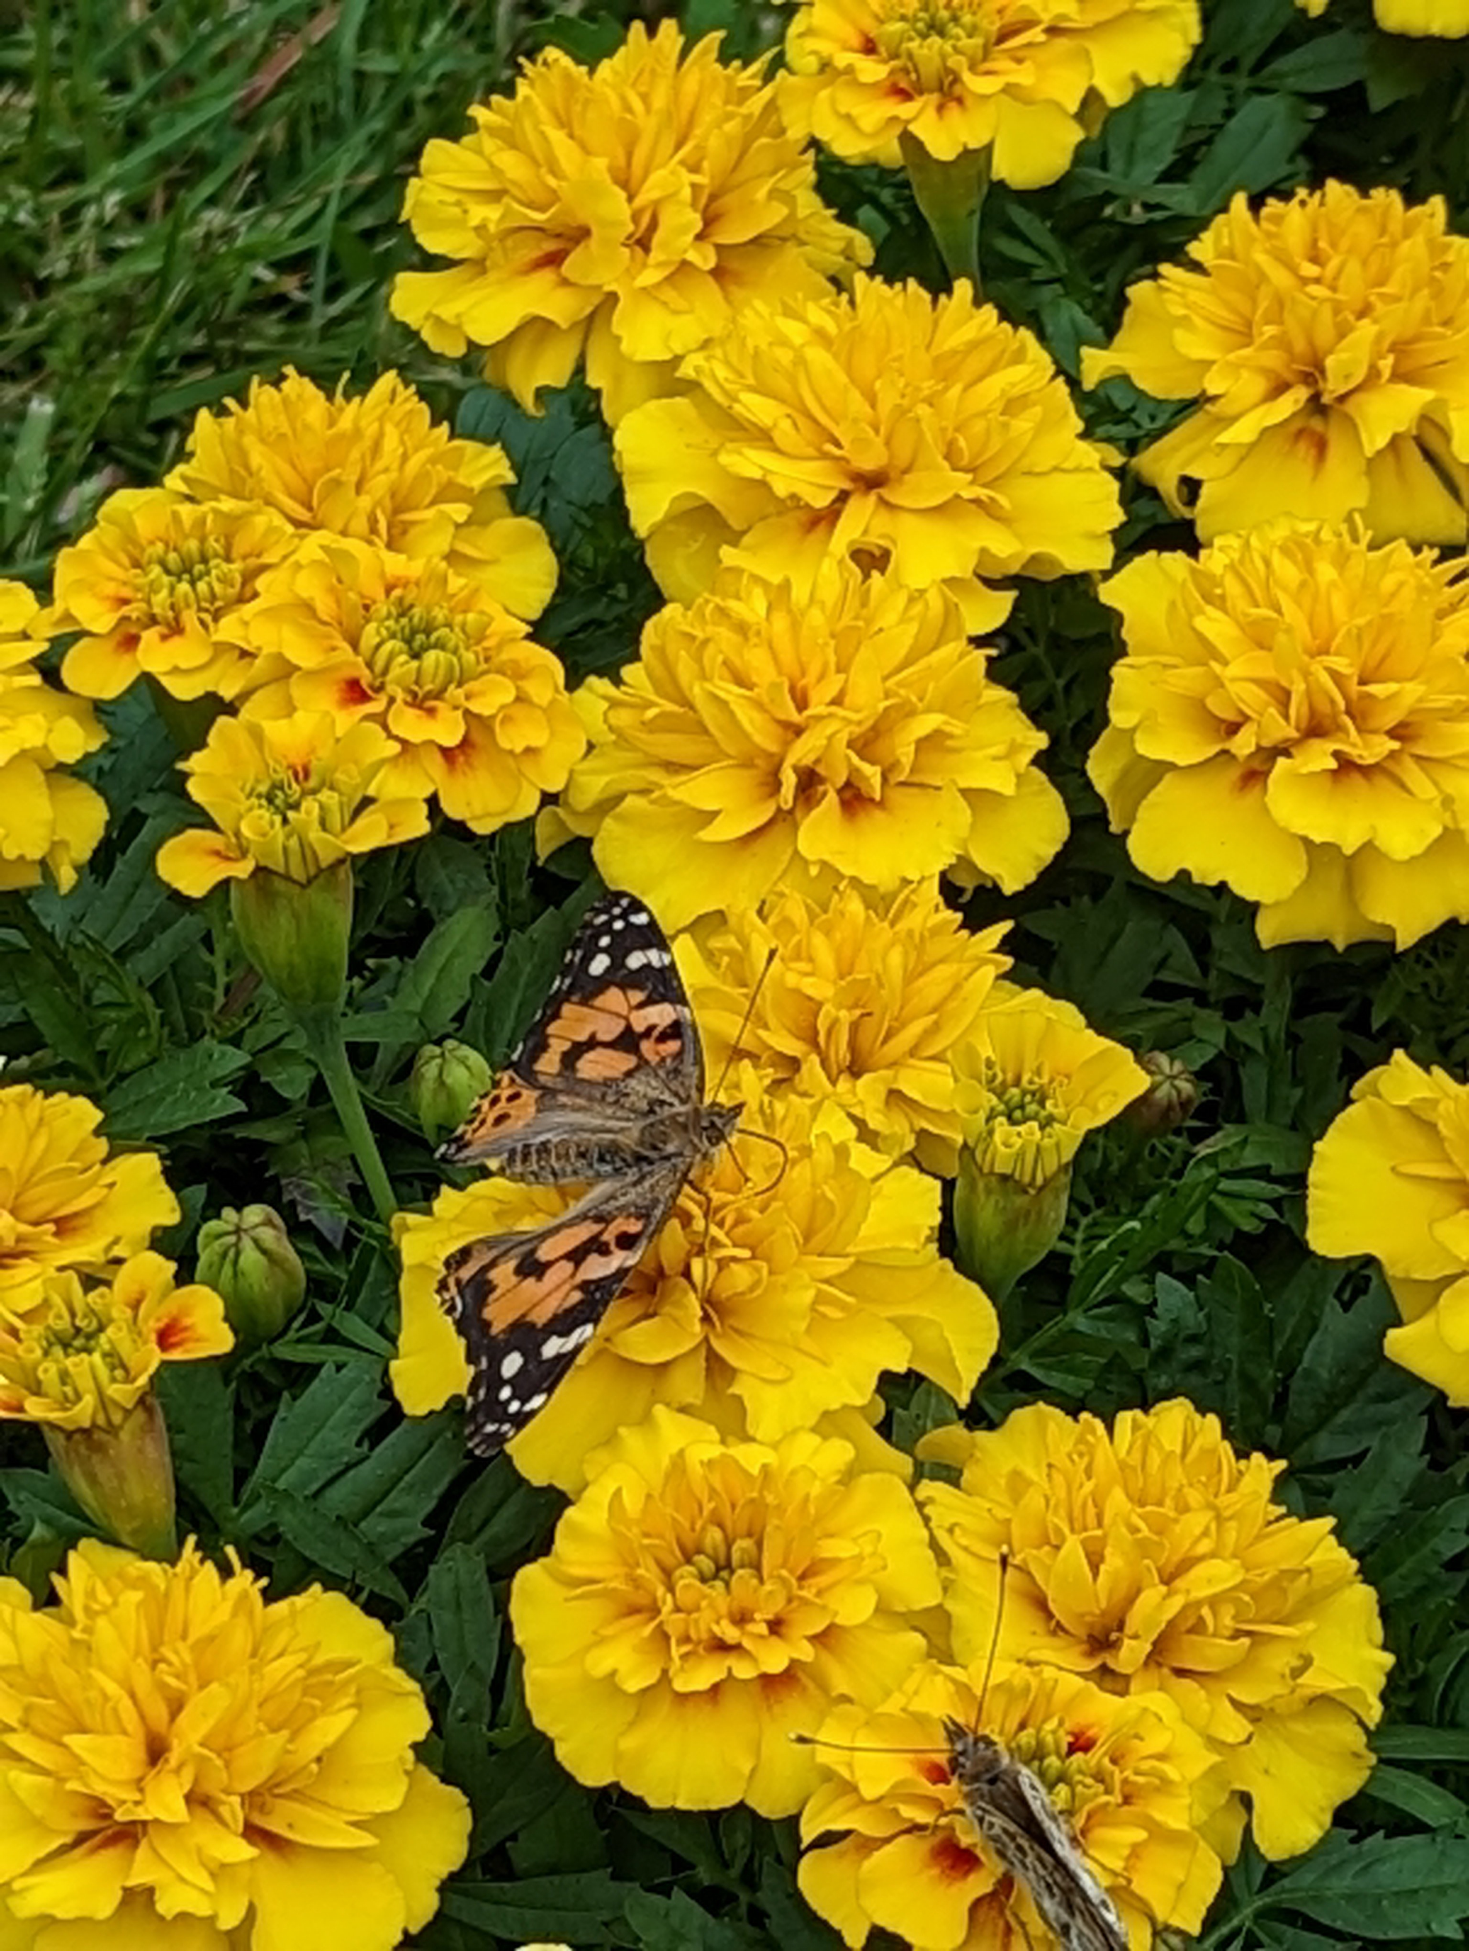
How are we stronger together?
Together:
Various gifts
Various locations
Various responses
Various listening techniques
Various needs
Various times
Many needs supported

Slide 9
Stronger Together
The combination of the Faith Community Inclusion, clinical, behavior support, and creative arts clinicians became a way to increase the support and offer different paths available for people.
A Grief Support Team of multiple disciplinaries strengthens the responses available to those grieving
A multidisciplinary Grief Support Team provides encouragement and guidance to team members through difficult situations (self care)

Slide 10
Stronger Together: Work of the Grief Support Team
Be present
Use simple but appropriate language
Honor the faith of the person and their loved one
Honor the relationship of the person to the staff who moved away
If possible invite them to do something physical with you, such as throw rocks into a lake, take a walk, or visit their faith community building
Listen to what people communicate with spoken language, sign language, body language, pointing, technology

Slide 11
Grief Support Team: Stronger Together
Listen to support staff as they tell stories
Speak respectfully of both parents if there is a separation or divorce
Communicate plans with the members of the Grief Support Team, even if they cannot be present. They need the information to provide support to the team (we use our shared Grief Support Team email and Microsoft Teams)
Members of the Grief Support Team who supported the person or site should be one of the first people to respond
The members support the primary Grief Support Team responders for each loss (self care)

Slide 12
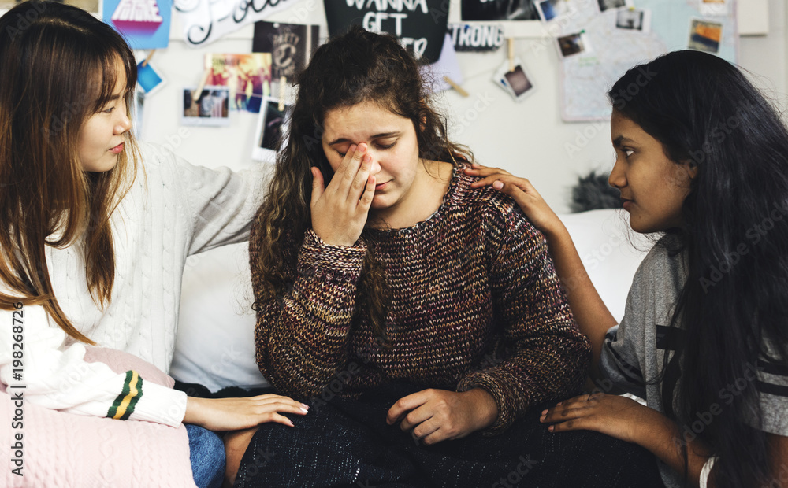
Stronger Together: Finding Hope Together

Slide 13
Stronger Together: We have
  Created an agency wide shared document file
  A small group of team members went to a variety of leadership groups to introduce the Grief Support Team and our team goal.
  Created a Grief Support Team email for easier connection
  Tending for an Agency memory garden
  Discerning a way to track where a person has lived or worked to communicate with others who know them

Slide 14
Stronger Together: We also have
  Grief Support on-line seminar offered for Agency employees and others
  “How to Support Someone who is Grieving” document created with the support of graphic designers; available via shared document file
  Organized a meal train for sites, providing extra time for staff and people supported to be together; provides other sites a way to support
  Blue Holiday and Time Together events for on-going support

Slide 15
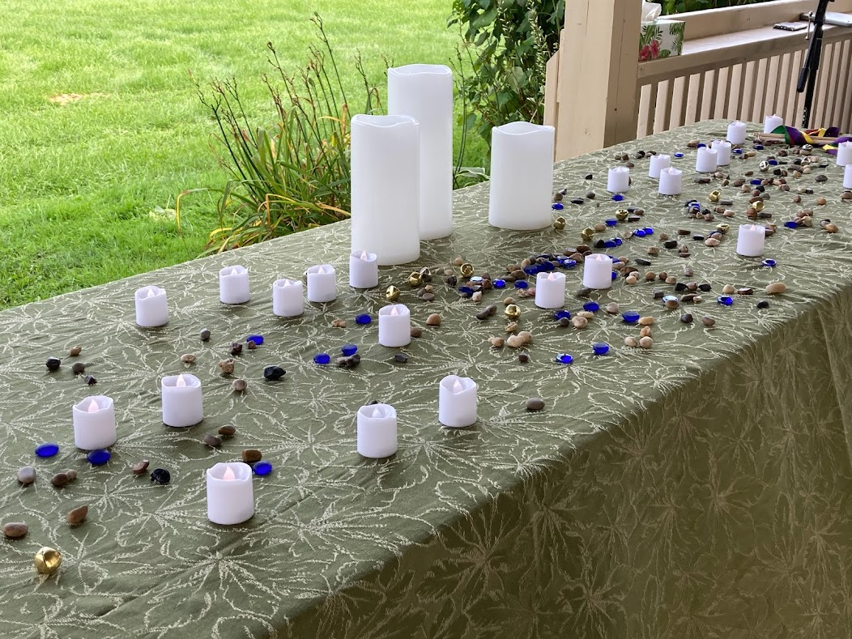
Stronger Together: Service of Grief for 27 people who died Jan 2020-September 2022

Slide 16
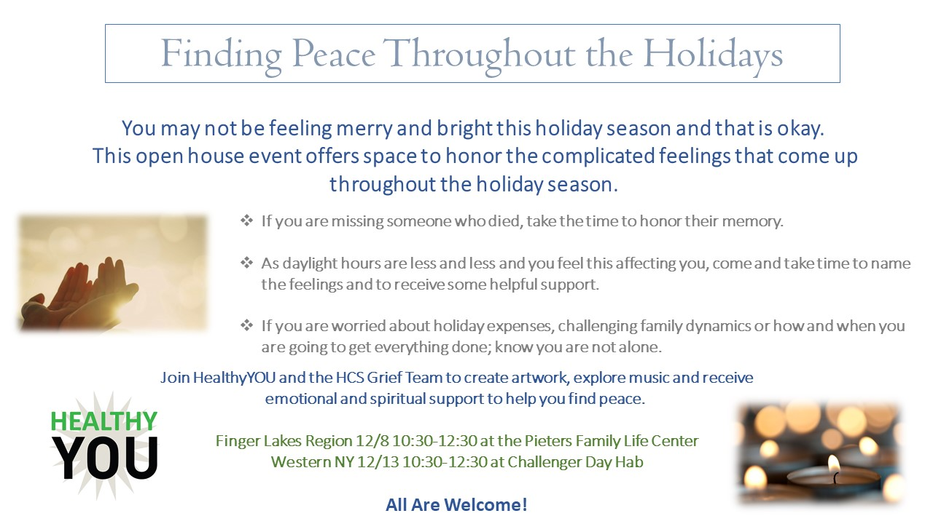
Stronger Together: Finding Peace Throughout the Holidays & Meaningful Memories

Slide 17
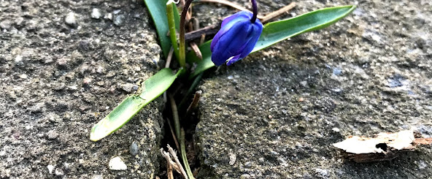
Together we can support people to make beautiful things happen as they adjust to their grief

Slide 18
Q & A
Padraic.Collinsbohrer@HeritageChristianServices.org
Lida.Merrill@gmail.com

Slide 19
Upcoming Webinars
Spirituality and Healing Through Expressive Arts
Wednesday, May 8 at 2 p.m. ET
NACDL + RespectAbility: Fostering Disability-Inclusive Cultures and Workplaces
Thursday, April 25 at 2 p.m. ET
Equity at the Ballot Box: Getting Involved in Community Activism and Running for Office
Wednesday, May 1 at 2 p.m. ET
Learn More and Register at www.RespectAbility.org/Category/Events

