Slide 1
Workshop: How to Stand Out in a Competitive Environment

Slide 2
Consider The Job You are Applying For
What are the requirements of a job you're interested in
  How do you showcase those skill sets in your resume?
Depending on your industry create multiple resumes so you have an idea of which one to submit for the job you are looking for.

Slide 3
Get Creative

Slide 4
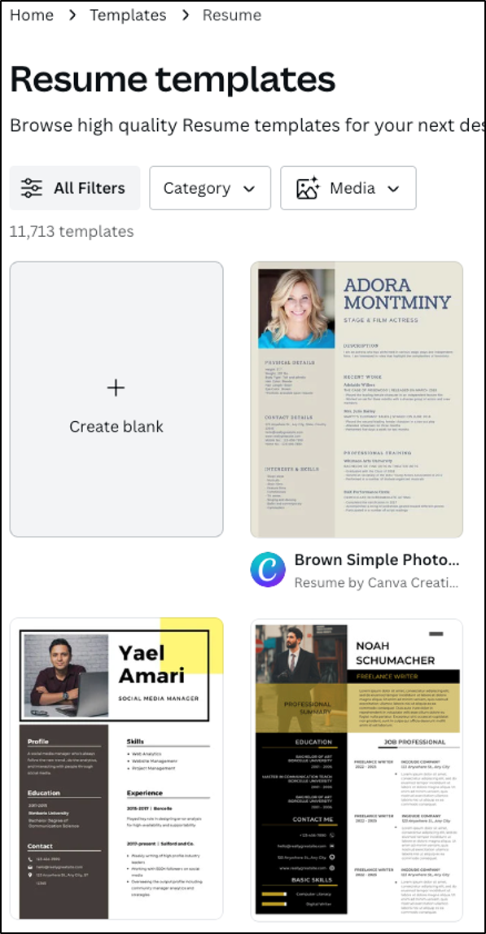
Job hunting doesn't have to be boring
Think of this: Many people are applying for your role. Meaning the hiring manager will see many resumes come in.
Think of ways to make your text stand out.
  Highlight the Topics
  Make your name and contact info a different size or color
  Give icons for contact information
Tip: Canva is a free resource with many templates for you to choose from. You can type in resume and many options will come up.

Slide 5
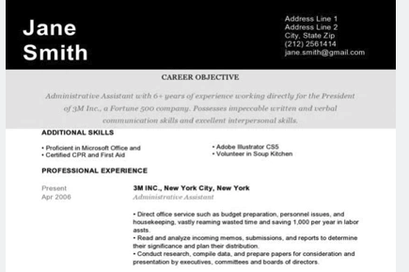
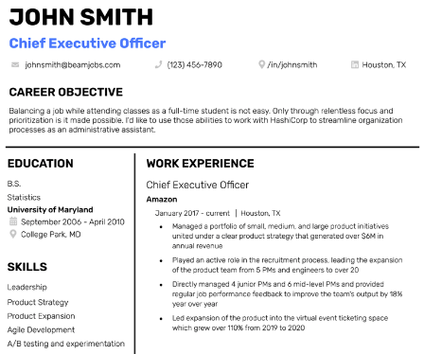
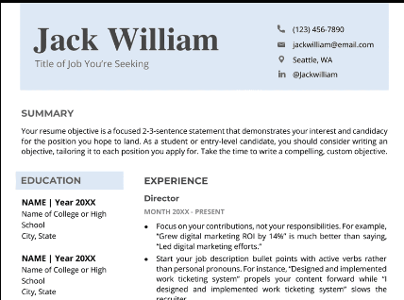
Examples

Slide 6
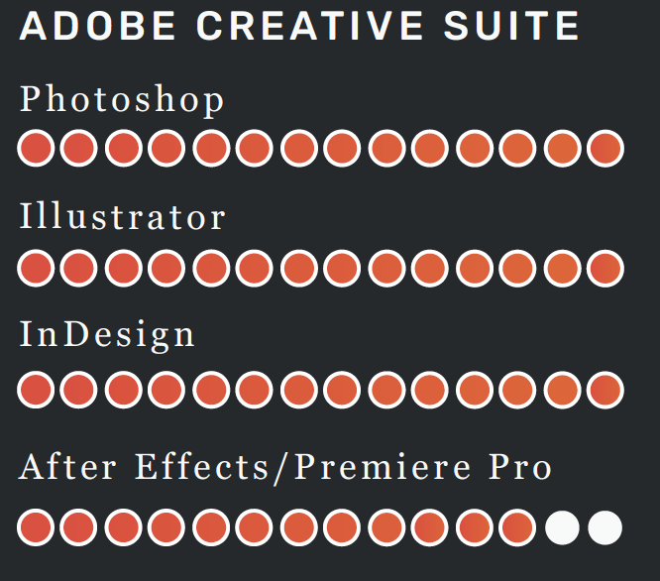
Job hunting doesn't have to be boring (continued)
Think of ways to show case your skills and experience in your resume.
For programs and skill sets think of adding graphics or a section that stands out to portray your skill level.
Tip: Keep it simple. You don't want to overload the resume with too many graphics and icons. Find the section where it will be the most effective.

Slide 7
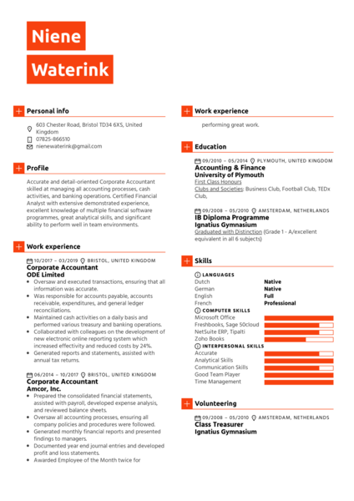
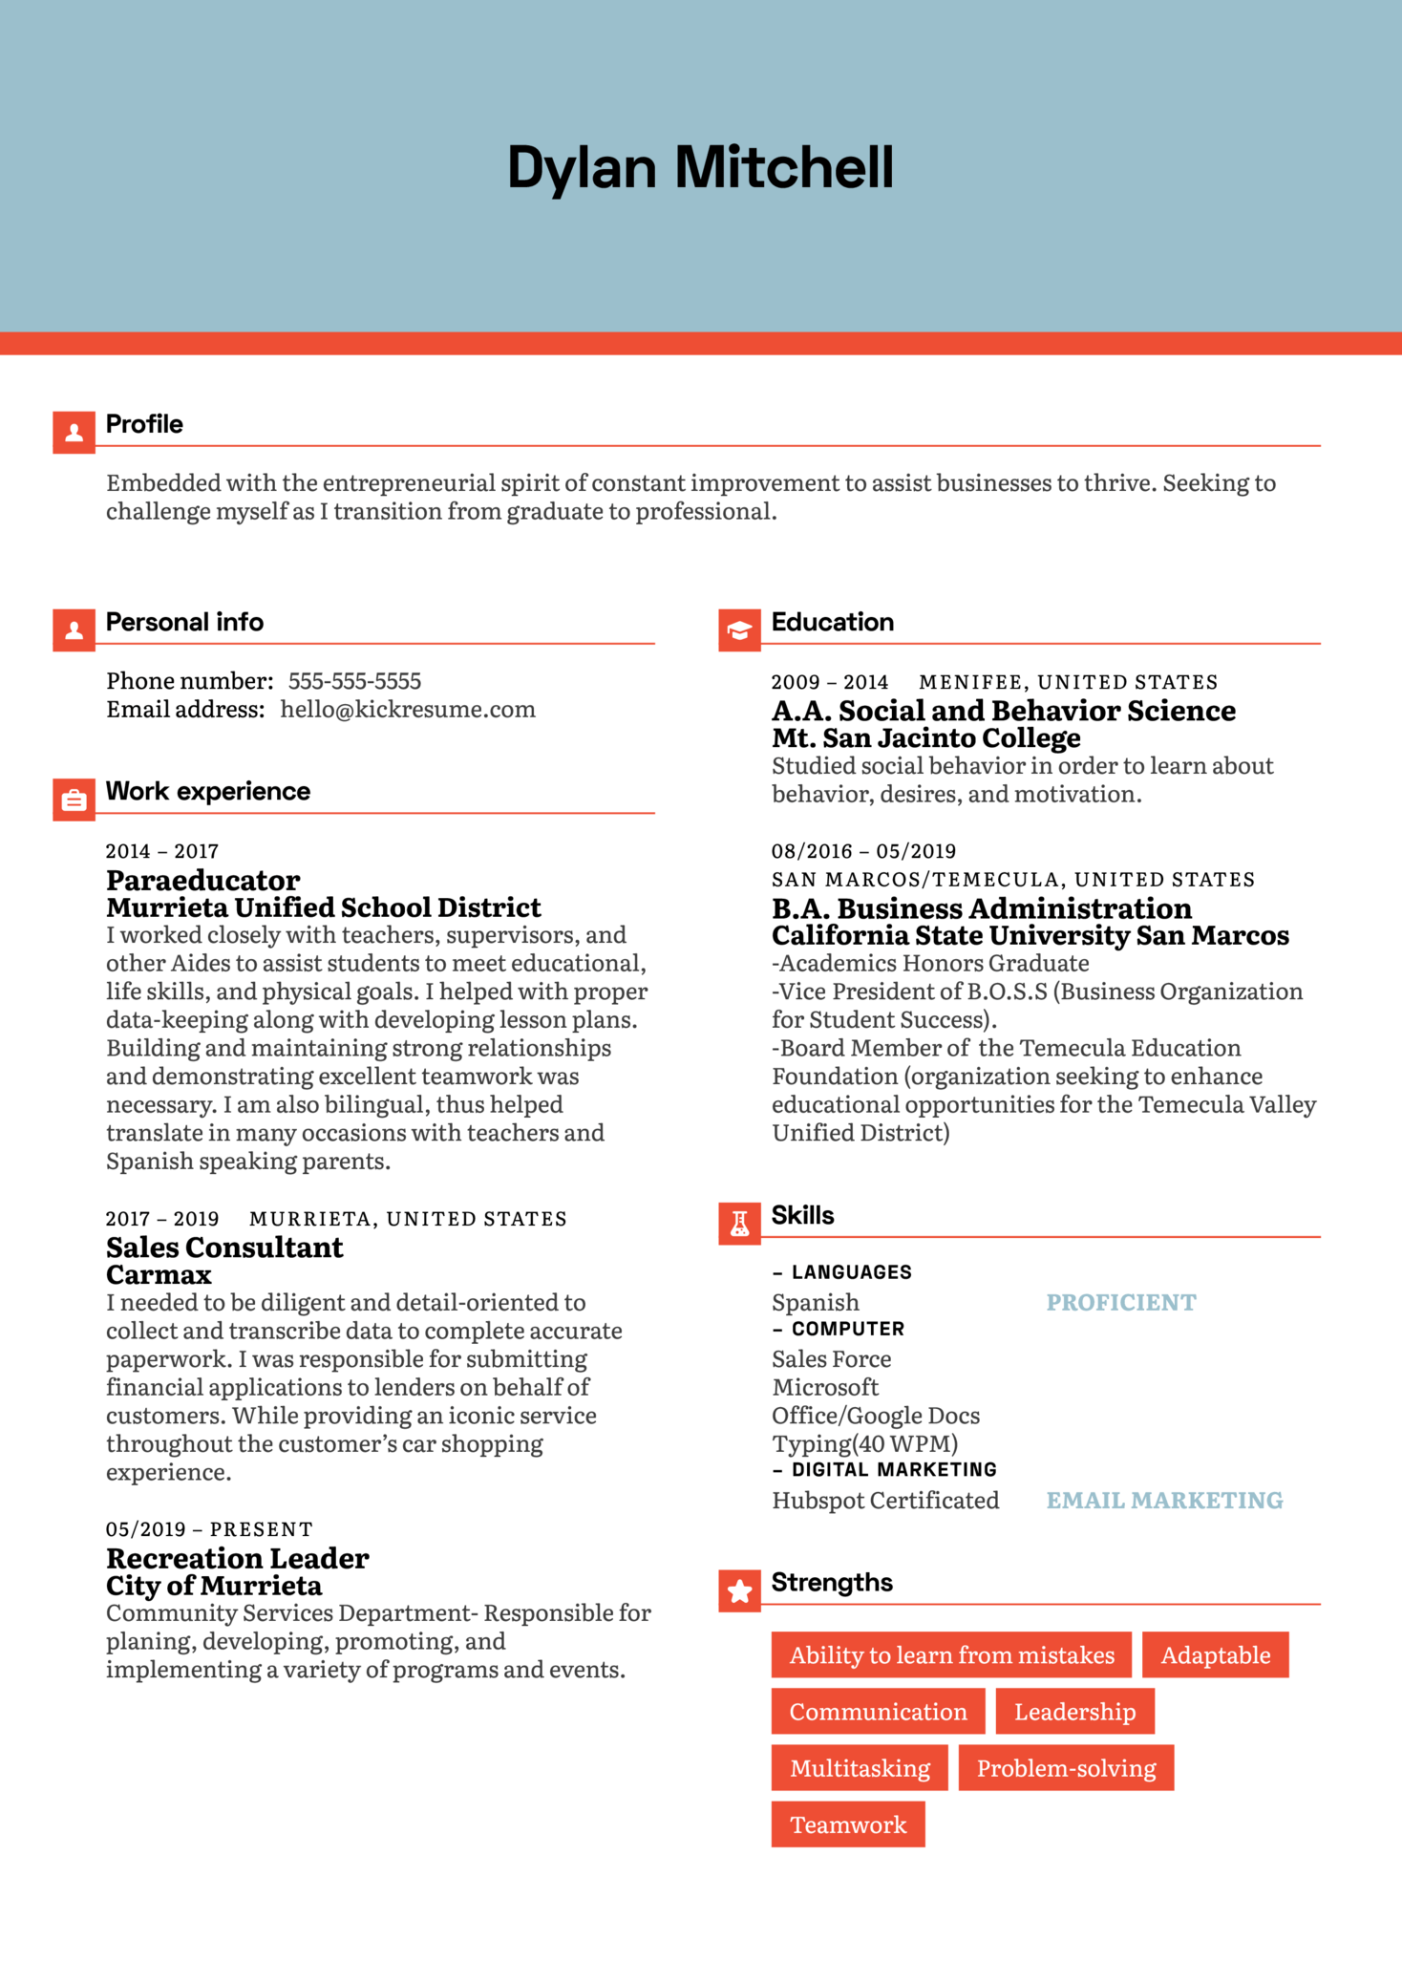
More
Examples

Slide 8
Have an Online Portfolio

Slide 9
Portfolios are for all Professions
A great way to showcase yourself is having a place for a hiring manager to explore your work in action.
This is a space where you can explain your role in a project, challenges that you overcame, and the finished result.
It also makes it easier for hiring managers share it with others without coming back to request samples or examples.
Tip: Use your portfolio to speak about yourself a bit more in what is relevant to the job profile.

Slide 10
Portfolios are for all Professions (continued)
You always want to include a link to your portfolio on your resume and cover letter.
  Make sure you use explicit language to draw attention to it.
    Example: To see sample of my work view my online portfolio.
Always download a PDF version of your portfolio that you can send in an email if necessary.
Choose pieces that really speak to your expertise.
Ask someone else to review it for a second opinion.
Tip: Canva is also a great space to start your online portfolio for free. You can easily drag or drop your info in the spaces and customize.

Slide 11
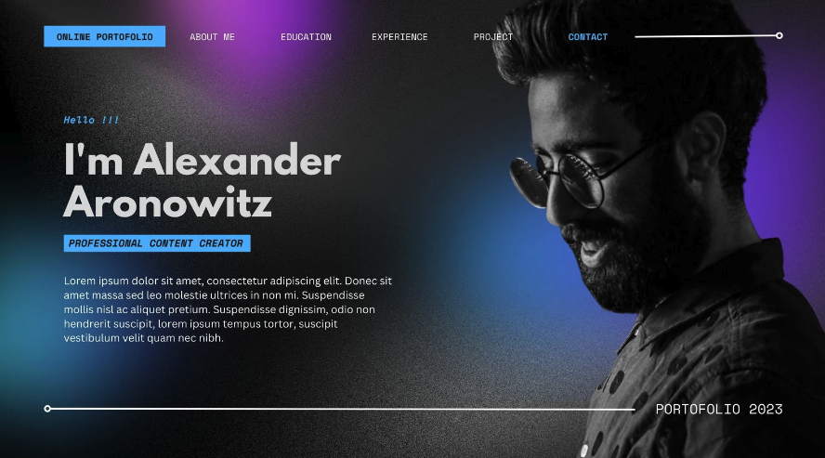
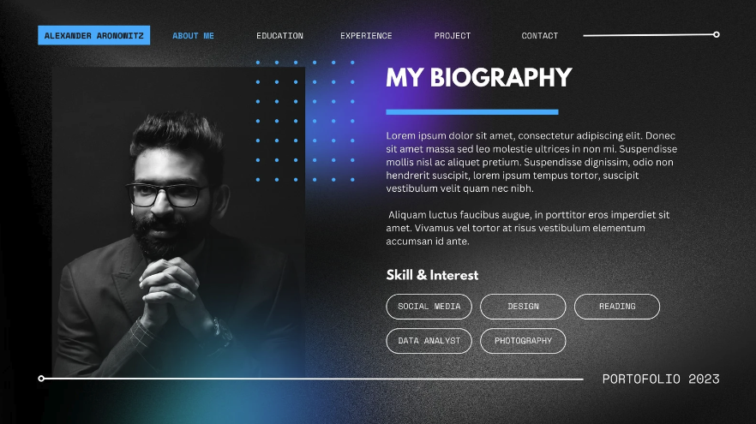
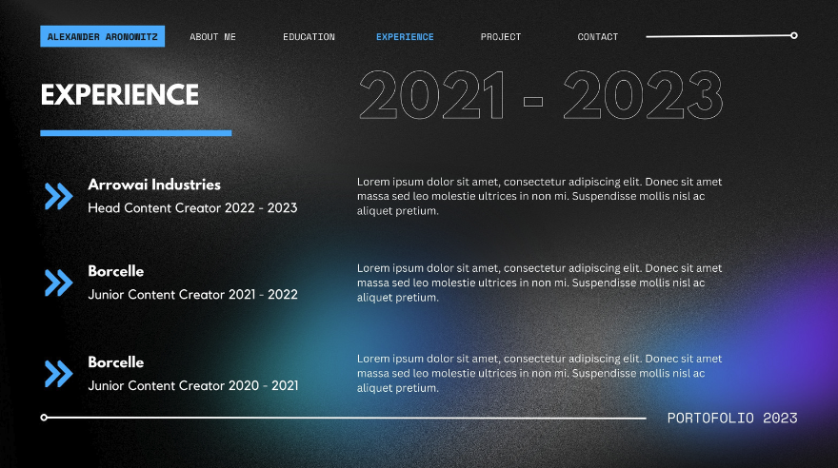
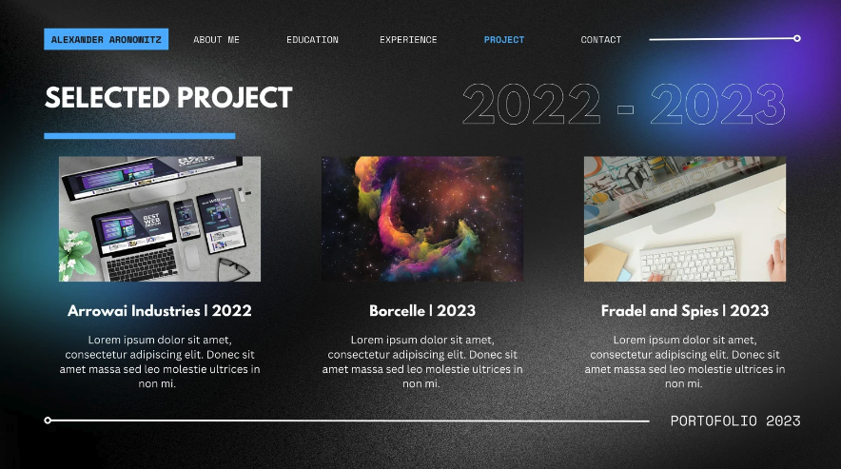
Portfolio Examples

Slide 12
Portfolios are for all Professions (part 3)
Make sure you include explanations for your wor​k
Include
  Navigation – Home page, About, My Work (whatever is appropriate in your field)
  A link to your resume as a pdf or word doc
  Contact information
This is about you but not about you. One image of yourself only (unless model or photographer)
Don't overshare personal information. Small quirky things like your pet is okay but really stick to your professional experience.
Tip: If you use an online form, make sure you check it regularly to see if someone reached out to you.

Slide 13
Formatting

Slide 14


Use Universal Formats
Make accessing your resume, cover letter, or portfolio as easy for the hiring manager to open.
Make your resume available in a word doc and a pdf.
Avoid formats like publisher or Adobe Creative Suite files like .ai , .psd, .indd

Slide 15
Do's and Don'ts

Slide 16
Do's
Practice what you are going to say before the interview.
Bring physical copies of your resume and a physical portfolio
  Alternative to a printed portfolio: Bring a laptop or ipad with your portfolio already open
If you have accessibility needs reach out to the hiring manager prior to interiew to make them aware.
Make sure your Linkedin is the most up to date.
Invest in yourself. Invest your time.
  Take your time to review all of your materials for grammar and spelling.
  Take the time to ask a second opinion.
Stay positive

Slide 17
Don'ts
Don't share personal social media profiles if they are not connected to your professional work.
Don't connect with the hiring manager on Linkedin and send a personal note. They most likely will not respond.
  Do follow the organization on Linkedin
Don't wear clothes you are uncomfortable in to an interview.
Don't wing it!
  Practice will set you a part. Don't rely on a winning personality and not account for nerves.
Don't request things of the employer that you did not provide.
  Example: Coming into an interview and asking if they have your resume.

Slide 18
Questions?

Slide 19


FOR MORE INFORMATION
Ashley Nyaley
(she/her)
Senior Director of Marketing and Commnications
RespectAbility
Ashleyn@respectAbility,org

