Slide 1
Allowing Your Transferable Skills to Blossom
Identify and Access Your Transferable Skills to Unleash Your Career Potential

Slide 2
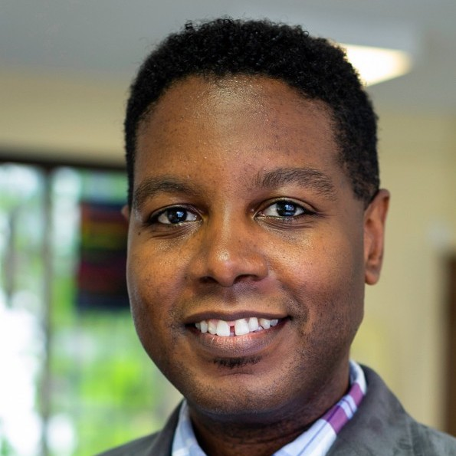
Meet Your Presenter
Graciano Petersen is RespectAbility’s Senior Director of Talent, Culture, and Training​
Lead Internal and External DEIA efforts​
Over 14 years of Adult Education experience and is passionate about making education accessible to all types and levels of learners​
Manage the work of the Disability Training & Consulting Bureau

Slide 3
Transferable Skills
Transferable skills are the competencies you develop during your experiences that you carry with you in all of your endeavors
Identifying your transferable skills will help you to pinpoint ways that are marketable to you for employment.
Being able to spot coded transferable skills in job ads will allow you to put your best version of yourself forward when applying.

Slide 4
What Color is Your Parachute?

Slide 5

What Color is your parachute? (2)

Slide 6
Flower Diagram/Exercise

Slide 7
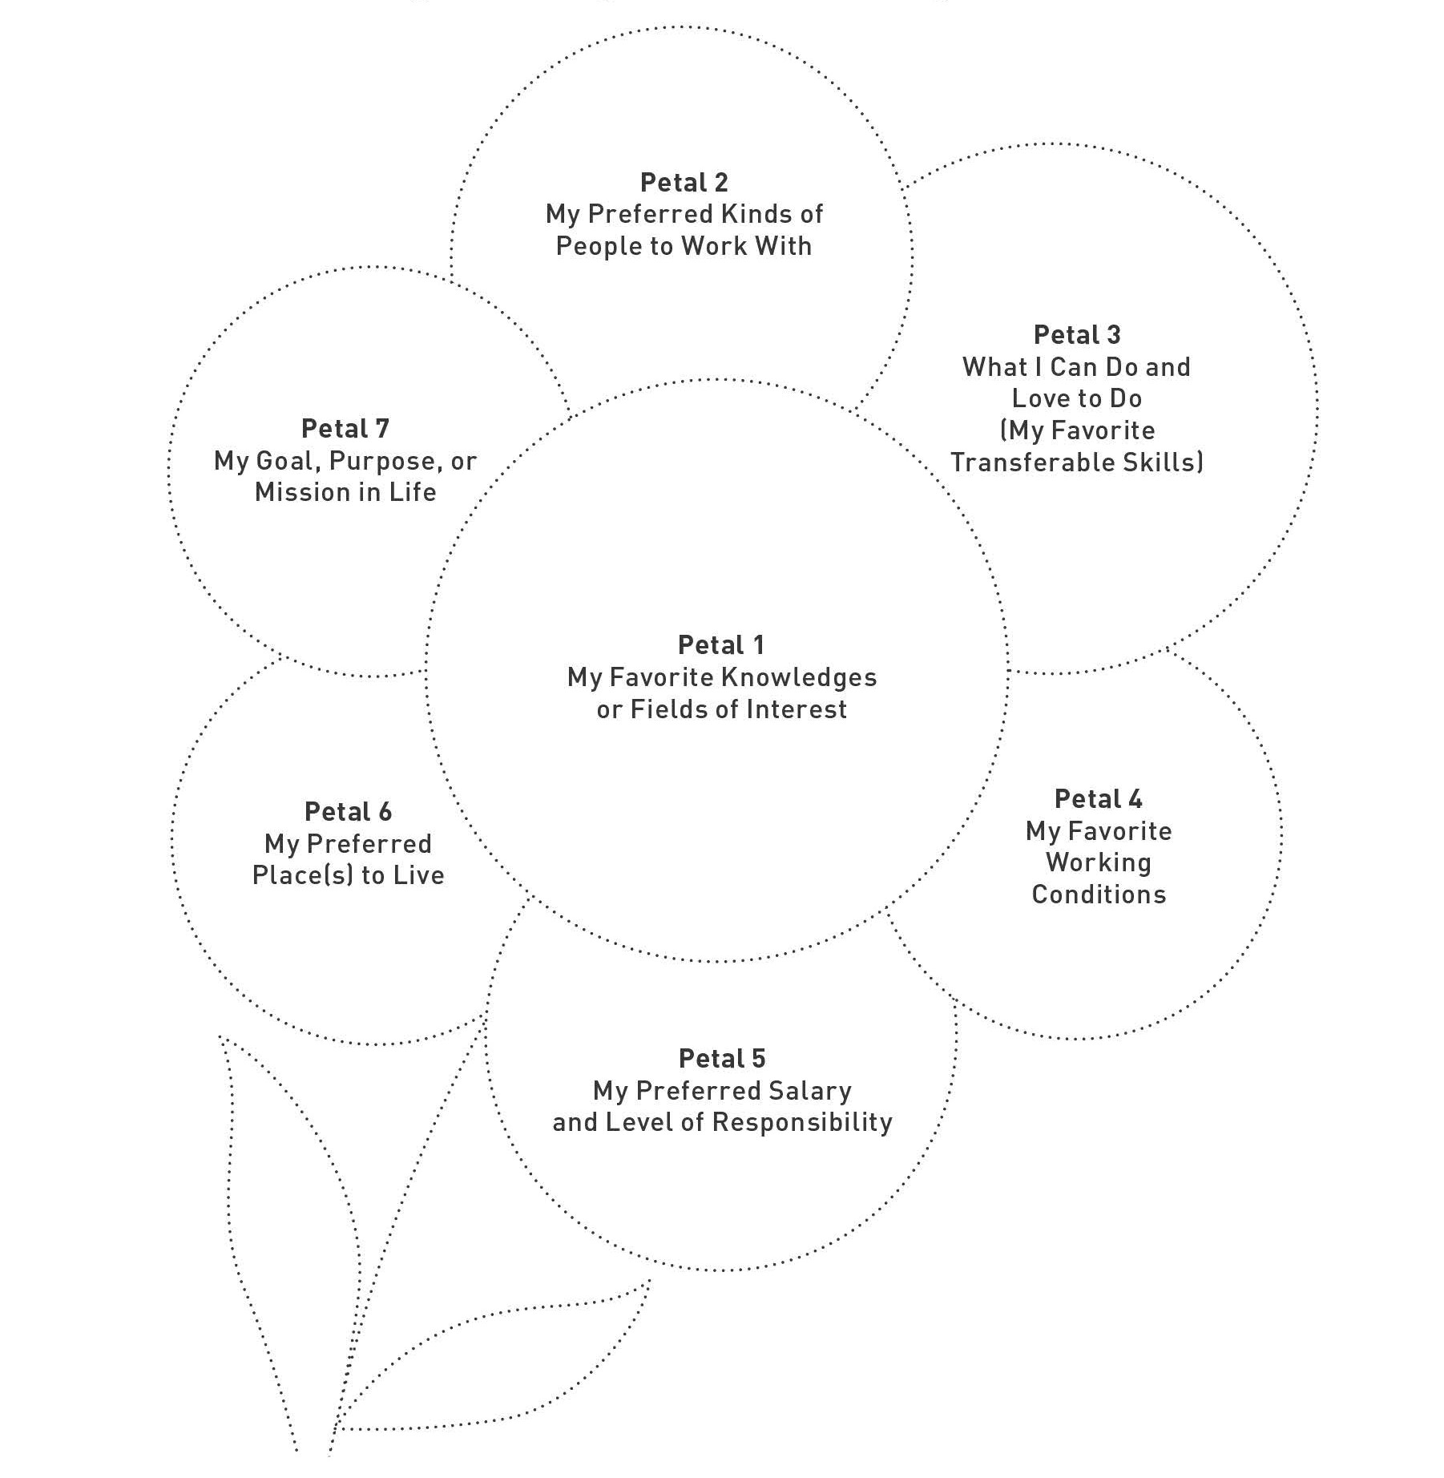
Flower Diagram

Slide 8
Flower Petals
Petal 1: Favorite Knowledges
  What are you most interested in or have a deep understanding of?
    This could be anything from technology to psychology or even history
Petal 2: People Environments
  Who do you enjoy working with?
    Consider factors such as company culture, team size, or the sociopolitical views of your colleagues
Petal 3: Transferable Skills
Petal 4: Working Conditions
  What do you need to be able to do your best work?
    Consider factors like flexible working hours, remote work, office settings, or your preference for a structured versus unstructured work environment
Petal 5: Salary and Responsibility
Petal 6: Preferred Places to Live
Petal 7: Values and Goals
  What are your personal values and life goals?
    Consider how you might align your future career with your moral compass and your long-term aspirations

Slide 9
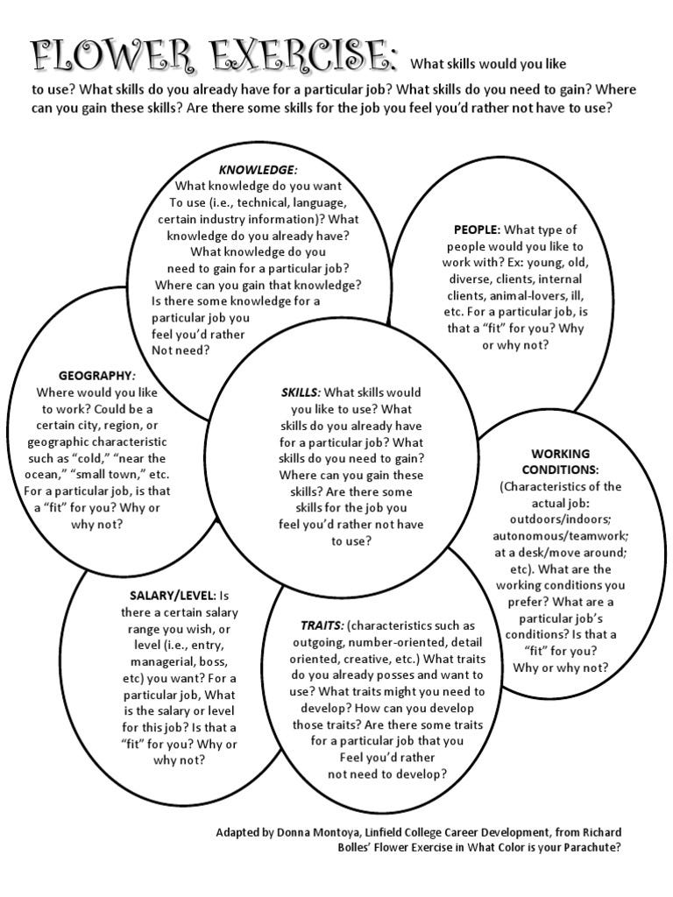
Flower Exercise

Slide 10
Padlet Link
https://padlet.com/gracianop/raNDEAM2023

Slide 11

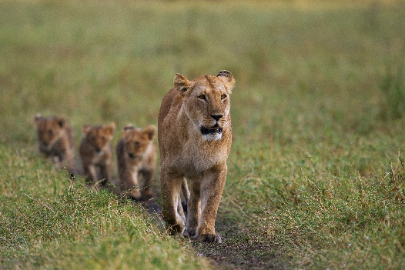


Categories of Transferable Skills
Communication
Research and Planning
Leadership and Management
Human Relations and Interpersonal

Slide 12
Communication Skills
Speaking effectively in public
Writing clearly and concisely
Expressing ideas in an open forum
Facilitating group discussion
Providing appropriate feedback
Persuading or advocating
Reporting technical information to a non-technical audience
Interviewing for information
Editing documents

Slide 13

Research and Planning Skills
Gathering information
Goal Setting and Evaluation
Conducting Needs Analysis
Developing evaluation and feedback strategies
Generating ideas
Identifying problems
Developing alternative solutions
Identifying resources
Budgeting

Slide 14

Leadership and Management Skills
Managing projects
Oversight and supervision
Counseling for performance improvement
Promoting change
Managing conflict
Recruiting and hiring staff
Providing direction, coaching and feedback
Handling details or coordinating tasks
Managing groups
Delegating responsibility
Teaching or Instruction

Slide 15

Human Relations and Interpersonal Skills
Developing rapport
Listening actively
Providing support for others
Motivating
Sharing credit
Counseling
Cooperating
Representing others
Perceiving feelings, situations
Asserting

Slide 16
Put Your Transferable Skills Front and Center

Slide 17
Find Transferable Skills:
Academic Writing Specialist
Actively support existing Dissertation and Thesis support services, assist with facilitating writing retreats and the Dissertation Institute, and other related projects.
Assist Professional Development Team with additional projects and programs, such as the Dissertation Institute, Writing Retreats, and technical writing/publications to support unit.
Preferred Experience, Skills, Training/Education
Experience developing and providing instructional content in classroom and online environments, especially in the genre of technical writing.
Strong working experience with various software platforms used to produce publications, analyze data, and develop visual representations of data and concepts, processes, and procedures.
Essential Job Duties
Work within the School Professional Development Team to develop a robust curriculum that supports and develops students’ writing and research communication capabilities, and that builds intellectual as well as administrative skills that will enhance student work in the academy and beyond.
Develop and teach several semester-long, courses and additional workshops that train students, alone and in teams, to effectively research, evaluate, and communicate complex technical ideas, concepts, processes or procedures in written and presentation form.
Provide instruction through various modalities, including face-to-face and online instructional interactions.

Slide 18
Showcase your skills
In your Resume
  Brag about your skills in your Summary/Objective
  Highlight where you’ve used those skills in your Experience
  Call out specific instances of Leadership/Professional Development
In your Cover Letter
  Why are you interested and why are you a good fit?
  Be sure to highlight relevant experiences in narrative form
  Close with other skills that might not be readily apparent in the resume.

Slide 19
Let’s Try It!

Slide 20
Make Your Case For a Job
Content Analyst
  What are they looking for?
  What makes you a good candidate and why?
  What are the transferable skills that you have that apply to this role?

Slide 21
Padlet Link (Again)
https://padlet.com/gracianop/raNDEAM2023

Slide 22
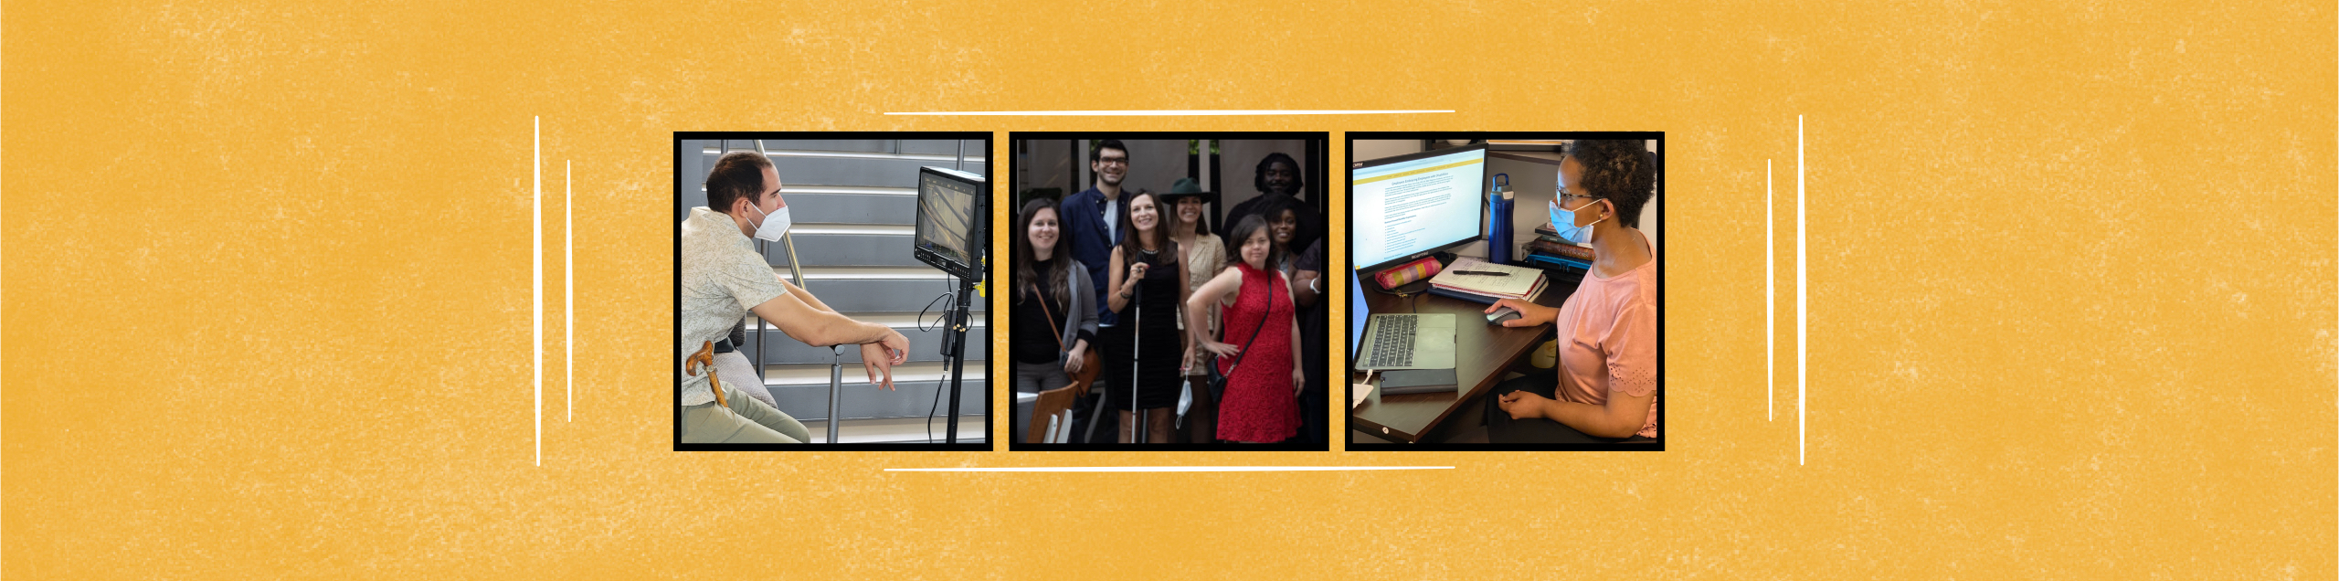
FOR MORE INFORMATION
Graciano Petersen, GracianoP@respectability.org

