Slide 1
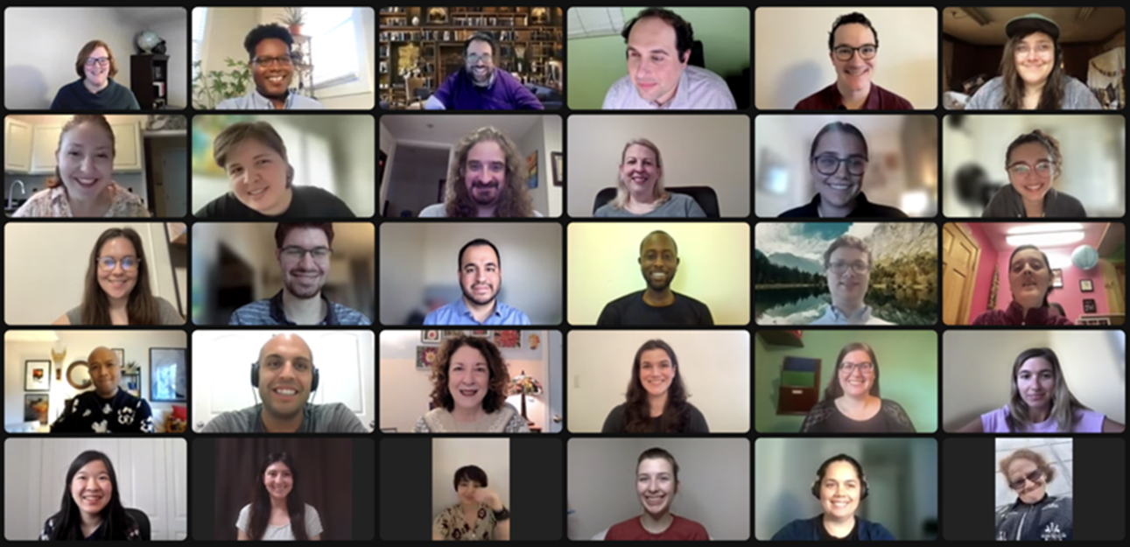
Challenges and Opportunities for Educators with Disabilities
September 13, 2023

Slide 2
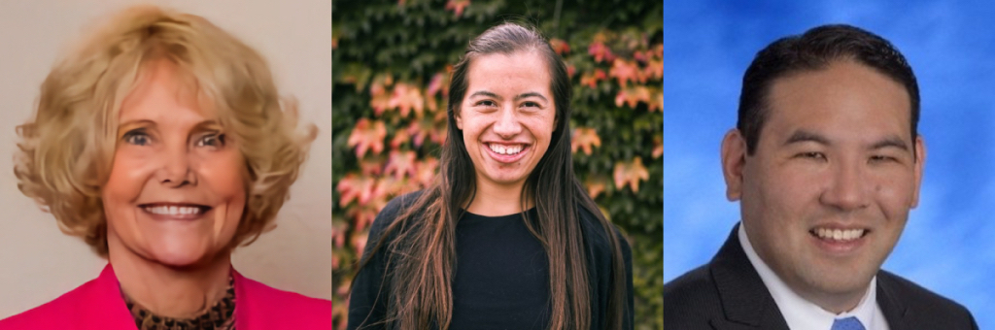
Our Speakers
Sheryl Burgstahler, Director, Accessible Technology & DO-IT Center, UW-IT, University of Washington Seattle
Nicole Homerin, Inclusion Communities Manager, Partners for Youth with Disabilities
Winston Sakurai, Curriculum Innovation Branch Director, Hawaii State Department of Education

Slide 3

RespectAbility’s 10th Anniversary Celebration
Learn More and Buy Your Tickets: www.RespectAbility.org/Ten/

Slide 4
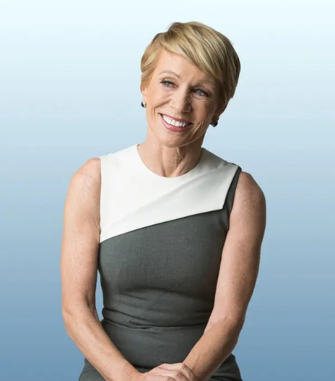
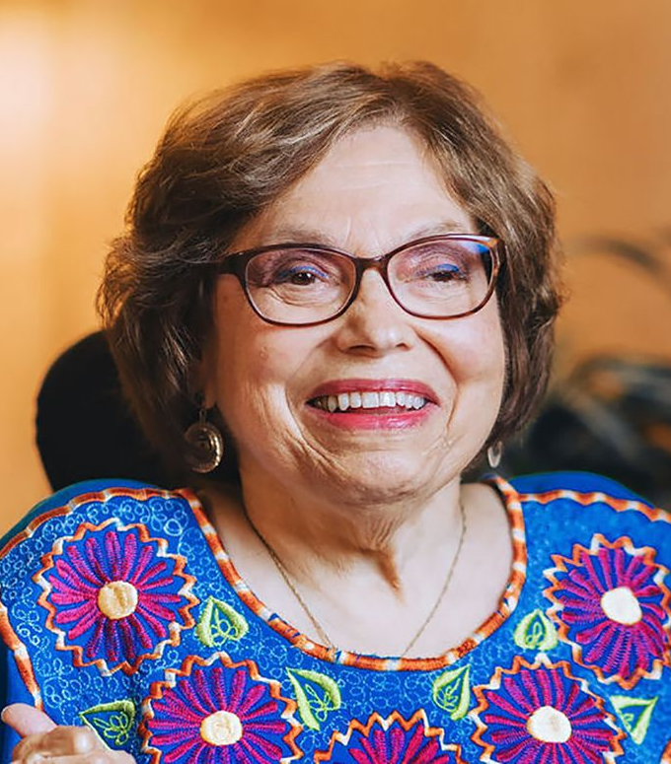
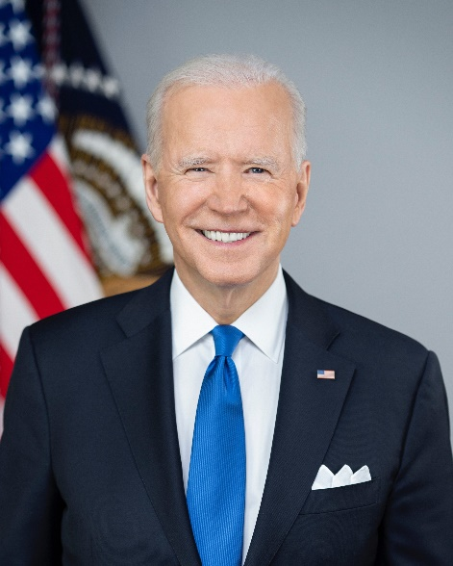




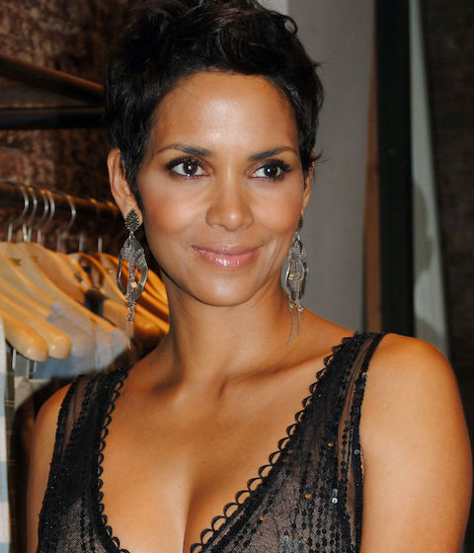


These are people with disabilities.
First row — Barbara Corcoran, Judy Heumann, Joe Biden, Demi Lovato, Amanda Gorman
Second row — Albert Einstein, Greta Thunberg, Halle Berry, Daymond John, Mariah Carey

Slide 5
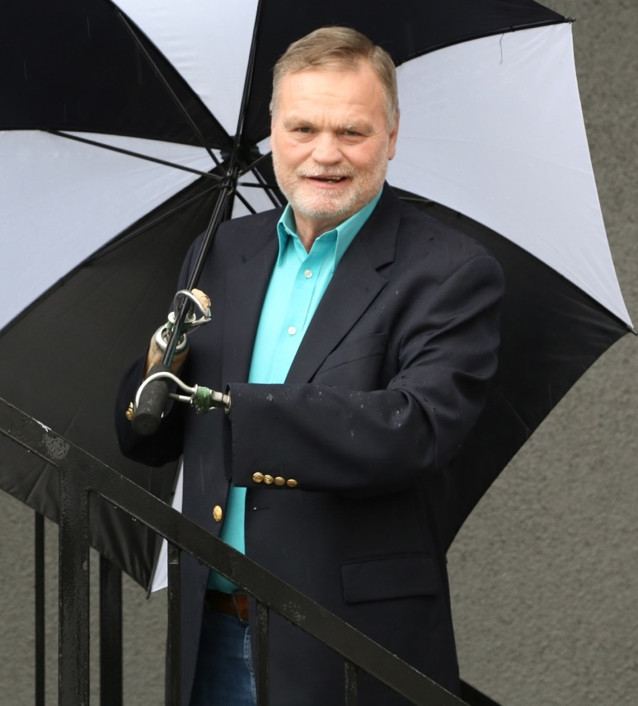

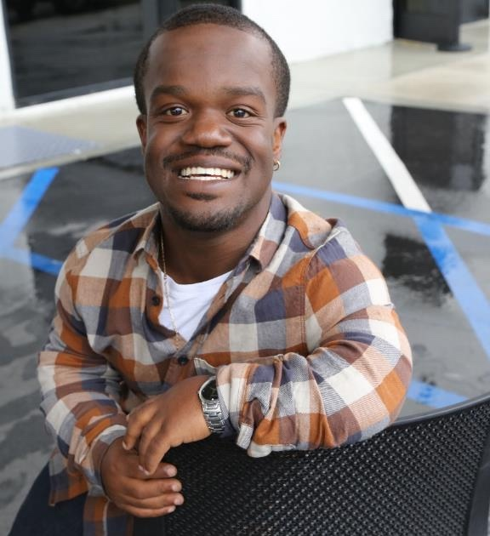
Disabilities are…
Temporary and Permanent
Apparent and Nonapparent
From Birth or Acquired Later

Slide 6
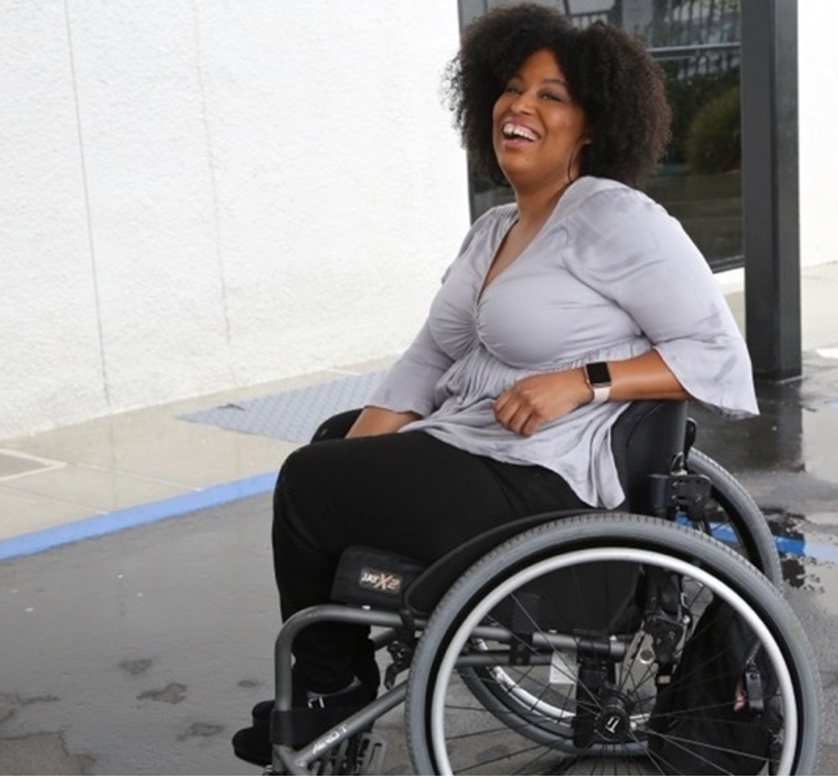
61 million people
61 million
people in the United States have a disability
1 in 4
adults have a disability
(physical, sensory, cognitive, mental health or other)
*Source: U.S. Census

Slide 7
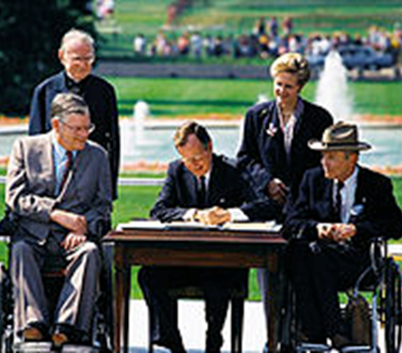
What is a Disability?
The Americans with Disabilities Act (ADA) of 1990 defines a person with a disability as a person who has a physical or mental impairment that substantially limits one or more major life activities.​
This includes people who have a record of such an impairment, even if they do not currently have a disability.
The ADA prohibits discrimination on the basis of disability against “an individual who, with or without reasonable accommodation, can perform the essential functions of the employment position that such individual holds or desires” … “unless [the employer] can demonstrate that the accommodation would impose an undue hardship on the operation of the business of [the employer]”

Slide 8
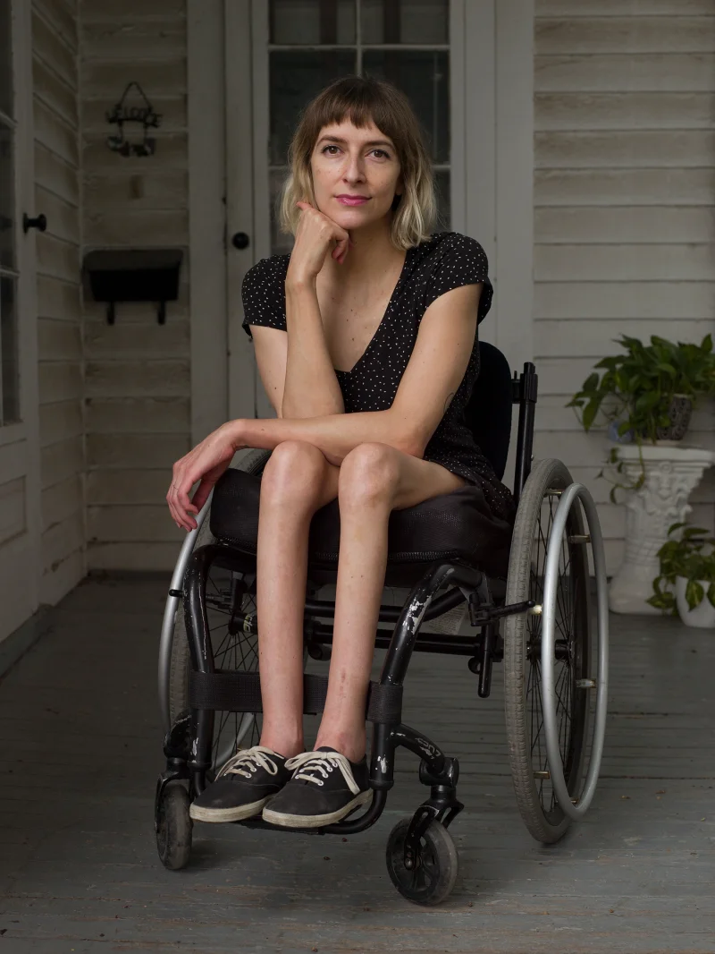
Definition of Disability
The definition of disability is intentionally broad.
A physical or mental impairment that substantially limits one or more major life activities – “actual disability”
Has had a physical or mental impairment that substantially limited one or more major life activities at one time – “record of”
When an employment action is taken based on an individual's impairment or perceived impairment, unless transitory and minor – “regarded as”
Rebekah Taussig, a writer and activist

Slide 9
Underlying Concepts
Universal Design (UD): “the design of products and environments to be usable by all people, to the greatest extent possible, without the need for adaptation or specialized design.” —The Center for Universal Design, North Carolina State University
Reasonable Accommodation: a change [to help an individual]…perform the essential functions of the employment, i.e. those things which are the primary reason the job exists. This does not include provision of personal use items needed in accomplishing daily activities both on and off the job (e.g., hearing aids), or removing essential functions, lowering production standards, and creating new jobs. The obligation is generally limited to things which are not an undue hardship, i.e. a significant difficulty or expense for that employer at that size.

Slide 10

Setting People Up
To Succeed
A reasonable accommodation is about enabling a person with a disability to perform the essential (not ancillary) functions of a job and enjoy the privileges and benefits of employment.
Universal design can be used as a framework employers can use to proactively designing employment opportunities that are more inclusive of people with disabilities—“born accessible”—and thereby reduce the need for accommodations for employees with disabilities.
Thought question: If our program has already been designed with natural access for blind and sighted people, for example, is a person’s blindness anymore disabling than any other feature might be?

Slide 11

Some of the Essential Roles of Educators
The essential roles of educators include:
Developing and delivering flexible lesson plans and curricula to different learners
Managing the classroom and fostering student connection.
Communicating with parents about students’ progress
Ensuring students are thriving inside and outside the classroom
Daija Coleman, a first-grade teacher in Topeka, Kansas
If you can do these things with an appropriate accommodation, or because of how the school was already set up, you can be a great educator!

Slide 12
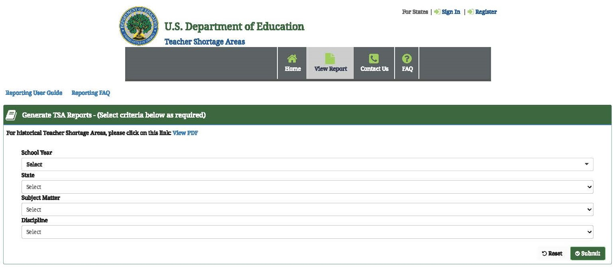
The Opportunity
According to the National Center for Education Statistics, 45 percent of public schools reported having one or more vacant teaching positions in October of the previous school year. Check your own state at https://tsa.ed.gov/#/reports
The Annual Disability Statistics Compendium found that in 2021, 694,517 Americans with disabilities were employed in the education services industry, representing 5.08%

Slide 13
The Solution: A Huge
Talent Pool
Despite the 20% increase over prepandemic levels, meaning that record numbers of people with disabilities are going to work and looking for work, the labor force participation of people with disabilities is only 51.5% of those without.
Population | Total | Employed | % of Population
Working Age Population | 177,527,241 | 135,973,591 | 76.6
Working Age Population with Disabilities | 21,375,164 | 8,705,513 | 40.7
This means that the rate would have to increase by 35.9 percentage points to catch up
So, there are 7,673,683 more potential employees out there if we employ people with disabilities!

Slide 14
Benefits of Employing Educators with Disabilities

Slide 15
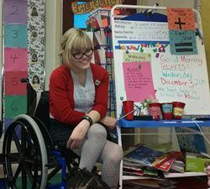
Benefits of Hiring People with Disabilities In General
The retention rate for employees with disabilities is much higher than it is for those without disabilities---a 2007 study found that the employee turnover rate for employees with disabilities was half that of others in similar positions.
According to the U.S. Department of Labor, employers who have embraced disability as a part of their strategy report a:
  90% increase in retention of valued employees
  72% increase in employee productivity
  45% increase in workplace safety
Carolyn Diaz, an elementary school teacher with Larsen Syndrome

Slide 16
Educators with Disabilities Make Excellent Role Models
Clayton E. Keller, co-author of Enhancing Diversity: Educators with Disabilities, kids with disabilities greatly benefit from having teachers similar to them. “If kids with disabilities don’t see people with disabilities in positions of responsibility,” he says, “will they think they’ll ever be able to do those things?”
Researchers at the University of Alaska found that students with disabilities tend to prefer teachers with disabilities and feel that these teachers are more skilled in their interactions with them.

Slide 17

Educators with Disabilities Bring Unique Approaches
Because many teachers with disabilities are aware of the academic difficulties their students (especially those with disabilities) face, they seek to implement creative pedagogical practices that cater to their students’ individual needs.
Alison Venter, an early childhood educator

Slide 18
Students of Disabled Teachers Show More Positive Attitudes About Disabilities
Teachers with disabilities show students that disability is a normal and natural part of life and that they do not need to “overcome” their disabilities to succeed in life.
Researchers at the Centre for Applied Studies in Early Childhood Education in Queensland, Australia, found that students developed a more positive attitude towards disability in general after having a teaching assistant with a disability in the classroom for a semester.

Slide 19
Students Benefit from Representation
Seeing themselves in their educators
People need to be understood
Teachers without disabilities might assign disabling assumptions
A wheelchair using educator made a student chair user feel less self conscious about accommodation needs

Slide 20
Challenges Educators with Disabilities Face

Slide 21
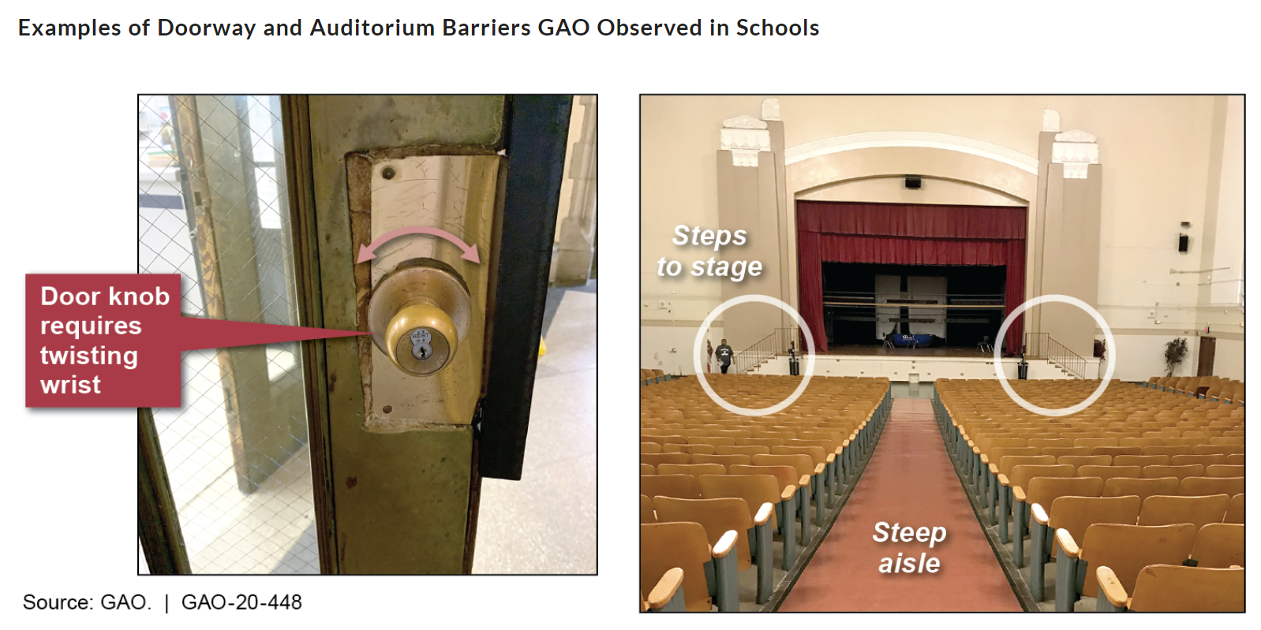
Educators Face Special Barriers to Physical Accessibility
According to the Government Accountability Office, two-thirds of school districts had facilities with accessibility barriers.
Due to funding constraints, school districts prioritize operational updates, such as heating and roofing projects, over renovations pertaining to accessibility.

Slide 22
School Administrators Lack Awareness of Obligations to Employees
The Americans with Disabilities Act (ADA) requires that employers provide reasonable accommodations for employees with disabilities
However, the National Policy Board for Educational Administration, a chief organization for setting standards for school administrators, has no standards pertaining to accommodations for teachers with disabilities and the laws surrounding accommodations.
If administrators are unaware of disability employment law, they will not be adequately equipped to handle their teachers’ requests for accommodations.

Slide 23
Teachers Fear Disclosing Disability Status
Teachers with disabilities can feel concerned that principals will avoid hiring them if they know about their disability---this belief is consistent with studies that show employers can be reluctant to hire people with disabilities.
A study conducted by King’s College London found that 35% of teachers with autism has never disclosed their disability status to anyone in their school, and many of the remaining educators only disclosed it to one or two colleagues.

Slide 24
Secrets to Success

Slide 25

Universal Design (UD) of physical spaces
“The Daily”
UW
1970

Slide 26

3 Sets of Principles Underpin UD Guidance for All Aspects of Education
UDL
WCAG
7 Universal Design
  3 Universal Design for Learning
  4 Web Content Accessibility
  Guidelines
UD

Slide 27
In A Nutshell…
Provide multiple ways for people to learn, demonstrate what they have learned, and engage.
Ensure all technologies, facilities, services, resources, and strategies are accessible to individuals with a wide variety of disabilities.

Slide 28
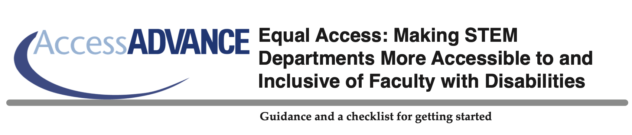
Learn More Online
https://www.washington.edu/doit/equal-access-making-stem-departments-more-accessible-and-inclusive-faculty-disabilities

Slide 29
Policies and Evaluation
Ensure that diversity, including disability, issues are addressed in all policies and evaluations.
Are new hires told of your workplace accommodation process?
Are people with diverse characteristics, including disabilities, encouraged to engage in planning and advisory committees?
Do policies and procedures require that accessibility be considered in design, development, and procurement processes (e.g., for facilities, IT, and services)?
Are disability-related access issues addressed in internal and external evaluations of the school?

Slide 30
Culture
Consider disability issues as you plan and evaluate your facilities and offerings.
Do school diversity, equity, and inclusion (DEI) initiatives address issues relevant to employees with disabilities?
Do you include disability issues on climate and other surveys of employees and compare responses of people with disabilities to those of others?

Slide 31
Physical Environments
Ensure physical access, comfort, and safety within an environment that is welcoming to people with a variety of abilities.
Are all levels of facilities connected via wheelchair-accessible routes of travel? Are these routes easy to find? Do all commonly used exterior and restroom doors have sensors or buttons for automatic opening?
Are there ample high-contrast, large-print directional signs? Is braille signage used where appropriate?
Do elevators have auditory, visual, and tactile signals and controls accessible from a seated position? Are wheelchair-accessible restrooms with well-marked signs available?
Are adjustable-height tables, ergonomic chairs, and adequate/adjustable light available?

Slide 32
Support Services
Make sure support staff are prepared to work with everyone, including those with disabilities.
Do staff members know how to respond to requests for disability-related accommodations?
Are staff familiar with the availability of alternate document formats?
Are staff aware of issues related to communicating with individuals with disabilities?
Are staff responsible for designing and developing websites knowledgeable about accessible web design?

Slide 33
Information Resources and Technology
Ensure that publications and websites welcome a diverse group and that information is accessible to everyone. Make sure accessible technology is available to employees with disabilities.
Are important meetings captioned, recorded, and shared for those who cannot attend or wish to watch them at a later time?
Do web pages adhere to accessibility standards adopted by your school?
Do key publications and websites include a statement with procedures for requesting disability-related accommodations?
Do policies and procedures require that accessibility be considered in development and procurement processes (e.g., with respect to software purchases, website development)?

Slide 34
An attitude; a framework, goal, process — UD:
Values diversity, equity, and inclusion
Promotes best practices and does not lower standards
Is proactive and can be implemented incrementally
Benefits everyone
Minimizes the need for accommodations

Slide 35
Success Stories of Teachers with Disabilities

Slide 36

Best Practices From Our Success Stories
These are not standout or “unicorn” cases; they are simply putting a face to the nearly 700,000 educators with disabilities across the United States.
Teachers with disabilities are excellent advocates and role models for both their disabled and non-disabled students alike.
Brad Cohen, a teacher and speaker with Tourette's Syndrome

Slide 37
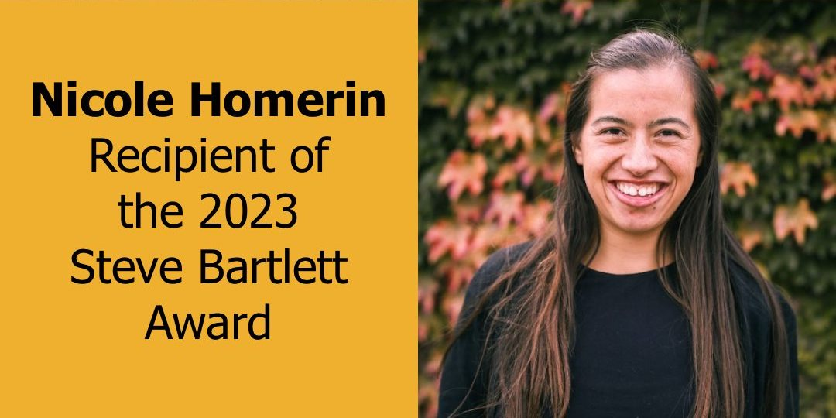
Nicole Homerin is the 2023 Recipient of the Steve Bartlett Award

Slide 38
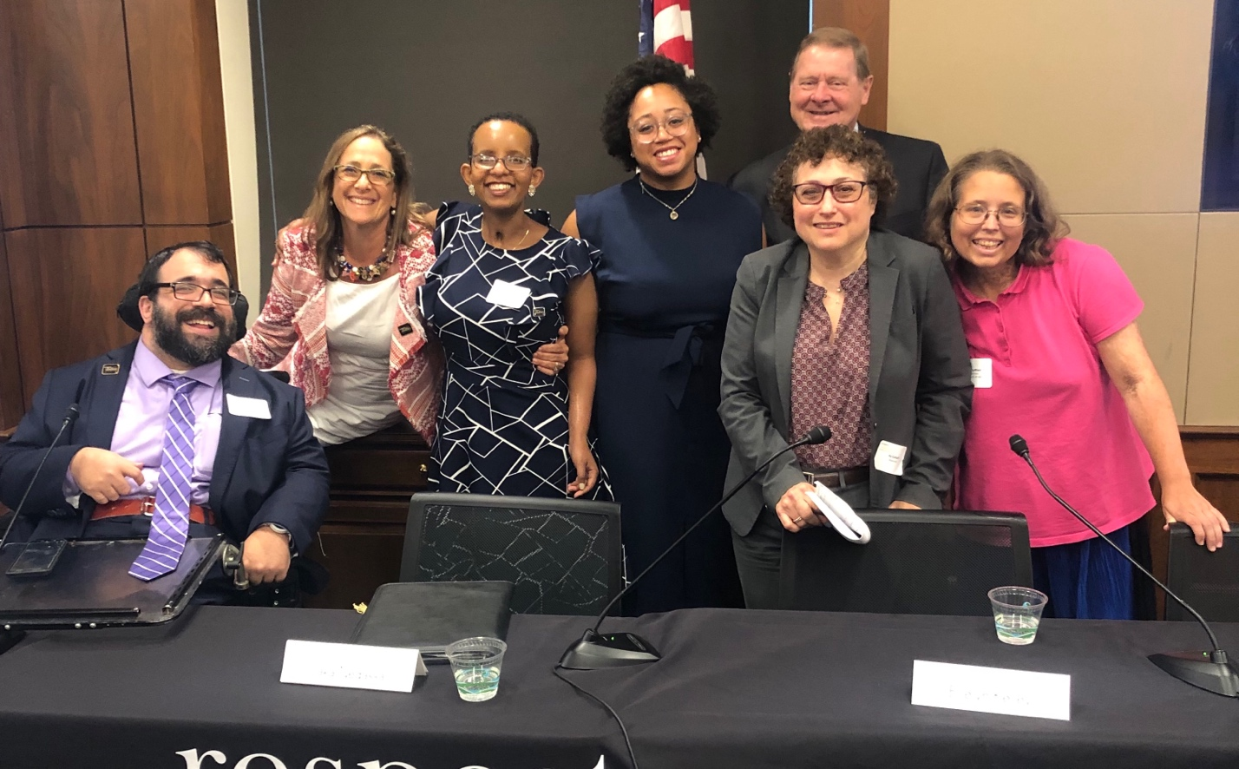
Questions? Thank You!
For More Information:
Contact MatanK@RespectAbility.org
Link to Free RespectAbility Webinars

