Slide 1
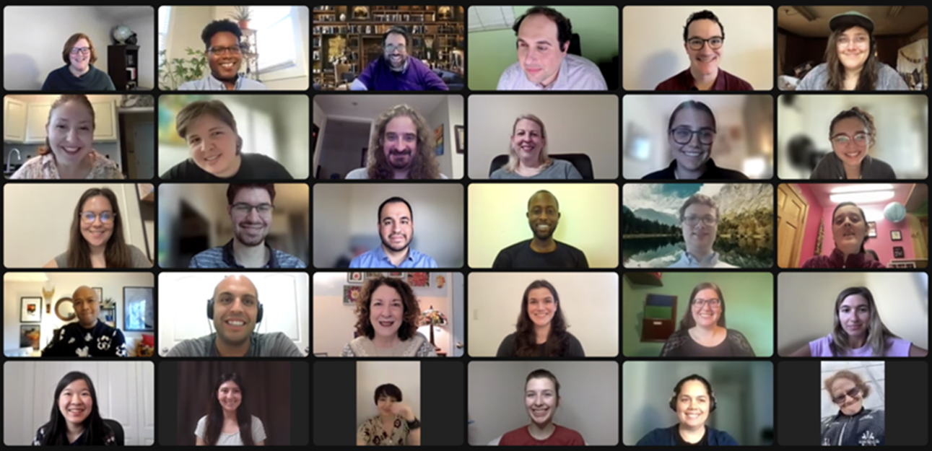
Supporting Employment for Disabled Veterans
September 27, 2023

Slide 2
Today’s Speakers
Billy W. Wright
National Employment Coordinator
U.S. Department of Veterans Affairs
Charles W. McCaffrey
Director, Veterans Career Program
Paralyzed Veterans of America
Mike Thompson
Director/Investigator, State of Indiana, Veterans’ Employment & Training Service (VETS)
U.S. Department of Labor

Slide 3
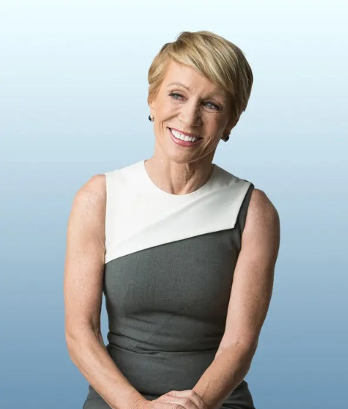

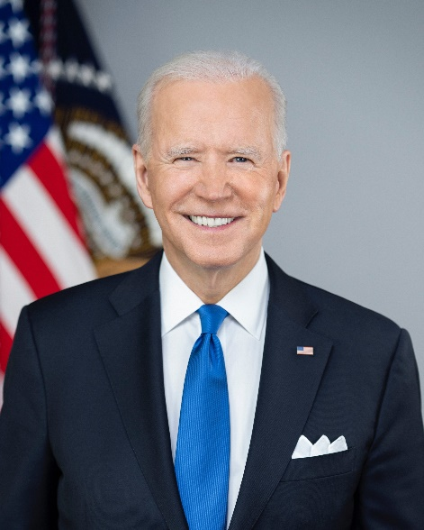


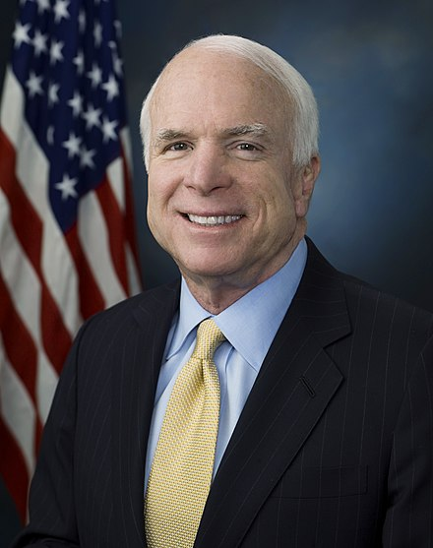

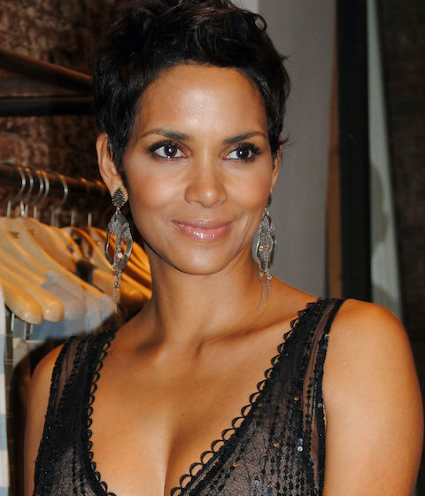
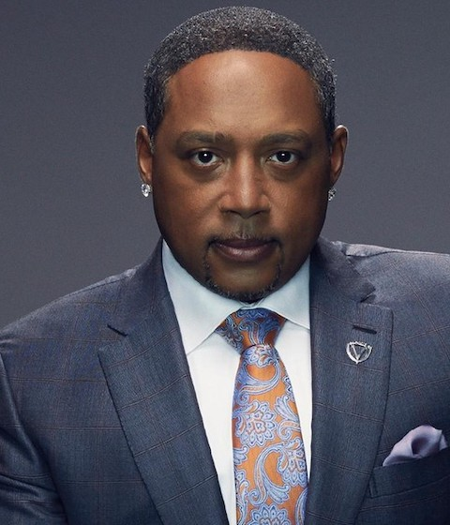

These are people with disabilities.
First row — Barbara Corcoran, Whoopi Goldberg, Joe Biden, Demi Lovato, Amanda Gorman
Second row — John McCain, Greta Thunberg, Halle Berry, Daymond John, Mariah Carey

Slide 4
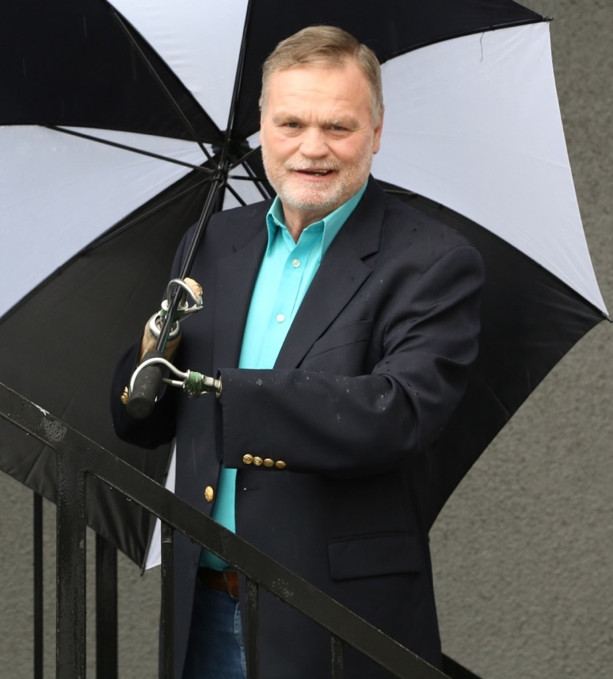


Disabilities are…
Temporary and Permanent
Apparent and Non-Apparent
From Birth or Acquired Later

Slide 5
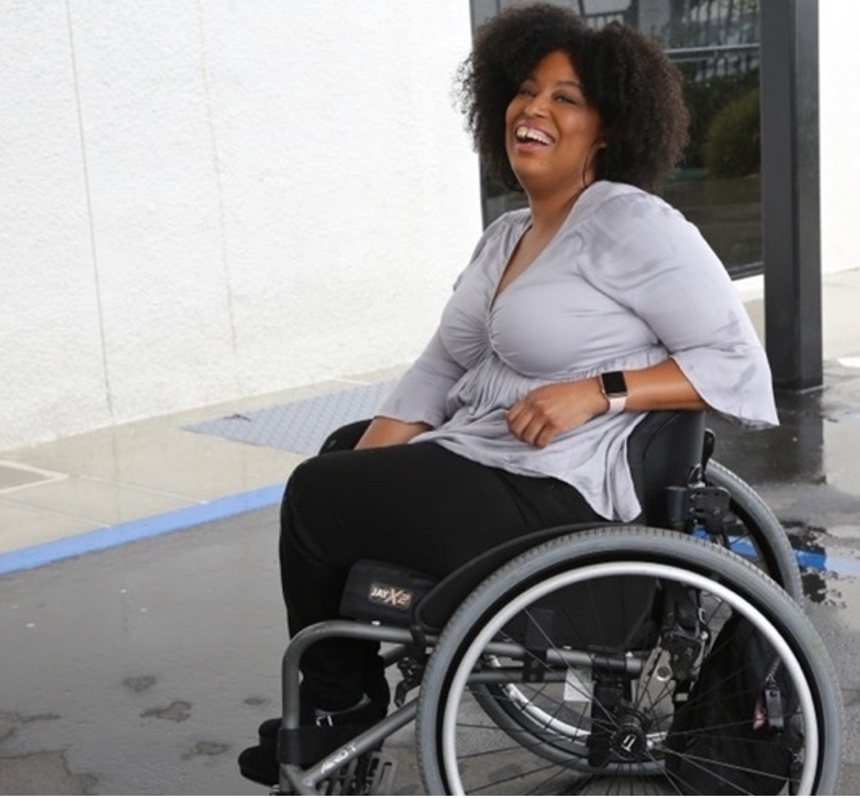
61 million people
61 million
people in the United States have a disability
1 in 4
adults have a disability
(physical, sensory, cognitive, mental health or other)
*Source: U.S. Census

Slide 6
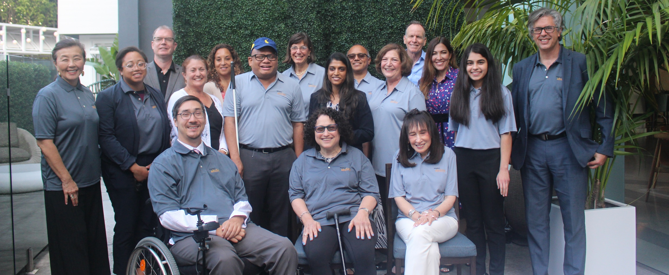
Importance of Lived Experience
Organizations are at their best when they welcome, respect and include people of all backgrounds. This includes people with disabilities.

Slide 7

Who Are
Disabled Veterans?
The term “disabled veteran” means (A) a veteran who is entitled to compensation (or who but for the receipt of military retired pay would be entitled to compensation) under laws administered by the Secretary, or (B) a person who was discharged or released from active duty because of a service-connected disability. The population also includes veterans who retired from service normally but qualify for compensation due to a service-connected disability (38 U.S. Code § 4211)
Disabled veterans can also have a disability that is unrelated to their service.
In each of these situations, disabled veterans tend to be working-age at the time of their retirement or discharge and in need of a new career.

Slide 8

The Disabled Veteran
Talent Pool
There were more than 1.6 million total working-age disabled veterans in 2021.¹
Every year, more than 100,000 disabled veterans leave the military to transition into new careers.^{2,3}
1) 2023 Annual Disability Compendium Report 2) VA.gov 3) 2022 BLS Employment Situation of Veterans Report

Slide 9
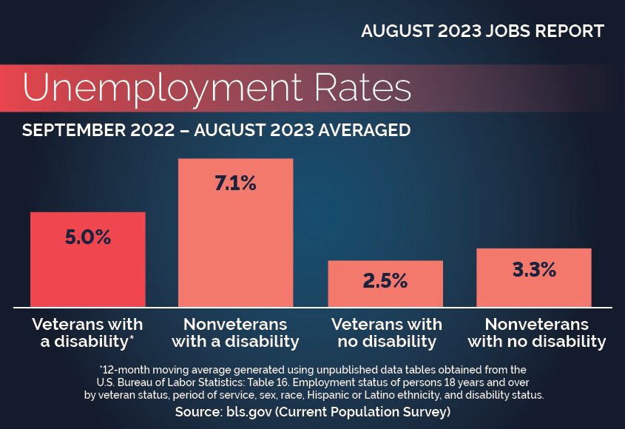
Employment Status
The current unemployment rate for disabled veterans is 5.0%–which is higher than non-disabled veterans (2.5%)
For recent (post-1990) veterans, there is a 21-point gap in labor force participation between those with severe service-connected disabilities and those without. (See next slide)

Slide 10
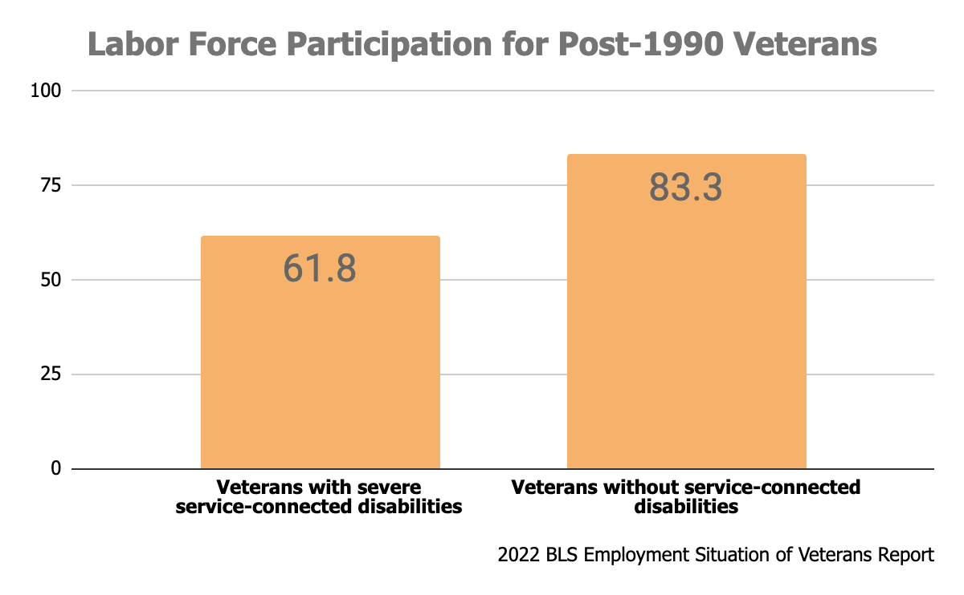
Employment Status (2)

Slide 11
Employment Status (3)
Unemployment Rate for Veterans:
  SC Rating < 60%: 36.6%
  SC Rating > 70%: 55.3%
  With SCI/D: 70.2%
Unemployment Rate Military Spouses (Active): 21%
  42% No Longer Looking
  Military Spouse Unemployment Biggest Stressor in Military Households
Half of all Military Caregivers (~5.5M) have had to adjust their work lives as a result of caregiving
  62% report that caregiving has caused financial strain.
  63% of Military Caregivers have jobs but have had to cut down on the time they spend working or transfer to more accommodating jobs, or are considering quitting or early retirement

Slide 12

Specific Challenges for Disabled Veterans
Career Transition: Disabled veterans choosing a new career path might not know exactly what accommodations they need, especially if their disability was recently acquired.
Negative Perceptions:
  Unemployable due to disability
  Mentally or emotionally unstable
  Less imaginative or creative than others
  Poor social skills (ex. strict or rigid)
  Expensive to hire (ex. accommodations)
1) CNAS Veteran Pathways to Employment: Hurdles and Opportunities 2) Major Barriers Facing Veteran Transition, Brian K. Ward

Slide 13
Myths about PTSD
Myth | Reality
Most veterans have PTSD. | Only about 10-20% of veterans develop PTSD due to their service.
PTSD can only result from military service. | Anyone can develop PTSD due to traumatic experiences.
Veterans are much more likely to have PTSD than non-veterans. | The prevalence of PTSD among veterans is not much higher than the rate among the non-veteran population—6-8%.
Veterans and people with PTSD are prone to violence. | Veteran status does not predict violence. Associations between PTSD and violence are mostly explained by other risk factors.
People with PTSD cannot be reliable, efficient employees. | Many people with PTSD are successfully employed, with or without accommodations.
Accommodating PTSD is difficult and expensive. | It is usually easy and inexpensive to accommodate PTSD in the workplace.
1) PTSD: National Center for PTSD Home (va.gov) 2) askjan.org

Slide 14
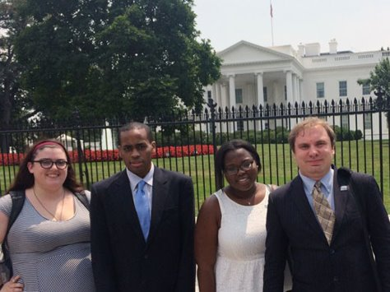
Benefits of
Hiring Veterans
Veterans tend to…
  Be internally motivated/have a strong work ethic
  Have leadership skills
  Value teamwork and diversity
  Be adaptable and efficient under pressure
  Have advanced technical skills
Why Hire Veterans? In: Military Veteran Employment, J. Michael Haynie

Slide 15
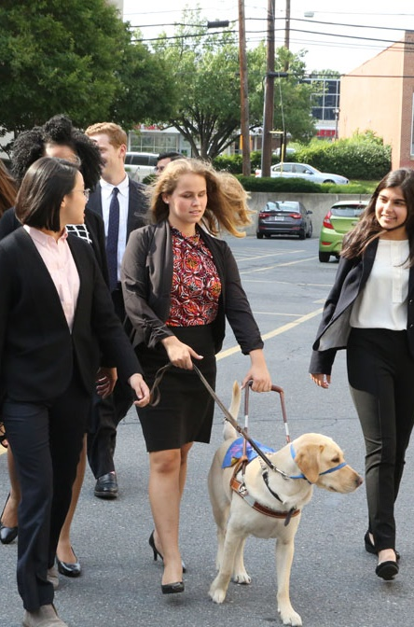
General Benefits of
Disabled Talent
People with disabilities are loyal to our employers and are used to solving problems creatively.
People with disabilities are a largely untapped talent pool
Know & grow your customer base: all
workers are consumers―a 1 percent increase in disability labor force participation could add to $25 billion to the GDP

Slide 16
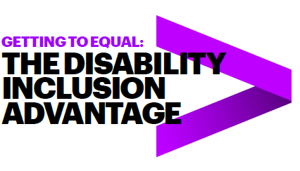
Benefits of Hiring
People with Disabilities
Over four years, the Champions who embraced the talent of workers with disabilities vastly outperformed their peers. They had:
2X higher income
30% higher economic profit margin
Up to 30% less staff turnover
Followed 140 US companies from 2015-2018
45 Inclusion Champions, 95 peer companies
Read the full study online!
* Study completed by Accenture, Disability:IN and the American Association of People with Disabilities

Slide 17
Effective Inclusion Practices for Disabled Veterans

Slide 18

What Employers Can Do To Attract & Retain Disabled Veterans
Use inclusive language in job descriptions.
Include disabled veterans as part of their recruiting/HR team.
Have a quick, simple and published accommodations process.
Follow-up after hiring: ex. Orientation, mentors and employee resource/ veteran affinity groups

Slide 19
Accessibility in
Job-Seeking
Agencies and organizations such as VA VR&E, DOL VETS and PVA assist both employees and employers in making the hiring process accessible to disabled veterans. Some of their services include:
  Helping applicants translate their military skills to their desired position by providing resources or 1-1 counselling.
  Assisting with advanced education and certifications to increase employment opportunities.
  Working with employers to develop processes and programs to find, hire and retain disabled veterans.
  Educating hiring managers about veteran and disability topics, and/or including disabled veterans in the hiring process.
1) VA VR&E 2) DOL VETS 3) PVA

Slide 20
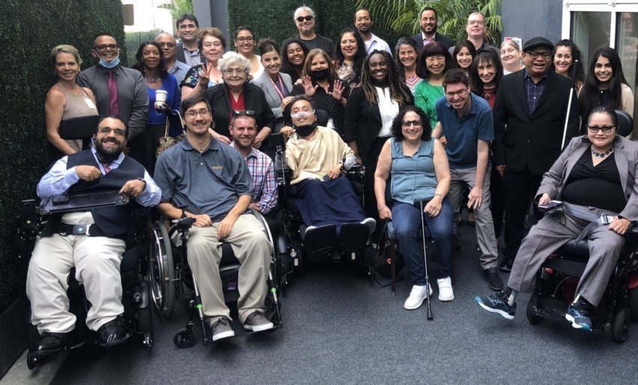
Awareness Training for Supervisors
In a recent study, veterans expressed support for awareness training, so that employers and co-workers would:
  Understand the veteran experience and the difficulty of reintegration
  Reject negative stereotypes about veterans (especially regarding PTSD)
  Make reasonable accommodations, such as time off for physical and mental health appointments
Supervisor veteran awareness training is evidence-based and proven to improve employee well-being.
Training resources include:
  Cornell University DEI Certificate Programs
  National Organization on Disability’s Disability in the Workplace Toolkit
  RespectAbility Veterans Resources
Read the full studies here:
Supporting Veteran Reintegration, Sayer et al.
Supervisor Training Effectiveness, Mohr et al.

Slide 21
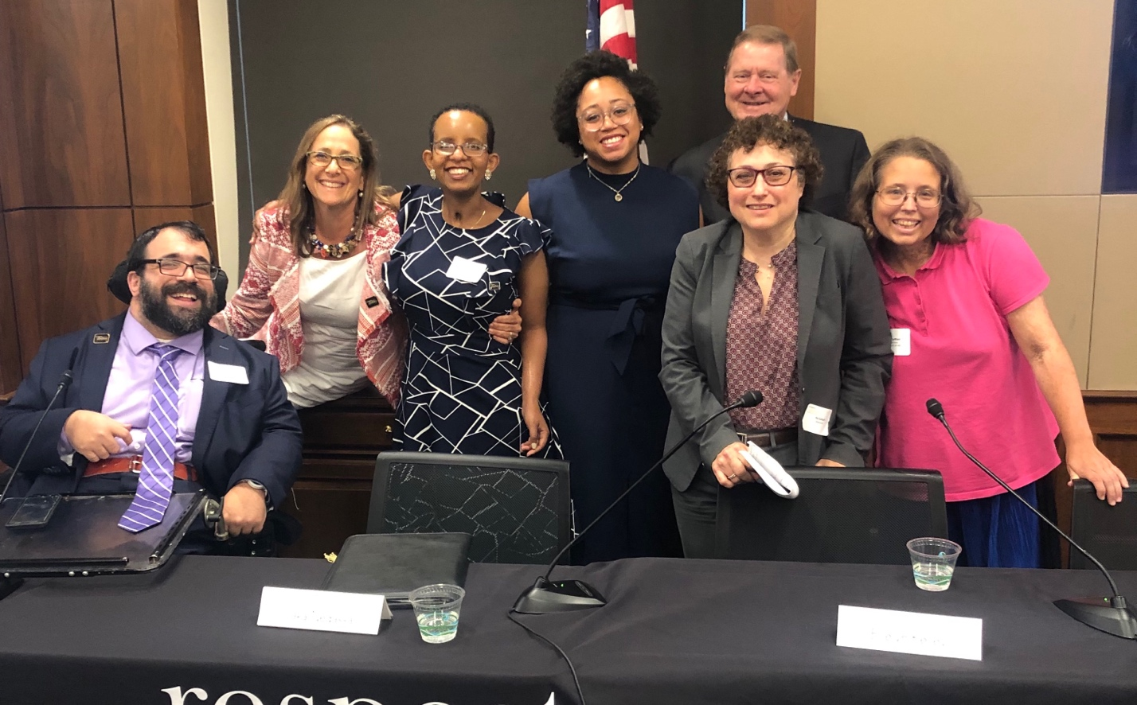
Questions? Thank You!
Presenters:
Billy W. Wright
Charles W. McCaffrey
Mike Thompson
Matan Koch
For More Information:
Contact MatanK@RespectAbility.org
Link to Free RespectAbility Webinars

