Slide 1
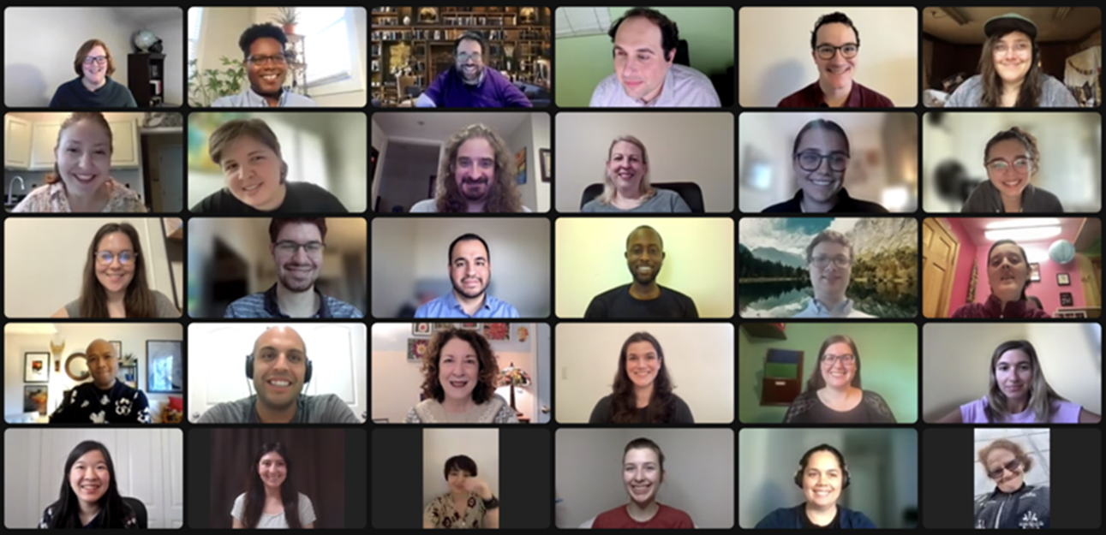
Road to NDEAM:
Medical Professionals with Disabilities
August 23, 2023

Slide 2
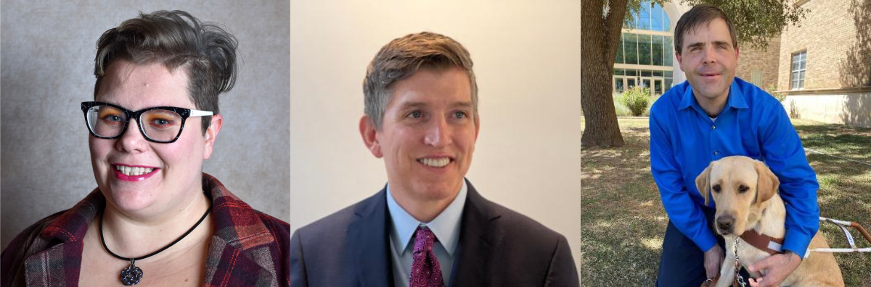
Our Speakers
Nurse Jackie Anne (Senz) Blair
Dr. Peter D. Pollous
Dr. Adam Schmidt

Slide 3
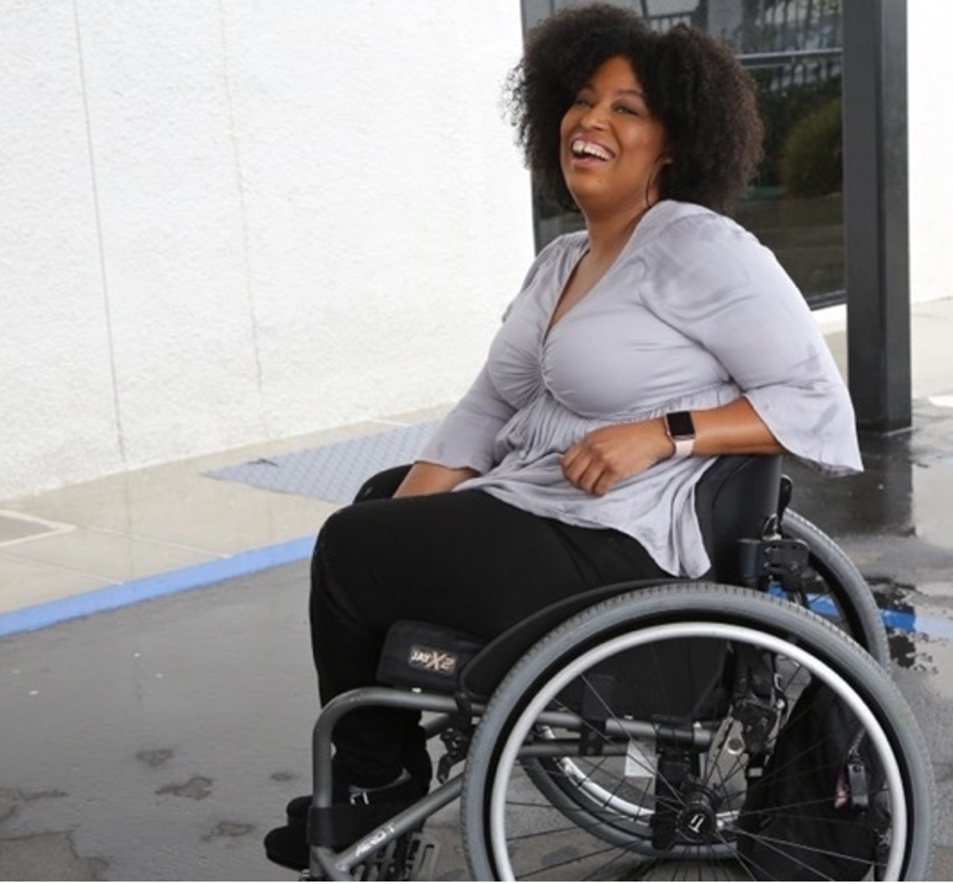
61 million people
61 million
people in the United States have a disability
1 in 4
adults have a disability
(physical, sensory, cognitive, mental health or other)
*Source: U.S. Census

Slide 4
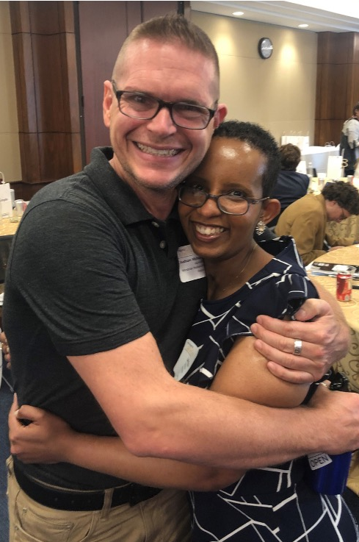
Three Facts
Anyone can acquire a disability
from aging, an accident, trauma, and/or illness.
Becoming an ally now can make adapting to having a disability easier.
People with disabilities are diverse and part of all communities.

Slide 5
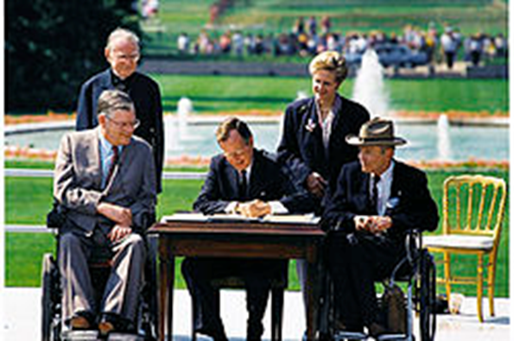
What is a Disability?
The Americans with Disabilities Act (ADA) of 1990 defines a person with a disability as a person who has a physical or mental impairment that substantially limits one or more major life activities.​
This includes people who have a record of such an impairment, even if they do not currently have a disability.

Slide 6
Definition of Disability
The definition of disability is intentionally broad.
A physical or mental impairment that substantially limits one or more major life activities – “actual disability”
Has had a physical or mental impairment that substantially limited one or more major life activities at one time – “record of”
When an employment action is taken based on an individual's impairment or perceived impairment, unless transitory and minor – “regarded as”

Slide 7
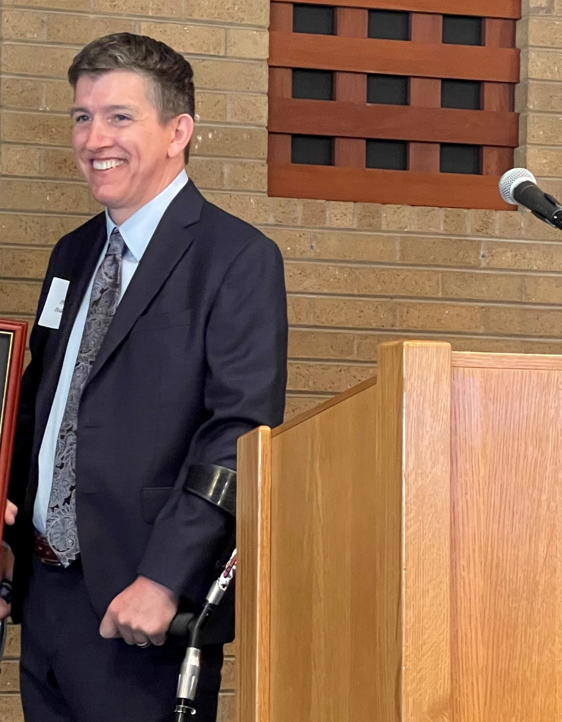
Put it into Practice
If a doctor cannot do a physical exam but can make a diagnosis and treatment after supervising the exam, it makes sense to have a nurse do the exam.
If a resident cannot do overnight calls, they can be replaced with evening calls to keep that resident.

Slide 8
Nonessential Functions
Charting
Administering tasks like drawing blood, running IVs, and administering vaccines are not performed by all medical personnel.
  Doctors usually request orders for them and other medical personnel like phlebotomists and nurses complete these tasks.
  The act of administering these tasks is therefore a nonessential function of the job for doctors ordering them.
Physical exams or overnight calls
The work is essential, but no one individual is required for their special expertise at these tasks, so they can be reassigned as an accommodation.

Slide 9
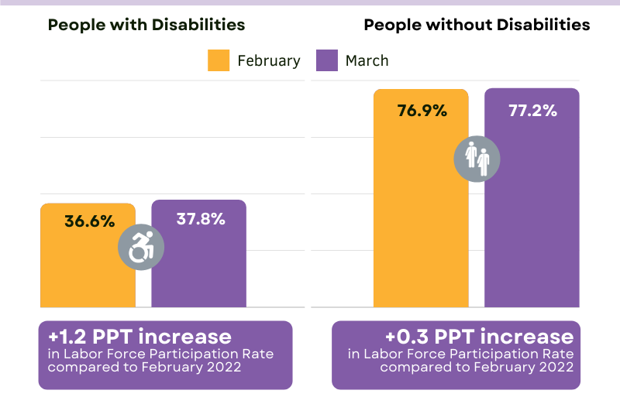
The Disability Community is a Large Talent Pool
As of March 2022, the labor force participation rate for working-age people with disabilities is 2.5% points higher than it was before COVID-19.
This means that people with disabilities are engaging with the labor force in higher numbers than before the pandemic.

Slide 10
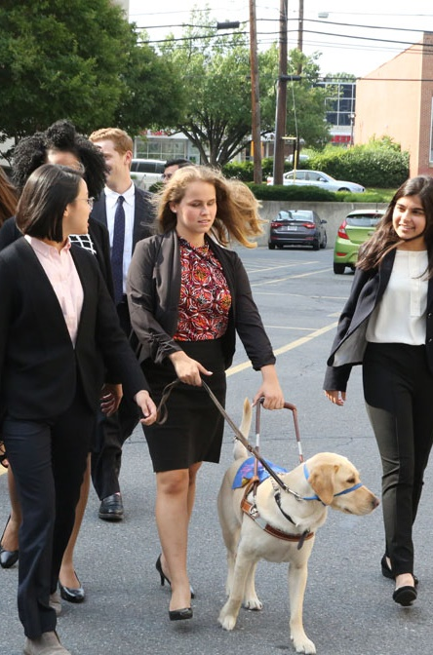
Benefits of Hiring Disabled Talent
People with disabilities are loyal to our employers and are used to solving problems creatively.
People with disabilities are a largely untapped talent pool
Know & grow your customer base: all
workers are consumers―a 1 percent increase in disability labor force participation could add to $25 billion to the GDP

Slide 11
Setting People Up
To Succeed
A reasonable accommodation is about enabling qualified talent with a disability to perform the essential (not ancillary) functions of a job, and enjoy the privileges and benefits of employment
Create an atmosphere where all employees can identify and ask for things that make them more productive, better employees.
If even senior level managers are open about their disabilities and/or tools they use, it may encourage other employees to do the same.

Slide 12
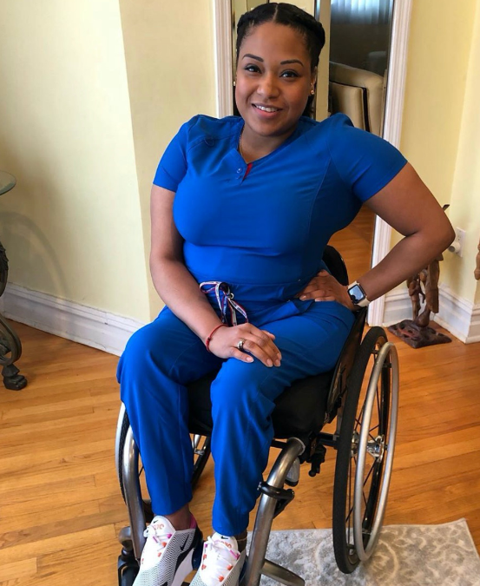
Healthcare Is A Popular Field For Workers with Disabilities
There are about 400,000 people with disabilities in Healthcare Practitioners and Technical Occupations according to the 2023 Disability Compendium (disabilitycompendium.org)
In 2019, a survey indicated that 3.1 percent of physicians identify as having a disability (McAdams, Ryan M., (2022).

Slide 13
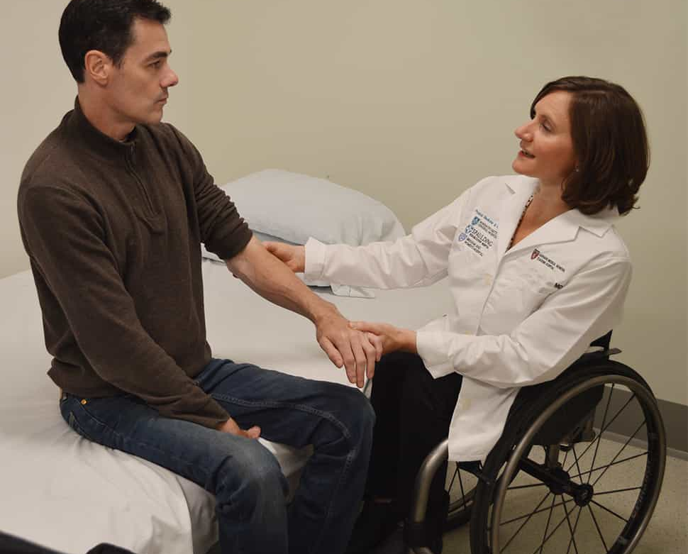
Benefits of Hiring Disabled Medical Personnel
Normalizing the experience of disabilities in the medical setting
Opening up more opportunities for those who develop the knowledge and skills of the field to improve the lives of others disabled and non-disabled alike
Medical personnel with disabilities can relate better to patients with disabilities considering their lived experience or Patient-provider concordance (Marks, B., Sisirak, J., 2022). Patient self-care also improves.

Slide 14
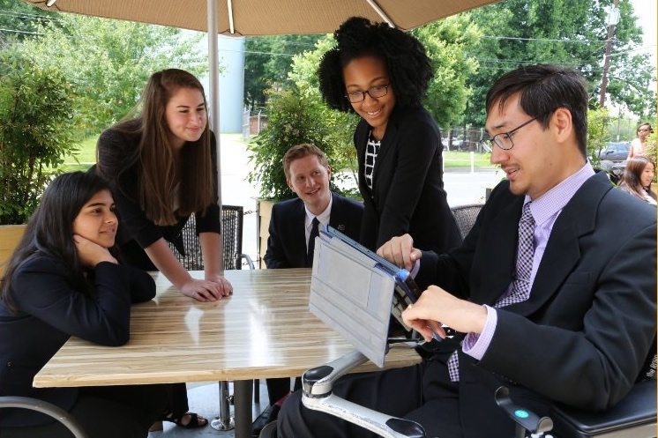
Field-Specific Challenges for Medical Personnel
Doctors and nurses still face ableist bias from colleagues and patients
The higher up the educational ladder medical students with disabilities go, the more likely they are to leave their education (Meeks 2022)
Today, though, medical schools and residency programs are doing a better job of accommodating students with disabilities
  Major headway made with visible disabilities;
  Need to improve admissions and accommodations for those with invisible disabilities

Slide 15
Recommendations to Address Field-Specific Challenges
Disability awareness and impact of ableism education important for medical students, educators, and practicing providers
  Include trainings on rights and policies under ADA and success stories
Encourage disclosure and work with students, residents, and practitioners to figure out accommodations
Provide universal design elements in facilities and educational programs
Provide disciplinary actions for overt, hostile displays of ableism
Proactively address milder forms of ableist behavior

Slide 16
Make the Process Work
For Everyone
Employers cannot ask if employees have a disability pre-job offer (can only ask in certain circumstances post job offer), but employers can ask if they need any accommodations to perform the essential functions of the job
Disclosure of disability status does not equate to a formal request for an accommodation
Employees’ right is to be accommodated in whatever reasonable way can help them to do the job, NOT to be excused from any of the essential functions of the job

Slide 17
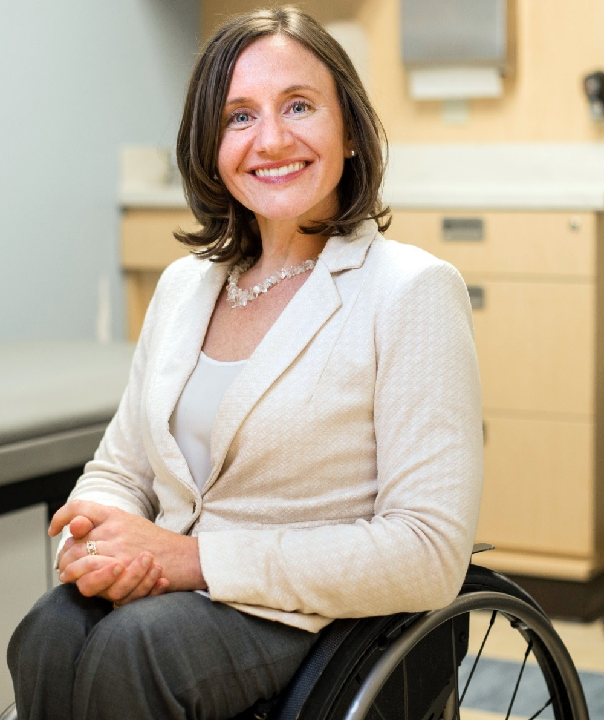
Success Story: Dr. Cheri Blauwet, Sports Medicine
Wheelchair-accessible environment in undergrad and medical school
Stanford medical school was willing to provide accommodations
  Had a dean she could consult with
  Stanford was willing to pioneer a program for students with disabilities
Current practice at Brigham and Women's Hospital and Spaulding Rehabilitation Hospital in Boston has accessible exam tables and supplies and instruments in easy reach

Slide 18
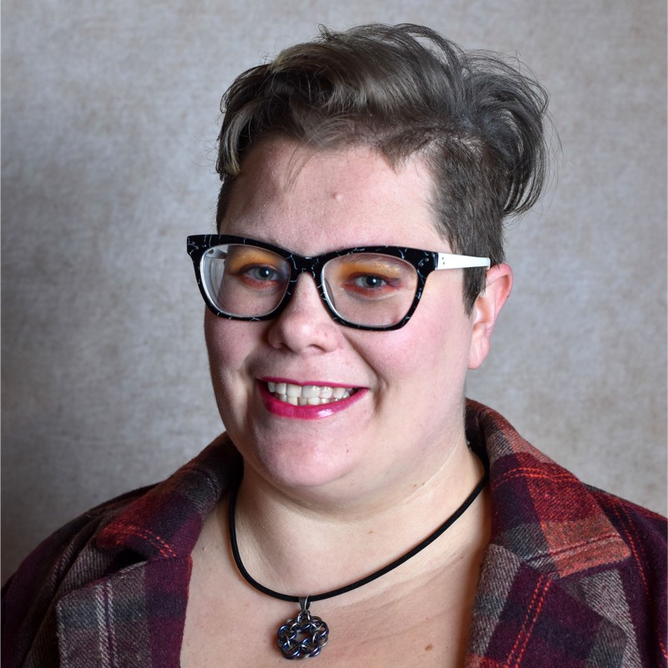
Success Story: Jackie Anne (Senz) Blair, Nurse
Would prepare for workplace noise by listening to soundtrack loop of medical equipment while at home
Lived experience of Autism Spectrum Disorder helped them work with patients with developmental disabilities such as when they worked in long-term care facilities run by the New York State Office for Persons with Developmental Disabilities

Slide 19
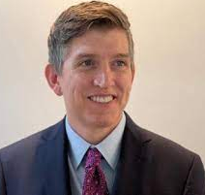
Success Story:
Dr. Peter Poullos
  Retrained as a radiologist after a spinal cord injury
  Is able to continue to bring his talents to patients and colleagues alike
  Has helped to pave the way for other doctors with disabilities

Slide 20
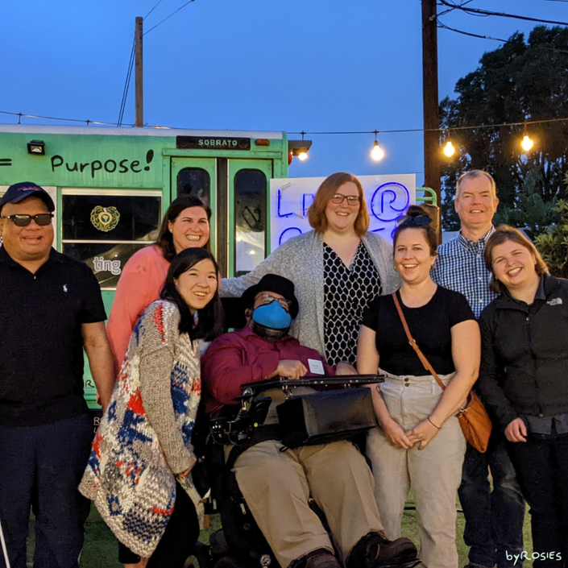
Best Practices From Our Success Stories
Making facilities accessible in both space and equipment
Encouraging a professional environment of understanding and appreciation for colleagues with disabilities
  Focusing on what colleagues with disabilities can do and allowing them to use their skills and expertise to fulfill essential job functions

Slide 21
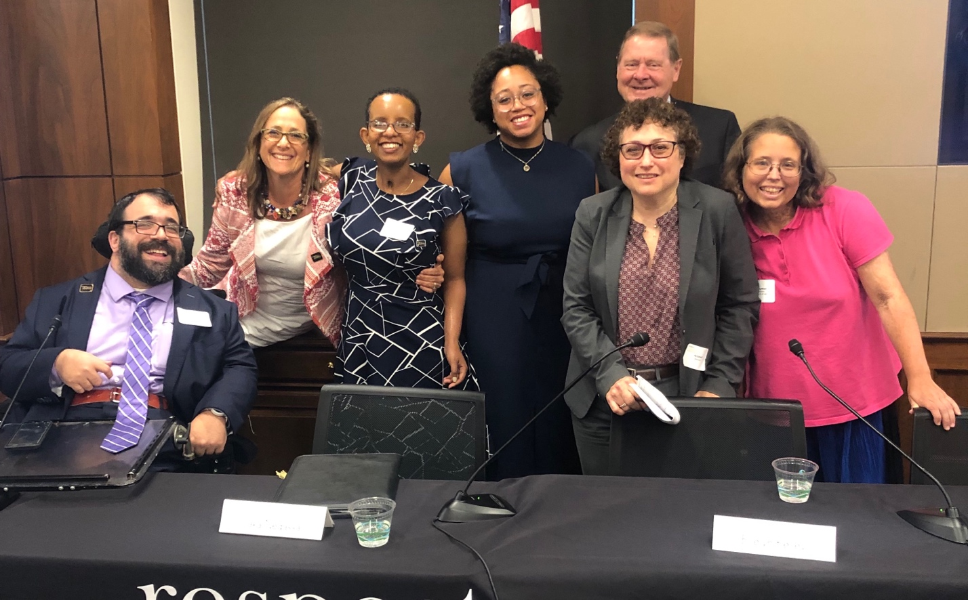
Questions? Thank You!
For More Information:
Contact MatanK@RespectAbility.org
Hiram Helfman (slide presentation producer) hiram.helfman@gmail.com or Hiram Helfman on LinkedIn
Link to Free RespectAbility Webinars

