Slide 1

Building Relationships and Collaborating with Faith Communities

Slide 2
Accessibility Notes
Turn on captions with CC button in Zoom.
You can pin the interpreter to ensure they are visible throughout the presentation.
To view live transcript in a separate window: https://carolinascaptioning.1capapp.com/event/respectability (link in chat box)
Please put questions for our speakers in the Q&A box.
This webinar is being recorded. After open captions are added, you will find it at RespectAbility.org/AAIDD-2023-Series/ (link in chat box)

Slide 3


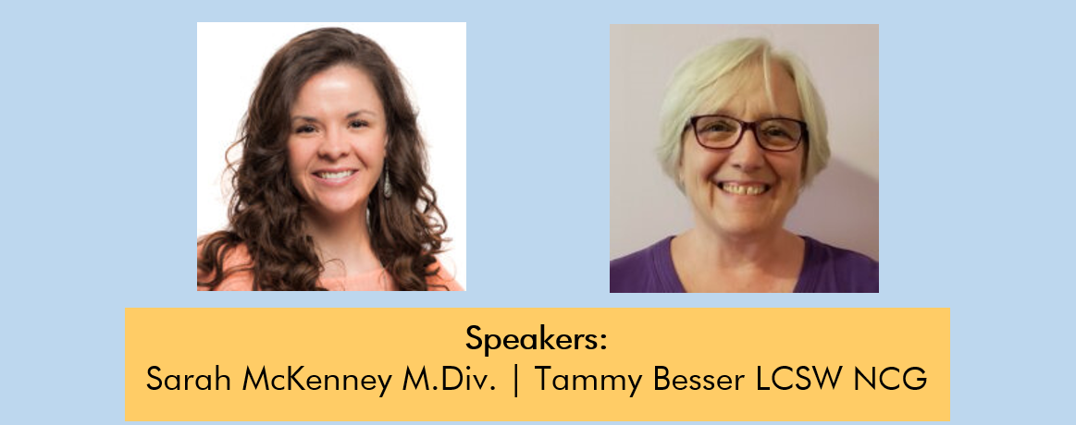
Speakers

Slide 4
What Are Spiritual Health Needs?

Slide 5
The Big Questions
How did I get here?
What is my purpose? What is OUR purpose?
Who am I?
Is there a God?
If so, what are they like?
What comes after death?
What is good and bad?
Who or what decides that?
Why do bad things happen?

Slide 6
Spiritual Needs
LOVE
FRIENDSHIPS
FEELING VALUED
JOY
CONNECTION
A SENSE OF PURPOSE
BELONGING
NEEDED

Slide 7
What do Faith Communities Offer?
Soup Kitchen/Community Feast
Rummage Sale
Book Groups
Knitting Groups
Environmental Justice
Gardening/Landscaping
Food Pantry
Thrift Store
Sacred Text Study
Baking
Teaching
Baby/Toddler/Preschool

Slide 8
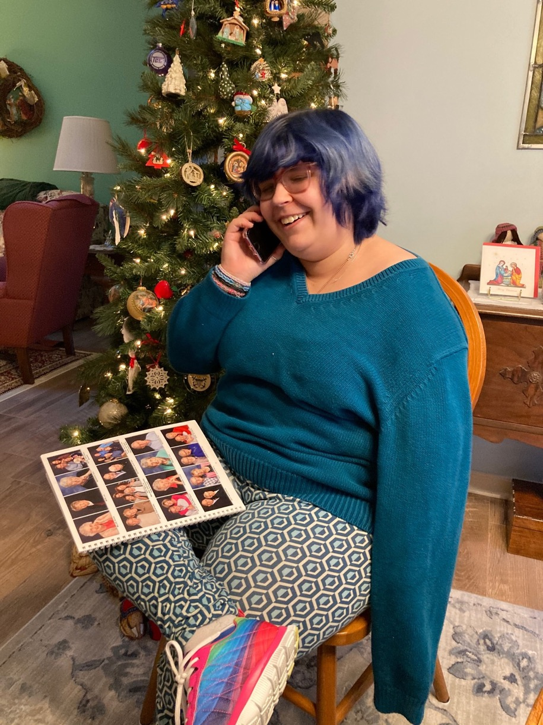
Mikaelas' Service
How do you experience God?
When I serve and help others
Tell me more...How does God show God's self to you in those moments?
God reminds me I am important. I can help and serve others and make a difference in other people's lives.
Service:
Helps at the coffee cart where they sell Fair Trade coffee, tea, and chocolate.
Helps at social hour by getting the sweat treats and punch ready for people after the worship service
Has helped build multiple ramps and decks for people in need during church's mission trips to West Virginia. She especially loves using the power tools!
Started a phone call ministry during Covid all on her own!
Now an ordained Deacon

Slide 9
How Can Individuals Get Involved?
Young Adult Group
Retirement Group
Womens Group
Depression Support
Grief and Loss Support
Choirs
Rock Band
Musicians
Soccer
80s Dance Party
Friendship Dinners
Pancake Breakfast
Fried Chicken Dinner
Other Social Gatherings

Slide 10
Thomas' Story

Slide 11
Video

Slide 12
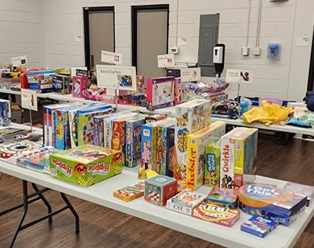
Holiday Gift Drive and Winter Warmth Success
Our 2022 Holiday Gift Drive was a success thanks to the generosity of our donors.
More than 20 volunteers packed gifts for over 500 children, teens, and refugee families who are supported by JCFS services.

Slide 13
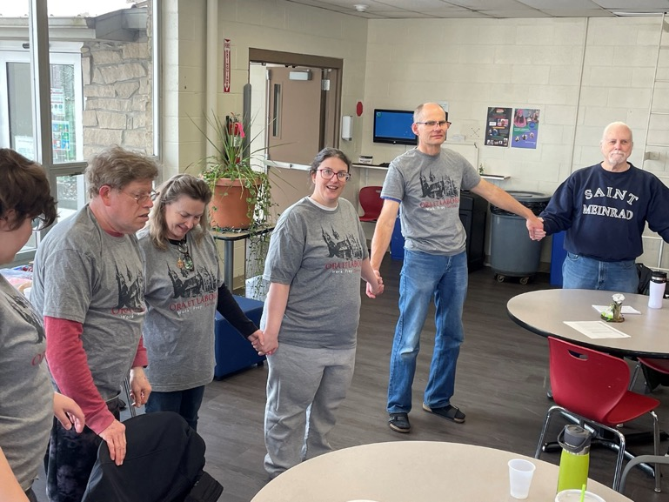
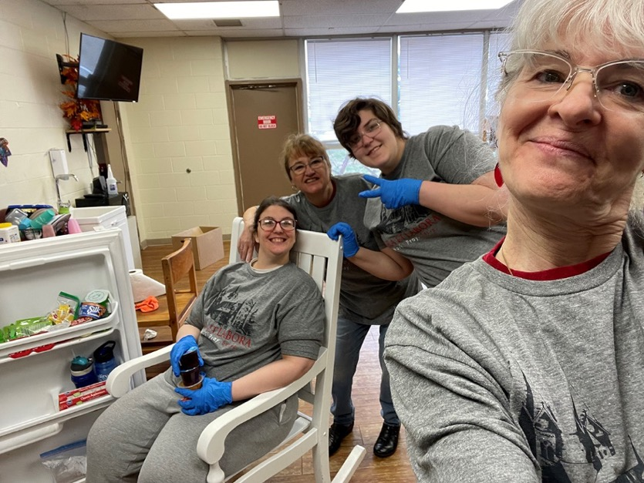
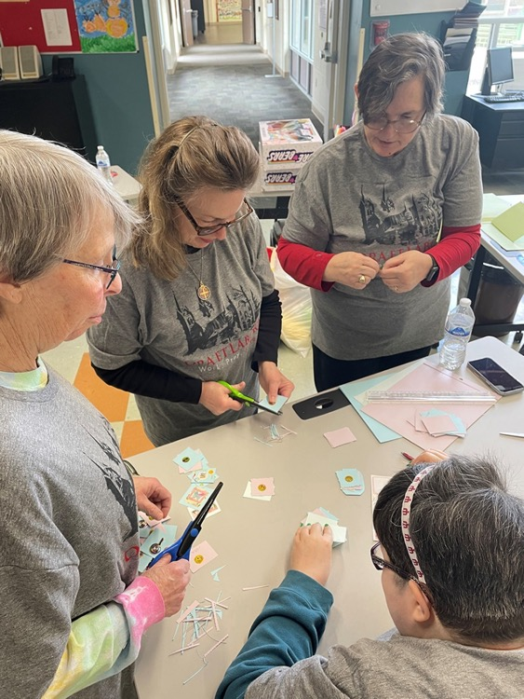
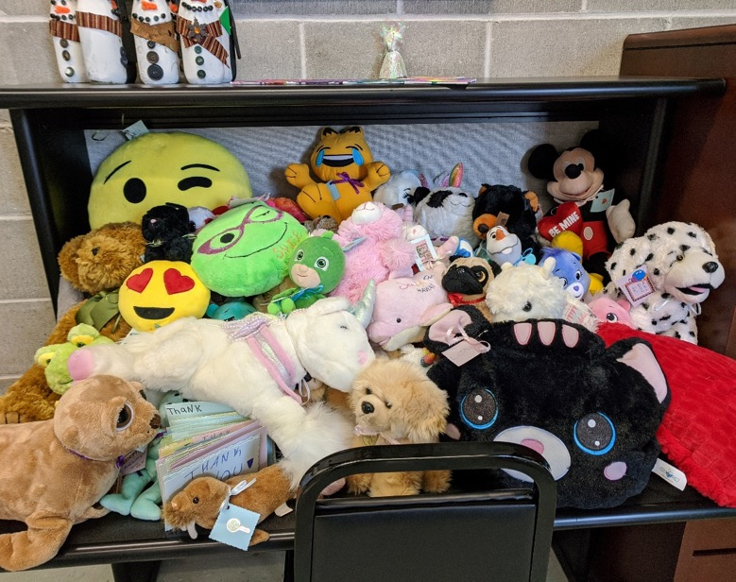
Photos 1

Slide 14
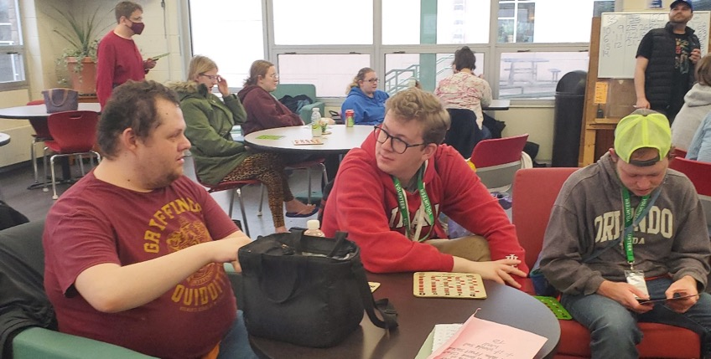
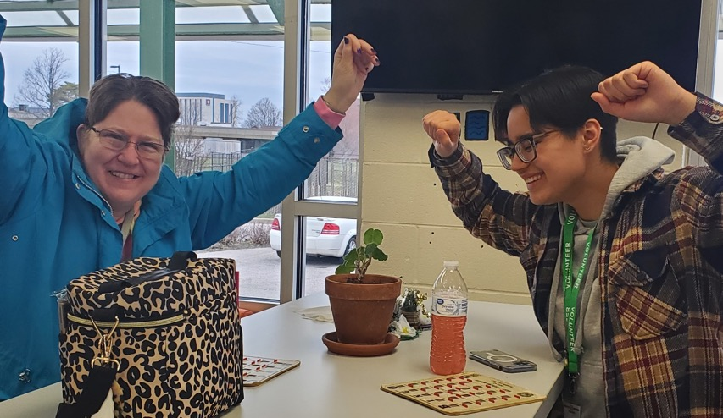
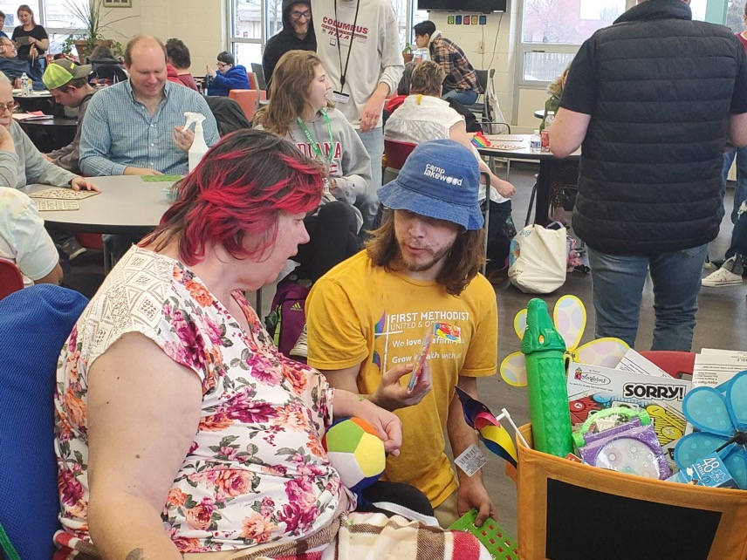
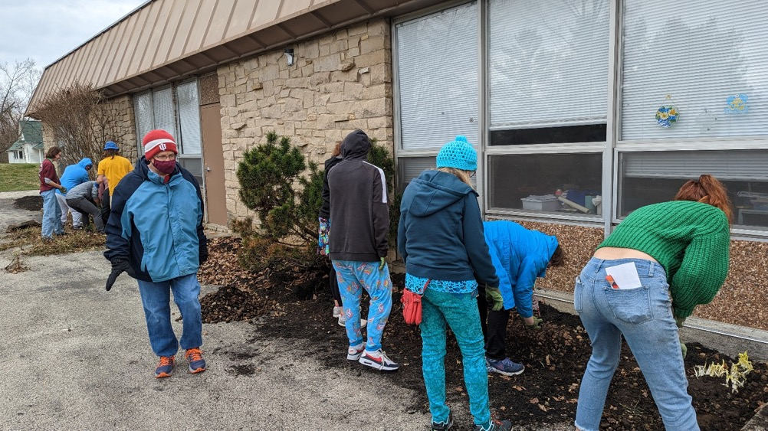
Photos 2

Slide 15
Employment
Employers
Networks with Knowledge
Customized Employment-Carve Outs
Mock Interviews
Recruiting Staff
Job Seeker Profile Brainstorming Sessions

Slide 16

Ways to do this:
Host a gallery wall – have artists with disabilities show their artwork on walls and/or hallways of your faith community
Purchase use of image for bulletins, slideshows, websites, social media, signage etc.
Commission artwork for specific projects, advertisements, etc.
Utilize artists with disabilities in your committees that need art and design
Title: Peace on Earth by Mia Dunn
(inspired by Magritte's dove)

Slide 17
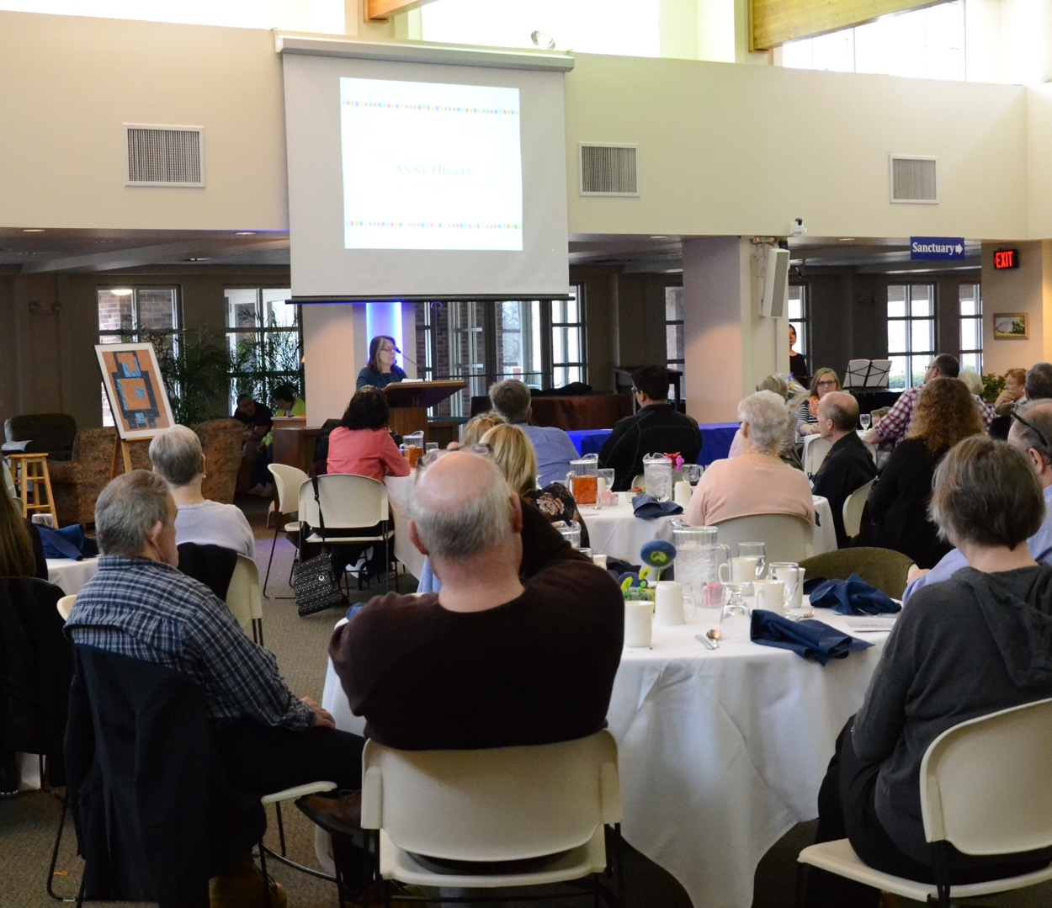
Volunteer and Collaboration
Space
Co-Sponsorships
Expertise
Donors
Volunteers, Donors, Board Members

Slide 18
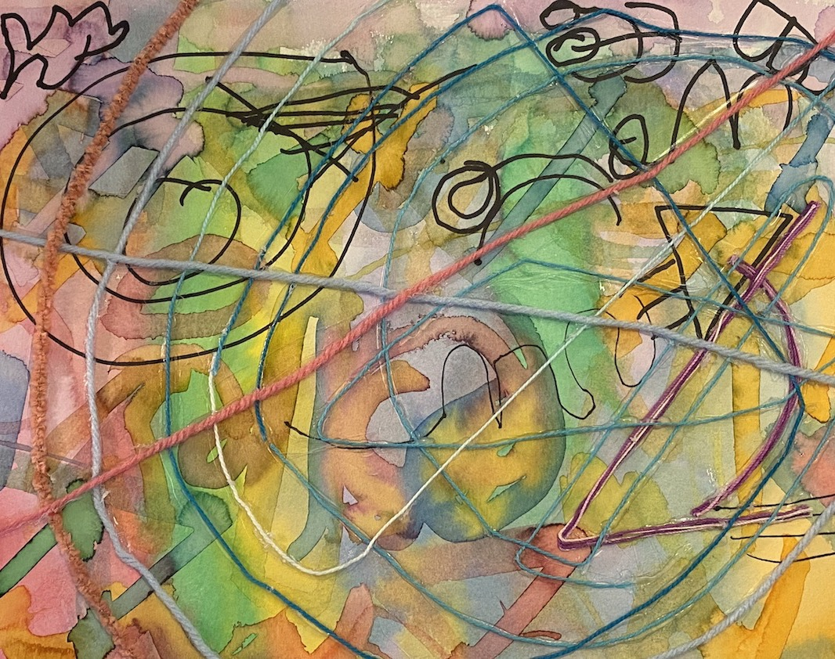
Get to know various congregations in your area
Each congregation has a different personality and even various sets of personalities within
Each congregation has different layouts
Each congregation has different goals/visions/interests
These also change over time
Title: James' Treasure Map by Wesley Mull

Slide 19
Contact us!
Tamara Besser, LCSW, NCG
Tamarabesser@jcfs.org
773-765-3159
Sarah McKenney, M.Div
Smckenney@stonebelt.org
812-345-6496

Slide 20

Join us May 17
Join us on May 17 for the last webinar in the series!
All webinars are 60 minutes and start at 2 p.m. ET / 11 a.m. PT
Learn More about the full series: RespectAbility.org/aaidd-2023-series/

