Slide 1
From Assessment to Participation:
Supporting Individual Preferences to Find Their Faith Community

Slide 2
Accessibility Notes
Turn on captions with CC button in Zoom.
You can pin the interpreter to ensure they are visible throughout the presentation.
To view live transcript in a separate window, use the link in the chat box.
Please put questions for our speakers in the Q&A box.
This webinar is being recorded. After open captions are added, you will find it at RespectAbility.org/AAIDD-2023-Series/ (link in chat box)

Slide 3
Evergreen’s Spiritual Life Program
Faith Based Organization
Policy
Assessment
Person Centered Planning
Outcome Measure
Personal Stories

Slide 4
Faith Based Organization - Core Values
Formally affiliated with Presbyterian Church
Primary focus of services provided at Evergreen
Recognize as an important aspect of life
People have the right to choose their own level of spirituality
Committed to supporting people to have the level of spirituality they choose
Committed to working with faith communities to welcome and include people

Slide 5
Policy
Spirituality - Integral part of person centered plan
People given assistance to participate but not coerced
Religious study materials made available
Individual and corporate prayer encouraged
Supports provided in conjunction with the faith community to assist people to exercise special rites or sacraments of the faith community
Transportation provided or arranged to services and other activities of the faith community
Executive Directors responsible for policy implementation

Slide 6
Assessment
Administered upon entrance to Evergreen and annually thereafter
Faith preference?
Level of participation?
More information and supports to participate?
Assistance in practicing the traditions of chosen faith?
Assistance with communication?
Visit different places of worship?
Assistance with transportation?
Other faith based activities to participate in?

Slide 7
Person Centered Planning
Data from assessment and outcome interview included in person centered plan
Individual supports developed to assist with and increase people’s level of participation in their chosen faith community

Slide 8
Outcome Measurement Sample Questions
Are you religious?
What religion are you?
Do you attend church/mosque/temple/mass?
Is it up to you where you attend?
Are you involved in any groups or activities there?
Do you get to attend when you want?
What kind of assistance do you need, if desired, to practice your faith at home?
Notes:
How we came up with the outcomes measurement
Outcome is there if people have no religious beliefs and don’t wish any involvement in a religious community or activities.

Slide 9
76%
People supported in their religious beliefs and practices
Notes:
Board of directors tracks this outcomes measure on an annual basis

Slide 10
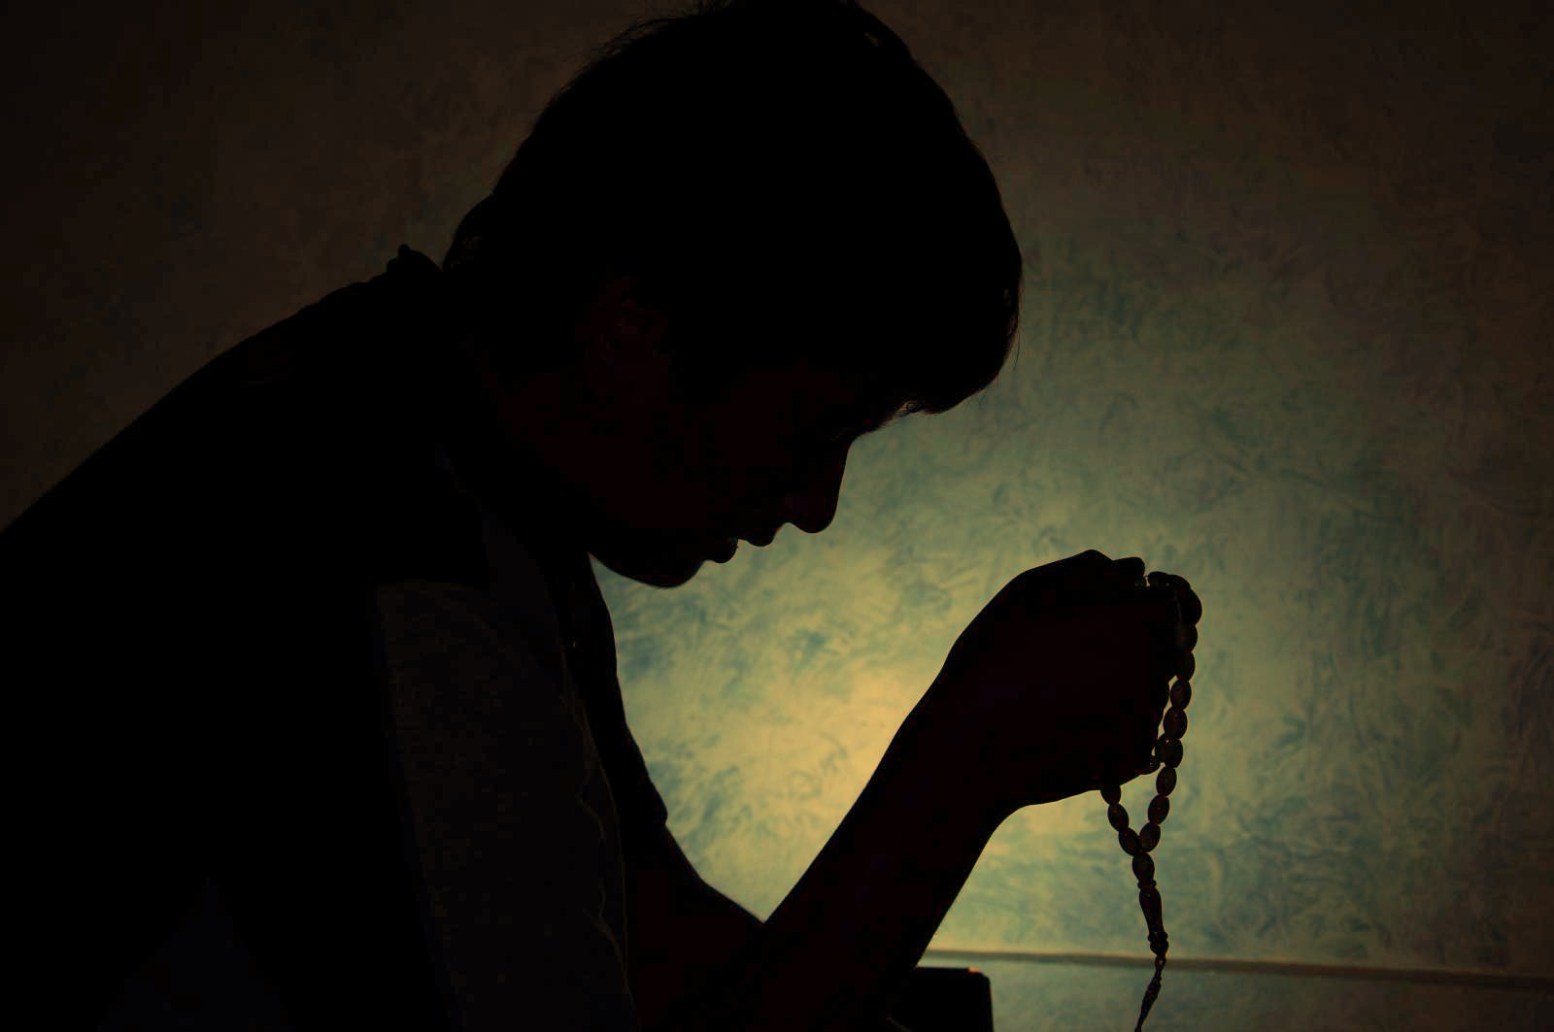
How Supported
Attending place of worship of their choice
Assisting with prayer and study in their home
Active participation in congregation: usher, choir, potlucks, plays, prison ministry
During Covid restrictions:
Watching live stream of their place of worship
Television broadcasts of churches
Bibles on CD
Gospel music
Choice
Rites and traditions of their faith community
Notes:
Karen can help talk about specifics (plays, prison ministries)
Things that I’ve heard in outcomes measurement over the years
Choice: try to find out what they want (or not)
Used to have ELS chaplain: assisted to find synagogue have Bar Mitzvah
Baptisms

Slide 11
Barriers
Staffing
Transportation
Community perception
Accessibility
Communication
Notes:
Barriers
Staffing
not enough at times
Housemates may want to go different places, or one may not want to go anywhere, and have only one staff
Not aware of person’s desires to practice their faith

Slide 12
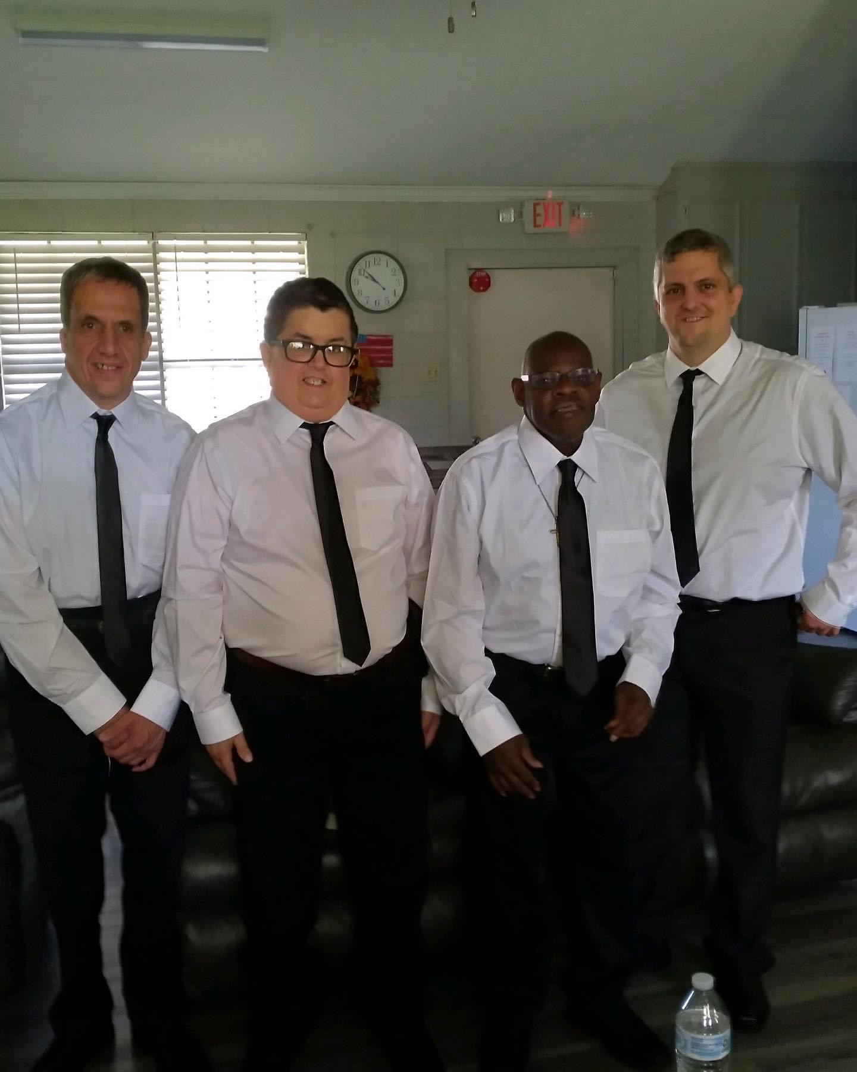
Meet Joseph, Jimmy, Rocky, and Mitchell
Members of Morning Star Baptist Church
Serve as Ushers
Participate in Bible Study
Enjoy Church Fellowships

Slide 13
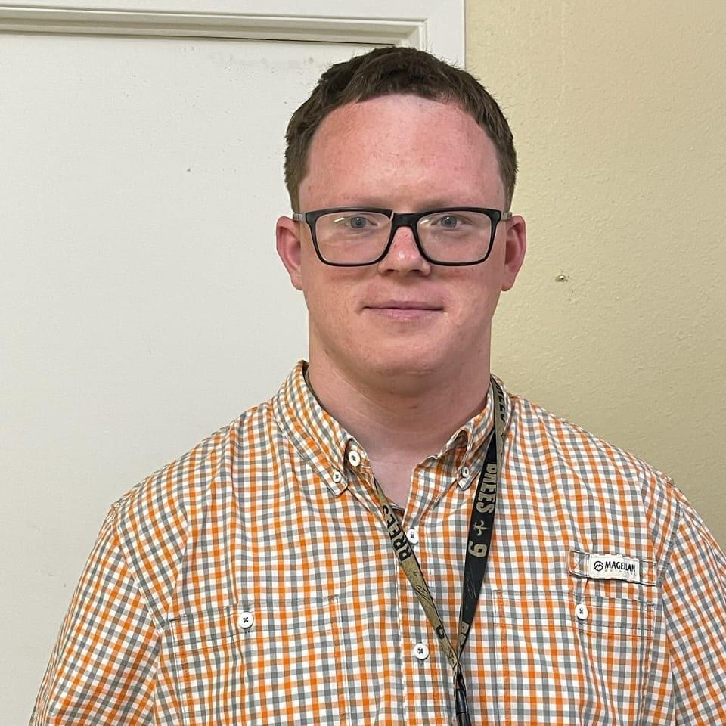
Meet David
Member of the Boulevard Church of Christ
A Baptized Believer
Attends Church
Participates in Bible Study
Waits on the Lord’s Table
Leads Closing Prayer
Enjoys Church Fellowships and Men’s Prayer Breakfasts

Slide 14
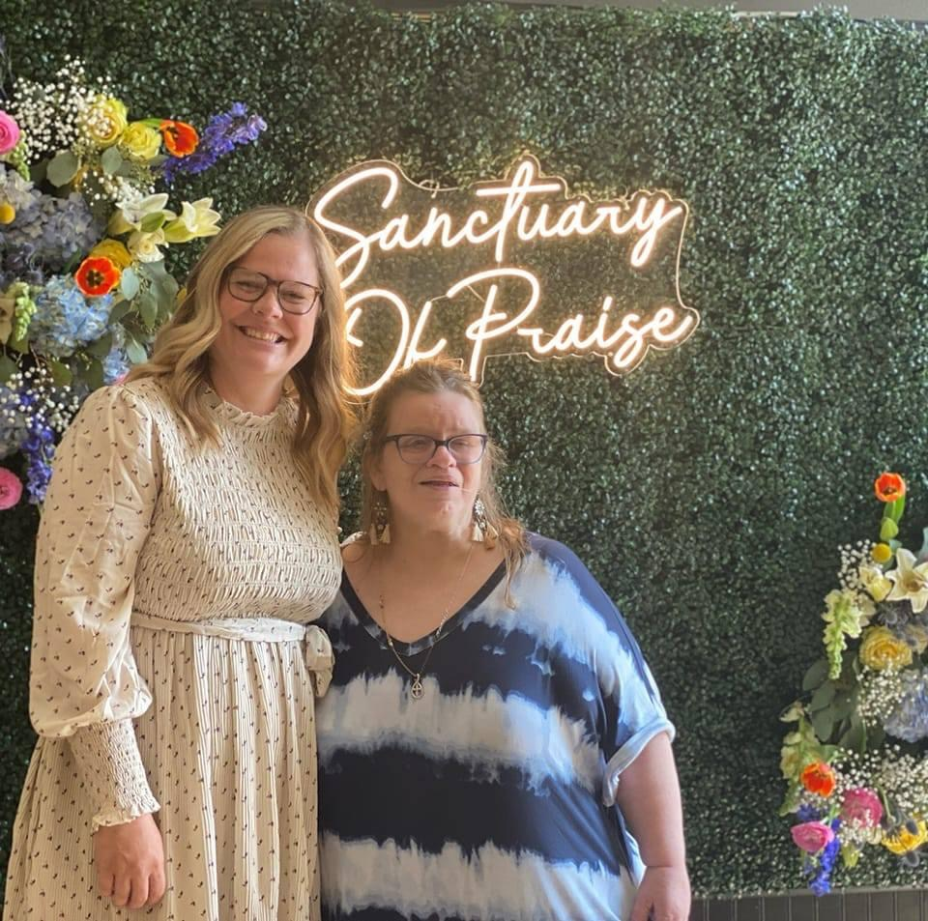
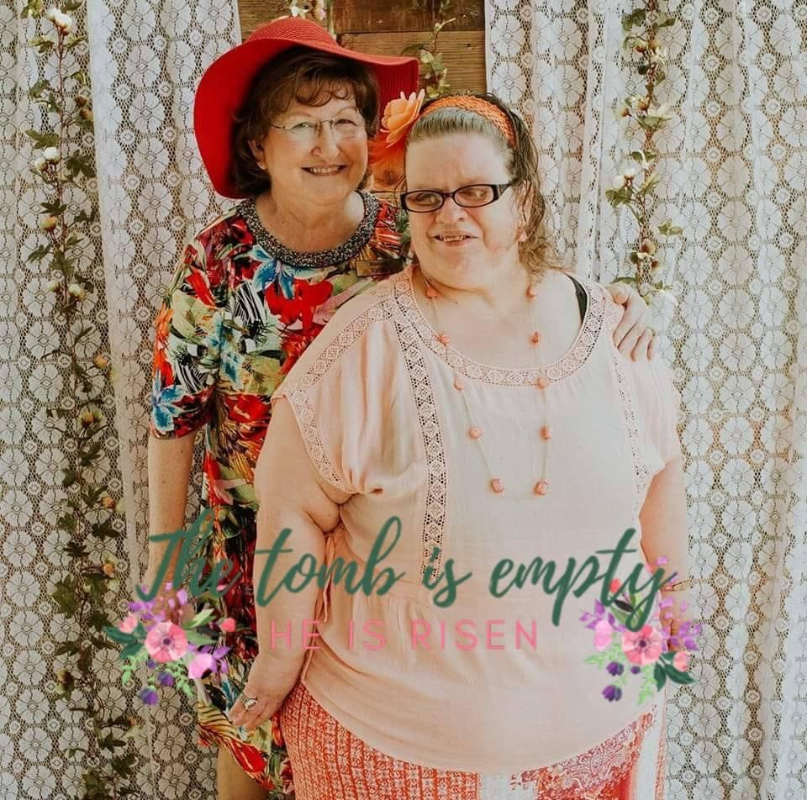
Meet Tammy
Member of the Sanctuary of Praise Fellowship
Signed at Worship Service for members who are deaf
Baptized Believer
Member of Women’s Ministry
Deceased - Cremated
Ashes sprinkled around yellow rose bush at Sanctuary of Praise
Notes:
This church was very important to her
Shared at outcomes interview about end of life wishes: cremation, ashes sprinkled around rose bushes at church
Her favorite flower are yellow roses - church planted yellow rose bushes just for her
Two ladies pictured are her two best friends (picked up, brought to church, etc.)

Slide 15
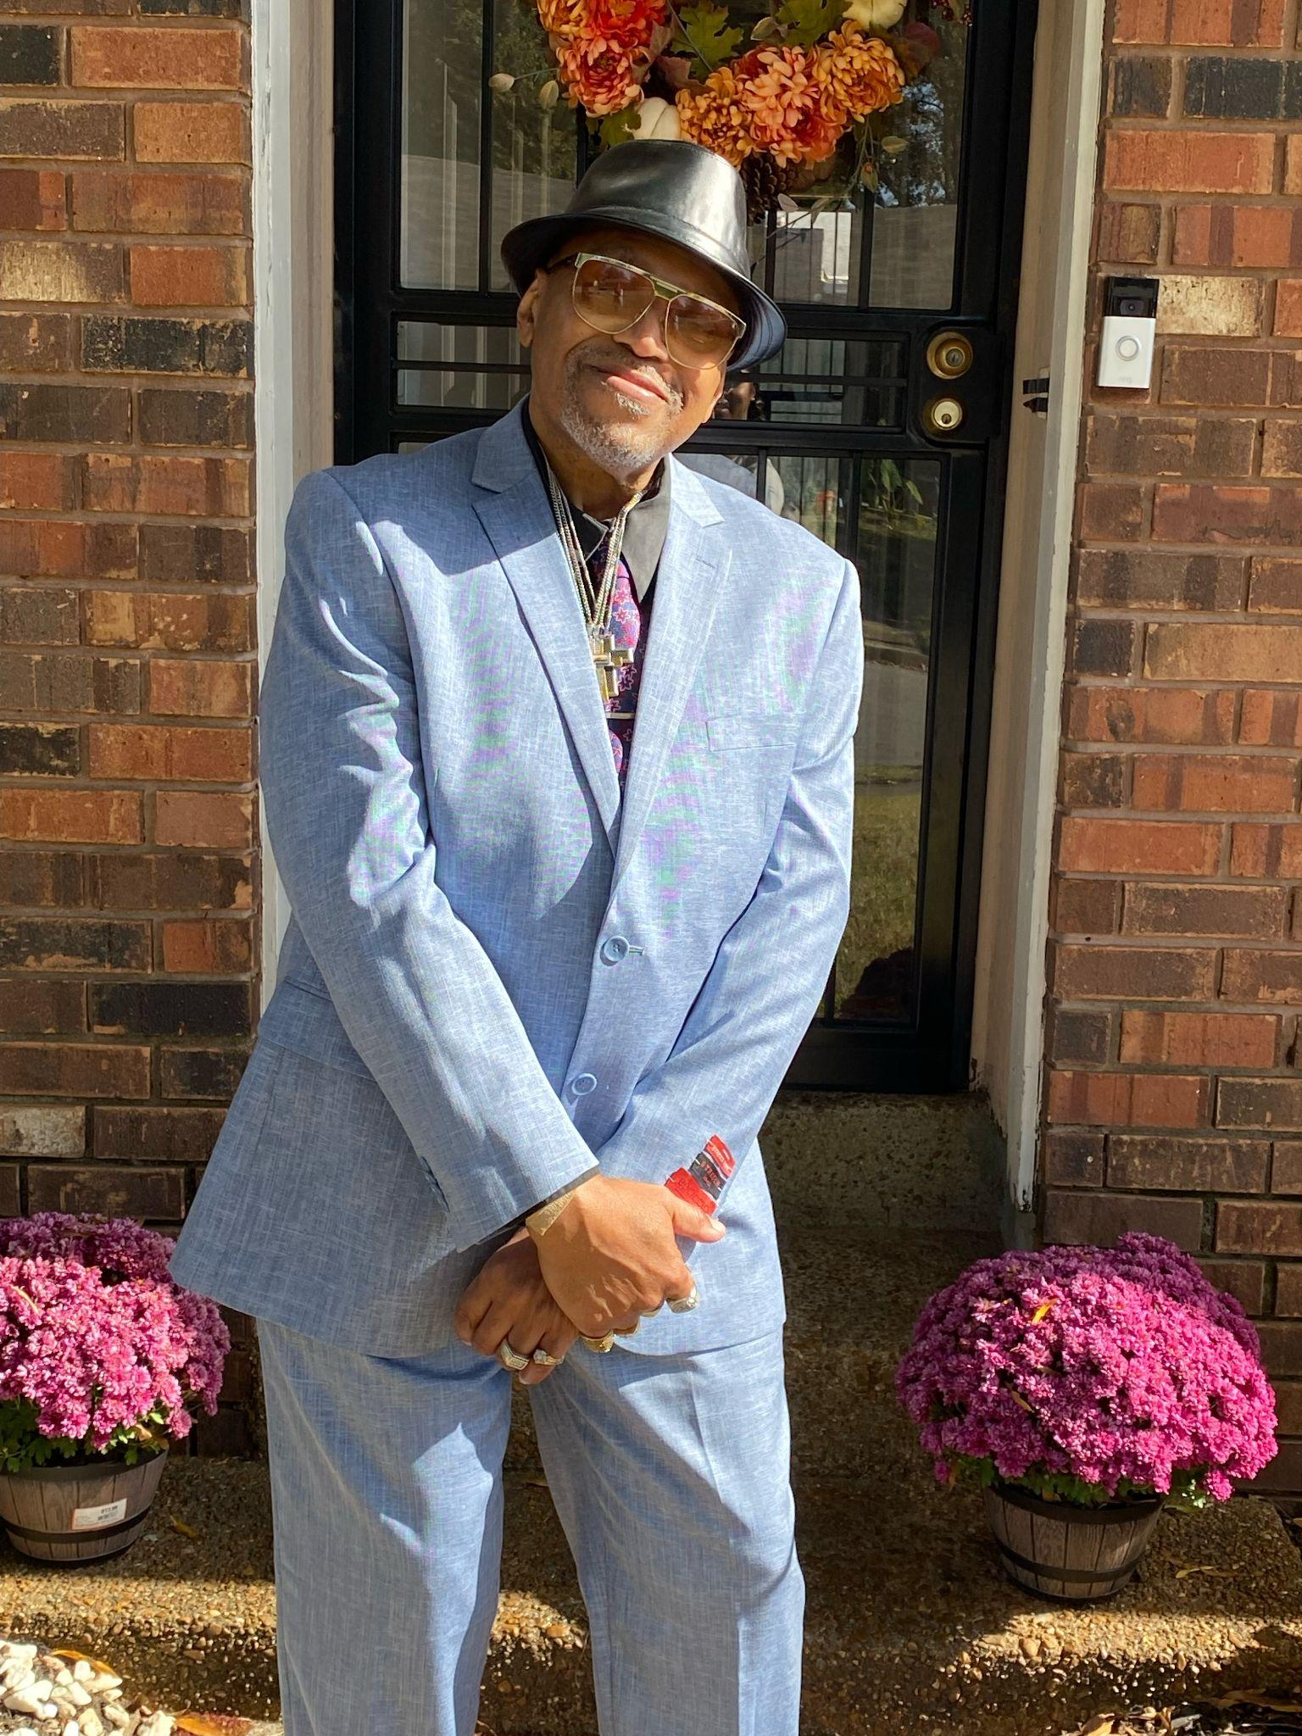
Meet Vertis
Attends Greatest Community Temple
Participates in Bible Study
Sings in the choir
Enjoys Church Fellowships

Slide 16
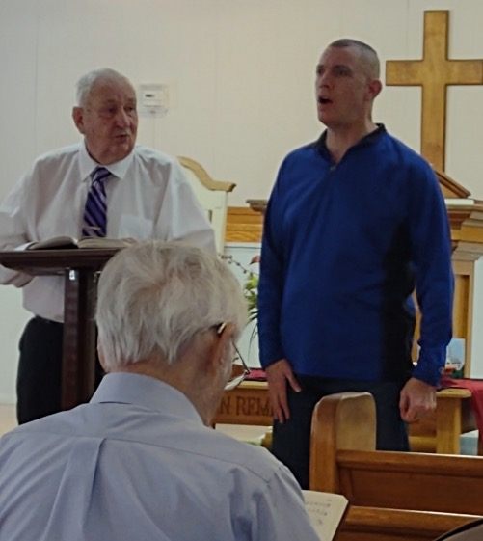
Meet Amos
Loves attending Church
Participates in Bible Study
Loves singing solos at Church
Loves participating in the music ministry of the Church

Slide 17
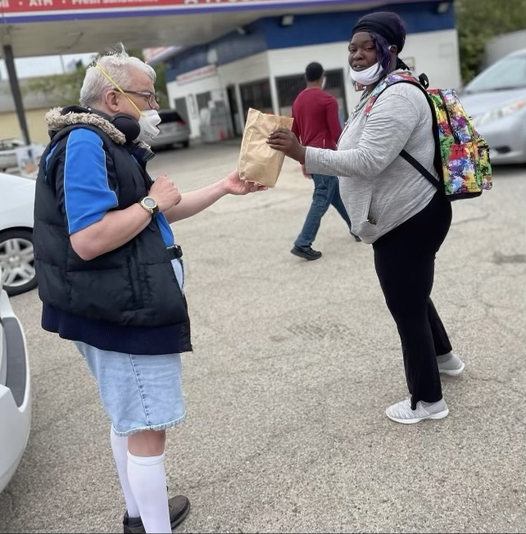
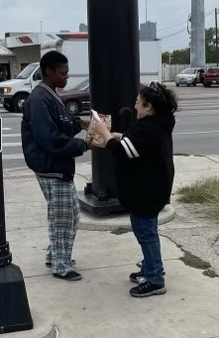
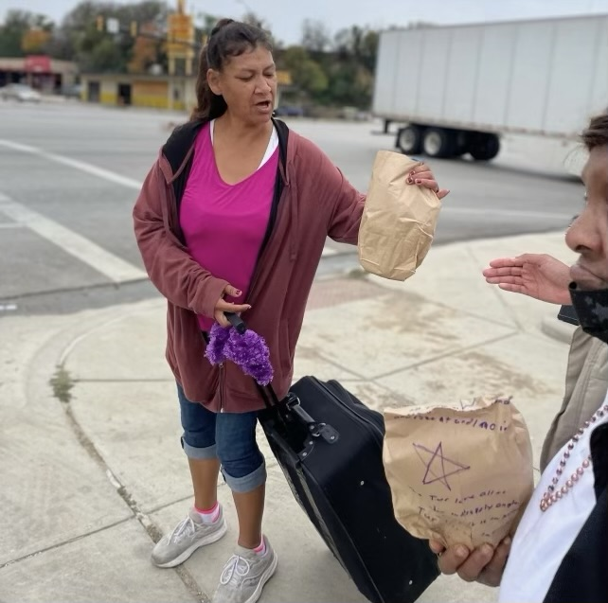
If we do nothing
Individuals possess spirituality in spite of our process.
Those that cannot voice their choice, inherently participate in their choice.
Put together comfort bags to give to the local homeless population.

Slide 18
Meet Roberto
Limited ability to speak used gestures and vocalizations.
Attended St Phillips Presbyterian Church.
Always had a Bible with him.
Transcribed every page of his Bible to notebooks.
He filled 100s of notebooks.

Slide 19
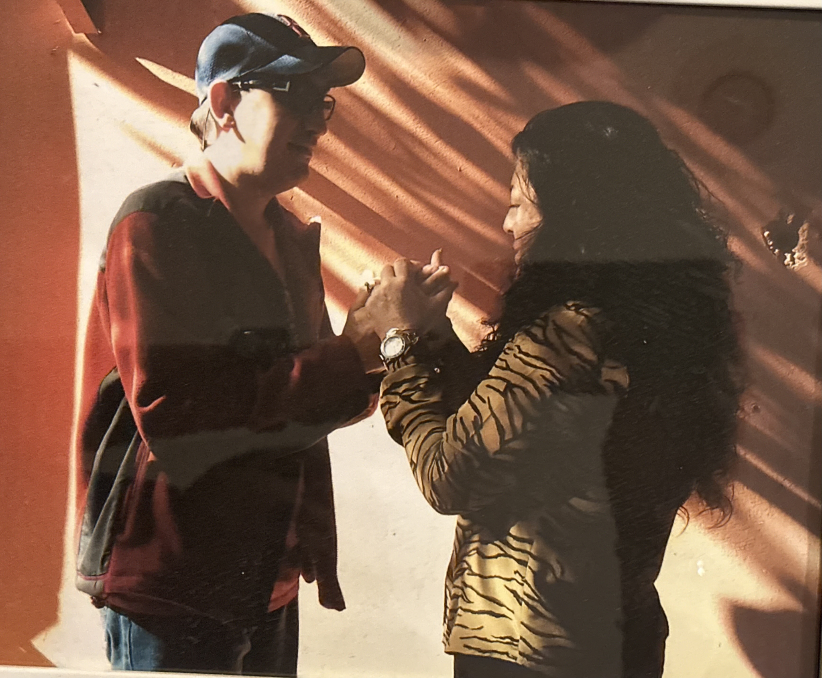
Meet Charlie
Limited vocabulary and communication skills.
Always wanted to pray for the day, his friends and his mom.
Told others about Jesus.
Enjoyed listening to Praise and Worship Music.

Slide 20
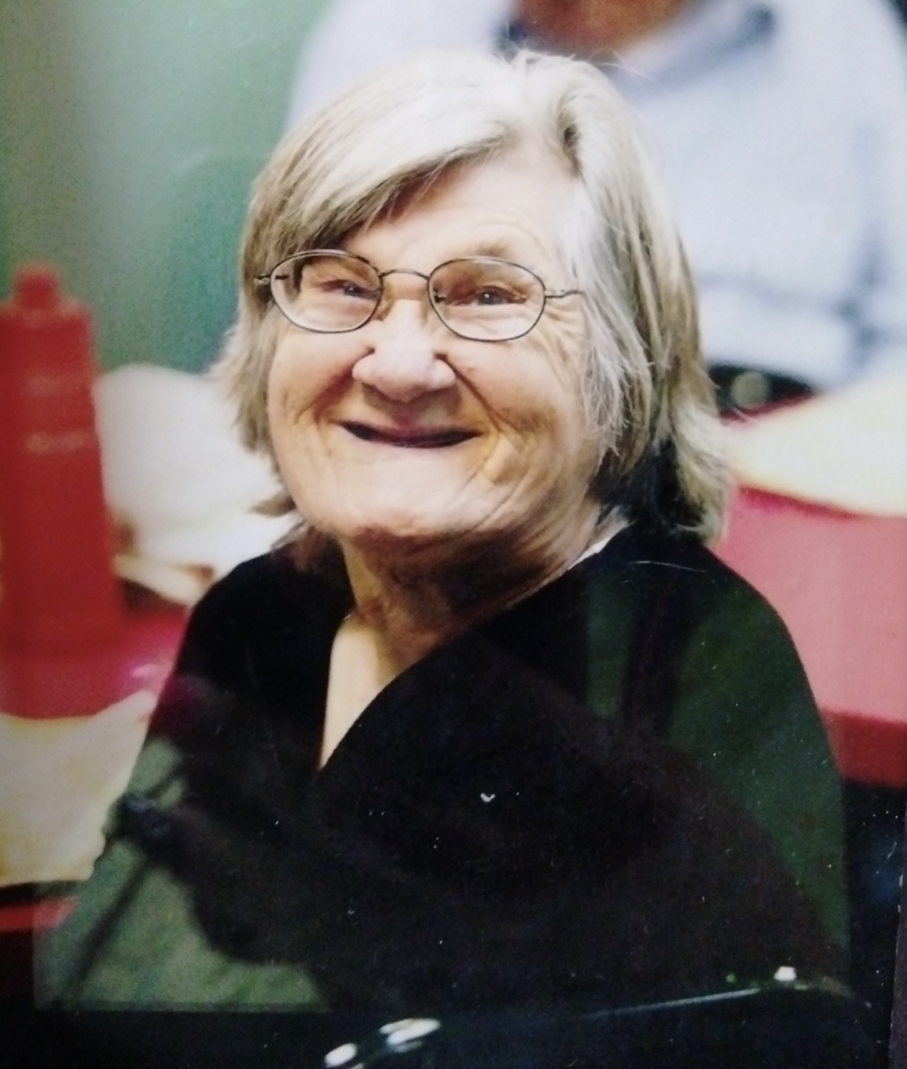
Meet Loretta
She is a spitfire.
Attends St. Phillips Presbyterian Church.
Loves the people and activities.
Likes visiting with new people then asks to pray for them.
Lotetta always knows exactly how to pray for others.

Slide 21
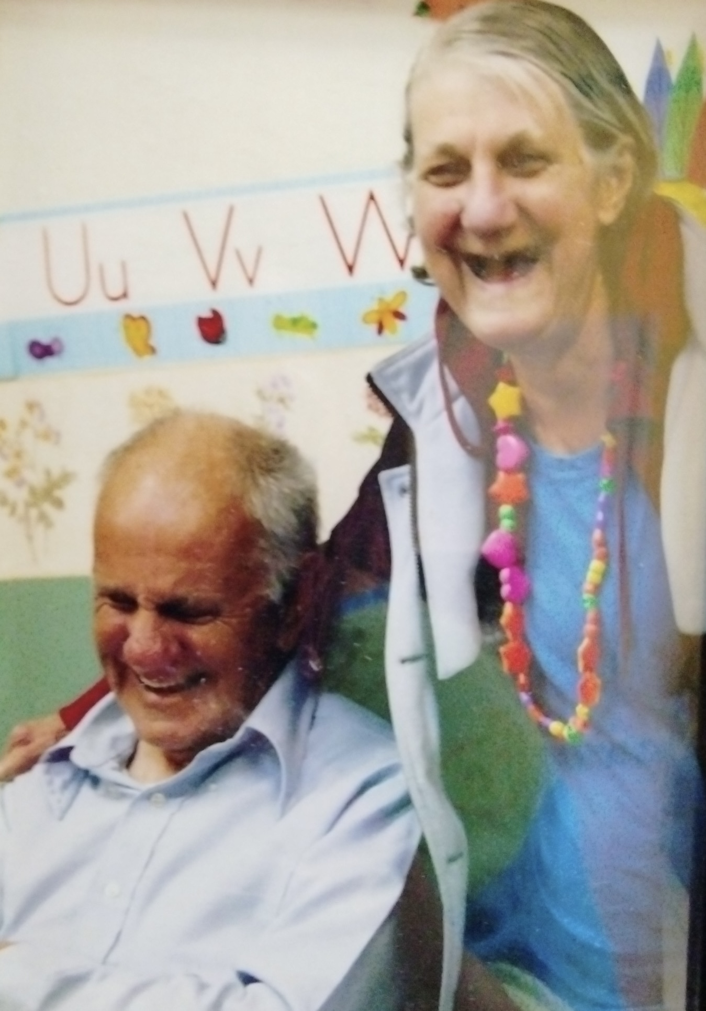
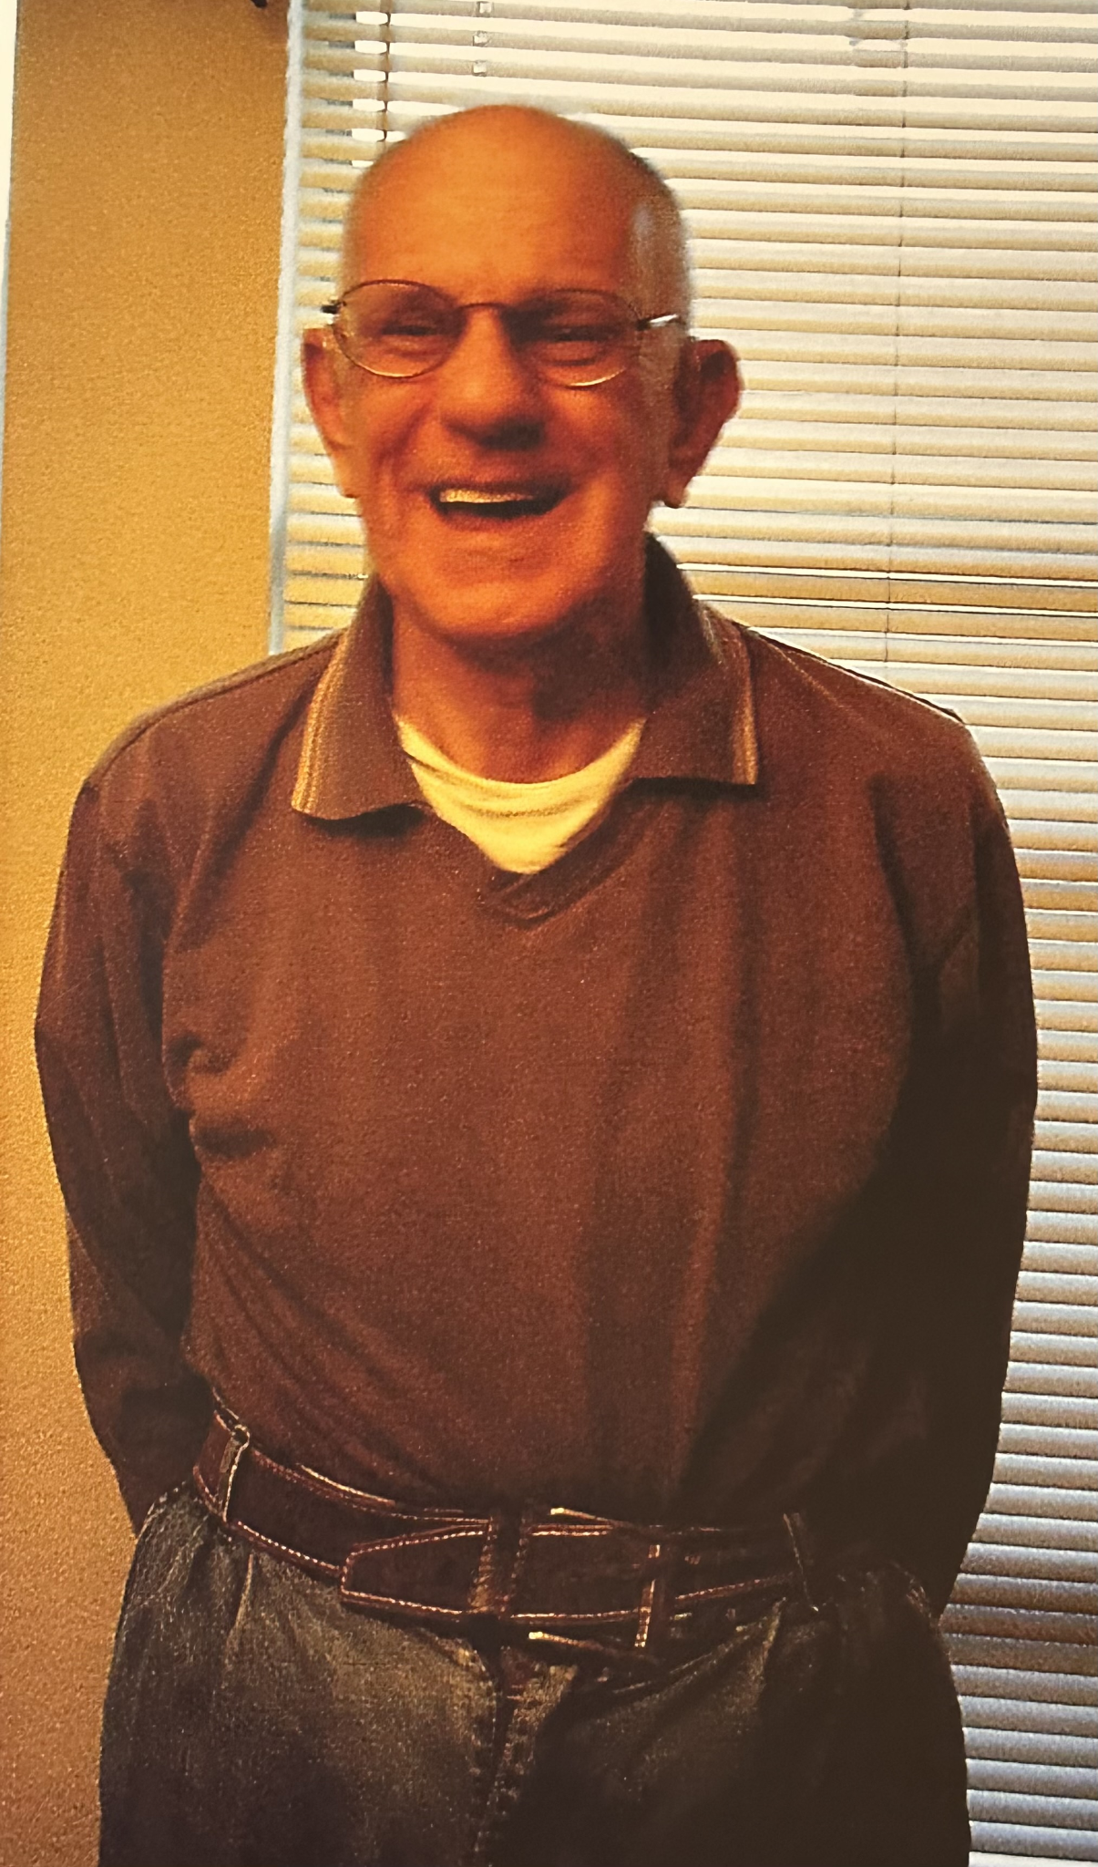
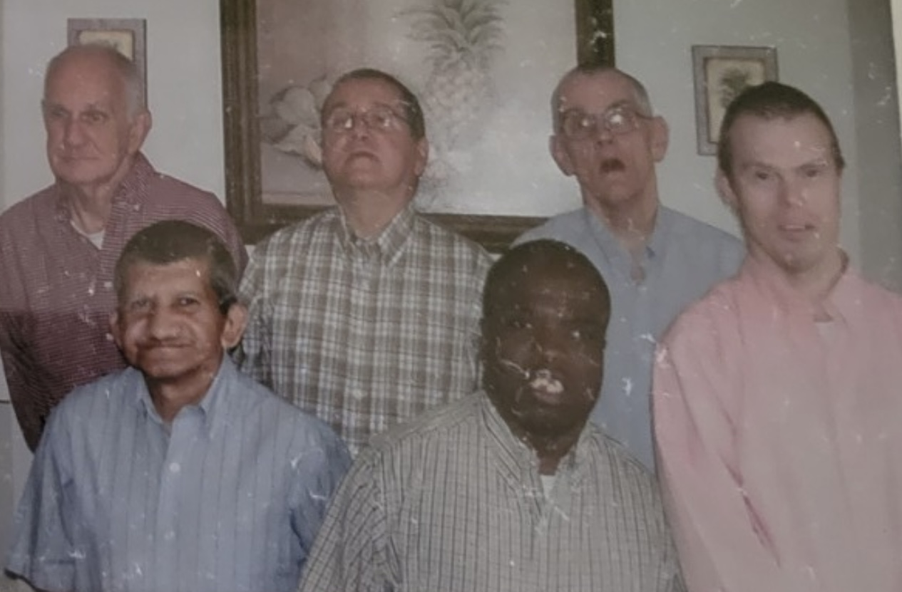
Faith Community
The house of FAITH is the building, the community is the people.
Meet Bobby. He passed away in 2014. Bobby had no biological family except his sister, she lived in the same community.
His final service was planned and executed by the only family he had known, his housemates and friends.
One of his housemates ended his service with, “Bobby was sick, his stomach hurt, he is in Heaven.”

Slide 22
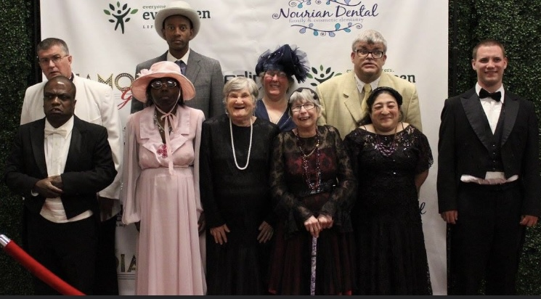
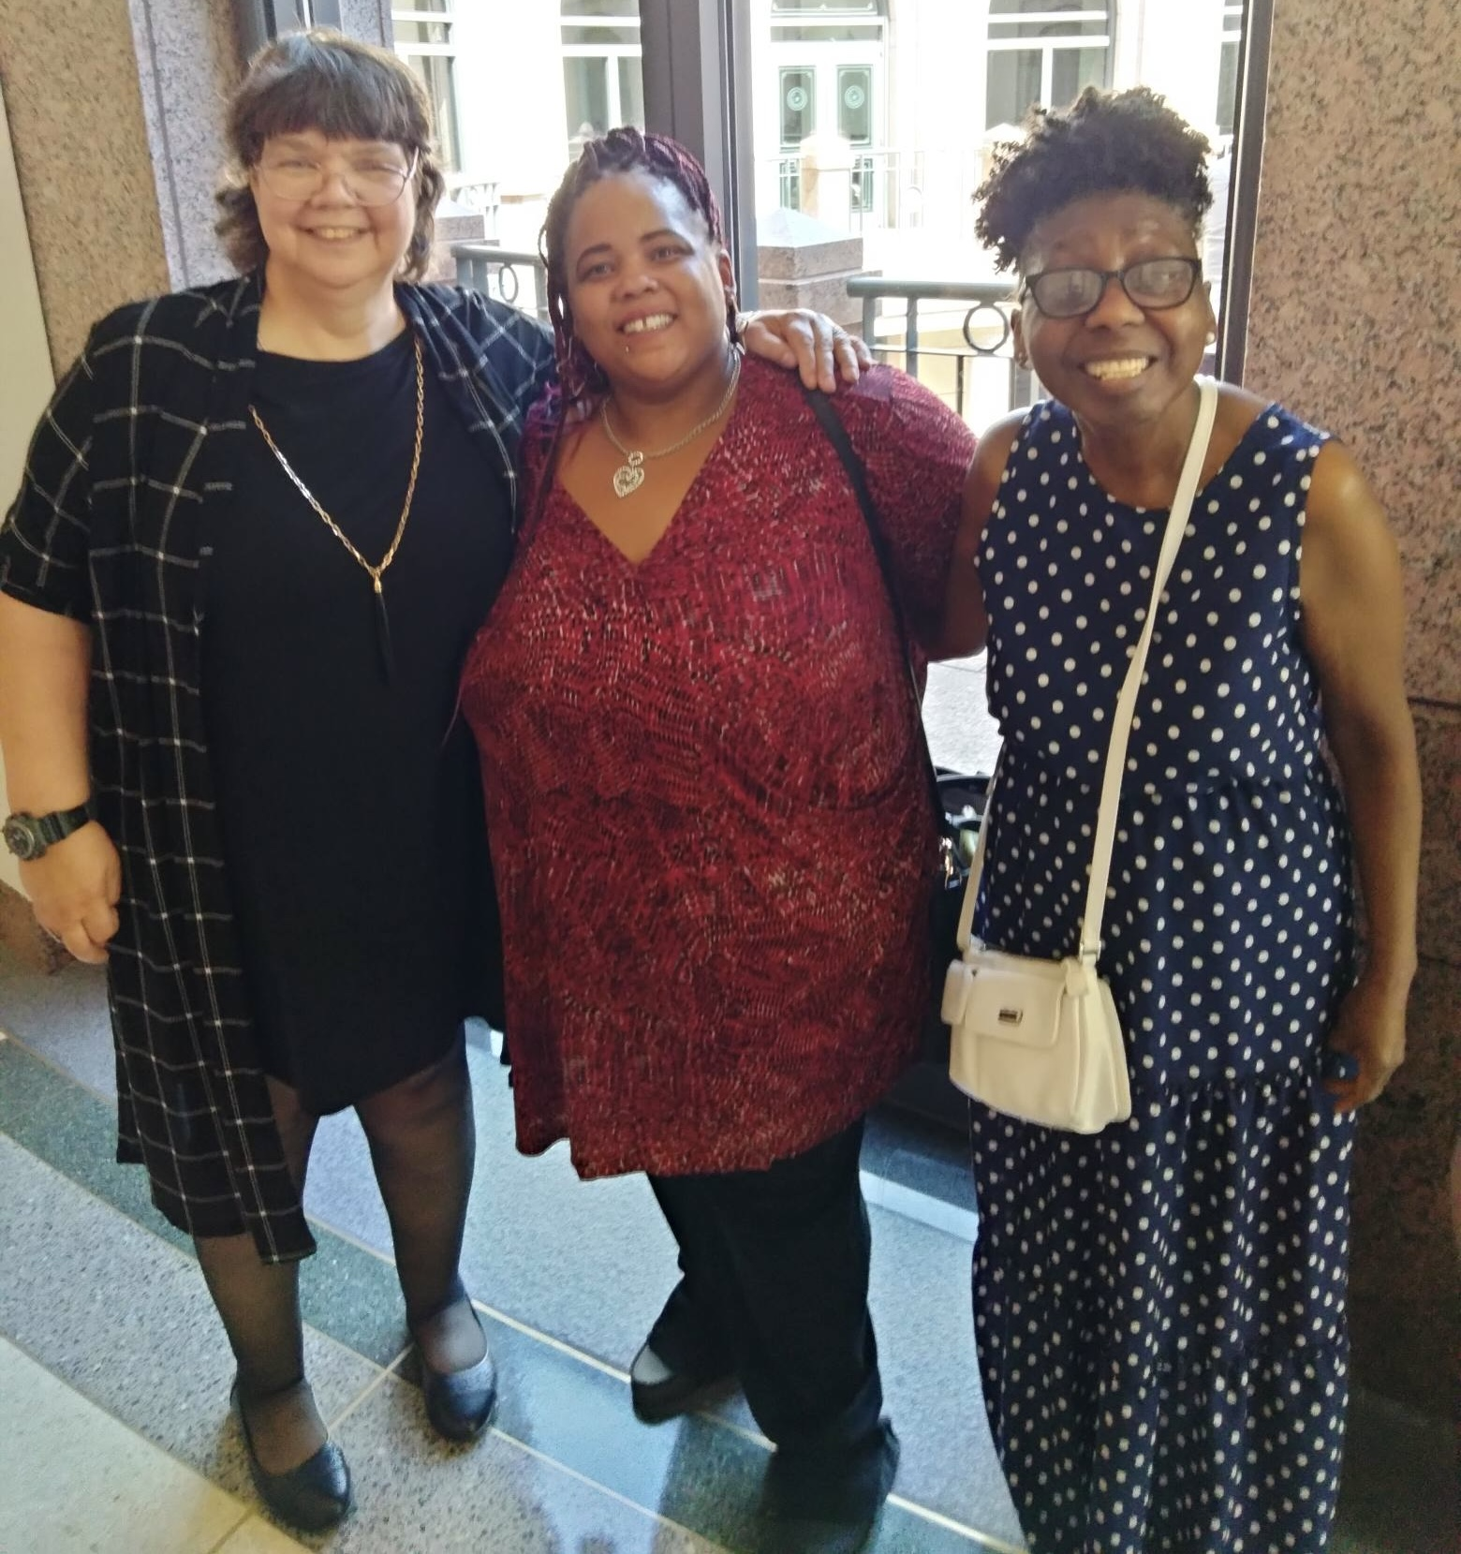
A Glimpse of Heaven
When given complete autonomy to express spirituality, the individuals display the truest form of worship and faith, surpassing our understanding. In this arena, pretense and imitation do not exist. We are allowed to glimpse the honest simplicity of faith. Connection and communication, giving and receiving in pure relationship with their chosen higher power.

Slide 23
Don’t Miss the Rest of the Series!
Join us for parts 3 and 4 on April 19 and May 17
All webinars are 60 minutes and start at 2 p.m. ET / 11 a.m. PT
Learn More about the full series: RespectAbility.org/aaidd-2023-series/

