Slide 1

Direct Support Professionals: Accompanying People in their Spiritual Journey
Bill Gaventa,
Jasmine Duckworth,
and Keith Dow

Slide 2
Accessibility Notes
Turn on captions with CC button in Zoom.
You can pin the interpreter to ensure they are visible throughout the presentation.
To view live transcript in a separate window: https://carolinascaptioning.1capapp.com/event/respectability (link in chat box)
Please put questions for our speakers in the Q&A box.
This webinar is being recorded. After open captions are added, you will find it at RespectAbility.org/AAIDD-2023-Series/ (link in chat box)

Slide 3
What do we mean by “spirituality?”
It includes experience and involvement in faith communities but also in many other areas of life.
“Spirituality is the of a person that seeksdimension to find meaning in his or her life. It is also the quality that supports connection to and relationship with the sacred, as well as with each other.”
Powerful role in building resilience, combatting loneliness, positive healthcare outcomes, and quality of life.
Dr. Christina Puchalski

Slide 4
Barriers to Addressing Spirituality
Spirituality as private matter, not public or professional.
Equation of faith with reason and understanding
Separation of church and state.
Bad experiences in the past for both people with disabilities and staff.
Science vs. religion
Lack of training in how to address it

Slide 5
Spirituality:
A Three-Fold Definition
Identity
Experience of sacred and/or holy
What’s most important to someone?
Connections
Self
Others (family, friends, groups, etc.)
The Holy and/or Sacred
Places and time (e.g., nature, buildings, ancestors, etc.)
Purpose
Using my gifts and passions to make a difference.
Contributing to others.

Slide 6

FICA Spiritual Assessment
FICA Spiritual Assessment
  Faith: Is it important to someone and/or their family? What else is important to someone and their identity?
  Influence and importance? History? How is someone involved? How would they like to be involved?
  Community: What communal expression does it take? Or could it take?
  Assist: How can staff and agency help support their choice and preferences?

Slide 7
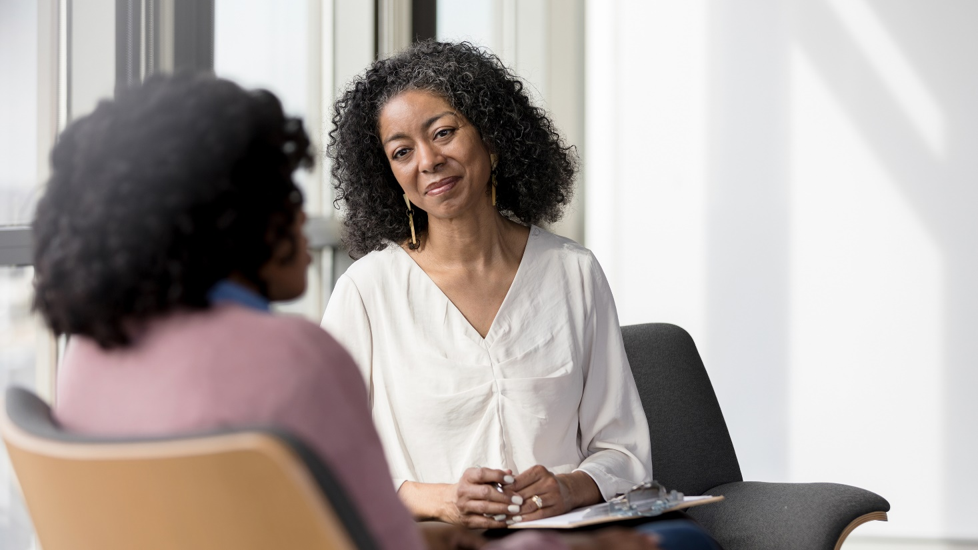

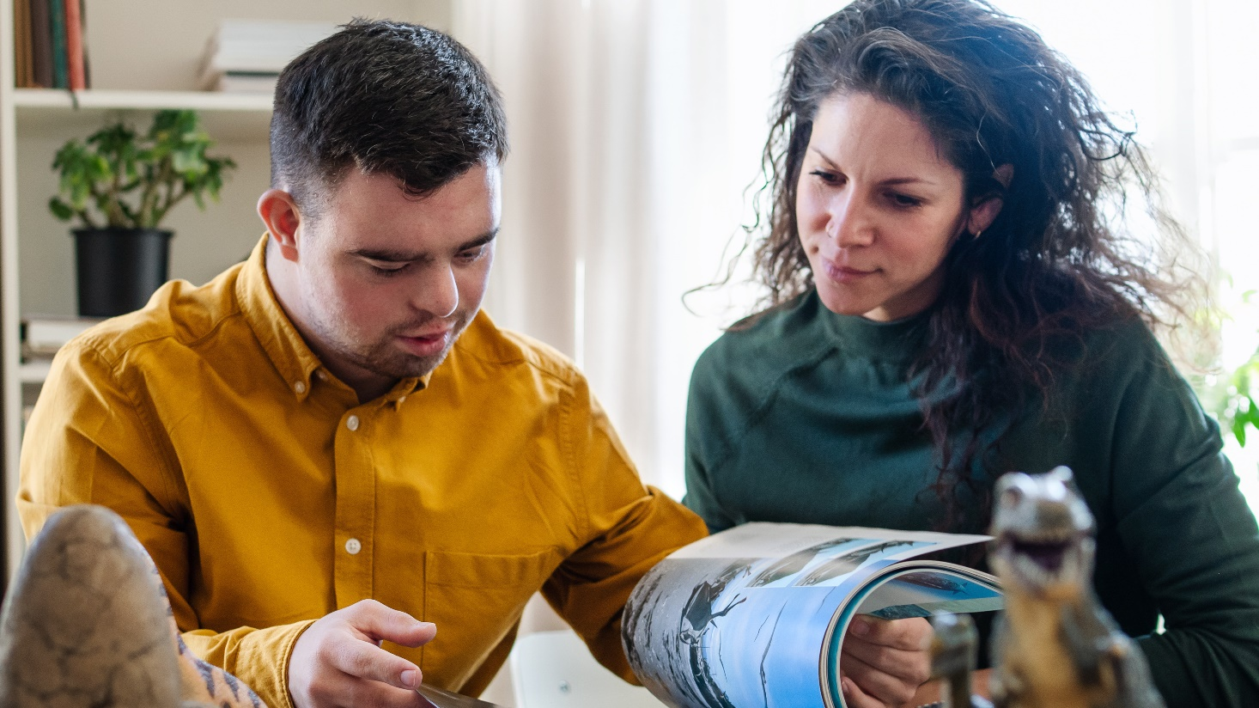

DSP’s as Listeners, Explorers, Teachers and Coaches

Slide 8
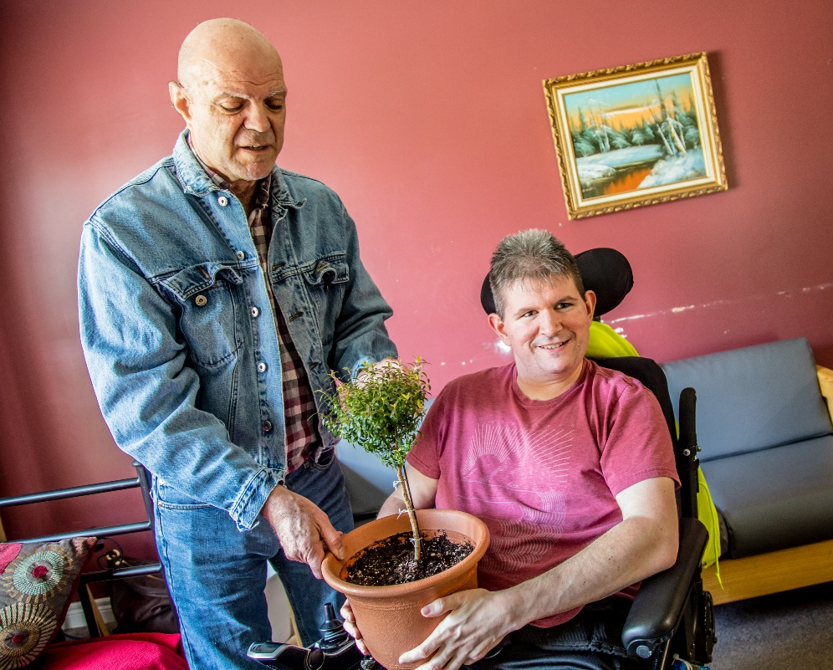
Beginning and Introductions
Personal conversations and connections
Who do you know who knows someone there?
Visits before hand to get familiar with church, synagogue, mosque.
Meet people who may assist.
Start with story, not labels.
“Spiritual companions” “circles of support”

Slide 9
Inclusion and Belonging
“Location, location, location.”
Relationship, Relationship, Relationship
I don’t just go there. It’s mine. I’m missed.
I am ____. They’re my people.

Slide 10
You are helping people move:
Fear | Pity | Anger | Love
Apart | For | With | By
Exclusion | Tolerance | Inclusion | Belonging

Slide 11
Inclusive Faith Communities as
Major Allies to Service Providers
”Ports of Entry” into Community Life
Not everywhere, but resources, models, networks, and momentum exist.
Major source of volunteers and donations
440,000 Natural Generic Support Communities
Diversity of Activities: worship, service, recreation, learning, social, leadership
Spiritual supports as a pathway to meeting community support standards, like the HCBS Rule.,

Slide 12
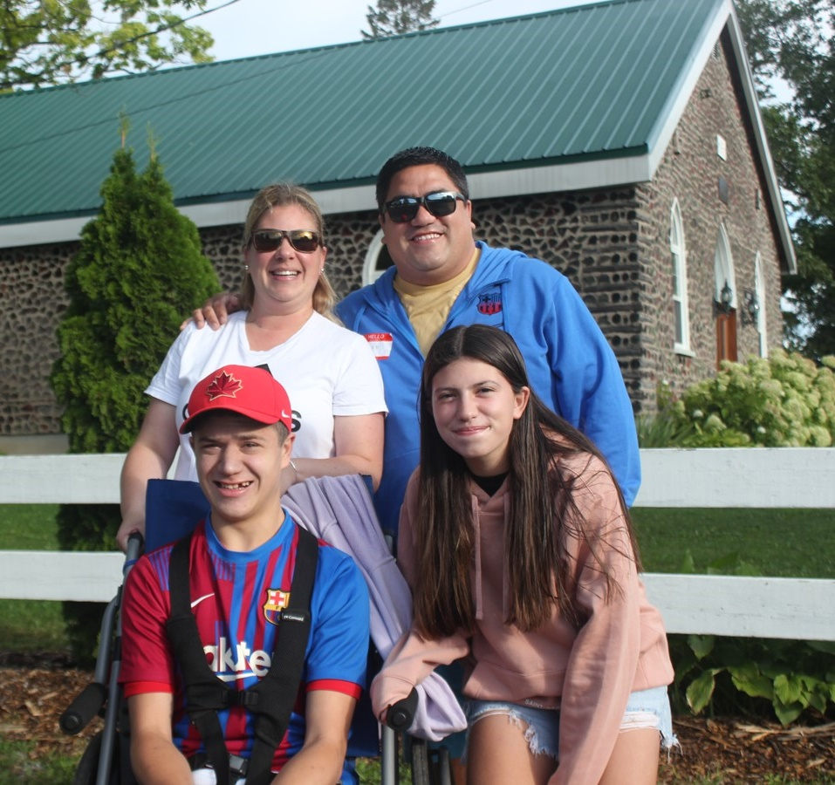
“People who experience disabilities belong in communities in which their God-given gifts are valued and respected.”
~ Christian Horizons Vision

Slide 13
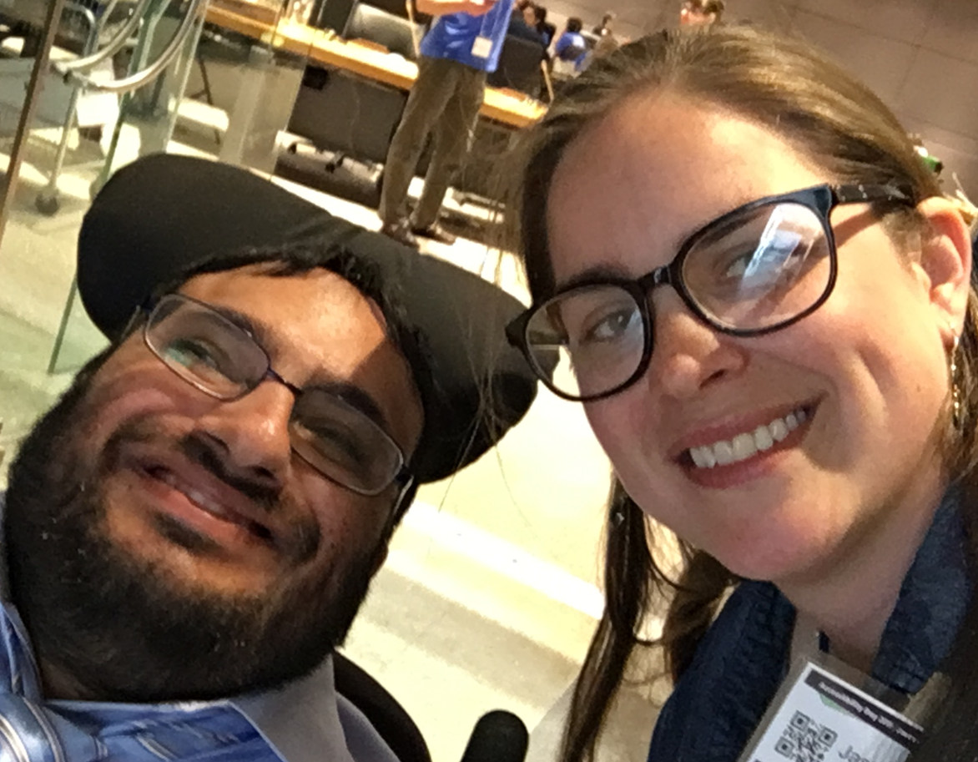
Preparation
Get clear info on what the person wants (conversation, personal plan, history, ask others, etc.)
Ask others who might have more experience.
Use Google, street view, phone calls, emails, etc.
Make contact before showing up.
Explain, ask for help.
Don’t be afraid to make mistakes.
Make sure you’re clear on the etiquette/expectations.

Slide 14
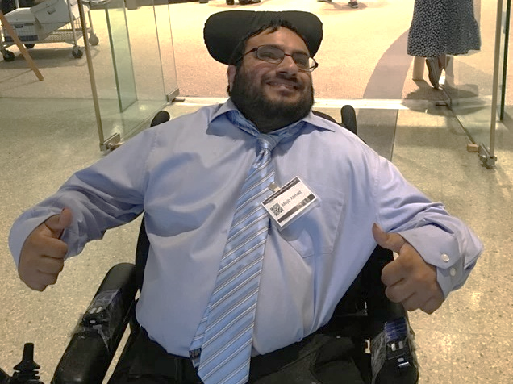
The day of…
Keep an open mind.
Be on time.
Bring a list of good questions.
Let the person lead as much as possible.
Take notes and communicate clearly to the rest of the team.
Plan, from the beginning, to fade staff support, as possible.
Think beyond just the worship service.

Slide 15
My Top 3 Takeaways
I needed to bring my whole self- professional and personal.
This was a great chance to affirm the expertise and follow the leadership of the person.
It was about faith but also about culture and community

Slide 16
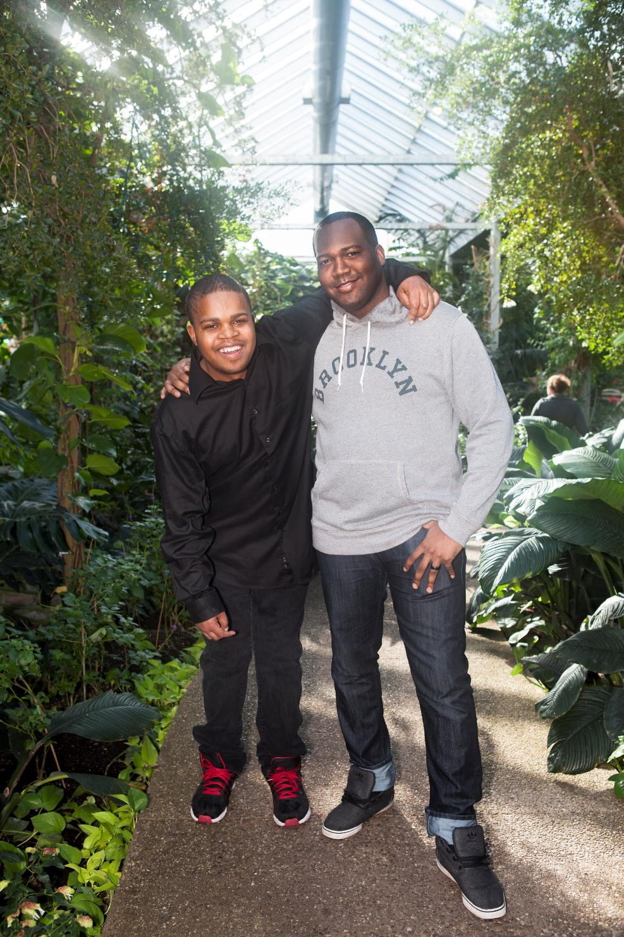
“DSP’s truly enjoy working with people with developmental disabilities and appear deeply committed to the nature of direct support work.”
~ Robert Hickey,
Queens University

Slide 17
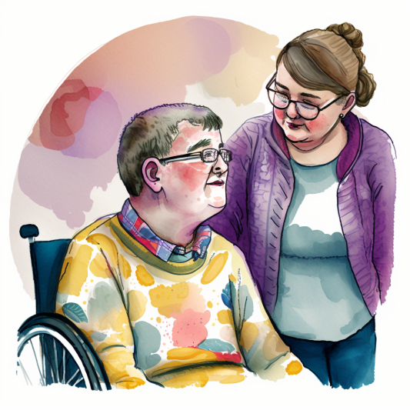
Bringing your whole self to work

Slide 18

Staying Ahead of the Robots, 101
Be value clear.
We are people first.
Know your professional responsibilities.
Know when to advocate for new, creative solutions to existing problems.
“It is vital to inject soul into bureaucracy.” ~ The Trampoline Effect

Slide 19
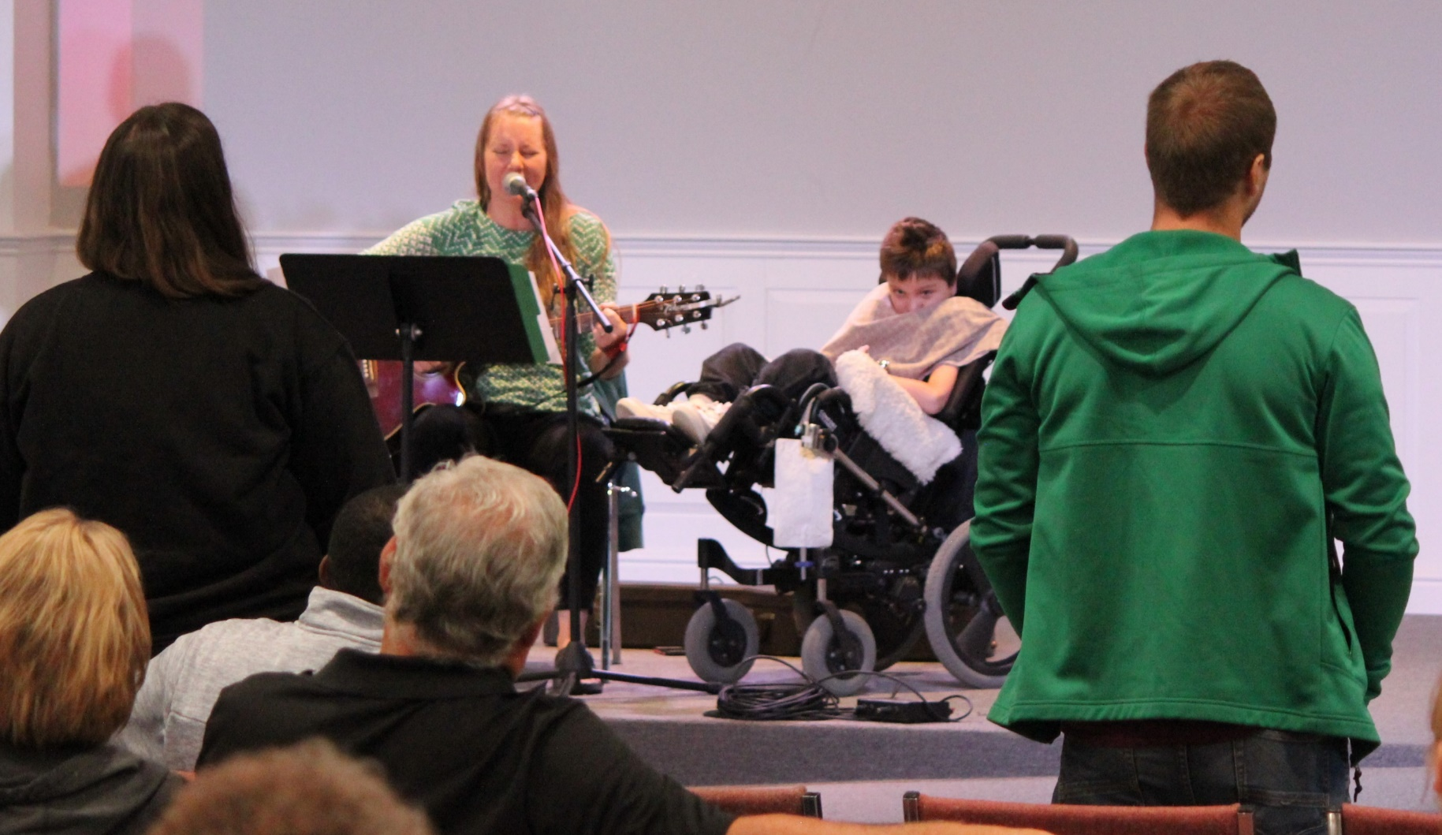
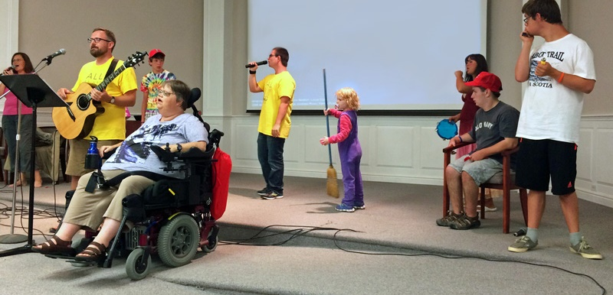

Family Camp
FAMILY
CAMP

Slide 20

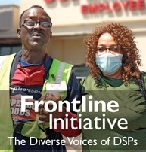

NADSP
NADSP
  E-Badge
  Frontline Initiative
  (Aug, 2022).

Slide 21
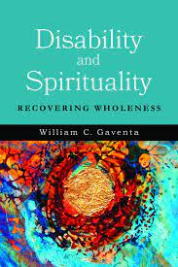
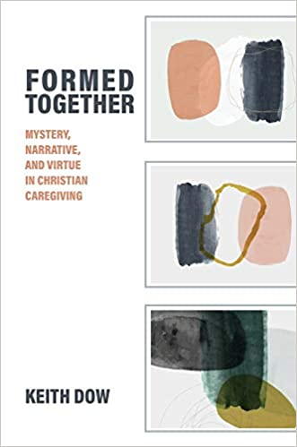
Books
Books

Slide 22
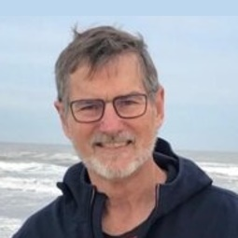
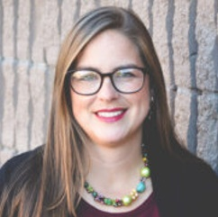
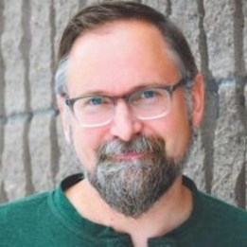
Direct Support Professionals:
Accompanying People in their Spiritual Journey
Bill Gaventa
billgaventa@gmail.com
Jasmine Duckworth
jduckworth@christian-horizons.org
Keith Dow
kdow@christian-horizons.org

Slide 23

Don’t Miss the Rest of the Series!
Join us for parts 2, 3, and 4 on March 15, April 19, and May 17
All webinars are 60 minutes and start at 2 p.m. ET / 11 a.m. PT
Learn More about the full series: RespectAbility.org/aaidd-2023-series/

