Slide 1
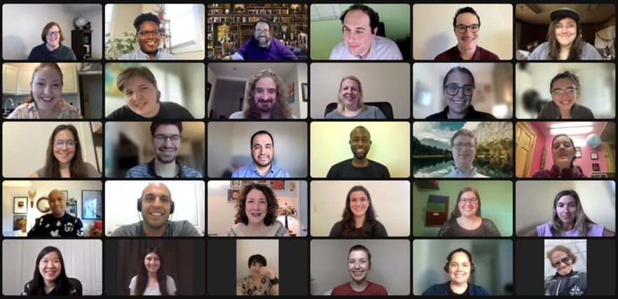
How to Advocate Within Your Business for Disability Employment
March 3, 2023

Slide 2
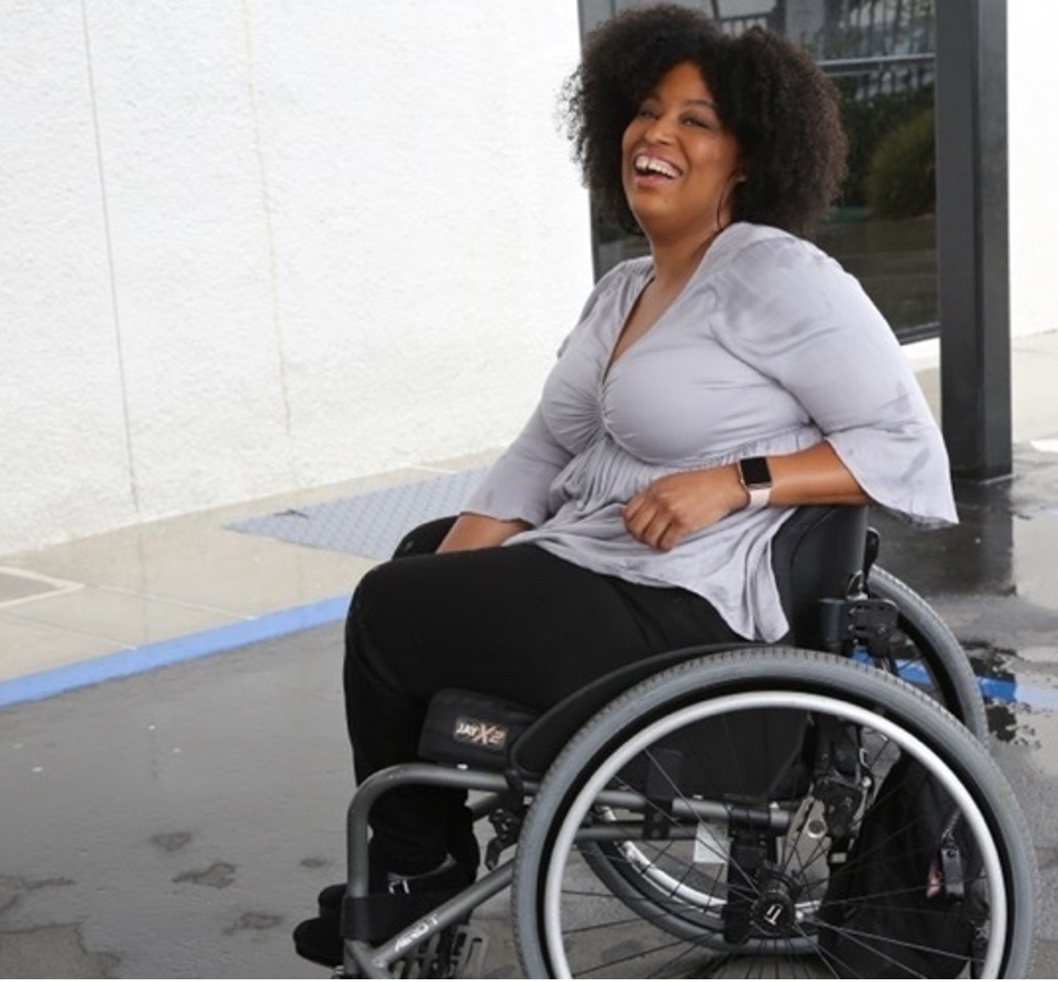
61 million people
61 million
people in the United States have a disability
1 in 4
adults have a disability
(physical, sensory, cognitive, mental health or other)
*Source: U.S. Census

Slide 3
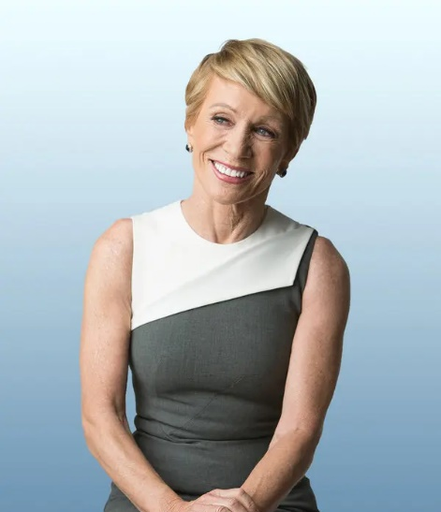




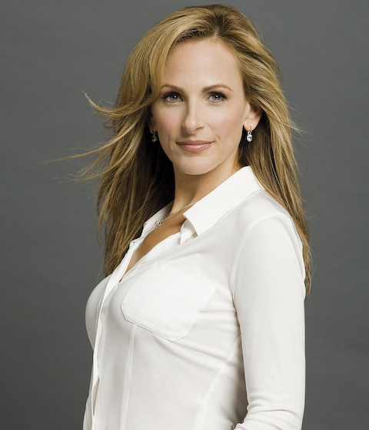

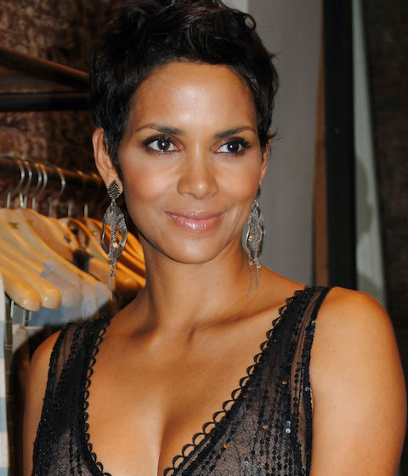


These are people with disabilities.
First row — Barbara Corcoran, Whoopi Goldberg, Richard Branson, Demi Lovato, Amanda Gorman
Second row — Marlee Matlin, Greta Thunberg, Halle Berry, Daymond John, Mariah Carey

Slide 4
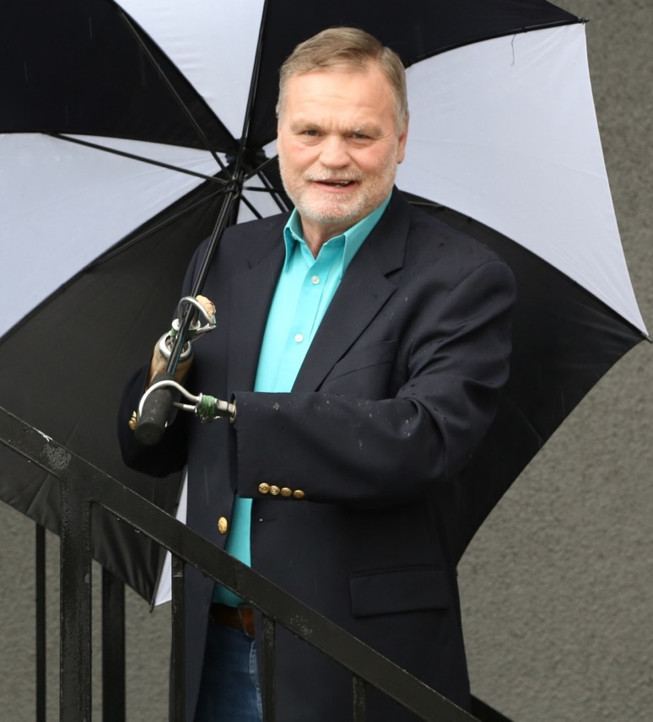
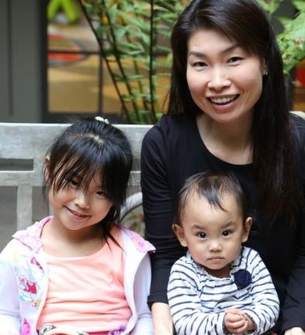
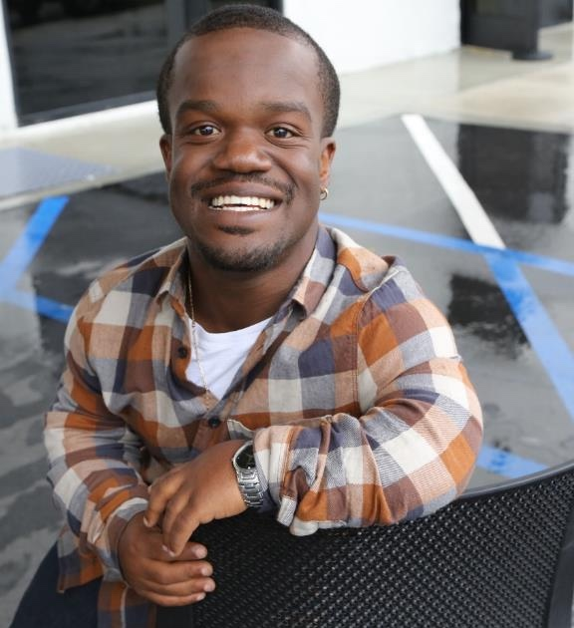
Disabilities are…
Temporary and Permanent
Visible and Nonvisible
From Birth or Acquired Later

Slide 5
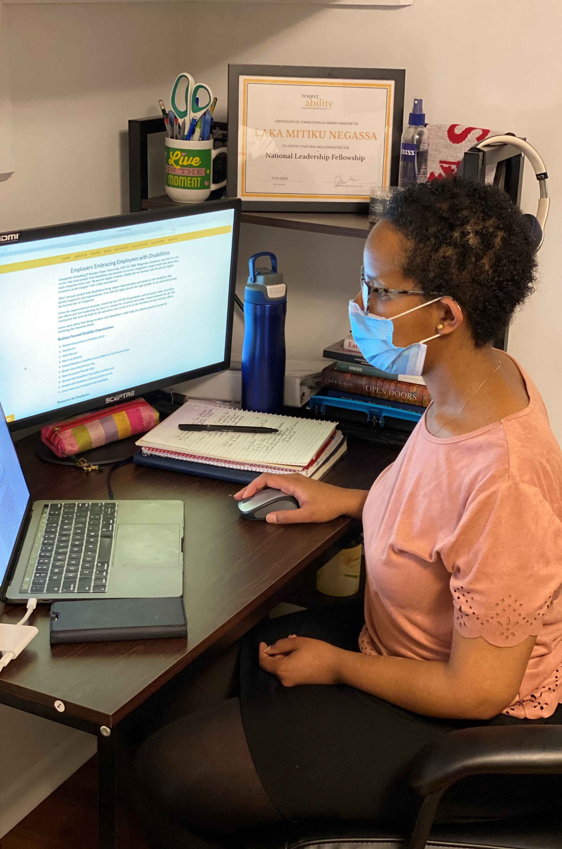
Three Facts
Anyone can acquire a disability
from aging, an accident, trauma, and/or illness.
Becoming an ally now can make adapting to having a disability easier.
People with disabilities are diverse and part of all communities.

Slide 6
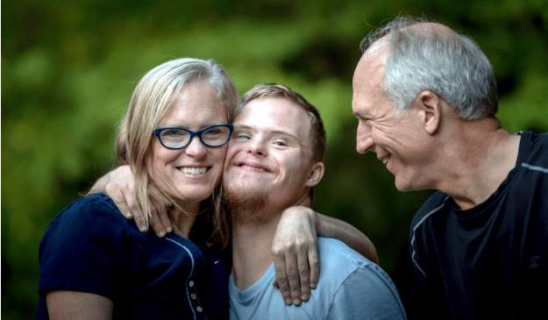

Americans are Connected to People with Disabilities
have a family member with a disability
have a close friend with a disability
48%
42%
* Source: September 2012 poll, Laszlostrategies.com

Slide 7
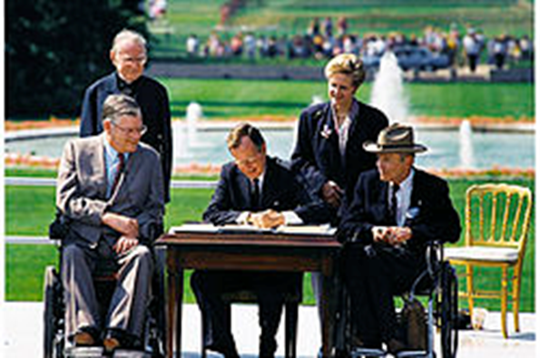
What is a Disability?
The Americans with Disabilities Act (ADA) of 1990 defines a person with a disability as a person who has a physical or mental impairment that substantially limits one or more major life activities.​
This includes people who have a record of such an impairment, even if they do not currently have a disability.

Slide 8
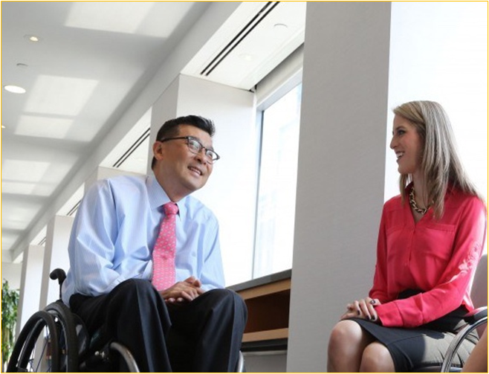
Defining the Problem
90% of companies prioritize diversity (2020 report)
80% of the 415 employers that participate in Disability:IN's Disability Equality Index list disability inclusion in diversity commitments (Bloomberg law)
Return on Disability Group’s primary research shows that only 27.5% of the 1,283 largest U.S. companies have publicly observable activity in relation to PWD (2020 Report: The Global Economics of Disability)

Slide 9
930 companies have no mention of disability at all!

Slide 10
Even the People that Prioritize Disability Miss Out on the Value

Slide 11

The Valuable 500
The 500 companies are publicly committed to putting disability on the business leadership agenda, increasing their organization's confidence and competence in disability inclusion. Collectively, the group represents over 22 million employees across 41 countries and brings a combined revenue of over USD 8 trillion (Valuable 500)

Slide 12
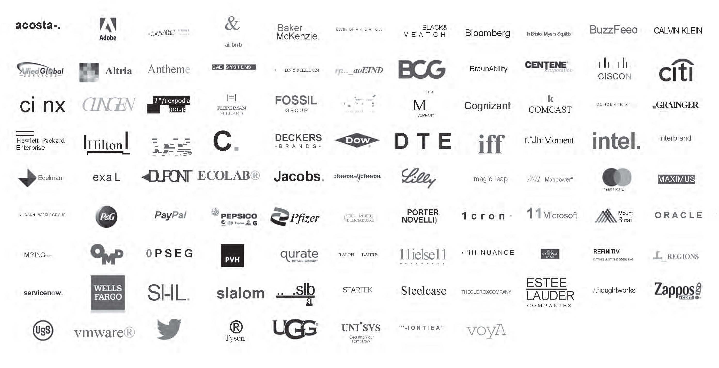
Some Valuable 500 Companies

Slide 13
Even the Valuable 500 isn’t getting as much value as they could
87% of the Valuable 500 included a section on social investment and/or diversity, equity, and inclusion efforts in their annual report as reported in 2022 (Valuable 500).
Only 56% mention their participation in the Valuable 500 in their annual report (Valuable 500).
Only 54% of companies said their organization has a disability inclusion accessibility policy in place versus 58% in 2020.
Even 56% of companies that have a public commitment to disability are missing accessibility

Slide 14
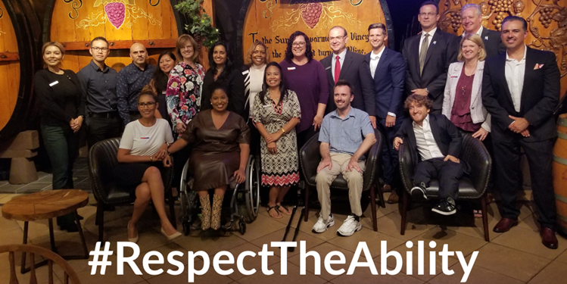
This Creates a Massive Opportunity
This doesn’t support their stated priorities
Recruitment is a top priority for a lot of companies – 74% of companies reported that they highlight the fact that they are an inclusive employer when advertising (Valuable 500).
Companies report that they are actively investing in services and support for disabled employees. For example, 70% have a resource network and/or a support group in place (Valuable 500).
This means that you have a solution that your employer wants.

Slide 15
Learning Objectives
If you are attending this training today, more than likely you already believe in the value of disability employment. At the same time, the previous slides show that you have something that your employer is looking for. What we will give you today is:
The messages that work in a business context
How to back them up with data
How to address the concerns that your colleagues may raise

Slide 16
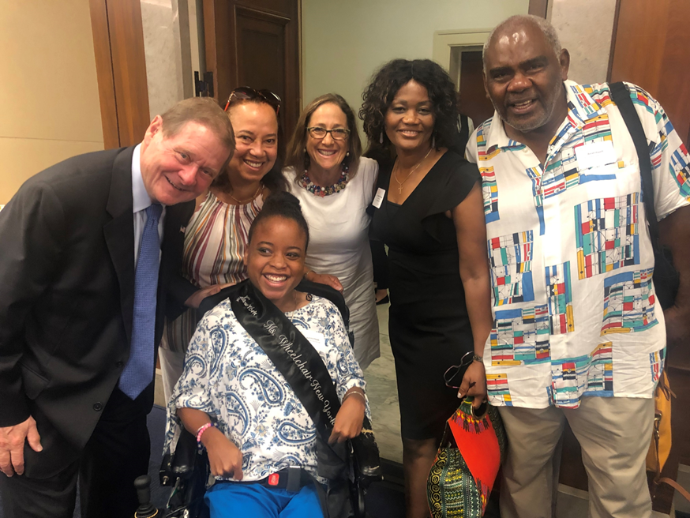
People Like to be Sold on Positivity
RespectAbility has done more than 10 years of research about the messages that resonate
92% of survey respondents agree with the idea that our communities are at their best when all people, including people with disabilities, have the opportunity to get skills, jobs and succeed.

Slide 17
People Like Messaging About Both Values and Value
In a RespectAbility study, these messages were found to be very convincing by a large number of respondents, both in and out of the disability community.
Message | Total | Disability Community
Our nation was founded on the principle that anyone who works hard should be able to get ahead in life. People with disabilities deserve to be able to work to achieve the American dream, just like anyone else | 58 | 62
Notes:
KGW: Unique talents (Disability community): 42 => 40
Reformatted

Slide 18
People Like Messaging About Both Values and Value (2)
Message | Total | Disability Community
Government policies that help people with disabilities get and keep jobs are a win-win because they allow people with disabilities the dignity and financial benefits of work and also grow our economy and save taxpayer money. | 41 | 42
We cannot afford to have more than 10 million Americans who are able to work sit at home and collect benefits when they could help make America stronger. Our current system costs 350 billion dollars a year and actually discourages people from working. It is not sustainable. | 38 | 38
Notes:
KGW: Unique talents (Disability community): 42 => 40
Reformatted

Slide 19
Other Ways to
Make the Point
Companies including JPMC, Starbucks and Bank of America have shown that employees with disabilities are loyal, successful and help them become more profitable. If we find the right people for the right jobs, it can increase the bottom line of all sorts of companies.
Government policies that help people with disabilities get and keep jobs are a win-win because they allow people with disabilities the dignity and financial benefits of work. Those same policies also grow our economy and save taxpayer money.

Slide 20
How Do I Create a Positive Message?

Slide 21

Focus On Talent and Customers
People with disabilities have problem-solving experience, as well as loyalty to their employers.
Companies that recruited and supported talent with disabilities have a much higher profit margin.
Untapped talent pool.
Know your customers!

Slide 22

The Disability Market is Huge, and Skews Older
With an estimated population of 1.85 billion, people with disabilities (PWD) are an emerging market larger than China.
The prevalence of disability above age 65 is 51.8% 2020 Report: The Global Economics of Disability).
Their friends and family add another represent another 3.3 billion potential consumers with disability-motivated purchasing behaviour.

Slide 23

It Represents a Huge Amount of Money
As consumers, people with disabilities represent a market the size of the United States, Brazil, Pakistan and Indonesia combined and a disposable income of more than $13 trillion, as noted by the Return On Disability Group. (Harvard Business Review & 2020 Report: The Global Economics of Disability)

Slide 24
2020 Global Economics of Disability
Category | Statistic
U.S. average income | 63,179
U.S. average disposable income | 47,818
Disposable/Total income | 76%
PWD/Total population income | 0.907
% of PWD working age | 67%
# PWD age 16-65 | 53,381,900
Implied PWD average income | 57,303.35
Implied PWD disposable income | 43,370.93
Historical participation rate | 59%
Current employment rate | 93%
# of PWD Employed | 29,394,078
Aggregate PWD income | 1,684,379,217,273.88
Aggregate PWD disposable income | 1,274,848,373,852.11

Slide 25
It’s Also a Huge Whitespace
Of the 1,283 top US companies analysed for “The Global Economics of Disability”, only 3.6% are acting to create shareholder value ie with a market focus.
This creates an incredible opportunity to market to the 73% of the marketplace that disability touches impacting the creation of both shareholder and social value (2020 Report: The Global Economics of Disability).

Slide 26
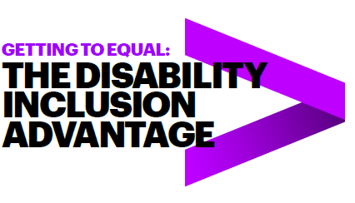
The Benefits of Disability Talent
Followed 140 US companies from 2015-2018
45 Inclusion Champions, 95 peer companies
Over four years, the Champions who embraced the talent of workers with disabilities vastly outperformed their peers. They had:
2X higher income
30% higher economic profit margin
Up to 30% less staff turnover
Read the full study online!
* Study completed by Accenture, Disability:IN and the American Association of People with Disabilities

Slide 27

How Do We Set People
Up to Succeed?
A reasonable accommodation is about enabling qualified talent with a disability to perform the essential (not ancillary) functions of a job, and enjoy the privileges and benefits of employment
Create an atmosphere where all employees are able to identify and ask for things that make them more productive, better employees.
If even senior level managers are open about their disabilities and/or tools they use, it may encourage other employees to do the same.

Slide 28
It’s Important to Know Employee Rights
Employers cannot ask if employees have a disability pre-job offer (can only ask in certain circumstances post job offer), but employers can ask if they need any accommodations to perform the essential functions of the job
Disclosure of disability status does not equate to a formal request for an accommodation
Employees’ right is to be accommodated in whatever reasonable way can help them to do the job, NOT to be excused from any of the essential functions of the job
Notes:
Add a picture

Slide 29
You Can Proactively Address Your Employer’s Concerns
Will not show up at work most of the time​
Will not be able to complete job tasks timely​
Will not be able to understand the needs ​ of my customers
My insurance rates will go up​
Will not be able to engage with other employees properly​
Will not be able to be disciplined or fired

Slide 30
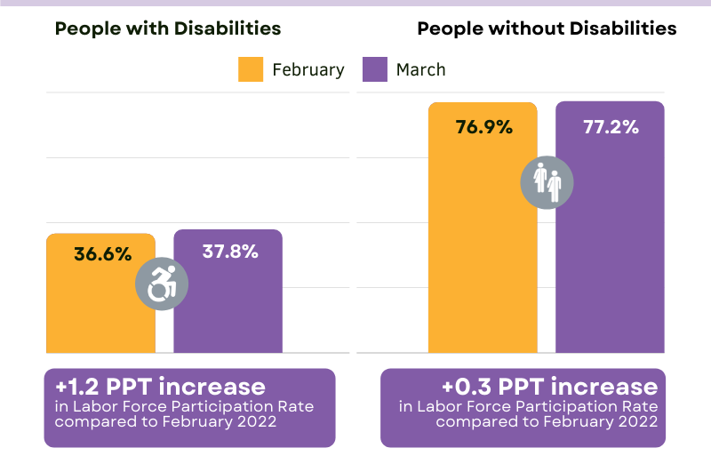
A Huge Talent Pool!
As of March 2022, the labor force participation rate for working-age people with disabilities is now 2 and a half percentage points higher than it was before COVID-19.
This means that people with disabilities are engaging with the labor force in higher numbers than before the pandemic.
Notes:
Skip over, mention briefly

Slide 31

Advancing Opportunities
There could be as many as 400,000 Americans with disabilities looking for new opportunities to earn an income and become independent.
Notes:
Skip over, mention briefly. Spend a little longer than the slide before

Slide 32
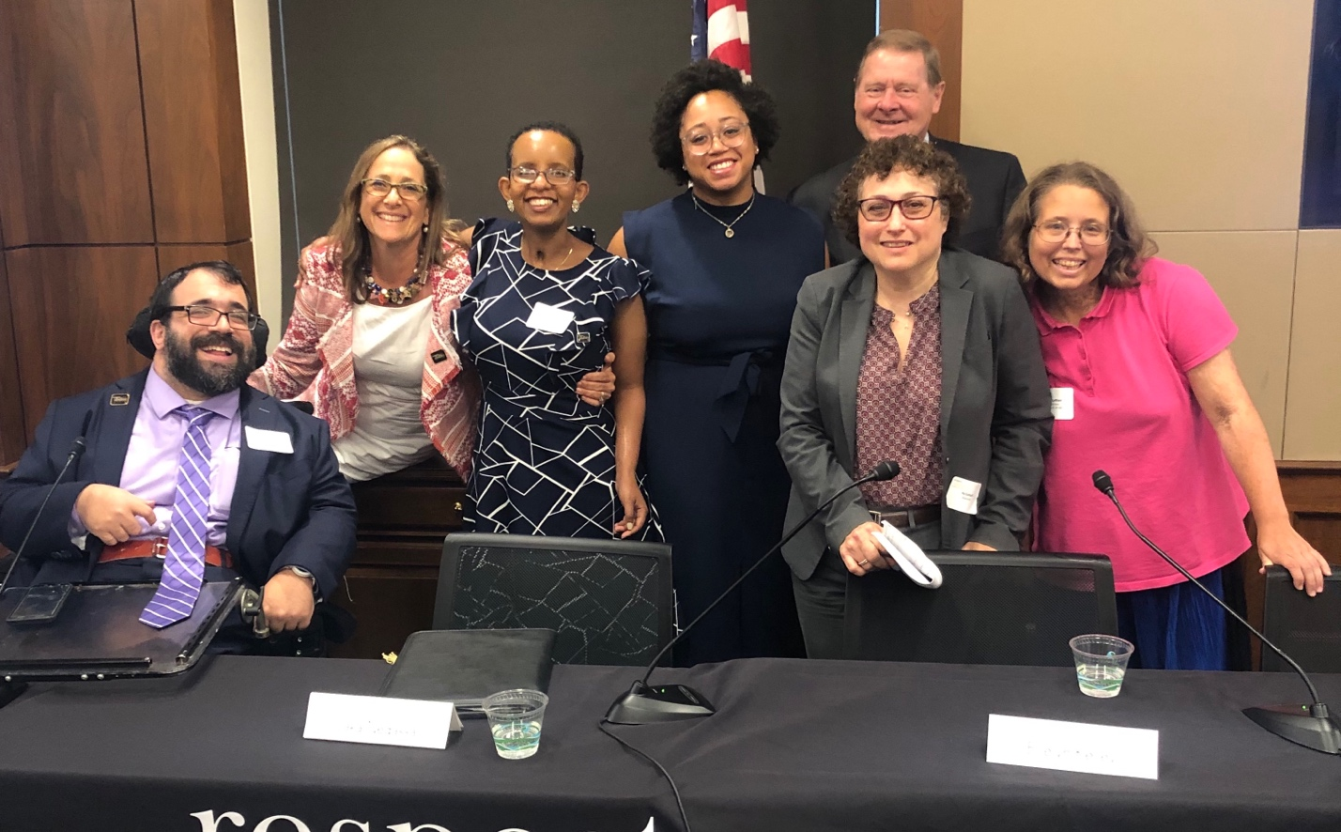
Questions? Thank You!
Presenter:
Matan Koch, Senior Policy Advisor, RespectAbility
For More Information:
Contact MatanK@RespectAbility.org
Link to Free RespectAbility Webinars

