Slide 1
Community Connectedness and Technology

Slide 2
Accessibility Notes
Turn on captions with CC button in Zoom.
You can pin the interpreter to ensure they are visible throughout the presentation.
To view live transcript in a separate window: https://carolinascaptioning.1capapp.com/event/respectability (link in chat box)
Please put questions for our speakers in the Q&A box.
This webinar is being recorded. After open captions are added, you will find it at RespectAbility.org/AAIDD-2023-Series/ (link in chat box)

Slide 3
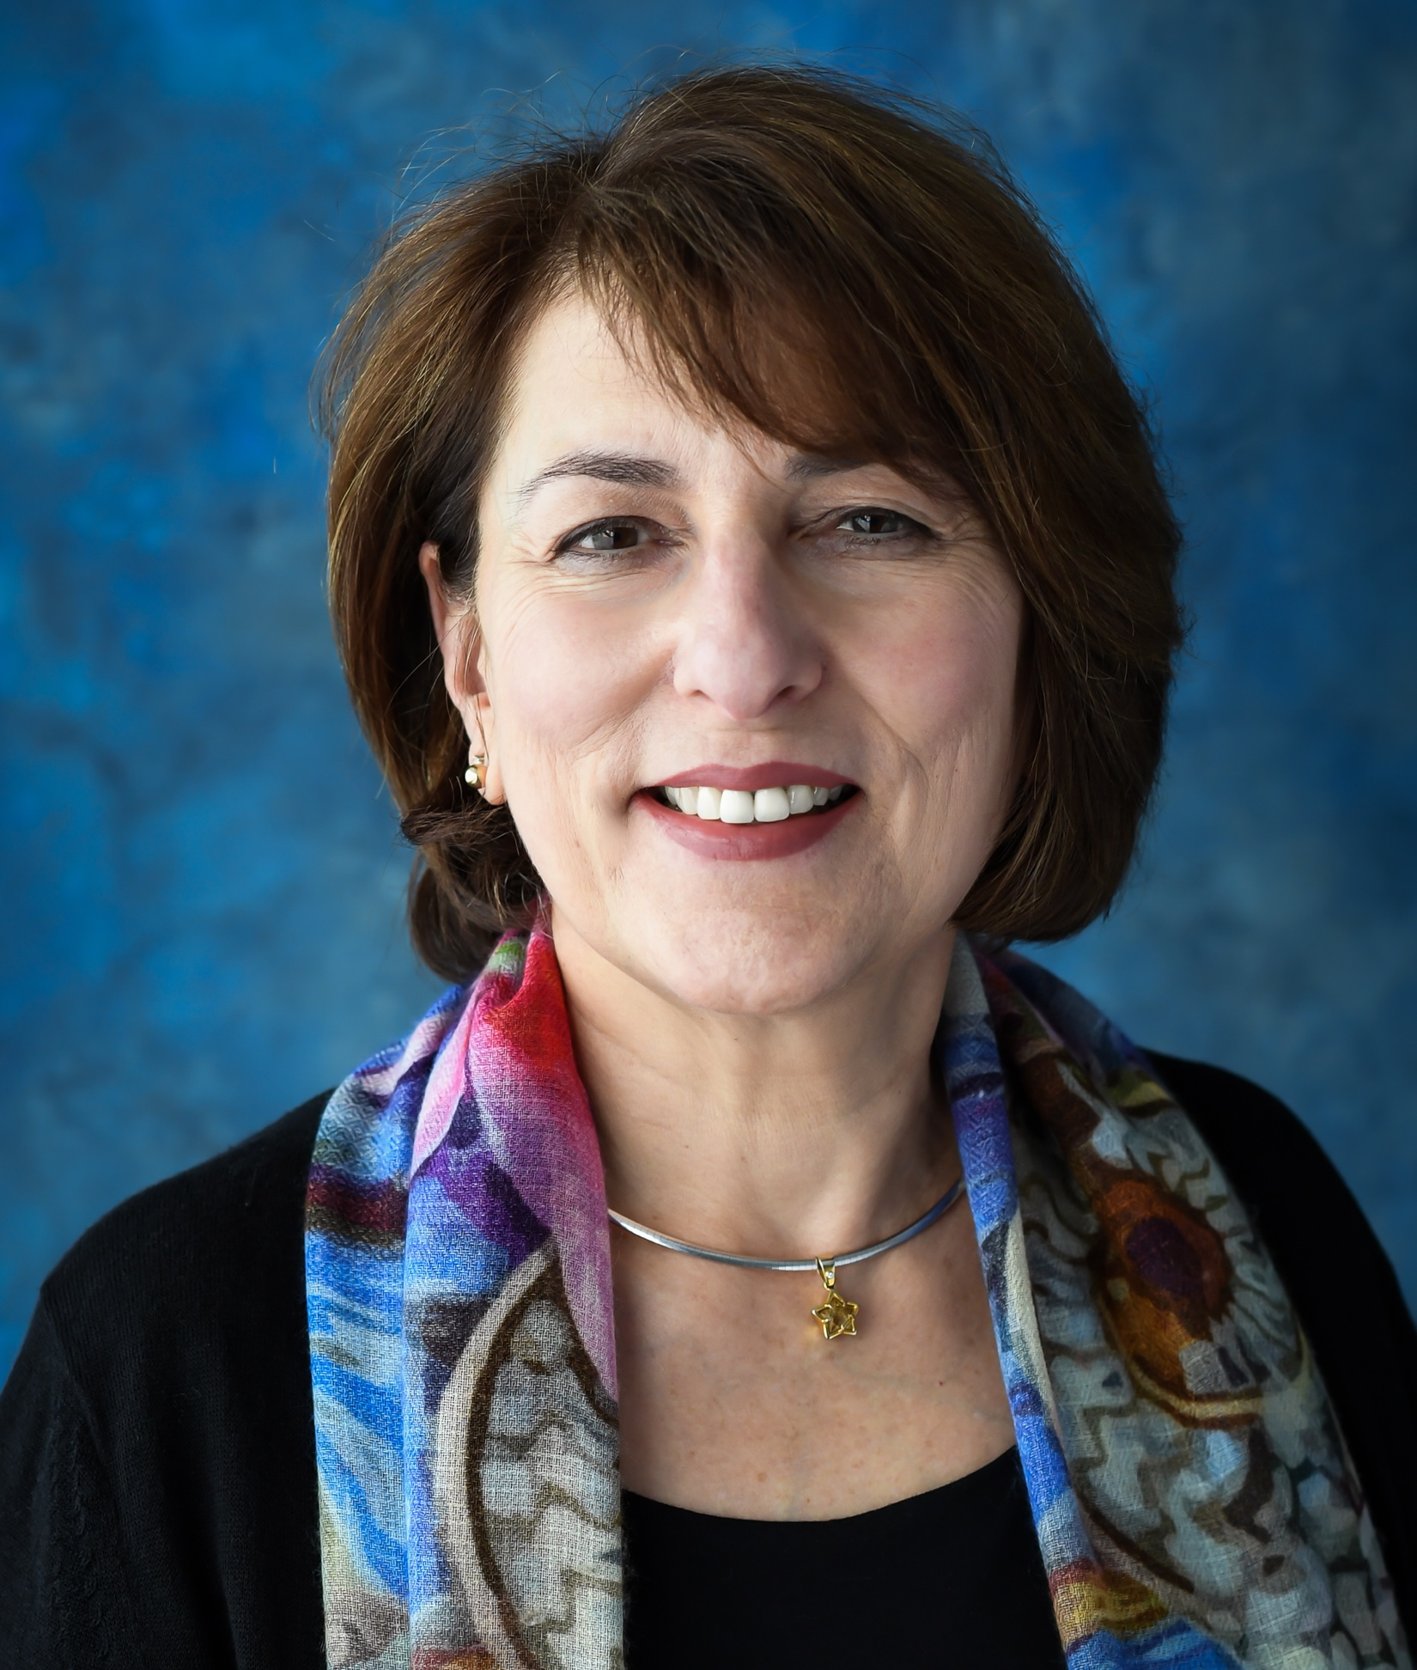
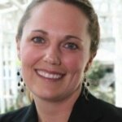
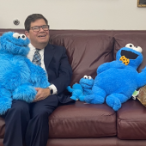
Speakers
Anne Masters, PhD, FAAIDD
Office for Pastoral Ministry with PWD for Archdiocese of Newark
Anne.Masters@rcan.org
www.rcan.org/disabilities
Emily Shea Tanis, PhD
Associate Research Professor
Kansas University Center in Developmental Disabilities
tanis@ku.edu
Rabbi Alan Cook
Sinai Temple
Champaign, Illinois

Slide 4
Agenda
Anne: Intro
What is spirituality, faith, & religion?
Why technology?
How to navigate faith communities?
Shea: Using technology to enhance participation in community settings
Rabbi Alan: Real-world examples
Anne Masters, PhD, FAAIDD
Archdiocese of Newark
Pastoral Ministry w/ Persons w/ Disabilities

Slide 5
Spiritual Assessment Domains – Meaning – Core Questions*
Belief & Meaning | Core values, beliefs, purpose, affiliation | “Who am I?”
Vocation & Obligations | Sense of calling | “Why am I?”
Experience & Emotions | How one experiences the divine, sacred, or demonic. Feelings about.
Courage & Growth | Sense of hope, sources to change beliefs.
Ritual & Practice | Personal & communal, relation to beliefs.
Community | Where and what are formal & informal networks of shared belief, practice, etc. | “Whose am I?” *George Fitchett, et al,
Authority & Guidance | Source of beliefs, guidance? | 7 x 7 model in Gaventa, Disability & Spirituality.

Slide 6
Human Beings …
Are SOCIAL and INTERDEPENDENT.
Grow through meaningful participation in life and appropriate supportive education.
To BELONG* is a basic need.
Present
Invited, Welcomed, Known
Accepted, Supported, Cared For
Befriended, Needed, Loved
To be UNDERSTOOD
Spirituality is nurtured.
*E. Carter, E. Biggs, and T. Boehm, ”Being Present vs. Having a Presence.”

Slide 7
Communication and Voice
Communication: process of exchanging information b/w individuals through a common system.
Communication is access, opportunity, power, justice.*
Voice: expressing a wish, choice, or opinion.
Voice: right of expression.
Can someone BELONG without a VOICE?
* https://Communicationfirst.org

Slide 8
YOU Are Important! Person-Centered Planning & Support
Supporting someone’s voice
Educating community
Nurturing beyond charity model of disability
Modeling interpersonal engagement and participation
Nurturing connections and natural supports
In-person over remote – assessing concerns

Slide 9
Faith Communities as Community Setting
Recall the many possibilities
Created in image of the Divine: source of respect and responsibility
Sense of congregation: website, bulletin, newsletter
Contact Pastor, Rabbi, Imam
Person Centered Planning – Identify natural supports
Think of roles rather than tasks
Opportunities for participation, relationships, interests
Worship – Choir - Social justice – Fellowship – Service - Education/formation

Slide 10
Community Connectedness and Technology
Shea Tanis Ph.D.
Kansas University Center on Developmental Disabilities
May 17, 2023
AAIDD Religion and Spirituality Webinar Series

Slide 11
Technology and Humanity
The ubiquity of technology is changing the world around us and how we must interact, survive, and thrive within that world. Some argue it is changing what it means to be human.
Religion©E.S. Tanis
Notes:
The conflict and harmony between technology and religion has spanned centuries. The new applications and advancements of technology solutions are making it difficult to ignore the scientific advancements that can be of benefit to faith communities.

Slide 12
Technology Interest Network

Slide 13
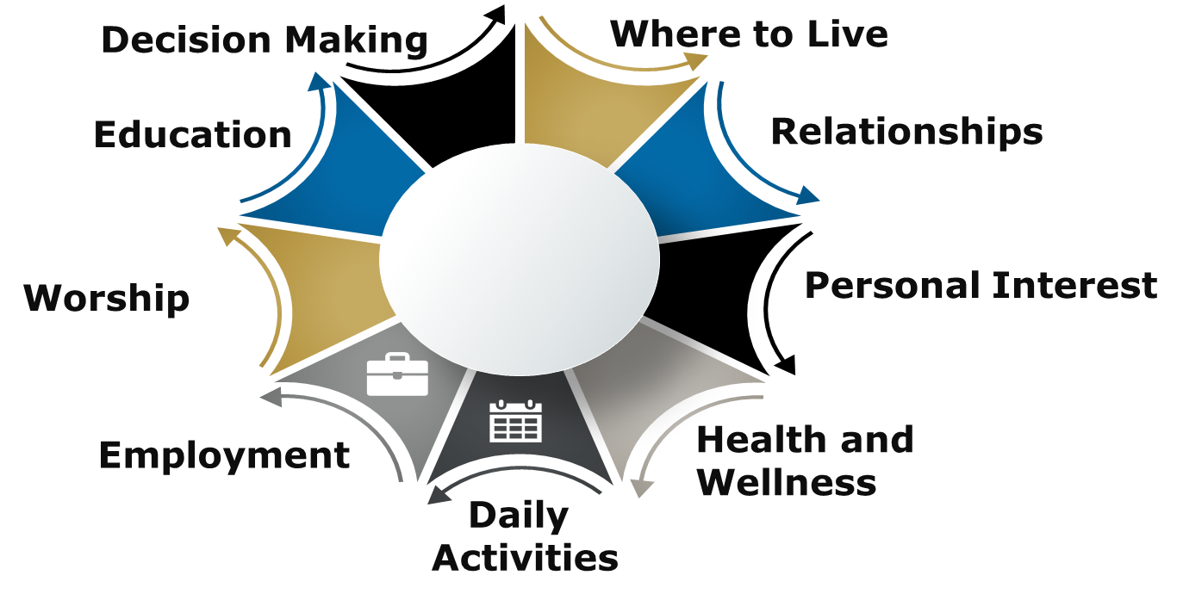
Domains of High-Quality Community Living
Religion©E.S. Tanis
Notes:
25th Anniversary of the ADA
Where and with whom a person lives;
Where a person works and how he or she earns money;
What a person does during the day;
The quality of the relationships developed with others during daily activities;
What and with whom a person does activities of personal interest
An individual’s health, both physical and emotional,
If, where, and with whom they worship
Their interest and opportunities to engage in learning and personal growth; and
Their ability to make informed decisions about their lives (Hewitt, 2014)

Slide 14
How We Experience Faith - Practice
Virtual religious services
Meditation technologies
Verse eBooks
Ethical technology
Religion©E.S. Tanis
Notes:
Not to discuss the contention of to become religion or a candidate for religion discussed in many forums since about 1999 but rather technology as a conduit and tool to share faith

Slide 15
Receptive and Expressive
INPUTS
OUTPUTS
Religion©E.S. Tanis
Notes:
Receptive vs. Expressive communication – Technology as a tool

Slide 16
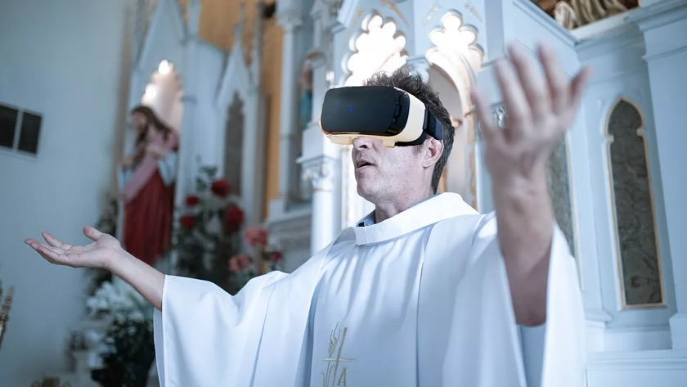
Receive Information – Sensory
Digital delivery – baked-in accessibility
Connected communities - togetherness
Mixed Realities
Haptic touch
Digital music
AI Sermon builders and religious searches
Religion©E.S. Tanis
Notes:
Not to discuss the contention between religion and technology or technology as a candidate for religion or entanglement, but rather the use of technology conduit and tool to share faith – an assistant
Chat GPT – Large language models – exploration about religious and faith communities word search driving.
Balance utility and implications
Robots will never replace rabbi’s because they have no soul – Robo Rabbi (open with verse ), SanTo Catholic robot; Buddist Kannon the goddess of mercy - Mindar

Slide 17
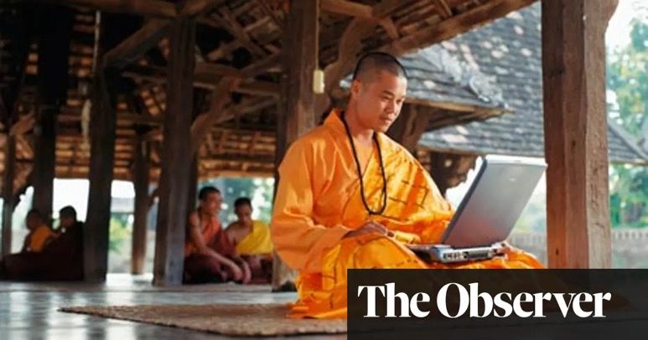
Outputs – Engagement
Communication Technologies – Various forms of expression
Connectedness – Accessible formats
Digital Art, music, and haptic touch
Transportation navigation
Religion©E.S. Tanis

Slide 18
Person-directed Process for Tech Solutions
Search for technology solutions that address and eliminate barriers
Identify environmental demands that may create barriers to goal achievement
04
Identify personal strengths/assets that will help achieve the goal
03
02
Individual goal setting
01
Religion©E.S. Tanis

Slide 19
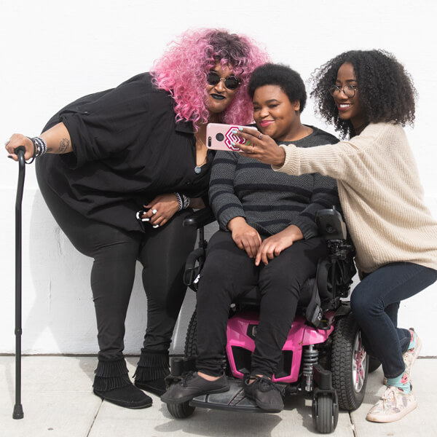
2023 Tech Disruptors
Spiritual Technologies
Datafication – something is turned into data
Virtualization – converting something to a computer-generated simulation of reality
Disabled and here collection https://affecttheverb.com/collection/
Religion©E.S. Tanis

Slide 20
Humanity
“People are going to realize that human beings are no longer the best purveyors of information…but what they can do that makes them distinctly human are those things that are precisely in the realm of religion and spirituality.”
- Rabbi Joshua Franklin
Religion©E.S. Tanis
Notes:
But in faith communities what

Slide 21
Rabbi Alan Cook
Sinai Temple in Champaign, Illinois

Slide 22
Passage 1
Speak to Aaron and say: No man of your offspring throughout the ages who has a defect shall be qualified to offer the food of his God. No one at all who has a defect shall be qualified: no man who is blind, or lame, or has a limb too short or too long; no man who has a broken leg or a broken arm; or who is a hunchback, or a dwarf, or who has a growth in his eye, or who has a boil-scar, or scurvy, or crushed testes. No man among the offspring of Aaron the priest who has a defect shall be qualified to offer Adonai’s offering by fire; having a defect, he shall not be qualified to offer the food of his God. He may eat of the food of his God, of the most holy as well as of the holy; but he shall not enter behind the curtain or come near the altar, for he has a defect. He shall not profane these places sacred to Me, for I Adonai have sanctified them.
Leviticus 21:17-23

Slide 23
Passage 2
לֹא־תְבַעֲר֣וּ אֵ֔שׁ בְּכֹ֖ל מֹשְׁבֹֽתֵיכֶ֑ם בְּי֖וֹם הַשַּׁבָּֽת׃ {פ}
You shall kindle no fire throughout your settlements on the sabbath day.
Exodus 35:2

Slide 24
Hineih Mah Tov
Hineih mah tov
u'mah na-im
shevet achim
gam yachad.
How good and how pleasant it is that brothers and sisters dwell together. (Psalm 133:1)

Slide 25
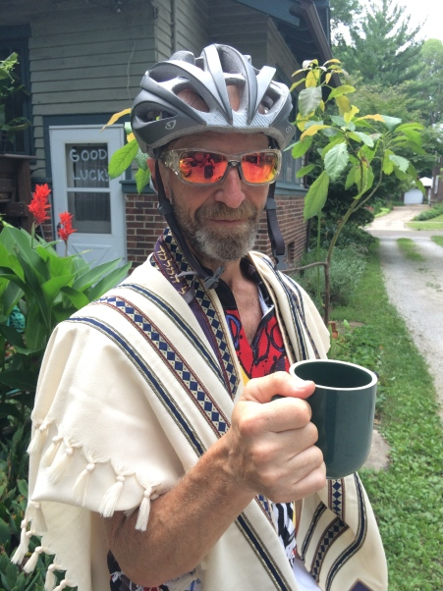
Photo

Slide 26
I am Ray Spooner, and this is my voice…

Slide 27
Ray reading the Torah
Notes:
Slide 27

Slide 28
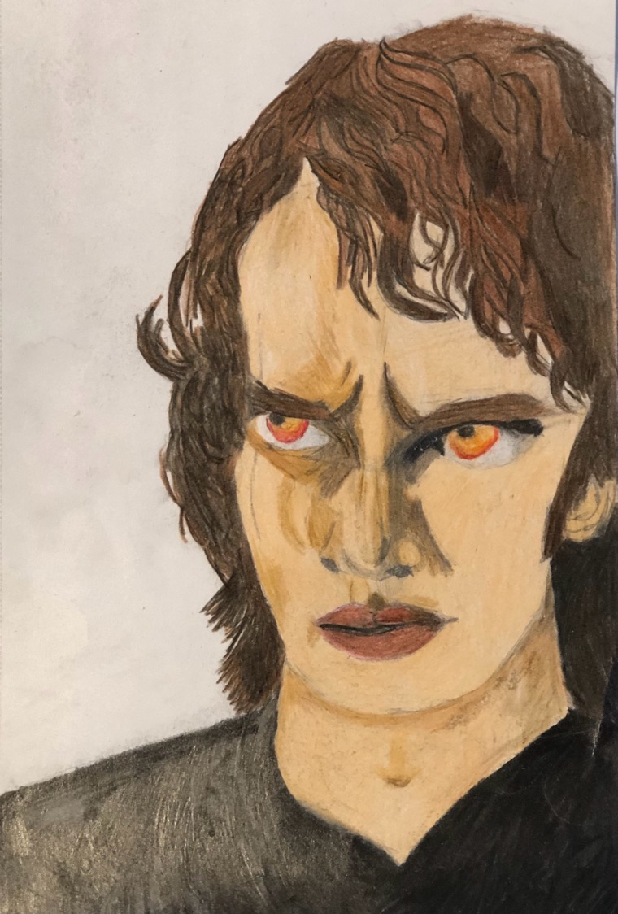
Anakin Skywalker
My Torah portion is Naso. It comes from the book of Numbers. Naso contains a number of stories. In fact, chapter 6 which is part of my portion is the longest chapter in the whole Torah! All the different stories in Naso talk about respecting each other and respecting God. But sometimes the Torah has to remind us not to be disrespectful to the people we care about. The part of my Torah portion that I studied made me mad when I learned what it was about. But I talked to my Dad and Sara about it and we thought about focusing this speech on eliminating suspicion and restoring trust. This made me think about Star Wars and Anakin Skywalker.

Slide 29
Anakin Skywalker 2
He became suspicious of Obi-Wan and Obi-Wan was suspicious of Anakin when he found out Anakin and Padme were married. Jedi aren’t supposed to be married but it is allowed for species that are going extinct. After Obi-wan found out, Anakin became bad. But later he was saved by his son, Luke. Luke trusted him to turn good and he turned good. He defeated the Emperor and restored trust. We see his ghost with other Jedis.
To me this means don’t betray the people you love because Anakin betrayed Padme and Obi-Wan and the rest of the Jedi by joining the Dark Side. Just like Anakin, you can always make amends and restore trust.

Slide 30
A Mandala from Pam Falcon Kennedy

Slide 31
Communication Device
Notes:
Slide 31

Slide 32
Augmentative and Alternative Communication System
Notes:
Slide 32

Slide 33
Postscript
Some more information.
Notes:
Later in his life, as Ray’s ALS robbed him of the ability to speak and be understood, he got very good at typing with the one finger with which he still had strength. He wrote a very meaningful (though sometimes profane) blog, which is archived on his website www.rayslittleride.com I highly recommend it for his theological insights.
Ray was a member of a more traditional sub-group in our congregation, which adheres a bit more strongly to the tradition of not introducing electronics into the service. Though in recent years (post-COVID) they have adopted leniencies based on the realities of the pandemic, at the time (2015), there were still members of this group that did not want to offer adaptations—not, they argued, because of any prejudice against Ray, but because of “tradition.” Tradition, even without ill intent, can sometimes become a stumbling block for accommodations. Ray proposed that he would like one final hurrah of reading scripture publicly, by playing a previously recorded sample of him reading. In the end, the philosophical and technological hurdles proved too challenging, and this did not happen. I would like to imagine that if we were encountering a similar issue today, we would be in a different place.
Blog post 12/31/2014 Whether we have a diagnosis or not, there is a number to our days. The problems that we are going to face won’t change, but we can change how we face them. Because that’s ultimately who we are. Not a product of the challenges placed before us but a product of how we have faced those challenges.

Slide 34
Some Supportive Resources Communicating with People Using AAC
Communication Partner Strategies to Support Students Using Speech-Generating Devices in Inclusive Settings.
Biggs, E.E. “OPEPP Research Brief #2,” Ohio Partnership for Excellence in Paraprofessional Preparation, 1/23/2023. Click here for link.
Communication Bill of Rights. National Joint Committee for the Communication Needs of Persons with Severe Disabilities (NJC). Click here for link.
The Right to Communicate, Tennessee Kindred Stories of Disability. 2019. Click here for link.
Click here for OPEPP Researcher Interview with Elizabeth Biggs, author of above, Dept. of Special Education, Peabody College, Vanderbilt University.
CommunicationFIRST : a good resource for better understanding communication and voice for those who cannot speak. https://communicationfirst.org/
Focus On: Speaking with Someone who Uses AAC. Communication Matters, UK. 2015. Click here for link.

Slide 35
Some Resources on Spirituality & Disability
William C. Gaventa, Disability and Spirituality: Recovering Wholeness. Baylor University Press, 2018.
Supporting Spirituality e-badge, developed by AAIDD Religion & Spirituality Interest Network for NADSP. Click here for link to learn more.

Slide 36
Technology Extending Ray’s Cycling Days
“My mechanic Drew has it set up so I can run the front and rear shifting off one side. … both the front and rear brakes running off the right lever.”
“A prosthetic maker and a group of engineering students from the University of Illinois worked with Ray,” trying to figure out how to keep my left hand from popping off the handlebars every time I hit a bump in the road while at the same time allowing me to move freely from aerobars to handlebars.”*
*From Ray’s Blog, www.rayslittleride.com, September 22, 2015. Picture posted October 18, 2015.

Slide 37
More on Communication
Later in his life, as Ray’s ALS robbed him of the ability to speak and be understood, he got very good at typing with the one finger with which he still had strength. He wrote a very meaningful (though sometimes profane) blog, which is archived on his website www.rayslittleride.com I highly recommend it for his theological insights.
Pam Falcon Kennedy is available as a resource, particularly for anyone working with augmentative and alternative communication devices by email pam.kennedy@live.com.

