Slide 1

Disability in the Gospel of John

Slide 2
Elizabeth Hastings Quote
“With all the respect due to the ten lepers, the various possessed, and the sundry blind, lame, and deaf faithful of scripture, I reckon people who have disabilities may have been better off for the last two thousand years if Our Lord had not created quite so many miraculous cures but occasionally said, ‘your life is perfect as it is given to you – go ye and find its purpose and meaning,’ and to onlookers, 'this disability is an ordinary part of human being, go ye and create the miracle of a world free of discrimination.’"
-Elizabeth Hastings

Slide 3

Terms
An impairment: a physiological and medical designation
Disability: a social phenomenon
Medical model of disability: says this impairment is a problem that must be fixed
Social model of disability: a society disables people with impairments when it refuses to take steps to ensure that all members of society have equal access to all benefits of that society

Slide 4
Cure vs. Healing
Cure: follows the medical model—it is the elimination of impairment. Experienced at the individual level
Healing: refers to the person who has experienced integration and reconciliation to self, God, and the community
Disability is a communally imposed limitation
Healing is a communally-based liberation

Slide 5
John 1:1-4
In the beginning was the Word, and the Word was with God, and the Word was God.
He was in the beginning with God.
All things came into being through him, and without him not one thing came into being. What has come into being in him was life, and the life was the light of all people.

Slide 6
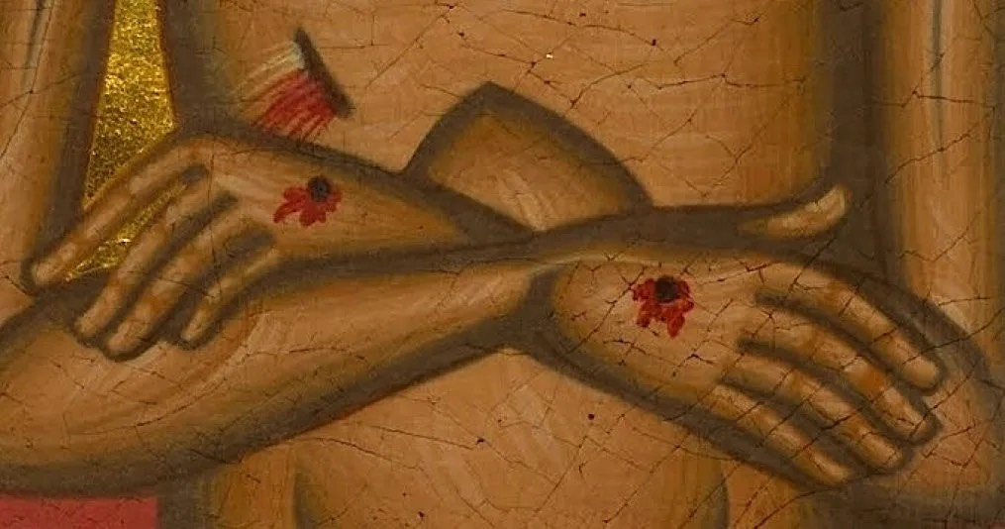
Nancy Eiesland Quote
  “I was overwhelmed by this image: God in a sip-puff wheelchair, the kind used by many quadriplegics that enables them to maneuver the chair by blowing and sucking on a straw-like device. Not an omnipotent, self-sufficient God, but neither a pitiable, suffering servant. This was an image of God as a survivor, as one of those whom society would label ‘not feasible,’ ‘unemployable,’ with ‘questionable quality of life.’”
– Nancy Eiesland

Slide 7
John 9:1-6
            ‘
As he walked along, he saw a man blind from birth.
His disciples asked him, "Rabbi, who sinned, this man or his parents, that he was born blind?"Jesus answered, "Neither this man nor his parents sinned; he was born blind so that God's works might be revealed in him. We must work the works of him who sent me while it is day; night is coming when no one can work. As long as I am in the world, I am the light of the world.” When he had said this, he spat on the ground and made mud with the saliva and spread the mud on the man's eyes, saying to him,

Slide 8
John 9:1-6 (Again)
"Go, wash in the pool of Siloam" (which means Sent). Then he went and washed and came back able to see. The neighbors and those who had seen him before as a beggar began to ask, "Is this not the man who used to sit and beg?” Some were saying, "It is he." Others were saying, "No, but it is someone like him." He kept saying, "I am the man.” But they kept asking him, "Then how were your eyes opened?” He answered, "The man called Jesus made mud, spread it on my eyes, and said to me, "Go to Siloam and wash.' Then I went and washed and received my sight.”

Slide 9
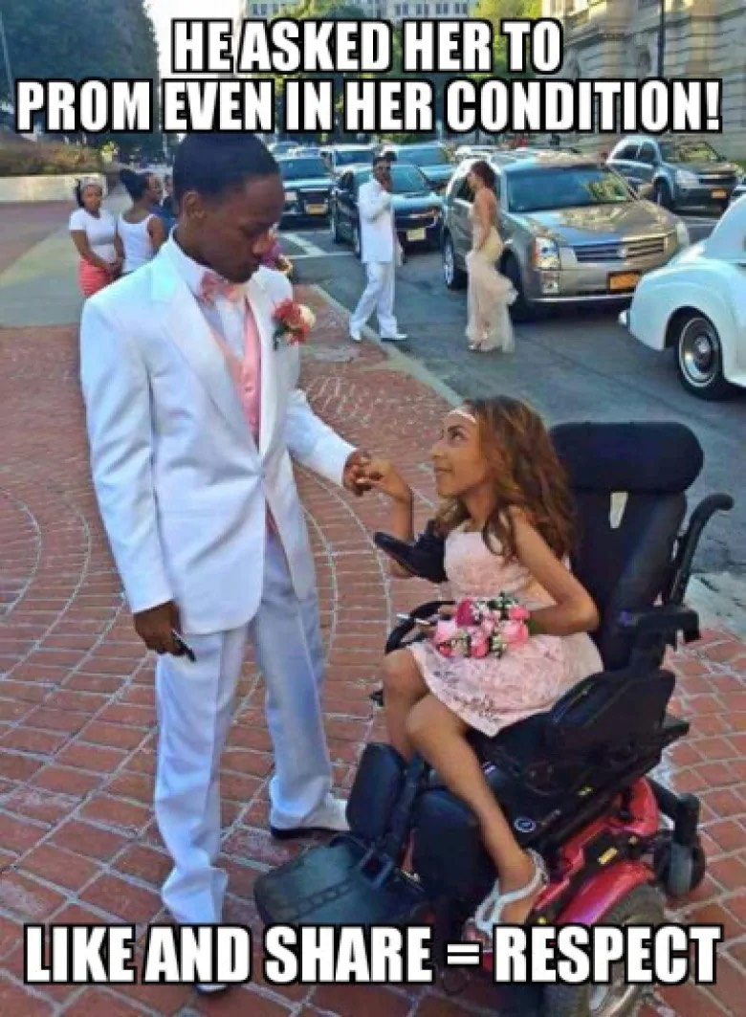
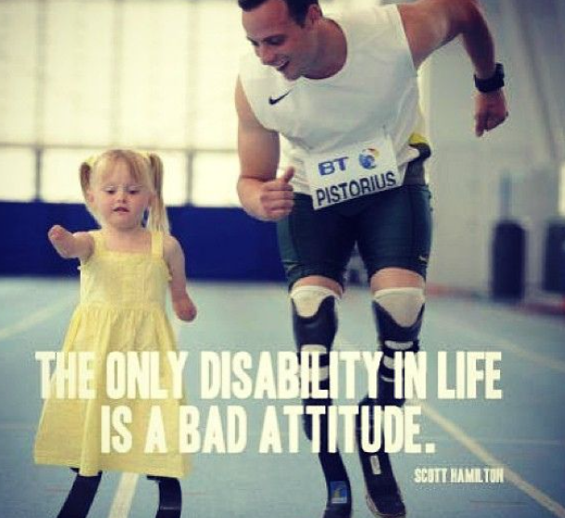
Inspiration Porn

Slide 10
Jesus Quote
Jesus answered: "Neither this man nor his parents sinned; he was born blind so that God's works might be revealed in him. We must work the works of him who sent me while it is day; night is coming when no one can work.

Slide 11
Jesus Quote 2
Jesus answered: “Neither this man nor his parents sinned. [He was born blind]. So that God’s works might be revealed in him, we must work the works of him who sent me while it is day. Night is coming when no one can work.

Slide 12
Questions
In light of this passage, in what ways can we work with God?
Are we to work on healing?
Who in this passage needs to be healed? The blind man? The disciples who don’t see that their biases disable the one with the impediment?
Does our ableist society need to be healed? How do we do that?

Slide 13
Verse 13
They [the crowd] brought to the Pharisees the man who had formerly been blind.

Slide 14
Questions 2
In light of this passage, in what ways can we work with God?
Are we to work on healing?
Who in this passage needs to be healed? The blind man? The disciples who don’t see that their biases disable the one with the impediment?
Does our ableist society need to be healed? How do we do that?
Have you noticed what parts of your community aren’t accessible, either in structure or in attitude? How you work for that change?

