Slide 1
Bible and Disability: Session 4
Disability in the Prophets (and Psalms): Mephibosheth and Disability Outside the Priesthood

Slide 2
Review: Moses as Disabled Leader
1. Moses had a ‘heavy mouth’ and tongue; also possible mobility impairment and difficulty stretching out hand?
2. In Exod 4: 10-12, speech impediments counted on same level with blindness, deafness, hearing, sight, and speech facility (all these words use Heb. qittēl form)
3. Nevertheless, Moses led

Slide 3
Review: Aaron as Cyborg
1. Aaron’s body, to function as High Priest, required “assistive devices”
2. Any of 12 visible bodily ‘blemishes’ (mumim) could disable a priest—but not deafness or muteness.
3. Two biblical disability categories emerge: mumim, ‘blemishes’, and ‘not’

Slide 4
Review: First Disability law
1. Leviticus 19:14: “You shall not revile the deaf or put a stumbling-block before the blind…”
2.‘Blind’ a mum, and ‘deaf’ a non-mum are head-terms for two biblical categories.
3. ‘Blind and lame’ word pair also names the Israelite category of ‘permanent’ disabilities (mumim).
4. Miriam experiences a temporary disability—scaly skin disease in a third category: tum‘a.

Slide 5
Review: Flipped: Disability as Punishment
Tuma‘a, ritual impurity, is not a punishment; Miriam’s case an exception
Num 5:11-31, the sotah, or suspected adulteress, reproductive organs prolapse or foetus miscarries, induced by ritual curse. An exception?
Deut 23:2 (v.1 English) Castrate expelled from congregation. Exceptional?

Slide 6
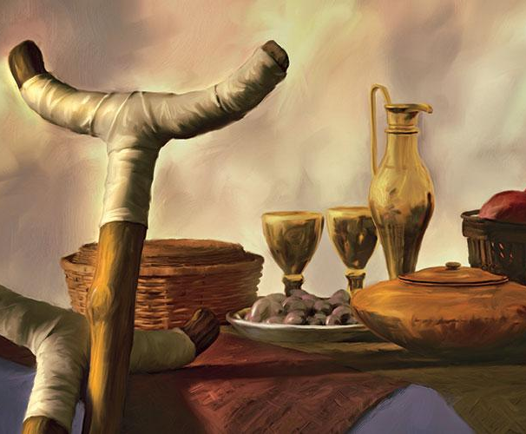
Mephibosheth, ben-Yonatan ben Shaul
“Lame in both feet” by trauma
2nd Samuel 9:13

Slide 7
Mephibosheth, lame in feet
From Saulide royal family—son of Yonatan
M’s feet injured in childhood trauma 2 Sam 9:4; lame in both feet v. 13
David favors him because of father
M pulled into coup attempt but offers excuse to David: “Your servant is lame” 2 Sam 25:16. Flipped: Lameness here an assistive device?

Slide 8
NationHOOD Promised to People with Lameness: Micah 4:6-7
On that day, says the Lord,
I will assemble the lame [tsole‘a = limping one = sheep with limited mobility]
and gather those who have been driven away,
and those whom I have afflicted.
⁷ The lame I will make the remnant,
and those who were cast off, a strong nation;
and the Lord will reign over them in Mount Zion, now and for evermore.

Slide 9
Flipped: Deafness promised to nations:
Micah 7:15-16
As in the days when you came out of the land of Egypt,
show us marvellous things.
¹⁶ The nations shall see and be ashamed
of all their might;
they shall lay their hands on their mouths;
their ears shall be deaf

Slide 10
Metaphorization of disability
J. Blake Cooey:
Limited mobility disability, as metaphor for trauma of exile
Projects on disabled people qualities of helplessness and dependency
Jacob is also tsole‘a Genesis 32:32 (v.31 Eng) after wrestling. Encounter with God disables?

Slide 11
more metaphors & flips
“The visual experience in Micah 7:16 “results in loss of other sensory capacities”
Meetings with God can be disabling !

Slide 12
More metaphors in isaiah
Isaiah 1:5-6: God strike’s Judah’s body –sets up disability as major imagery in Isaiah
Isaiah 3:1, 8: nation as lame person; leaders as crutch
Isaiah 6:6-7: Isaiah’s lips burned to enable speech
Isaiah 6:9-10: “Listen, but don’t comprehend”; “see but do not know” –People’s self-inflicted disability?

