Slide 1
Bible and Disability: Session 3
The First Disability Law (and some others)

Slide 2
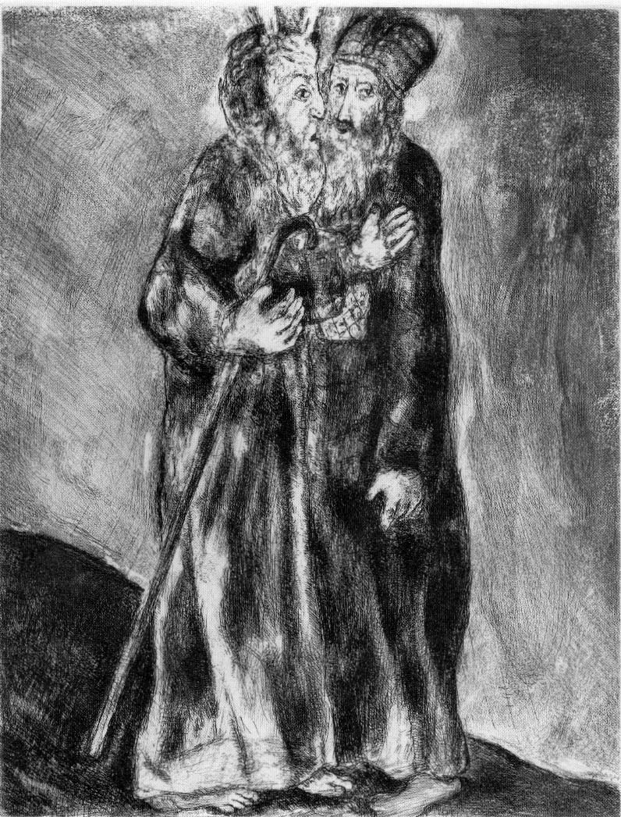
Moses meets Aaron

Slide 3
Review: Moses as Disabled Leader
1. Moses had a ‘heavy mouth’ and tongue; also possible mobility impairment and difficulty stretching out hand?
2. In Exod 4: 10-12, speech impediments counted on same level with blindness, deafness, hearing, sight, and speech facility (all these words use Heb. qittēl form)
3. Nevertheless, Moses led

Slide 4
Review: Aaron as Cyborg
1. Aaron’s body had to be modified—enabled by ‘assistive devices’—for him to function as High Priest
2. Any priest could be kept from priesthood by one of 12 visible bodily ‘blemishes’ (mumim)—but not deafness or muteness.

Slide 5
Review: Aaron as Cyborg, cont’d
3. Two biblical disability categories emerge: mumim, ‘blemishes’, and ‘not’
4. Any Israelite—woman, man, child, disabled priest, etc.—could undertake a Nazirite vow and participate in sacred ritual.
5. A workaround!

Slide 6
The First Disability law
Leviticus 19:14:
“You shall not revile the deaf or put a stumbling-block before the blind; you shall fear your God: I am the Lord.”
Note the two ’head’ terms: ‘blind’ a mum, and ‘deaf’ a non-mum. Each category is named by it’s lead term. ‘blind and lame’ names the Israelite category of ‘permanent’ disabilities

Slide 7
The First Disability law, cont’d
Leviticus 19:14:
“Not revile”—are people with deafness hurt?
No stumbling block”
“I am the Lord”—associates this with First of Ten Commandments
Akin to “Love neighbor” in Lev 19:18?

Slide 8
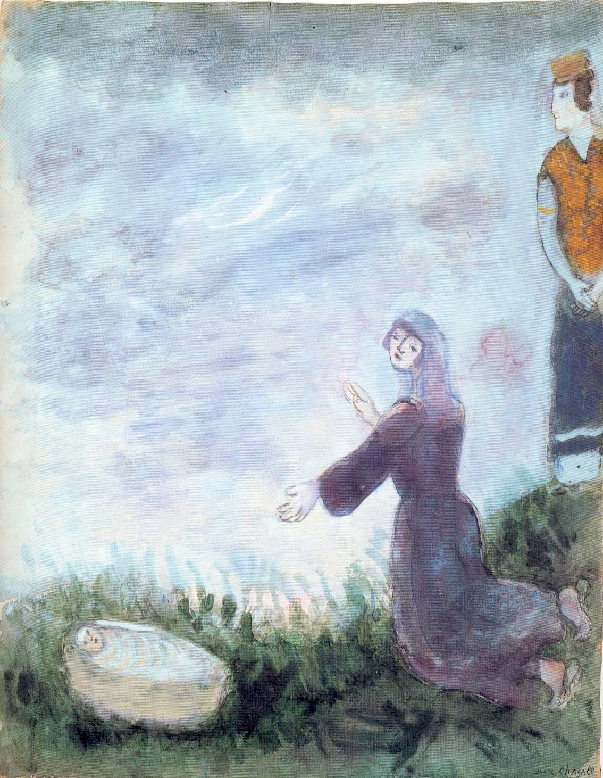
Miriam & Moses
Miriam is the third leader (Micah 6:4)

Slide 9
Miriam meets temporary disability
Numbers 12:10-11:
10 When the cloud went away from over the tent, Miriam had become leprous [had scaly skin disease], as white as snow. And Aaron turned towards Miriam and saw that she was leprous [had scale disease]. 11 Then Aaron said to Moses, ‘Oh, my lord, do not punish us for a sin that we have so foolishly committed.

Slide 10
Temporary Disability from Impurity
Some impairing conditions in the Bible are ‘temporary’—e.g., impurities from natural causes: discharges, lochial flows after childbirth, touching corpses, and ‘scale disease’.
When these pass, ritual impurity is resolved by ritual—including for scale disease (Lev 13-14).
This is a third biblical category not like mumim and non-mumim.

Slide 11
Disability as Punishment
Ritual impurity is not a punishment; but the divine cause for Miriam’s was. Ouch!
So, we’re also facing uncomfortable things. Where do modern people get ideas like this?
Num 5:11-31, the sotah [suspected adultress], where reproductive organs prolapse or miscarriage induced by ritual curse. Ouch!

