Slide 1
Bible and Disability: Session 2
Aaron as Cyborg: Disabled Priests and the Nazirite Workaround

Slide 2
Review: Moses as Disabled Leader
1. Heavy mouth and tongue; also possible mobility impairment and difficulty stretching out hand?
2. Exod 4: 10-12 speech impediment counted on same level with blindness, deafness, hearing, sight, and speech facility
3. Evidence: use of qittēl noun form for Hebrew words related to disability

Slide 3
Review: Moses as Disabled Leader
4. “Aaron” as initial accommodation
5. Moses’ confidence & willingness to speak develops in Exodus and Leviticus
6. Disability as a literary “assistive device” in telling the biblical story

Slide 4
Aaron as Cyborg, Enabled
Hillel Said: “Be one of Aaron’s students … loving people and bringing them to the Torah”—Pirke Avoth 1:12
Leviticus 8:6-9, 12, 22-24, 30

Slide 5
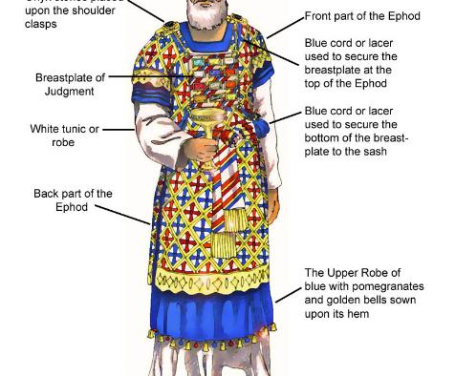
High Priest ‘s Garments

Slide 6
DIsabled Priests
Leviticus 21:18-21
¹⁸ For no one who has a blemish shall draw near, one who is blind or lame, or one who has a mutilated face or a limb too long, ¹⁹ or one who has a broken foot or a broken hand, ²⁰ or a hunchback, or a dwarf, or a man with a blemish in his eyes or an itching disease or scabs or crushed testicles. ²¹ No descendant of Aaron the priest who has a blemish shall come near to offer the Lord’s offerings by fire; since he has a blemish,

Slide 7
Disabled Sacrificial animals
Leviticus 22:21-24
^{21 …} there shall be no blemish in it. ²² Anything blind, or injured, or maimed, or having a discharge or an itch or scabs—these you shall not offer to the Lord or put any of them on the altar as offerings by fire to the Lord. ²³ An ox or a lamb that has a limb too long or too short you may present for a freewill-offering; but it will not be accepted for a vow. ²⁴ Any animal that has its testicles bruised or crushed or torn or cut, you shall not offer to the Lord; such you shall not do within your land,

Slide 8
Nazirite vow: who can do this?
Numbers 6:1-21
Full access to the altar: Num 6:13-18
Shaved hair burnt on the altar. But wither universal alopecia?

Slide 9
Nazirite vow: hair sacrifice
¹⁸ Then the nazirites^{[f]} shall shave the consecrated head at the entrance of the tent of meeting, and shall take the hair from the consecrated head and put it on the fire under the sacrifice of well-being. ¹⁹ The priest shall take the shoulder of the ram, when it is boiled, and one unleavened cake out of the basket, and one unleavened wafer, and shall put them in the palms of the nazirites,^{[g]} after they have shaved the consecrated head. ²⁰ Then the priest shall elevate them…

