Slide 1
The Bible and Disability:
Moses the Disabled Leader
David Tabb Stewart, Ph.D.
California State University, Long Beach

Slide 2
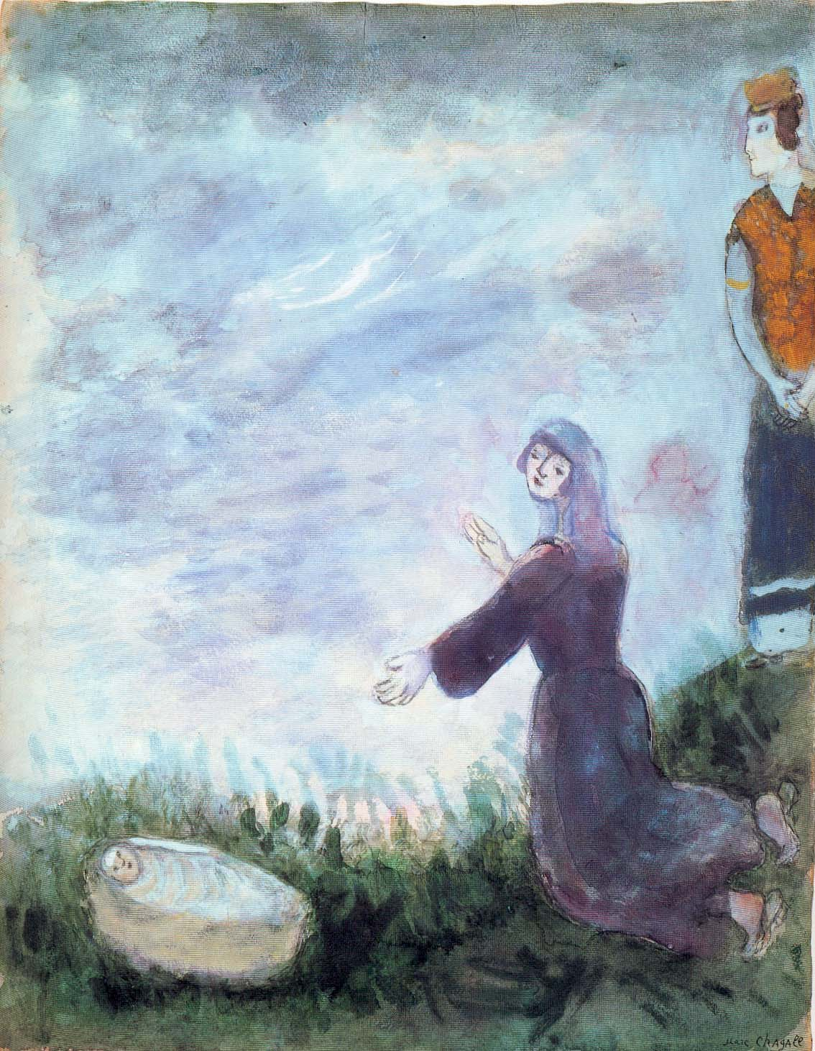
Miriam and Moses
Miriam and Moses

Slide 3
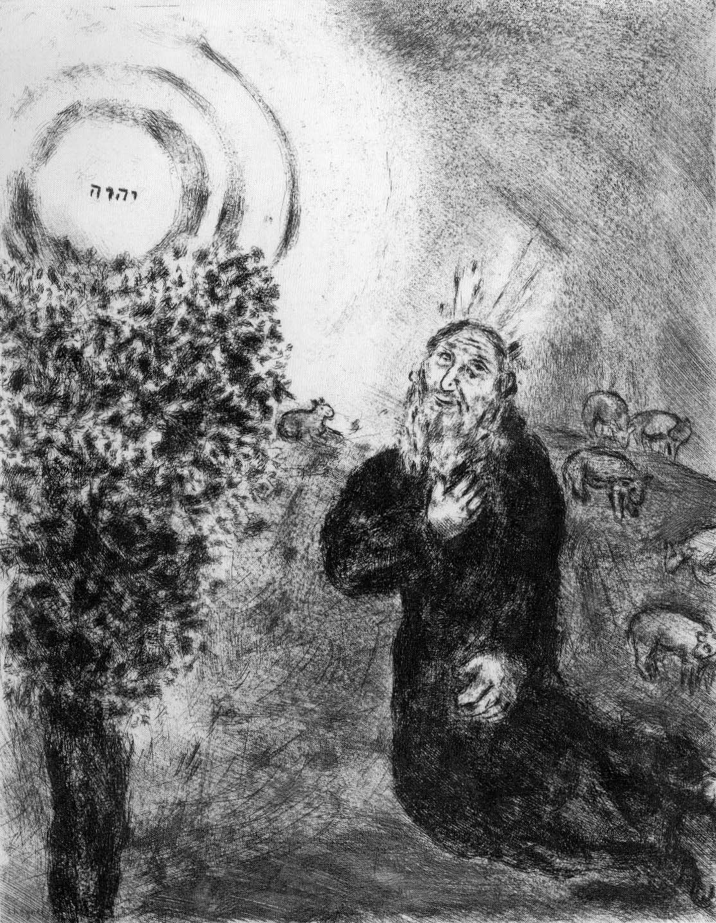
Moses and the Burning Bush
Divine Name
Moses and the Burning Bush

Slide 4
Exodus 4:10-12
¹⁰ But Moses said to the Lord, ‘O my Lord, I have never been eloquent, neither in the past nor even now that you have spoken to your servant; but I am slow of speech and slow of tongue.’ ¹¹ Then the Lord said to him, ‘Who gives speech to mortals? Who makes them mute or deaf, seeing or blind? Is it not I, the Lord? ¹² Now go, and I will be with your mouth and teach you what you are to speak.’

Slide 5
Some Hebrew Terms
Heavy-mouthed = kebad-pe
Heavy-tongued = kebad-lishon
Mute = ˀillēm
Deaf = khērēsh
Perceiving, or literally “open” = piqqeākh
i.e. = open-mouthed, open-eared, open-eyed
Blind = ˁiwwēr
NOUN form = qittēl

Slide 6
An Accommodation: Exod 4:13-15
¹³ But he said, ‘O my Lord, please send someone else.’ ¹⁴ Then the anger of the Lord was kindled against Moses and he said, ‘What of your brother Aaron the Levite? I know that he can speak fluently; even now he is coming out to meet you, and when he sees you his heart will be glad. ¹⁵ You shall speak to him and put the words in his mouth; and I will be with your mouth and with his mouth, and will teach you what you shall do.

Slide 7
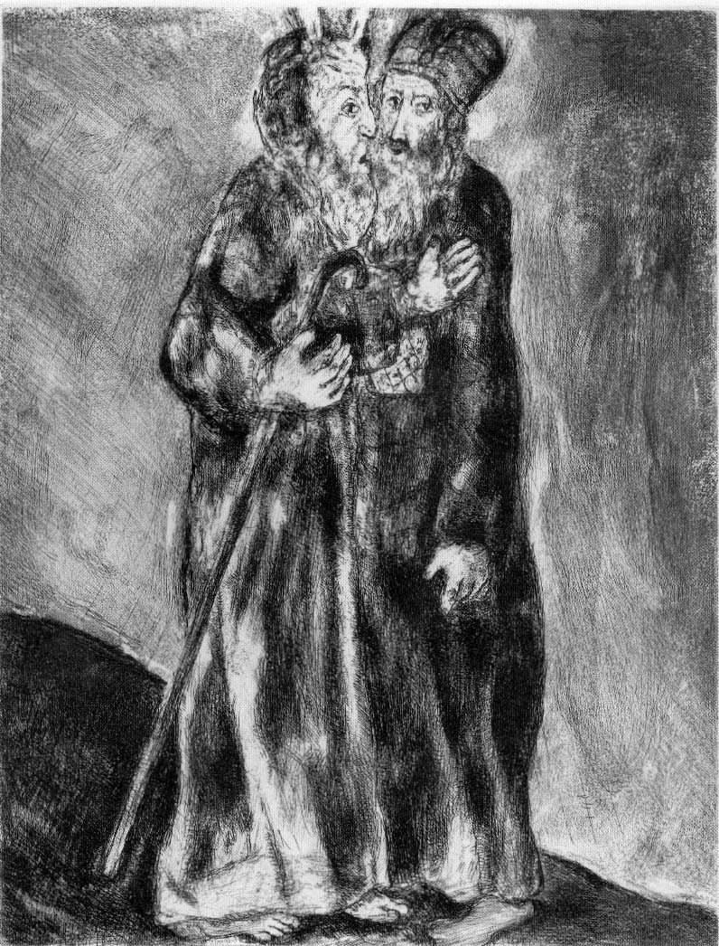
Moses Meets Aaron
Moses meets Aaron

