Slide 1
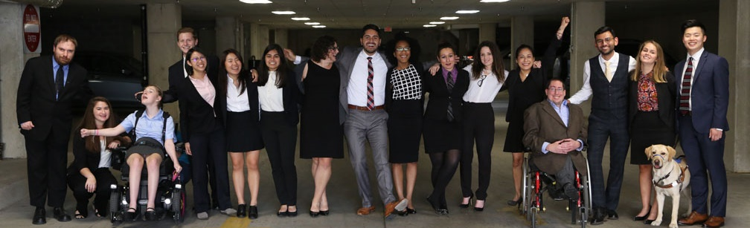
Accessibility in ERGs
Presented by Nick Sophinos and Ila Eckhoff

Slide 2
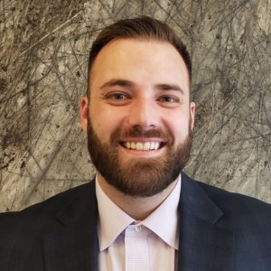
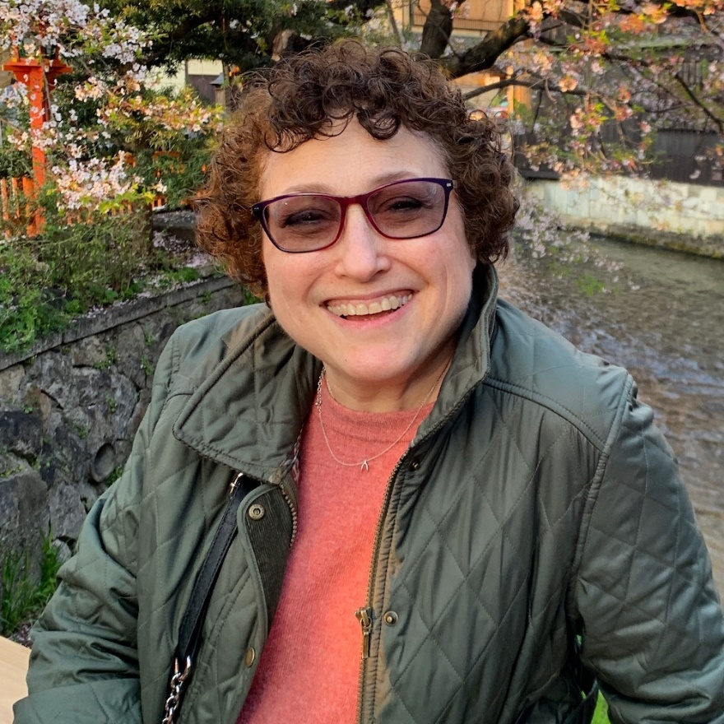
Today’s Speakers
Nick Sophinos (they/them)
Business Professional and Queer/Disability Advocate
Ila Eckhoff (she/her)
Corporate Disability Advocate

Slide 3
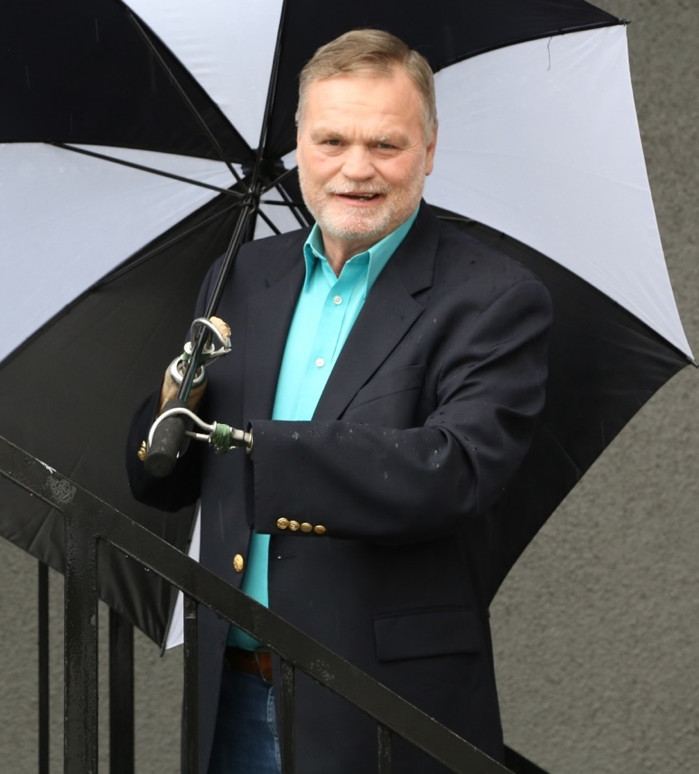
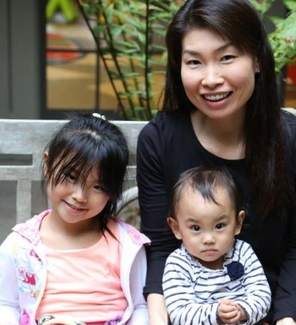
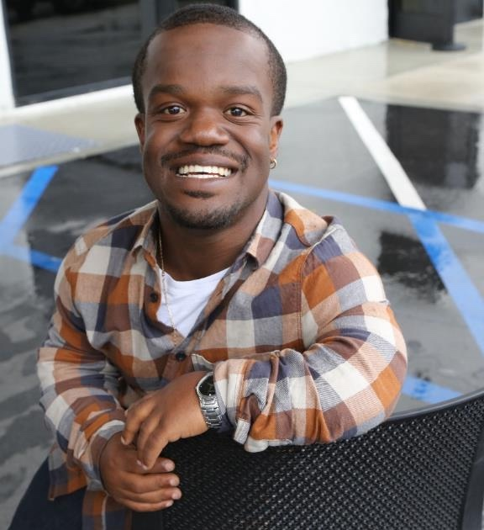
Disabilities are…
Temporary and Permanent
Visible and Nonvisible
From Birth or Acquired Later

Slide 4
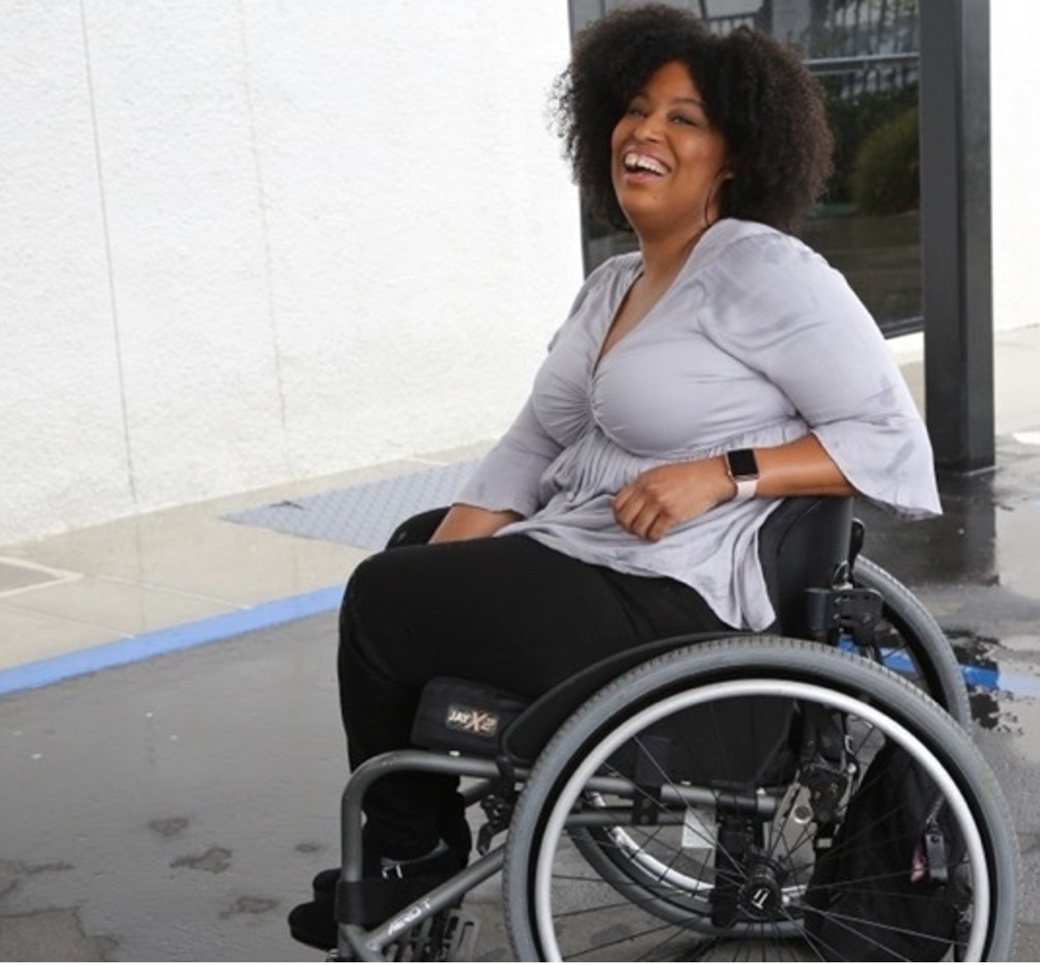


61 million people
61 million
people in the United States have a disability
1 in 4
adults have a disability
(physical, sensory, cognitive, mental health or other)
*Source: U.S. Census

Slide 5
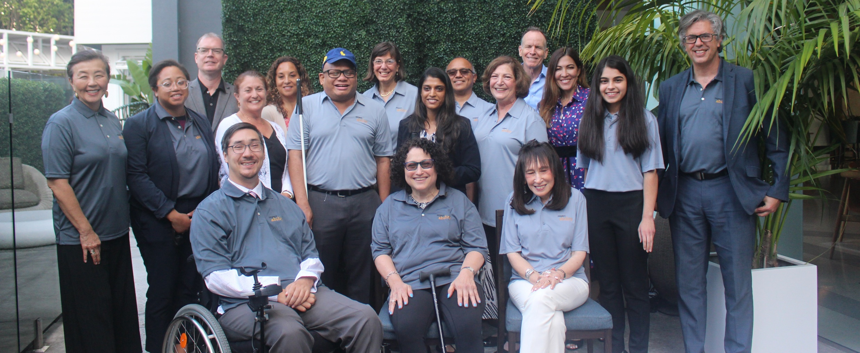
Importance of Lived Experience
Organizations are at their best when they welcome, respect and include people of all backgrounds. This includes people with disabilities.

Slide 6
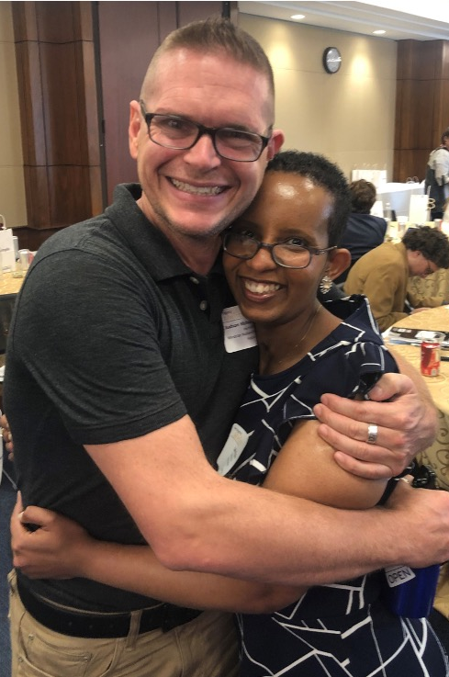
Three Facts
Anyone can acquire a disability
from aging, an accident, trauma, and/or illness.
Becoming an ally now can make adapting to having a disability easier.
People with disabilities are diverse and part of all communities.

Slide 7
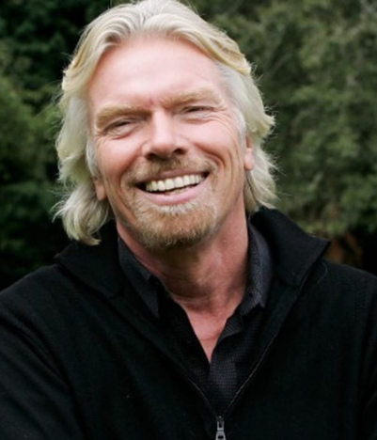
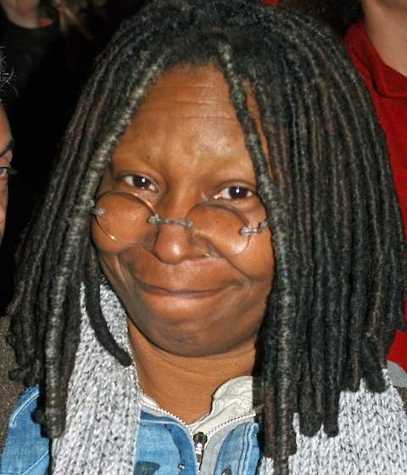
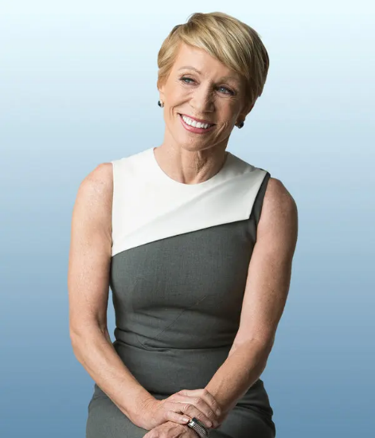
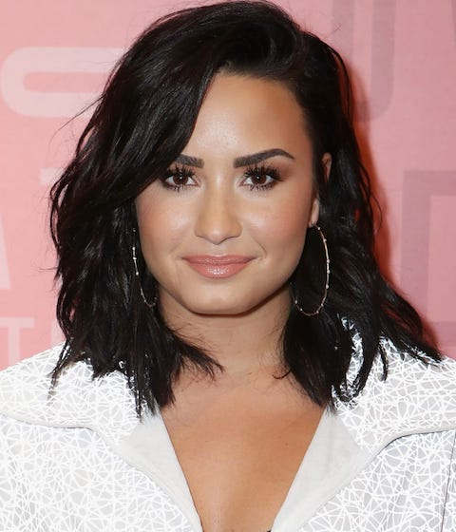
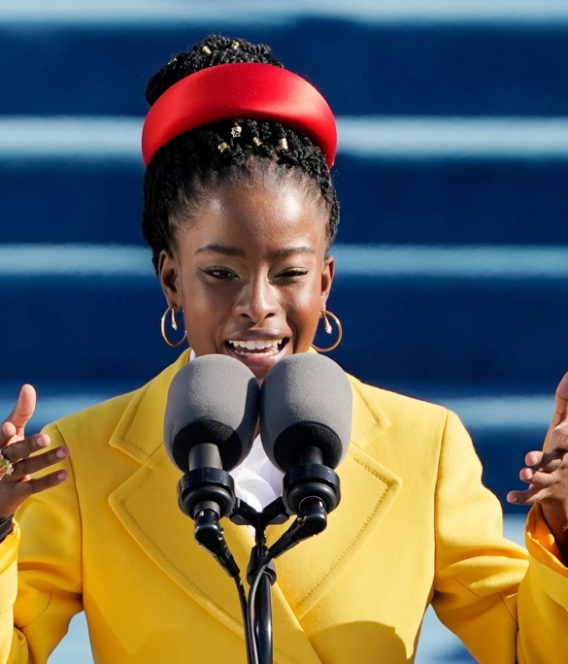
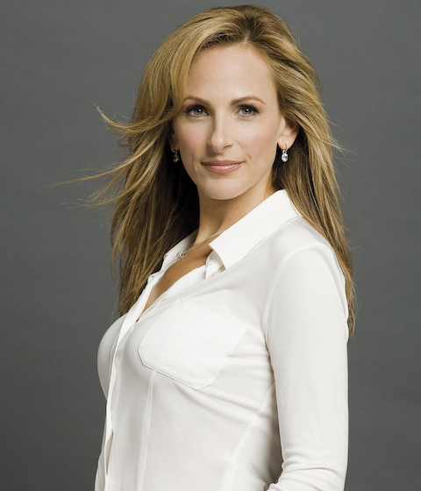
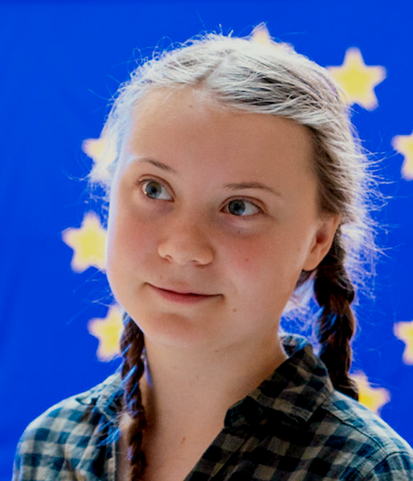
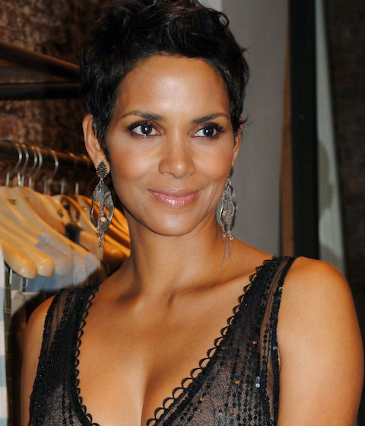
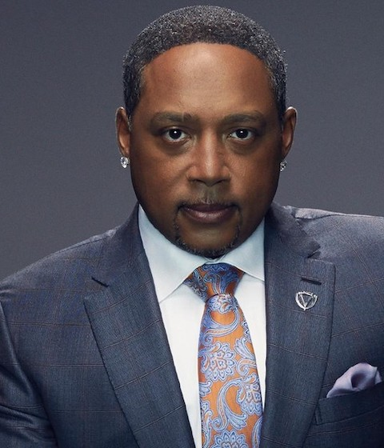

These are people with disabilities.
First row — Richard Branson, Whoopi Goldberg, Barbara Corcoran, Demi Lovato, Amanda Gorman
Second row — Marlee Matlin, Greta Thunberg, Halle Berry, Daymond John, Mariah Carey

Slide 8
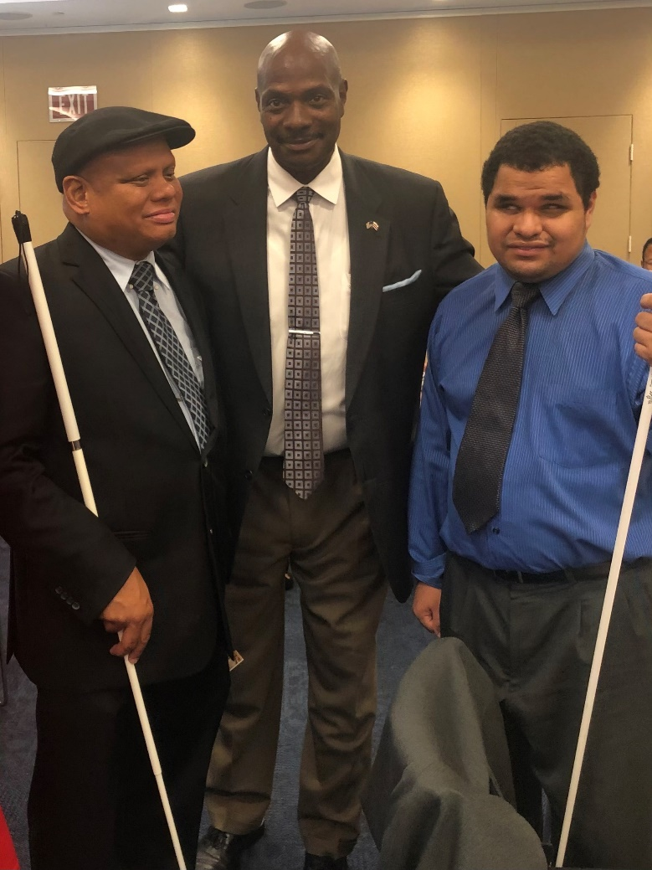
Reaffirm your ERG Commitment to Disability Inclusion
Make sure all ERG leads and sponsors understand the needs of people with disabilities
Advertise how you include disability in all ERGs
  Promote this in job postings, onboarding and all communications
  Make sure all communications are accessible so you can appeal to the disability community
Invest in learning and development around disability
  Utilize intersectionality in ERGs regarding disability

Slide 9
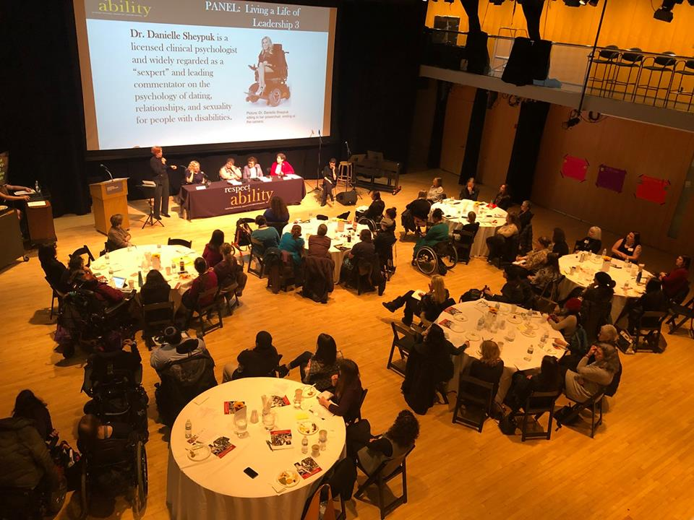
Ensuring Accessibility in all ERG events
Continue hosting virtual or hybrid events
Virtual events
  ASL interpreters
  Closed captioning
In person events
  Accessible location, including parking spots and transportation. This includes entrances and bathrooms
  Don’t rely on alcohol-centered events
Ensuring Virtual Events are Accessible for all

Slide 10
Requesting Accommodations at Events
Make it easy and comfortable for employees, members of the management team, volunteers and participants to request accommodations beforehand
Include this phrase in every registration form:
“Do you need any accommodations to
fully participate in this event?”
Provide email/phone number of employee who is assigned to handle accommodations.

Slide 11

Website/Presentation Accessibility
Explain pictures in live presentations
Screen readers
  Alt text
  Forms and buttons
Captions on videos
  Subtitles only reflect what is being spoken.
  Captions go a step further by also including non-spoken information including [laughter], [applause] and [music], as well as environmental sounds.

Slide 12

Ila’s Personal Story and ERG Work

Slide 13
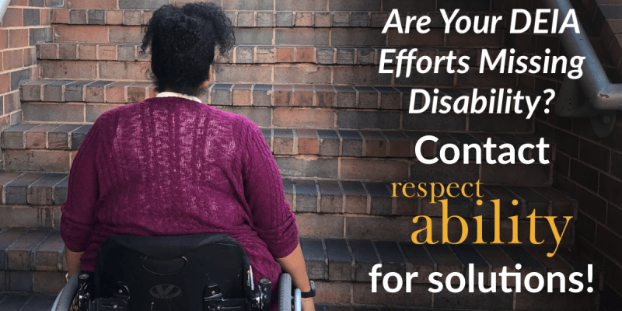
Continue Your Disability Inclusion Journey
Continue your learning with RespectAbility’s Disability Training & Speakers Bureau:
Disability 101: Ensuring Best Practices in Disability Inclusion
Best Practices: Recruitment and Retention
Creating a Welcoming, Inclusive and Accessible Organization
Ensuring Accessible In-Person and Virtual Events
Living with a Disability in an Inaccessible World
Mental Health & Wellness in the Workplace
Disability Inclusion in Philanthropy
Email JakeS@RespectAbility.org for more information

Slide 14
Equity and Access Webinar Series
Disability 101
Disability History
How to Ensure Accessible Events
How to Recruit, Accommodate and Promote People with Disabilities for Paid Employment, Volunteer Leadership and Board Positions
How to Ensure A Welcoming Lexicon and Inclusive Storytelling
How to Ensue Accessible Websites, Social Media and Inclusive Photos
Premium Skills Workshop in Social Media Accessibility
How to Ensure Legal Rights and Compliance Obligations
Watch Recordings, Download Transcripts and PowerPoints:
https://www.respectability.org/accessibility-webinars/

Slide 15
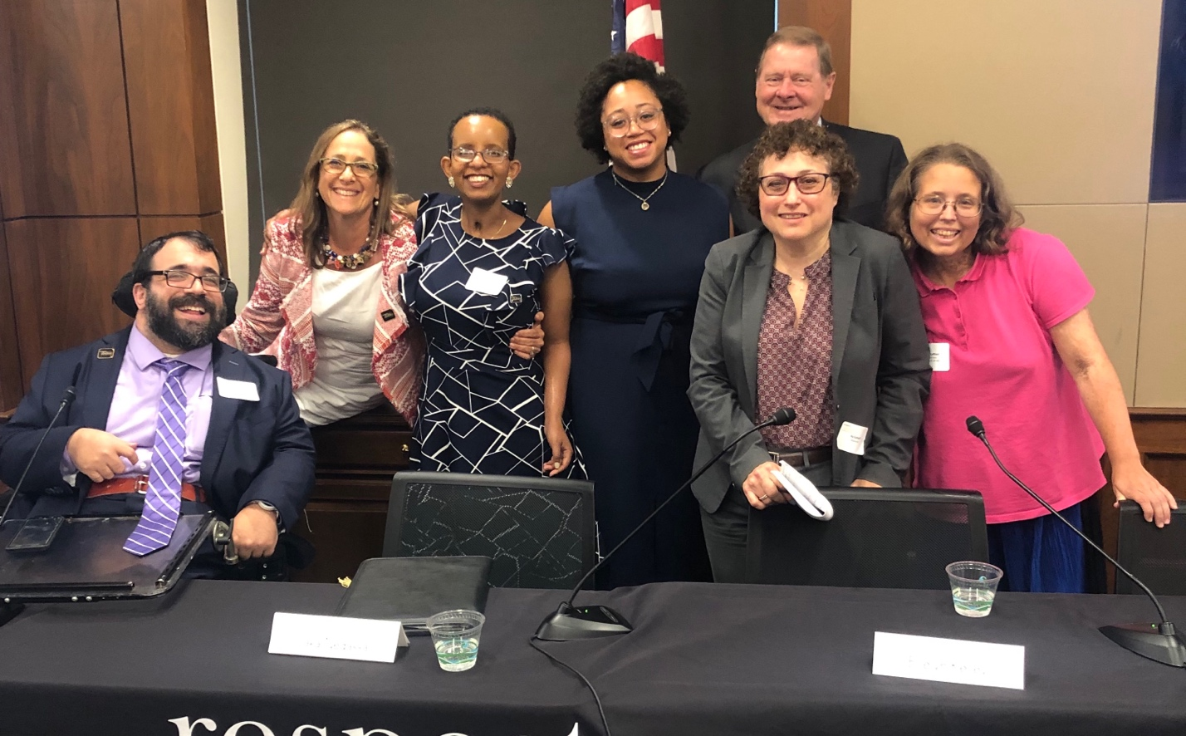
Questions? Thank You!
Presenters:
Nick Sophinos, Business Professional and Queer/Disability Advocate
Ila Eckhoff, Corporate Disability Advocate
Jake Stimell, Associate, Disability Training & Speakers Bureau, RespectAbility
For More Information:
Contact JakeS@RespectAbility.org
Link to Free RespectAbility Webinars

