Slide 1
ABLE accounts
ABLE accounts
Expanding Financial Empowerment and
Community Inclusion for People with Disabilities
www.ABLETODAY.org
Notes:
Type your notes

Slide 2
Who is this presentation for?
ARE YOU?
WHO IS THIS PRESENTATION FOR?
A person with a disability
that plans your finances month-to-month to ensure you do not lose your benefits like SSI and Medicaid?
A family member
or caregiver
that supports a person with a disability but are concerned how they will live, work, and enjoy their community in the future?
A disability benefits provider, financial advisor or special needs trust lawyer that monitors the asset limits for people with disabilities?
Notes:
Type your notes

Slide 3
Imagine if people with disabilities could
IMAGINE
If People with Disabilities Could...
Save money in their own names –
and more than just $2,000
Move from a
monthly
financial plan to a
lifetime
financial plan
Accumulate wealth without losing their eligibility for benefits
Work without having to “spend down” their current or future income
ABLE accounts make these choices possible
Notes:
Type your notes

Slide 4
What is an ABLE account?
What is an ABLE Account?
ABLE accounts are savings and investment tools, built specifically for people with disabilities, that allow them to save money without impacting public benefits. ABLE accounts are offered under Section 529 of the U.S. Tax Code.
Notes:
Type your notes

Slide 5
ABLE Accounts by the numbers
ABLE ACCOUNTS | BY THE NUMBERS
Accounts are offered through state-run ABLE Programs
46 STATES + DC
120,000+ Total Accounts
There are currently 49 total ABLE Programs offered through each state, some with nationwide offerings as well.
As of 2022, there are currently more than 120,000 total ABLE accounts - increasing every day.
Over $1 Billion in Nationwide ABLE accounts
People with disabilities and their families believe are using ABLE accounts as savings, checking and investments accounts. The amount of money flowing through this vehicle keeps growing and growing.
visit OUR WEBSITE TO FIND YOUR STATE'S PROGRAM: abletoday.org/able-programs
Notes:
Type your notes

Slide 6
Ownership
OWNERSHIP
ABLE Accounts arE owned by the person with the disability.
01
02
03
Multiple Functions
Opportunity
Spend Down Alternative
Short-term spending and
long-term savings
Financial empowerment
and community inclusion
An alternative option
for “spend down”
04
05
Easy To Use
Tax Benefits
Easy to open, close, and use – similar to a regular bank account!
Tax-free earning
and deductions
Notes:
Type your notes

Slide 7
Who is eligible?
WHO IS ELIGIBLE?
ABLE accounts are for individuals whose disability began before age 26.
26 YEARS OLD
1
The disability must be long-term (more than 12 months) and must cause “marked & severe functional limitations.”
LONG-TERM
2
You are eligible for SSI or SSDI; or a doctor has diagnosed you with a disability (physical or mental).
DIAGNOSIS
3
Note: you do not have to be on public benefits to open up an ABLE account
Notes:
Type your notes

Slide 8
Meet Amanda & Dalton
MEET AMANDA & DALTON
AMANDA
13 YEARS OLD
DALTON
34 YEARS OLD
Amanda has a physical disability and will utilize Medicaid services throughout her life. Amanda’s parents are saving for her to go to college. They are concerned about who will support and care for Amanda when they are gone. Amanda’s parents want to plan for the future.
Dalton has a developmental disability and is employed. Dalton receives SSI, which he uses for his monthly rent payments. He wants to purchase his own home one day, but because of SSI limits, Dalton cannot save up money for a down payment. Dalton wants to plan for his future and keep his benefits.
Notes:
Type your notes

Slide 9
Who Can Serve as an ABLE Account Support Person
Who Can Serve as an ABLE Account Support Person
Can be an individual or an organization
Supporters can manage multiple accounts at once
1
2
3
4
Power of Attorney
Conservator
Guardian
Spouse
5
6
7
8
Parent
Sibling
Grandparent
Representative Payee
.
.
.
.
.
.
.
.
Notes:
Type your notes

Slide 10
Getting money in
General Banking
Deposit money electronically or by check
GETTING MONEY IN
Features
Most programs allow payroll deductions and e-gifting
ABLE OFFERS A VARIETY OF OPTIONS FOR GETTING MONEY INTO YOUR ACCOUNT
Rollover
Can also rollover money from a 529 College Savings Account
Notes:
Type your notes

Slide 11
How much can you contribute?
How much can you contribute?
ABLE ACCOUNTS HAVE LIMITS BASED ON EMPLOYMENT STATUS
LIFETIME
ANNUAL
IF EMPLOYED
$400,000+
$16,000
$28,880
Contributions can come from any source including directly from the ABLE account enrollee, family, friends, organizations, nonprofits,
and employers
The person with the disability can contribute up to an extra $12,880+ more every year (if they are not contributing to their workplace retirement account)
Programs also have balance limits that differ by State ($400,000-$500,000+)
Notes:
Type your notes

Slide 12
Annual costs
ANNUAL COSTS
Annual Account Fees:
RANGES
$0 to $60
Asset-Based
Fees:
RANGES
0% to 0.9%
Account Management Fee
Investment Management Fee
Notes:
Type your notes

Slide 13
Investment options
INVESTMENT OPTIONS
Most ABLE accounts offer multiple places to put your money:
You can pick one option or spread your money across multiple options.
CHECKING
Choose from:
(a) Checking and savings options
- FDIC insured
(b) Market-based investment options
- stocks, bonds, etc
SAVINGS
INVESTMENTS
Notes:
Type your notes

Slide 14
Spending your funds
Spending Your Funds
A “Qualified Disability Expense” (QDEs) is anything that relates to the disability and
helps maintain or improve health, independence, or quality of life
Housing and Rent
Transportation
Assistive Technology
Health & Wellness
Basic Living Expenses
Education
Financial Management
Legal Fees
Notes:
Type your notes

Slide 15
How to Withdraw Money from Your ABLE Account
How to Withdraw Money from Your ABLE Account
DIFFERENT PROGRAMS HAVE VARIOUS OPTIONS
CHECKBOOKS
THIRD PARTY CHECKS
DEBIT CARDS
BANK TRANSFER
Notes:
Type your notes

Slide 16
Special Benefits Rules
Special Benefits Rules
SSI & Medicaid
IF YOU
RECEIEVE
IF YOU
RECEIVE
SSI
Medicaid
Balances over $100,000 start counting as a resource
If you withdraw money to use for housing, you must spend it within the same calendar month
Medicaid does not have a balance limit
MEDICAID RECOVERY PAYBACK still applies to ABLE, just as it applies to other bank accounts - check with your state to confirm
Notes:
Type your notes

Slide 17
What if I already have – or am considering –
a Special Needs Trust?
What if I already have – or am considering –
a Special Needs Trust?
Great! You can use both! Special Needs Trust can accept larger annual deposits than ABLE Accounts can. People frequently put large deposits into a Trust, and then regularly transfer that money to an ABLE Account for easy access.
For others, an ABLE Account can complement a Trust as they:
Less Expensive
No Legal Help
Buy More Things
Are often far less expensive to set up and maintain
Do not require an attorney’s help
They expand the purchasing power of a Trust
Tax Deductions
Ownership
Independence
Some states offer tax incentives on the contributions
Can be established, administered, and owned by an individual with a disability
Gives people with disabilities additional autonomy to save and spend their own money
Notes:
Type your notes

Slide 18
EXAMPLE SHOWING HOW AMANDA's ACCOUNT IS ADMINISTERED
EXAMPLE SHOWING HOW AMANDA's ACCOUNT IS ADMINISTERED
1
Amanda's mom opened her account online in about 20 minutes.
Amanda is listed as the account owner, but her mom is listed as the support person.
2
3
Amanda's mom handles the day-to-day management of the account, including the contributions and withdrawals.
Notes:
Type your notes

Slide 19
Example showing how Dalton contributed to his ABLE account.
Example showing how Dalton contributed to his ABLE account.
Dalton set up a direct deposit feature WITH his employer to contribute
part of his paycheck into his ABLE account.
Annual Basis
e-gifting
Dalton can contribute up to $12,880
(tied to the amount he earns in income).
Dalton uses this feature and receives $5,000 annually from family and friends.
Before ABLE...
Now...
Dalton’s resource limit was
$2,000 a month before ABLE.
With an ABLE Account he now saved $17,880.
Notes:
Type your notes

Slide 20
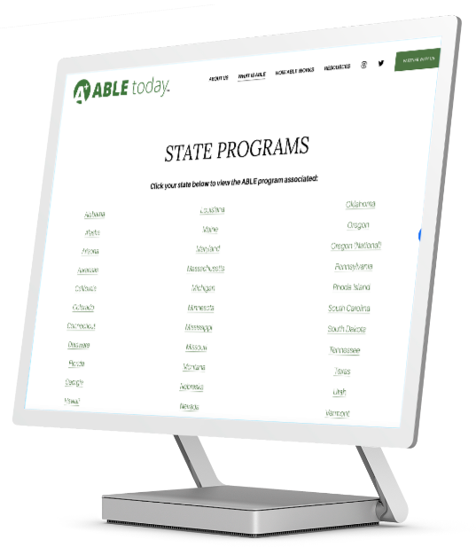
How do you open an ABLE account?
How do you open an ABLE account?
Almost all ABLE Programs have online enrollment
Find Your ABLE Program
See abletoday.org/able-programs for more info and examples
Most programs let you enroll from anywhere
ABLE Programs allow you to either enroll in a bank branch, enroll online and/or submit a paper application
Flexible Enrollment
The individual with the disability can open and manage their own account, or a support person can oversee account management
Notes:
Type your notes

Slide 21
Next Steps...
Next Steps...
RESEARCH ABLE PROGRAMS
Research ABLE Programs via the ABLE today™ website, abletoday.org
SPREAD THE WORD
Help us spread the word! Share via email, social media, and with your network
REQUEST A PRESENTATION
Reach out and let us know if you would like a group presentation
Notes:
Type your notes

Slide 22
Resources
RESOURCES
ABLE accounts are a game changer for financial empowerment and community inclusion. To learn more, visit:
abletoday.org/videos
abletoday.org/federal-benefits
abletoday.org/able-programs
Notes:
Type your notes

Slide 23
Thank you!
THANK
YOU!
Notes:
Type your notes

