Slide 1
Overcoming Barriers and Work Disincentives

Slide 2
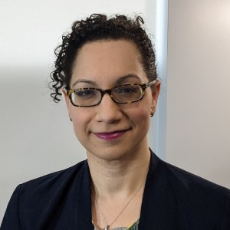
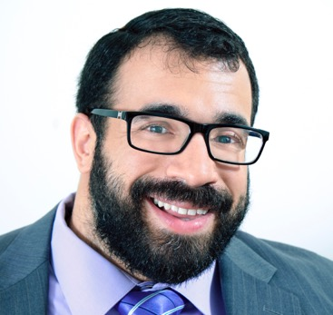
Meet our Speakers
Matan A. Koch
VP, Workforce and Faith Programs, RespectAbility
Joshua Basile
Advocate, philanthropist, lawyer and founder, Determined2Heal
Alexandra Bennewith
VP, Government Relations, United Spinal Association
Philip Kahn-Pauli
Policy and Practices Director, RespectAbility

Slide 3
Request for Information Background and Overview
Medicaid eligibility groups through:
Section 4733 of the Balanced Budget Act (BBA) of 1997
Section 201 of the Ticket to Work and Work Incentives Improvement Act (TWWIA) of 1999
The positive results of MBI for workers with disabilities
increased enrollee income; increased number of hours worked; and a greater opportunity to accrue savings for home purchases, retirement, and other needs.
An analysis of Social Security Administration (SSA) earnings data by Mathematica Policy Research, Inc. determined an average of 40% of participants increased their wages after enrollment in the MBI for workers with disabilities

Slide 4
Request for Information Background and Overview (2)
Cost-effective for state Medicaid agencies
MBI participants have better health outcomes and lower Medicaid utilization rates than their non-working peers with disabilities.
Employers also benefit from hiring workers with disabilities—demonstrated by increased profits and cost-effectiveness, higher employee retention.
Despite these successes, less than half of working-age people with disabilities (30.9%) were employed in 2019. This compares to an employment rate of 74.6% for people without disabilities. (Bureau of Labor Statistics 2020)
Bipartisan Policy Center, Improving Opportunities for Working People with Disabilities, January 2021, https://bipartisanpolicy.org/

Slide 5
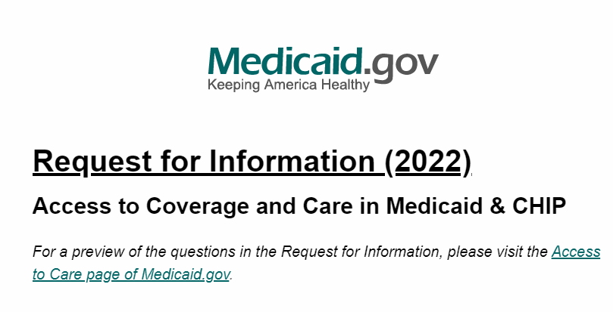
CMS RFI 2022
CMS is seeking to develop and implement a comprehensive access strategy for Medicaid and the Children’s Health Insurance Program (CHIP). Using regulations and guidance, along with other tools, CMS will set forth a multifaceted approach to help ensure equitable access to health care for Medicaid and CHIP beneficiaries across all care delivery systems. There are a wide range of barriers to accessing Medicaid and CHIP covered services, including long-term services and supports (LTSS), which include institutional care and home and community-based services (HCBS).

Slide 6
How to Send Feedback
In order to ensure that the feedback collected is specific and actionable, CMS has identified five key objectives for this RFI. The questions in this RFI cover a wide range of topics related to health care access. CMS does not expect respondents to provide feedback on all questions. Respondents should focus on questions that are most relevant to them. The RFI is open for a 60 day public comment period from February 17, 2022 through April 18, 2022.
Submit comments on the RFI via the survey response fields. Comments on the RFI may contain links to supplemental or supporting materials, such as research articles, data, and/or visuals. When linking to supplemental materials in comments, describe the material in the question response field to which the material applies.
https://cmsmedicaidaccessrfi.gov1.qualtrics.com/jfe/form/SV_6EYj9eLS9b74Npk

Slide 7
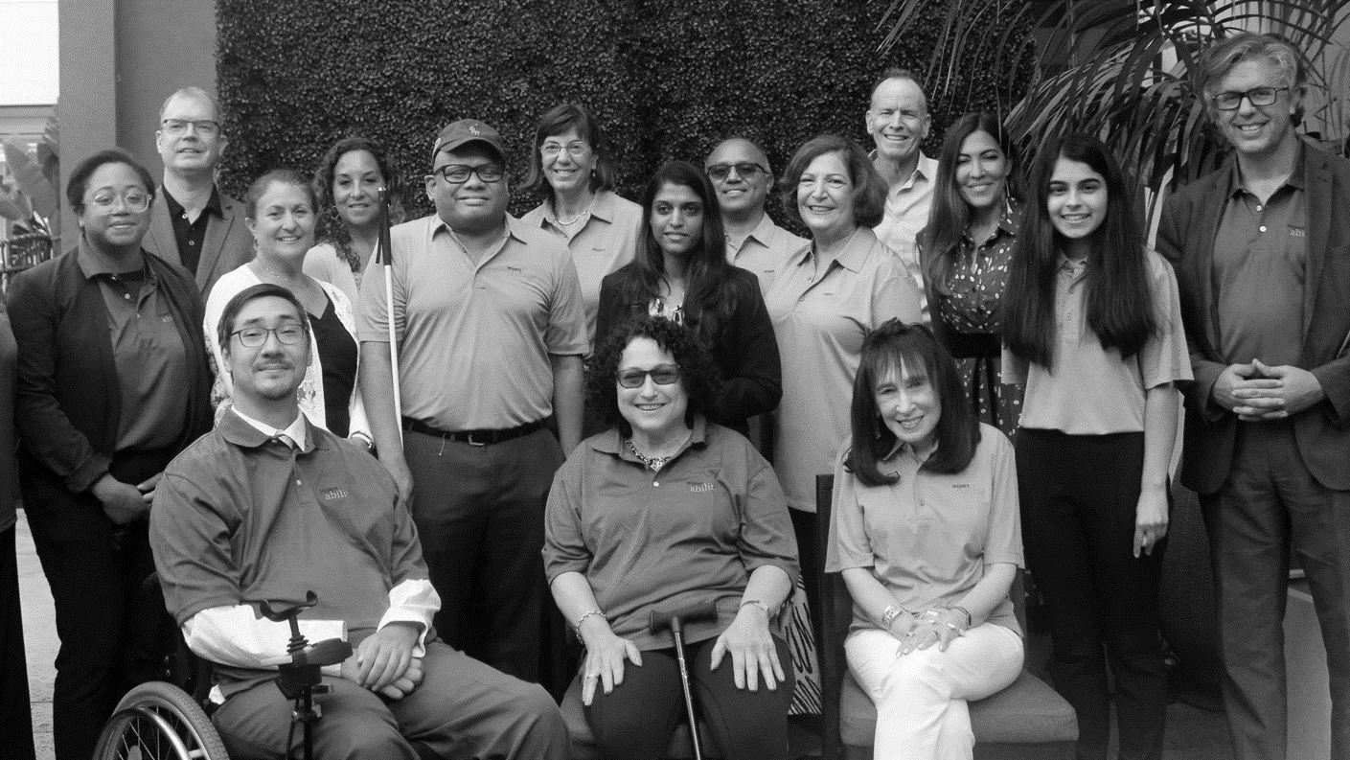
The Importance of Lived Experience
The disability community lives by the motto “Nothing about us, without us.” We must have a seat at any decision-making table that affects us – which is every table, as disability cuts across all other demographics. Those with lived experience know the solutions that work and must be part of the decision-making process.

Slide 8
What do you have to share?

Slide 9
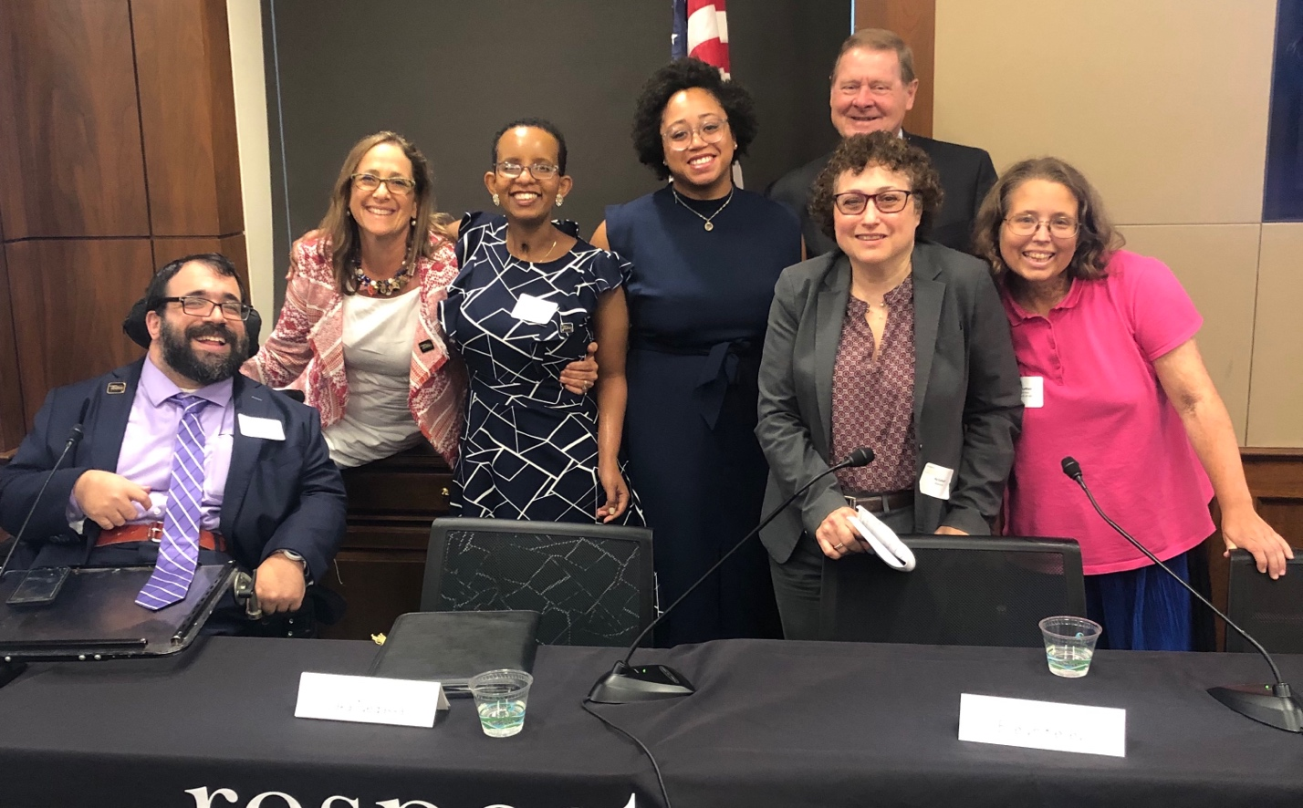
Questions? Thank You!
THANK YOU!
Alexandra Bennewith, MPA, Vice President, Government Relations United Spinal Association abennewith@unitedspinal.org
Philip Kahn-Pauli
Policy and Practices Director
RespectAbility
philipp@respectability.org
Link to Free Webinars

