Slide 1
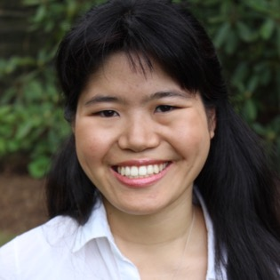
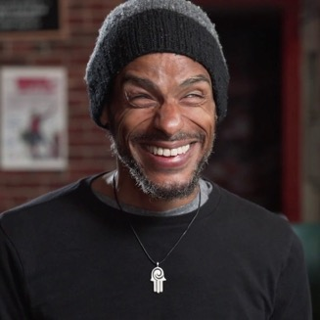
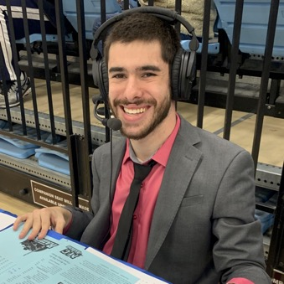
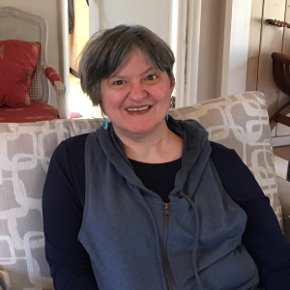
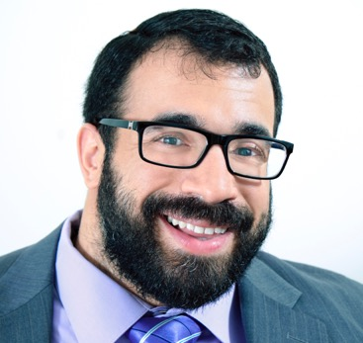

JDAIM: New Disability Toolkit and Rising Stars
Ava Rigelhaupt
Aaron Seglin
Justin Borses
Erika Abbott
Matan Koch
Sunday, February 20 / 7 pm ET

Slide 2
Faith Inclusion is Part of our Theory of Change
MISSION
RespectAbility fights stigmas and advances
opportunities so people with disabilities can fully
participate in all aspects of community.

Slide 3
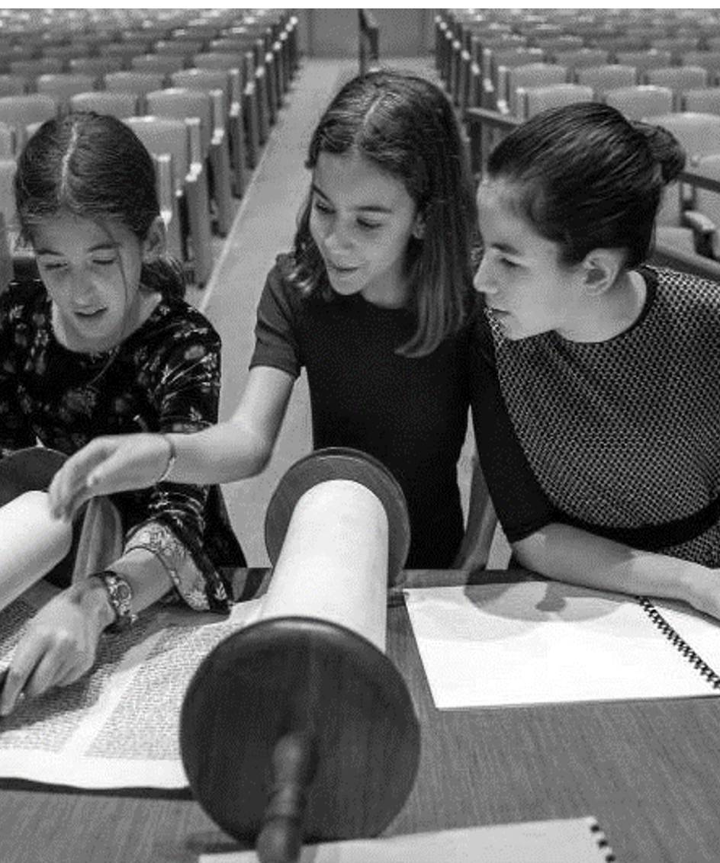
Jewish Inclusion Mission
RespectAbility’s
Faith Inclusion Mission
RespectAbility’s inclusion efforts are working to create a model for all religions as faith and faith-based organizations are an important parts of the fabric of many lives.
RespectAbility works to equip Jews with disabilities and Jewish organizations with the capacity to ensure interested Jews can participate in, and contribute to, all aspects of Jewish life and organizations.
RespectAbility strives to work in partnerships with established organizations and with change makers to build disability inclusion.

Slide 4
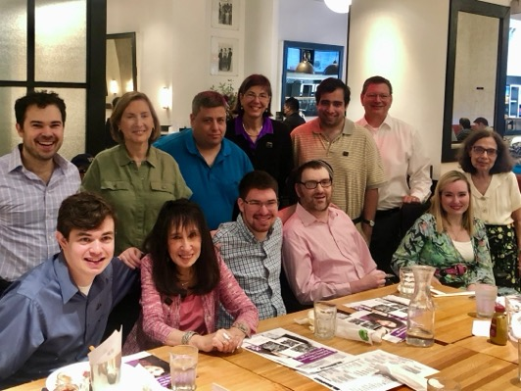
Jewish Disability Inclusion Toolkit
Basic inclusion tips
Resources connecting disability inclusion to Jewish values
Tips for hosting in-person, virtual and hybrid events
Strategies to avoid common inclusion pitfalls
Toolkit also includes
  Tips on lexicon and language
  Resources around holidays, b’nai mitzvah, education, camp
Access the toolkit at: respectability.org/jewish-toolkit/

Slide 5
Acknowledgements for toolkit
We would like to extend our deepest thanks and gratitude to those who have contributed resources to this toolkit, including RespectAbility’s Jewish Inclusion Staff, Apprentices Samantha Haas, Blair Webb, Alex Howard, Becca Block, and Nicole Olarsch, as well as co-collaborator Howard Blas, and our many other partners. Without these partners, RespectAbility would not be able to create these guides to aid in creating a more inclusive and accepting Jewish community for those with disabilities.
We also want to thank our generous donors, including Vivian and Raymond Bass, The David Berg Foundation, The Beverly Foundation, Shelley and Ruvan Cohen, Judith Creed and Robert Schwartz, Einstein Sim Family, Cheri Fox, Daniel Goldsmith, Aline and Leo Jacobsohn Foundation, Jewish Community Foundation of Los Angeles, Jewish Venture Philanthropy Fund, Charles and Lynn Schusterman Family Philanthropies, and Ann and Andrew Tisch.
Our Jewish work could not be done without our fabulous co-chairs Vivian Bass and Shelley R. Cohen and other board members. RespectAbility’s Board of Directors and Advisors include: Chairman Ollie Cantos, President Jennifer Laszlo Mizrahi, Chairs Emeritus Rep. Steve Bartlett and Calvin Harris, Vice Chairs Vivian G. Bass, Randall Duchesneau, and Delbert A. Whetter, Linda L. Burger, Ila Eckhoff, Shelley Richman Cohen, Khadija Bari, Christine Cadena, Eleanor Clift, Judith Creed, Sneha Dave, Stacie M. De Armas, Andrew Egan, Gabrielle Einstein-Sim, Karren Horne, Janie Jeffers, Evelyn Kelley, Craig Green, Paul Martin, Donna Meltzer, Jonathan Murray, Jaime H. Pacheco-Orozco, Victor Santiago Pineda, Vincenzo Piscopo, Gerard Robinson, and Jim Sinocchi.
Emeritus Board Members include Aaron Orlofsky, Dana Marlowe, Donn Weinberg, Donna R. Walton, Dr. Dee Soder, Heidi Krizer Daroff, Janet Labreck, Neil Jacobson, Richard G. Phillips, Jr., Rick Guidotti, Robert Schwartz, Stephen Chobsky, and Thomas Sweitzer.
Most of all, we want to thank you! If you are using this toolkit, you have begun the critical work of opening the Jewish community to Jews with disabilities. We are excited to contemplate the mutual benefits as you welcome the one-in-five Jews with disabilities into your communities.

