Slide 1
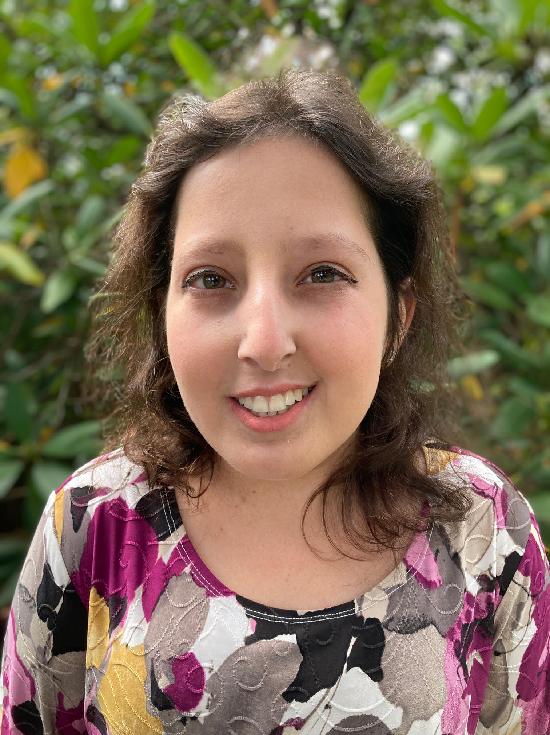
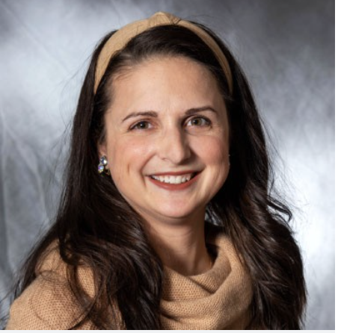



Disability & Inclusion In Our Jewish Community
Virtual Town Hall
Sunday, February 20 / 1:00 ET
Moderators:
Lily Coltoff, Internal Communications Associate at Hillel International
Amanda Thomas, Ph.D.
Disability Liaison
Jewish Family Service Lehigh Valley
Notes:
a white female who has long brown hair and is wearing black

Slide 2
Housekeeping
Today’s program is recorded.
Closed Captioning as well as ASL is provided, you may need to enable CC, adjust size level
When not speaking, please mute yourself. Use chat to ask questions or make comments during Lily’s presentation.
Recording, slides, and transcript will be sent to your email.
Notes:
There will be plenty of opportunity to speak, however the next 20 mins Lily will be sharing her story and presenting a few things on jewish inclusion. While she is presenting, feel free to use the chat if you have any questions

Slide 3
Overview
Lily’s Story
Disability 101
Brief overview of RespectAbility’s national data on Jewish Disability Inclusion
Polls and Community Discussion
Create action plan
Last 20-30 minutes will give members the opportunity to connect personally with Amanda or Lily.
Notes:
Before I welcome and Introduce Lily, I wanted to take a moment and overview today’s agenda

Slide 4
Welcome & Introduction

Slide 5
Lily Coltoff’s Story
from Erdenheim, PA (Montgomery County)
former RespectAbility Apprentice in Communications
passionate about invisible disabilities, universal design
“It’s not enough to ramp buildings; we must also ramp attitudes.” - Rabbi Lynne Landsberg z”l

Slide 6
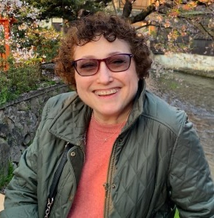
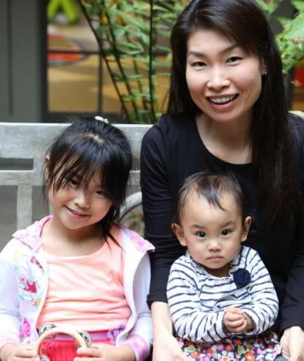
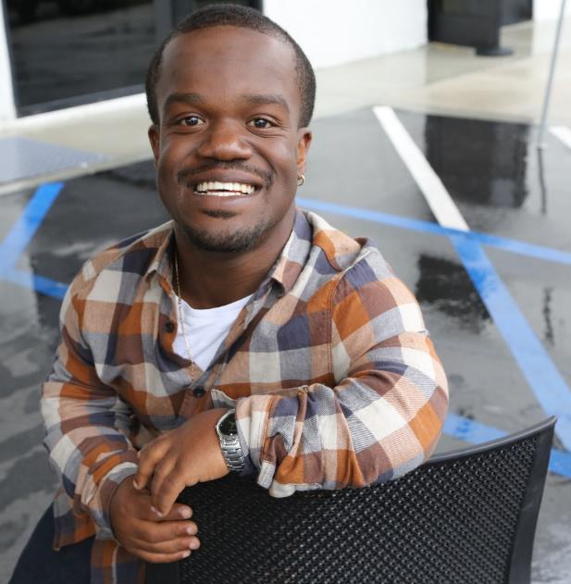
Disabilities Are….
Temporary and Permanent
Visible and Nonvisible
From Birth or Acquired Later

Slide 7
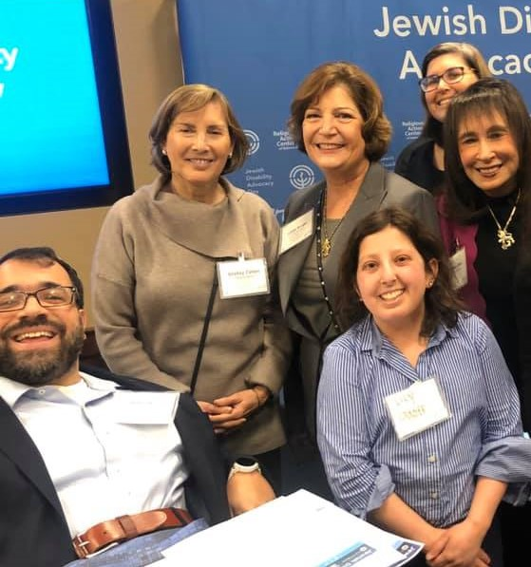
Three Facts
Anyone can acquire a disability from aging, an accident, trauma, and/or illness.
The disability community is innovative and resilient.
People with disabilities are diverse and part of all communities.

Slide 8
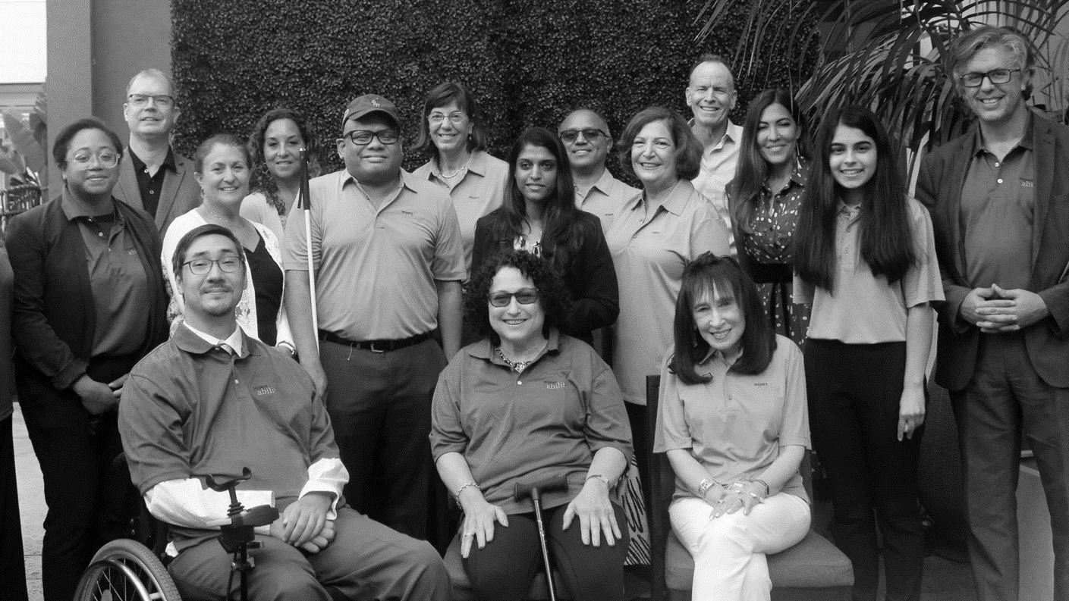
Including the D – Disability – in Diversity
Organizations are at their best when they welcome, respect and include people of all backgrounds. This includes people with disabilities.

Slide 9
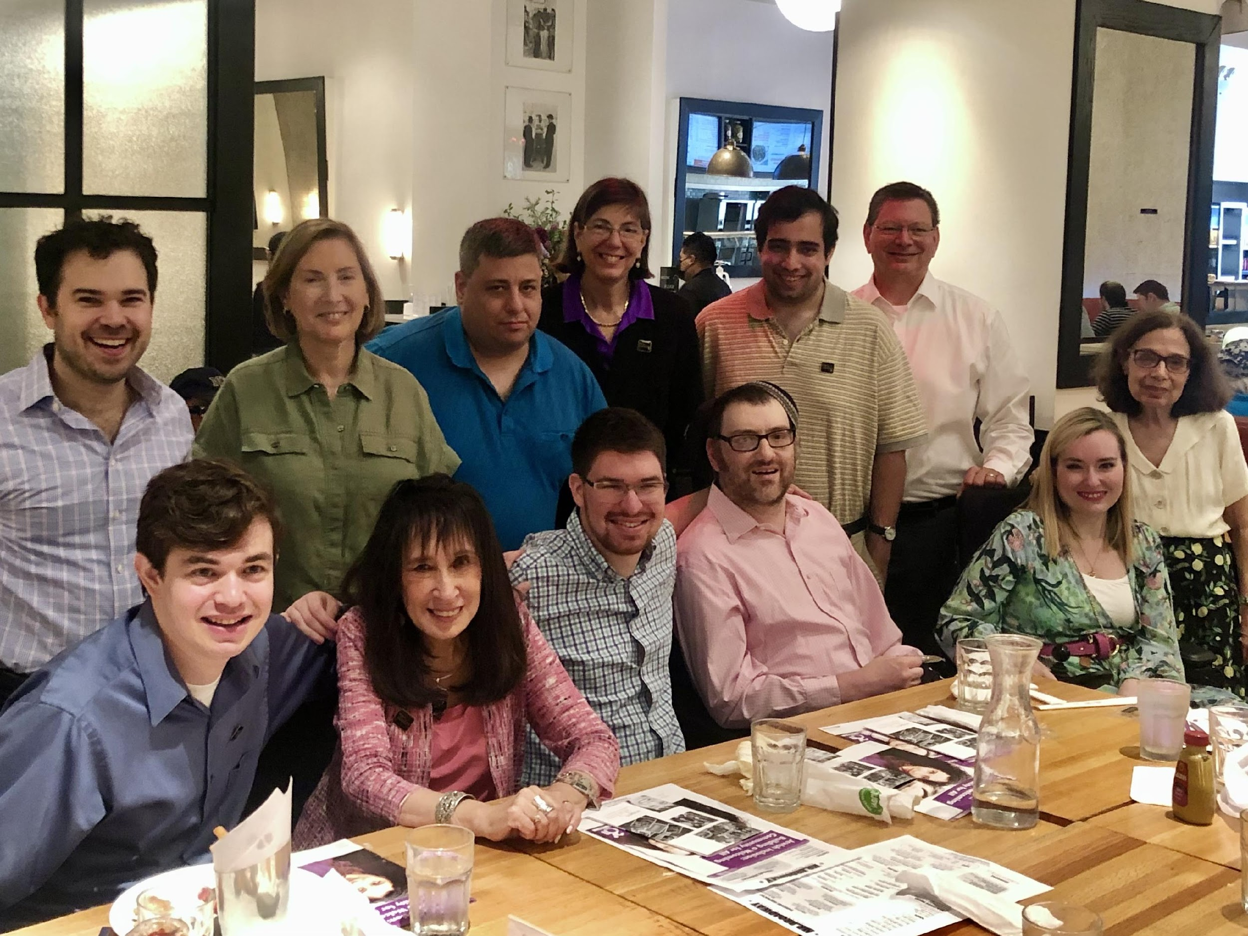
People with disabilities want opportunities just like anyone else.
People with disabilities want opportunities
Just like anyone else.

Slide 10
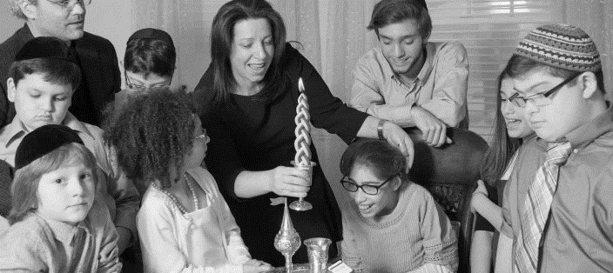
1 in 5 Jews has a disability.
1 in 5 people have a disability.

Slide 11
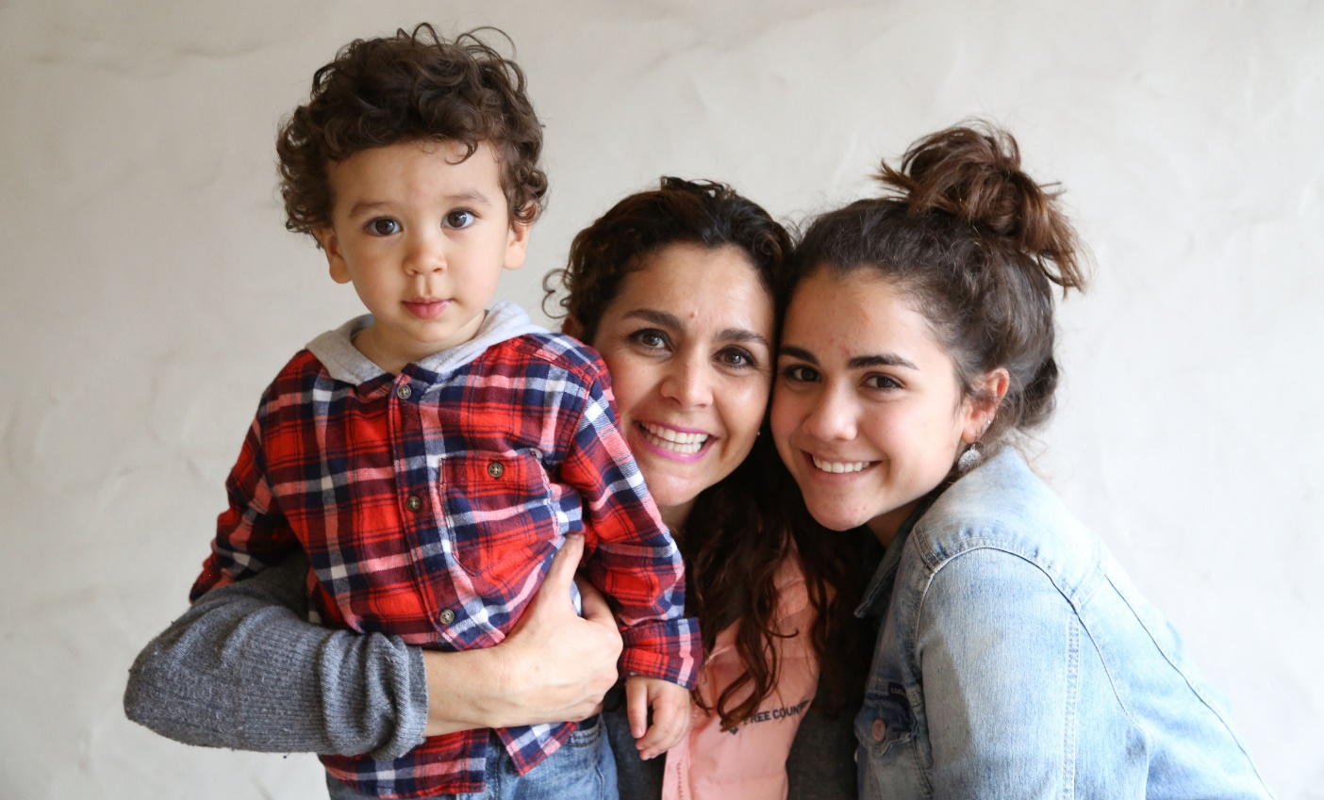
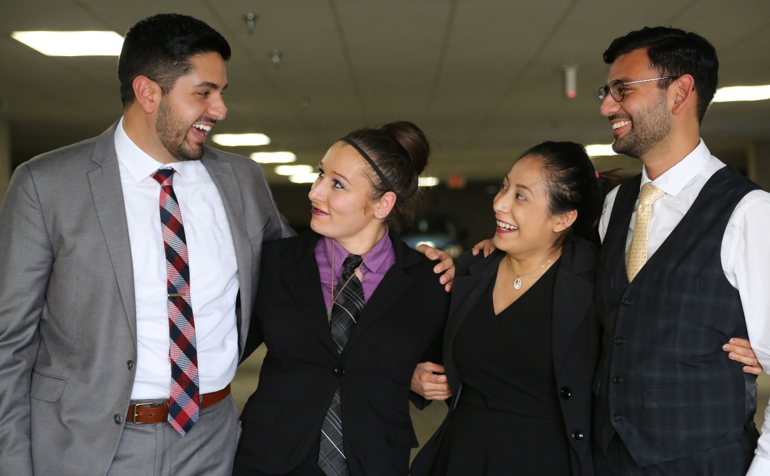
Disability is Close to All of Us
have a family member with a disability
have a close friend with a disability
48%
42%
* Source: September 2012 poll, Laszlostrategies.com

Slide 12


Jewish values encompass all types of inclusion, including disability inclusion
Tikkun Olam—Repairing the World- is a key Jewish value

Slide 13
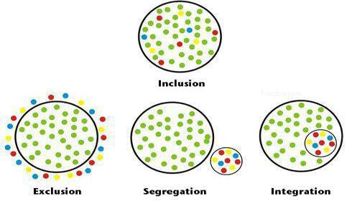
What Does Inclusion Look Like

Slide 14
RespectAbility Study on Jewish Disability Inclusion
Notes:
2021
2019 identical

Slide 15
65-1 Margin: People Feel Things Are Better
Compared to five years ago, how is the Jewish community at including people with disabilities?
Choices | 2021 | 2018 | Change
Much Better | 27% | 19% | +8%
A Little Better | 38% | 37% | +1%
About The Same | 20% | 16% | +4%
Somewhat Worse | 1% | 1% | -
Much Worse | 0.19% | 0.18% | -
I Don't Know | 14% | 27% | -13%
Notes:
65 to 1 shows add them up

Slide 16
NPwDs 2x as likely to say things going extremely well
Overall, how well is the Jewish community doing at including people with disabilities in synagogues, Jewish organizations, and communal activities?
Choices | PwDs | NPwDs
Extremely Well | 7% | 14%
Very Well | 18% | 23%
Somewhat Well | 41% | 36%
Not So Well | 20% | 9%
Not At All Well | 4% | 1%
I Don’t Know | 12% | 17%

Slide 17
Faith Inclusion Overall is Strong but Inconsistent
In the faith-based institutions and groups that you are active in, do you feel that people with disabilities are included? (i.e. social activities, men's clubs/sisterhoods, youth groups)

Slide 18
Good News: Majority See Jewish Groups Have Diversity, Equity, Inclusion Commitments
Has the leadership of the faith organization you most closely align with made a specific commitment to diversity, equity, and inclusion that has been made public to management, staff, stakeholders, and the public?

Slide 19
Good News: Disability is Included in Diversity Commitments
(If yes to diversity commitment) Please check all the diversity areas that were specifically named:
Choices | Percentage
Race | 72%
Gender | 71%
Sexual Orientation/Gender Identity | 71%
Disability | 88%
Ideology | 29%
Other (please specify) | 8%

Slide 20
Barriers: Nearly Identical to 2018
Which of the following do you think is the biggest barrier to fully including more people with disabilities in your faith community? Notes: PwDs cite stigmas, NPwDs cite stigma and cost. Two answers are similar and point to need for training.
Answer | % | PwD | NPwD
There is prejudice and unacknowledged stigma against people with disabilities. | 32% | 36% | 25%
Inclusion is expensive and the community has limited resources. | 21% | 21% | 25%
Religious leaders and activists want to be inclusive, but they don’t know how. | 19% | 18% | 17%
Including people with disabilities can be complicated and we don’t have the expertise to serve every need. | 15% | 13% | 16%
Other emergencies and communal needs are more pressing. | 5% | 5% | 6%
There aren’t many people with disabilities and those in the community are included. | 4% | 2% | 8%
The Americans with Disabilities Act (ADA) exempted religious institutions. | 3% | 5% | 3%

Slide 21
Exclusion: Still Too Prevalent
Have you or another person with a disability in your household ever been turned away from an activity at an organization in your faith community because of its inability or unwillingness to make a reasonable accommodation?
22%
of PwDs report exclusion

Slide 22
Disability Access and Inclusion Training Series for Jewish Organizations and Activists
Inclusion as a Jewish Value
How to Advance Disability Inclusion in Jewish Education
How to Recruit, Accommodate and Promote Jewish Leaders with Disabilities for Paid Employment and Volunteer Leadership
How to Ensure Accessible Events: Both Live and Virtual Across All Platforms
How to Ensure a Welcoming Lexicon, Accessible Websites and Social Media and Inclusive Photos
How to Create and Implement Successful Diversity and Inclusion Initiatives
How to Ensure Legal Rights and Compliance Obligations
Watch Recordings, Download Transcripts and PowerPoints:
https://www.respectability.org/jewish-events/#2020series
Jewish Inclusion Toolkit

Slide 23
Why we are here
Notes:
Jewish Family Service of the Lehigh Valley (JFSLV) and Jewish Federation of the Lehigh Valley (JFLV) recognize the need to improve our understanding of ways to create a more inclusive community. We hope to use this opportunity today to have a discussion and share experiences so we begin to understand issues, challenges, and opportunities for change.
The purpose of this town hall is not to point the finger at certain organizations. This is so we can begin to understand your needs and work together to meet them.
We are a small community, we recognize that we have aging buildings that affect accessibility. That is already on our list for a long-term goal. We know its not an excuse
In between polling questions, we will have the opportunity to talk, I will be taking notes and sharing them on a whiteboard.

Slide 24
JFS Survey Results
29 responses
Autism and Cognitive most prevalent, followed by Other Health Impairments, Multiple Disabilities, and Mental Health
  -9 respondents chose more than 1 category
- ages primarily under 12, 35-44 and 55-64
-10 respondents were turned away due to lack of accommodations
- 25% of respondents were not affiliated
Notes:
25% of individuals with disabilities are not affiliated

Slide 25
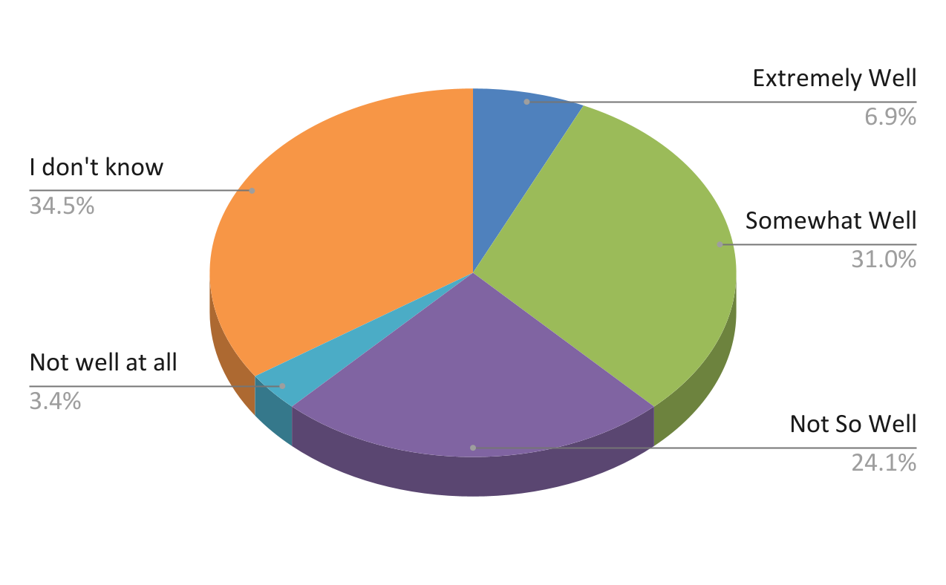
JFS Inclusion Survey Results
How well is the Lehigh Valley Jewish Community doing at including individuals with disabilities in synagogues, Jewish organizations, and communal activities?
Notes:
How well is the Lehigh Valley Jewish Community doing at including individuals with disabilities in synagogues, Jewish organizations, and communal activities?

Slide 26
Comments
Digital accessibility
Text used in shul are unreadable (spacing, use of italics, font)
Lack of accessible (large print, sans serif, high contrast) Orthodox Siddurs
Virtual meetings have been beneficial
Access to bimah
Building accessibility an issue
Jewish Education unable to accommodate wide range of students with disabilities
Notes:
JDS and

Slide 27

Let’s hear your voice

Slide 28
Polling instructions
A poll box will appear in the middle of your screen with a question and list of response
You will be asked to vote once per question
Your responses will be anonymous when displaying results
If you have trouble accessing the poll, you may use the chat to write your response (message Jake if you want it to be anonymous).

Slide 29
Have you (or a loved one) ever been or felt excluded from a Jewish event in the Lehigh Valley?
Poll Question 1

Slide 30
Discussion

Slide 31
Have you (or a loved one) ever been or felt excluded from a specific club in the Lehigh Valley Jewish Community?
Poll Question 2

Slide 32
Discussion

Slide 33
Have you ever helped in creating or advocating for accommodations/accessibility in the Lehigh Valley Jewish Community?
Poll Question 3

Slide 34
Discussion

Slide 35
Do you (or a loved one) feel comfortable in asking for accomodations at Jewish events in the Lehigh Valley?
Poll Question 4

Slide 36
Discussion

Slide 37
Do you (or a loved one) feel comfortable in disclosing your disability at Jewish events in the Lehigh Valley?
(for people with disabilities)
Poll Question 5

Slide 38
Discussion

Slide 39
Are you proud of the current state of affairs regarding disability inclusion in the Lehigh Valley Jewish Community?
Poll Question 6

Slide 40
Discussion

Slide 41
Would you be interested in serving on the Disability & Inclusion committee?
Poll Question 7

Slide 42
Discussion

Slide 43
Would you be interested in staying up-to-date with our disability and inclusion initiative?
Poll Question 8

Slide 44
Discussion

Slide 45
How well is the Lehigh Valley Jewish Community doing at including individuals with disabilities in synagogues, Jewish organizations, and communal activities?
Poll Question 9

Slide 46
Discussion

Slide 47
Next Steps

Slide 48
Questions?

Slide 49
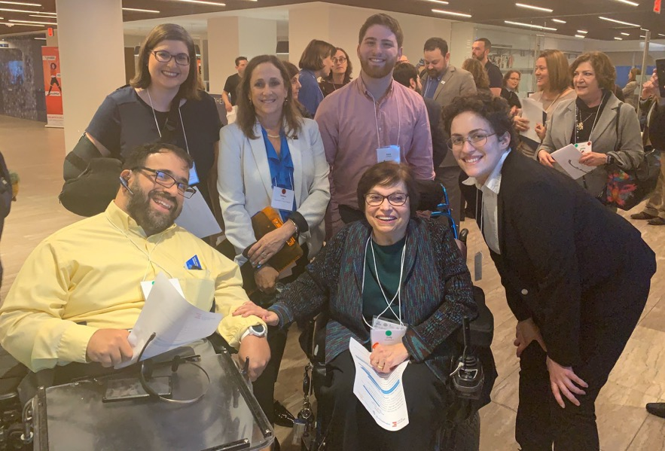
Thank You!
Moderators:
Lily Coltoff, Internal Communications Associate at Hillel International
Amanda Thomas, Ph.D.
Jewish Family Service of the Lehigh Valley
amthomas@jfslv.org
Jake Stimell, Associate, Speakers Bureau & Faith Inclusion, RespectAbility
JakeS@RespectAbility.org

Slide 50
Appendix

Slide 51
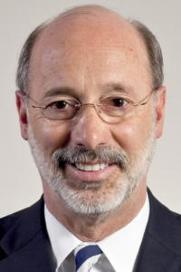
Disability Statistics in Pennsylvania
There are 1,774,575 Pennsylvanians with disabilities.
The disability community is 14.1 percent of the total population in the Commonwealth.
There are 900,776 working-age people with disabilities in the Keystone State.
Out of that number, 350,024 had jobs in 2019.
Pennsylvania’s disability employment rate is 38.8 percent.
The employment rate for Pennsylvanians without disabilities is 79.7 percent.
There is a 40.8 percentage point gap in Labor Force Participation Rates between PWDs and non-PWDs in PA.
28.5 percent of working-age Pennsylvanians with disabilities live in poverty.
Philadelphia County has the commonwealth’s largest number of PWDs (261,440) and Forest County has the highest concentration of PWDs (28.4%)
Gov. Tom Wolf (D)
Source: Annual Disability Statistics Compendium: 2020 Durham, NH: Univ. of New Hampshire, Institute on Disability
https://disabilitycompendium.org/

Slide 52
Recognizing Racial Disparities in Pennsylvania
There are 140,588 working-age African Americans with disabilities. Out of that number, only 46,070 or 32.8 percent have jobs. (Tables 3.22/3.27)
Fully 35.5 percent of African Americans with disabilities live in poverty compared to 24.3 percent of African Americans without disabilities. (Tables 6.7/6.12)
There are 91,459 working-age Latinx people with disabilities. Out of that number, fully 31,619 or 34.6 percent have jobs. (Tables 3.25/3.30)
Fully 45.9 percent of Latinx people with disabilities live in poverty, compared to only 25.6 of Latinx people without disabilities. (Tables 6.10/6.15)
There are 14,846 working-age Asian Americans with disabilities. Out of that number, 5,865 or 39.5 percent have jobs. (Tables 3.23/3.28)
16.5 percent of Asian Americans with disabilities live in poverty compared to 15.5 percent of Asian Americans without disabilities. (Tables 6.8/6.13)
SOURCE: Annual Disability Statistics Supplement: 2020. Univ. of New Hampshire, Institute on Disability.
https://disabilitycompendium.org/compendium/2020-annual-disability-statistics-supplement

Slide 53
Employment Rates for Working-Age Pennsylvanians w/
& w/o Disabilities, by Race – 2019 (Pre-COVID)

Slide 54
Poverty Rates for Pennsylvanians w/
& w/o Disabilities, by Race – 2019 (Pre-COVID)

Slide 55
Pennsylvania, Disability and Health Conditions
 |  | People with Disabilities (%) 2012 | People with Disabilities (%) 2013 | People without Disabilities (%) 2012 | People without Disabilities (%) 2013
Poverty ¹ | US | 29.2 | 28.7 | 13.6 | 13.6
 | PA | 28.4 | 28.9 | 11.0 | 11.1
Smoking ¹ | US | 26.0 | 25.4 | 16.9 | 16.2
 | PA | 29.8 | 28.8 | 18.9 | 18.7
Obesity ¹ | US | 39.1 | 40.1 | 24.5 | 25.0
 | PA | 39.3 | 43.8 | 26.2 | 26.1
Employment ¹ | US | 32.7 | 33.9 | 73.6 | 74.2
 | PA | 33.0 | 33.9 | 75.1 | 75.6
1.Annual Disability Statistics Compendium. Pg 53, 54, 72, 73, 29

Slide 56
Students with Disabilities served under IDEA in PA
Disability | 2011 | 2012
All Disabilities | 262,241 | 262,461
Specific Learning Disability | 125,624 | 121,646
Speech or Language Impairment | 39,517 | 39,068
Intellectual Disability | 18,702 | 18,794
Emotional Disturbance | 23,068 | 22,858
Multiple Disability | 2,896 | 2,868
Hearing Impairment | 2,621 | 2,720
Orthopedic Impairment | 739 | 724
Other Health Impairment | 26,772 | 29,692
Visual Impairment | 1,082 | 1,101
Autism | 20,372 | 22,117
Deaf Blindness | 74 | 89
Traumatic Brain Injury | 678 | 655
Developmental Delay | 96 | 129
Source: Annual Disability Statistics Compendium

Slide 57
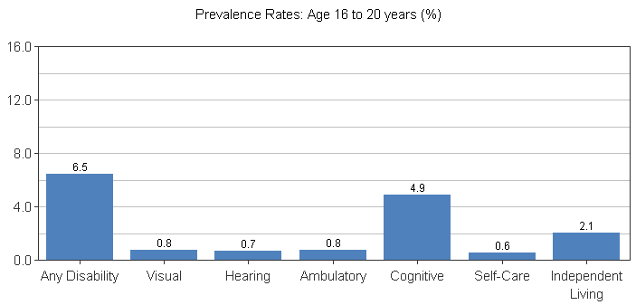
Prevalence of Disability Among Non-Institutionalized People Ages 16 to 20 in Pennsylvania in 2012
59,000* 6,900* 6,000* 7,300* 43,900* 5,800* 19,200*
*Total numbers reported
Source: Cornell University

Slide 58
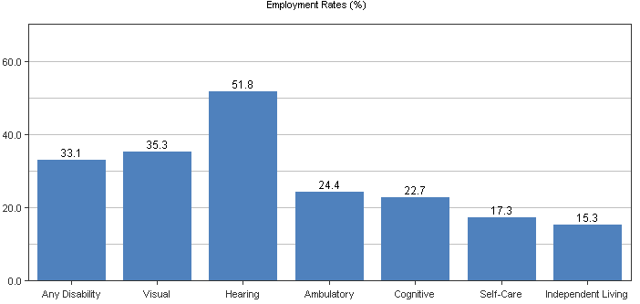
Employment of Non-Institutionalized Working-Age People (Ages 21 to 64) by Disability Status in PA in 2012
275,500* 46,900* 81,500* 101,100* 81,000* 24,900* 46,000*
*Total numbers reported
Source: Cornell University

Slide 59
PA Project SEARCH Sites
Bryn Mawr Rehab Hospital, Malvern
DeKa-East Penn Manufacturing Company, Inc., Lyon Station
Good Shepherd Rehabilitation Network, Allentown
Lancaster General Health, Lancaster
Lehigh County, Allentown
Phoenixville Hospital, Phoenixville
UPMC Mercy Hospital, Pittsburgh
UPMC NW, Seneca
UPMC Passavant, Pittsburgh
VA Medical Center (121), Lebanon
WellSpan Health/York Hospital, York
Project SEARCH: www.projectsearch.us
Contact Erin Riehle at Erin.Riehle@cchmc.org

Slide 60
PA Federal Contractors
Top contractors:
  Bechtel Group INC.
  The Boeing Company
  Merck & Co INC.
  Amerisourcebergen Corp.
  Pfizer INC.
-Complete list🡪 fed spending website
http://www.fedspending.org/fpds/fpds.php?stateCode=PA&sortp=r&detail=-1&datype=T&reptype=p&database=fpds&fiscal_year=2012&submit=GO
- Complete federal lists of 2006-2013 🡪 Federal Procurement Data System website
https://www.fpds.gov/fpdsng_cms/index.php/en/reports/62-top-100-contractors-report3.html
- How to get started: Job Accommodation Network 🡪 https://askjan.org/

Slide 61
More Information on RespectAbility’s Study

Slide 62
Methodology of the Poll
The survey was administered online from October 5 – October 19, 2021. The questions reached a total of 2,924 respondents.
Respondents were reached through:
Paid email blasts (JTA, The Forward, Jewish Journal)
Email blasts to RespectAbility and partner lists, as well as social media
Individual outreach to Jewish leaders
This is not a random sample and will include more engaged Jews and people with a disability connection than in the general population. The conclusions carry statistical significance within the respondent group, because it is a large population with more than 2,300 Jews responding.
Due to rounding, some of the numbers in the presentation will not always add to 100%.
Same methodology as 2018 survey

Slide 63
Who Took the Poll
2,321 Jewish Respondents
Including:
646 People with Disabilities (PwD)
1477 Disability Community (Comm) – includes 336 PwD
534 People with No Disability Connection (NPwD)
Denomination | % | #
Just Jewish/Culturally Jewish | 13% | 282
Reconstructionist | 5% | 99
Reform | 24% | 521
Conservative | 26% | 547
Modern Orthodox | 12% | 263
Orthodox | 4% | 79
Chabad | 10% | 209
Other (please specify) | 6% | 130
Note: Non-Jewish respondent data to be released at a later date.

Slide 64
Who Took the Poll (2)
Disability | Respondents
On The Autism Spectrum | 243
Learning Disability | 281
Developmental Disability | 155
Cognitive Disability | 134
Intellectual Disability | 100
Speech Or Language Disability | 127
Mental Health | 380
Orthopedic Disability | 217
Hard Of Hearing/Hearing Loss | 255
Deafness | 50
Blindness Or Low Vision | 63
Traumatic Brain Injury | 41
Neoromuscular Disability | 102
Neurological Disability | 143
Imuno-Deficiency | 74
Auto-Immune | 184
Chronic Pain | 275
Other (please specify) | 216
What type of disability do you have or does a member of your household have? (Please check all that apply)
Note: large number of people with nonvisible disabilities

Slide 65
Major Trends: 2018-2021

Slide 66
65-1 Margin: People Feel Things Are Better
Compared to five years ago, how is the Jewish community at including people with disabilities?
Choices | 2021 | 2018 | Change
Much Better | 27% | 19% | +8%
A Little Better | 38% | 37% | +1%
About The Same | 20% | 16% | +4%
Somewhat Worse | 1% | 1% | -
Much Worse | 0.19% | 0.18% | -
I Don't Know | 14% | 27% | -13%

Slide 67
Meaningful Movement: Good News Overall
Overall, how well is the Jewish community doing at including people with disabilities in synagogues, Jewish organizations, and communal activities?
Choices | 2021 | 2018 | Change
Extremely Well | 11% | 3% | +8%
Very Well | 20% | 15% | +5%
Somewhat Well | 41% | 43% | -2%
Not So Well | 14% | 16% | -2%
Not At All Well | 3% | 2% | +1%
I Don’t Know | 12% | 21% | -9%

Slide 68
NPwDs 2x as likely to say things going extremely well
Overall, how well is the Jewish community doing at including people with disabilities in synagogues, Jewish organizations, and communal activities?
Choices | PwDs | NPwDs
Extremely Well | 7% | 14%
Very Well | 18% | 23%
Somewhat Well | 41% | 36%
Not So Well | 20% | 9%
Not At All Well | 4% | 1%
I Don’t Know | 12% | 17%

Slide 69
5 Year Trend in the Right Direction: Gap With Less Intensity Among PwDs
Compared to five years ago, how is the Jewish community at including people with disabilities?
Choices | Total Jewish | PwD | Comm | NPwD
Much Better | 27% | 19% | 27% | 30%
A Little Better | 38% | 40% | 41% | 32%
About The Same | 20% | 24% | 20% | 17%
Somewhat Worse | 1% | 2% | 1% | --
Much Worse | -- | -- | -- | --
I Don't Know | 14% | 16% | 11% | 20%

Slide 70
Faith Inclusion Overall is Strong but Inconsistent
In the faith-based institutions and groups that you are active in, do you feel that people with disabilities are included? (i.e. social activities, men's clubs/sisterhoods, youth groups)

Slide 71
Differences Felt by PwDs: Big Gap in Perceptions
In the faith-based institutions and groups that you are active in, do you feel that people with disabilities are included? (i.e. social activities, men's clubs/sisterhoods, youth groups)
Answer | Percentage | PwD | NPwD
Yes | 37% | 31% | 42%
Sometimes | 42% | 43% | 37%
No | 7% | 10% | 3%
I Don’t Know | 9% | 9% | 12%
I am not active in any faith-based institutions | 6% | 8% | 7%

Slide 72
Good News: Majority See Jewish Groups Have Diversity, Equity, Inclusion Commitments
Has the leadership of the faith organization you most closely align with made a specific commitment to diversity, equity, and inclusion that has been made public to management, staff, stakeholders, and the public?

Slide 73
Good News: Disability is Included in Diversity Commitments
(If yes to diversity commitment) Please check all the diversity areas that were specifically named:
Choices | Percentage
Race | 72%
Gender | 71%
Sexual Orientation/Gender Identity | 71%
Disability | 88%
Ideology | 29%
Other (please specify) | 8%

Slide 74
Challenges

Slide 75
Barriers: Nearly Identical to 2018
Which of the following do you think is the biggest barrier to fully including more people with disabilities in your faith community? Notes: PwDs cite stigmas, NPwDs cite stigma and cost. Two answers are similar and point to need for training.
Answer | % | PwD | NPwD
There is prejudice and unacknowledged stigma against people with disabilities. | 32% | 36% | 25%
Inclusion is expensive and the community has limited resources. | 21% | 21% | 25%
Religious leaders and activists want to be inclusive, but they don’t know how. | 19% | 18% | 17%
Including people with disabilities can be complicated and we don’t have the expertise to serve every need. | 15% | 13% | 16%
Other emergencies and communal needs are more pressing. | 5% | 5% | 6%
There aren’t many people with disabilities and those in the community are included. | 4% | 2% | 8%
The Americans with Disabilities Act (ADA) exempted religious institutions. | 3% | 5% | 3%

Slide 76
A Tale of Two Synagogues
Where in the community do you find the most access and inclusive environment for people with disabilities?
Where in the community do you find the most challenges for access and inclusion of people with disabilities?
Choices | Access | Challenge
Jewish Federation | 5% | 3%
Jewish Day Schools | 4% | 12%
Jewish Summer Camps | 9% | 5%
Synagogues | 21% | 18%
Social Organizations such as Pop-Up Shabbat, Chavurahs | 3% | 5%
Jewish Human Services Organizations | 14% | 1%
Jewish Social Justice/Civic Engagement/Advocacy Groups | 5% | 2%
I Don't Know | 32% | 50%
Other (please specify) | 7% | 4%

Slide 77
Room for Growth

Slide 78
Leadership: Nearly 54% Increase But Improvement Still Needed Note: Leading Edge survey shows more exist!
Do you know of any clergy or staff with disabilities at your own faith-based institutions?

Slide 79
Leadership: PwDs Not Actively Encouraged to Lead
Do you feel that people with disabilities are encouraged to serve on the boards and committees of your faith-based institutions?

Slide 80
Exclusion: Still Too Prevalent
Have you or another person with a disability in your household ever been turned away from an activity at an organization in your faith community because of its inability or unwillingness to make a reasonable accommodation?
22%
of PwDs report exclusion

Slide 81
People shared painful experiences, hoping that we could keep it from happening again
OPTIONAL: If you or someone with a disability has been excluded, please share when and what happened and any ideas you have in order to ensure it doesn’t happen again.
“My son was welcome at synagogue preschool but only if we hired / provided a 1:1 support person for him (doubling the cost of his attending) and only if his inclusion did not negatively effect the experience of other kids and teachers.”
“Both my husband and I have been excluded, because my autism and his anxiety disorder made other congregants/club members feel uncomfortable. Some said we are ‘too complicated’ needing ‘always’ special accommodation.”
“Online programs that do not include closed captioning or similar, holiday celebrations and event that did not factor in the needs and access of those with disabilities – those accommodations need to be considered essential NOT optional / nice to have.”

Slide 82
People shared painful experiences, hoping that we could keep it from happening again (2)
OPTIONAL: If you or someone with a disability has been excluded, please share when and what happened and any ideas you have in order to ensure it doesn’t happen again.
“Often lack of inclusion goes hand in hand with lack of resources and forethought. This is the situation at my synagogue. Though I am a board member and have offered to train staff for free, the resource of time has been at a premium with staff stretched to the limits.”
“When making bathroom renovations a local synagogue, did not make the bathroom accessible citing prohibitive costs.”
“Shadchans are often prejudiced and unhesitatingly refuse a person with a disability. Addressing the issue in publications widely read by Orthodox Jews could help a bit.”

Slide 83
Common Examples of Successful Disability Inclusion
OPTIONAL: If you have seen a particular example of successful disability inclusion in your faith community, please share it with us.
“Friendship Circle run by Chabad has made a big impact on how the Jewish community engages individuals with disabilities”
“We raised money to build a ramp up to the bimah so it would be accessible to anyone in a wheelchair or with mobility issues.”
“My synagogue began incorporating visual descriptions into all virtual events to support low-vision congregants.”
“Accommodations have been regularly accessible on Zoom programming via subtitles, sharing screens to make notes available in real time, and other great technological means of inclusion.”

Slide 84
Next Steps

Slide 85
Virtual Formats Can Significantly Increase Access
How has the increase in virtual formats/online participation impacted your ability to access and be included in your faith community?
Choices | Total Percent | PwDs
Significantly Increased my ability to participate | 34% | 41%
Somewhat Increased my ability to participate | 33% | 32%
Somewhat Decreased my ability to participate | 6% | 6%
Significantly Decreased my ability to participate | 3% | 3%
No Impact | 25% | 18%
Webinar with more information on how to be accessible

Slide 86
Overwhelmingly Positive Messaging Works
Which of the following do you think is the most convincing reason why inclusion of people with disabilities should be a more important priority for the Jewish community?
Choices | 1st Choice | 2nd Choice | Total
We are a stronger community when we are welcoming, diverse, and respect one another. Everyone should feel that their presence and participation is welcome and meaningful. We want our children, parents, grandparents and friends with disabilities to have an equal opportunity to fully participate in our community. | 58% | 25% | 83%
Jews should be at the forefront of social justice and inclusion of all people, including in racial equity, sexual orientation and identity, disability status and other marginalized identities. | 15% | 21% | 36%
Problems are best solved by working with people who have experienced them firsthand and understand solutions that work. Jews with disabilities should be at decision making tables, just like anyone else. | 9% | 20% | 29%
Jewish tradition teaches us to include people with disabilities. Some of our greatest religious leaders had disabilities, including Moses, Jacob and Isaac. | 9% | 18% | 27%
If we value Jewish survival, that means we value all Jews, everyone is needed. If we exclude a Jew with a disability, we will lose not only them but risk alienating their entire family as well. | 9% | 16% | 25%

Slide 87
Education Level of Jews With & Without Disabilities Are Similar
What is the highest level of education that you have completed?
Choices | Total Jewish | PwD | Comm | NPwD
Some High School | -- | -- | -- | 1%
Certificate Of Completion | -- | 1% | -- | --
High School Graduate/GED | 2% | 3% | 2% | 1%
Some College/Vocational School | 7% | 9% | 6% | 8%
Associate Degree | 3% | 4% | 3% | 3%
Bachelor’s Degree | 27% | 28% | 28% | 26%
Graduate Degree | 39% | 40% | 41% | 36%
Professional Degree (JD, MD, DVM, etc.) | 20% | 14% | 20% | 25%

Slide 88
Jews with Disabilities 2X more likely to be single
What is your marital status?
Choices | Total Jewish | PwD | Comm | NPwD
Single | 17% | 30% | 15% | 12%
Married | 66% | 48% | 70% | 67%
Divorced/Separated | 8% | 11% | 8% | 9%
Widowed | 7% | 7% | 5% | 10%
Civil Union/Partner | 2% | 3% | 2% | 3%

Slide 89
Household Income: PwDs lower incomes
What is your approximate average household income?
Choices | Total Jewish | PwD | Comm | NPwD
$0-$49,999 | 14% | 26% | 13% | 8%
$50,000-$99,999 | 18% | 21% | 18% | 18%
$100,000-$149,999 | 13% | 14% | 14% | 13%
$150,000-$199,999 | 8% | 6% | 8% | 7%
$200,000 and up | 15% | 6% | 17% | 17%
I prefer not to answer | 31% | 27% | 30% | 36%

Slide 90
Respondents Prioritize Fighting Stigmas,
Education, Skills and Jobs
How important are each of the following to you?
Choices | Not At All Important | Not So Important | Somewhat Important | Very Important | Extremely Important | Weighted Average
Enabling people with disabilities to get the education, skills and jobs they need to succeed | -- | -- | 3% | 24% | 72% | 3.67
Fighting stigmas and low expectations that undermine and limit people with disabilities | -- | 1% | 5% | 29% | 65% | 3.58
Empowering people with disabilities to get leadership opportunities and have seats at decision-making tables | 1% | 2% | 10% | 33% | 54% | 3.38
Increasing inclusion of people with disabilities in faith-based organizations and institutions | -- | 1% | 14% | 38% | 47% | 3.3

Slide 91
Respondents Prioritize Fighting Stigmas,
Education, Skills and Jobs (2)
How important are each of the following to you? (Extremely Important)
Choices | Jewish | PwD | Comm | NPwD
Enabling people with disabilities to get the education, skills and jobs they need to succeed | 72% | 74% | 74% | 66%
Fighting stigmas and low expectations that undermine and limit people with disabilities | 65% | 71% | 68% | 54%
Empowering people with disabilities to get leadership opportunities and have seats at decision-making tables | 54% | 62% | 55% | 46%
Increasing inclusion of people with disabilities in faith-based organizations and institutions | 47% | 49% | 50% | 36%

Slide 92
Thank You
Everyone who responded to our survey, plus:
Promoters: E-Jewish Philanthropy, Gateways, Hillel, JCC Association of North America, Jewish Orthodox Feminist Alliance, JFNA, Leading Edge, NJHSA, Shalom DC, URJ, USCJ
Funders: Stanford & Joan Alexander Family Fund, Sandy Baklor and Arlene Kaufman, Vivian and Raymond Bass, The Belz Foundation, The David Berg Foundation, The Beverly Foundation, Linda and Andy Burger, Shelley and Ruvan Cohen, Ila Eckhoff, The Einstein Sim Family, Diane Feinberg, Daniel Feldman, Moe Feldman, Robert Feldman, Benjamin Fink, Cheri Fox, Margie Glancz, Daniel Goldsmith, Nancy Grossman-Samuel, Andrew and Jan Groveman, The Harnisch Foundation, Robert Horwitz, The Aline and Leo Jacobsohn Foundation, Jewish Community Foundation of Los Angeles, Charles and Esther Lee Kimerling Charitable Foundation, Robert P. and Arlene R. Kogod Family Foundation, Joseph and Phyllis Korff, John and Patricia Laszlo, Rebecca Laszlo, Jennifer Laszlo Mizrahi and Victor Mizrahi, Marty Linsky and Lynn Staley, Adam and Gila Milstein, Robert P. Parker, Shelley Pozez, Jarrow Rogovin, Ben and Esther Rosenbloom Foundation, Dr. Michael L. Ross and Elizabeth F. Ross, Charles and Lynn Schusterman Family Foundation, Schwartz Foundation, Ann and Andrew Tisch, The Harry and Jeanette Weinberg Foundation, Eliot Zev Fishman
Staff: Jennifer Laszlo Mizrahi, Matan Koch, Lauren Appelbaum, Josh Steinberg, Jake Stimell, Eric Ascher
Board Members: Vivian G. Bass, Linda Lait Burger, Shelley Richman Cohen, Judith Creed, Ila Eckhoff, Gabrielle Einstein-Sim, Donna Meltzer
Pollster: Meagan Buren

