Slide 1
The Community Reinvestment Act (CRA) and Why It Matters for People with Disabilities
WIOA State Plan Modification – Public Comment
Workforce Services Information Notice WSIN21-29
www.RespectAbility.org

Slide 2
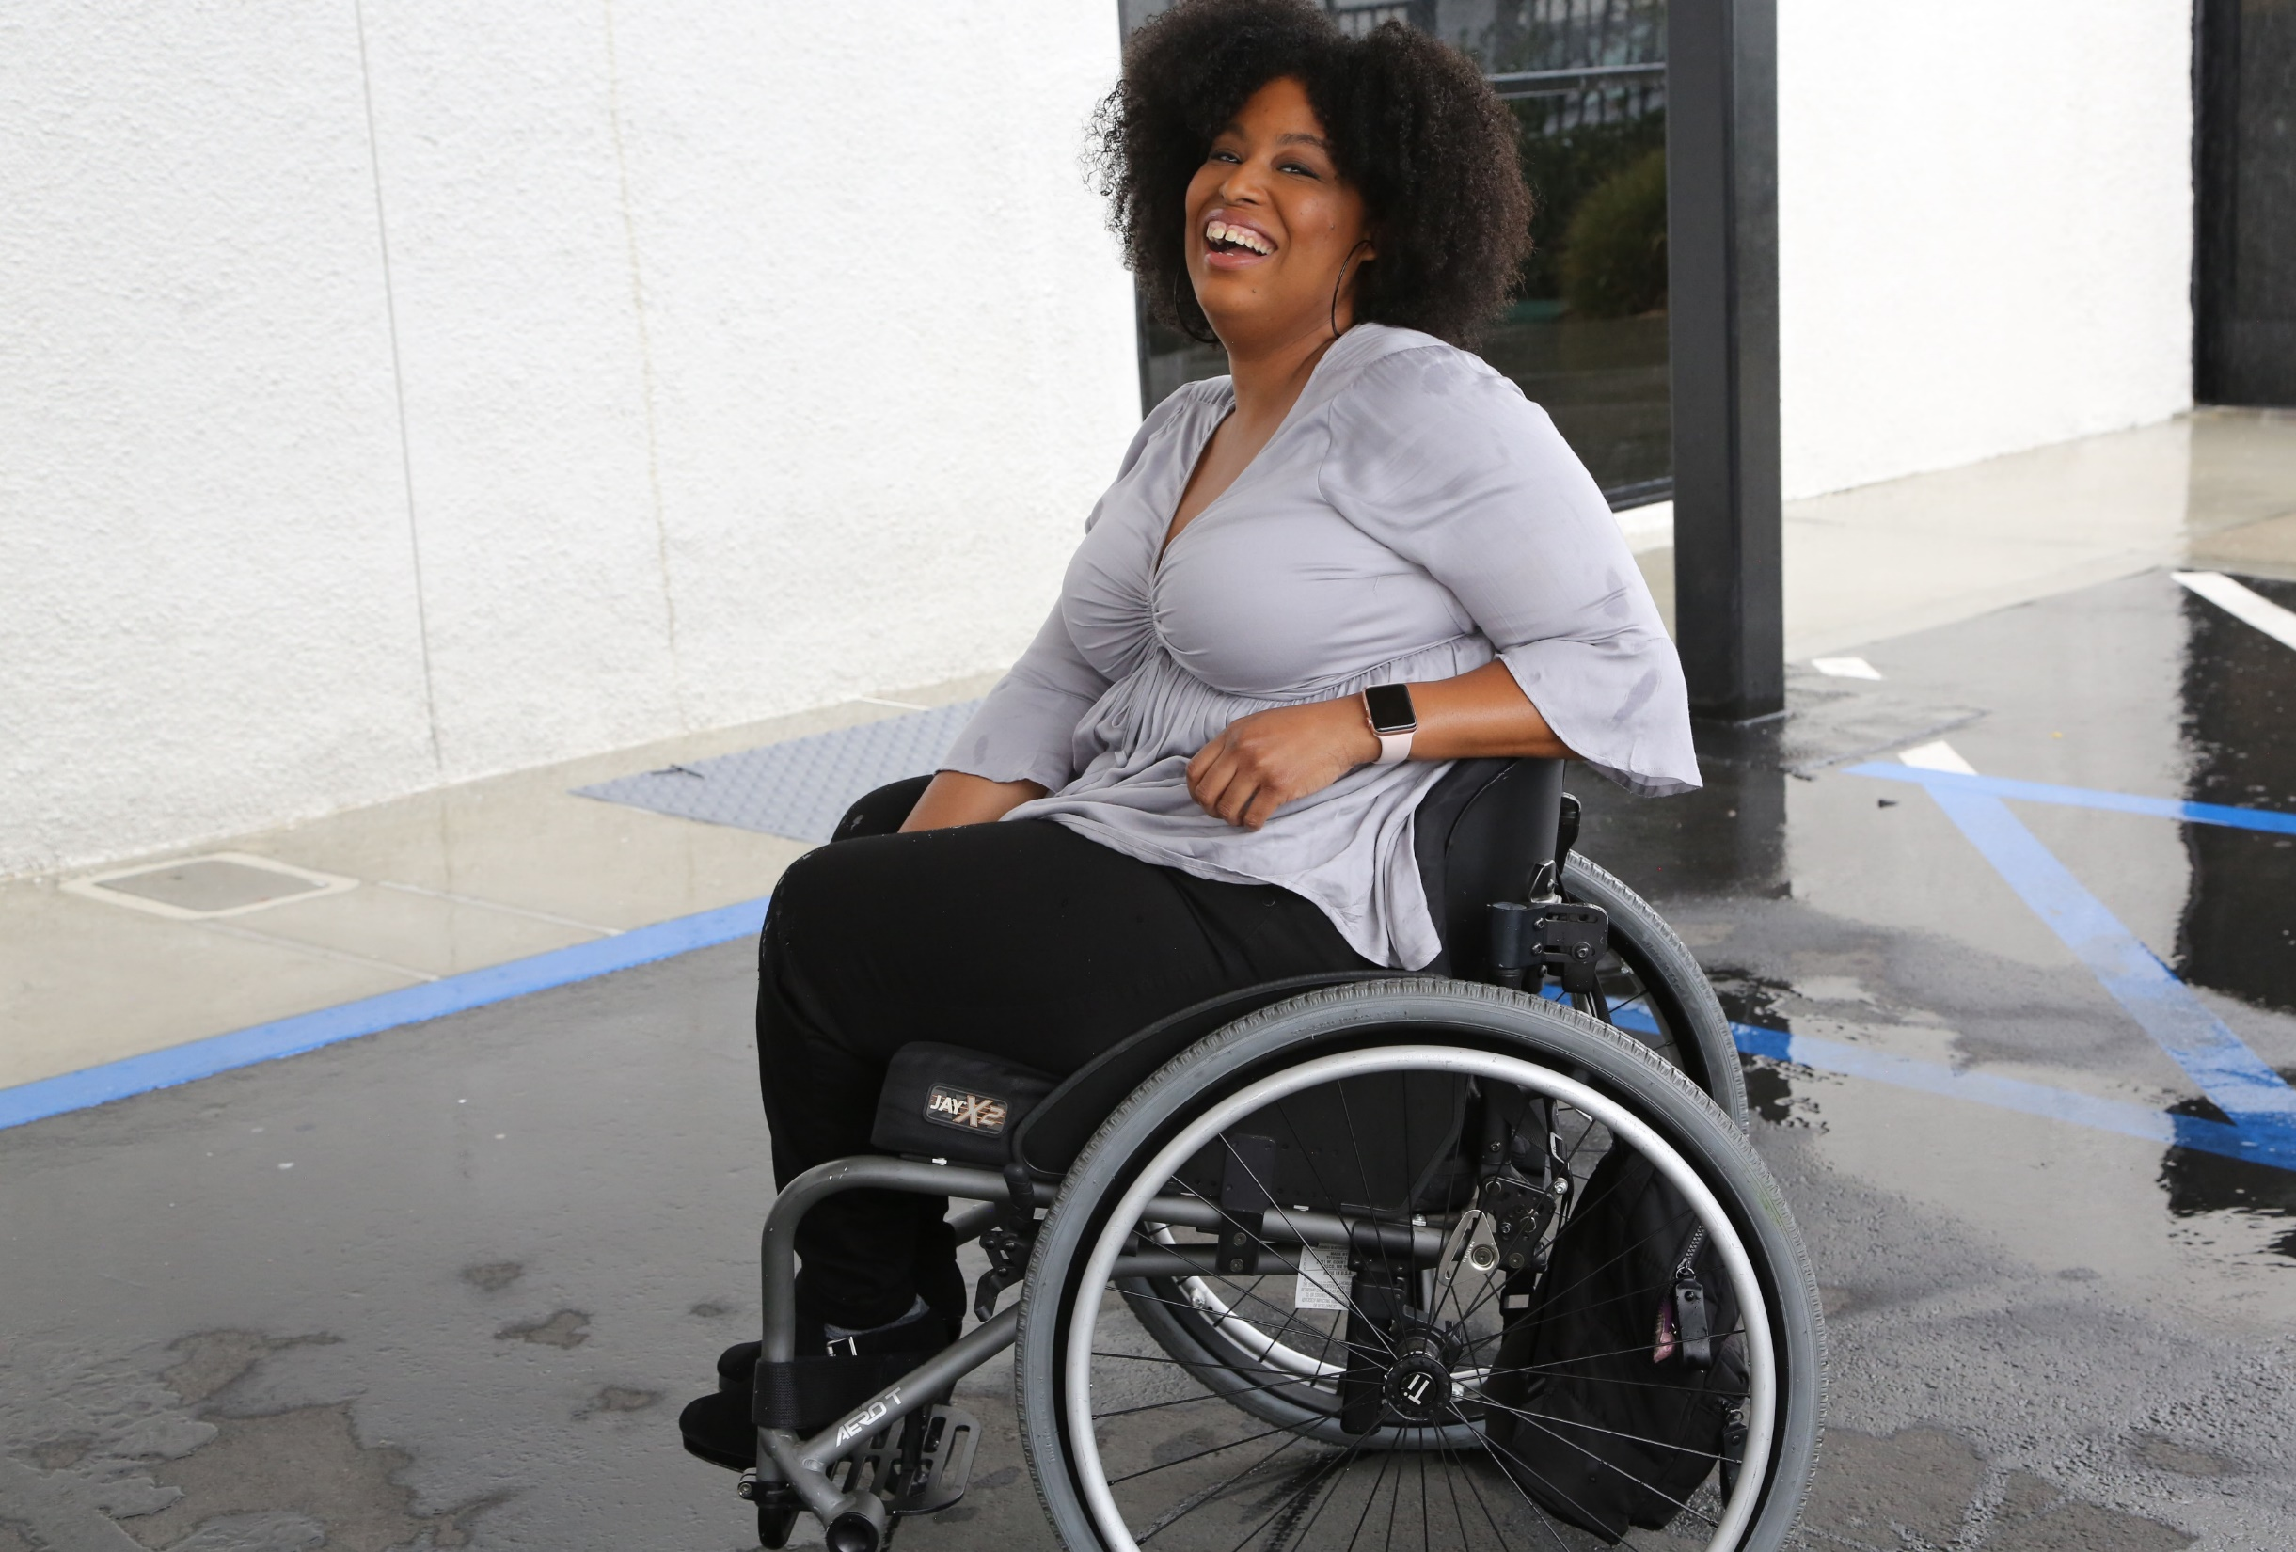
1 in 4 adults
1-in-4
adults have a disability
(physical, sensory, cognitive, mental health or other)
61 million people in America have a disability and the majority of people have a loved one with a disability

Slide 3
Employment Rates for Working-Age Americans w/ & w/o Disabilities, by Race – 2019 (Pre-COVID)
SOURCE: Annual Disability Statistics Supplement: 2020. Univ. of New Hampshire, Institute on Disability.
https://disabilitycompendium.org/compendium/2020-annual-disability-statistics-supplement

Slide 4
Poverty Rates for Working-Age Americans w/ & w/o Disabilities, by Race – 2019 (Pre-COVID)
SOURCE: Annual Disability Statistics Supplement: 2020. Univ. of New Hampshire, Institute on Disability.
https://disabilitycompendium.org/compendium/2020-annual-disability-statistics-supplement

Slide 5
Employment Rates of Minority Populations (Percentage of population) – 2008 to 2018
SOURCES: https://www.statista.com/statistics/793961/employment-among-disabled-us-adults/ https://www.bls.gov/charts/employment-situation/employment-population-ratio.htm

Slide 6
Unemployment Rates for PWDs in 2020
Source: https://www.stlouisfed.org/on-the-economy/2021/november/current-labor-market-workers-disability

Slide 7
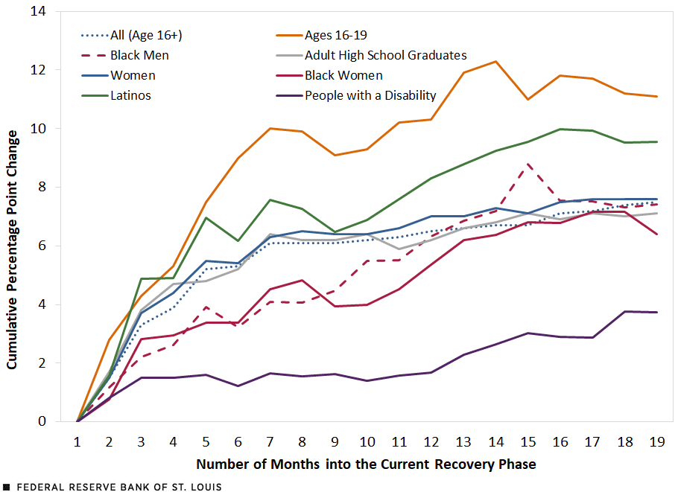
Rebound in the Employment-to-Pop Ratio for Vulnerable Groups during the Recovery
Source: https://www.stlouisfed.org/on-the-economy/2021/november/current-labor-market-workers-disability

Slide 8
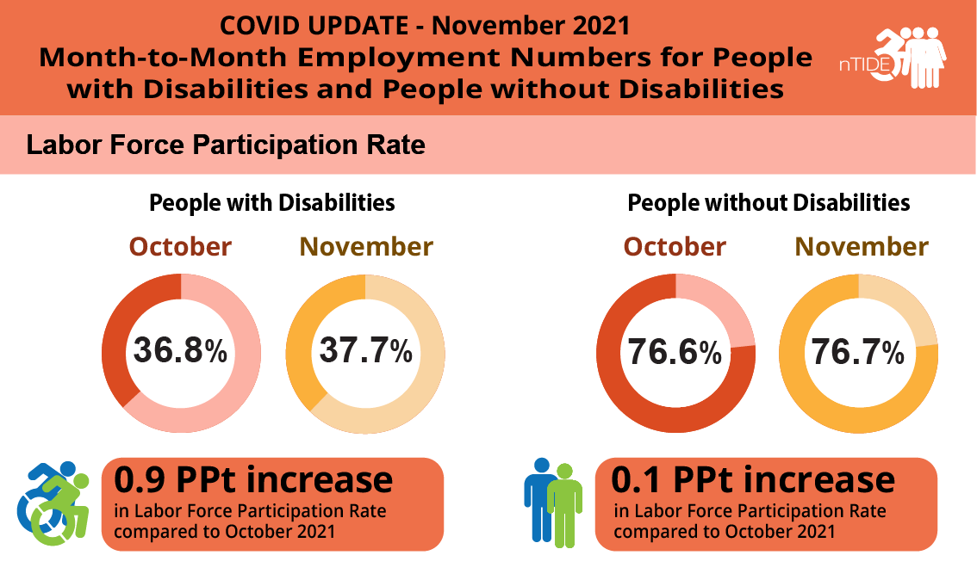
Labor Force Participation Rate in Nov 2021
As of Nov 2021, the labor force participation rate for working-age people with disabilities is now 2 full percentage points higher than it was before COVID-19.
This means that people with disabilities are engaging with the labor force in higher numbers than before the pandemic.

Slide 9
African Americans with Disabilities – 2019
As of 2019, there were 39,412,670 African Americans living in the United States.
Out that number, there are 5,598,758 African Americans living with some form of disability.
There are 3,268,440 working-age African Americans with disabilities. Out of that number, only 1,048,745, or 32.1 percent, have jobs.
By comparison, fully 75.5 percent of African Americans without disabilities have jobs.
The employment gap between African Americans with and without disabilities is 43.4 percentage points.
Fully 32 percent of African Americans with disabilities live in poverty compared to 20.9 percent of African Americans without disabilities.
SOURCES: https://www.statista.com/statistics/793961/employment-among-disabled-us-adults/ https://www.bls.gov/charts/employment-situation/employment-population-ratio.htm

Slide 10
Hispanic/LatinX People with Disabilities - 2019
As of 2019, there were 59,709,293 Hispanic/LatinX people living in the United States.
Out of that number, there are 5,412,676 Hispanic/LatinX people living with some form of disability.
There are 2,969,668 working-age Hispanic/LatinX people with disabilities. Out of that number, fully 1,213,802, or 40.9 percent, have jobs.
By comparison, fully 77.1 percent of Hispanic/LatinX people without disabilities have jobs.
The employment gap between Hispanic/LatinX people with and without disabilities is 36.1 percentage points.
Fully 26 percent of Hispanic/LatinX people with disabilities live in poverty, compared to only 17.5 of Latinx people without disabilities.
SOURCES: https://www.statista.com/statistics/793961/employment-among-disabled-us-adults/ https://www.bls.gov/charts/employment-situation/employment-population-ratio.htm

Slide 11
Asian Americans with Disabilities – 2019
As of 2019, there were 18,297,153 Asian Americans living in the United States.
Out that number, there are 1,315,999 Asian Americans living with some form of disability.
There are 537,908 working-age Asian Americans with disabilities. Out of that number, only 231,821, or 43.1 percent, have jobs.
By comparison, fully 76 percent of Asian Americans without disabilities have jobs.
The employment gap between Asian Americans with and without disabilities is 32.9 percentage points.
Fully 17.9 percent of Asian Americans with disabilities live in poverty compared to 10.6 percent of Asian Americans without disabilities
SOURCES: https://www.statista.com/statistics/793961/employment-among-disabled-us-adults/ https://www.bls.gov/charts/employment-situation/employment-population-ratio.htm

Slide 12
BIPOC Subtotal
In total, there are 2,777,677 American Indian and Alaska Natives living in the United States. Out of that number, approximately 477,954 have disabilities.
In total, there are 612,857 Native Hawaiian and Other Pacific Islander living in the United States. Out of that number, approximately 64,782 have disabilities.
Subtotal: 12,870,169 Black, Indigenous and People of Color (BIPOC) People with Disabilities
SOURCES: https://www.statista.com/statistics/793961/employment-among-disabled-us-adults/ https://www.bls.gov/charts/employment-situation/employment-population-ratio.htm

Slide 13
Women with Disabilities – 2019
As of 2019, there were 165,302,064 women living in the United States.
Out that number, there are 21,201,155 women living with some form of disability.
There are 10,174,591 working-age women with disabilities. Out of that number, only 3,727,186, or 36.6 percent have jobs.
By comparison, fully 73.8 percent of women without disabilities have jobs.
The employment gap between women with and without disabilities is 37.1 percentage points.
Fully 22.5 percent of women with disabilities live in poverty compared to 13.5 percent of women without disabilities.
SOURCES: https://www.statista.com/statistics/793961/employment-among-disabled-us-adults/ https://www.bls.gov/charts/employment-situation/employment-population-ratio.htm

Slide 14
Students with Disabilities in K-12 Schools
Total Number of K-12 students with disabilities: 6,561,998
85,680 American Indian or Alaska Native students with disabilities
165,353 Asian students with disabilities
1,158,862 Black or African American students with disabilities
1,826,344 Hispanic/LatinX students with disabilities
23,809 Native Hawaiian or Other Pacific Islander students with disabilities
283,819 Biracial students with disabilities
3,018,131 White students with disabilities
Subtotal of BIPOC Students with Disabilities: 3,543,867
Source: IDEA Section 618 Data Products: Static Table - https://www2.ed.gov/programs/osepidea/618-data/static-tables/index.html

Slide 15
Percentage & Number of Disability by Type - SWDs
 | Autism | Deaf-blindness | Developmental delay | Emotional disturbance | Hearing disabilities | Intellectual disabilities | Multiple disabilities | Orthopedic Disability | Other health conditions | Specific learning disabilities | Speech or language | Traumatic brain injury (TBI) | Visual disabilities
Number of SWDs with that Disability | 717,716 | 1,553 | 194,919 | 345,782 | 64,311 | 419,196 | 127,126 | 31,361 | 1,079,301 | 2,379,448 | 1,090,207 | 24,993 | 24,243
Percentage of SWDs with that Disability | 11% | 0.02% | 2.9% | 5% | 0.9% | 6% | 1.9% | 0.4% | 16% | 36% | 16% | 0.3% | 0.3%
In total, there are 6,561,998 students with disabilities in America’s Public School System today.
Source: IDEA Section 618 Data Products: Static Table - https://www2.ed.gov/programs/osepidea/618-data/static-tables/index.html

Slide 16
Demographics of K-12 Students with Disabilities
BIPOC Students with Disabilities make up 54 percent of all Students with Disabilities in America’s schools today.
Source: IDEA Section 618 Data Products: Static Table - https://www2.ed.gov/programs/osepidea/618-data/static-tables/index.html

Slide 17
Disability Statistics in California (Pre-COVID)
There are 4,131,700 Californians with disabilities.
There are 1,910,288 working-age Californians with disabilities. Out of that number, 731,093 working-age Californians with disabilities had jobs in 2019. California’s disability employment rate was 38.2 percent in 2019.
The employment rate for working-age Californians without disabilities was 76.4 percent in 2019.
There was a 38.1 percent Gap in Labor Force Participation Rates between PWDs and non-PWDs.
The poverty rate for working-age Californians with disabilities was 22.8 percent.
Gov. Gavin Newsom with Philip Kahn-Pauli of RespectAbility
Source: Annual Disability Statistics Compendium: 2020 Durham, NH: Univ. of New Hampshire, Institute on Disability
https://disabilitycompendium.org/

Slide 18
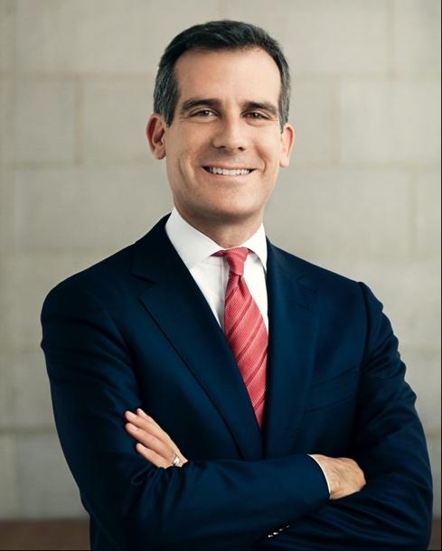
Disability Statistics in Los Angeles
In total, there are 992,719 Angelenos with disabilities living in L.A. County.
There are 466,385 working-age Angelenos with disabilities living in L.A. County. In the economic expansion prior to COVID-19, only 169,322 working-age Angelenos with disabilities had jobs. L.A. County’s disability employment rate was only 36.3 percent in 2019.
By contrast, the employment rate for Angelenos without disabilities was 74.7 percent.
That means that there is a 38.4 percentage point gap in the labor force participation rates between Angelenos with and without disabilities.
Mayor Eric Garcetti (D)
Source: Annual Disability Statistics Compendium: 2020 Durham, NH: Univ. of New Hampshire, Institute on Disability
https://disabilitycompendium.org/

Slide 19
Racial Disparities for People with Disabilities in California
180,888 working-age African Americans with disabilities
53,874 or 29.8 percent had jobs in 2019.
28.5 percent of African Americans with disabilities live in poverty
18.9 percent of African Americans without disabilities.
684,515 working-age Latinx people with disabilities.
274,399 or 40.1 percent had jobs in 2019.
21 percent of Latinx people with disabilities live in poverty
15.6 of Latinx people without disabilities.
167,672 working-age Asian Americans with disabilities.
68,725 or 41 percent have jobs.
18.4 percent of Asian Americans with disabilities live in poverty
9.3 percent of Asian Americans without disabilities.
SOURCE: Annual Disability Statistics Supplement: 2020. Univ. of New Hampshire, Institute on Disability.
https://disabilitycompendium.org/compendium/2020-annual-disability-statistics-supplement

Slide 20
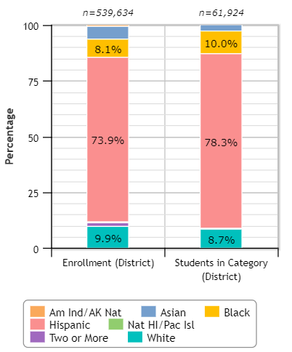
LA Unified & Students with Disabilities
78.3 percent of LAUSD’s students with disabilities are Hispanic
10 percent of LAUSD’s students with disabilities are African-American
8.7 percent of LAUSD’s students with disabilities are White
Overall, 11.5 percent of LAUSD students are students with disabilities.
Source: Civil Rights Data Collection: https://ocrdata.ed.gov/Page?t=d&eid=30388&syk=8&pid=2396

Slide 21
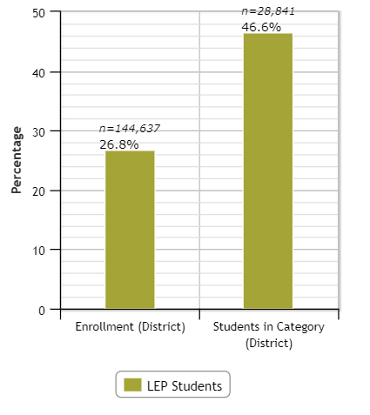
LA Unified & Students with Disabilities – LEP
Overall, 26.8 percent of LAUSD students have Limited English Proficiency (LEP)
46.6 percent of LAUSD’s students with disabilities have Limited English Proficiency (LEP)
Source: Civil Rights Data Collection: https://ocrdata.ed.gov/Page?t=d&eid=30388&syk=8&pid=2396

Slide 22
California High School Grad Rates for Students w/ & w/o Disabilities, by Race – Class of 2020
Source: 2019-20 Four-Year Adjusted Cohort Graduation Rate Statewide Report
https://dq.cde.ca.gov/dataquest/dqcensus/CohRate.aspx?cds=00&agglevel=state&year=2019-20

Slide 23
LAUSD High School Grad Rates for Students w/ & w/o Disabilities, by Race – Class of 2020
Source: 2019-20 Four-Year Adjusted Cohort Graduation Rate Los Angeles County Report
https://dq.cde.ca.gov/dataquest/dqcensus/CohRate.aspx?cds=19&agglevel=county&year=2019-20&initrow=&ro=y

Slide 24
Disability by Type – SWDs in LAUSD and CA
 | Intellectual Disability | Hard of Hearing | Deaf | Speech or Language Disability | Visual Disability | Emotional Disturbance | Orthopedic Disability | Other health conditions | Specific Learning Disability | Deaf-Blindness | Multiple Disability | Autism | Traumatic Brain Injury (TBI)
Number of SWDs with that Disability in LAUSD | 9,655 | 2,825 | 695 | 34,621 | 843 | 4,999 | 3,020 | 24,472 | 74,623 | 25 | 1,118 | 33,834 | 289
Number of SWDs with that Disability in California | 43,770 | 10,657 | 3,223 | 164,698 | 3,405 | 25,233 | 9,916 | 104,792 | 300,295 | 114 | 7,308 | 120,095 | 1,541
In total, there are 191,019 students with disabilities in LAUSD
There are 795,047 students with disabilities in CA’s K-12 schools.
Source: Special Education Enrollment by Ethnicity and Disability - https://bit.ly/3fCEAaD

Slide 25
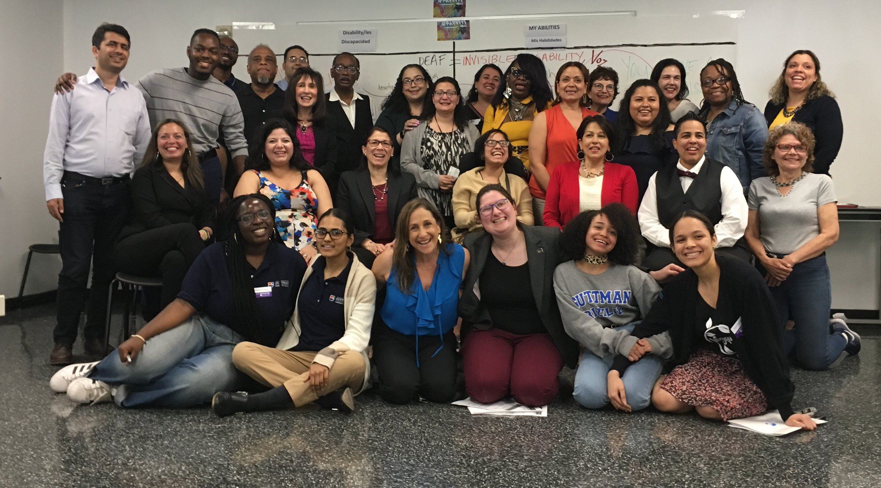
More statistics
Enable people with disabilities to have a better future, just like anyone else!
Twitter: @respect_ability
Facebook: Facebook.com/RespectAbilityUSA
Donate: RespectAbility.org/Donate
For more information email JenniferM@RespectAbility.org
.

