Slide 1
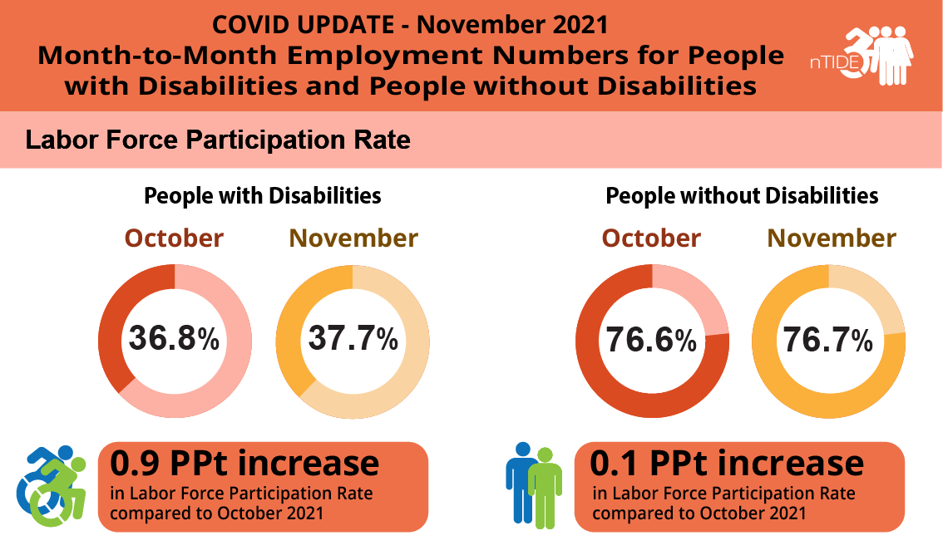
Job Growth for Disabled Significantly Outpaces that of Non-Disabled Workers: Labor Force Participation Rate in November 2021
As of November 2021, the labor force participation rate for working-age people with disabilities is now 2 full percentage points higher than it was before COVID-19.
This means that people with disabilities are engaging with the labor force in higher numbers than before the pandemic.

Slide 2
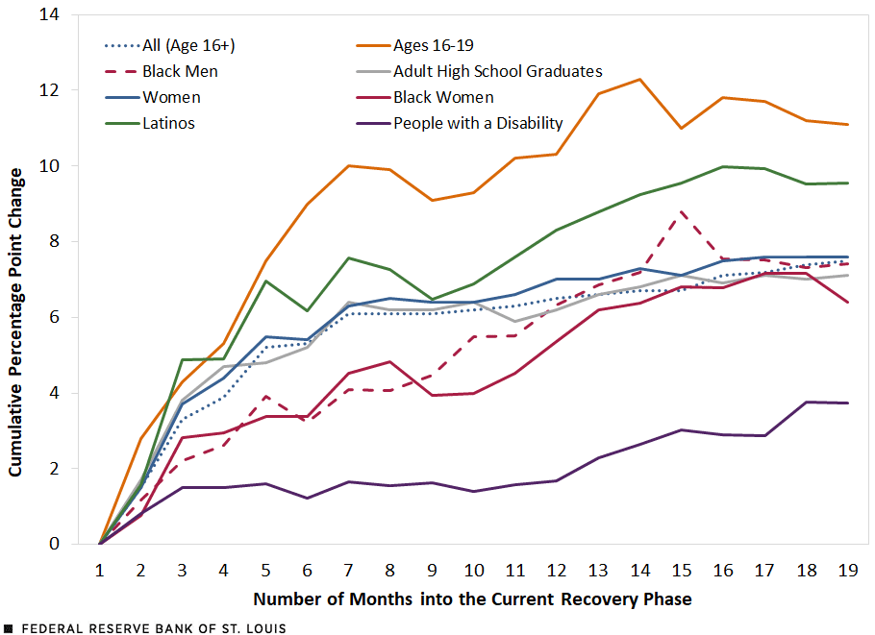
Rebound in the Employment-to-Pop Ratio for Vulnerable Groups during the Recovery
Source: https://www.stlouisfed.org/on-the-economy/2021/november/current-labor-market-workers-disability

Slide 3
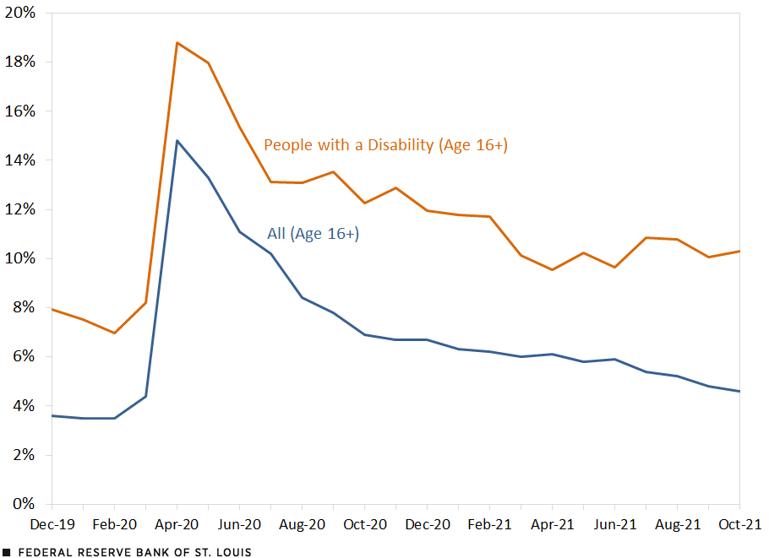
Unemployment Rates for People with Disabilities (PWDs) Dropped in 2020
Source: https://www.stlouisfed.org/on-the-economy/2021/november/current-labor-market-workers-disability

Slide 4
Employment Rates of Minority Populations
(Percentage of population) – 2008 to 2018
SOURCES: https://www.statista.com/statistics/793961/employment-among-disabled-us-adults/ https://www.bls.gov/charts/employment-situation/employment-population-ratio.htm

