Slide 1

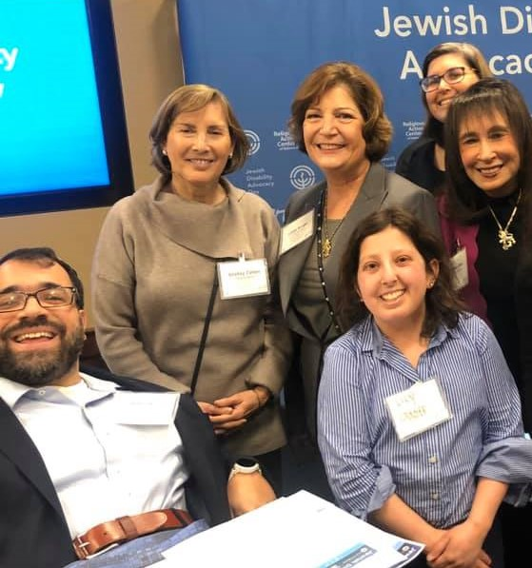
Ensuring Best Practices for Disability Inclusion
Inclusion of People with Disabilities:
Trends in the Jewish Community
Jewish Family Service of Greater Houston
Matan Koch
December 17, 2021

Slide 2
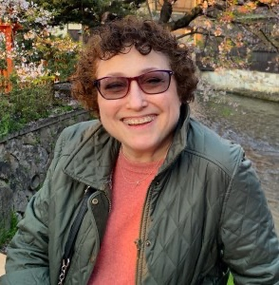
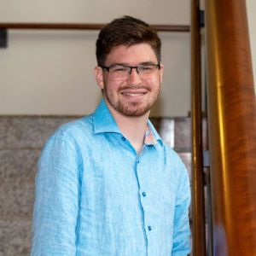
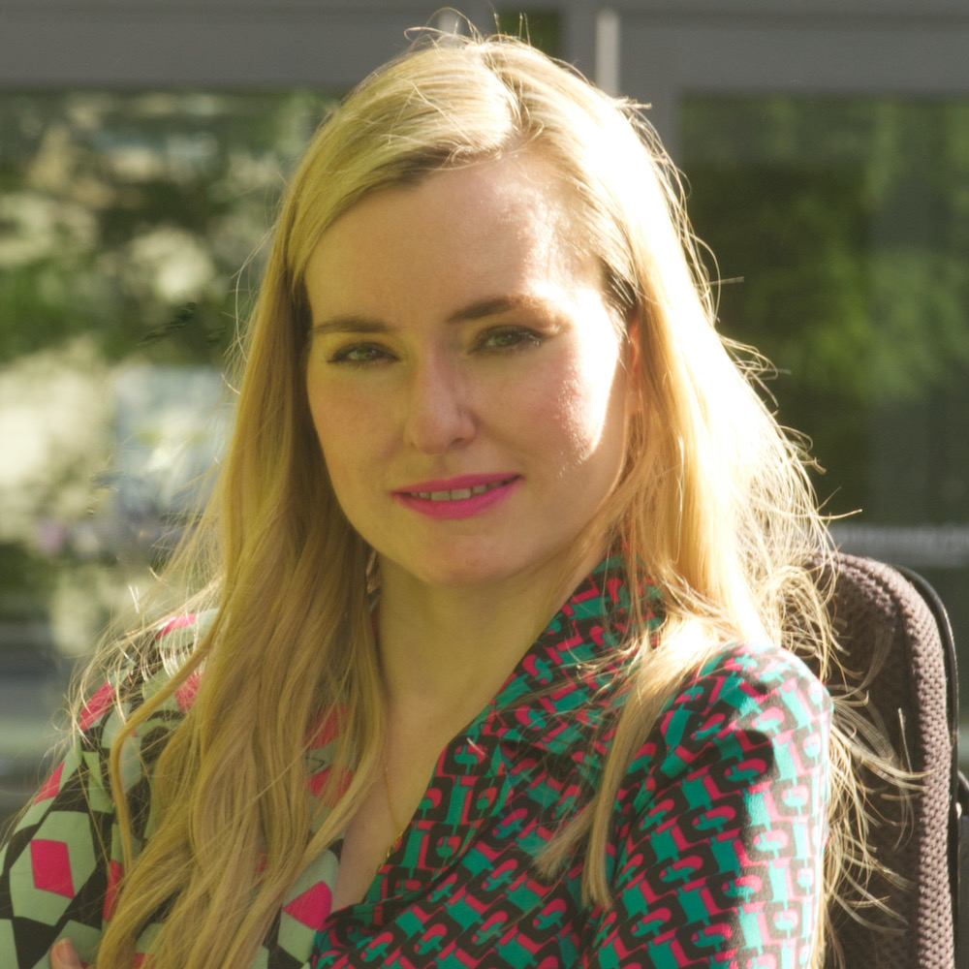
Disabilities Are….
Temporary and Permanent
Visible and Nonvisible
From Birth or Acquired Later

Slide 3
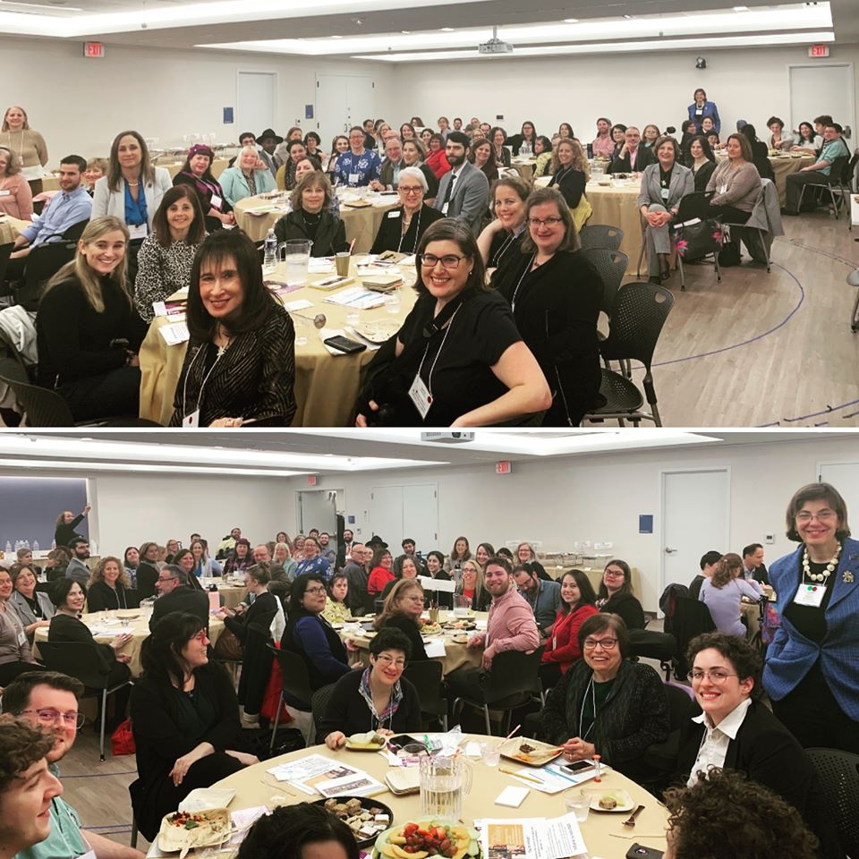
Three Facts
Anyone can acquire a disability from aging, an accident, trauma, and/or illness.
The disability community is innovative and resilient.
People with disabilities are diverse and part of all communities, including the Jewish community.

Slide 4
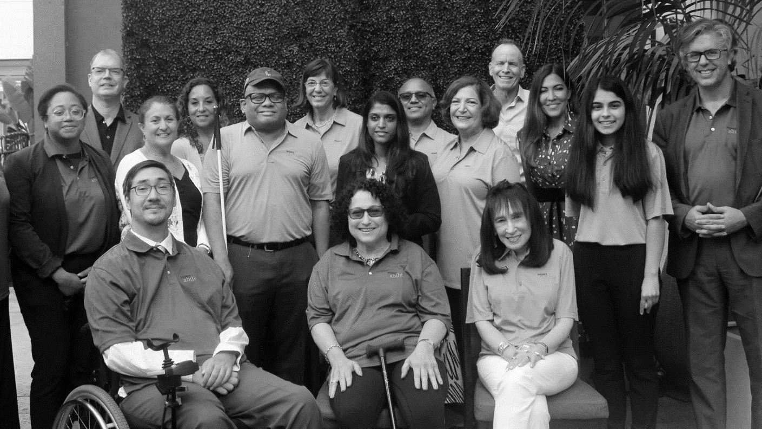
Including the D – Disability – in Diversity
Organizations are at their best when they welcome, respect and include people of all backgrounds. This includes people with disabilities.

Slide 5
Theory of Change
MISSION
RespectAbility fights stigmas and advances
opportunities so people with disabilities can fully
participate in all aspects of community.

Slide 6
Survey Methodology

Slide 7
Methodology of the Poll
The survey was administered online from October 5 – October 19, 2021. The questions reached a total of 2,924 respondents.
Respondents were reached through:
Paid email blasts (JTA, The Forward, Jewish Journal)
Email blasts to RespectAbility and partner lists, as well as social media
Individual outreach to Jewish leaders
This is not a random sample and will include more engaged Jews and people with a disability connection than in the general population. The conclusions carry statistical significance within the respondent group, because it is a large population with more than 2,300 Jews responding.
Due to rounding, some of the numbers in the presentation will not always add to 100%.
Same methodology as 2018 survey

Slide 8
Who Took the Poll
2,321 Jewish Respondents – 1477 people in the disability community
192 Jewish Respondents served by the Jewish Federation of Greater Houston
39 people with disabilities
107 with a close friend or family member with a disability
52 work professionally on behalf of people with disabilities
38 regularly volunteer for disability causes
20 primary and unpaid caregiver to a person with a disability
32 people with no disability connection
Note: Non-Jewish respondent data to be released at a later date.

Slide 9
Who Took the Poll Nationwide
Disability | Respondents
On The Autism Spectrum | 243
Learning Disability | 281
Developmental Disability | 155
Cognitive Disability | 134
Intellectual Disability | 100
Speech Or Language Disability | 127
Mental Health | 380
Orthopedic Disability | 217
Hard Of Hearing/Hearing Loss | 255
Deafness | 50
Blindness Or Low Vision | 63
Traumatic Brain Injury | 41
Neoromuscular Disability | 102
Neurological Disability | 143
Imuno-Deficiency | 74
Auto-Immune | 184
Chronic Pain | 275
Other (please specify) | 216
What type of disability do you have or does a member of your household have? (Please check all that apply)
Note: large number of people with nonvisible disabilities

Slide 10
Major Trends: 2018-2021

Slide 11
65-1 Margin: People Feel Things Are Better
Compared to five years ago, how is the Jewish community at including people with disabilities?
Choices | Houston 2021 | Houston 2018 | Houston Change | 2021 | 2018 | Change
Much Better | 30% | 37% | -7% | 27% | 19% | +8%
A Little Better | 37% | 39% | -2% | 38% | 37% | +1%
About The Same | 18% | 9% | +9% | 20% | 16% | +4%
Somewhat Worse | - | - | - | 1% | 1% | -
Much Worse | - | - | - | 0.19% | 0.18% | -
I Don't Know | 15% | 15% | - | 14% | 27% | -13%

Slide 12
Meaningful Movement: Good News Overall
Overall, how well is the Jewish community doing at including people with disabilities in synagogues, Jewish organizations, and communal activities?
Choices | Houston 2021 | Houston 2018 | Houston Change | 2021 | 2018 | Change
Extremely Well | 10% | 4% | +6% | 11% | 3% | +8%
Very Well | 30% | 26% | +4% | 20% | 15% | +5%
Somewhat Well | 37% | 48% | -11% | 41% | 43% | -2%
Not So Well | 7% | 10% | -3% | 14% | 16% | -2%
Not At All Well | 1% | 2% | -1% | 3% | 2% | +1%
I Don’t Know | 15% | 10% | +5% | 12% | 21% | -9%

Slide 13
NPwDs 2x as likely to say things going extremely well
Overall, how well is the Jewish community doing at including people with disabilities in synagogues, Jewish organizations, and communal activities?
Choices | PwDs | NPwDs
Extremely Well | 7% | 14%
Very Well | 18% | 23%
Somewhat Well | 41% | 36%
Not So Well | 20% | 9%
Not At All Well | 4% | 1%
I Don’t Know | 12% | 17%

Slide 14
Faith Inclusion Overall is Strong but Inconsistent
In the faith-based institutions and groups that you are active in, do you feel that people with disabilities are included? (i.e. social activities, men's clubs/sisterhoods, youth groups)
National
Houston

Slide 15
Differences Felt by PwDs: Big Gap in Perceptions
In the faith-based institutions and groups that you are active in, do you feel that people with disabilities are included? (i.e. social activities, men's clubs/sisterhoods, youth groups)
Answer | Percentage | PwD | NPwD
Yes | 37% | 31% | 42%
Sometimes | 42% | 43% | 37%
No | 7% | 10% | 3%
I Don’t Know | 9% | 9% | 12%
I am not active in any faith-based institutions | 6% | 8% | 7%

Slide 16
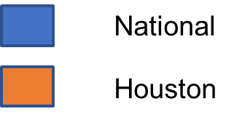
Good News: Majority See Jewish Groups Have Diversity, Equity, Inclusion Commitments
Has the leadership of the faith organization you most closely align with made a specific commitment to diversity, equity, and inclusion that has been made public to management, staff, stakeholders, and the public?

Slide 17
Good News: Disability is Included in Diversity Commitments
(If yes to diversity commitment) Please check all the diversity areas that were specifically named:
Choices | Houston | Percentage
Race | 65% | 72%
Gender | 69% | 71%
Sexual Orientation/Gender Identity | 71% | 71%
Disability | 95% | 88%
Ideology | 31% | 29%
Other (please specify) | 3% | 8%

Slide 18
Challenges

Slide 19
Barriers
Which of the following do you think is the biggest barrier to fully including more people with disabilities in your faith community?
Answer | Houston | National
There is prejudice and unacknowledged stigma against people with disabilities. | 37% | 32%
Inclusion is expensive and the community has limited resources. | 18% | 21%
Religious leaders and activists want to be inclusive, but they don’t know how. | 18% | 19%
Including people with disabilities can be complicated and we don’t have the expertise to serve every need. | 13% | 15%
Other emergencies and communal needs are more pressing. | 8% | 5%
There aren’t many people with disabilities and those in the community are included. | 3% | 4%
The Americans with Disabilities Act (ADA) exempted religious institutions. | 2% | 3%

Slide 20
A Tale of Two Synagogues
Where in the community do you find the most access and inclusive environment for people with disabilities?
Where in the community do you find the most challenges for access and inclusion of people with disabilities?
Choices | Access-Houston | Challenge- Houston
Jewish Federation | 7% | 4%
Jewish Day Schools | 4% | 12%
Jewish Summer Camps | 1% | 4%
Synagogues | 17% | 10%
Social Organizations such as Pop-Up Shabbat, Chavurahs | 1% | 3%
Jewish Human Services Organizations | 30% | 3%
Jewish Social Justice/Civic Engagement/Advocacy Groups | 4% | 1%
I Don't Know | 26% | 57%
Other (please specify) | 11% | 7%

Slide 21
Room for Growth

Slide 22
Leadership: Houston
Do you know of any clergy or staff with disabilities at your own faith-based institutions?

Slide 23
Leadership: Houston (2)
Do you feel that people with disabilities are encouraged to serve on the boards and committees of your faith-based institutions?

Slide 24
Exclusion: Still Too Prevalent
Have you or another person with a disability in your household ever been turned away from an activity at an organization in your faith community because of its inability or unwillingness to make a reasonable accommodation?
22% of PwDs report exclusion nationwide
vs
12% in Houston

Slide 25
There were painful Houston experiences, but many more successes
OPTIONAL: If you have seen a particular example of successful disability inclusion in your faith community, please share it with us.
“Houston's Jewish Family Service has extensive programs and initiatives serving people with disabilities. It also does a excellent job heightening inclusion awareness and initiatives throughout the community, as well as being an Avenue for advocacy. Dedicated staff, stakeholders, and volunteers have worked tirelessly to educate and sensitize the Jewish and general communities: effecting long overdue change.”
“Our Congregation was one of the first to formalize inclusion by establishing an Inclusion Committee with the goal of making our facility accessible; welcoming; participatory; more caring; and a place where the disabled will want to be. We have been successful in many areas. So, we installed automatic doors to our building, the rest rooms, etc.; set aside areas in the different parts of the Sanctuary for disabled seating; installed ramps; held religious events open to all of the disabled community to attend at no cost; and more.”
“Celebration Company at JFS Houston is phenomenal!”
OPTIONAL: If you or someone with a disability has been excluded, please share when and what happened and any ideas you have in order to ensure it doesn’t happen again.
“Shadchans are often prejudiced and unhesitatingly refuse a person with a disability. Addressing the issue in publications widely read by Orthodox Jews could help a bit.”

Slide 26
Virtual Formats Can Significantly Increase Access
How has the increase in virtual formats/online participation impacted your ability to access and be included in your faith community?
Choices | Houston | Total Percent | PwDs
Significantly Increased my ability to participate | 35% | 34% | 41%
Somewhat Increased my ability to participate | 34% | 33% | 32%
Somewhat Decreased my ability to participate | 4% | 6% | 6%
Significantly Decreased my ability to participate | 2% | 3% | 3%
No Impact | 25% | 25% | 18%
Webinar with more information on how to be accessible

Slide 27
Overwhelmingly Positive Messaging Works
Which of the following do you think is the most convincing reason why inclusion of people with disabilities should be a more important priority for the Jewish community?
Choices | Houston 1st Choice
We are a stronger community when we are welcoming, diverse, and respect one another. Everyone should feel that their presence and participation is welcome and meaningful. We want our children, parents, grandparents and friends with disabilities to have an equal opportunity to fully participate in our community. | 58%
Jews should be at the forefront of social justice and inclusion of all people, including in racial equity, sexual orientation and identity, disability status and other marginalized identities. | 16%
Problems are best solved by working with people who have experienced them firsthand and understand solutions that work. Jews with disabilities should be at decision making tables, just like anyone else. | 8%
Jewish tradition teaches us to include people with disabilities. Some of our greatest religious leaders had disabilities, including Moses, Jacob and Isaac. | 8%
If we value Jewish survival, that means we value all Jews, everyone is needed. If we exclude a Jew with a disability, we will lose not only them but risk alienating their entire family as well. | 9%

Slide 28
Education Level of Jews With & Without Disabilities Are Similar
What is the highest level of education that you have completed?
Choices | Houston | Total Jewish | PwD | Comm | NPwD
Some High School | 1% | -- | -- | -- | 1%
Certificate Of Completion | 1% | -- | 1% | -- | --
High School Graduate/GED | 1% | 2% | 3% | 2% | 1%
Some College/Vocational School | 9% | 7% | 9% | 6% | 8%
Associate Degree | 4% | 3% | 4% | 3% | 3%
Bachelor’s Degree | 35% | 27% | 28% | 28% | 26%
Graduate Degree | 36% | 39% | 40% | 41% | 36%
Professional Degree (JD, MD, DVM, etc.) | 15% | 20% | 14% | 20% | 25%

Slide 29
Jews with Disabilities 2X more likely to be single
What is your marital status?
Choices | Total Jewish | PwD | Comm | NPwD
Single | 17% | 30% | 15% | 12%
Married | 66% | 48% | 70% | 67%
Divorced/Separated | 8% | 11% | 8% | 9%
Widowed | 7% | 7% | 5% | 10%
Civil Union/Partner | 2% | 3% | 2% | 3%

Slide 30
Household Income: PwDs lower incomes
What is your approximate average household income?
Choices | Total Jewish | PwD | Comm | NPwD
$0-$49,999 | 14% | 26% | 13% | 8%
$50,000-$99,999 | 18% | 21% | 18% | 18%
$100,000-$149,999 | 13% | 14% | 14% | 13%
$150,000-$199,999 | 8% | 6% | 8% | 7%
$200,000 and up | 15% | 6% | 17% | 17%
I prefer not to answer | 31% | 27% | 30% | 36%

Slide 31
Respondents Prioritize Fighting Stigmas,
Education, Skills and Jobs
How important are each of the following to you?
Choices | Not At All Important | Not So Important | Somewhat Important | Very Important | Extremely Important | Weighted Average
Enabling people with disabilities to get the education, skills and jobs they need to succeed | -- | 1% | 3% | 26% | 70% | 3.65
Fighting stigmas and low expectations that undermine and limit people with disabilities | -- | 2% | 4% | 31% | 63% | 3.56
Empowering people with disabilities to get leadership opportunities and have seats at decision-making tables | 2% | 1% | 9% | 36% | 52% | 3.36
Increasing inclusion of people with disabilities in faith-based organizations and institutions | -- | 2% | 14% | 43% | 41% | 3.23

Slide 32
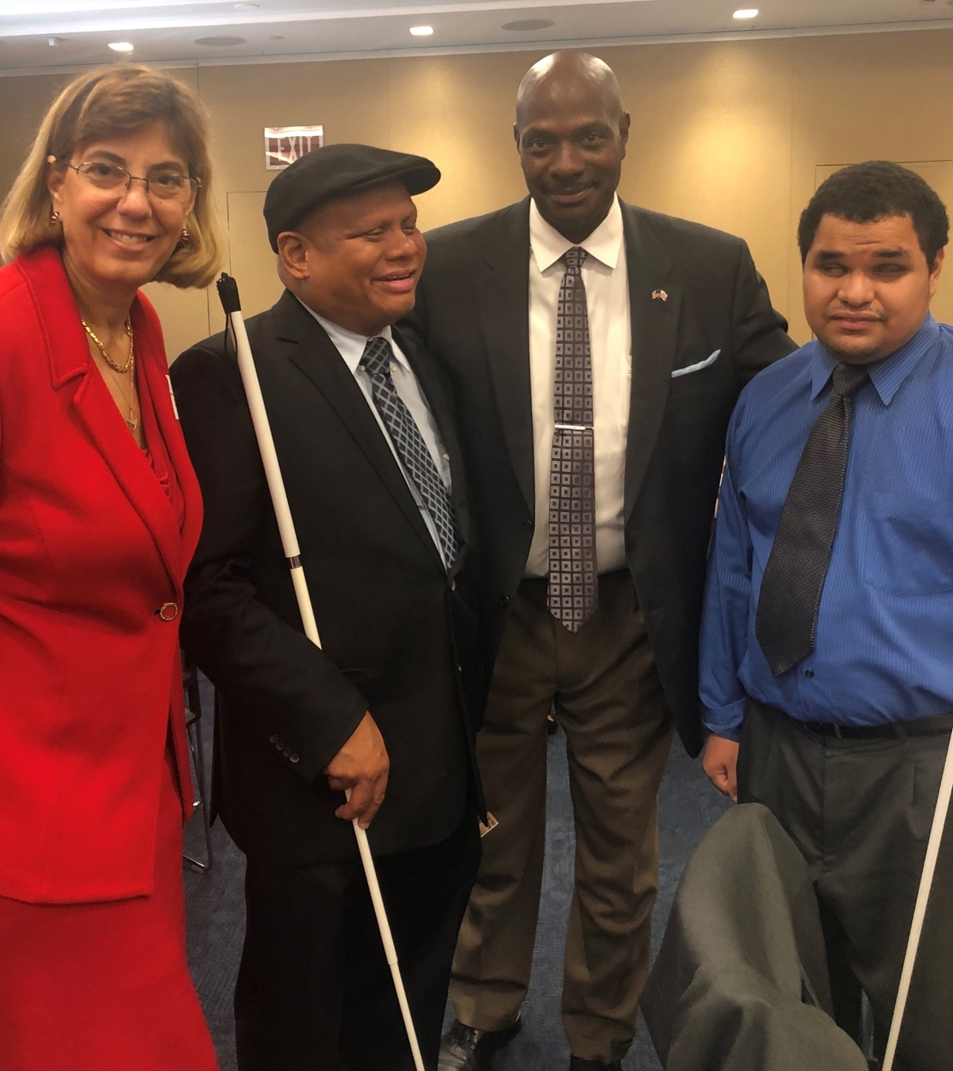
7 Tips in
Disability Inclusion

Slide 33
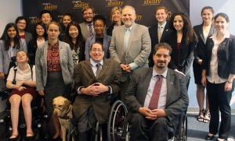
Tip #1
Commit Publicly to Inclusion of People with Disabilities
The message that all people are of equal value and must be respected and treated fairly, must be communicated by the President and Board of your synagogue/organization.
Make it a consistent part of your messaging, and build it into all DEI programming, human resource systems, and communications.

Slide 34
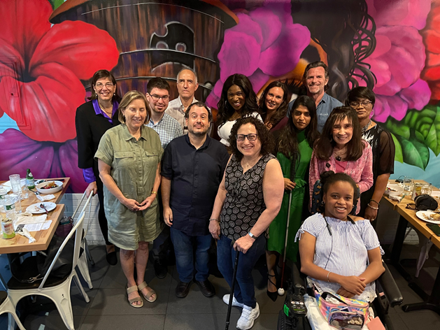
Tip #2
Recognize Your Own Implicit Bias
Major studies have found that people with disabilities are viewed through the lens of what we CANNOT do, instead of what we can achieve. However, people with disabilities can be the most talented people when their skills and interests are aligned and are provided the appropriate accommodations.

Slide 35
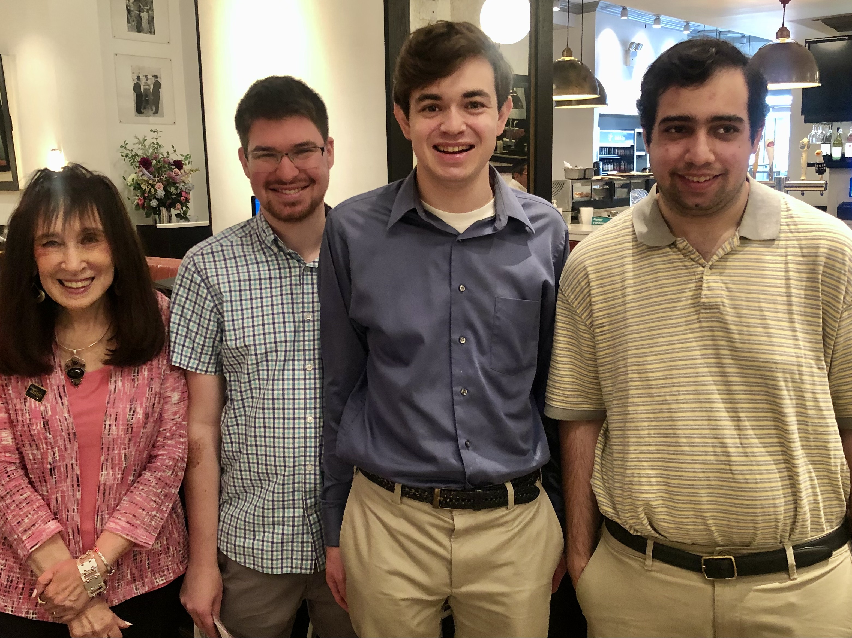
Tip 3:
Onboard talent with disabilities
People with disabilities are loyal to our employers and are used to solving problems creatively.
People with disabilities are a largely untapped talent pool
Know & grow the population you serve:
Employing people with disabilities can help to serve the 1-in-5 Jewish American adults with disabilities
Engaging with people with disabilities can increase your impact

Slide 36
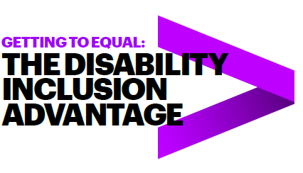
Benefits of Hiring People with Disabilities
Followed 140 US companies from 2015-2018
45 Inclusion Champions, 95 peer companies
Over four years, the Champions who embraced the talent of workers with disabilities vastly outperformed their peers. They had:
2X higher income
30% higher economic profit margin
Up to 30% less staff turnover
Read the full study online!
* Study completed by Accenture, Disability:IN and the American Association of People with Disabilities
Notes:
Do we have any studies that focus on impact, which may be more applicable to nonprofits than the Accenture study?

Slide 37

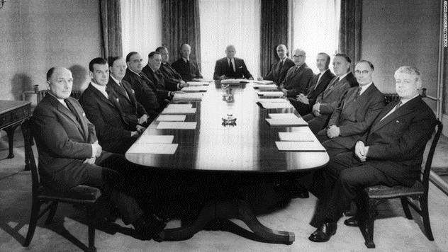
Tip #4: Learn To Recognize Ableism, And Call It Out As You Would Racism Or Sexism
Nobody Would Accept This Sign Today
Most people recognize the problem with this picture

Slide 38
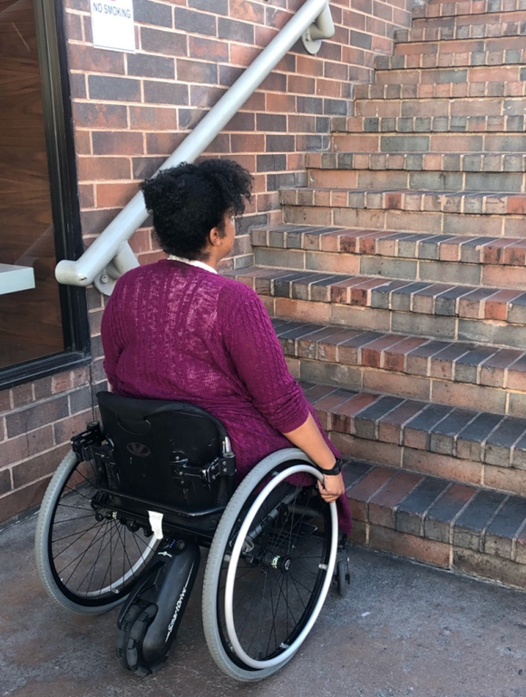
This Is Ableism – What Can You Do?
When you enter a building that does not have a doorway or bathroom accessible to someone who uses a wheelchair, do you recognize it as an ableist choice, and advocate for a solution?
When a virtual public meeting is happening over Zoom without free instant captioning turned on – so people who are Deaf and/or Hard of Hearing can participate – do you call out the ableism and ask them to click on the button to enable accessibility?
When organizations post photos of large groups at events without a single person with a visible disability, do you call out the omission?
Once you look for ableism, you will realize it is everywhere.
Recognizing it is the first step to fixing it.

Slide 39
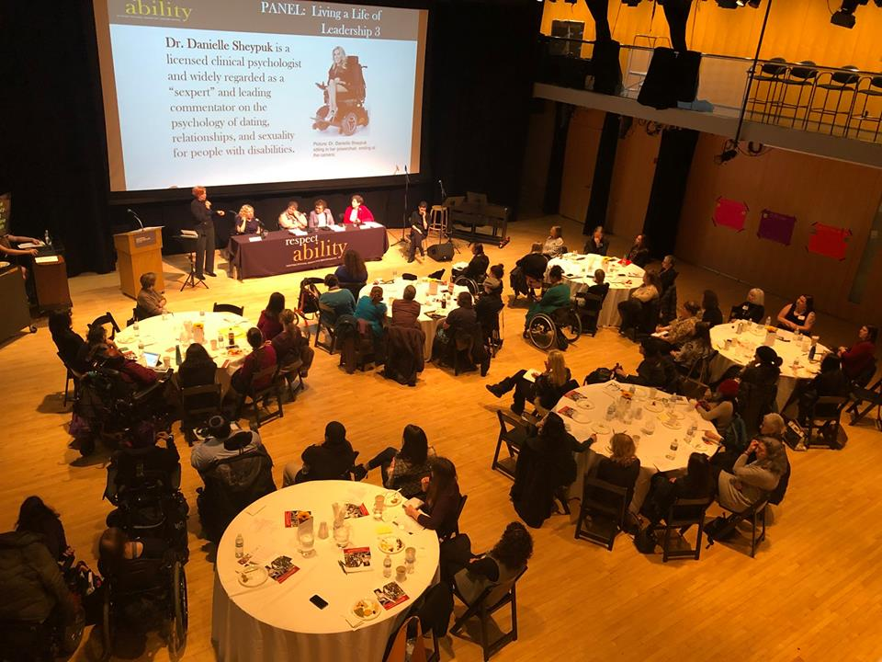
Tip #5: Ensuring Accessible Events: In-Person and Virtual
At your first planning meeting, make sure to:
Ensure that your event will be held in an accessible location, including parking spots and transportation. This includes entrances and bathrooms
Make it easy and comfortable for employees, board members, volunteers and participants to request accommodations beforehand
Include this phrase in every registration form:
“Do you need any accommodations to
fully participate in this event?”
Provide email/phone # of employee who is assigned to handle accommodations.

Slide 40
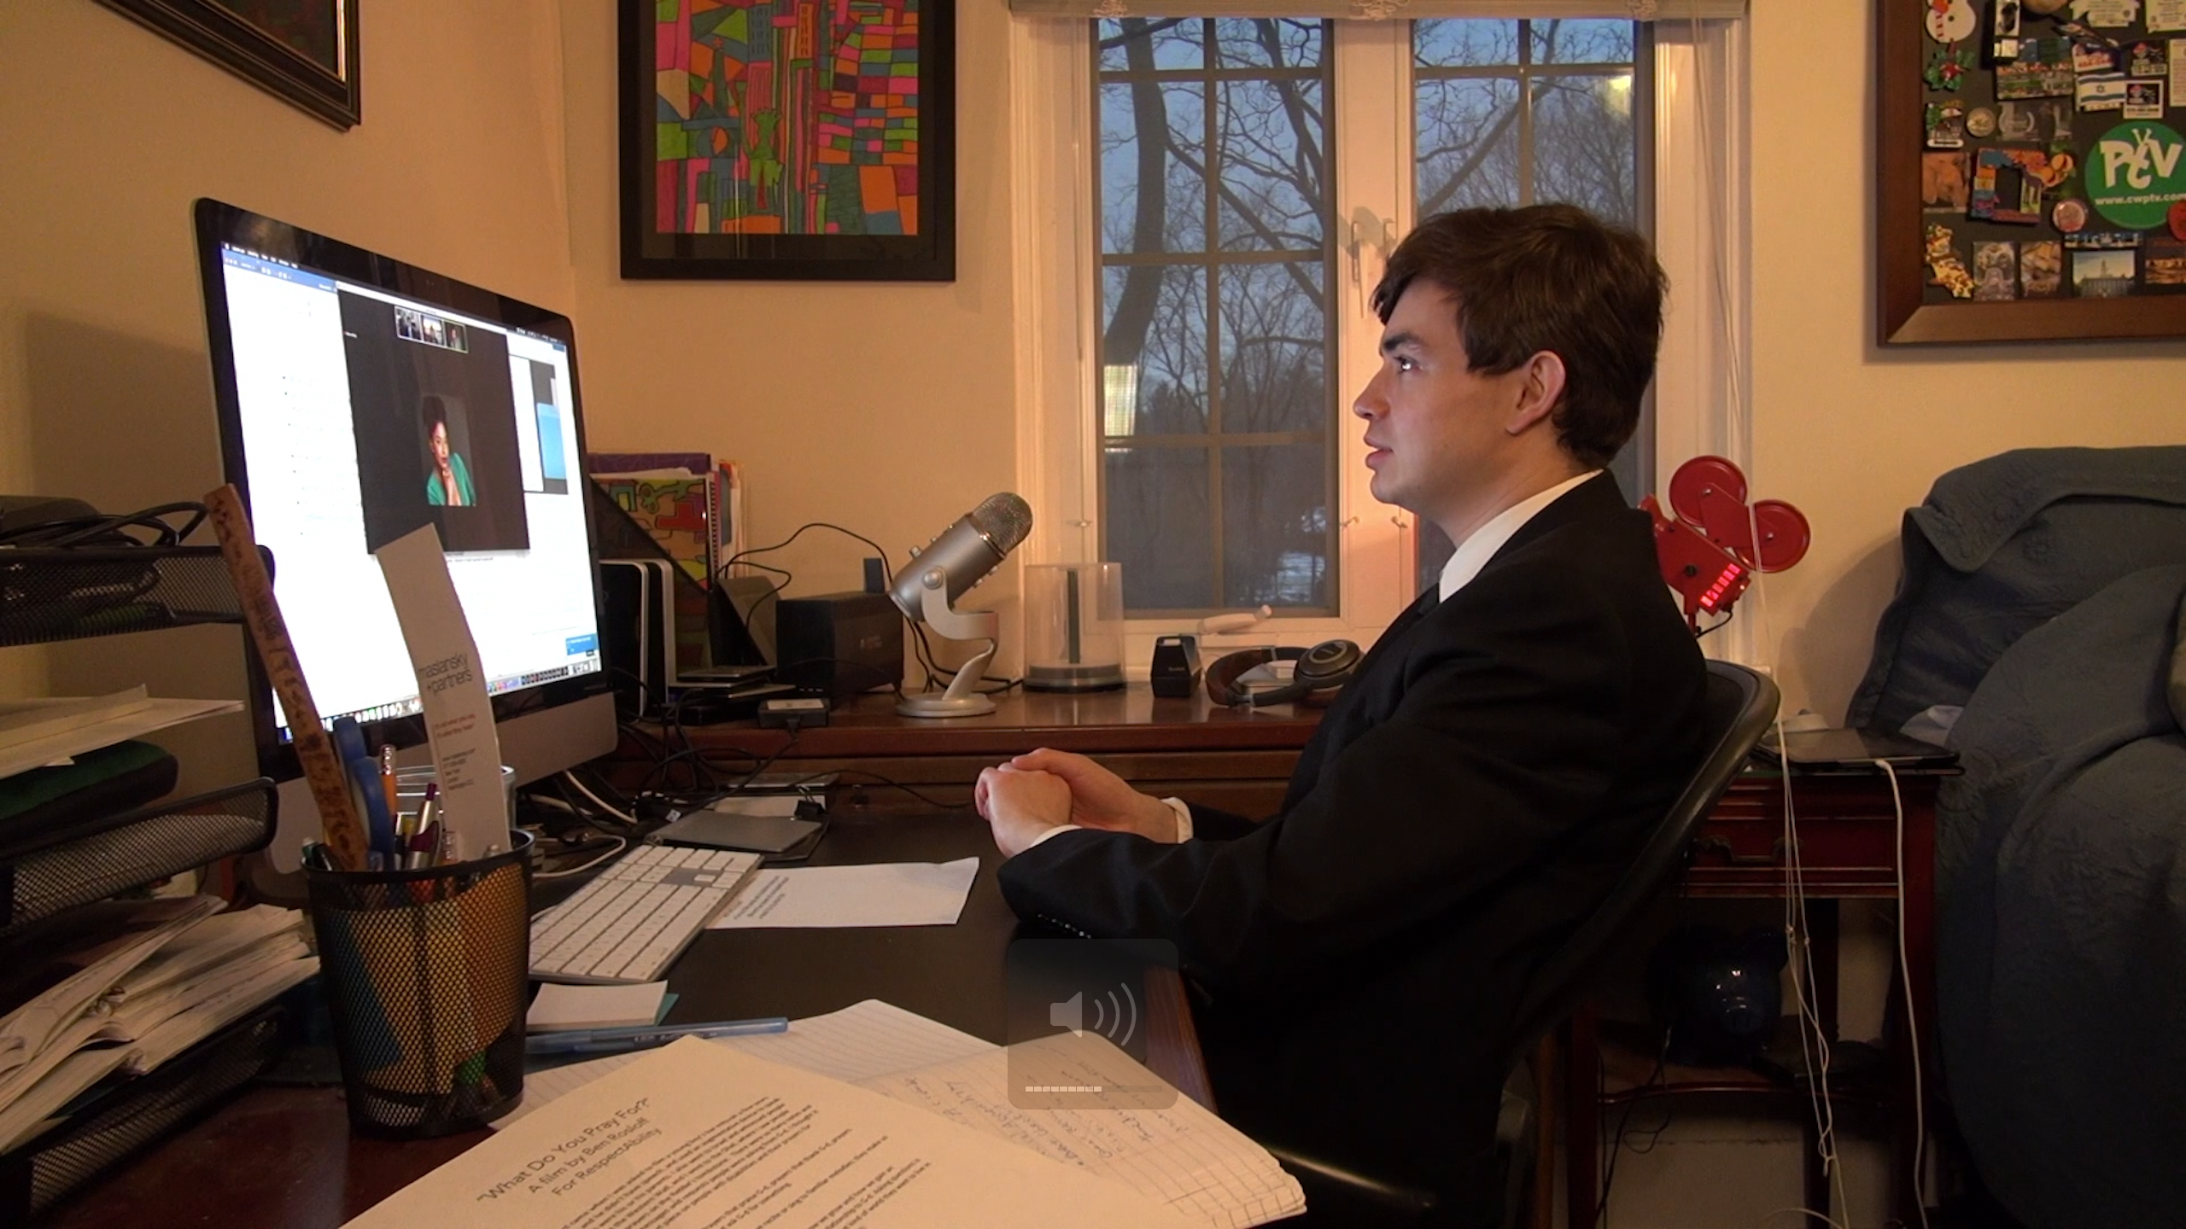
Website Accessibility
Screen readers
  Alt text
  Forms and buttons
Captions on videos
  Subtitles only reflect what is being spoken.
  Captions go a step further by also including non-spoken information including [laughter], [applause] and [music], as well as environmental sounds.

Slide 41
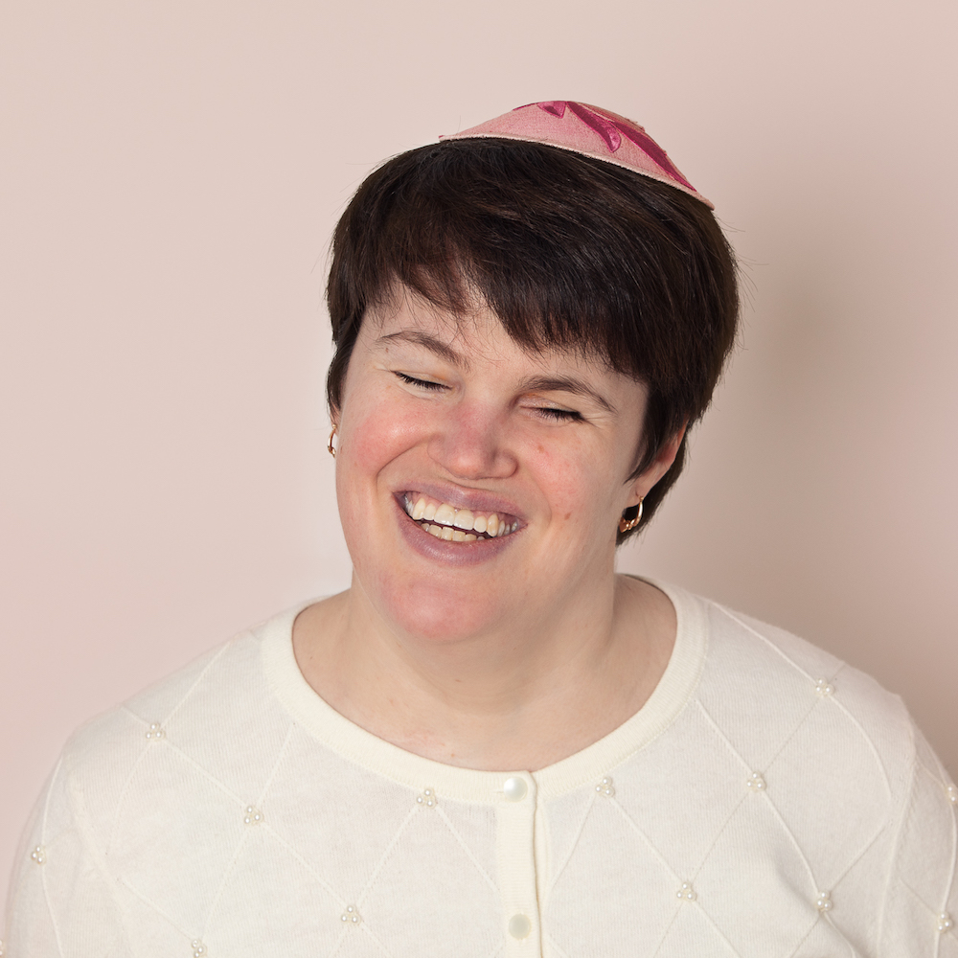
Tip #6: Inclusion in the Synagogue
Inclusive language
Braille prayer & large print siddurs
Ramp with handrail to the bimah
Making sure sukkahs and sukkot meals are inclusive
CART and ASL interpreters at services
  Closed captioning on zoom
Write siddur page numbers down on a whiteboard
RespectAbility High Holiday Toolkit
Notes:
https://www.respectability.org/high-holidays-2020/; Language and Intent, Part 3 of 3: The Quiet Power of Inclusive Language

Slide 42
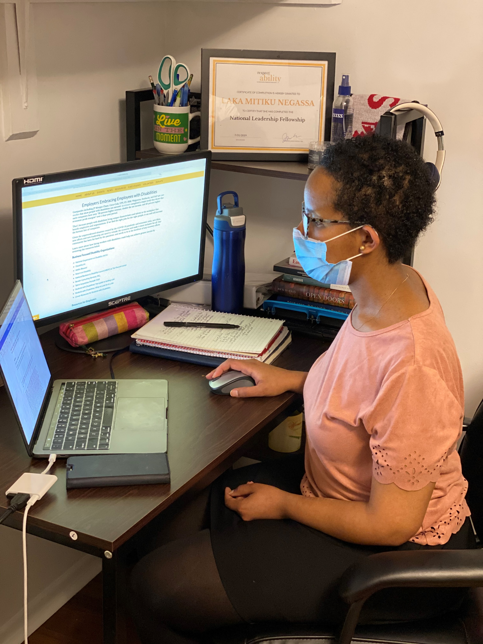
Tip #7:
Set SMART Disability Access and Inclusion Goals
SMART (Specific, Measurable, Achievable, Relevant and Time-Bound)
Key goals can include using free accessibility tools and practices to ensure online events are screen reader accessible and have captions
An easy-to-meet goal is ensuring all in-person events are in fully accessible venues
  invite participants to request disability accommodations
It is also important to enable virtual work/programming and offer healthcare and wellness programs.

Slide 43

Mental Health Resources
If you or someone you know is experiencing
a mental health crisis:
go to the local hospital emergency room &/or contact:
National Suicide Prevention Hotline
(24 hours, free, in English or Spanish):
1-800-273-8255
U.S.-BASED MENTAL HEALTH CARE RESOURCES:
Mental Health America: https://www.mhanational.org
American Psychological Association: https://www.apa.org/
Project Semicolon: https://projectsemicolon.com/
And/or contact your insurance company for further guidance.

Slide 44
Disability Access and Inclusion Training Series for Jewish Organizations and Activists
Inclusion as a Jewish Value
How to Advance Disability Inclusion in Jewish Education
How to Recruit, Accommodate and Promote Jewish Leaders with Disabilities for Paid Employment and Volunteer Leadership
How to Ensure Accessible Events: Both Live and Virtual Across All Platforms
How to Ensure a Welcoming Lexicon, Accessible Websites and Social Media and Inclusive Photos
How to Create and Implement Successful Diversity and Inclusion Initiatives
How to Ensure Legal Rights and Compliance Obligations
Watch Recordings, Download Transcripts and PowerPoints:
https://www.respectability.org/jewish-events/#2020series
Jewish Inclusion Toolkit

Slide 45
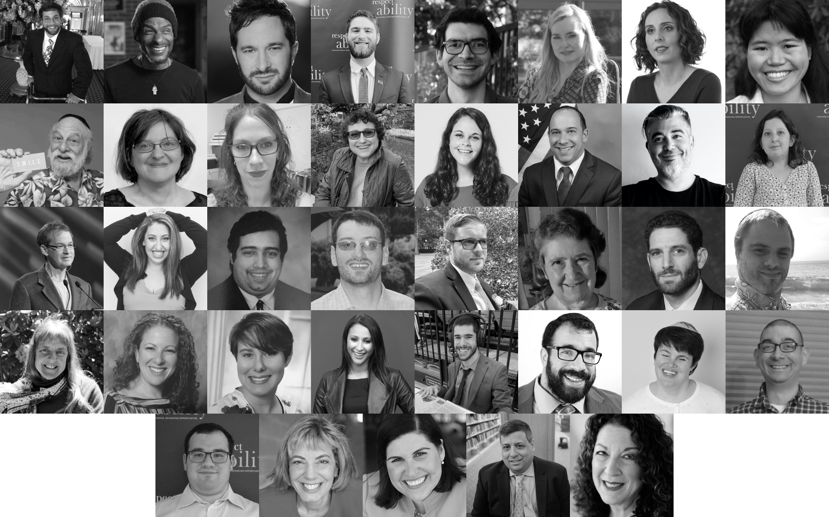
RespectAbility’s Disability Training & Speakers Bureau: Jewish Division

Slide 46
Questions?

Slide 47
Thank You
Everyone who responded to our survey, plus:
Promoters: E-Jewish Philanthropy, JFS, Gateways, Hillel, JCC Association of North America, Jewish Orthodox Feminist Alliance, JFNA, Leading Edge, NJHSA, Shalom DC, URJ, USCJ
Funders: Stanford & Joan Alexander Family Fund, Sandy Baklor and Arlene Kaufman, Vivian and Raymond Bass, The Belz Foundation, The David Berg Foundation, The Beverly Foundation, Linda and Andy Burger, Shelley and Ruvan Cohen, Ila Eckhoff, The Einstein Sim Family, Diane Feinberg, Daniel Feldman, Moe Feldman, Robert Feldman, Benjamin Fink, Cheri Fox, Margie Glancz, Daniel Goldsmith, Nancy Grossman-Samuel, Andrew and Jan Groveman, The Harnisch Foundation, Robert Horwitz, The Aline and Leo Jacobsohn Foundation, Jewish Community Foundation of Los Angeles, Charles and Esther Lee Kimerling Charitable Foundation, Robert P. and Arlene R. Kogod Family Foundation, Joseph and Phyllis Korff, John and Patricia Laszlo, Rebecca Laszlo, Jennifer Laszlo Mizrahi and Victor Mizrahi, Marty Linsky and Lynn Staley, Adam and Gila Milstein, Robert P. Parker, Shelley Pozez, Jarrow Rogovin, Ben and Esther Rosenbloom Foundation, Dr. Michael L. Ross and Elizabeth F. Ross, Charles and Lynn Schusterman Family Foundation, Schwartz Foundation, Ann and Andrew Tisch, The Harry and Jeanette Weinberg Foundation, Eliot Zev Fishman
Staff: Jennifer Laszlo Mizrahi, Matan Koch, Lauren Appelbaum, Josh Steinberg, Jake Stimell, Eric Ascher
Board Members: Vivian G. Bass, Linda Lait Burger, Shelley Richman Cohen, Judith Creed, Ila Eckhoff, Gabrielle Einstein-Sim, Donna Meltzer
Pollster: Meagan Buren

Slide 48
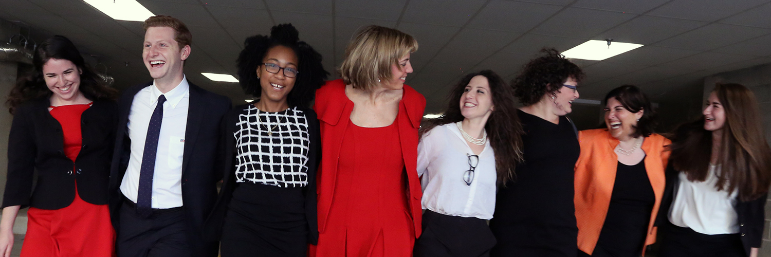
Thank You!
Presenter: Matan Koch
For More Info: Contact MatanK@RespectAbility.org
Jewish Inclusion Resources

