Slide 1
The Community Reinvestment Act (CRA) and Why It Matters for People with Disabilities
CWDB – December 1st, 2021
RespectAbility Comments
Presented by: Nelly Nieblas and Philip Kahn-Pauli
https://www.respectability.org/

Slide 2
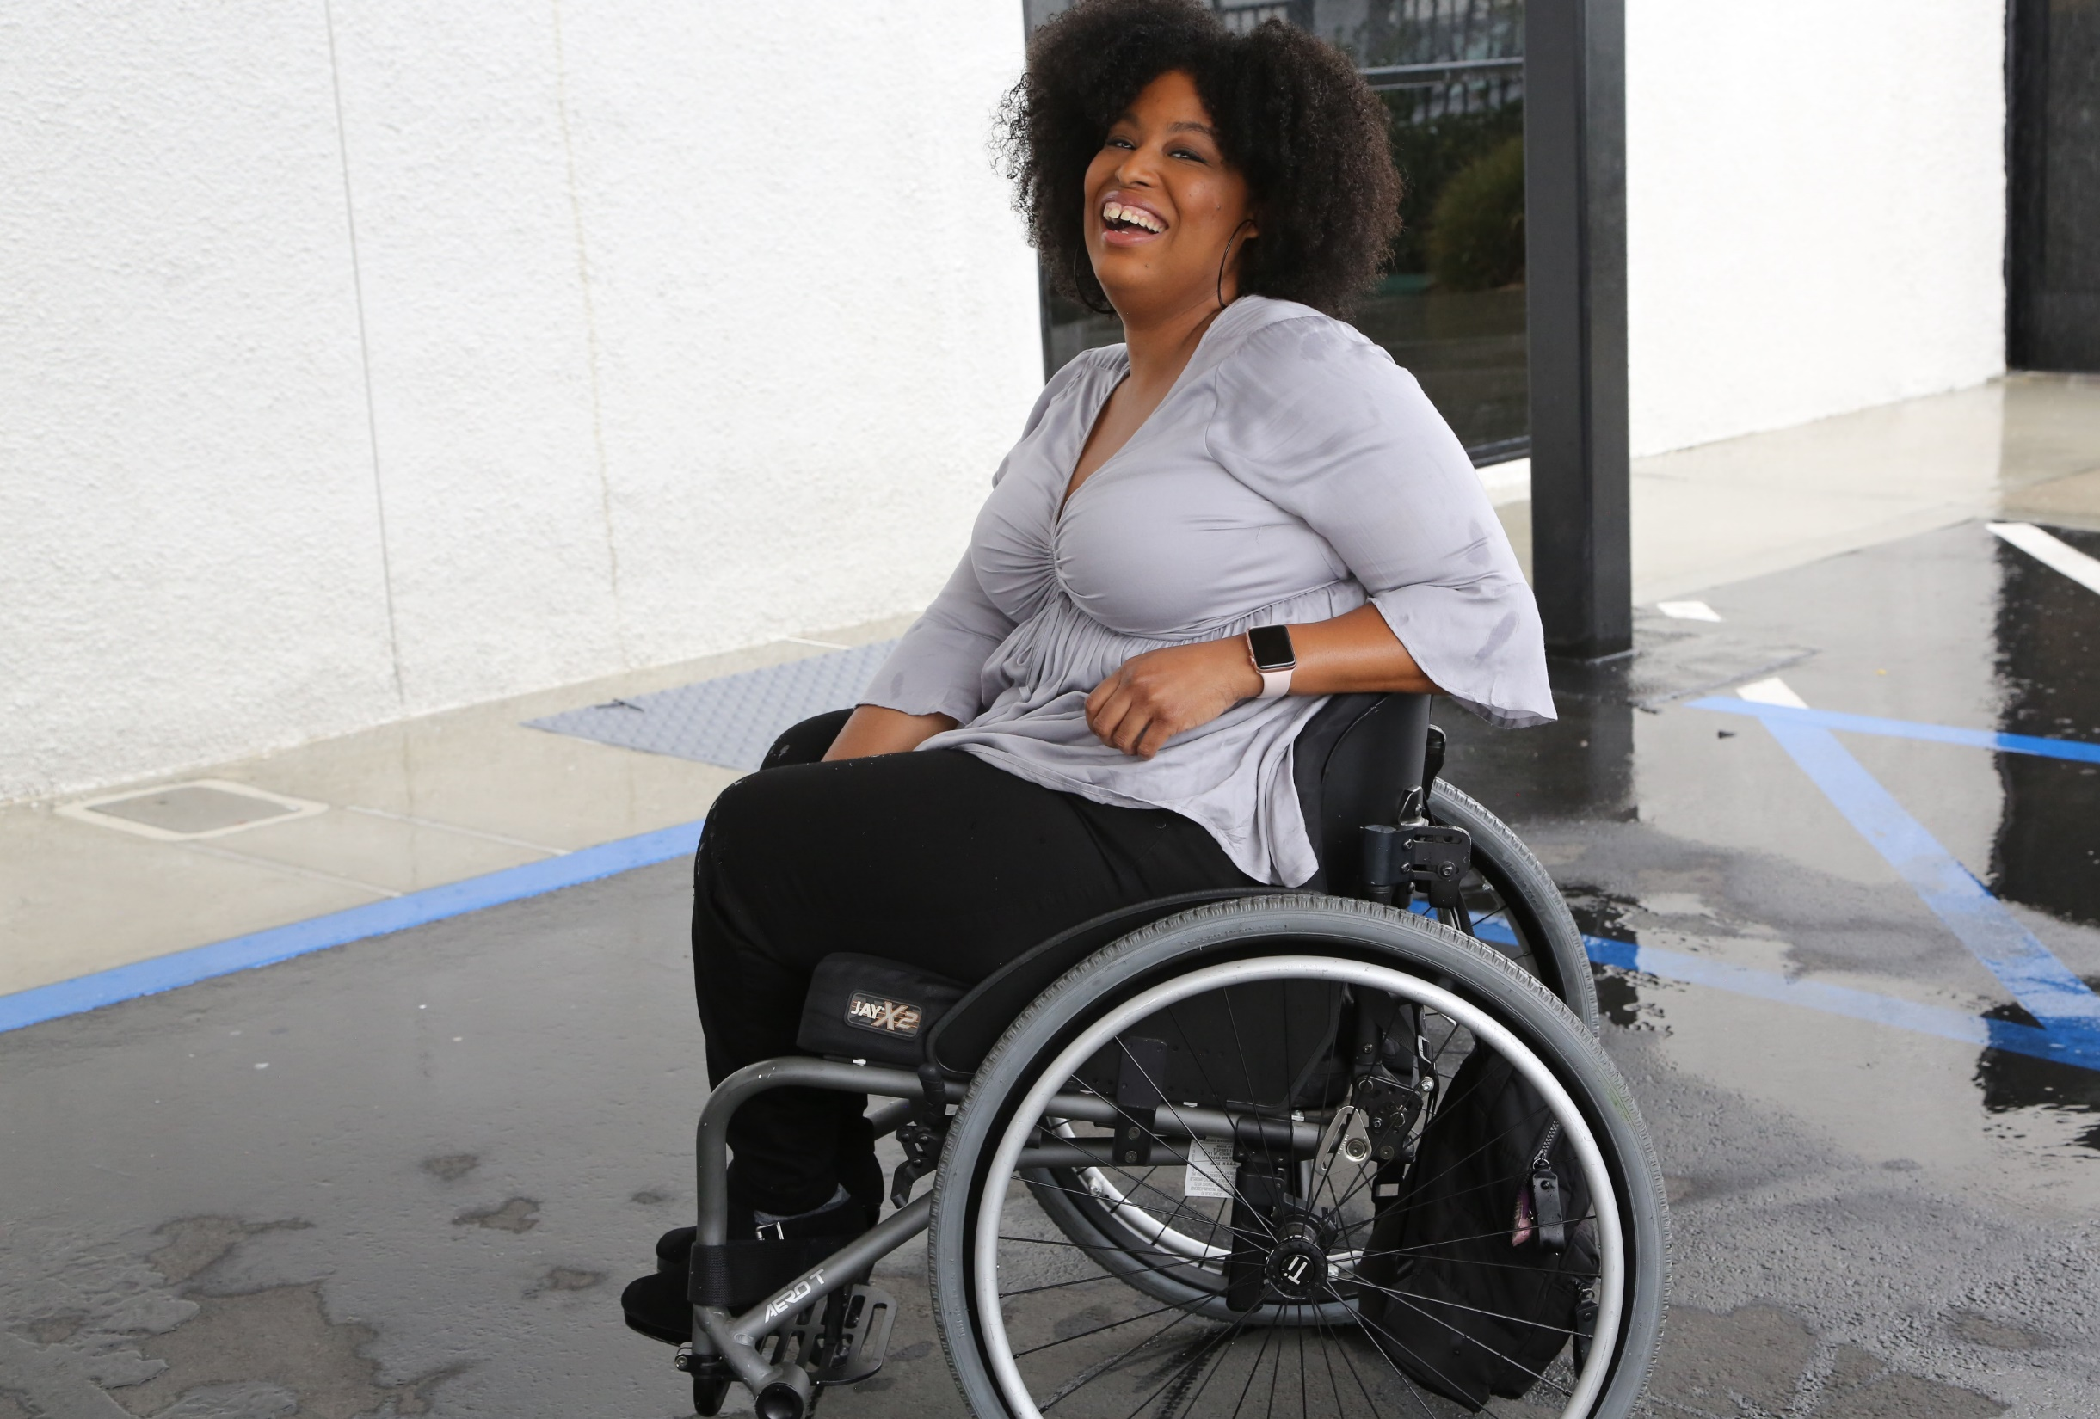
1 in 4 adults
1-in-4
adults have a disability
(physical, sensory, cognitive, mental health or other)
61 million people in America have a disability and the majority of people have a loved one with a disability

Slide 3
Poverty Rates for Working-Age Californians w/ & w/o Disabilities, by Race – 2019 (Pre-COVID)
SOURCE: Annual Disability Statistics Supplement: 2020. Univ. of New Hampshire, Institute on Disability.
https://disabilitycompendium.org/compendium/2020-annual-disability-statistics-supplement

Slide 4
Employment Rates of Minority Populations (Percentage of population) – 2008 to 2018
SOURCES: https://www.statista.com/statistics/793961/employment-among-disabled-us-adults/ https://www.bls.gov/charts/employment-situation/employment-population-ratio.htm

Slide 5
Employment Rates for Working-Age PWDs/Non-PWDs in LA City, CA, and WV– 2019
SOURCE: Selected Economic Characteristics for the Civilian Population by Disability Status 2019: ACS 1-Year Estimates Subject Tables https://data.census.gov/cedsci/table?q=disability&g=1600 000US0644000&tid=ACSST1Y2019.S1811

Slide 6
Employment Rates for Working-Age Californians w/ & w/o Disabilities, by Race – 2019 (Pre-COVID)
SOURCE: Annual Disability Statistics Supplement: 2020. Univ. of New Hampshire, Institute on Disability.
https://disabilitycompendium.org/compendium/2020-annual-disability-statistics-supplement

Slide 7
Employment Rates for Working-Age Americans w/ & w/o Disabilities, by Race – 2019 (Pre-COVID)
SOURCE: Annual Disability Statistics Supplement: 2020. Univ. of New Hampshire, Institute on Disability.
https://disabilitycompendium.org/compendium/2020-annual-disability-statistics-supplement

Slide 8
Disability Statistics in California (Pre-COVID)
There are 4,131,700 Californians with disabilities.
There are 1,910,288 working-age Californians with disabilities. Out of that number, 731,093 working-age Californians with disabilities had jobs in 2019. California’s disability employment rate was 38.2 percent in 2019.
The employment rate for working-age Californians without disabilities was 76.4 percent in 2019.
There was a 38.1 percent Gap in Labor Force Participation Rates between PWDs and non-PWDs.
The poverty rate for working-age Californians with disabilities was 22.8 percent.
Gov. Gavin Newsom with Philip Kahn-Pauli of RespectAbility
Source: Annual Disability Statistics Compendium: 2020 Durham, NH: Univ. of New Hampshire, Institute on Disability
https://disabilitycompendium.org/

Slide 9
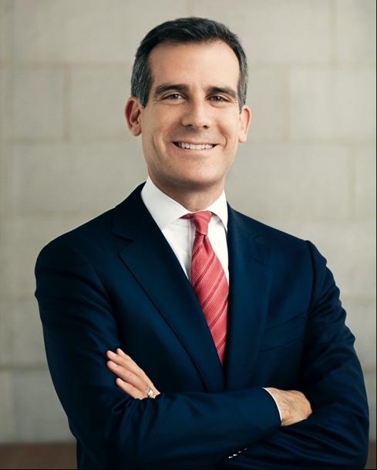
Disability Statistics in Los Angeles
In total, there are 992,719 Angelenos with disabilities living in L.A. County.
There are 466,385 working-age Angelenos with disabilities living in L.A. County. In the economic expansion prior to COVID-19, only 169,322 working-age Angelenos with disabilities had jobs. L.A. County’s disability employment rate was only 36.3 percent in 2019.
By contrast, the employment rate for Angelenos without disabilities was 74.7 percent.
That means that there is a 38.4 percentage point gap in the labor force participation rates between Angelenos with and without disabilities.
Mayor Eric Garcetti (D)
Source: Annual Disability Statistics Compendium: 2020 Durham, NH: Univ. of New Hampshire, Institute on Disability
https://disabilitycompendium.org/

Slide 10
Racial Disparities for People with Disabilities in California
180,888 working-age African Americans with disabilities
53,874 or 29.8 percent had jobs in 2019.
28.5 percent of African Americans with disabilities live in poverty
18.9 percent of African Americans without disabilities.
684,515 working-age Hispanic/Latinx people with disabilities.
274,399 or 40.1 percent had jobs in 2019.
21 percent of Latinx people with disabilities live in poverty
15.6 of Latinx people without disabilities.
167,672 working-age Asian Americans with disabilities.
68,725 or 41 percent have jobs.
18.4 percent of Asian Americans with disabilities live in poverty
9.3 percent of Asian Americans without disabilities.
SOURCE: Annual Disability Statistics Supplement: 2020. Univ. of New Hampshire, Institute on Disability.
https://disabilitycompendium.org/compendium/2020-annual-disability-statistics-supplement

Slide 11
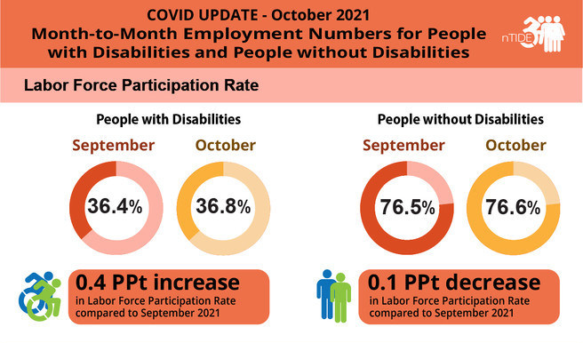
The Labor Force Participation Rate in October 2021
As of October 2021, the labor force participation rate for working-age people with disabilities is now 2 full percentage points higher than it was before COVID-19.
This means that people with disabilities are engaging with the labor force in higher numbers than before the pandemic.

Slide 12
Thank you!
THANK YOU!
Nelly Nieblas
Manager of Policy, Advocacy and Engagement
RespectAbility
NellyN@RespectAbility.org

