Slide 1
Lessons on Virtual Pre-ETS from Tennessee
Transition Tennessee and The Tennessee Department of Human Services

Slide 2
Welcome

Slide 3
Objectives
Explain the VR and Transition TN Partnership
Understand how Tennessee provides Pre-ETS and the impact of COVID-19
Discuss the proactive response to the impact COVID-19 had on Pre-ETS
Explore resources that can be used for virtual or in-person instruction
Share strategies for instruction
Discover the new student website on TransitionTN

Slide 4
Transition TN Partnership
TransitionTN.org was originally a contract between the Tennessee Department of Education and Vanderbilt Kennedy Center that began development in 2015
The aim was to provide on-demand professional development, resources, and in-person training related to transition planning and services
The site quickly gained state and national attention with thousands of registered users
In 2017, and with the provision of Pre-Employment Transition Services, Tennessee VR began planning for a provider portal on Transition TN to complement the educator blueprint
As of 9/29/2021, 11,523 registered users
https://transitiontn.org

Slide 5
Pre-ETS Providers in Tennessee

Slide 6
Pre-ETS Providers in Tennessee

Slide 7
Pre-ETS Providers in Tennessee

Slide 8
Program Year 2019 vs. 2020
PY Q1 – July, August, and September
PY Q2 – October, November, and December
PY Q3 – January, February, and March
PY Q4 – April, May, and June
Notes:
PY Q1 – July, August, and September
PY Q2 – October, November, and December
PY Q3 – January, February, and March
PY Q4 – April, May, and June

Slide 9
Metaphorical Components of Pre-ETS
Notes:
Take this information for example. Sometimes we are presented with information, in this case various shapes but a metaphor for (e.g., new policy, mandates, standards, etc.) and we wrestle with how to make it work and make sense. We determine how to make that work and be complete and once we put all the pieces together, we have decided this information provided are the building blocks for a car.

Slide 10
Metaphorical Components of Pre-ETS

Slide 11
Metaphorical Components of Pre-ETS
Notes:
Later on someone comes back and says, that was great what you initially came up with, but I want you to take that same information and build something different with it. Our brains struggle to comprehend what that might be because that information put together is now a car.
Our car isn’t necessarily wrong, but we can see on the next slide other possibilities. We have to unlearn what we know so we can see other possibilities. Another example you may have seen is when people try to unlearn how to ride a bicycle.

Slide 12
Metaphorical Components of Pre-ETS
Notes:
Later on someone comes back and says, that was great what you initially came up with, but I want you to take that same information and build something different with it. Our brains struggle to comprehend what that might be because that information put together is now a car.
Our car isn’t necessarily wrong, but we can see on the next slide other possibilities. We have to unlearn what we know so we can see other possibilities. Another example you may have seen is when people try to unlearn how to ride a bicycle.

Slide 13
Metaphorical Components of Pre-ETS
Notes:
Later on someone comes back and says, that was great what you initially came up with, but I want you to take that same information and build something different with it. Our brains struggle to comprehend what that might be because that information put together is now a car.
Our car isn’t necessarily wrong, but we can see on the next slide other possibilities. We have to unlearn what we know so we can see other possibilities. Another example you may have seen is when people try to unlearn how to ride a bicycle.

Slide 14
Metaphorical Components of Pre-ETS
Notes:
Later on someone comes back and says, that was great what you initially came up with, but I want you to take that same information and build something different with it. Our brains struggle to comprehend what that might be because that information put together is now a car.
Our car isn’t necessarily wrong, but we can see on the next slide other possibilities. We have to unlearn what we know so we can see other possibilities. Another example you may have seen is when people try to unlearn how to ride a bicycle.

Slide 15
Tennessee’s Response to the COVID-19 Pandemic for Pre-ETS.
TN VR and Transition TN developed a Virtual Pre-ETS Best Practice Guide
Providers were required to submit a proposal for equitable access to virtual Pre-ETS
Provided a memo and policy update on flexibilities to ensure continuity of operations
Developed a Key Operational Goal to increase access to Pre-ETS through virtual services
During this most recent fiscal year, 50-60% of Pre-ETS have been provided virtual
Click Path: tn.gov/humanservices → Disability Services → Vocational Rehabilitation → Transition Services
https://www.tn.gov/humanservices/ds/vocational-rehabilitation/transition-services.html

Slide 16
Placeholder slides for a video showing the Virtual Pre-ETS Proposal form.
Notes:
This slide will have a video recording scrolling through the document submitted from Pre-ETS providers on providing virtual services. It’s too large to email.

Slide 17
Virtual Pre-ETS Guide
Goal: Give providers practical information to deliver high-quality Pre-ETS remotely
This was a developed as a guide, not directives
Includes information on:
The definitions of Pre-ETS
Eligibility
Collaborating with schools
Virtual Platforms
Virtual Curriculums
Resources

Slide 18
A chart of some potential resources and how they can help with providing Pre-ETS virtually.
Resource | About | Transition Activity Examples | Highlights or Benefits
Kahoot | Quiz or game with multiple choice answers | Game with questions about job applications | Competition and fun effects like music
Poll Everywhere | Create a question or prompt and students respond in real time | Rank order or open response: “What job(s) are you interested in?” | Can be anonymous. Graphic or bar graph will show summary of student responses.
Quizlet | Study sets (like flashcards) for students to learn from | Study set with job application vocabulary | Add images or can be read aloud. Also, definitions will auto populate for terms.
Flipgrid | Video responses to a question or prompt | Students respond to prompt: “Why do you want this job?” | Students practice oral communication skills.
Remind | Communicate with students and families individually or in groups | To group: “There is a virtual Transition Fair on October 2nd. See this link to register.” | You and recipients can get text messages, but phone numbers stay confidential.
TimeStation | Site to punch in and out | Punch in and out of Pre-ETS sessions and other tasks | Students practice this skill as you monitor or keep record.
Padlet | Create a board of shared information collaboratively in real time | Students respond to prompt: “What does self-advocacy mean to you?” | Updates in real time; can create a map or timeline
Notes:
Blake

Slide 19
Shelby County & Shelby Co. Schools
Notes:
Number of Schools in Shelby Co. Schools –
Number of Schools in Shelby Co. -
Number of Students Served –
Number of Pre-ETS Specialists - 5
Number of CRPs –
Number of TSWs – 2 (I think) Shelby and Germantown

Slide 20
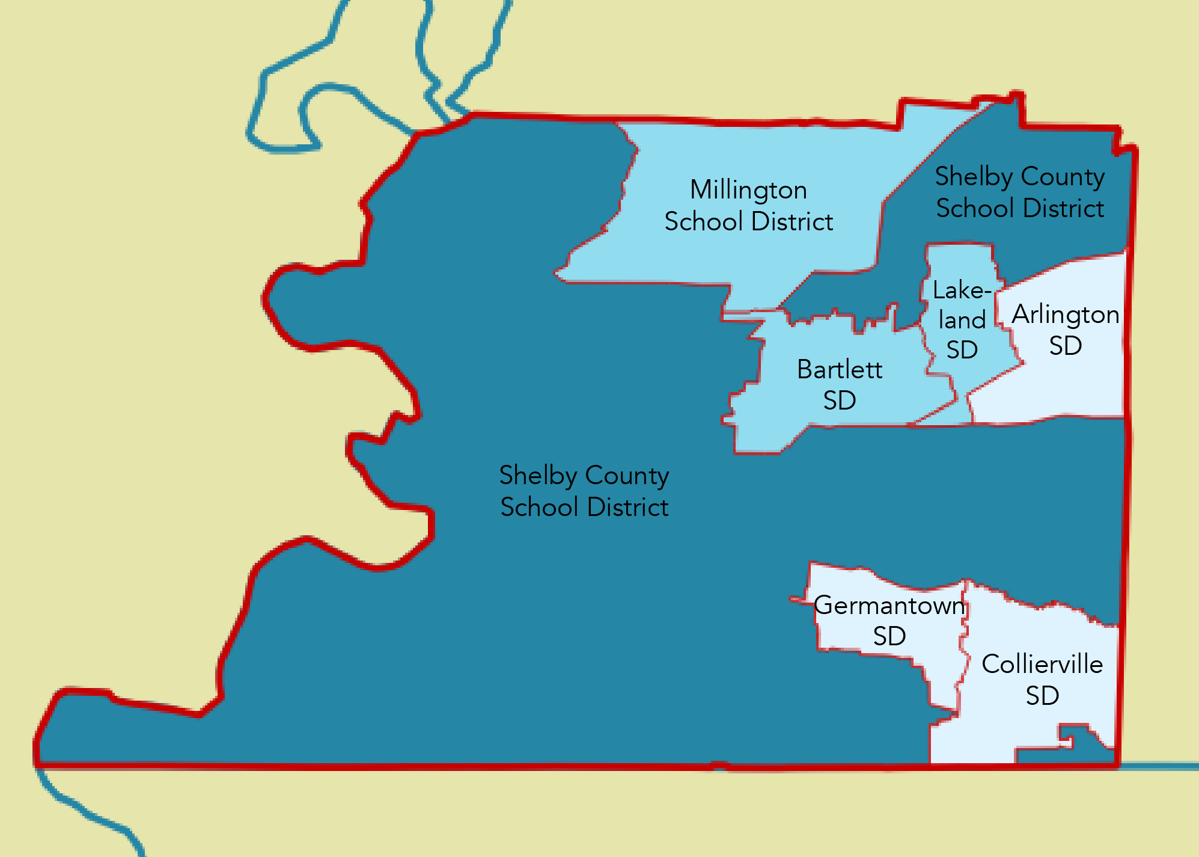
Shelby County & Shelby Co. Schools
Notes:
Number of Schools in Shelby Co. Schools –
Number of Schools in Shelby Co. -
Number of Students Served –
Number of Pre-ETS Specialists - 5
Number of CRPs –
Number of TSWs – 2 (I think) Shelby and Germantown

Slide 21
Potential Challenges to Virtual Student Engagement
Communication Barriers- Some students rely on proximity and body language for communication cues. Technology and digital platforms can make it difficult for students to participate fully.
Practicality of Instruction- Students still require the same supports and reassurances online they would receive face to face. Digital devices are a resource, and should be used to enhance the content not teach it.
Access to technology- The current K-12 population is culturally perceived to be tech natives, however this is not always true. Consider a student’s prior access and interaction with technology, when planning for virtual services.

Slide 22
Strategies to Improve Participation
Asynchronous Blend- Incorporate a balance of synchronous instruction and asynchronous components to promote independence and discussion during virtual learning
Utilizing Platform Features- (Chat, Emojis Whiteboard, Breakout Rooms) Utilizing the digital platform’s features will allow students to become familiar with the format and teachers to check for understanding quickly.
Autonomy over Assignments- Giving students the choice to probe and explore their interests within curriculum creates buy-in and sets a foundation for purposeful discussion

Slide 23
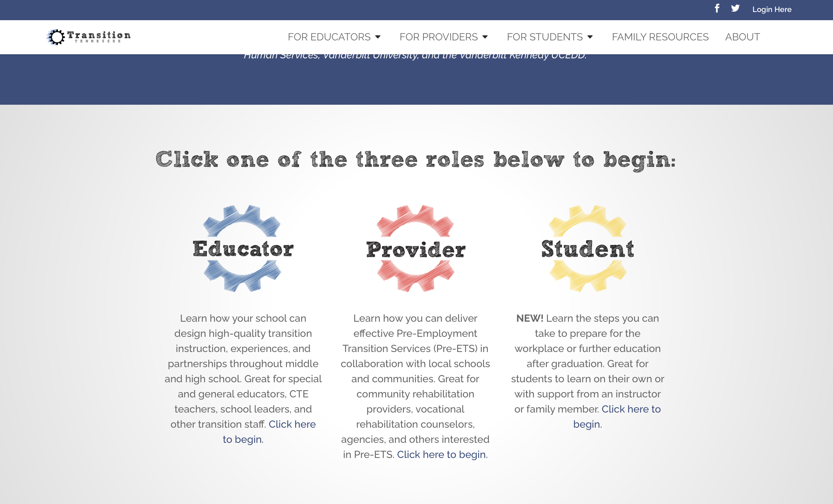
Transition TN
Educator, Provider, Student
Notes:
Instructor guide includes:
Site overview
Lesson topics and activity descriptions
Activity plans and resources
Transition portfolio tip sheet
Lesson trackers for instructors and students

Slide 24
Transition TN
Provides individuals with knowledge, training, resources and evidence-based practices that promote collaboration and leads to students being ready for postsecondary success
Online modules, trainings and workshops
Regional trainings for Pre-ETS providers
Communities of practice
Notes:
Instructor guide includes:
Site overview
Lesson topics and activity descriptions
Activity plans and resources
Transition portfolio tip sheet
Lesson trackers for instructors and students

Slide 25
Transition TN
Each section features
Free Video Modules
Downloadable Resources
Webcasts
Information about upcoming conferences and trainings
Notes:
Instructor guide includes:
Site overview
Lesson topics and activity descriptions
Activity plans and resources
Transition portfolio tip sheet
Lesson trackers for instructors and students

Slide 26
Transition TN
The curriculum data base is searchable by
Pre-ETS category
Cost of curriculum
Accessibility
All the above
The assessment database is searchable by transition domain, assessment focus, assessment approach and?
Language
Cost
Language and cost
https://transitiontn.org

Slide 27
Transition TN
Curriculum Database
Database of curricula related to transition for students with disabilities
Searchable by Pre-ETS addressed, accessibility options, price and curriculum name.
Assessment Database
Relevant tools to inform transition planning
Over 100 assessments
Search by domain and disabilities they address, language, person to complete and cost
Notes:
Instructor guide includes:
Site overview
Lesson topics and activity descriptions
Activity plans and resources
Transition portfolio tip sheet
Lesson trackers for instructors and students

Slide 28
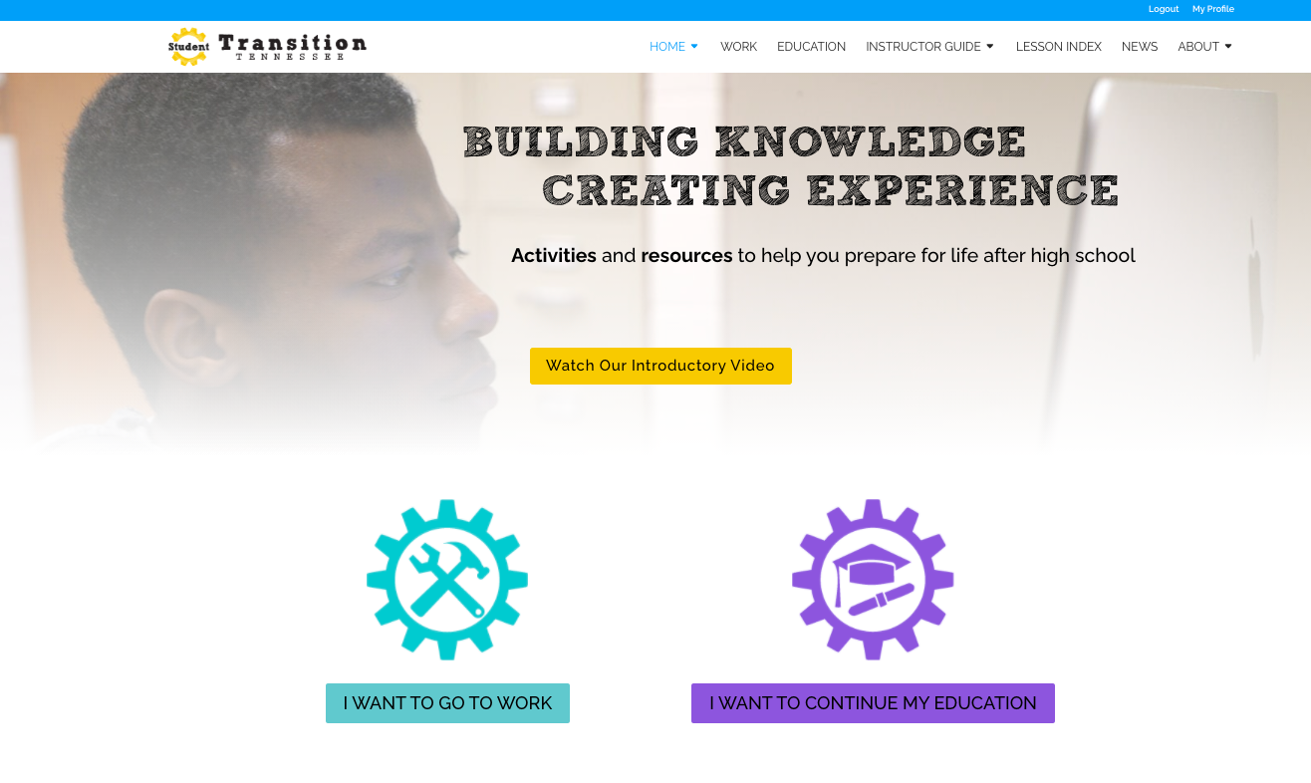
Transition TN’s Student Website

Slide 29
Transition TN’s Student Website
Developed in partnership with the Tennessee Department of Human Services’ Vocational Rehabilitation program
Offers two pathways tailored to students who have goals of either being employed or continuing their education after high school
Designed to guide students through activities for Pre-ETS and transition instruction on their own or with the help of an instructor
Notes:
Instructor guide includes:
Site overview
Lesson topics and activity descriptions
Activity plans and resources
Transition portfolio tip sheet
Lesson trackers for instructors and students

Slide 30
Transition TN’s Student Website
Lesson Activities
Role-Play Scenario
Get involved Activity
My Portfolio Activity
Quick Picks
No login for students

Slide 31
Links
https://transitiontn.org
https://www.tn.gov/humanservices/ds/vocational-rehabilitation/transition-services.html

Slide 32
Questions?

Slide 33
Contact Information
Blake Shearer, VR Transition Director
Blake.A.Shearer@tn.gov
Triniti Holden, Pre-ETS Supervisor
Triniti.Holden@tn.gov
Jessica Awsumb, Senior Research Associate
Jessica.M.Awsumb@Vanderbilt.edu

Slide 34
Thank You
Visit us at:
www.transitiontn.org

