Slide 1
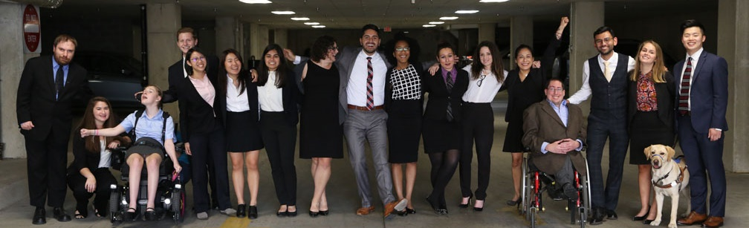

Cover
Montana and Advancing Opportunities for PWDs
https://www.respectability.org/

Slide 2
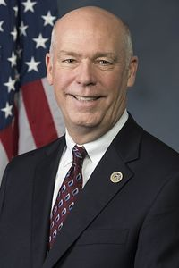
Disability Statistics in Montana
Total # of PWDs in State: 139,511
Total # of working-age PWDs: 63,386
# of working-age PWDs with Jobs: 29,769
Employment Rate-working-age PWDs: 46.9%
Employment Rate- working-age Non-PWDs: 79.8%
Gap in Labor Force Participation Rates between PWDs and non-PWDs: 32.8%
Poverty Rate of PWDs: 20.1%
Gov. Greg Gianforte (R)
Source: Annual Disability Statistics Compendium: 2020 Durham, NH: Univ. of New Hampshire, Institute on Disability
https://disabilitycompendium.org/

Slide 3
Recognizing Racial Disparities in Montana
There are 200 working-age African Americans with disabilities.
Fully 47.5 percent of African Americans with disabilities live in poverty compared to 17.7 percent of African Americans without disabilities.
There are 2,881 working-age Latinx people with disabilities. Out of that number, fully 2,415 or 83.8 percent have jobs.
Fully 17.1 percent of Latinx people with disabilities live in poverty, compared to only 24.6 percent of Latinx people without disabilities.
There are 58 working-age Asian Americans with disabilities. Out of that number, 58 or 100% percent have jobs.
SOURCE: Annual Disability Statistics Supplement: 2020. Univ. of New Hampshire, Institute on Disability.
https://disabilitycompendium.org/compendium/2020-annual-disability-statistics-supplement

Slide 4
Students with Disabilities in Montana’s K-12 Schools
Total Number of K-12 students with disabilities:18,598
  2,668 American Indian or Alaska Native students with disabilities
  81 Asian students with disabilities
  195 Black or African American students with disabilities
  1,104 Hispanic/Latino students with disabilities
  34 Native Hawaiian or Other Pacific Islander students with disabilities
  822 Biracial students with disabilities
  13,694 White students with disabilities
  Subtotal of BIPOC Students with Disabilities: 4,904
Source: IDEA Section 618 Data Products: Static Table - https://www2.ed.gov/programs/osepidea/618-data/static-tables/index.html

Slide 5
Employment Rates of Minority Populations
(Percentage of population) – 2008 to 2018
SOURCES: https://www.statista.com/statistics/793961/employment-among-disabled-us-adults/ https://www.bls.gov/charts/employment-situation/employment-population-ratio.htm

