Slide 1

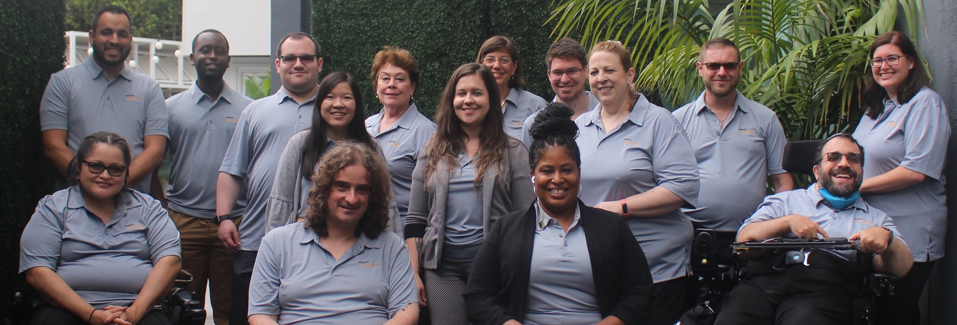
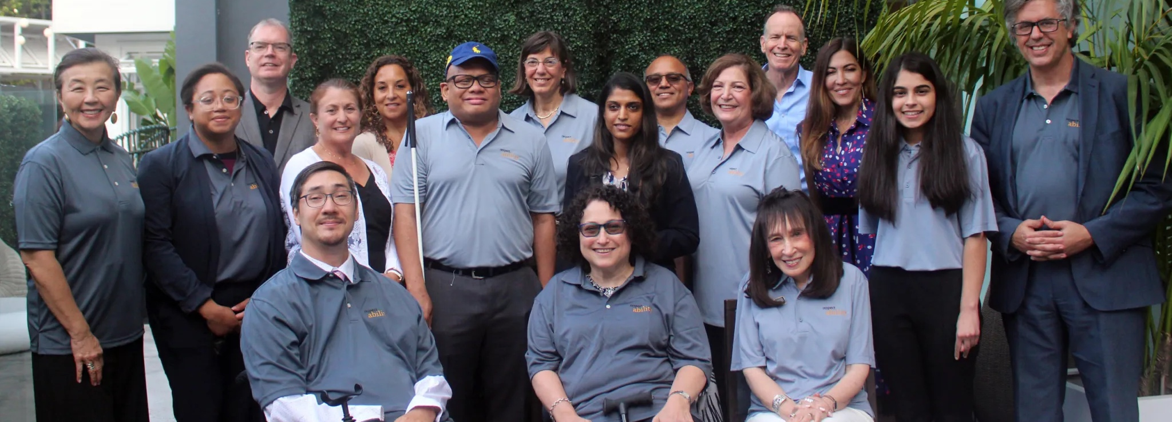
2021 Strategic Plan
2021
Strategic Plan
www.RespectAbility.org
RespectAbility fights stigmas and advances opportunities so that people with disabilities can fully participate in all aspects of community.
Top: RespectAbility Staff
Bottom: RespectAbility Board

Slide 2
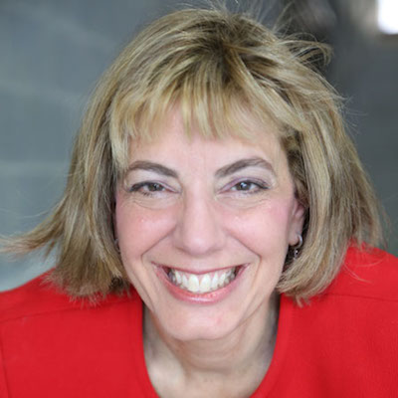
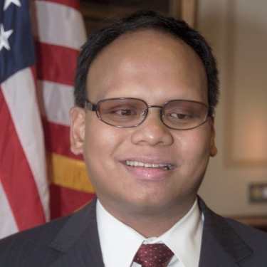
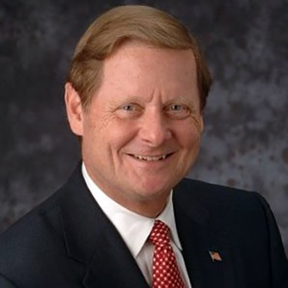
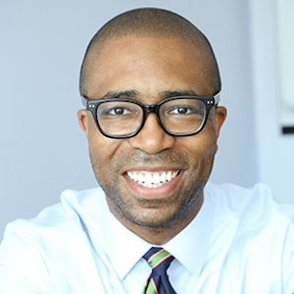
Board Officers: Proven
Disability Leadership Experience
Jennifer Laszlo Mizrahi, President
Ollie
Cantos,
Chairman
Steve
Bartlett,
Chair Emeritus
Calvin
Harris,
Chair Emeritus

Slide 3
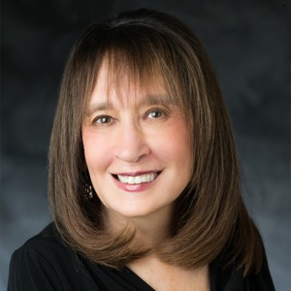
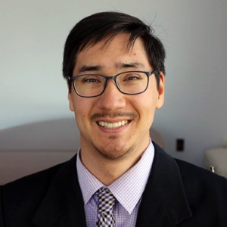
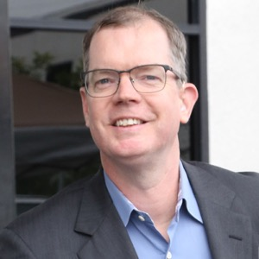
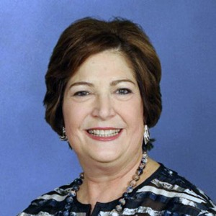
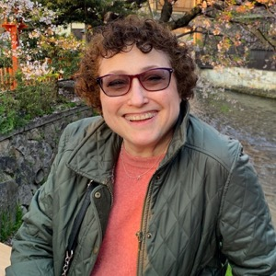
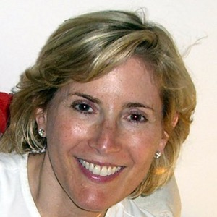
More Board Officers: Proven
Disability Leadership Experience
Vivian
Bass,
Vice Chair
Randall Duchesneau,
Vice Chair
Delbert Whetter,
Vice Chair
Shelley Richman Cohen,
Executive Committee
Linda Burger,
Treasurer
Ila
Eckhoff,
Secretary
For full board and bios, visit our website.

Slide 4
Theory of Change
MISSION
RespectAbility fights stigmas and advances
opportunities so people with disabilities can fully
participate in all aspects of community.

Slide 5
Core Tenets
Diversity, Equity, Inclusion and Accessibility
Collaboration
Commitment to Performance Metrics

Slide 6
Commitment to Equity
RespectAbility knows we are stronger and better when we are accepting, welcoming and respectful of all people. Since day one, RespectAbility had board-approved intentional diversity and equality policies. We are a “Nothing About Us Without Us” organization.
Organization Level | People of Color/BIPOC | White | Disability | LGBTQIA+ | Female/ Non-Binary | Male
Board | 53% | 47% | 50% | 6% | 50% | 50%
Staff | 36% | 64% | 85% | 21% | 50% | 50%

Slide 7
Program Summary: Four Key Areas of Impact
Area | Purpose
Policy and Practices | Create access, advance opportunities, and break down barriers to education, employment, entrepreneurship, and civic engagement for diverse people with disabilities.
Entertainment and News Media | Create equitable and accessible opportunities to increase the number of people with lived disability experience throughout the entire media ecosystem, which increases diverse and authentic representation of disabled people on screen, thus leading to systemic change enabling people with disabilities to be seen for what they CAN do, instead of what they cannot do. Ensure that these changes are reflected not only in entertainment, but in the way that other forms of media, especially digital and television news, portray people with disabilities.
Leadership Development | Help diverse people with disabilities acquire the training, skills, contacts, and opportunities they need to have a seat at decision-making tables. Increase awareness and opportunity by speaking on disability inclusion and advocacy.
Faith Inclusion | Deepen and build upon the organization’s strong history of working with the Jewish community. We will equip individuals with disabilities, the faith organizational ecosystem, and other faith-based organizations with the capacity to ensure that individuals with disabilities can participate and contribute to all aspects of religious life.

Slide 8
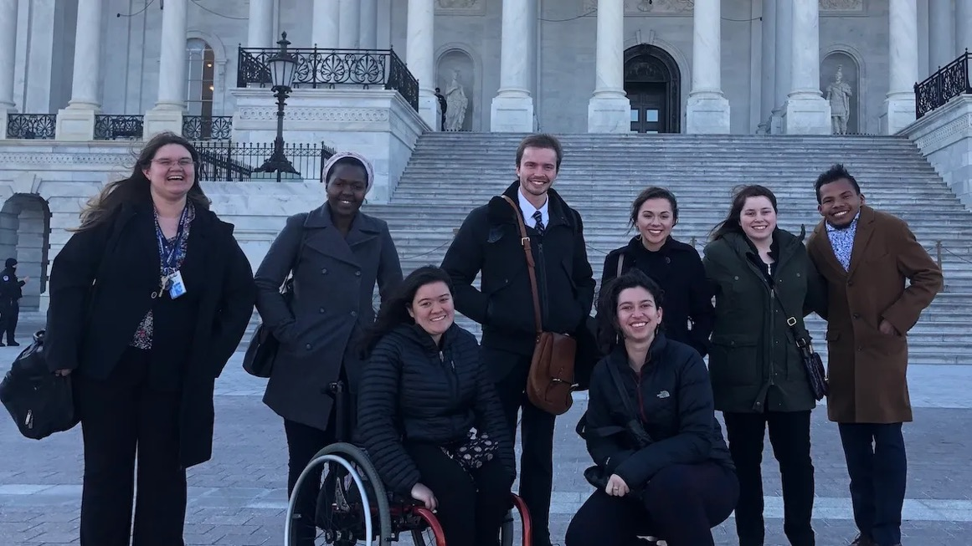
Policy & Practices
Create access, advance opportunities and break down barriers to education, employment, entrepreneurship and civic engagement and access for diverse people with disabilities. Newly-added or expanded activities within our policy and practices program include education policy, civic engagement, and state-level coalition building.

Slide 9
Major Policy & Practices Achievements
RespectAbility co-chairs a national task force representing 110+ disability groups on skills and jobs. RespectAbility’s team has testified in every state and has met 1-1 with 48 of America’s governors. Dozens of states have adopted our policy changes, leading to increases in employment for people with disabilities. Likewise, we have had an impact on the development of new regulations, executive orders and legislation actions at the federal level. Ideas, issues and specific language that we advocated for were included in major legislative packages in 2017 and 2020 and are set to be included in major legislative vehicles in 2021. Likewise, we have influenced the development of policies to drive inclusion among federal contractors and support communities of practices, as well as executive orders around diversity, equity and inclusion.
During the pandemic, RespectAbility helped enable approximately 10 million disabled people to use their SNAP food assistance benefits for online ordering and delivery, allowing them to obtain food without exposing themselves to the disproportionate risks to this community that come with in-person shopping.

Slide 10
More Major Policy & Practices Achievements
RespectAbility has reached out to candidates for Senate, Governor and president in every election cycle since we were founded. Our nonpartisan disability voter guides, as well as education and outreach to candidates, have brought new and significant commitments from elected officials who then delivered better policies so people with disabilities can gain skills, jobs and success.
Our reports, toolkits and resources have been highlighted on wide-ranging media platforms including The New York Times and PBS NewsHour, bringing critical attention to the role that disability plays on issues such as the school-to-prison pipeline, virtual schooling, and students from marginalized communities. Exposure to these issues helped change policies for justice involved youth to get tested for disabilities, receive the services to stay in school and to have greater access to tools to achieve success.

Slide 11
Policy & Practices Goal #1
Achieve parity for people with and without disabilities in relevant measures for working-age people residing in the U.S. from all backgrounds.
Enable diverse children with disabilities and their parents to get the early intervention and resources they need to succeed.
Reduce the gap in high school completion rates between students with and without disabilities from all racial backgrounds.
Reduce the gap in the Labor Force Participation Rate (LFPR) between working-age people with and without disabilities, including among marginalized communities.

Slide 12
Policy & Practices Goal #2
The public benefits system will no longer disincentivize work and punish people with disabilities who have more than $2,000 to their name to be able to earn a living wage.
Any person with a disability in America who desires to and is otherwise able to secure a job or start a business can choose to work without fear of losing their healthcare and personal care benefits, as well as have resources to earn an income, save money, and become independent.
Increase the percentage of people with disabilities on long term Social Security and/or Medicaid who choose to enter the workforce.

Slide 13
Policy & Practices Goal #3
Ensure a comprehensive network of support systems to equip people with disabilities to start their own disability-owned business enterprise (DOBE), earn certification as a DOBE, access credit, and succeed as entrepreneurs.
Work to ensure that people with disabilities are included in small business programs, policies, and strategic priorities as other underrepresented communities currently are.
Work to ensure that people with disabilities are included in regulatory structures that ensure access to credit, that self-employment is recognized as a competitive, integrated outcome, that vocational rehabilitation programs offer greater resources for jobseekers with disabilities who choose self-employment, and that self-employment opportunities are more inclusive of BIPOC people with disabilities.
Develop and disseminate best practices, including training on how to get government contracts, to equip individuals with disabilities to start their own Disability Owned Business Enterprise (DOBE).

Slide 14
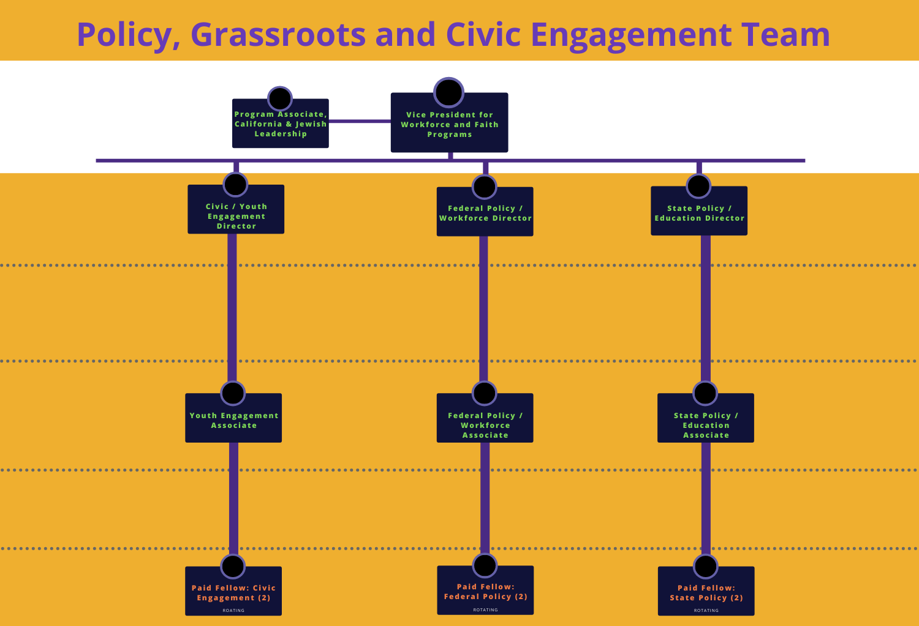
Policy, Grassroots and Civic Engagement Team

Slide 15
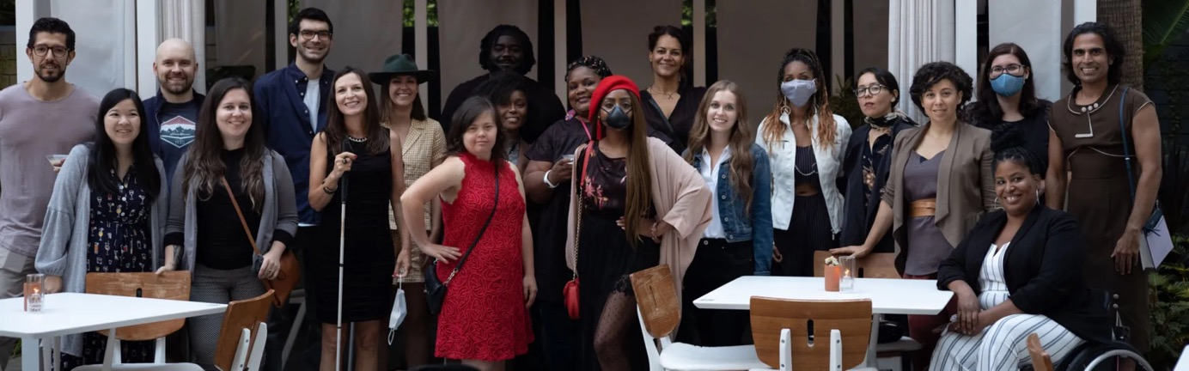
Entertainment & News Media
Create equitable and accessible opportunities to increase the number of people with lived disability experience throughout the entire media ecosystem, which increases diverse and authentic representation of disabled people on screen, thus leading to systemic change enabling people with disabilities to be seen for what they CAN do, instead of what they cannot do. Ensure that these changes are reflected not only in entertainment, but in the way that other forms of media, especially digital and television news, portray people with disabilities.

Slide 16










Major Entertainment & News Media and Communications Achievements
Trainings
  Conducted dozens of trainings since 2015 for entertainment industry companies, including NBCUniversal, Netflix, Nickelodeon, Pixar, Sony Pictures Entertainment, Sundance Institute, ViacomCBS, the Walt Disney Company and WarnerMedia
Entertainment Media Consulting Team
  Consulted on 160+ projects (TV episodes and films) in 2021 thus far (compared to 70 in 2020 and a dozen in 2019)
  Bring in external consultants for projects – have trained 30 folks to assist with this project-based work
Advisory Councils
  RespectAbility team members serve on the CAA Full Story Initiative Advisory Council, Disney+ Content Advisory Council, MTV Entertainment Group Culture Code, MTV Entertainment Mental Health Storytelling Coalition, and Sundance Institute’s Allied Organization Initiative.

Slide 17
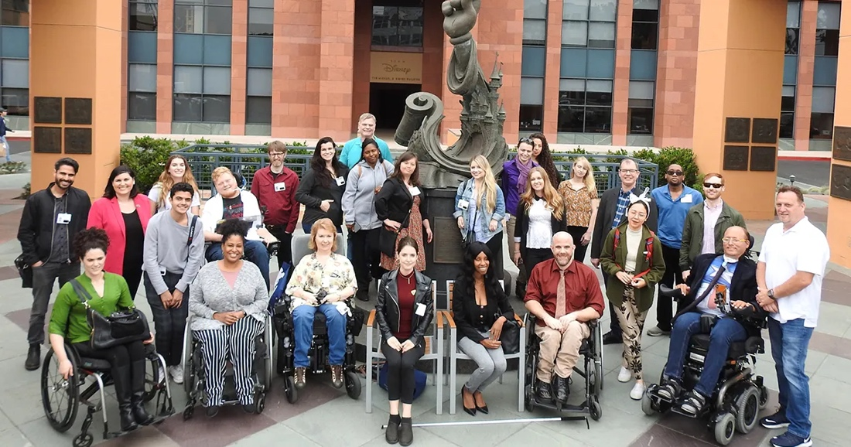
More Major Entertainment & News Media and Communications Achievements
News Media
  Replicating Training Model for Entertainment Media with the News Media
  New partnerships with ACES Editing Society and Radio Television Digital News Association
Successes of our Lab Alumni
  Working at Discovery, Nickelodeon, Paramount Pictures, Sony Pictures Entertainment, The Walt Disney Company
  In writers’ rooms for Netflix’s Mech Cadet, CW’s 4400, Showtime’s Dexter
Entertainment Media newsletter
  Sent to more than 5,000 contacts each week
  Examples of best practice, event invitations, job opportunities and casting calls
Presence at Sundance Film Festival and SXSW

Slide 18
Entertainment & News Media Goal #1
Measure and change public opinion so society values people with disabilities equally in all areas, including employment, education, and healthcare.
Conduct regular one-on-one interviews, focus groups and surveys to understand, move, and track public opinion in the U.S. about the competency of people with disabilities. Goal is to continually move public opinion favorably.
Track good examples of representation and eventually collect enough quantitative data to show change. Currently studios, guilds, and productions do not track disability status of crew members, which leads to focusing on qualitative data in the near future.

Slide 19
Entertainment & News Media Goal #2
Create equitable and accessible opportunities to increase the number of people with lived disability experience in positions of authority throughout the overall storytelling process of both entertainment and news medias.
People with disabilities, who are 1-in-5 people and 1-in-4 adults, will be employed on screen and behind the camera in approximately the same numbers as in reality. In the short-term, see larger increases in representation every year.
Work with USC, UCLA, studios, and the guilds to expand behind-the-camera studies to include people with disabilities so we can track improvements.
Track increased representation on screen (utilizing GLAAD, USC, and GDIGM studies for characters with disabilities), both in terms of overall disability representation and in terms of intersectional identities such as being BIPOC or LGBTQ+ in similar numbers to what exists naturally.

Slide 20
Entertainment & News Media Goal #3
Ensure our work garners a reputation in which people in the studio system get hired from the Lab because the RespectAbility program means something significant to them.
Track and expand the number of hires in the industry among our Lab and Fellowship alumni.
Identify, nurture, and promote diverse talent who will create narrative and systems change in the entertainment and news media.
Track and expand the reach of RespectAbility’s consulting business.

Slide 21
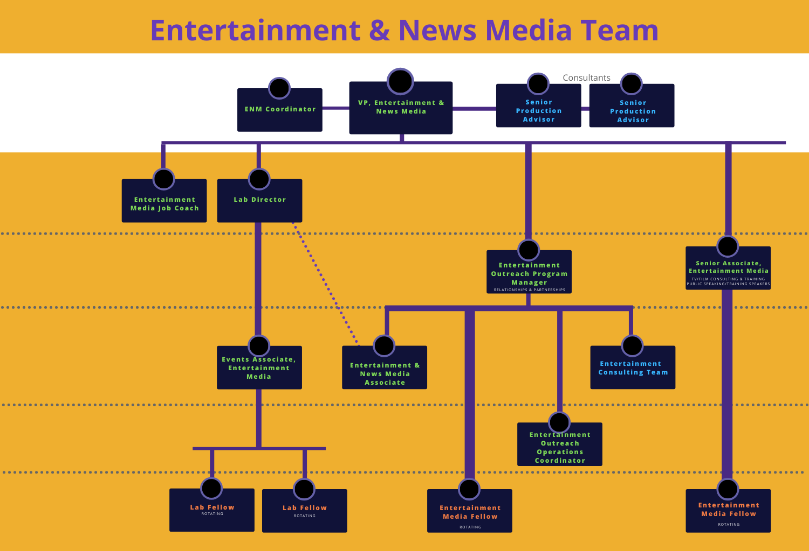
Entertainment & News Media Org Chart

Slide 22
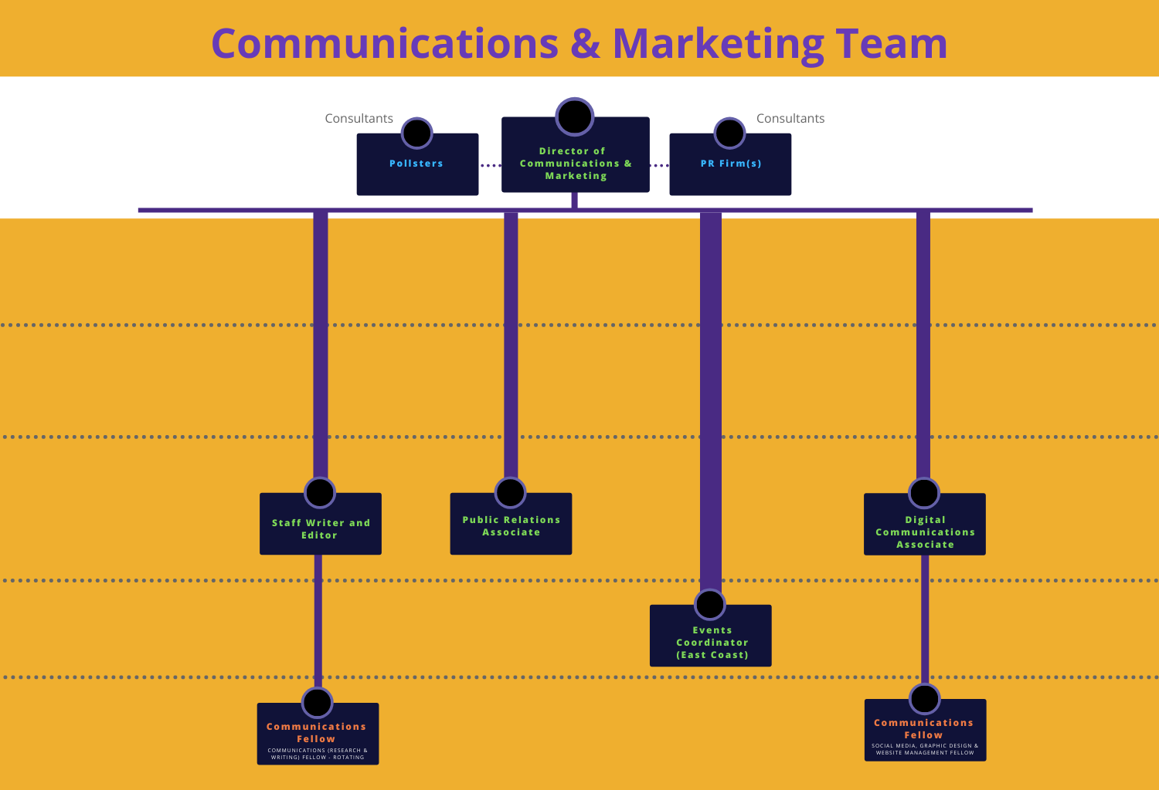
Communications Org Chart

Slide 23
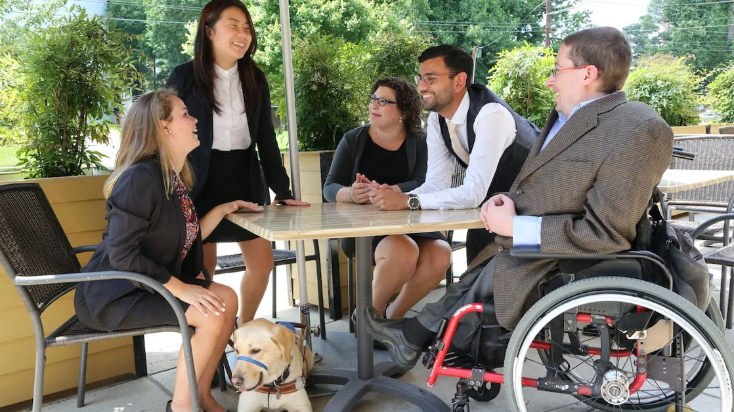
Leadership Development
Help diverse people with disabilities acquire the training, skills, contacts and opportunities they need to have a seat at decision-making tables, raising awareness and opportunity by speaking on disability inclusion and advocacy.

Slide 24
Major Leadership Development Achievements
RespectAbility has recruited and trained 200+ Fellows in its public policy, nonprofit management and faith inclusion program areas. Nearly all Fellows obtain employment or attain further education following the program.
Our National Disability Speakers Bureau has recruited, trained and empowered dozens of disabled speakers to help advance disability access and inclusion.

Slide 25
More Major Leadership Development Achievements
In our Inclusive Philanthropy work, our partnership with foundations is leading to a new generation of philanthropists who put disability inclusion front and center.
83 disabled entertainment professionals have completed RespectAbility’s Entertainment Lab, advancing their careers within the entertainment industry through networking and other opportunities.

Slide 26
Leadership Development Goals
National Leadership Program – Expanded
Expand opportunities for future job placement and impact by providing post-programmatic leadership tracks.
Create partnerships with industries where training would begin inside the RespectAbility office but would involve placements beyond RespectAbility. Implement expanded apprenticeship program.
The goal is to be at 17 paid fellows at a time by 2026, and to sharply curtail or eliminate the concept of “stipended” Fellows.
Rising Leaders Fellowship Council
Develop a program for graduating Fellows. The Council can play a decision-making role in RespectAbility’s influential projects, with the primary purpose of turning our alumni into an engaged community supporting our work in pushing for change and greater inclusion in the world. While all our alumni will be advocates, these are the alumni with whom we envision a long-term strategic interaction.

Slide 27
Leadership Development Goals (2)
National Disability Training Bureau (NDTB)
Moving beyond the current concepts of Divisions, and even the primary focus on speakers, the current Speakers Bureau will evolve into a Training Bureau, primarily supported by fee-for-service, deploying talented individuals with disabilities to substantially move best practices at client organizations, who will evaluate precisely because they pay for it. This involves thoughtful recruitment, onboarding, training, and coaching of qualified, dynamic, and diverse speakers with disabilities and intersectional identities, who are prepared and willing to deliver high-level, actionable content to their audiences. The specific focus will be on candidates whom we feel can significantly advance disability inclusion, access, and impact.
High School Leadership Program
Create a program that possesses elements of training, networking, and mentorship from political and other leaders with disabilities, with the goal of engaging young people with disabilities in advocacy, both through increased knowledge and through a confidence in their own potential impact.

Slide 28
Leadership Development Goals (3)
Nonpartisan Campaign Training for Candidates and Activists with Disabilities
RespectAbility will recruit and train diverse people with disabilities to run for office and/or help on political and issue advocacy campaigns. We will also encourage people to shadow elected officials to learn about how to best participate in campaigns. We will do civic engagement work to support policies that will achieve our goals. RespectAbility will not endorse or support candidates or campaigns and will stay nonpartisan. This will include introducing these potential candidates and volunteers to current political influencers.
Offer Lifetime of Leadership & Impact Opportunities
Ongoing mentoring, career services, networking, and other offerings to enable alumni of our leadership programs (Fellowship, Lab, Speakers Bureau, etc.) to have a lifetime of impact.

Slide 29
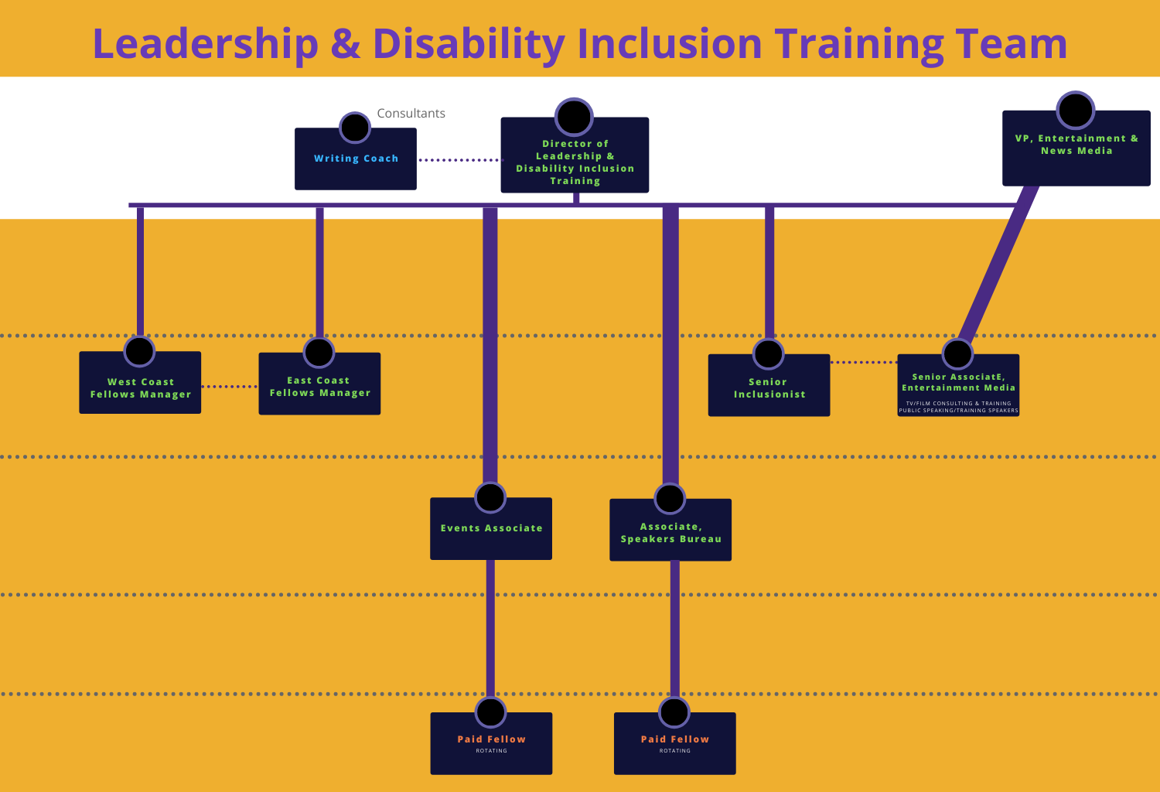
Leadership & Disability Inclusion Training Team

Slide 30
Faith Inclusion
Build upon the organization’s strong history of working with the Jewish community. We will equip individuals with disabilities, the faith organizational ecosystem, and other faith-based organizations with the capacity to ensure that individuals with disabilities can participate and contribute to all aspects of religious life.

Slide 31
RespectAbility: Major Jewish Achievements
RespectAbility’s faith-inclusion outreach has enabled dozens of organizations to get the skills and tools they need to be respectful, welcoming and inclusive of people with disabilities.
Each week in our Jewish Disability Perspectives newsletter, thousands of leaders who care about faith inclusion receive tips on how to succeed and see best practices from around the world. We lift up and amplify the great work of Jews with and without disabilities serving the disability community throughout the U.S. and Israel.
We have conducted trainings with numerous synagogues and Jewish organizations throughout the country to make them more inclusive of people with disabilities.
We serve as a trusted advisor to Jewish organizations large and small throughout the Jewish world, representing disability in councils and gatherings.

Slide 32
Faith Inclusion Goal #1
Widespread use of RespectAbility’s resources throughout the Jewish world, with a clear plan for duplication and adaptation to other faith-based initiatives.
Increase the number of Jewish groups to which we provide online training/webinars.
In a broad scale survey, there will be at least a 20% increase from 2018 in survey respondents who feel the community is inclusive/accessible. At least 50% will feel that we are doing better than we were 5 years before the survey.
In collaboration with other organizations, create central coordination or a one-stop shop around best practices, event calendars, community advocacy, and funding.

Slide 33
Faith Inclusion Goal #2
Jewish Speakers from our National Disability Training Bureau will be broadly utilized at Jewish conferences and organizations and will be recognized for their leadership potential.
In a broad scale survey, we will move from the less than 15% of Jews who feel they can currently identify a Jewish leader with a disability to 30%.
Feedback from events will be highly positive and contribute to advancing disability inclusion.

Slide 34
Faith Inclusion Goal #3
Jews with disabilities and their loved ones will be included in Jewish life and communities and an integral part of the fabric of all aspects of Jewish community leadership.
Train Jewish Fellows each year to advance inclusion.
Increase the reach of our weekly e-news service, which is written by a variety of leaders and sent to Jewish subscribers. Current reach is 3,000+ subscribers.

Slide 35
Faith Inclusion Goal #4
Major Jewish organizations will join with RespectAbility in a community of practice and innovation (COPI) centralizing Jewish inclusion practices and training.
More than 40 Jewish organizations will participate in partnerships with RespectAbility on disability inclusion. Policies and practices will change so that people with disabilities are included.

Slide 36
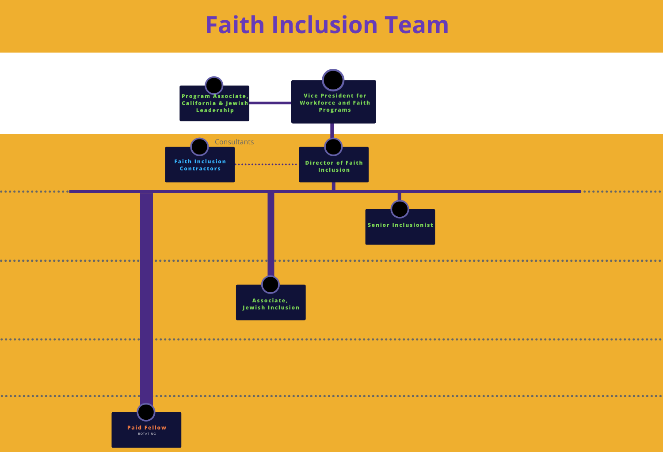
Faith Inclusion Team

Slide 37
Total Anticipated Organizational Staff Growth
Department
Entertainment
Policy
Future Totals
9
7
Net Change
Leadership
6
2021 Totals
+4.25
+5.75
Faith Inclusion
Comms
MGMT
Dev
3.25
2.75
2.25
1.25
1.5
2.5
2.5
4
5
5.5
6.5
+2.75
+3.5
+3
+4
Total
16
43
+27
+3.75

Slide 38
Financial Plan: % of Budget Balance Program Mix
 | 2021 | Future
Entertainment | 44% | 34%
Policy | 24% | 28%
Leadership | 17% | 24%
Faith Inclusion | 14% | 14%
Total Revenue | $2,200,500 | $5,850,000
*Communications, Development and General Operating amortized across slide.

Slide 39
Financial Plan – Diversify Revenue
2021
2026

Slide 40
Future Projected Financial Plan - Revenue
REVENUE | Entertainment | Policy | Leadership | Faith Inclusion | Total
Foundations - Grants | $ 400,000 | $ 1,134,000 | $ 707,500 | $ 489,000 | $ 2,730,500
Individual Giving | 400,000 | 486,000 | 141,500 | 326,000 | 1,353,500
Government Grants | 200,000 | - | 424,500 | - | 624,500
Earned Income | 1,000,000 | - | 141,500 | - | 1,141,500
Total Revenue | 2,000,000 | 1,620,000 | 1,415,000 | 815,000 | 5,850,000

Slide 41
Future Projected Financial Plan - Expenses
EXPENSES | Entertainment | Policy | Leadership | Faith Inclusion | Total
Salaries | $ 747,143 | $ 746,393 | $ 592,143 | $ 376,393 | $ 2,462,072
Benefits | 147,033 | 146,778 | 96,036 | 78,509 | 468,357
Consultants | 200,000 | - | 85,000 | 30,000 | 315,000
Subtotal Direct Expenses | 1,094,176 | 893,171 | 773,179 | 484,902 | 3,245,429
Other OpEx: (e.g. evaluation, supplies, IT, etc) | 273,500 | 209,500 | 193,300 | 47,950 | 724,250
Communication Expense | 182,250 | 148,770 | 128,783 | 80,767 | 540,569
Development Expense | 241,470 | 197,111 | 170,630 | 107,011 | 716,222
Operations Expense | 208,604 | 171,448 | 149,108 | 94,370 | 623,530
Total Expenses | 2,000,000 | 1,620,000 | $1,415,000 | 815,000 | 5,850,000

Slide 42
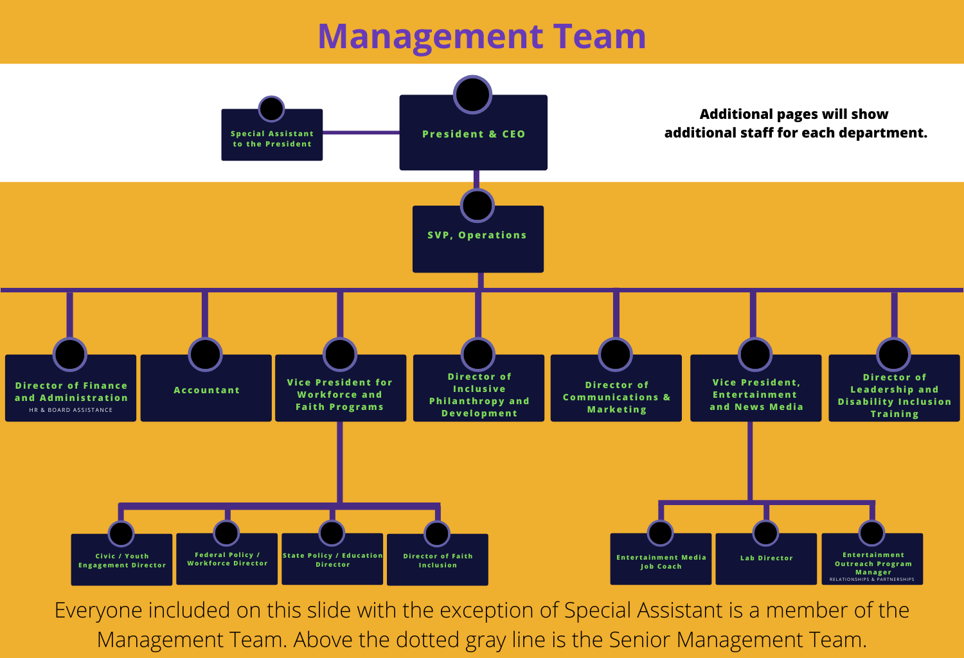
Management Team

Slide 43
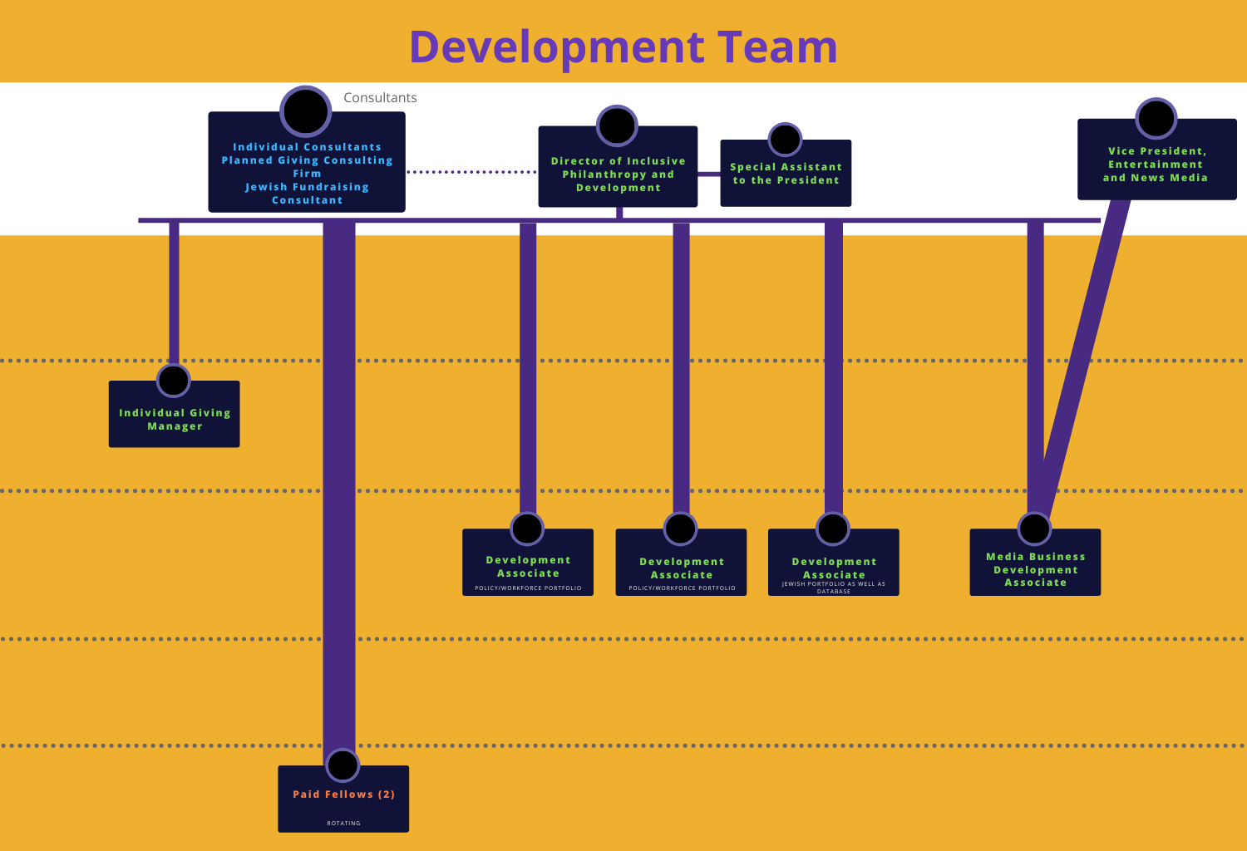
Development Team

Slide 44
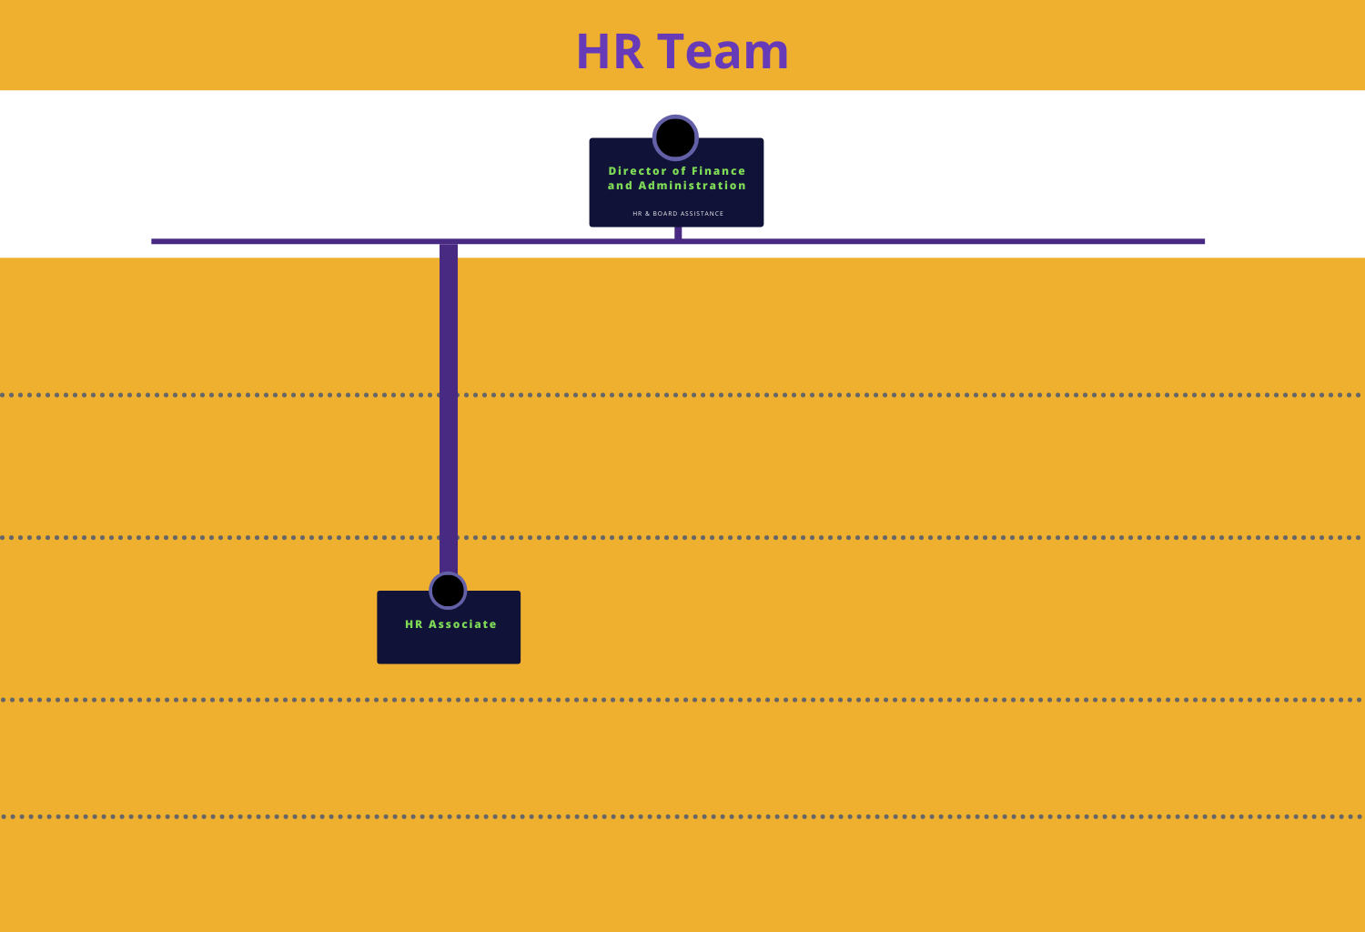
HR Team

Slide 45
Leadership Development and Succession
President and CEO Succession Plan
Temporary, unplanned absence
Permanent, planned or unplanned absence
Board Development
Board Structure: Directors, Advisory Council, and Executive Committee
Board Fundraising Responsibilities
Instructions on frequency of plan update

Slide 46

For More Information
For More Information, Contact:
Jennifer Laszlo Mizrahi
www.RespectAbility.org
Cell: (202) 365-0787
JenniferM@RespectAbility.org

