Slide 1

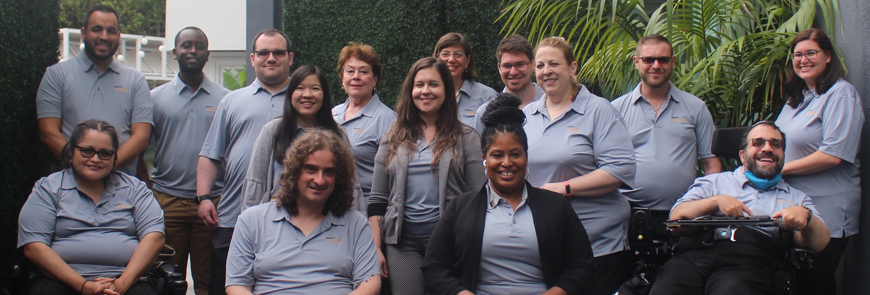
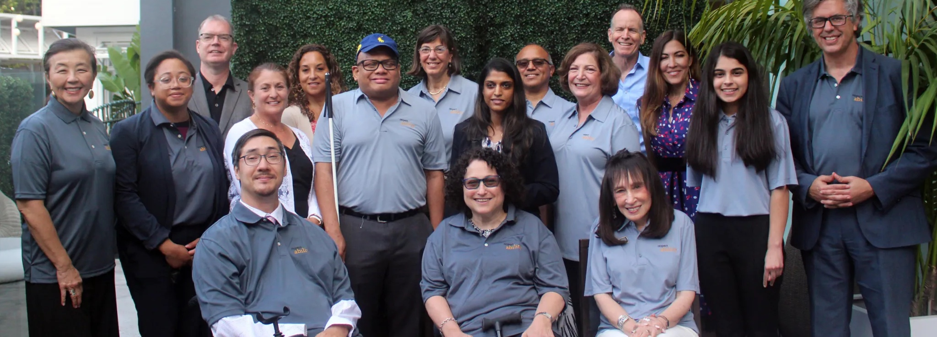
2021 Strategic Plan
2021
Strategic Plan
www.RespectAbility.org
RespectAbility fights stigmas and advances opportunities so that people with disabilities can fully participate in all aspects of community.
Top: RespectAbility Staff
Bottom: RespectAbility Board

Slide 2
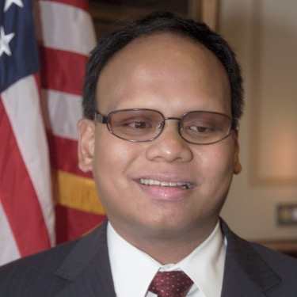
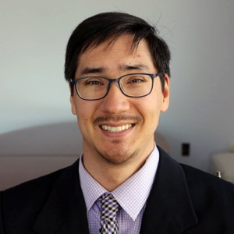
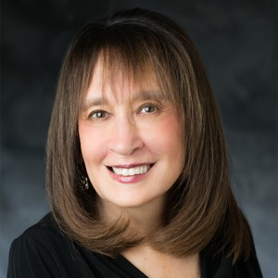
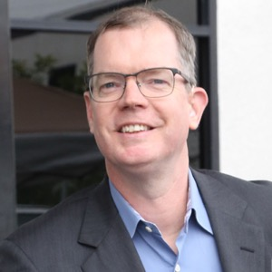
Today’s Speakers
Ollie
Cantos,
Chairman
Randall Duchesneau,
Vice Chair
Vivian
Bass,
Vice Chair
Delbert Whetter,
Vice Chair

Slide 3
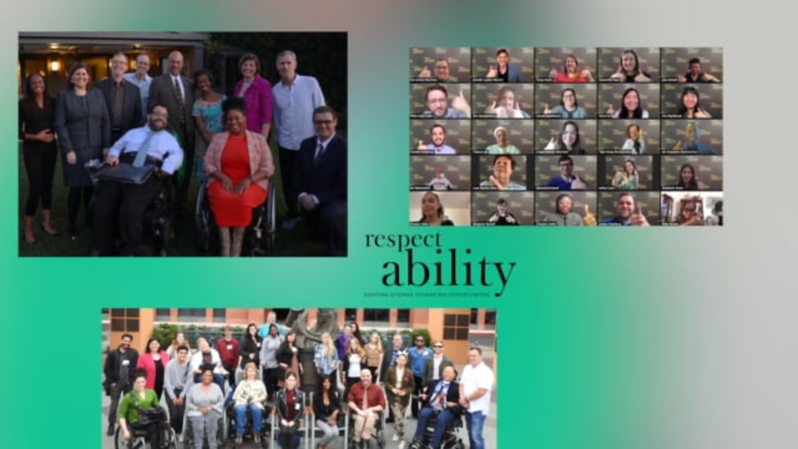
VIDEO

Slide 4
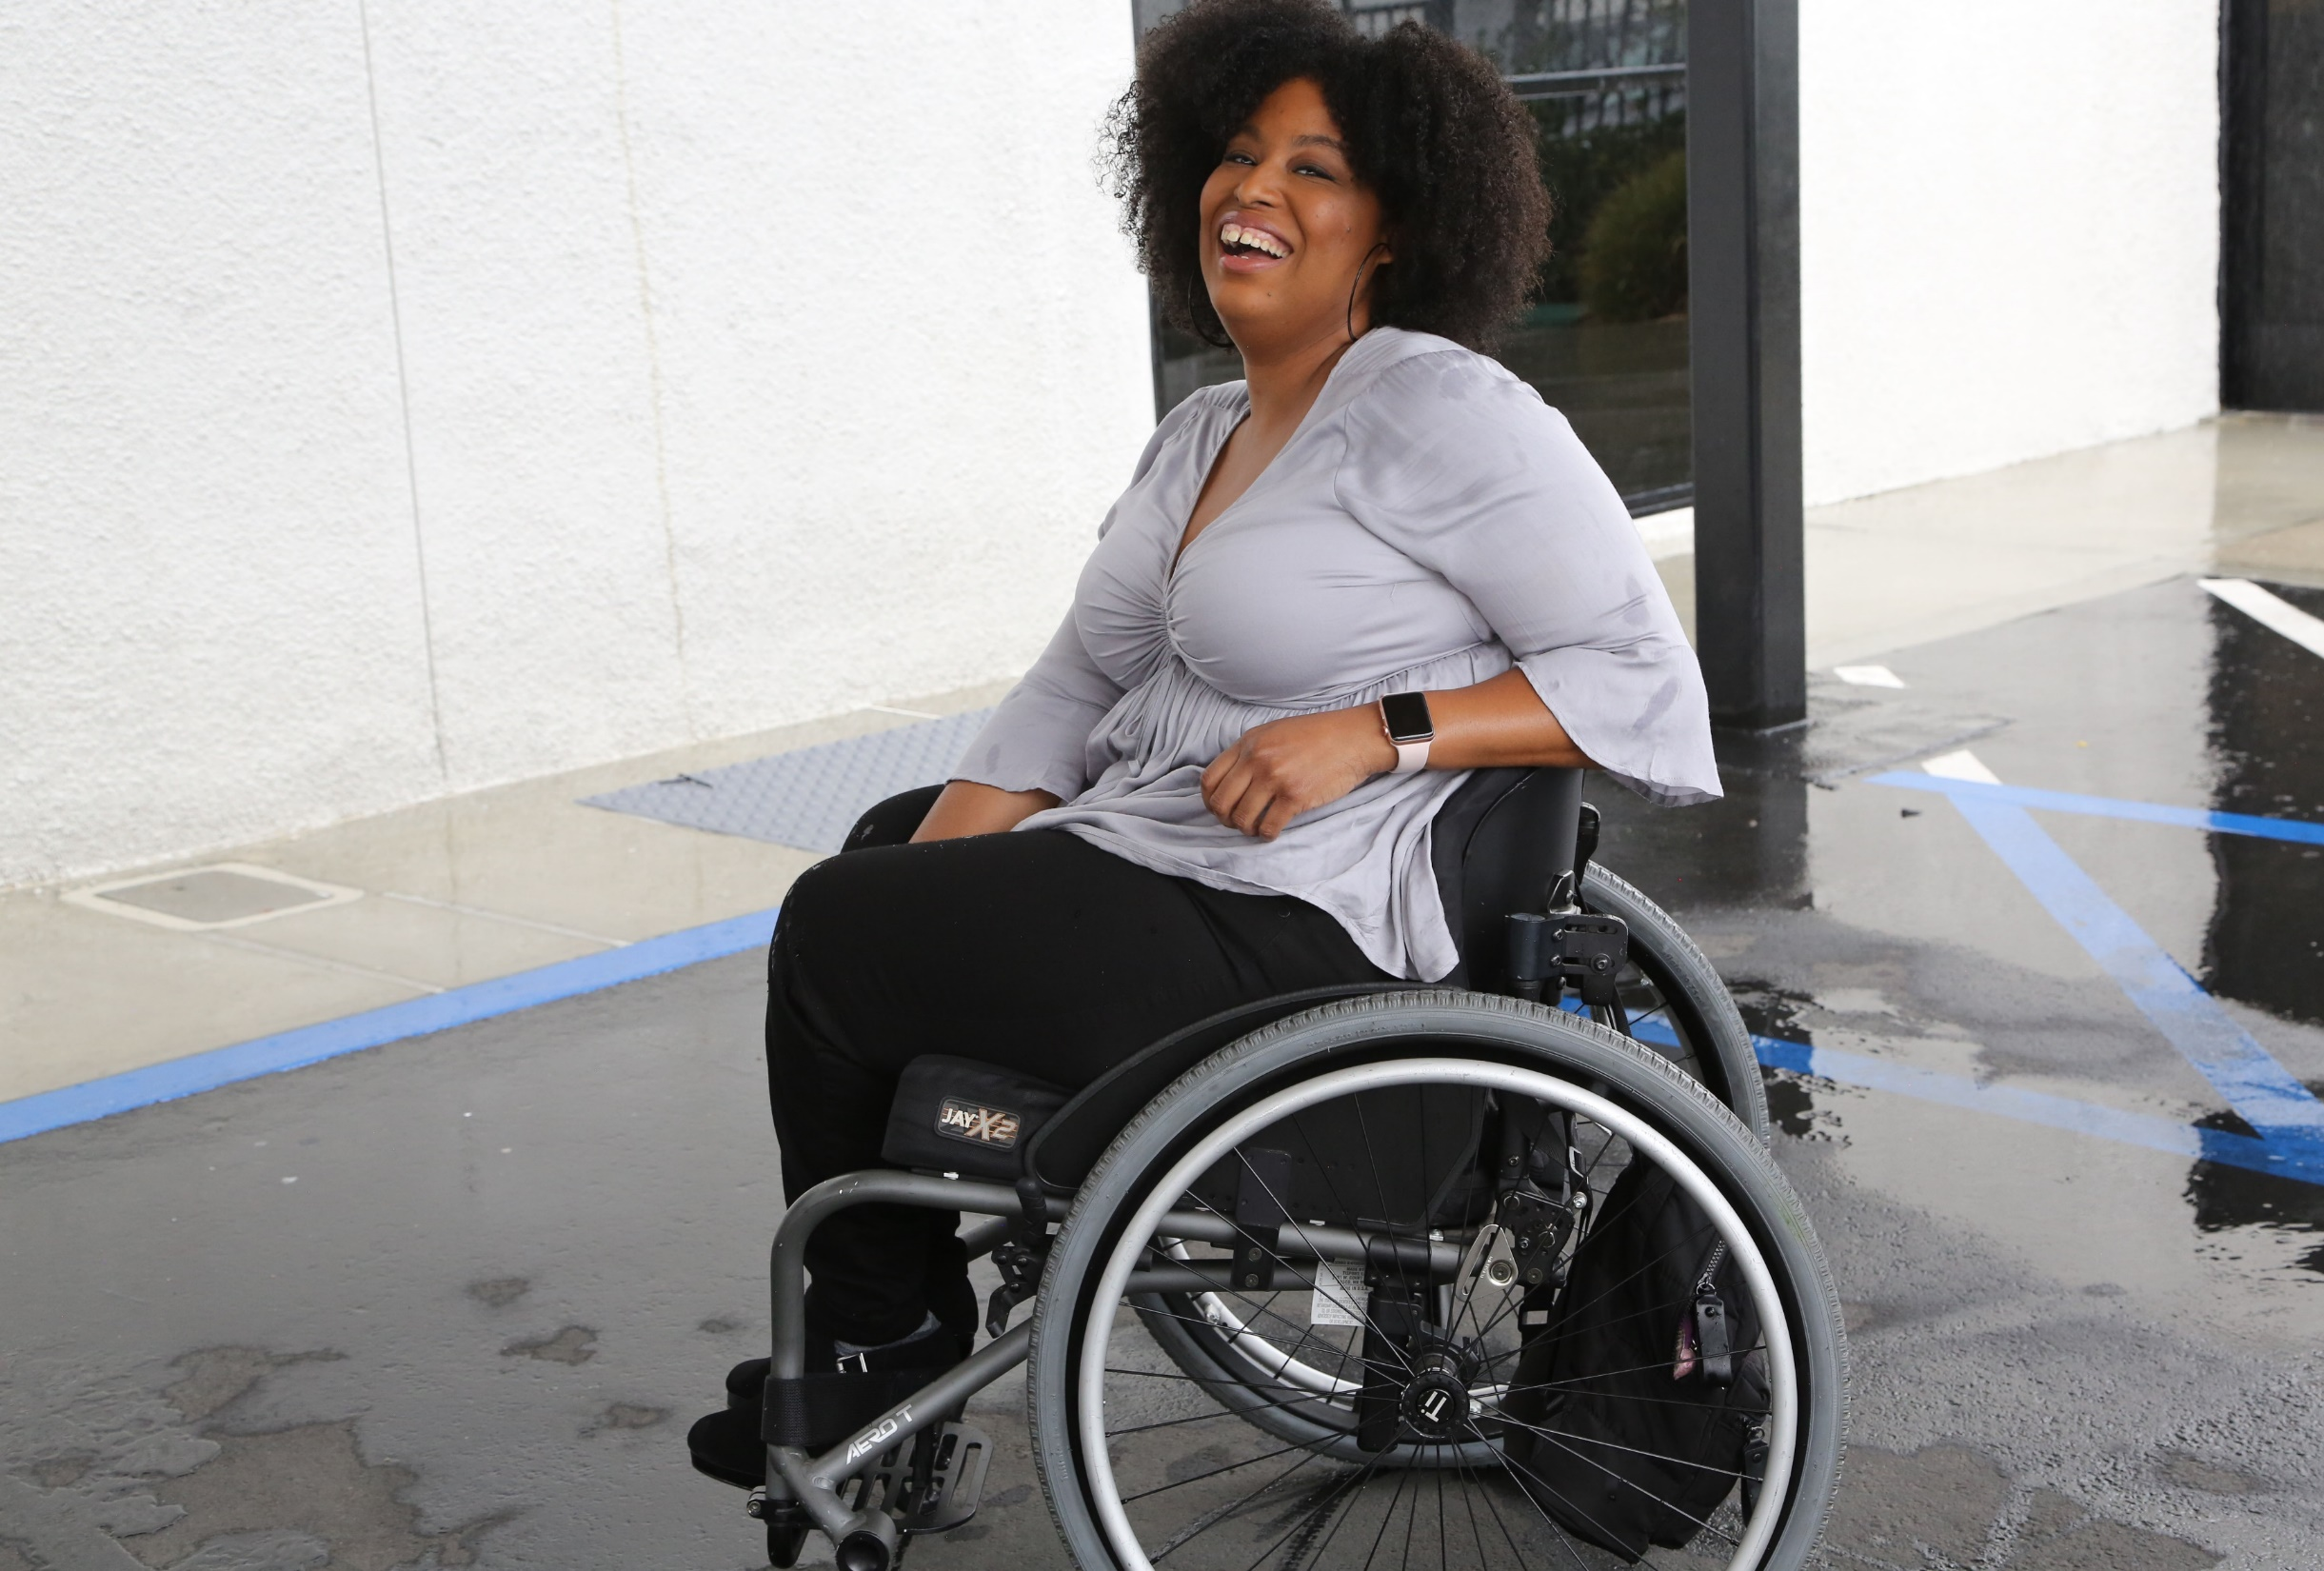

1 in 4 adults
Serving 61 million people in America with disabilities

Slide 5
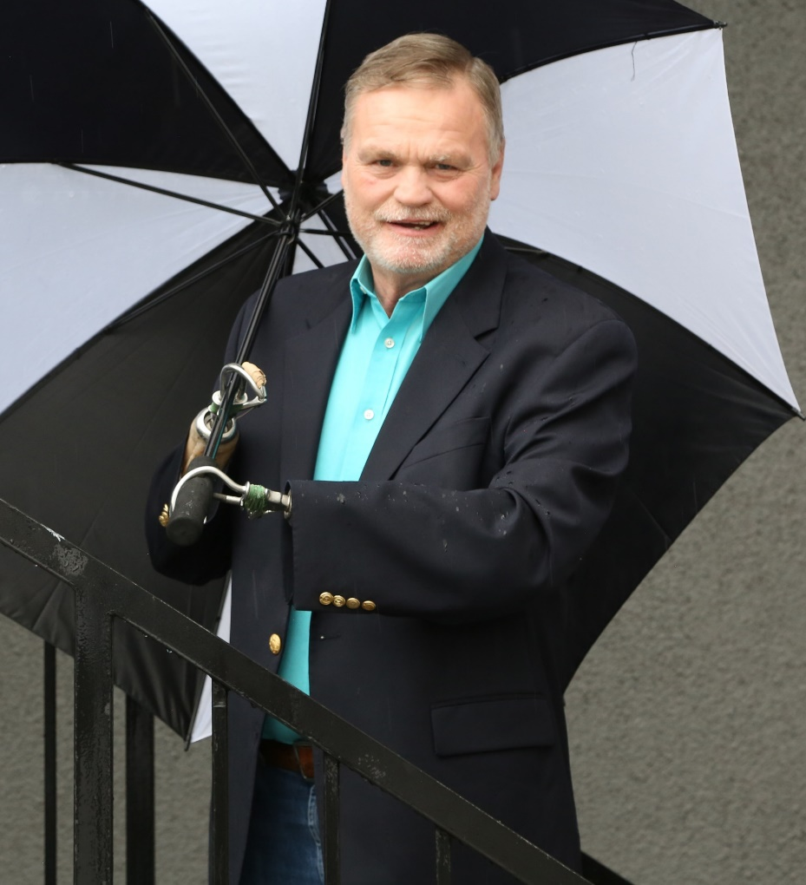
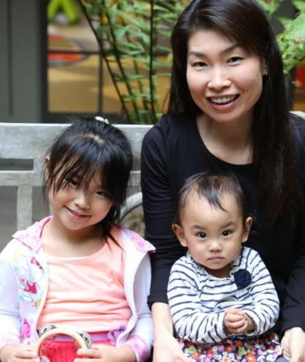
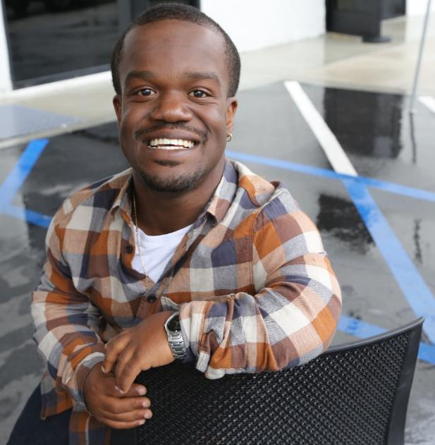
Disabilities Are….
Temporary and Permanent
Visible and Nonvisible
From Birth or Acquired Later

Slide 6
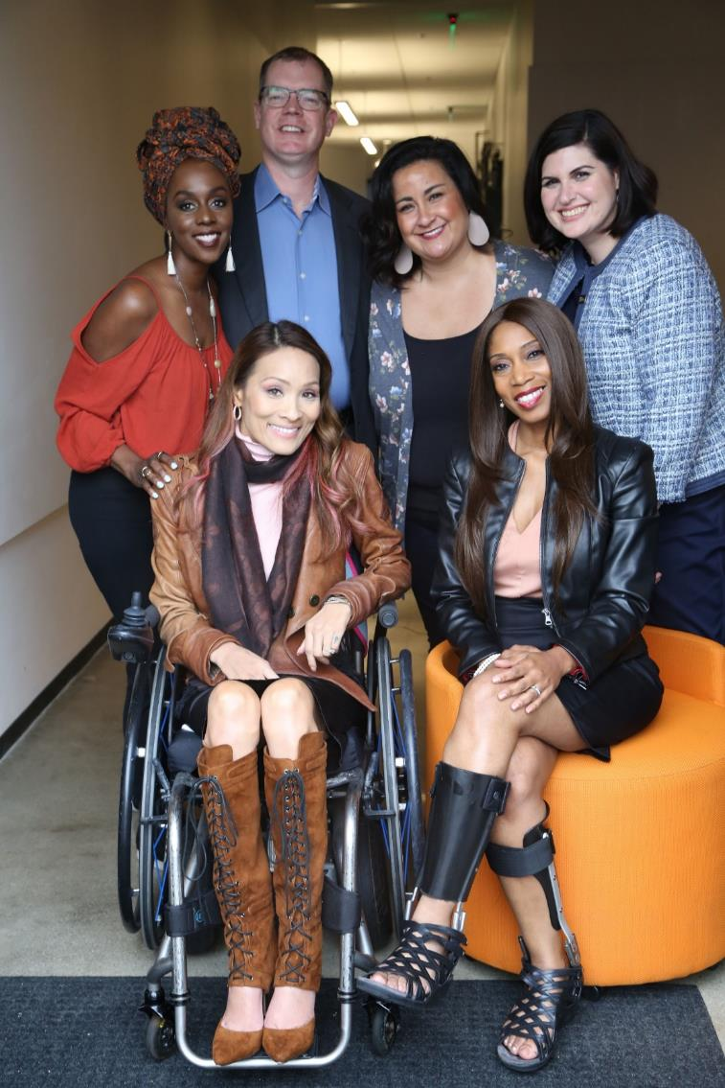
Anyone can join the disability community at any point.
The disability community is diverse.
People with disabilities want opportunities, just like anyone else.

Slide 7
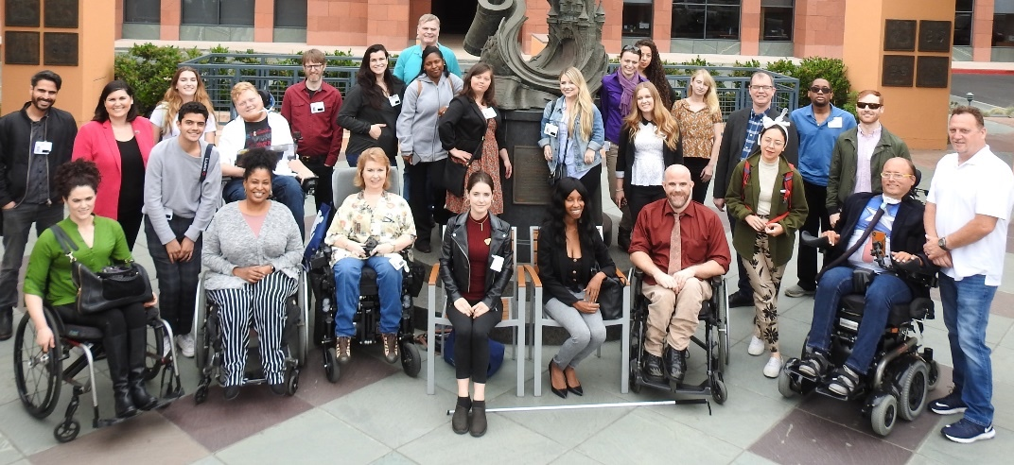
More statistics
Only 65% of people with disabilities finish high school.
Only 7% of people born with disabilities complete college.
Only 1 in 3 people with a disability have a job.
RespectAbility is working to ensure success for people with disabilities

Slide 8
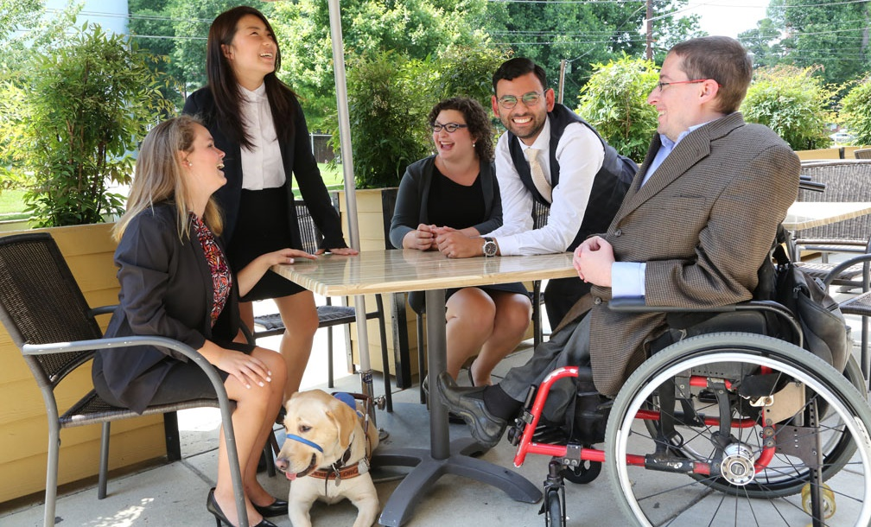

Why RespectAbility?
What is RespectAbility’s DNA?

Slide 9
RespectAbility offers effective solutions:
The majority of our team has disabilities themselves. We are self-advocates and allies who know the problems and what solutions work.
Serve people with ALL disabilities: Many disability groups are single disability (i.e. blindness OR Autism). RespectAbility is one of the few disability organizations representing and advocating for people with ALL disabilities.
Special focus on “opportunity agenda” (education, employment, entrepreneurship, access, civic engagement) for 7 million students and 22 million working age adults with disabilities.
Half of our board and a third of our staff are members of BIPOC communities. Also diverse in sexual orientation and gender identity, as well as age.
Focus on systemic change with authentic talent with lived disability experience.
We foster & convene partnerships, tools and training.

Slide 10
Core Tenets
Diversity, Equity, Inclusion and Accessibility
Collaboration
Commitment to Performance Metrics

Slide 11
Our Mission
RespectAbility fights stigmas and advances opportunities so people with disabilities can fully participate in all aspects of community
Mission:
1
Changing Attitudes Increasing diverse and authentic representation of disabled people on screen, leading to systemic change in how society views and values people with disabilities.
2
Advance Opportunities
We seek & promote best practices in education, employment, entrepreneurship, and civic engagement so people with disabilities can succeed, just like anyone else.
3
Developing Leaders
We help diverse people with disabilities get the training, skills, contacts and opportunities they need to have a seat at decision-making tables.

Slide 12
Theory of Change
MISSION
RespectAbility fights stigmas and advances
opportunities so people with disabilities can fully
participate in all aspects of community.

Slide 13
Commitment to Equity & Excellence
RespectAbility knows we are stronger and better when we are accepting, welcoming and respectful of all people. Since day one, RespectAbility had board-approved intentional diversity and equality policies. We are a “Nothing About Us Without Us” organization.
Organization Level | People of Color/BIPOC | White | Disability | LGBTQIA+ | Female/ Non-Binary | Male
Board | 53% | 47% | 50% | 6% | 50% | 50%
Staff | 36% | 64% | 85% | 21% | 50% | 50%

Slide 14
Program Summary: Four Key Areas of Impact
Area | Purpose
Entertainment and News Media | Increase diverse and authentic representation of disabled people in media so people with disabilities are seen for what they can do, instead of what they cannot.
Leadership Development | Enable diverse people with disabilities to participate fully in decision-making.
Policy | Promote best practices in education, employment, entrepreneurship, civic engagement, and access.
Faith Inclusion | Ensure the inclusion of people with disabilities in faith-based communities.

Slide 15
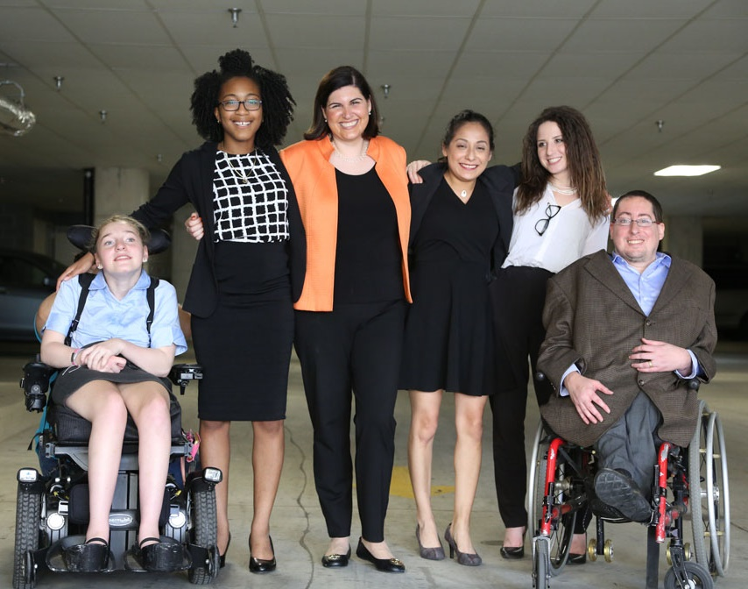
RespectAbility’s Major Accomplishments Across 4 Program Areas Since 2013:
Helped create major improvement in new jobs for people with disabilities
Consulted on disability inclusion for 200+ TV episodes and films
Met with 48 governors to advocate for better education, training & jobs
Provided skill-building tools and training to 5000+ people
Trained 200+ young leaders, 90+ Lab participants & 550+ volunteers

Slide 16
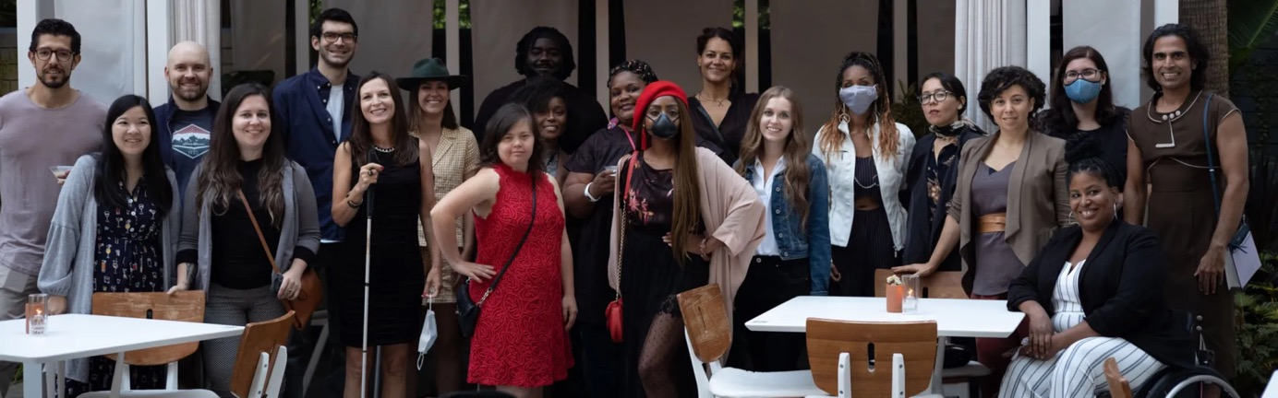
Program Area #1: Entertainment & News Media
Create equitable and accessible opportunities to increase the number of people with lived disability experience throughout the entire media ecosystem, which increases diverse and authentic representation of disabled people on screen, thus leading to systemic change enabling people with disabilities to be seen for what they CAN do, instead of what they cannot do.

Slide 17










Entertainment & News Media:
Major Achievements
  Conducted dozens of trainings for entertainment industry companies, including NBCUniversal, Netflix, Nickelodeon, Pixar, Sony Pictures Entertainment, Sundance Institute, ViacomCBS, the Walt Disney Company and WarnerMedia
  Consulted on approximately 250 projects (TV episodes and films)
  As a trusted partner of the entertainment industry, RespectAbility team members serve on the CAA Full Story Initiative Advisory Council, Disney+ Content Advisory Council, MTV Entertainment Group Culture Code, MTV Entertainment Mental Health Storytelling Coalition, and Sundance Institute’s Allied Organization Initiative.

Slide 18
Strategic Plan:
Entertainment & News Media Goals
Measure and change public opinion so society values people with disabilities equally in all areas, including employment, education, and healthcare
Create equitable and accessible opportunities to increase the number of people with lived disability experience in positions of authority in entertainment and the news media
Increase the number of individuals who have completed our internship and mentoring program for disabled entertainment professionals who gain employment within the industry

Slide 19
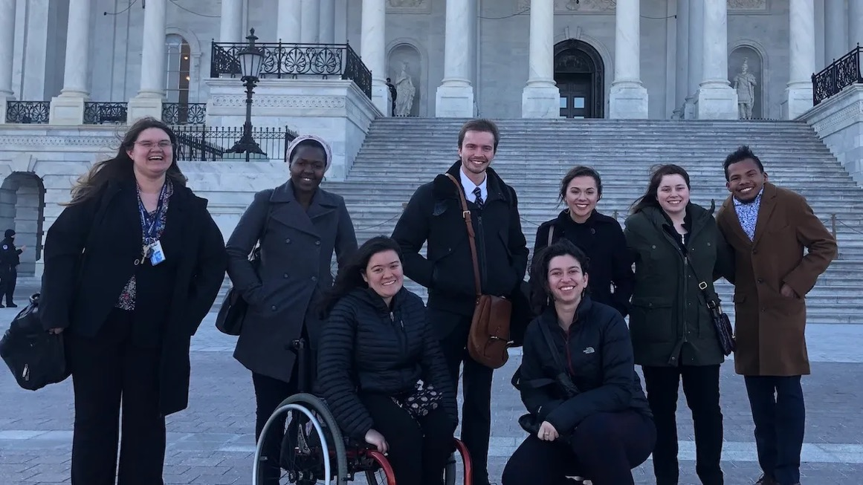
Program Area #2: Policy
Create access, advance opportunities and break down barriers to education, employment, entrepreneurship and civic engagement for diverse people with disabilities.

Slide 20
Demographics of approximately 7 million
K-12 Students with Disabilities
BIPOC Students with Disabilities make up 54 percent of all Students with Disabilities in America’s schools today.
Source: IDEA Section 618 Data Products: Static Table - https://www2.ed.gov/programs/osepidea/618-data/static-tables/index.html

Slide 21
Class of 2018 – National High School Graduation Rates for Students with and without Disabilities by Race
SOURCE: U.S. Department of Education, Office of Special Education Programs, Individuals with Disabilities Education Act (IDEA) Section 618 Data Products

Slide 22
Employment Rates of Minority Populations
(Percentage of population) – 2008 to 2018
SOURCES: https://www.statista.com/statistics/793961/employment-among-disabled-us-adults/ https://www.bls.gov/charts/employment-situation/employment-population-ratio.htm

Slide 23
Employment Rates for Working-Age Americans w/ & w/o Disabilities, by Race – 2019 (Pre-COVID)
SOURCE: Annual Disability Statistics Supplement: 2020. Univ. of New Hampshire, Institute on Disability.
https://disabilitycompendium.org/compendium/2020-annual-disability-statistics-supplement

Slide 24
Policy: Major Achievements
Co-chair a national task force representing 110+ disability groups on skills and jobs
Has testified in every state and has met 1-1 with 48 of America’s governors. Dozens of states have adopted our policy changes, leading to increases in employment for people with disabilities
Influenced the development of policies to drive inclusion among federal contractors, as well as Executive Orders around diversity, equity and inclusion

Slide 25
Strategic Plan Goals: Policy
Achieve parity for people with and without disabilities in education and in the US workforce
Ensure that the public benefits system will no longer disincentivize work
Expand opportunities for people with disabilities to start their own disability-owned business enterprise (DOBE), earn certification as a DOBE, access credit, and succeed as entrepreneurs

Slide 26
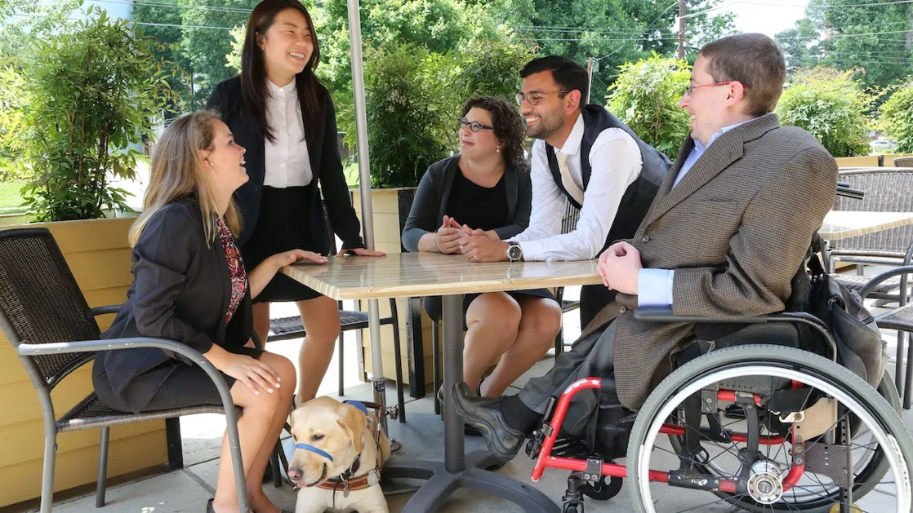
Program Area # 3: Leadership Development
Help diverse people with disabilities acquire the training, skills, contacts and opportunities they need to have a seat at decision-making tables, and increase awareness and opportunity by speaking on disability inclusion and advocacy.

Slide 27
Leadership Development: Major Achievements
Recruited and trained 200+ Fellows in public policy, nonprofit management and faith inclusion program areas. Nearly all Fellows obtain employment or attain further education following the program
Recruited, trained and empowered dozens of disabled speakers to help advance disability access and inclusion via a National Disability Speakers Bureau
Created a new generation of philanthropists who put disability inclusion front and center
Enabled 93 disabled professionals to advance their careers within the entertainment industry through networking and other opportunities

Slide 28
Strategic Plan: Leadership Development Goals
1) Expand National Leadership Program
2) Create opportunities for alumni of our Fellowship programs, including ongoing mentoring, career services, and networking
3) Expand National Disability Training Bureau (NDTB)
4) Create a leadership program for High School students with disabilities
5) Establish a nonpartisan Campaign Training Program for Candidates and Activists with Disabilities

Slide 29
Program Area # 4: Faith Inclusion
Build upon the organization’s strong history of working with the Jewish community to ensure that individuals with disabilities can participate and contribute to all aspects of religious life, thereby addressing the critical omission of a mandate for religious organizations to comply with Americans with Disabilities Act.

Slide 30
Faith Inclusion: Major Achievements
Enabled dozens of organizations to gain skills and tools so as to be respectful, welcoming and inclusive of people with disabilities
Created a Weekly Jewish Disability Perspectives newsletter, which is sent to thousands of leaders to share best practices and amplify the great work of Jews with and without disabilities serving the disability community in the U.S. and Israel
Conducted trainings with dozens of synagogues and Jewish organizations throughout the country to make them more inclusive of people with disabilities
Served as a trusted advisor to Jewish organizations large and small, and advocated for disability issues in communal settings

Slide 31
Strategic Plan: Faith Inclusion Goals
Expansion to serve people of all faith communities
Widespread use of RespectAbility’s resources throughout the Jewish world, with a clear plan for duplication and adaptation in other faith communities
Jewish Speakers from our National Disability Training Bureau will be broadly utilized at Jewish conferences and organizations and will be recognized for their leadership potential
Jews with disabilities and their loved ones will be included in Jewish life and communities, including in all aspects of Jewish community leadership
Major Jewish organizations will work with RespectAbility to centralize Jewish inclusion practices and training

Slide 32
Building An Infrastructure to Meet Ambitious Goals
Department
Entertainment
Policy
Future Totals
9
7
Net Change
Leadership
6
2021 Totals
+4.25
+5.75
Faith Inclusion
Comms
MGMT
Dev
3.25
2.75
2.25
1.25
1.5
2.5
2.5
4
5
5.5
6.5
+2.75
+3.5
+3
+4
Total
16
43
+27
+3.75

Slide 33
Future Projected Expenses
EXPENSES | 2026
Salaries | $ 2,462,072
Benefits | 468,357
Consultants | 315,000
Subtotal Direct Expenses | 3,245,429
Other OpEx: (e.g. evaluation, supplies, IT, etc) | 724,250
Communication Expense | 540,569
Development Expense | 716,222
Operations Expense | 623,530
Total Expenses | 5,850,000

Slide 34
Financial Plan – Grow AND Diversify Revenue
2021
2026

Slide 35
Our goals are ambitious….
We need YOUR help. Please join us now!
Donate now at
www.respectability.org/donate
Read the full strategic plan online

Slide 36

For More Information
For More Information, Contact:
Jennifer Laszlo Mizrahi
www.RespectAbility.org
Cell: (202) 365-0787
JenniferM@RespectAbility.org

