Slide 1
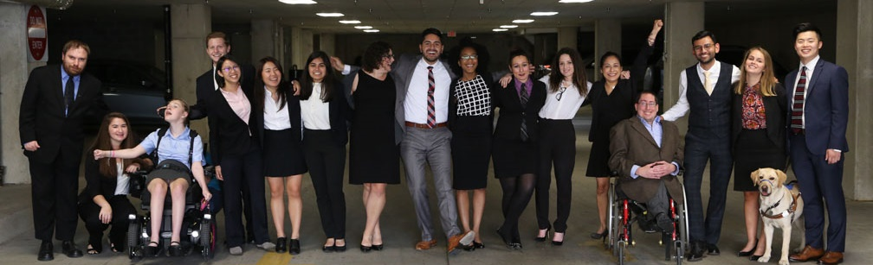

The Community Reinvestment Act (CRA) and Why It Matters for People with Disabilities
Public Comments for August 11th, 2021, CWDB Executive Committee Meeting
www.RespectAbility.org

Slide 2
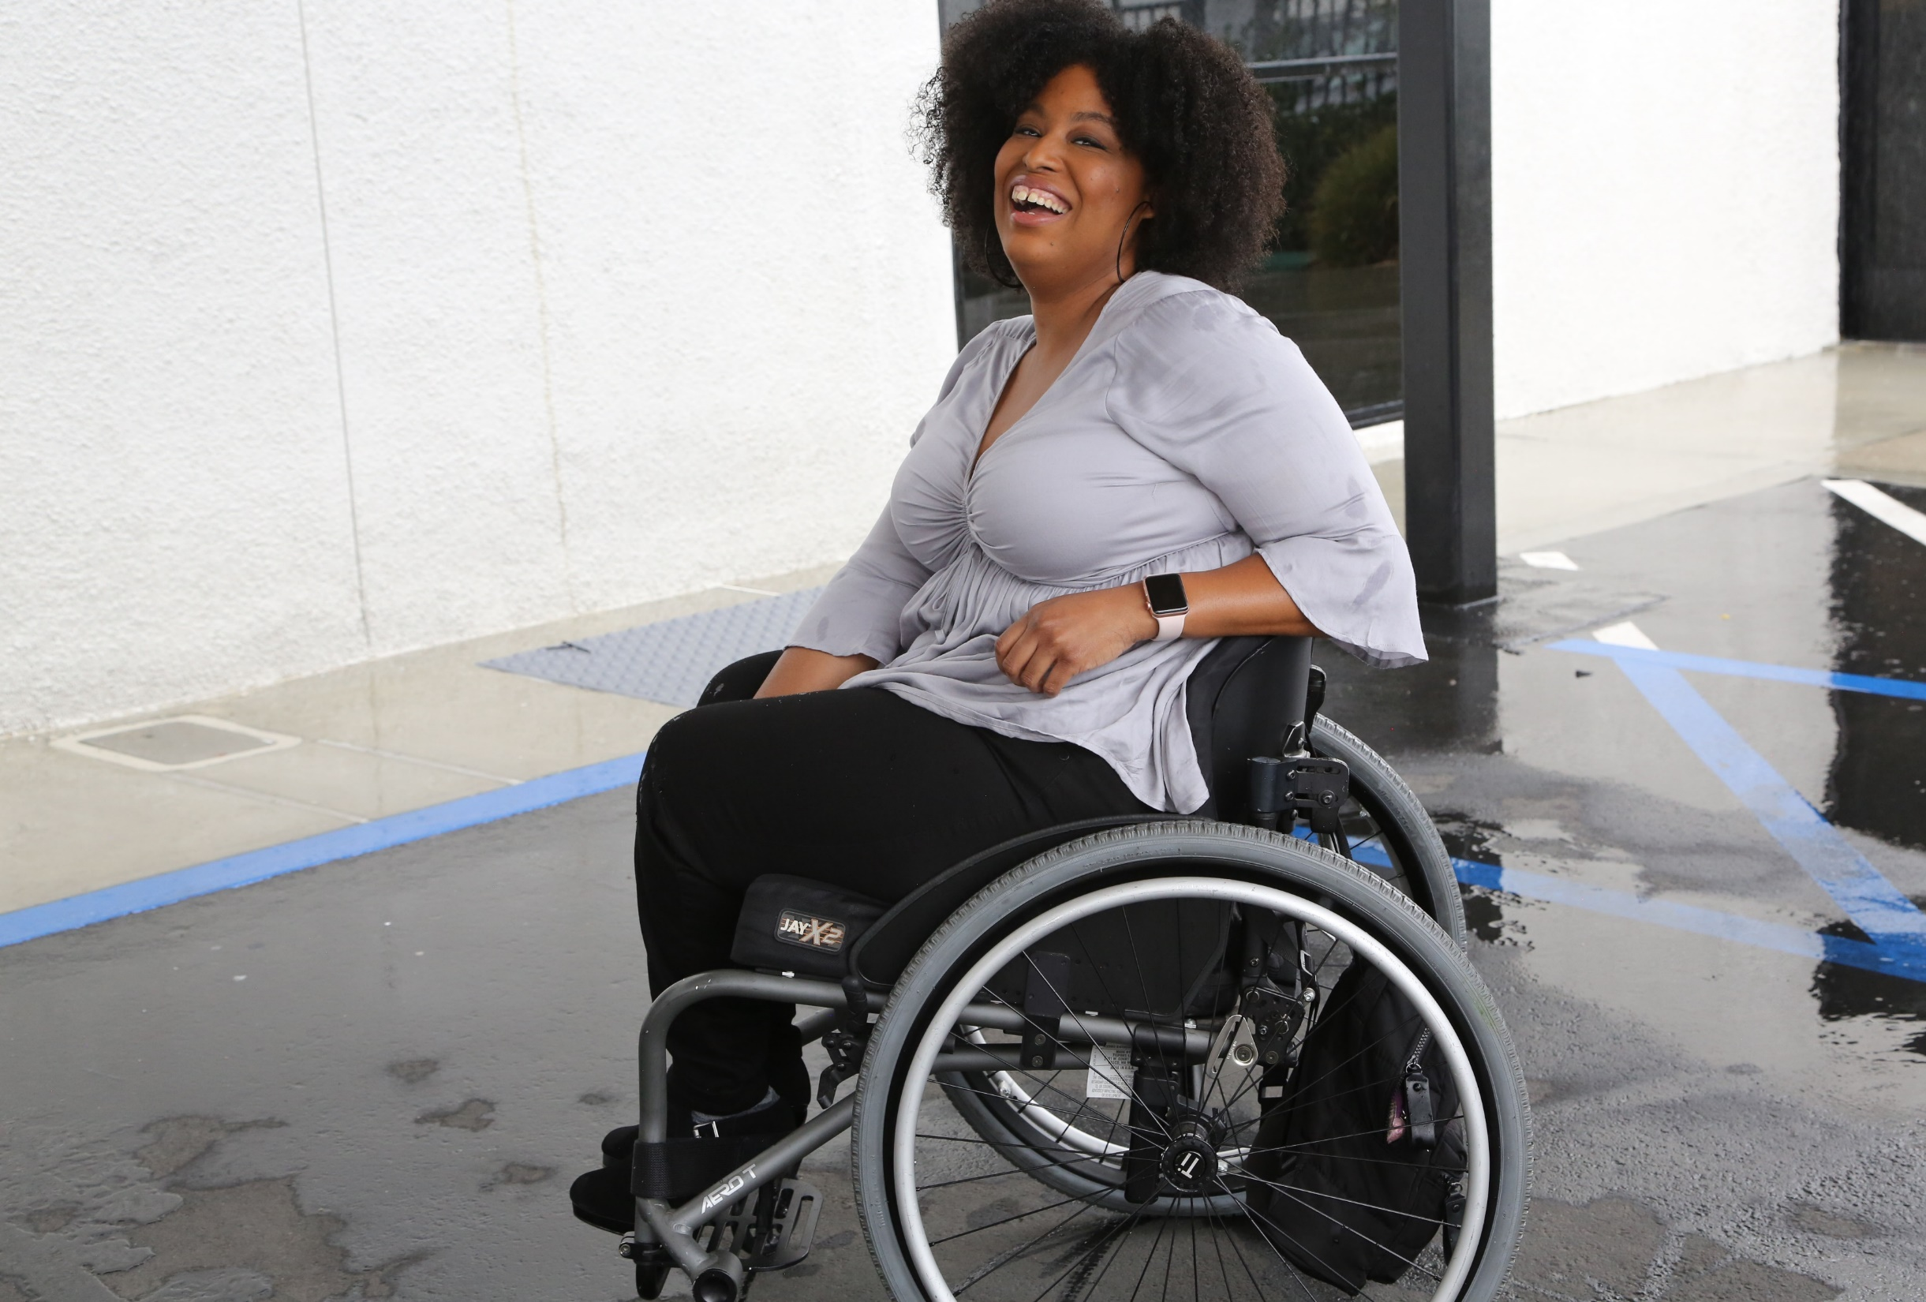

1 in 4 adults
1-in-4
adults have a disability
(physical, sensory, cognitive, mental health or other)
61 million people in America have a disability and the majority of people have a loved one with a disability

Slide 3
Employment Rates for Working-Age Americans w/ & w/o Disabilities, by Race – 2019 (Pre-COVID)
SOURCE: Annual Disability Statistics Supplement: 2020. Univ. of New Hampshire, Institute on Disability.
https://disabilitycompendium.org/compendium/2020-annual-disability-statistics-supplement

Slide 4
Poverty Rates for Working-Age Americans w/ & w/o Disabilities, by Race – 2019 (Pre-COVID)
SOURCE: Annual Disability Statistics Supplement: 2020. Univ. of New Hampshire, Institute on Disability.
https://disabilitycompendium.org/compendium/2020-annual-disability-statistics-supplement

Slide 5
Employment Rates of Minority Populations
(Percentage of population) – 2008 to 2018
SOURCES: https://www.statista.com/statistics/793961/employment-among-disabled-us-adults/ https://www.bls.gov/charts/employment-situation/employment-population-ratio.htm

Slide 6
African Americans with Disabilities – 2019
As of 2019, there were 39,412,670 African Americans living in the United States.
Out that number, there are 5,598,758 African Americans living with some form of disability.
There are 3,268,440 working-age African Americans with disabilities. Out of that number, only 1,048,745, or 32.1 percent, have jobs.
By comparison, fully 75.5 percent of African Americans without disabilities have jobs.
The employment gap between African Americans with and without disabilities is 43.4 percentage points.
Fully 32 percent of African Americans with disabilities live in poverty compared to 20.9 percent of African Americans without disabilities.
SOURCES: https://www.statista.com/statistics/793961/employment-among-disabled-us-adults/ https://www.bls.gov/charts/employment-situation/employment-population-ratio.htm

Slide 7
Hispanic/LatinX People with Disabilities - 2019
As of 2019, there were 59,709,293 Hispanic/LatinX people living in the United States.
Out of that number, there are 5,412,676 Hispanic/LatinX people living with some form of disability.
There are 2,969,668 working-age Hispanic/LatinX people with disabilities. Out of that number, fully 1,213,802, or 40.9 percent, have jobs.
By comparison, fully 77.1 percent of Hispanic/LatinX people without disabilities have jobs.
The employment gap between Hispanic/LatinX people with and without disabilities is 36.1 percentage points.
Fully 26 percent of Hispanic/LatinX people with disabilities live in poverty, compared to only 17.5 of Latinx people without disabilities.
SOURCES: https://www.statista.com/statistics/793961/employment-among-disabled-us-adults/ https://www.bls.gov/charts/employment-situation/employment-population-ratio.htm

Slide 8
Asian Americans with Disabilities – 2019
As of 2019, there were 18,297,153 Asian Americans living in the United States.
Out that number, there are 1,315,999 Asian Americans living with some form of disability.
There are 537,908 working-age Asian Americans with disabilities. Out of that number, only 231,821, or 43.1 percent, have jobs.
By comparison, fully 76 percent of Asian Americans without disabilities have jobs.
The employment gap between Asian Americans with and without disabilities is 32.9 percentage points.
Fully 17.9 percent of Asian Americans with disabilities live in poverty compared to 10.6 percent of Asian Americans without disabilities
SOURCES: https://www.statista.com/statistics/793961/employment-among-disabled-us-adults/ https://www.bls.gov/charts/employment-situation/employment-population-ratio.htm

Slide 9
BIPOC Subtotal
In total, there are 2,777,677 American Indian and Alaska Natives living in the United States. Out of that number, approximately 477,954 have disabilities.
In total, there are 612,857 Native Hawaiian and Other Pacific Islander living in the United States. Out of that number, approximately 64,782 have disabilities.
Subtotal: 12,870,169 Black, Indigenous and People of Color (BIPOC) People with Disabilities
SOURCES: https://www.statista.com/statistics/793961/employment-among-disabled-us-adults/ https://www.bls.gov/charts/employment-situation/employment-population-ratio.htm

Slide 10
Women with Disabilities – 2019
As of 2019, there were 165,302,064 women living in the United States.
Out that number, there are 21,201,155 women living with some form of disability.
There are 10,174,591 working-age women with disabilities. Out of that number, only 3,727,186, or 36.6 percent have jobs.
By comparison, fully 73.8 percent of women without disabilities have jobs.
The employment gap between women with and without disabilities is 37.1 percentage points.
Fully 22.5 percent of women with disabilities live in poverty compared to 13.5 percent of women without disabilities.
SOURCES: https://www.statista.com/statistics/793961/employment-among-disabled-us-adults/ https://www.bls.gov/charts/employment-situation/employment-population-ratio.htm

Slide 11
Students with Disabilities in K-12 Schools
Total Number of K-12 students with disabilities: 6,561,998
  85,680 American Indian or Alaska Native students with disabilities
  165,353 Asian students with disabilities
  1,158,862 Black or African American students with disabilities
  1,826,344 Hispanic/LatinX students with disabilities
  23,809 Native Hawaiian or Other Pacific Islander students with disabilities
  283,819 Biracial students with disabilities
  3,018,131 White students with disabilities
  Subtotal of BIPOC Students with Disabilities: 3,543,867
Source: IDEA Section 618 Data Products: Static Table - https://www2.ed.gov/programs/osepidea/618-data/static-tables/index.html

Slide 12
Percentage & Number of Disability by Type - SWDs
 | Autism | Deaf-blindness | Developmental delay | Emotional disturbance | Hearing disabilities | Intellectual disabilities | Multiple disabilities | Orthopedic Disability | Other health conditions | Specific learning disabilities | Speech or language | Traumatic brain injury (TBI) | Visual disabilities
Number of SWDs with that Disability | 717,716 | 1,553 | 194,919 | 345,782 | 64,311 | 419,196 | 127,126 | 31,361 | 1,079,301 | 2,379,448 | 1,090,207 | 24,993 | 24,243
Percentage of SWDs with that Disability | 11% | 0.02% | 2.9% | 5% | 0.9% | 6% | 1.9% | 0.4% | 16% | 36% | 16% | 0.3% | 0.3%
In total, there are 6,561,998 students with disabilities in America’s Public School System today.
Source: IDEA Section 618 Data Products: Static Table - https://www2.ed.gov/programs/osepidea/618-data/static-tables/index.html

Slide 13
Demographics of K-12 Students with Disabilities
BIPOC Students with Disabilities make up 54 percent of all Students with Disabilities in America’s schools today.
Source: IDEA Section 618 Data Products: Static Table - https://www2.ed.gov/programs/osepidea/618-data/static-tables/index.html

Slide 14
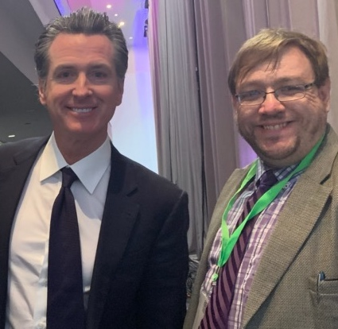
Disability Statistics in California (Pre-COVID)
There are 4,131,700 Californians with disabilities.
There are 1,910,288 working-age Californians with disabilities. Out of that number, 731,093 working-age Californians with disabilities had jobs in 2019. California’s disability employment rate was 38.2 percent in 2019.
The employment rate for working-age Californians without disabilities was 76.4 percent in 2019.
There was a 38.1 percent Gap in Labor Force Participation Rates between PWDs and non-PWDs.
The poverty rate for working-age Californians with disabilities was 22.8 percent.
Gov. Gavin Newsom with Philip Kahn-Pauli of RespectAbility
Source: Annual Disability Statistics Compendium: 2020 Durham, NH: Univ. of New Hampshire, Institute on Disability
https://disabilitycompendium.org/

Slide 15
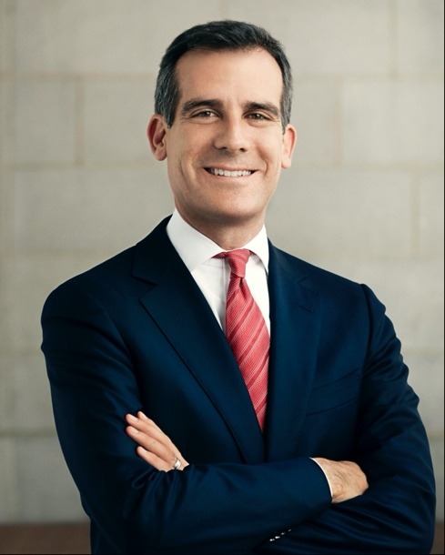
Disability Statistics in Los Angeles
In total, there are 992,719 Angelenos with disabilities living in L.A. County.
There are 466,385 working-age Angelenos with disabilities living in L.A. County. In the economic expansion prior to COVID-19, only 169,322 working-age Angelenos with disabilities had jobs. L.A. County’s disability employment rate was only 36.3 percent in 2019.
By contrast, the employment rate for Angelenos without disabilities was 74.7 percent.
That means that there is a 38.4 percentage point gap in the labor force participation rates between Angelenos with and without disabilities.
Mayor Eric Garcetti (D)
Source: Annual Disability Statistics Compendium: 2020 Durham, NH: Univ. of New Hampshire, Institute on Disability
https://disabilitycompendium.org/

Slide 16
Racial Disparities for People with Disabilities in California
180,888 working-age African Americans with disabilities
  53,874 or 29.8 percent had jobs in 2019.
  28.5 percent of African Americans with disabilities live in poverty
  18.9 percent of African Americans without disabilities.
684,515 working-age Latinx people with disabilities.
  274,399 or 40.1 percent had jobs in 2019.
  21 percent of Latinx people with disabilities live in poverty
  15.6 of Latinx people without disabilities.
167,672 working-age Asian Americans with disabilities.
  68,725 or 41 percent have jobs.
  18.4 percent of Asian Americans with disabilities live in poverty
  9.3 percent of Asian Americans without disabilities.
SOURCE: Annual Disability Statistics Supplement: 2020. Univ. of New Hampshire, Institute on Disability.
https://disabilitycompendium.org/compendium/2020-annual-disability-statistics-supplement

Slide 17
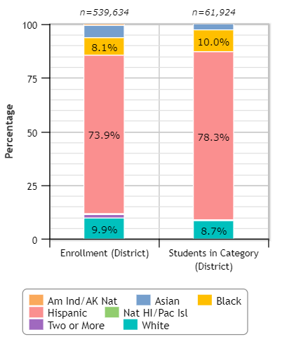
LA Unified & Students with Disabilities
78.3 percent of LAUSD’s students with disabilities are Hispanic
10 percent of LAUSD’s students with disabilities are African-American
8.7 percent of LAUSD’s students with disabilities are White
Overall, 11.5 percent of LAUSD students are students with disabilities.
Source: Civil Rights Data Collection: https://ocrdata.ed.gov/Page?t=d&eid=30388&syk=8&pid=2396

Slide 18
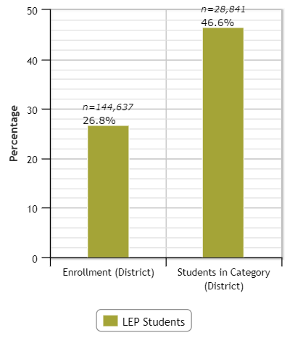
LA Unified & Students with Disabilities – LEP
Overall, 26.8 percent of LAUSD students have Limited English Proficiency (LEP)
46.6 percent of LAUSD’s students with disabilities have Limited English Proficiency (LEP)
Source: Civil Rights Data Collection: https://ocrdata.ed.gov/Page?t=d&eid=30388&syk=8&pid=2396

Slide 19
California High School Grad Rates for Students w/ & w/o Disabilities, by Race – Class of 2020
Source: 2019-20 Four-Year Adjusted Cohort Graduation Rate Statewide Report
https://dq.cde.ca.gov/dataquest/dqcensus/CohRate.aspx?cds=00&agglevel=state&year=2019-20

Slide 20
LAUSD High School Grad Rates for Students w/ & w/o Disabilities, by Race – Class of 2020
Source: 2019-20 Four-Year Adjusted Cohort Graduation Rate Los Angeles County Report
https://dq.cde.ca.gov/dataquest/dqcensus/CohRate.aspx?cds=19&agglevel=county&year=2019-20&initrow=&ro=y

Slide 21
Disability by Type – SWDs in LAUSD and CA
 | Intellectual Disability | Hard of Hearing | Deaf | Speech or Language Disability | Visual Disability | Emotional Disturbance | Orthopedic Disability | Other health conditions | Specific Learning Disability | Deaf-Blindness | Multiple Disability | Autism | Traumatic Brain Injury (TBI)
Number of SWDs with that Disability in LAUSD | 9,655 | 2,825 | 695 | 34,621 | 843 | 4,999 | 3,020 | 24,472 | 74,623 | 25 | 1,118 | 33,834 | 289
Number of SWDs with that Disability in California | 43,770 | 10,657 | 3,223 | 164,698 | 3,405 | 25,233 | 9,916 | 104,792 | 300,295 | 114 | 7,308 | 120,095 | 1,541
In total, there are 191,019 students with disabilities in LAUSD
There are 795,047 students with disabilities in CA’s K-12 schools.
Source: Special Education Enrollment by Ethnicity and Disability - https://bit.ly/3fCEAaD

Slide 22
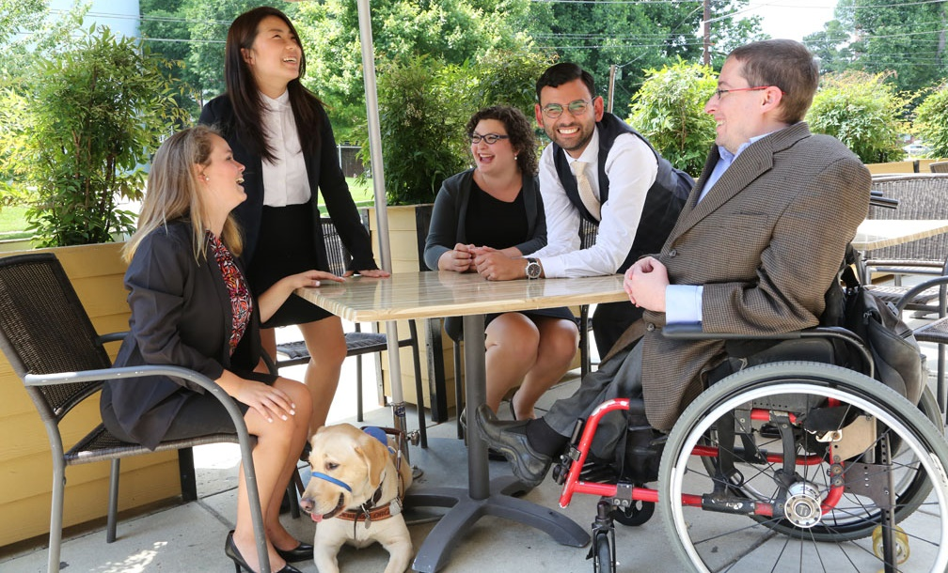

Why RespectAbility?
Why work with RespectAbility?

Slide 23
Our Mission
RespectAbility fights stigmas and advances opportunities so people with disabilities can fully participate in all aspects of community
Mission:
1
Changing Attitudes Increasing diverse and authentic representation of disabled people on screen, leading to systemic change in how society views and values people with disabilities.
2
Advance Opportunities
We seek & promote best practices in education, employment, entrepreneurship, and civic engagement so people with disabilities can succeed, just like anyone else.
3
Developing Leaders
We help diverse people with disabilities get the training, skills, contacts and opportunities they need to have a seat at decision-making tables.
.

Slide 24

Theory of Change: Our core programmatic activities intersect to drive long-term impact.
Developing Leaders
We help diverse people with disabilities get the training, skills, contacts and opportunities they need to have a seat at decision-making tables.
Changing Attitudes
Increasing diverse and authentic representation of disabled people on screen, leading to systemic change in how society views and values people with disabilities.
Mission
RespectAbility fights stigmas and advances opportunities so people with disabilities can fully participate in all aspects of community.
Advancing Opportunities
We seek & promote best practices in education, employment, entrepreneurship, and civic engagement so people with disabilities can succeed, just like anyone else.

Slide 25
How RespectAbility offers effective solutions:
The majority of our team has disabilities themselves. We are self-advocates and allies who know the problems and what solutions work.
Serve people with ALL disabilities: Many disability groups are single disability (i.e. blindness OR Autism). RespectAbility is one of the few disability organizations representing and advocating for people with ALL disabilities.
Disability Founded. Half of our board and a third of our staff are members of BIPOC communities. We are creating pathways for education, skills, jobs and a better future.
Focus on systemic change with authentic talent with lived disability experience.
We foster & convene partnerships, tools and training.

Slide 26
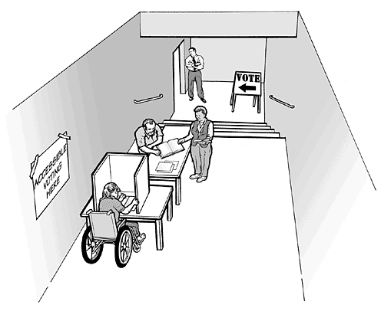
Inaccessibility Has Many Forms
Events at non-ADA accessible locations
Websites, ads and social media without captions and screen reader accessibility
Lack of ASL interpreters when requested at events
Lack of translations (Spanish) and too complex wording
Lack of ramp/elevator
Lack of accessibility in parking lot
Lack of accessible bathroom
Lack of Braille ballot
Inaccessible voting booths
Or when those who require assistance are judged to be not capable of voting by polling officials

Slide 27
Fight Stigmas
1
  Narrative Change in Hollywood
  Representation of People with Disabilities in News
  Facts, Studies, & Social Media
People with disabilities are viewed for what they can do – and as capable contributing members of society.

Slide 28
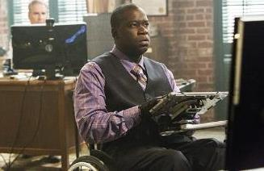


Onscreen Perceptions: Fighting Stigmas
3.1% of scripted television characters have disabilities*
Actors without disabilities play more than 95% of all characters with disabilities
Almost all portrayals of people with disabilities are white, despite the fact disabilities affect all
*2019-2020 TV Season

Slide 29
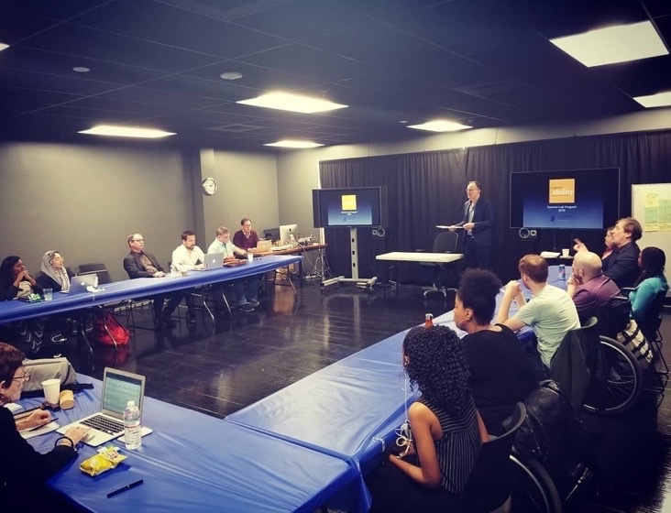
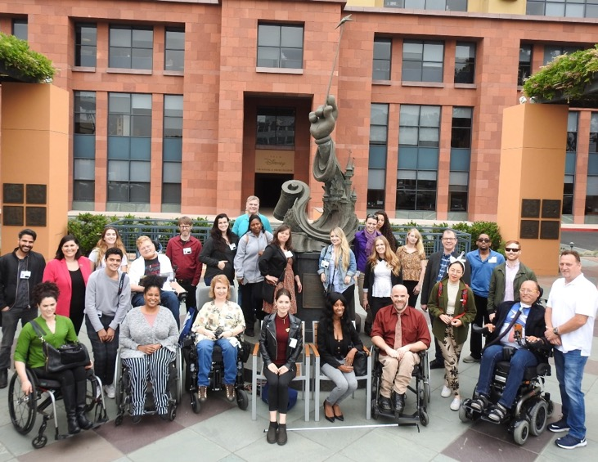
RespectAbility’s Summer Lab for Entertainment Professionals with Disabilities
RespectAbility’s Summer Lab for Entertainment Professionals with Disabilities
The Summer Lab is an award-winning innovative series for emerging entertainment talent and mid-level career professionals with disabilities who are pursuing a variety of entertainment careers, including writing, directing, producing, animation, cinematography and other production roles. These seminars allow participants and speakers from across the industry to network and learn from one another.
More Info: https://www.respectability.org/respectability-la-lab

Slide 30
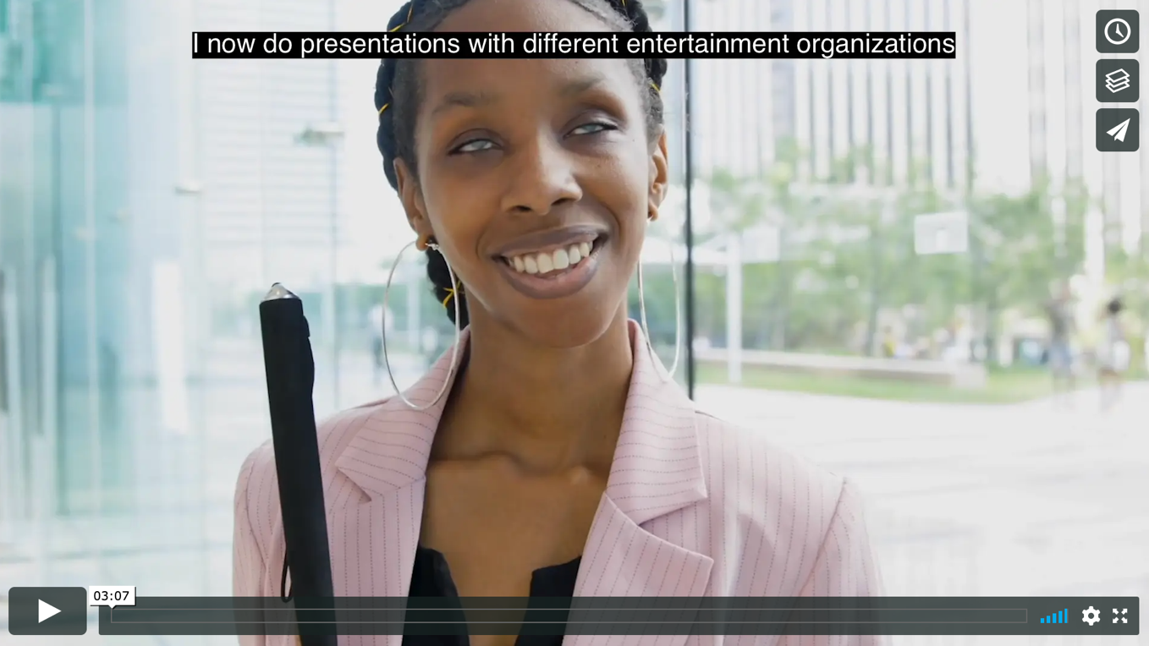
Video Featuring 2019 Lab Alumni
Watch video: https://vimeo.com/397118592 | More Info: https://www.respectability.org/respectability-la-lab

Slide 31

2021 Lab Program Goals
In our 2019 pilot program, we placed 5 of the 16 emerging track participants in employment at Disney, Paramount and Sony within three months of graduating. Since then, 20 graduates from 2019 & 2020 have found full-time or part-time employment in the industry. Our goals for 2021 include:
30 Participants: 15 Emerging Track, 15 Mid-Career Track
15+ graduates placed into competitive employment in studios and production companies in first year following graduation
100+ entertainment executives meeting participants, increasing equitable hiring of people with disabilities on and off screen

Slide 32














Our Entertainment Industry Partnerships

Slide 33
Advancing Opportunities
2
  Task Force of 110+ Disability Nonprofits
  Federal Task Force
  Partnership with L.A. Department on Disability
People with disabilities are hired, listened to
and are part of the solution.

Slide 34
Public Policy Advocacy and Disability Employment
Our policy advocacy work focuses on finding solutions to the systematic, legal and policy problems that create barriers to education and employment for working-age people with disabilities.
We co-chair a coalition with 110+ national disability organizations on training, skills and jobs
We have met with 48 governors to advocate for better education, training & jobs
COVID-19: In recent years, thousands of Americans with disabilities have entered the workforce in unprecedented numbers. With the pandemic, much of that progress has been lost. With millions of Americans out of work and people with disabilities uniquely at risk from this deadly disease, coalition work has provided tremendous benefits.

Slide 35
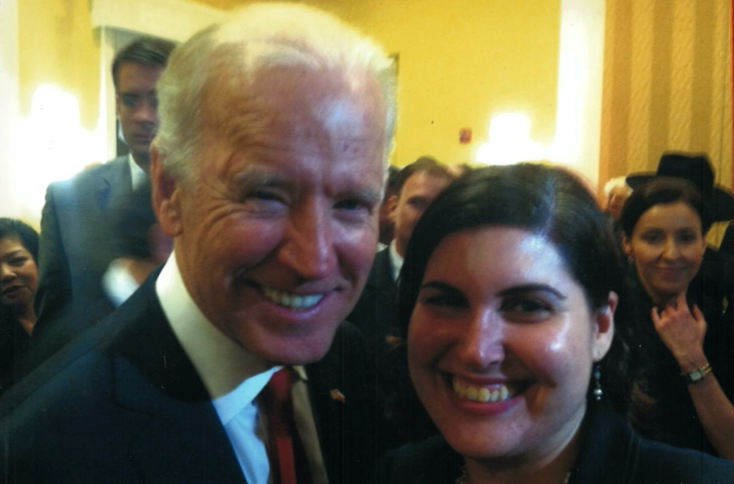
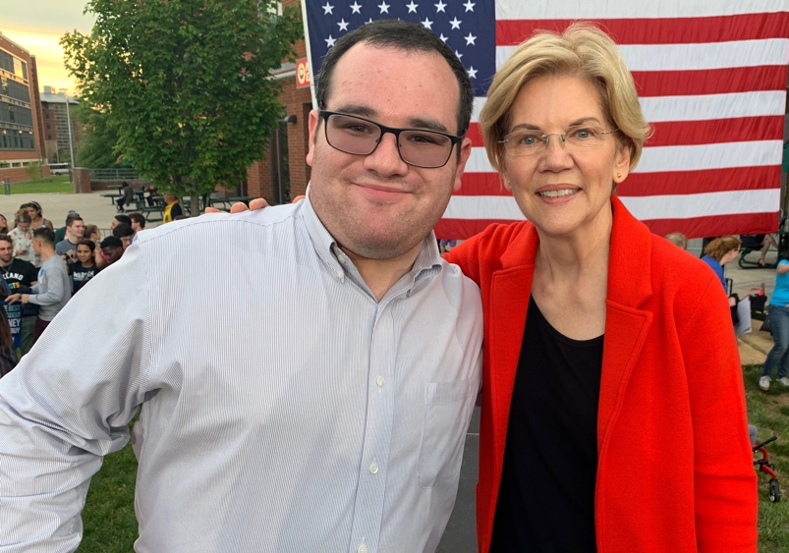
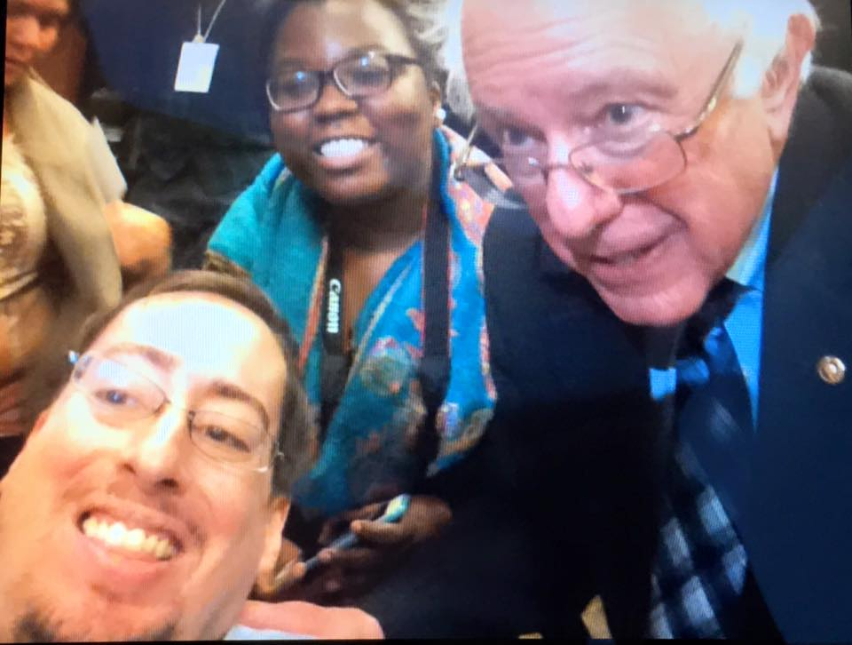
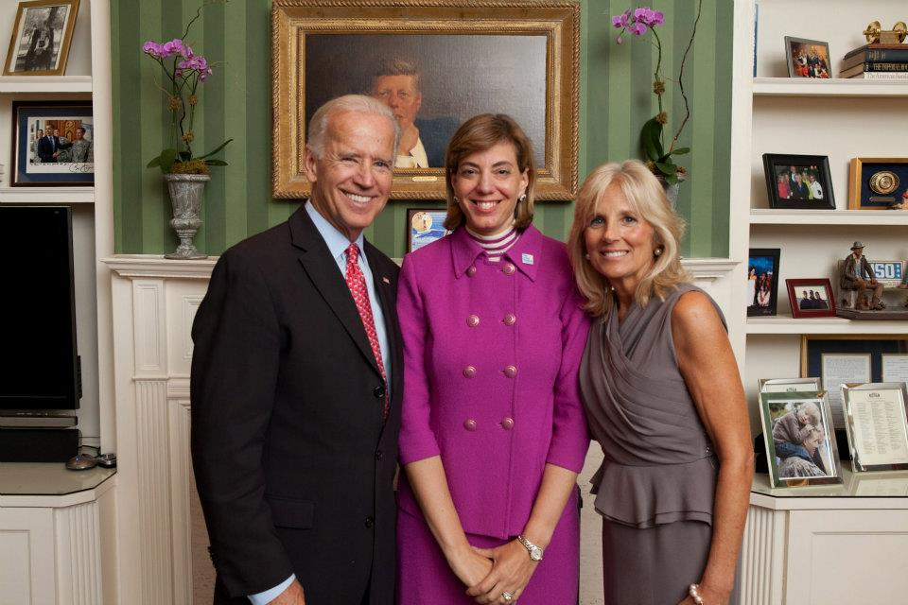

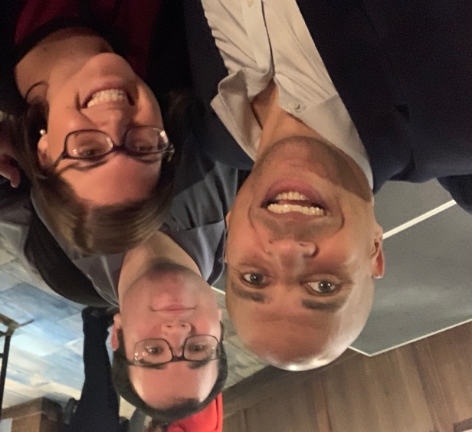
We Reach Out to Policymakers on a Bipartisan Basis

Slide 36
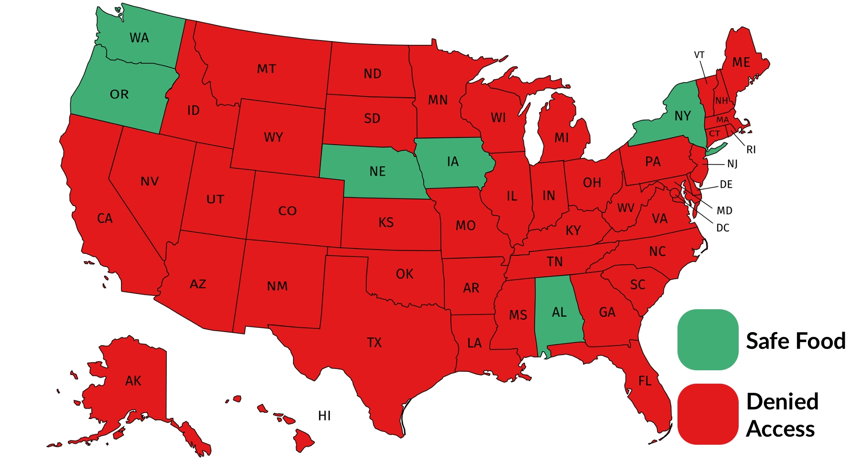
Before RespectAbility Took Action: 44 States had No Path for People with Disabilities to Safely Access Food

Slide 37
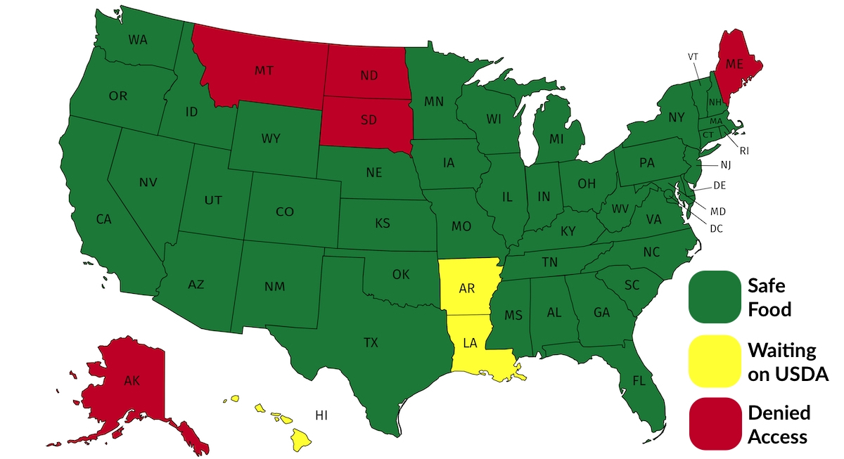
With RespectAbility’s Leadership: 9.9 million people with disabilities now have a safe way to access food

Slide 38
Prepare Leadership & Talent Pipeline
3
National Leadership Program
Lab for Entertainment Professionals
Inclusive Philanthropy
Disabilities Speakers Bureau
Diverse people with disabilities drive innovation & solutions.

Slide 39
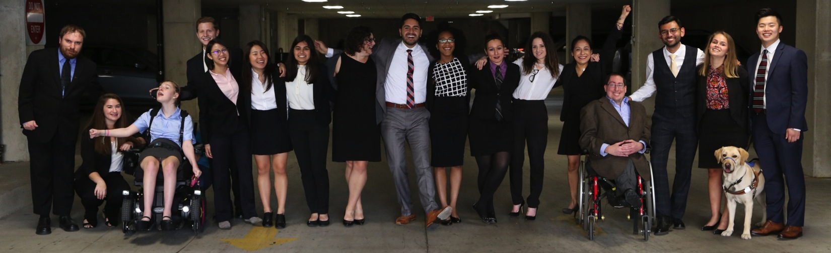
RespectAbility’s Fellowship Program
Enables talented leaders with disabilities to build skills, networks and strategies to advance inclusion and equity, makes nonprofits and government more responsive, and enables people with disabilities to have a seat at decision making tables & determine public agendas and priorities.

Slide 40
Diversity In Action: Paid Fellows Demographics
Demographic | Percentage
African American | 30.7%
Asian American | 30.8%
Caucasian | 11.5%
Latinx | 27%
LGBTQ | 34.6%
Disability | 100%

Slide 41
Theory of Change
To fight stigmas and advance opportunities so that people with disabilities can fully participate in all aspects of community.
Mission
Theory of Change
Fight Implicit Bias
Advocate for Best Practices
Prepare
Leadership
Pipeline
1
2
3
Narrative Change in Hollywood
Representation of PWDs in News Media
Facts, White Papers & Social Media
Center for Best Practices & Solutions
Task Force of Disability Groups
National Leadership Program
Inclusive Philanthropy
Faith inclusion
Speaker’s Bureau
Initiatives
PWDs drive innovation and solutions
PWDs are viewed for what they can do
PWDs are hired and heard
Outcomes

Slide 42
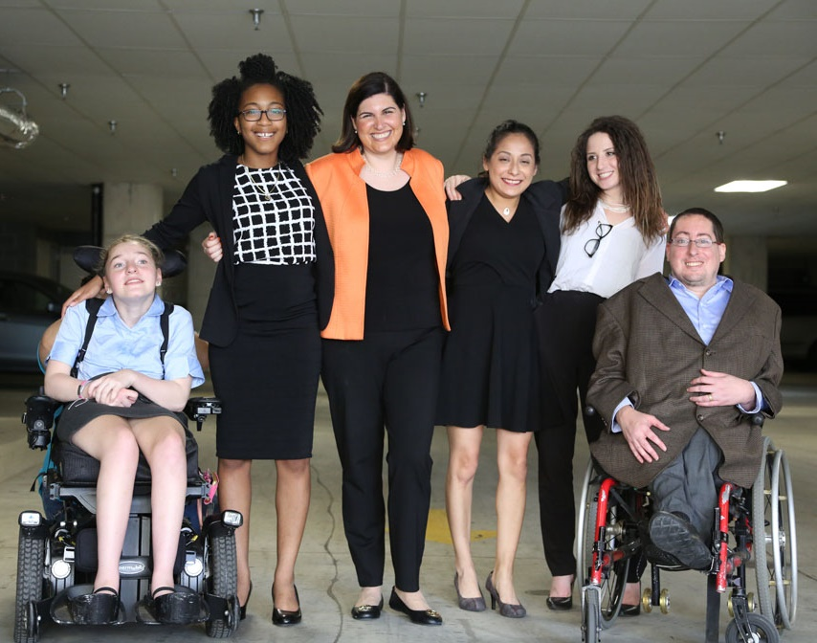
RespectAbility Accomplishments
Facilitated the creation of major improvement in new jobs for people with disabilities
Created the Hollywood Disability Inclusion Toolkit and Spanish language resources for parents
Met with 48 governors to advocate for better education, training & jobs
Provided skill-building tools and training to 5000+ people
Trained 260+ young leaders & 550 volunteers

Slide 43
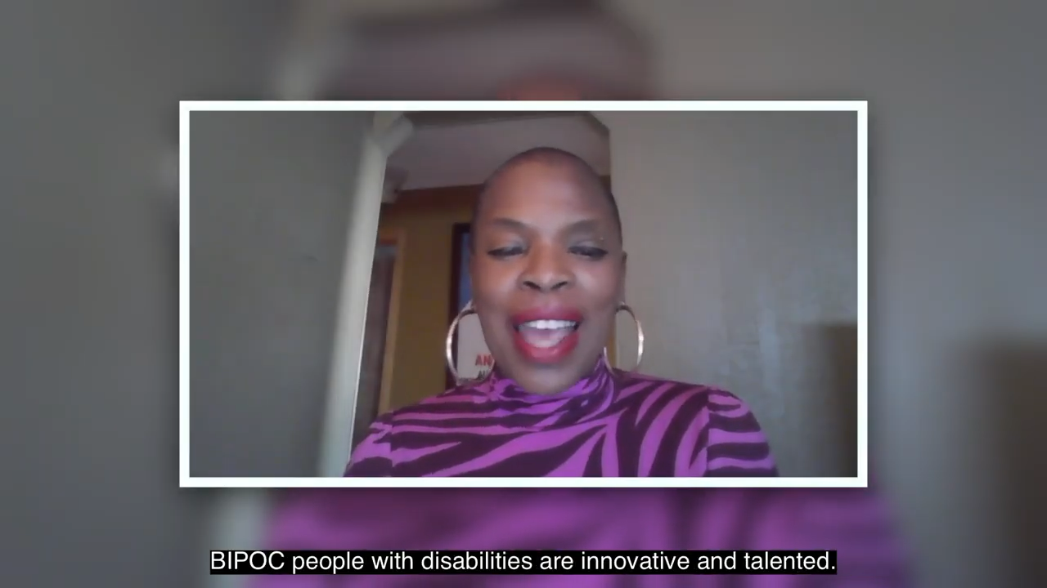
Watch this 90 second video to find solutions!

Slide 44
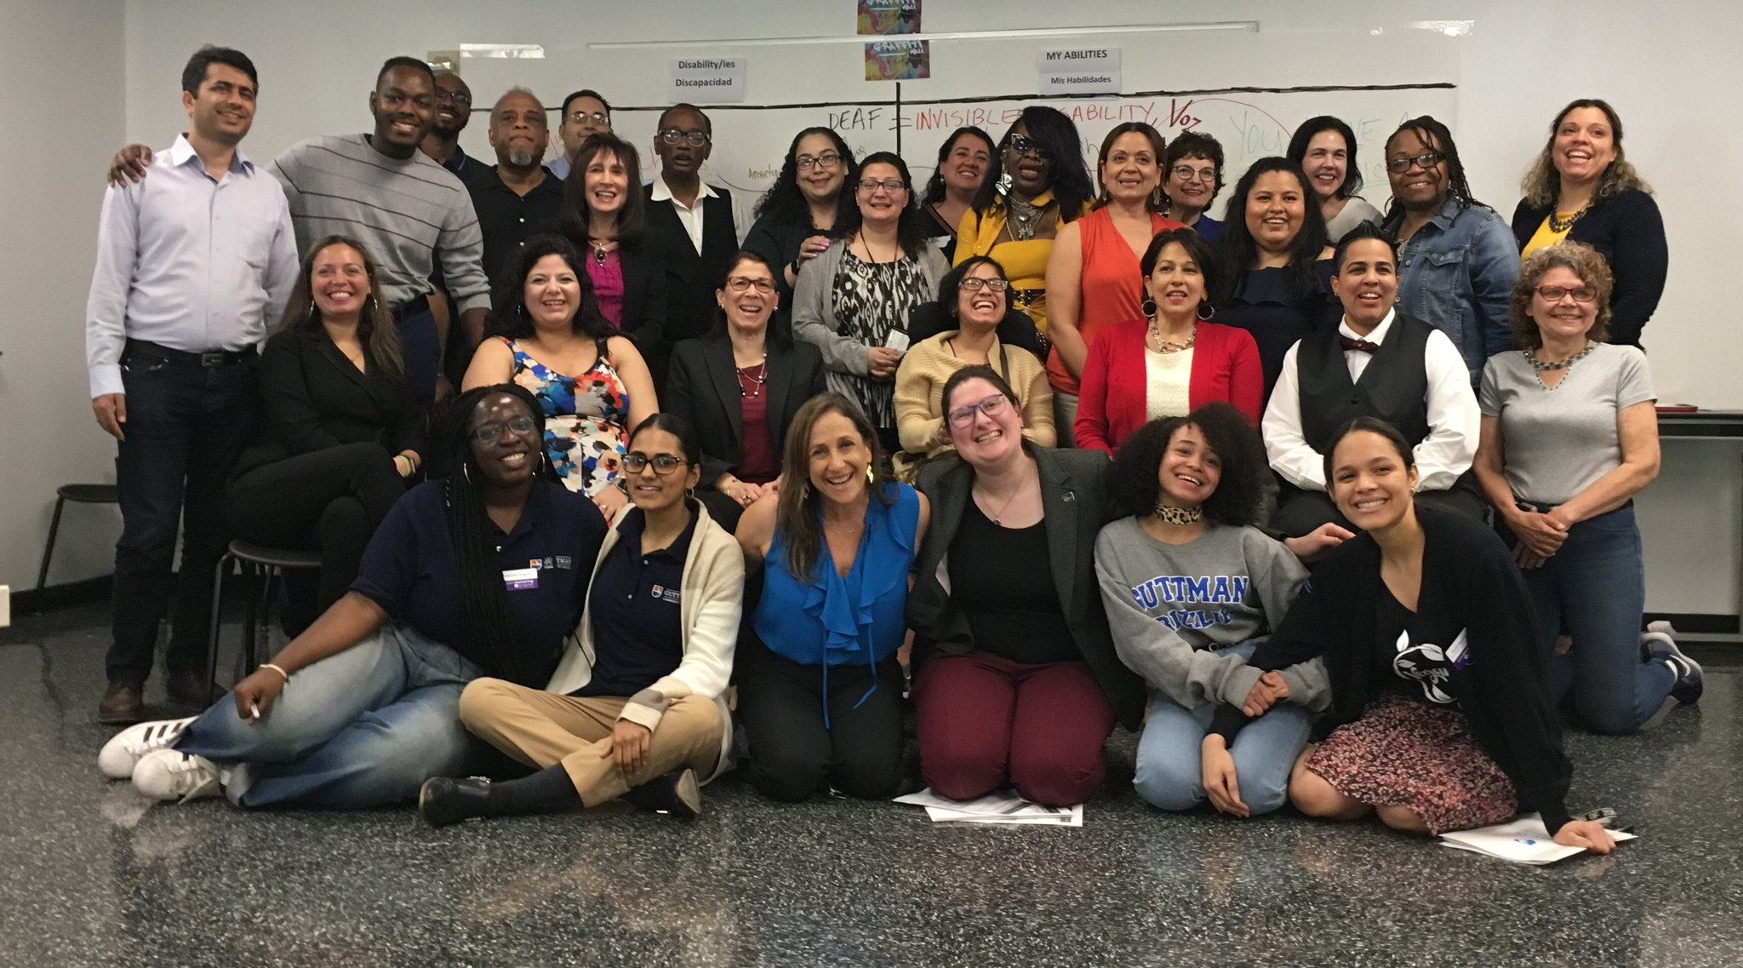
More statistics
Enable people with disabilities to have a better future, just like anyone else!
Twitter: @respect_ability
Facebook: Facebook.com/RespectAbilityUSA
Donate: RespectAbility.org/Donate
For more information email JenniferM@RespectAbility.org
.

