Slide 1

How Disability Inclusion & Equity Can Add to Your Success
Leading at the Next Level: Working in the Jewish World
Matan Koch, Vice President, Workforce, Leadership and Faith Programs, RespectAbility
Sarah Welch, VP - Workforce Development Services,
Network of Jewish Human Services
Gali Cooks, President & CEO, Leading Edge

Slide 2
Three Logistical Points
We have live captioning and an ASL interpreter for this webinar.
We are taking questions, so if you have something to ask our panelists, use the Q&A box on Zoom. Facebook comments are also being checked.
This webinar is being recorded and will be posted to RespectAbility’s website by the end of this week.

Slide 3
Partners/Co-Promoters
Builders of Jewish Education: JKidLA, Congregation Kol Ami, Edlavitch DCJCC, Gateways: Access to Jewish Education, Hillel International, Institute on Theology and Disability, Jewish Family and Children’s Service of Greater Philadelphia, Jewish Family Service Houston, Jewish Federation of Greater MetroWest NJ – Greater MetroWest ABLE, Jewish Residential Services, JVS SoCal, JPRO Network, Keshet: For LGBTQ equality in Jewish life, Keshet, Matan, The Miracle Project, National Ramah Commission, Network of Jewish Human Service Agencies (NJHSA), Pasadena Jewish Temple & Center, SoCal Jewish News, Whole Community Inclusion at Jewish Learning Venture, The Women’s Rabbinic Network

Slide 4
Sponsored by
We want to thank our generous funders: The Jewish Community Foundation of Los Angeles and the Charles and Lynn Shusterman Family Philanthropies. Without their support, this series would not be possible.
Additionally, we want to thank The David Berg Foundation, The Beverly Foundation and The Diane & Guilford Glazer Foundation for their support of our general Jewish inclusion work.

Slide 5
Upcoming Webinars
Thursday, July 15, 2021 – Effective Disability Advocacy from the Inside
Tuesday, July 20, 2021 – Accessible Events: Both In-Person and Online
Sign Up at www.respectability.org/jewish-events/

Slide 6
Why?
Including people with disabilities is something that more than 90% of Jewish organizations say they want to do.
Yet, a survey of the Jewish world shows that fewer than 15% of Jews can identify a single leader with a disability in Jewish communal life.
This series is a complement to our previous series training organizations (which is available to watch online) and is designed to introduce Jewish lay leaders with disabilities to topics and skills that will help them to lead as volunteers and professionals in nonprofit organizations.

Slide 7
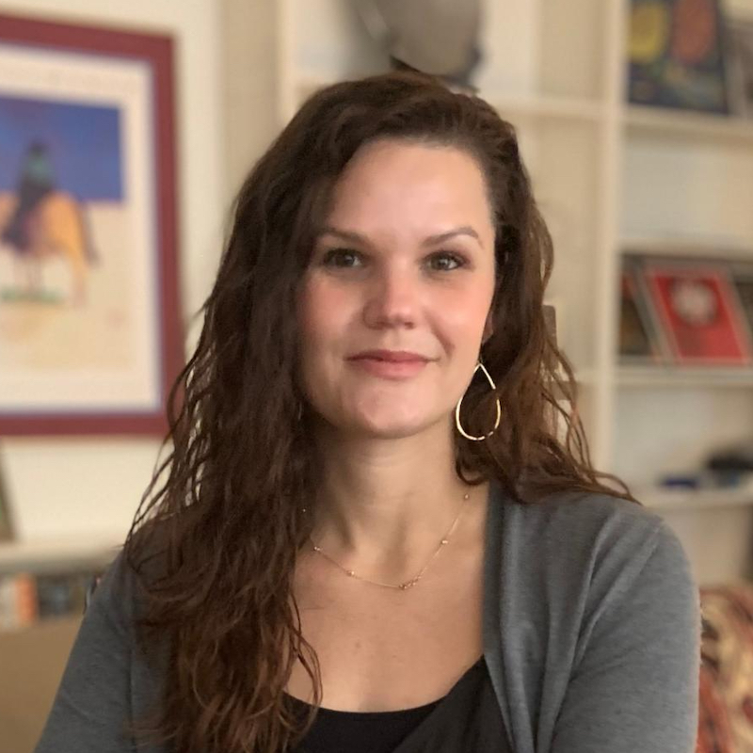
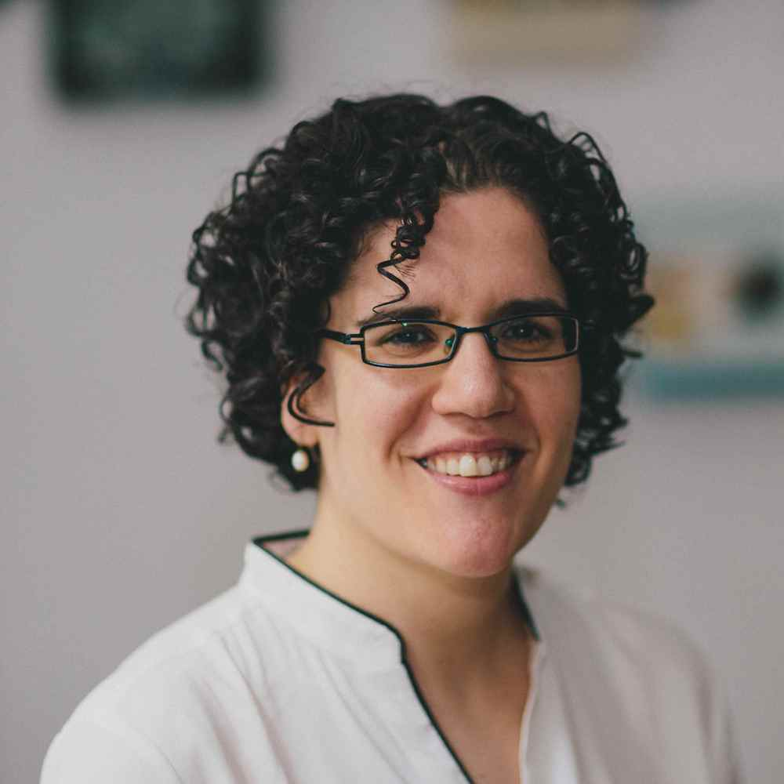
Speakers
Sarah Welch
VP - Workforce Development Services
Network of Jewish Human Services
Gali Cooks
President & CEO
Leading Edge

Slide 8
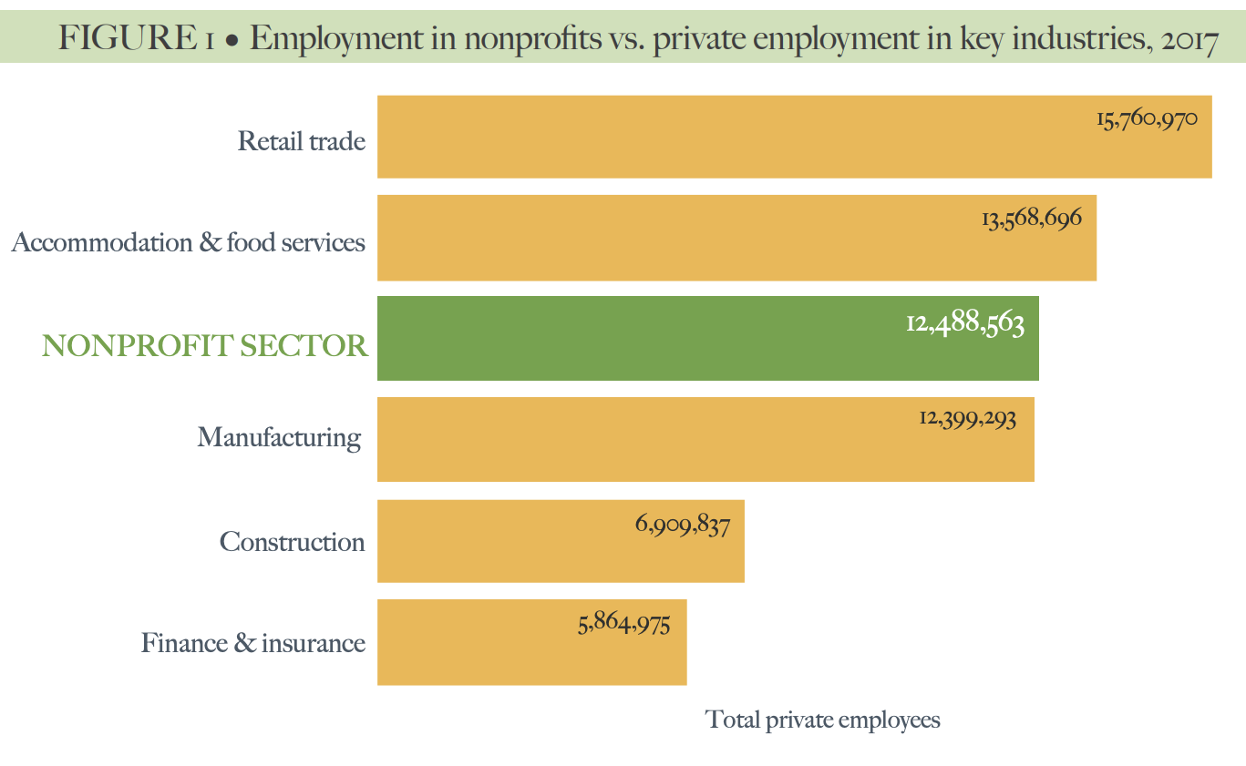
Nonprofits – 3rd largest employer in U.S.
5.4% of GDP
1.5 M
orgs
Source: Johns Hopkins Nonprofit Economic Data Project, 2020 Nonprofit Employment Report, June 2020

Slide 9

* Source: Burstein, Paul (2010). Jewish Nonprofit Organizations in the U.S.: A Preliminary Survey. Contemporary Jewry 31(1), p. 139.
** Source: Austin, Michael J. and Salkowitz, Tracy (2009). Executive Development and Succession Planning:
A Growing Challenge for the American Jewish Community. Jewish Funders Network. p. 3.
9,500 Jewish Organizations*
~100,000 Employees
75% to 90% of CEOs leaving
in 5 to 7 years (now)**
Notes:
The vast majority of CEOs in the Jewish community are beginning to turn over… and we are woefully unprepared

Slide 10

Leading Edge was founded in 2014 to create a forum for the Jewish community to address the leadership pipeline issues facing the American Jewish nonprofit sector.
Notes:
We want…the field to develop and advance the talent it already has….AND for Jewish nonprofits to be great places to work
What LE cares about is working to get and keep outstanding professionals to work for and lead Jewish nonprofit organizations
Founded in 2014…

Slide 11



Lay Leadership
Senior
Leadership
Workplace Culture
Great organizations
start at the top
When the lay-pro
partnership is healthy,
1 + 1 = 3
“Culture eats strategy
for breakfast”
- Peter Drucker

Slide 12



+
What | Employee Experience Survey
When | 2016 + 2017 + 2018 + 2019 + 2021
Who | 325 unique organizations 35,000+ unique respondents ~35% workforce

Slide 13
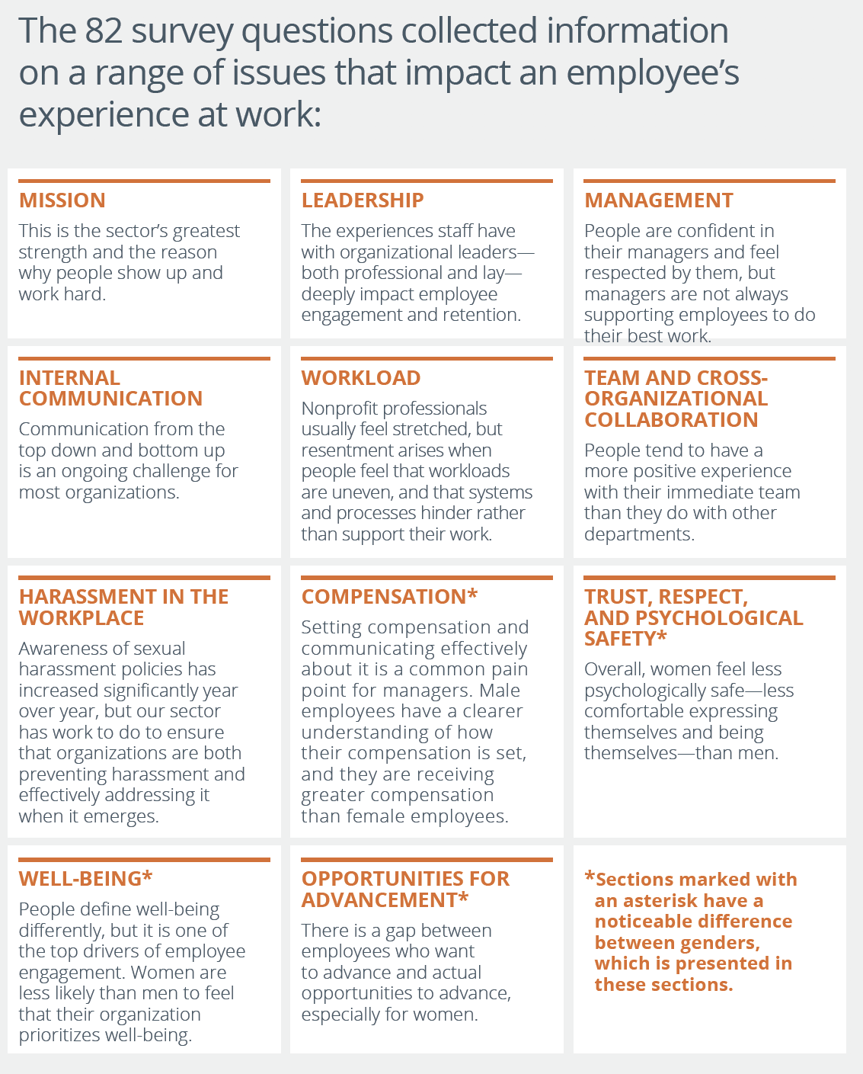

Link to report

Slide 14
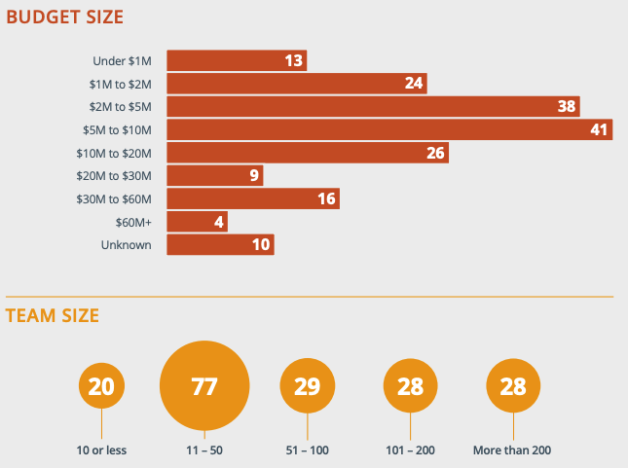
We’re an ecosystem of small orgs
Notes:
182 orgs total from 2019

Slide 15
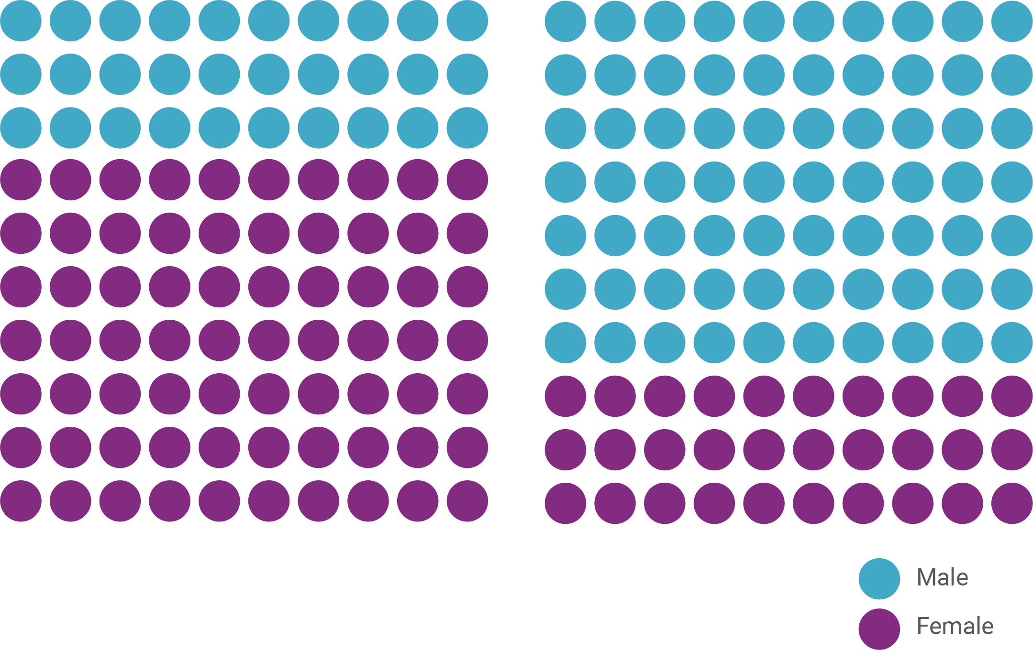
Our sector is made up of women and led by men
Jewish nonprofit
sector
CEOs
Notes:
MH
Additionally, our research found that equity is also lacking within Jewish workplaces and communal spaces.
It most clearly shows up as gender bias, discrimination, and sexism, and those survivors who did not disclose experiences of harassment did disclose experiences of these forms of gender-based inequity.
This was reinforced in the discourse analysis of Jewish audience media, which covered gender equity issues related to ordainment, marriage, and transgender and female leadership in Jewish institutions.
Leading Edge has helped paint a picture for the field of how gender inequities show up in the workplace, particularly through their survey of 80,000 Jewish nonprofit professionals.
As the stats here show, more often than not, women are at a disadvantage when it comes to representation in leadership and opportunities for advancement opportunities or salary increases.

Slide 16
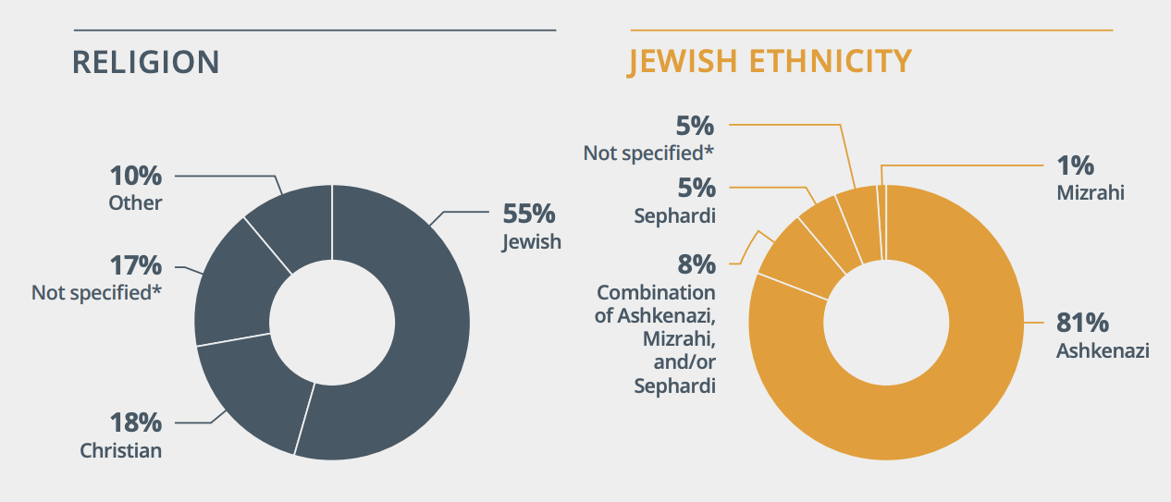
We are predominantly white, Ashkenzi Jewish, with a meaningful segment of non-Jews

Slide 17
In 2021, we learned...
Approximately 8.5% of employees (~950 out of 11,600 employees) have “a disability (either physical, emotional, mental, hearing, visual, etc.) that impacts daily living
Of these, 54% agreed that their organization provides the necessary disability accommodations that allow me to succeed in my work

Slide 18
Employees are motivated by mission + feel proud of their work
81
%
Feel like they are making a difference through their work.
88
%
Know how their work contributes to their organization’s mission, strategy, and goals.
Notes:
First, some good news...
Both of these points are 7% greater than the “Culture Amp U.S. Benchmark” – the benchmark that includes all of the other companies and organizations that have take the employee engagement survey (it ranges from GE, a bunch of tech companies, and some nonprofits like the American Red Cross). While this is not a perfect comparative benchmark to our sector, it’s our competition – since high-level talent can work anywhere.

Slide 19
Tip #1
Work at an organization whose mission aligns with your values.
Notes:
First, some good news...
Both of these points are 7% greater than the “Culture Amp U.S. Benchmark” – the benchmark that includes all of the other companies and organizations that have take the employee engagement survey (it ranges from GE, a bunch of tech companies, and some nonprofits like the American Red Cross). While this is not a perfect comparative benchmark to our sector, it’s our competition – since high-level talent can work anywhere.

Slide 20
Our managers are well-liked but not effective
88
I am treated with respect by my immediate manager
%
59
I receive regular feedback on how I’m performing – ↓16% US benchmark
%

Slide 21
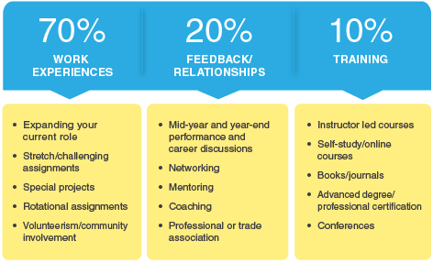
Source: Center for Creative Leadership

Slide 22
Tip #2
Managers matters. Look for a manager who will help you stretch and make you better every day.
Notes:
First, some good news...
Both of these points are 7% greater than the “Culture Amp U.S. Benchmark” – the benchmark that includes all of the other companies and organizations that have take the employee engagement survey (it ranges from GE, a bunch of tech companies, and some nonprofits like the American Red Cross). While this is not a perfect comparative benchmark to our sector, it’s our competition – since high-level talent can work anywhere.

Slide 23
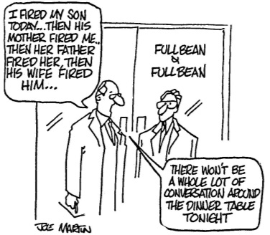
Are we a family business?

Slide 24
Tip #3
Relationships matter, in our community perhaps more than others.
Never burn bridges.
Notes:
First, some good news...
Both of these points are 7% greater than the “Culture Amp U.S. Benchmark” – the benchmark that includes all of the other companies and organizations that have take the employee engagement survey (it ranges from GE, a bunch of tech companies, and some nonprofits like the American Red Cross). While this is not a perfect comparative benchmark to our sector, it’s our competition – since high-level talent can work anywhere.

Slide 25









Who is best in class?
ORGANIZATION SIZE?
BUDGET SIZE?
GENDER OF CEO?
ORGANIZATION TYPE?

Slide 26
Tip #4
Leaders matter. Make sure you have confidence in the leader of the organization in which you work.
Notes:
First, some good news...
Both of these points are 7% greater than the “Culture Amp U.S. Benchmark” – the benchmark that includes all of the other companies and organizations that have take the employee engagement survey (it ranges from GE, a bunch of tech companies, and some nonprofits like the American Red Cross). While this is not a perfect comparative benchmark to our sector, it’s our competition – since high-level talent can work anywhere.

Slide 27
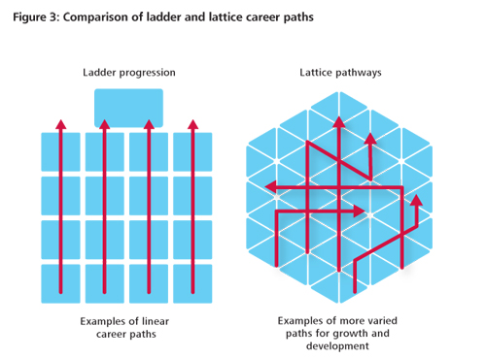
Career lattice not ladder

Slide 28
Tip #5
Recognize that your professional trajectory will most likely not be linear.
Notes:
First, some good news...
Both of these points are 7% greater than the “Culture Amp U.S. Benchmark” – the benchmark that includes all of the other companies and organizations that have take the employee engagement survey (it ranges from GE, a bunch of tech companies, and some nonprofits like the American Red Cross). While this is not a perfect comparative benchmark to our sector, it’s our competition – since high-level talent can work anywhere.

Slide 29
Resources
CareerHub (job board): https://jobs.jpro.org/
Job Seeking Resources: https://www.jpro.org/careerhub-resources

Slide 30


leadingedge.org
gali@leadingedge.org

Slide 31
Basic Steps to Finding a Job or Making a Career Transition
Presented by Sarah Cole Welch
NJHSA, VP – Workforce Development Services

Slide 32
Focus Your Search
Do a Self Interest Inventory
Use the job search engines to find jobs by using keywords that match your interests and the location where you want to work. But be careful! Never share your personal data!!!
Develop a list of companies that you are interested in working for and research them.

Slide 33
Build Your Brand
Your resume should be professionally formatted but showcase who you are (with words and numbers)
Your cover letter should give some insight into who you are and why you are passionate about the position
Create a PROFESSIONAL profile on LinkedIn.
A strong personal brand will provide recruiters, employers, and contacts with a positive impression of you as a candidate they should be interested in.

Slide 34
Network
Connect with everyone you know, because you never know which contact may be able to help you with your job search
  Your college alumni system
  Professional organizations
  Your friends and neighbors
  Everyone should be considered part of your network

Slide 35
Target Your Resume and Cover Letter
This will help employers to see that you are truly interested in the position and not just ’blanket’ sending out tons of resumes.
The hiring manager will be able to see, at a glance, why and how you are qualified for the job. You'll have a much better chance of getting an interview than if you merely sent a generic letter and resume.

Slide 36
Prepare For The Interview
Taking the time to prepare for an interview will help you succeed.
The more prepared you are, the less stressful it will be.
Research the company before you go for the interview.
Dress appropriately.
Practice answering and asking interview questions, and make a concerted effort to impress the interviewer with your skills, experience, confidence, and expertise.

Slide 37
Connect with People and Resources that Can Help
NJHSA Jobs Initiative
Your Local Jewish Vocational Center
Your College
Local OneStop

Slide 38
Questions?
Sarah Cole Welch
NJHSA, VP – Workforce Development Services
swelch@networkjhsa.org
Some information for this presentation taken from the thebalancecareers.com

Slide 39

National Disability Speakers Bureau:
Jewish Division
For more information contact JakeS@RespectAbility.org
www.RespectAbility.org/speakers-bureau/jewish/

Slide 40
RespectAbility Jewish Inclusion Fellowship
The National Leadership Program is a virtual program, ideal for people who want to gain skills and contacts while making a positive difference for people with disabilities.
For the Jewish inclusion fellowship program in particular, we’re looking for people with an absolute passion for learning and exploring about the different inclusion resources that exist, who would also enjoy research, interaction with other organizations, and deep thought about how to make information useful.
Do you know a future Jewish professional that fits the bill? Or perhaps someone who lost their job during this pandemic and wants to be helpful during their job search? Please encourage them to learn more and apply at: https://www.respectability.org/about-us/fellowship/jewish-inclusion-fellowship/

Slide 41
Upcoming Webinars – See You Thursday!
Thursday, July 15, 2021 – Effective Disability Advocacy from the Inside
Tuesday, July 20, 2021 – Accessible Events: Both In-Person and Online
Sign Up at www.respectability.org/jewish-events/

