Slide 1
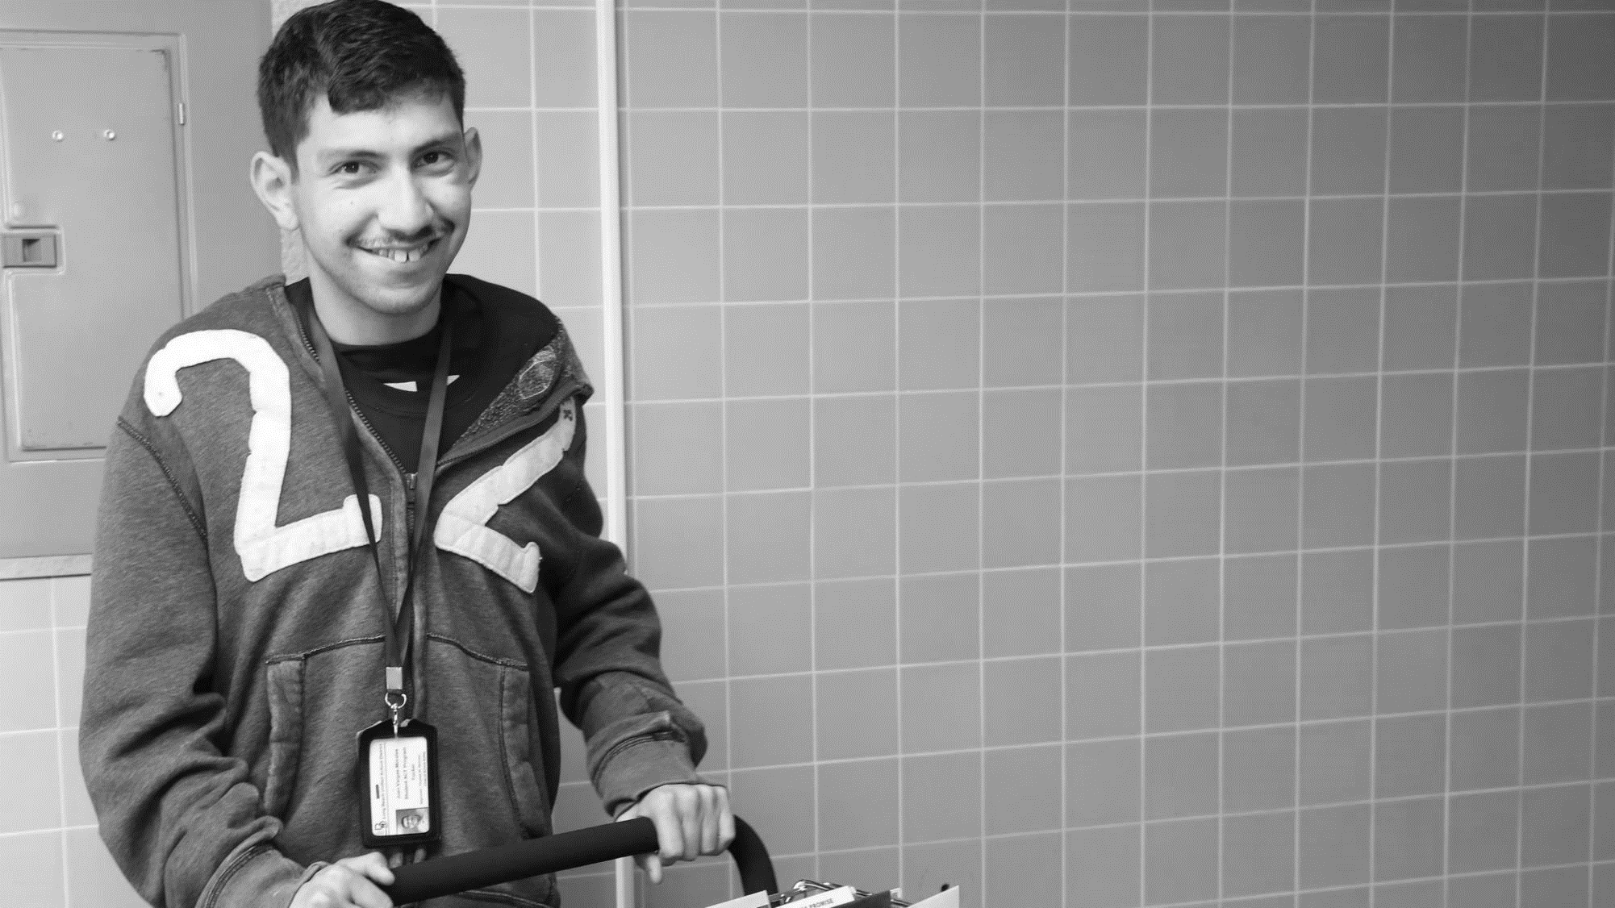
61 million people have a disability
61 Million
people in the US have a disability.*
People with disabilities
want
opportunities
Just like anyone else.
* Source: US Census

Slide 2
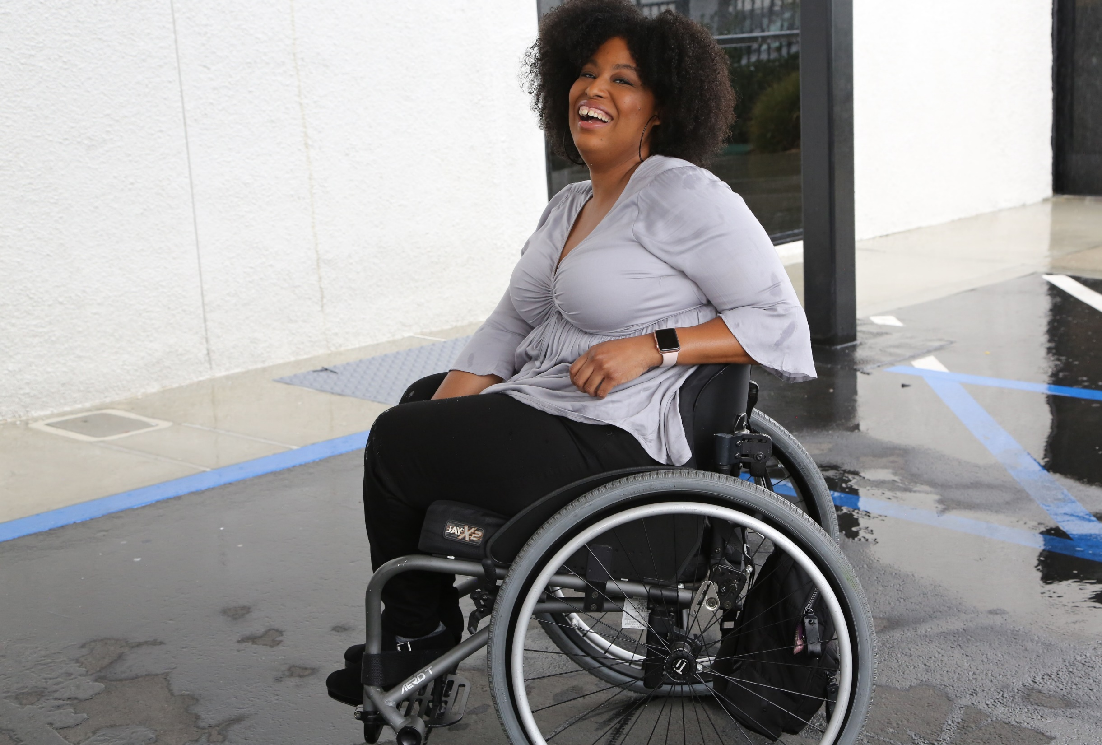
1 in 4 adults
1 in 4
adults have a disability
(physical, sensory, cognitive, mental health or other)

Slide 3
Employment Rates for Working-Age Americans w/ & w/o Disabilities, by Race – 2019 (Pre-COVID)
SOURCE: Annual Disability Statistics Supplement: 2020. Univ. of New Hampshire, Institute on Disability.
https://disabilitycompendium.org/compendium/2020-annual-disability-statistics-supplement

Slide 4
Poverty Rates for Working-Age Americans w/ & w/o Disabilities, by Race – 2019 (Pre-COVID)
SOURCE: Annual Disability Statistics Supplement: 2020. Univ. of New Hampshire, Institute on Disability.
https://disabilitycompendium.org/compendium/2020-annual-disability-statistics-supplement

Slide 5
Employment Rates of Minority Populations (Percentage of population) – 2008 to 2018 – WIP
SOURCES: https://www.statista.com/statistics/793961/employment-among-disabled-us-adults/ https://www.bls.gov/charts/employment-situation/employment-population-ratio.htm

Slide 6
African Americans with Disabilities – 2019
As of 2019, there were 39,412,670 African Americans living in the United States.
Out that number, there are 5,598,758 African Americans living with some form of disability.
There are 3,268,440 working-age African Americans with disabilities. Out of that number, only 1,048,745 or 32.1 percent have jobs.
By comparison, fully 75.5 percent of African Americans without disabilities have jobs.
The employment gap between African Americans with and without disabilities is 43.4 percentage points.
Fully 32 percent of African Americans with disabilities live in poverty compared to 20.9 percent of African Americans without disabilities.
SOURCES: https://www.statista.com/statistics/793961/employment-among-disabled-us-adults/ https://www.bls.gov/charts/employment-situation/employment-population-ratio.htm

Slide 7
Latinx People with Disabilities - 2019
As of 2019, there were 59,709,293 Latinx people living in the United States.
Out of that number, there are 5,412,676 Latinx people living with some form of disability.
There are 2,969,668 working-age Latinx people with disabilities. Out of that number, fully 1,213,802 or 40.9 percent have jobs.
By comparison, fully 77.1 percent of Latinx people without disabilities have jobs.
The employment gap between Latinx people with and without disabilities is 36.1 percentage points.
Fully 26 percent of Latinx people with disabilities live in poverty, compared to only 17.5 of Latinx people without disabilities.
SOURCES: https://www.statista.com/statistics/793961/employment-among-disabled-us-adults/ https://www.bls.gov/charts/employment-situation/employment-population-ratio.htm

Slide 8
Asian Americans with Disabilities – 2019
As of 2019, there were 18,297,153 Asian Americans living in the United States.
Out that number, there are 1,315,999 Asian Americans living with some form of disability.
There are 537,908 working-age Asian Americans with disabilities. Out of that number, only 231,821 or 43.1 percent have jobs.
By comparison, fully 76 percent of Asian Americans without disabilities have jobs.
The employment gap between Asian Americans with and without disabilities is 32.9 percentage points.
Fully 17.9 percent of Asian Americans with disabilities live in poverty compared to 10.6 percent of Asian Americans without disabilities
SOURCES: https://www.statista.com/statistics/793961/employment-among-disabled-us-adults/ https://www.bls.gov/charts/employment-situation/employment-population-ratio.htm

Slide 9
BIPOC Subtotal
In total, there are 2,777,677 American Indian and Alaska Natives living in the United States. Out of that number, approximately 477,954 have disabilities.
In total, there are 612,857 Native Hawaiian and Other Pacific Islander living in the United States. Out of that number, approximately 64,782 have disabilities.
Subtotal: 12,870,169 Black, Indigenous and People of Color (BIPOC) People with Disabilities
SOURCES: https://www.statista.com/statistics/793961/employment-among-disabled-us-adults/ https://www.bls.gov/charts/employment-situation/employment-population-ratio.htm

Slide 10
Women with Disabilities – 2019
As of 2019, there were 165,302,064 women living in the United States.
Out that number, there are 21,201,155 women living with some form of disability.
There are 10,174,591 working-age women with disabilities. Out of that number, only 3,727,186 or 36.6 percent have jobs.
By comparison, fully 73.8 percent of women without disabilities have jobs.
The employment gap between women with and without disabilities is 37.1 percentage points.
Fully 22.5 percent of women with disabilities live in poverty compared to 13.5 percent of women without disabilities.
SOURCES: https://www.statista.com/statistics/793961/employment-among-disabled-us-adults/ https://www.bls.gov/charts/employment-situation/employment-population-ratio.htm

Slide 11
Students with Disabilities in K-12 Schools
Total Number of K-12 students with disabilities: 6,561,998
85,680 American Indian or Alaska Native students with disabilities
165,353 Asian students with disabilities
1,158,862 Black or African American students with disabilities
1,826,344 Hispanic/Latino students with disabilities
23,809 Native Hawaiian or Other Pacific Islander students with disabilities
283,819 Biracial students with disabilities
3,018,131 White students with disabilities
Subtotal of BIPOC Students with Disabilities: 3,543,867
Source: IDEA Section 618 Data Products: Static Table - https://www2.ed.gov/programs/osepidea/618-data/static-tables/index.html

Slide 12
Percentage & Number of Disability by Type - SWDs
 | Autism | Deaf-blindness | Developmental delay | Emotional disturbance | Hearing disabilities | Intellectual disabilities | Multiple disabilities | Orthopedic Disability | Other health conditions | Specific learning disabilities | Speech or language | Traumatic brain injury (TBI) | Visual disabilities
Number of SWDs with that Disability | 717,716 | 1,553 | 194,919 | 345,782 | 64,311 | 419,196 | 127,126 | 31,361 | 1,079,301 | 2,379,448 | 1,090,207 | 24,993 | 24,243
Percentage of SWDs with that Disability | 11% | 0.02% | 2.9% | 5% | 0.9% | 6% | 1.9% | 0.4% | 16% | 36% | 16% | 0.3% | 0.3%
In total, there are 6,561,998 students with disabilities in America’s Public School System today.
Source: IDEA Section 618 Data Products: Static Table - https://www2.ed.gov/programs/osepidea/618-data/static-tables/index.html

Slide 13
Demographics of K-12 Students with Disabilities
BIPOC Students with Disabilities make up 58 percent of all Students with Disabilities in America’s schools today.
Source: IDEA Section 618 Data Products: Static Table - https://www2.ed.gov/programs/osepidea/618-data/static-tables/index.html

Slide 14
Thank you!
THANK YOU!
Jennifer Laszlo Mizrahi
www.RespectAbility.org
Cell: (202) 365-0787
JenniferM@RespectAbility.org

