Slide 1
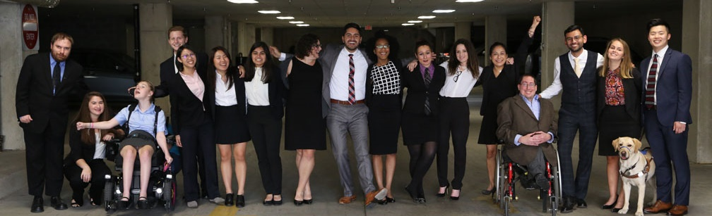

Cover
Building an Equitable Recovery - Solutions for Washingtonians with Disabilities
https://www.respectability.org/

Slide 2

61 million people have a disability
61 Million
people in the US have a disability.*
People with disabilities
want
opportunities
Just like anyone else.
* Source: US Census

Slide 3
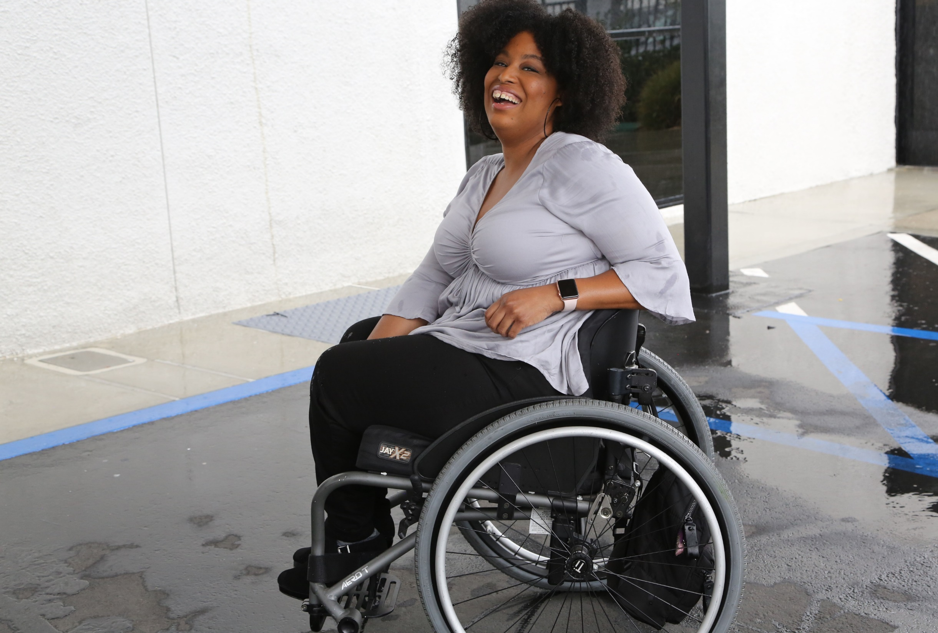

1 in 4 adults
1 in 4
adults have a disability
(physical, sensory, cognitive, mental health or other)

Slide 4
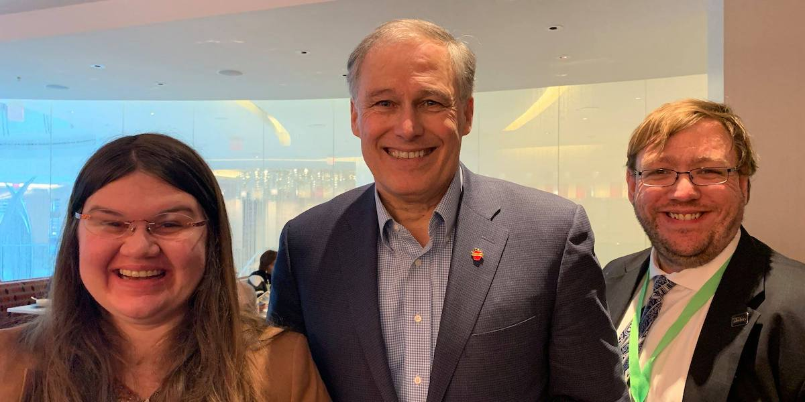
Disability Statistics in Washington
Total # of people with disabilities (PWDs) in Washington: 958,138
Total # of working-age PWDs: 478,673
# of working-age PWDs with Jobs: 201,400
Employment Rate: working-age PWDs: 42%
Employment Rate: working-age Non-PWDs: 79.5%
Gap in Labor Force Participation Rates between PWDs and non-PWDs: 37.4%
Poverty Rate of PWDs: 22.1%
Gov. Jay Inslee (D-WA)
Source: Annual Disability Statistics Compendium: 2020 Durham, NH: Univ. of New Hampshire, Institute on Disability
https://disabilitycompendium.org/

Slide 5
Recognizing Racial Disparities in Washington
There are 20,982 working-age African Americans with disabilities. Out of that number, only 7,105 or 33.9% percent have jobs. (Tables 3.22/3.27)
Fully 30.7% percent of African Americans with disabilities live in poverty compared to 14.7% percent of African Americans without disabilities. (Tables 6.7/6.12)
There are 46,579 working-age Latinx people with disabilities. Out of that number, fully 24,647 or 52.9% percent have jobs. (Tables 3.25/3.30)
Fully 22.7% percent of Latinx people with disabilities live in poverty, compared to only 16.9% Of Latinx people without disabilities. (Tables 6.10/6.15)
There are 18,563 working-age Asian Americans with disabilities. Out of that number, only 7,612 or 41% percent have jobs. (Tables 3.23/3.28)
Fully 26.1% percent of Asian Americans with disabilities live in poverty compared to 8% percent of Asian Americans without disabilities. (Tables 6.8/6.13)
SOURCE: Annual Disability Statistics Supplement: 2020. Univ. of New Hampshire, Institute on Disability.
https://disabilitycompendium.org/compendium/2020-annual-disability-statistics-supplement

Slide 6
Employment Rates for Working-Age Washingtonians w/ & w/o Disabilities, by Race – 2019 (Pre-COVID)
SOURCE: Annual Disability Statistics Supplement: 2020. Univ. of New Hampshire, Institute on Disability.
https://disabilitycompendium.org/compendium/2020-annual-disability-statistics-supplement

Slide 7
Poverty Rates for Working-Age Washingtonians w/ & w/o Disabilities, by Race – 2019 (Pre-COVID)
SOURCE: Annual Disability Statistics Supplement: 2020. Univ. of New Hampshire, Institute on Disability.
https://disabilitycompendium.org/compendium/2020-annual-disability-statistics-supplement

Slide 8
Employment Rates of Minority Populations
(Percentage of population) – 2008 to 2018 – WIP
SOURCES: https://www.statista.com/statistics/793961/employment-among-disabled-us-adults/ https://www.bls.gov/charts/employment-situation/employment-population-ratio.htm

Slide 9
Percentage & Number of Disability by Type - SWDs
 | Autism | Deaf-blindness | Developmental delay | Emotional disturbance | Hearing disabilities | Intellectual disabilities | Multiple disabilities | Orthopedic Disability | Other health conditions | Specific learning disabilities | Speech or language | Traumatic brain injury (TBI) | Visual disabilities
Number of SWDs with that Disability | 15,383 | 20 | 8,979 | 5,633 | 997 | 5,010 | 3,007 | 347 | 27,913 | 48,076 | 18,143 | 313 | 418
Percentage of SWDs with that Disability | 1.28% | 0.00% | 0.18% | 0.58% | 0.07% | 0.53% | 0.17% | 0.03% | 2.12% | 3.27% | 1.07% | 0.02% | 0.03%
In total, there are 134,239 students with disabilities in Washington State’s Public School System today.
Source: IDEA Section 618 Data Products: Static Table - https://www2.ed.gov/programs/osepidea/618-data/static-tables/index.html

Slide 10
Thank you!
THANK YOU!
Nelly Nieblas
Manager of Policy, Advocacy and Engagement
RespectAbility
NellyN@RespectAbility.org

