Slide 1
An Update on our COVID-19 Response
COVID-19 Pandemic & People with Disabilities
Jennifer Laszlo Mizrahi, President
Ben Spangenberg
National Leadership Program Director
Philip Kahn-Pauli
Policy and Practices Director

Slide 2
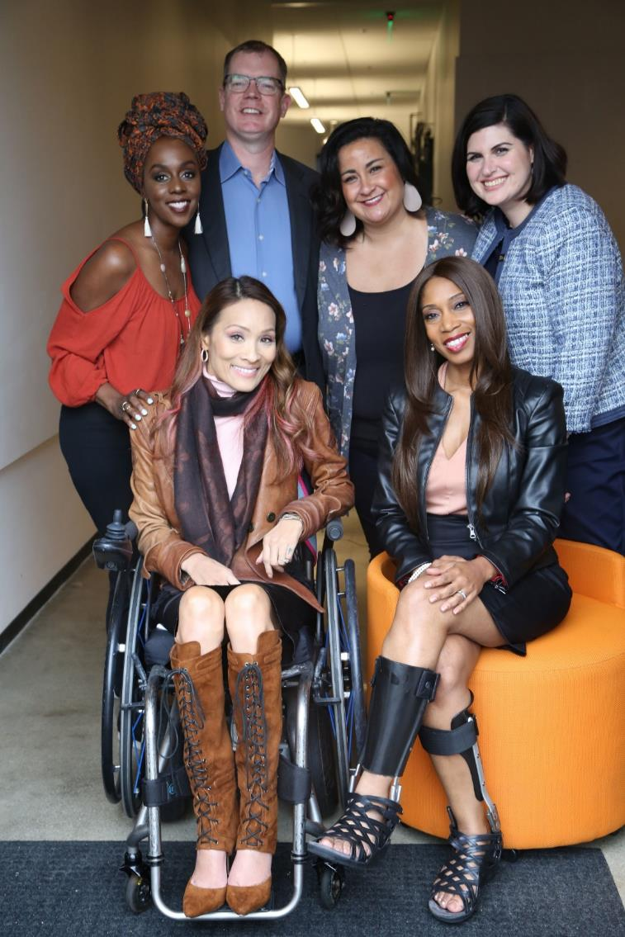
61 million people
61 Million
people in the U.S. have a disability.*
According to the CDC, 90% of hospital admissions due to COVID-19 are people with underlying conditions.

Slide 3
On The Front Lines
RespectAbility is on the front lines of the policy and media war to protect people with disabilities during the COVID-19 crisis. Based on actual experiences of diverse people with disabilities, we get leaders and journalists the facts and sources they need so policy makers and the public understand both the stakes and solutions to solving this shared crisis.

Slide 4
Disability Prevalence in the DMV
Prior to the current crisis (2019 data):
79,695 people with disabilities live in the District of Columbia
13,526 residents with disabilities live in Arlington, VA
83,602 residents with disabilities live in Montgomery County, MD
85,973 people with disabilities residents live in Prince George’s County, MD
Source: https://disabilitycompendium.org/county-reports

Slide 5
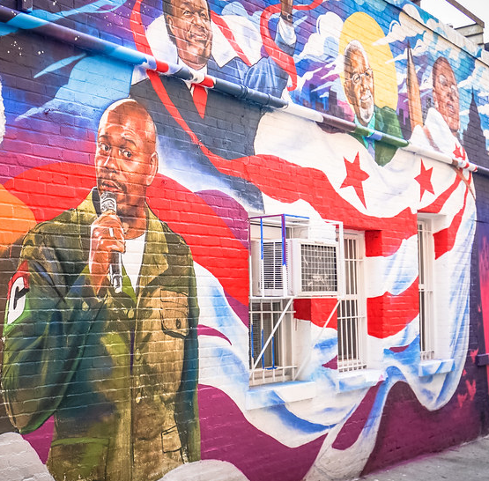
Disability in the District
According to the recently released 2020 Annual Disability Statistics Compendium, 79,695 people with disabilities live in the District of Columbia, comprising11.7 percent of the total population.
There are 45,972 working-age (ages 18-64) people with disabilities living in D.C.
In the economic expansion prior to COVID, only 16,961working-age District residents with disabilities have jobs.
This results in a disability employment rate of just 36.9 percent among working-age people with disabilities in the Nation’s Capital.

Slide 6
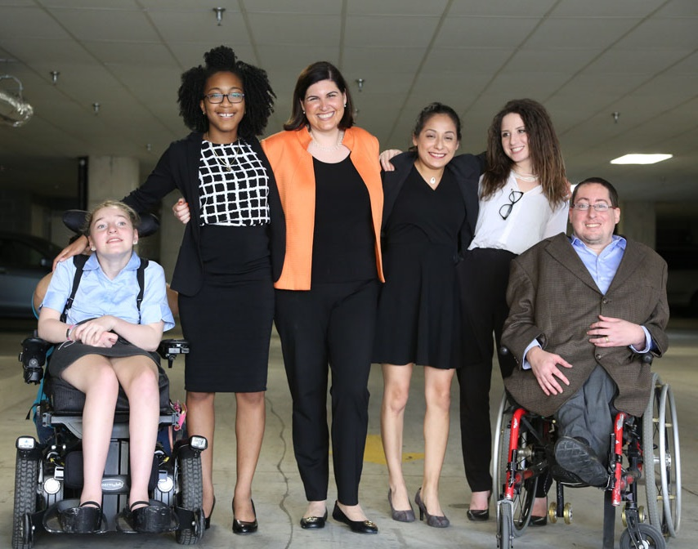
Disability Employment in the DMV
Prior to the economic lockdown and COVID-19, the states in the DMV had some of the nation’s best employment outcomes for PWDs:
In Montgomery County, MD, there are 36,243 working-age residents with disabilities. Out of that number, 18,295 have jobs.
MontCo. had a disability employment rate of 50.5 percent.
In Prince George’s County, MD there are 44,271 working-age residents with disabilities and 20,847 have jobs.
That puts the disability employment rate in PG at 47.1 percent.
6,703 working-age people with disabilities call Arlington home. Out of that number, 3,592 have jobs.
That puts Arlington County’s disability employment rate at 53.6 percent.
Source: https://disabilitycompendium.org/county-reports

Slide 7
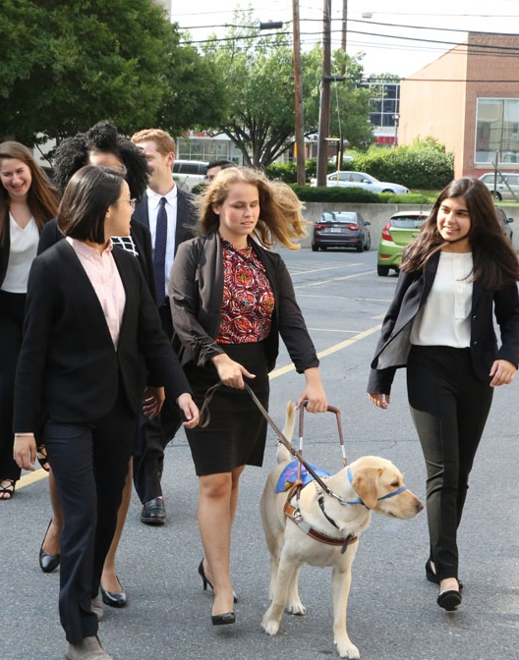
Measuring the Gap in D.C.
The most important metric we use to track states and municipalities is the gap in labor-force participation rates between people with and without disabilities.
This is a more inclusive measure of economic because it measures the number of people actively participating in the labor force compared to the total number of people eligible to participate in the labor force.
The employment rate for people without disabilities in D.C. is 78.5 percent compared to the 36.9 percent of Washingtonians with disabilities.
That means there is a 41.6 point gap in the labor force participation rate.

Slide 8
Measuring the Gap in the DMV Prior to COVID
In MontCo., 82.3 percent of people without disabilities had jobs compared to 50.5 percent of people with disabilities.
That means that MontCo. only had a 31.8 point gap in labor force participation rates.
That is better than 47 of the 50 states.
In Prince George’s County, 80.2 percent of people without disabilities had jobs compared to only 47.1 percent of people with disabilities.
That means that PG has a 33.1 point gap in labor force participation rates.

Slide 9
Measuring the Gap in VA Prior to COVID
In VA, there are 491,946 working-age people with disabilities and 213,043 had jobs.
That puts the Old Dominion disability employment rate at 43.3 percent.
80.0 percent of Virginians without disabilities have jobs.
That puts VA’s gap in labor force participation rate at 36.6 point.
Specifically in Arlington, 87 percent of residents without disabilities have jobs.
Arlington’s gap in labor force participation rates is currently 33.4

Slide 10
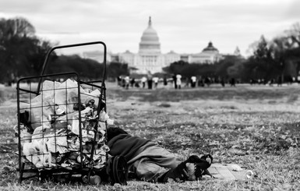
Disability and Poverty in the DMV
Fully 35.7 percent of District residents with disabilities live in poverty.
16.1 percent of Arlington residents with disabilities live in poverty.
Only 14.2 percent of Prince George’s County residents with disabilities live in poverty.
Only 15.6 percent of Montgomery County residents with disabilities live in poverty.

Slide 11
DMV High School Graduation Rates
School District | Overall Graduation Rates | Graduation Rates – People with Disabilities
Arlington Public Schools | 95% | 95%
Montgomery County Public Schools | 89.3% | 72.9%
District of Columbia Public Schools | 65% | 44%

Slide 12
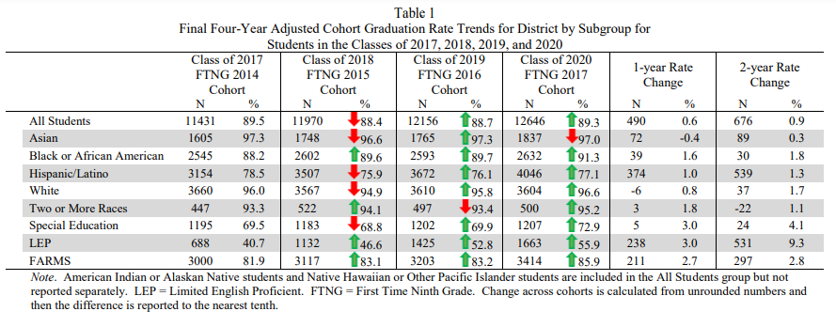
MontCo Graduation Rates – 2017 to 2020
SOURCE: https://www.montgomeryschoolsmd.org/uploadedFiles/AppendixA_2021.pdf

Slide 13
Students with Disabilities in MontCo K-12 Schools (IDEA)
Number of K-12 SWDs served under IDEA in MontCo: 18,147
34 American Indian or Alaska Native students with disabilities
1,397 Asian students with disabilities
4,721 Black or African American students with disabilities
6,470 Hispanic/Latino students with disabilities
9 Native Hawaiian or Other Pacific Islander students with disabilities
709 Biracial students with disabilities
4,807 White students with disabilities
Subtotal of BIPOC Students with Disabilities: 13,340
Source: US Dept of Education – Civil Rights Data Collection https://ocrdata.ed.gov/profile/9/district/26931/studentswithdisabilitiesidea

Slide 14
Students with Disabilities in MontCo K-12 Schools (Section 504)
Number of K-12 SWDs served under 504 in MontCo: 3,891
6 American Indian or Alaska Native students with disabilities
211 Asian students with disabilities
603 Black or African American students with disabilities
681 Hispanic/Latino students with disabilities
2 Native Hawaiian or Other Pacific Islander students with disabilities
252 Biracial students with disabilities
2,140 White students with disabilities
Subtotal of BIPOC Students with Disabilities under 504: 1,751
Source: US Dept of Education – Civil Rights Data Collection https://ocrdata.ed.gov/profile/9/district/26931/studentswithdisabilitiesidea

Slide 15
MD Ages 6-21 Served by IDEA
 | 2016 | 2015
All Disabilities | 92,962 | 91,967
Specific Learning Disability | 30,626 | 30,639
Speech or Language Impairment | 12,063 | 12,719
Intellectual Disability | 5,847 | 5,533
Emotional Disturbance | 6,239 | 6,203
Multiple Disabilities | 5,422 | 4,982
Hearing Impairment | 780 | 826
Orthopedic Impairment | 183 | 211
Other Health Impairment | 17,989 | 17,688
Visual Impairment | 272 | 270
Autism | 10,264 | 9,898
Deaf Blindness | 8 | 13
Traumatic Brain Injury | 224 | 222
Developmental Delay | 3,045 | 2,763
Source: Annual Disability Statistics Compendium

Slide 16
Students with Disabilities in Maryland’s K-12 Schools
Total Number of K-12 students with disabilities in MD: 98,188
257 American Indian or Alaska Native students with disabilities
2,991 Asian students with disabilities
40,262 Black or African American students with disabilities
16,203 Hispanic/Latino students with disabilities
103 Native Hawaiian or Other Pacific Islander students with disabilities
4,372 Biracial students with disabilities
34,000 White students with disabilities
Subtotal of BIPOC Students with Disabilities: 33,883
Source: IDEA Section 618 Data Products: Static Table - https://www2.ed.gov/programs/osepidea/618-data/static-tables/index.html

Slide 17
Percentage & Number of Disability by Type – SWDs in MD
 | Autism | Deaf-blindness | Developmental delay | Emotional disturbance | Hearing disabilities | Intellectual disabilities | Multiple disabilities | Orthopedic Disability | Other health conditions | Specific learning disabilities | Speech or language | Traumatic brain injury (TBI) | Visual disabilities
Number of SWDs with that Disability | 12,065 | 10 | 3,630 | 6,180 | 718 | 6,217 | 7,020 | 136 | 19,326 | 30,902 | 11,512 | 214 | 258
Percentage of SWDs with that Disability | 12% | 0.01% | 3% | 6% | 0.7% | 6% | 7% | 0.1% | 19% | 31% | 11% | 0.02% | 0.02%
In total, there are 98,188 students with disabilities in Maryland’s Public School System today.
Source: IDEA Section 618 Data Products: Static Table - https://www2.ed.gov/programs/osepidea/618-data/static-tables/index.html

Slide 18
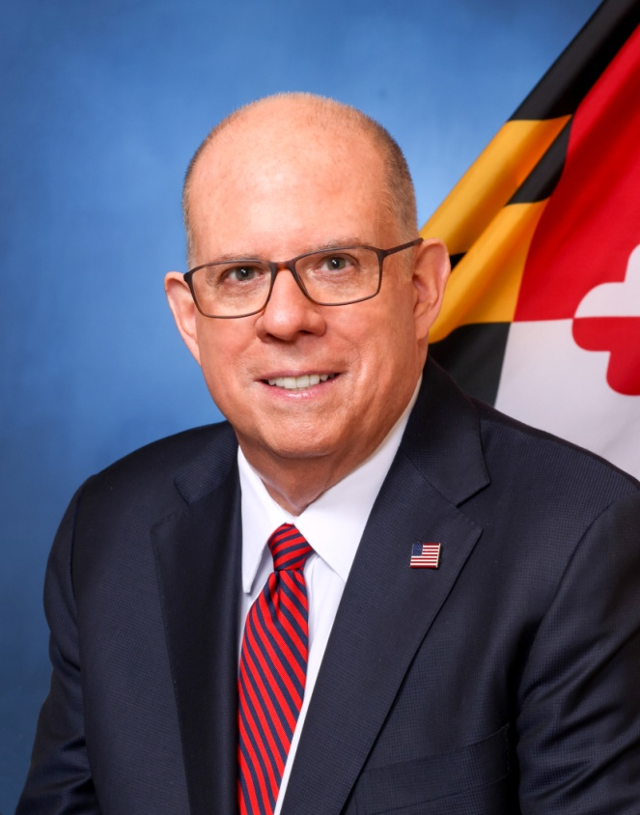
Disability Statistics in Maryland
Total of 669,208 of PWDs in Maryland.
Total of 324,652 working-age PWDs
141,768 of working-age PWDs with Jobs
Employment Rate of working-age MD PWDs is 43.6 percent
Employment Rate of working-age Non-PWDs in MD is 80.9 percent
Gap in Labor Force Participation Rates between PWDs and non-PWDs 37.2 percent.
Poverty Rate of PWDs in MD 24 percent.
Gov. Larry Hogan
(R-MD)
Source: Annual Disability Statistics Compendium: 2020 Durham, NH: Univ. of New Hampshire, Institute on Disability
https://disabilitycompendium.org/

Slide 19
Recognizing Racial Disparities in Maryland
There are 122,278 working-age African Americans with disabilities. Out of that number, only 46,699 or 38.2 percent have jobs.
Fully 26.4 percent of African Americans with disabilities live in poverty compared to 12.2 percent of African Americans without disabilities.
There are 19,844 working-age Latinx people with disabilities. Out of that number, fully 11,537 or 58.1 percent have jobs.
Fully 14.8 percent of Latinx people with disabilities live in poverty, compared to only 13.4 percent of Latinx people without disabilities.
There are 9,993 working-age Asian Americans with disabilities. Out of that number, only 5,832 or 58.4 percent have jobs.
Fully 17.6 percent of Asian Americans with disabilities live in poverty compared to 8.8 percent of Asian Americans without disabilities.
SOURCE: Annual Disability Statistics Supplement: 2020. Univ. of New Hampshire, Institute on Disability.
https://disabilitycompendium.org/compendium/2020-annual-disability-statistics-supplement

Slide 20
Employment Rates for Working-Age Marylanders w/ & w/o Disabilities, by Race – 2019 (Pre-COVID)
SOURCE: Annual Disability Statistics Supplement: 2020. Univ. of New Hampshire, Institute on Disability.
https://disabilitycompendium.org/compendium/2020-annual-disability-statistics-supplement

Slide 21
Poverty Rates for Working-Age Marylanders w/ & w/o Disabilities, by Race – 2019 (Pre-COVID)
SOURCE: Annual Disability Statistics Supplement: 2020. Univ. of New Hampshire, Institute on Disability.
https://disabilitycompendium.org/compendium/2020-annual-disability-statistics-supplement

Slide 22
Employment Rates of Minority Populations (Percentage of population) – 2008 to 2018
SOURCES: https://www.statista.com/statistics/793961/employment-among-disabled-us-adults/ https://www.bls.gov/charts/employment-situation/employment-population-ratio.htm

