Slide 1
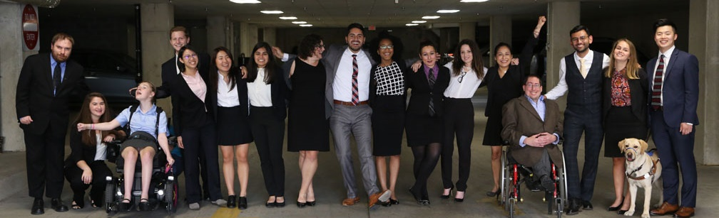

Cover
Building an Equitable Recovery - Solutions for Texans with Disabilities
https://www.respectability.org/

Slide 2
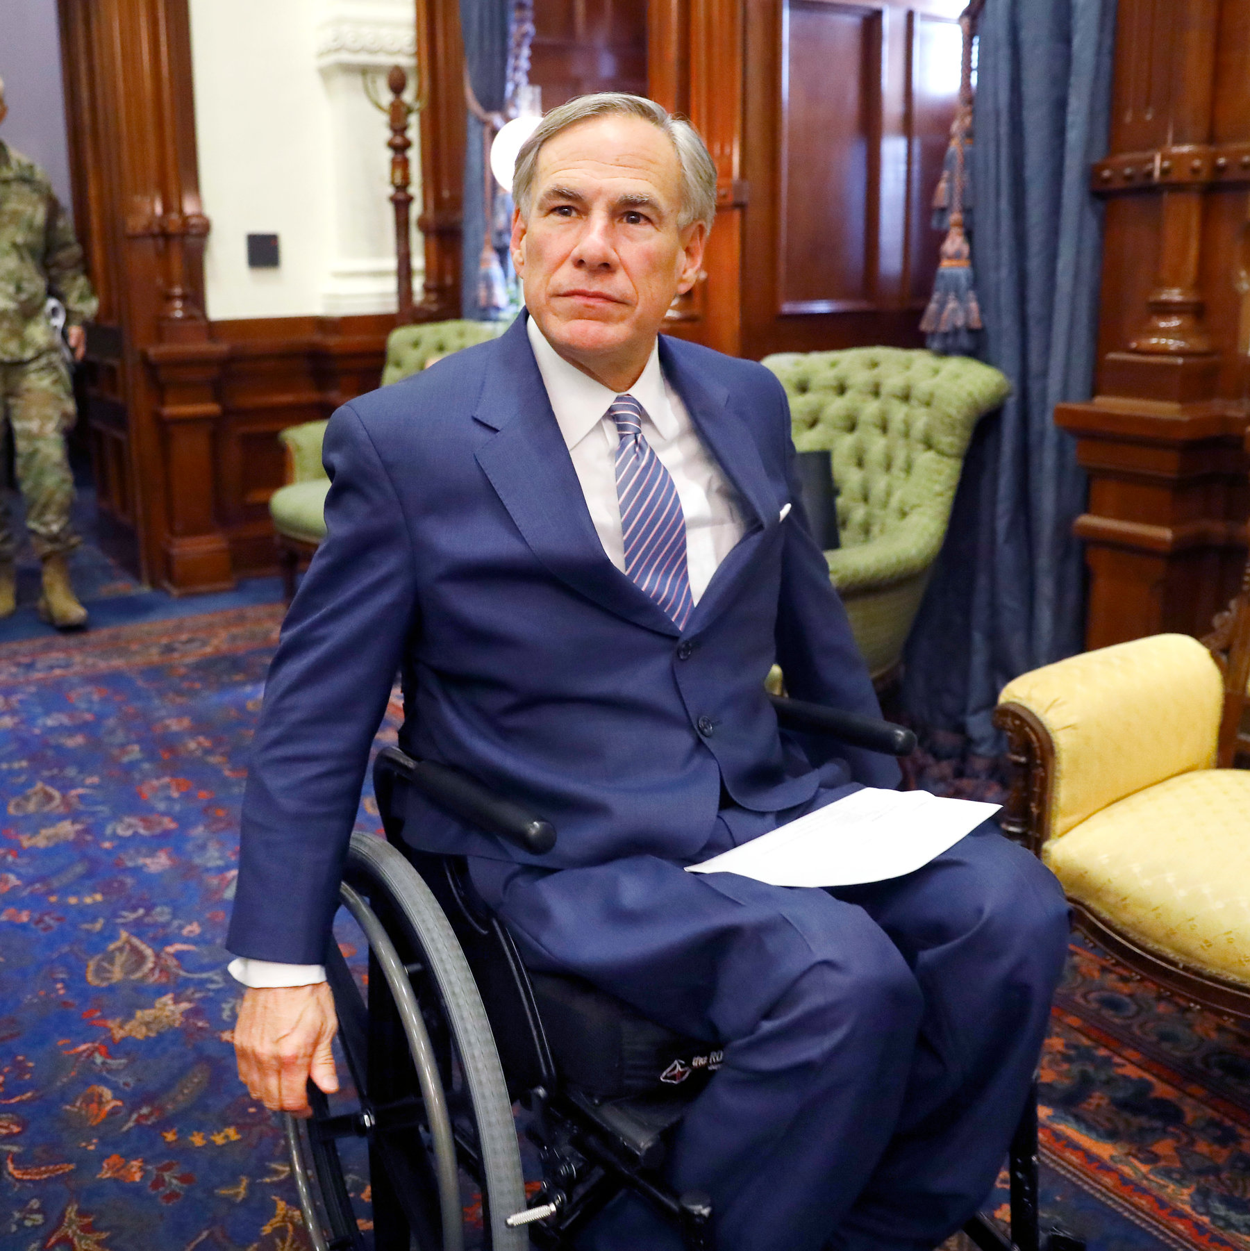
People with Disabilities (PWDs) in Texas
Total # of PWDs in State: 3,282,543
Total # of working-age PWDs: 1,658,935
# of working-age PWDs with Jobs: 695,898
Employment Rate-working-age PWDs: 41.9%
Employment Rate-working-age Non-PWDs: 77.5%
Gap in Labor Force Participation Rates between PWDs and non-PWDs: 35.5%
Poverty Rate of PWDs: 22.8%
Gov. Greg Abbott (R-TX)
Source: Annual Disability Statistics Compendium: 2020 Durham, NH: Univ. of New Hampshire, Institute on Disability https://disabilitycompendium.org/

Slide 3
Recognizing Racial Disparities in Texas
There are 271,739 working-age African Americans with disabilities. Out of that number, only 95,711 or 35.2% percent have jobs. (Tables 3.22/3.27)
Fully 29.1% percent of African Americans with disabilities live in poverty compared to 18.1% percent of African Americans without disabilities. (Tables 6.7/6.12)
There are 571,671 working-age Latinx people with disabilities. Out of that number, fully 246,550 or 43.1% percent have jobs. (Tables 3.25/3.30)
Fully 26% percent of Latinx people with disabilities live in poverty, compared to only 18.8% Of Latinx people without disabilities. (Tables 6.10/6.15)
There are 37,018 working-age Asian Americans with disabilities. Out of that number, only 16,345 or 44.2% percent have jobs. (Tables 3.23/3.28)
Fully 15.8% percent of Asian Americans with disabilities live in poverty compared to 9.8% percent of Asian Americans without disabilities. (Tables 6.8/6.13)
SOURCE: Annual Disability Statistics Supplement: 2020. Univ. of New Hampshire, Institute on Disability.
https://disabilitycompendium.org/compendium/2020-annual-disability-statistics-supplement

Slide 4
Employment Rates for Working-Age Texans w/ & w/o Disabilities, by Race – 2019 (Pre-COVID)
SOURCE: Annual Disability Statistics Supplement: 2020. Univ. of New Hampshire, Institute on Disability.
https://disabilitycompendium.org/compendium/2020-annual-disability-statistics-supplement

Slide 5
Poverty Rates for Working-Age Texans w/ & w/o Disabilities, by Race – 2019 (Pre-COVID)
SOURCE: Annual Disability Statistics Supplement: 2020. Univ. of New Hampshire, Institute on Disability.
https://disabilitycompendium.org/compendium/2020-annual-disability-statistics-supplement

Slide 6
Employment Rates of Minority Populations
(Percentage of population) – 2008 to 2018 – WIP
SOURCES: https://www.statista.com/statistics/793961/employment-among-disabled-us-adults/ https://www.bls.gov/charts/employment-situation/employment-population-ratio.htm

Slide 7
Percentage & Number of Disability by Type - SWDs
 | Autism | Deaf-blindness | Developmental delay | Emotional disturbance | Hearing disabilities | Intellectual disabilities | Multiple disabilities | Orthopedic Disability | Other health conditions | Specific learning disabilities | Speech or language | Traumatic brain injury (TBI) | Visual disabilities
Number of SWDs with that Disability | 74,581 | 199 | DATA INCOMPLETE | 36,065 | 6,603 | 59,192 | 7,841 | 2,861 | 80,570 | 183,177 | 97,810 | 1,129 | 3,177
Percentage of SWDs with that Disability | 13% | 0.0003% | DATA INCOMPLETE | 6% | 1% | 10% | 1.4% | 0.5% | 14% | 33% | 17% | 0.2% | 0.05%
In total, there are 553,205 students with disabilities in Texas’ Public School System today.
Source: IDEA Section 618 Data Products: Static Table - https://www2.ed.gov/programs/osepidea/618-data/static-tables/index.html

Slide 8
Cover
THANK YOU!
Nelly Nieblas, Manager of Policy, Advocacy and Engagement
nellyn@respectability.org
Philip Kahn-Pauli, Policy Director philipp@respectability.org

