Slide 1

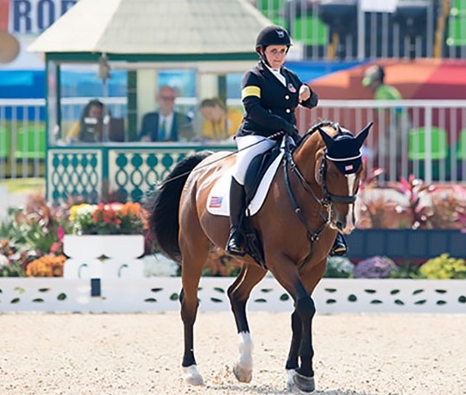


DEI Community Conversations:
Harnessing Accessibility and Inclusion of Persons with Disabilities
Wednesday, April 14th, 2021
Noon – 1:00 pm (ET)
Director/Producer: Debbie Fink

Slide 2
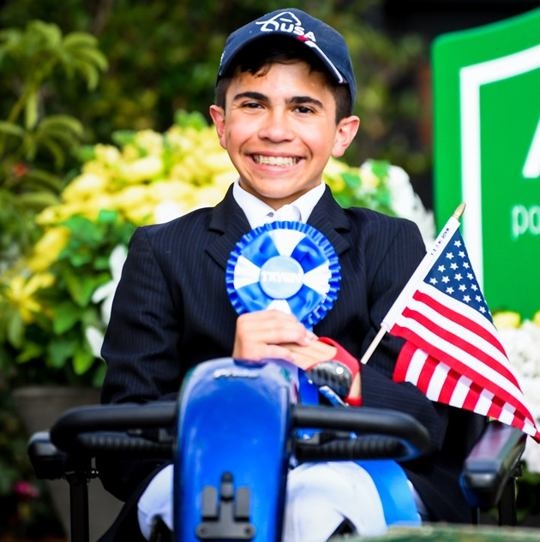
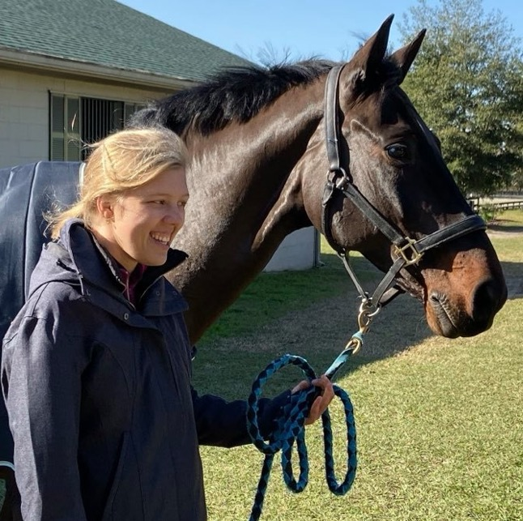

Disabilities Are….
Temporary and Permanent
Visible and Nonvisible
From Birth or Acquired Later

Slide 3
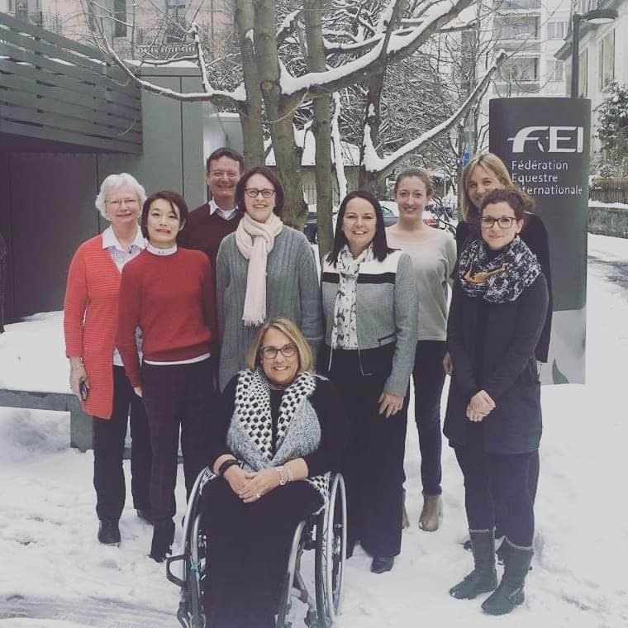
Three Facts
Anyone can join the disability community at any point due to aging, illness, accidents,
and/or trauma.
The disability community
is diverse.
People with disabilities from other underrepresented communities face double discrimination.

Slide 4


1 Billion People
Over 1 billion
– approximately 15% –
of the global population live with a visible and/or nonvisible disability
(pre-pandemic)

Slide 5
Disability Laws
According to the UN’s Department of Economic and Social Affairs:
“Disability laws and acts are instruments through which countries abolish discrimination against persons with disabilities and eliminate barriers towards the full enjoyment of their rights and their inclusion in society.”
(121 out of 197 countries have such laws)

Slide 6

Women with Disabilities
The United Nations Department of Economics and Social Affairs states:
Women with disabilities often face disproportionately high rates of gender-based violence, neglect, and discrimination.

Slide 7
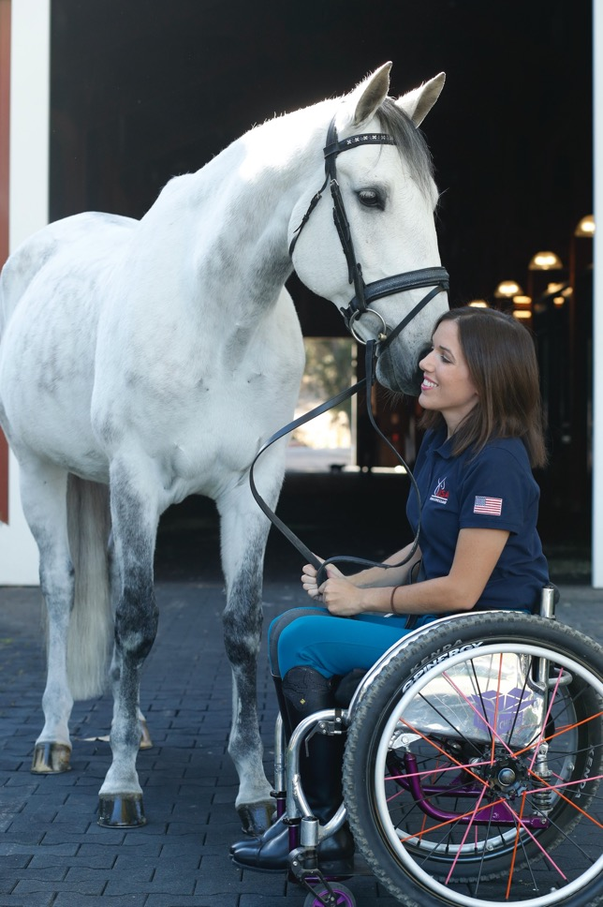
1-in-5 People in the US
1-in-5
people of all ages has a
disability
in the U.S.
(pre-pandemic)

Slide 8
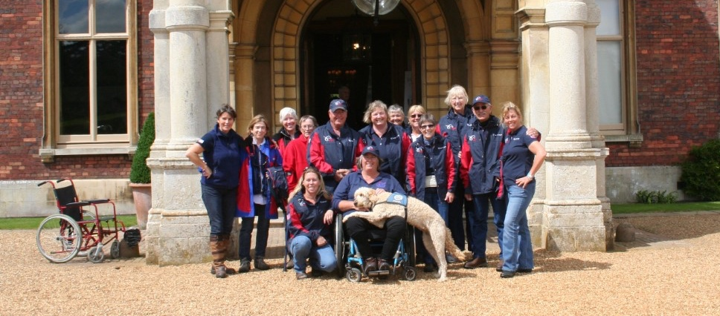
People with disabilities want opportunities
People with disabilities want opportunities
Just like anyone else.

Slide 9

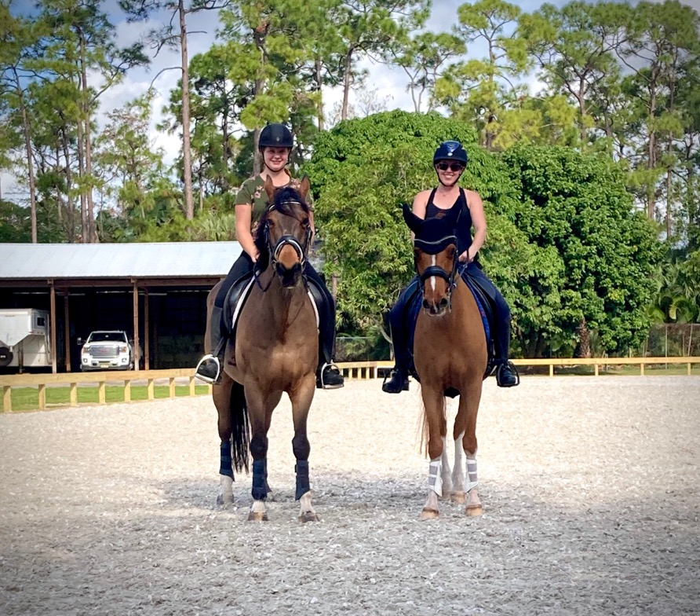
Helmets Prevent Injuries from Accidents –
Temporary and Permanent, Visible and Nonvisible
More information from USEF on helmet safety

Slide 10
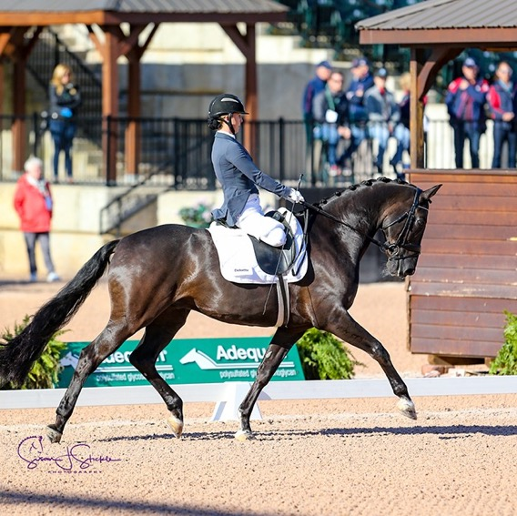
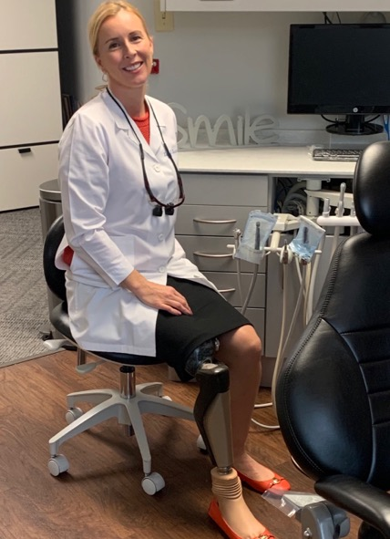
High-level Competition Skills –
These Skills Transfer to Work Skills
Competitors practice virtues and hone skills that are directly transferable in the workplace. Such as:
Good Sportsmanship
Flexibility
Teamwork
Respecting Fair Competition
Setting High Standards
Tenacity and Perseverance
Working towards Goals
Humility, Honor and Integrity

Slide 11
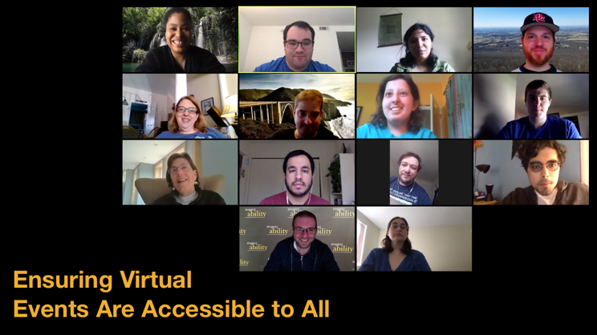
Ensuring Accessible Events: Virtual
At your first planning meeting, make sure to:
Make it easy and comfortable for people to request accommodations beforehand; include this phrase in every registration form:
“Do you need any accommodations to
fully participate in this event?”*
Offer and provide accommodations when requested (i.e. sign language interpreters; accessible PPTs or other materials) – Add captions to videos; add captioning via Zoom (free!) or hire a professional
Assign/provide email/phone number of employee who is responsible to handle accommodations.
Ensure that people with disabilities are on virtual panels and programs.
Webinar on Accessible Virtual Events

Slide 12
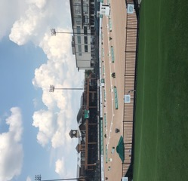
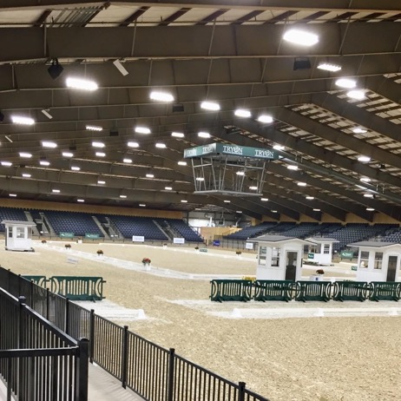
Ensuring Accessible Events: In–Person
At your first planning meeting, make sure to:
Ensure that your event will be held in accessible locations.
Make it easy and comfortable for people to request accommodations beforehand; include this phrase in every registration form:
“Do you need any accommodations to
fully participate in this event?”
Offer and provide accommodations when requested (i.e. sign language interpreters; large print handouts; live captioning; allergy-friendly food; substitute for bell sounds)
Assign/provide email/phone number of employee who is responsible to handle accommodations.

Slide 13
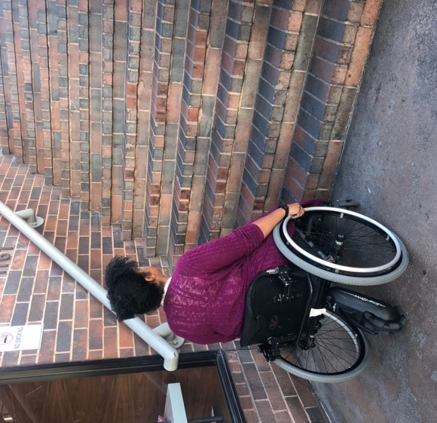
Physical Accessibility of Venue(s)
When choosing a venue, make sure that:
There is a ramp at the main entrance;
Rooms to be used do not require one or more stairs to access (unless there is an elevator);
Door entrances have a clear width for wheel-chairs;
Elevators have different requirements; (Measuring tapes will tell you!)
Bathrooms are accessible: at least one bathroom stall door must have this same clearance.
  (In the U.S.: See Americans with Disabilities Act guidelines at www.ADA.gov or specific requirements.)
Webinar on Ensuring Accessible Events

Slide 14
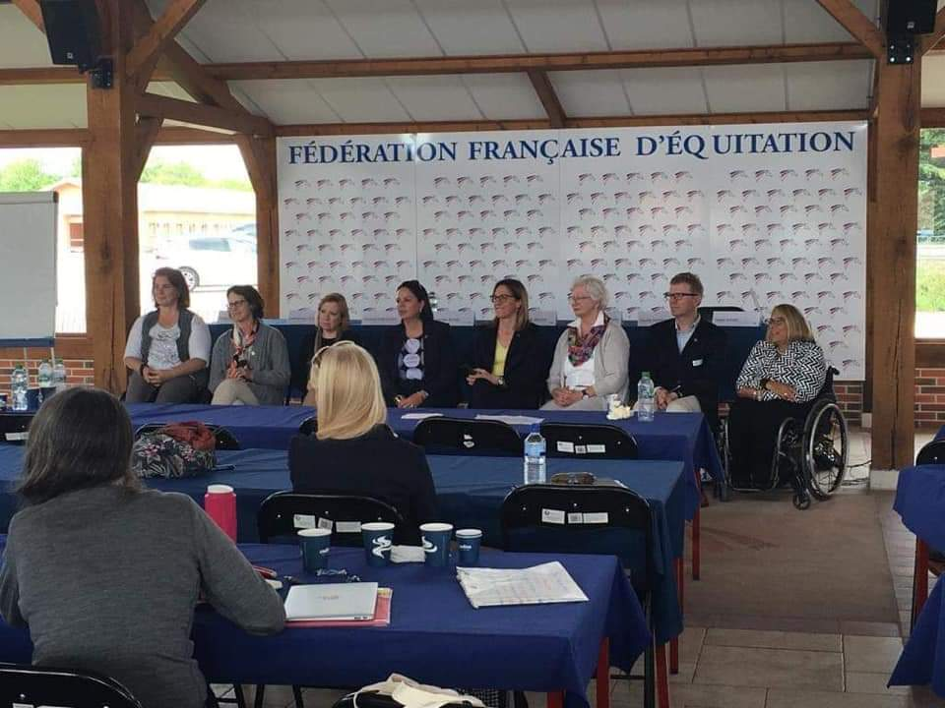
Work with people with disabilities
When planning an event, make sure to:
Include people with disabilities in the planning, and on panels and programs.
Use vendors who are – or who hire – people with disabilities.
Include people with visible disabilities in your marketing material.
Put captions on all videos and ensure screen reader accessibility on all documents, social media and website.
Webinar on Welcoming Lexicon, Websites and Social Media

Slide 15

10 Tips in
Disability Etiquette:
One-on-One
Interactions
Webinars on Disability Etiquette

Slide 16
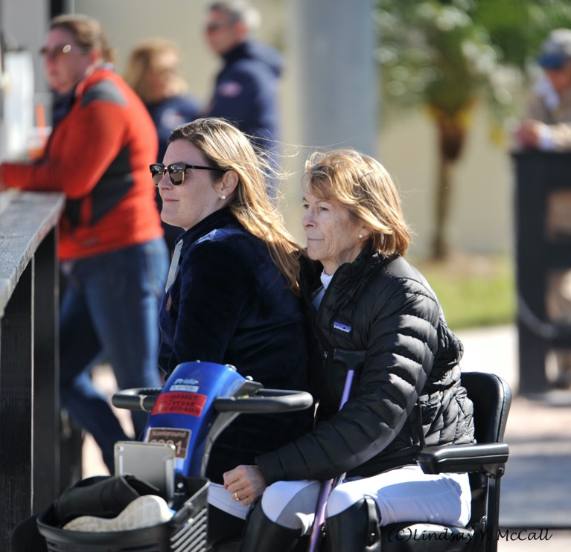
Tip #1: The Golden Rule
People with disabilities are people.
Follow The Golden Rule: Treat others the way you wish to be treated.
Acknowledge their differences as you would acknowledge anyone’s. Treat them the same.
Do not talk down to them – literally or figuratively.

Slide 17
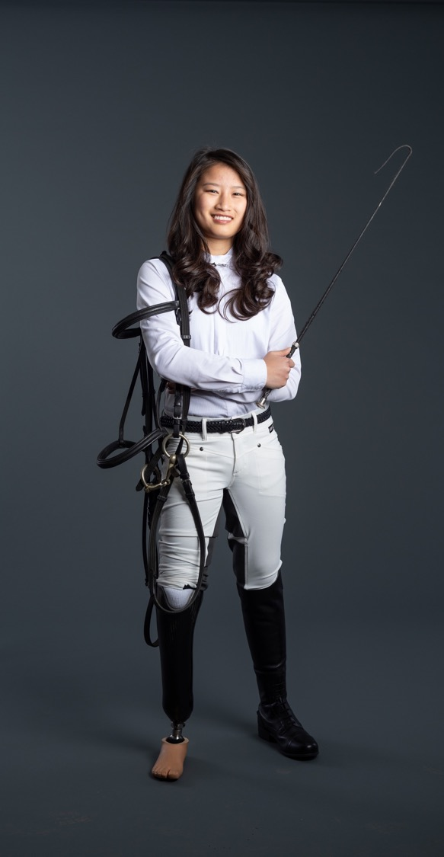
Tip #2: Language Matters!
Some people prefer person-first language – “person with a disability" – and others prefer identity-first language – “disabled person.”
Ask the person what language they prefer and respect their preference.
Avoid outdated terms like “handicapped,” “crippled” or the “R” word.

Slide 18
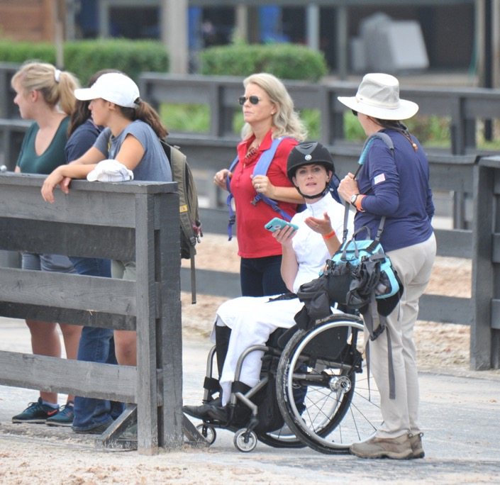
Tip #3: Unsure how to interact?
A-T-P! Ask the Person!
Not sure how to interact or refer to a person’s disability?
Just remember: A-T-P! Ask the Person!
Just because someone has a disability, do not assume they need help; always ask first.
Respect their response. If it is “No,” don’t respond with “are you sure?”
Respect someone’s choice even if it looks like they’re struggling.
If it is a dangerous situation, then help just as you would help someone without a disability.

Slide 19
Tip #4: Adults with disabilities are adults –
Treat them and speak to them as adults.
Do not make decisions for other adults.
Do not use childlike talk or tell them what to do.
Use “I suggest …” or “I think …”
Read their nonverbal cues.
Provide them with every option you provide those without disabilities.
If the option they choose presents a difficulty concerning their disability, discuss ways you could modify or adapt the choice with them.

Slide 20
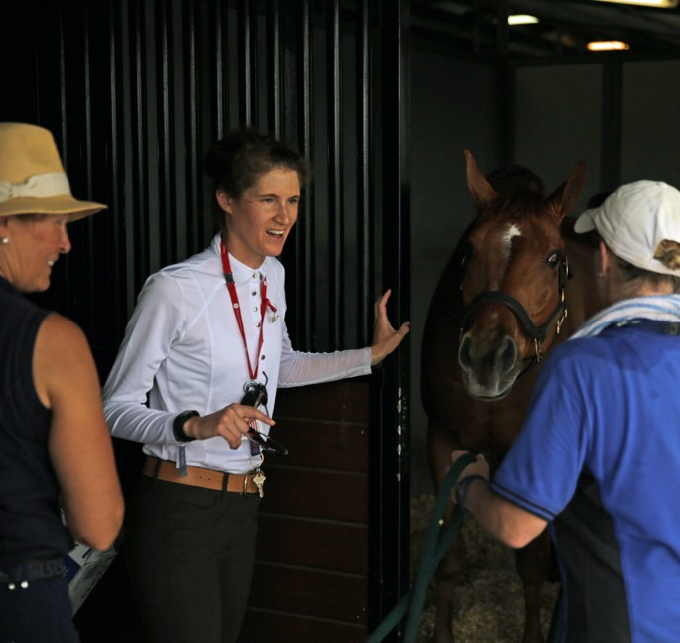
Tip #5: Listen attentively and patiently when talking with a person who has difficulty speaking.
Be patient and wait for the person to finish, rather than correcting, interrupting, or speaking for the person.
If necessary, ask short or close-ended questions that require short answers, a nod or shake of the head.
Never pretend to understand if you are having difficulty doing so.
Instead, repeat what you have understood and allow the person to respond. The response will clue you in and guide your understanding.

Slide 21
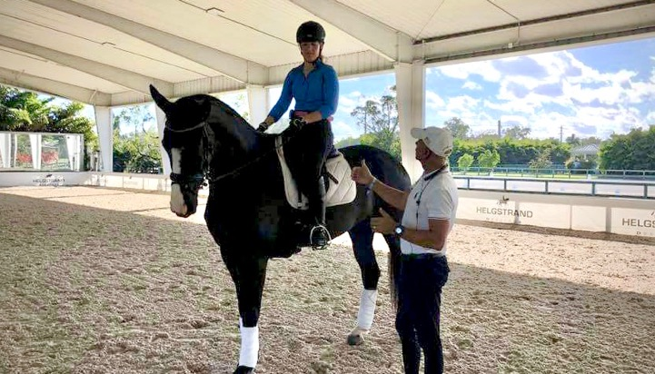

Tip #6: Speak directly to a person with a disability.
Look directly at the person, as you would anyone else with whom you are speaking.
Do not speak to their sign language (or other language) interpreter or their personal companion or assistant.
Try to read their nonverbal cues.
A lack of immediate response does not indicate that the person can’t or won’t respond.
Be patient.

Slide 22
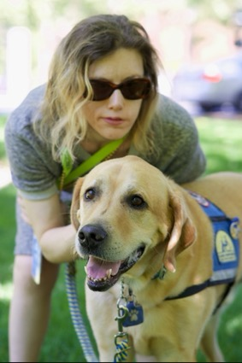
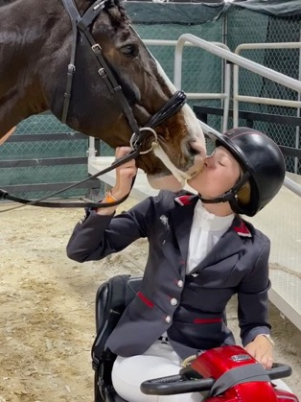
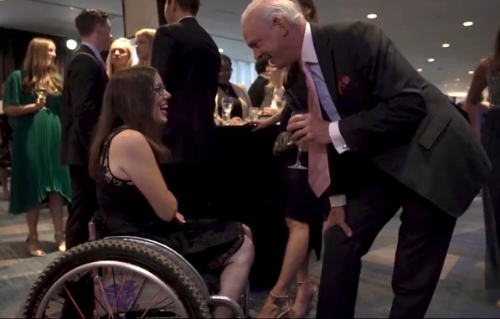
Tip #7: Respect Their Personal Space –
Wheelchairs, scooters & canes are someone’s personal space.
Do not touch or move an individual’s adaptive devices – even if they put it down or choose to leave it somewhere – without permission:
Leaning on someone’s wheelchair is like leaning on someone’s shoulder.
Putting something in someone’s carry basket is like putting something in their backpack.
It is vital that owners know where their equipment is at all times.
If they use a wheelchair, use a chair to be eye-level if you are having a long conversation.
Service animal etiquette: Request permission from owner prior to petting a service animal.

Slide 23
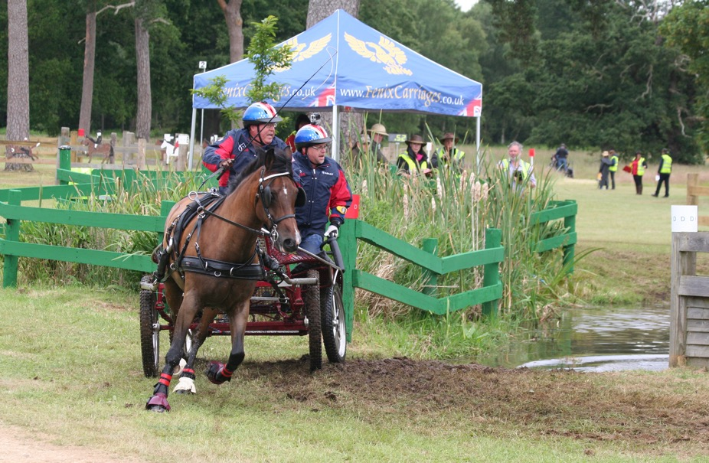
Tip #8: Don’t pretend to have a disability.
Disability simulation experiences should be done for design / navigational / educational purposes only.
Pretending to have a disability, without one of the above purposes, is considered insulting.

Slide 24
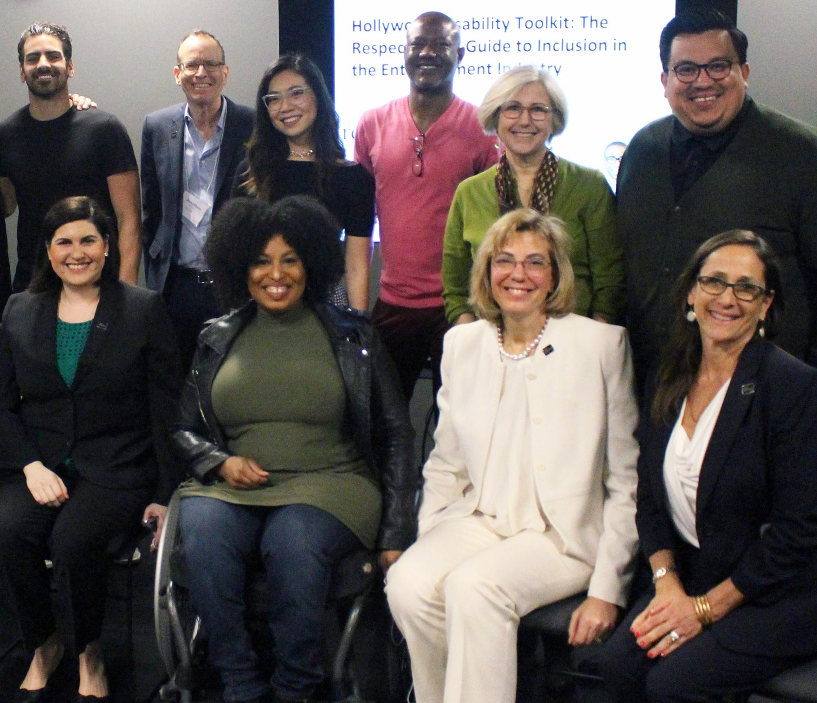
Tip #9: Visible and Nonvisible Disabilities –
Some you can see, some you cannot
A person may make a request or act in a way that you don’t understand. That request or behavior may be disability-related.
For example, you may give seemingly simple verbal directions to someone, but the person asks you to write it down.
The person may have a learning disability that makes written communication easier – or more difficult.
Or a person may be anxious or act depressed.
Notes:
Add quote: 70% of disabilities are NON VISIBLE – CHECK this

Slide 25
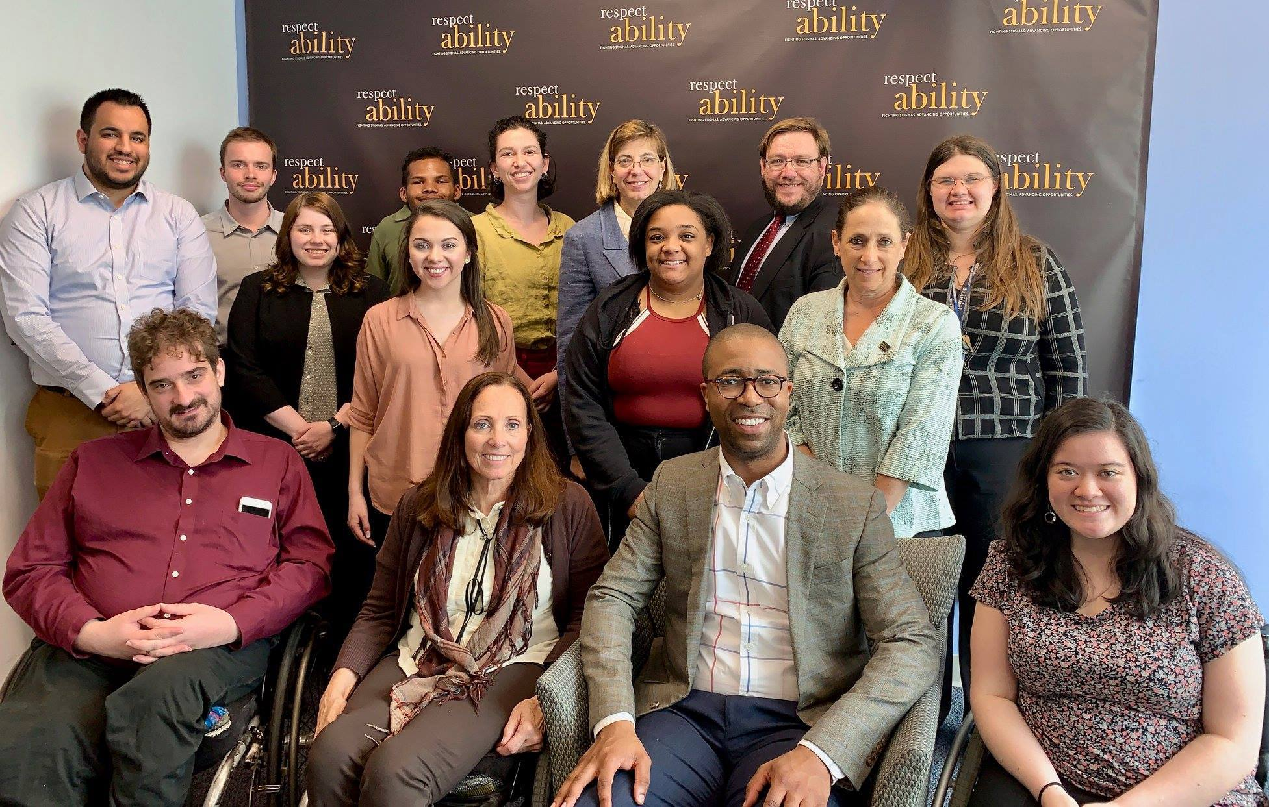
Tip #10: People with mental health disabilities –
This nonvisible disability presents differently for different people.
Mental health disabilities are the pandemic’s “shadow.” People of all ages are struggling:
If you or someone you know is struggling with anxiety and/or depression, seek help.
It is a sign of strength to ask for help.
Others may have trouble picking up on social cues; some may be super-sensitive.
One person may be very high energy, while someone else may appear sluggish or distant.
Treat each person as an individual.

Slide 26

Tip #10: Mental Health Resources
If you or someone you know is experiencing a mental health crisis:
go to the local hospital emergency room &/or contact:
National Suicide Prevention Hotline (24 hours, free, in English or Spanish):
1-800-273-8255
------------------
USEF-BASED MENTAL HEALTH FIRST AID HOTLINE (free for USEF members):
1-800-633-3353
The intake representatives who answer the calls are all licensed therapists.
------------------
U.S.-BASED MENTAL HEALTH CARE RESOURCES:
Mental Health America: https://www.mhanational.org
American Psychological Association: https://www.apa.org/
Project Semicolon: https://projectsemicolon.com/
And/or contact your insurance company for further guidance.

Slide 27
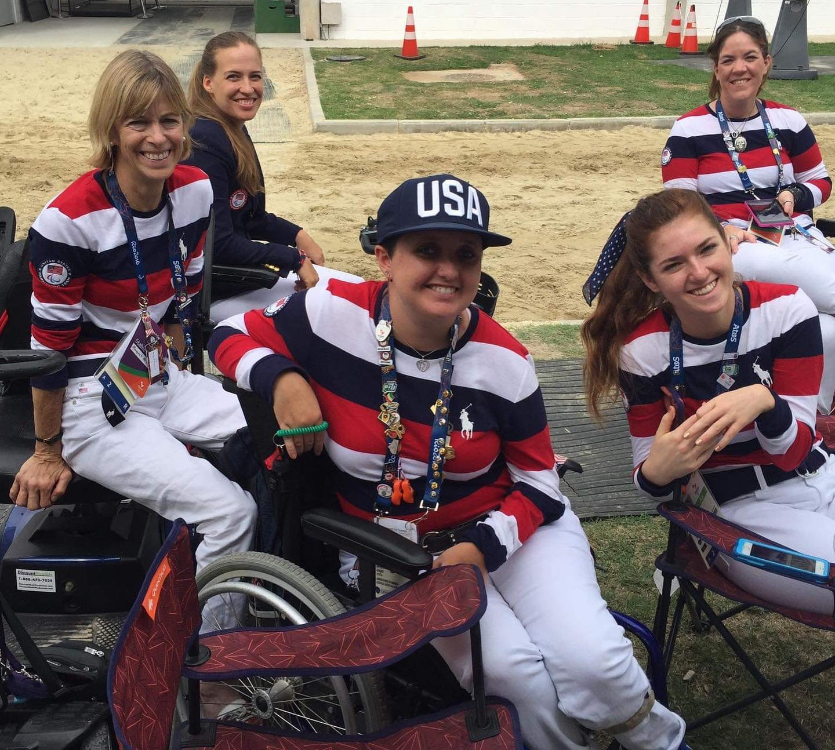
People with disabilities want opportunities (2)
People with disabilities want opportunities
Just like anyone else.

Slide 28


Thank You!
THANK YOU!
Ashley Swift, USEF Host
Debbie Fink, Director/Producer
Lauren Appelbaum, Moderator
Alanna Flax-Clark, Keynote Speaker
Ava Rigelhaupt, Speaker
Abigail Shaw, Speaker
Darby Leigh, Speaker
Andrea Jennings, Speaker
Jake Stimell, Fellow,
Community Outreach and Impact
Maya Cohen-Shields, Intern
FOR MORE INFO: Contact EricA@respectability.org
USEF Contact: Kbolton@usef.org
Link to Free RespectAbility Webinars

Slide 29
Photo Credits
(for slides with 2 photos, credits are listed left to right)
Slide 1: Marie de Ronde-Oudemans, Sydney Collier
Slide 2: Andrea Evans/US Equestrian
Cecily Byrd, Meghan Benge
Slide 3: Hope Hand
Slide 4: RespectAbility
Slide 5: RespectAbility
Slide 6: RespectAbility
Slide 7: Alanna Flax-Clark
Slide 8: Marie de Ronde-Oudemans
Slide 9: Charlotte Merle-Smith
Alanna Flax-Clark
Slide 10: Katie Jackson
Slide 11: RespectAbility
Slide 12: Alanna Flax-Clark
Marie and Cecile Vonderheyden
Slide 13: Respectability
Slide 14: Hope Hand
Slide 15: Lindsay McCall
Slide 16: Lindsay McCall
Slide 17: Barbie Roth
Slide 18: Lindsay McCall
Slide 19: Ava Rigelhaupt
Slide 20: Marie and Cecile Vonderheyden
Slide 21: Roxanne Trunnell
Mia Rodier-Dawallo
Slide 22: Natalie Abbott,
Veronica Gogan, Alanna Flax-Clark
Slide 23: Patricia Kastama
Slide 24: RespectAbility
Slide 25: RespectAbility
Slide 26: n/a
Slide 27: Sydney Collier
Slide 28: Alanna Flax-Clark

