Slide 1
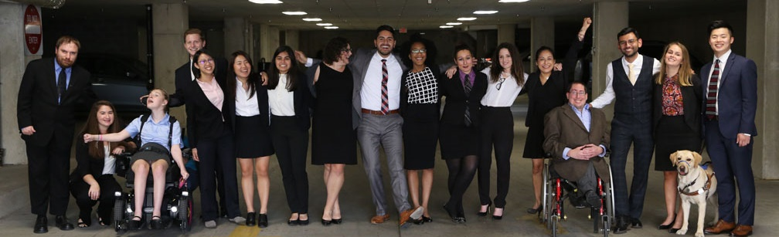

Ensuring Best Practices for Disability Inclusion
Ensuring Accessibility During the Return of In-Person Events – And Why We Should Keep Doing Accessible Virtual Events
Lauren Appelbaum and Tatiana Lee
June 2021

Slide 2
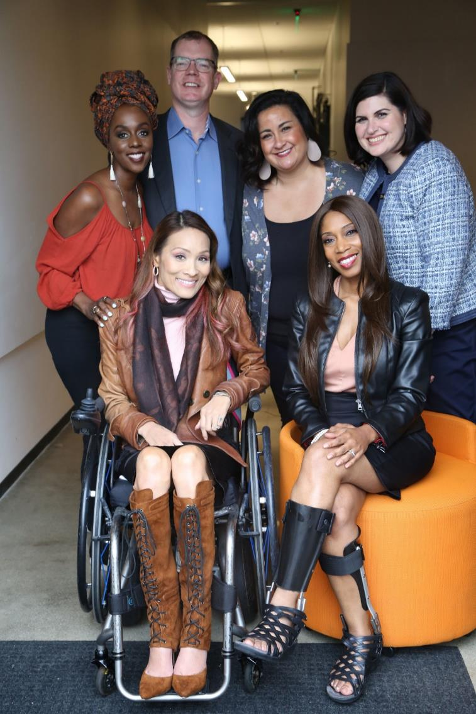
Including the D – Disability – in Diversity
Organizations are at their best when they welcome, respect and include people of all backgrounds. This includes people with disabilities.

Slide 3
Our Mission
To fight stigmas and advance opportunities so that people with disabilities can fully participate in all aspects of community.
RespectAbility’s
Mission:
Fight Stigmas by promoting authentic portrayals of people with disabilities in media.
Advance Opportunities by promoting best practices in education, jobs and accessibility.
Leadership Development to strengthen a diverse talent pipeline of people with disabilities.
1
2
3

Slide 4
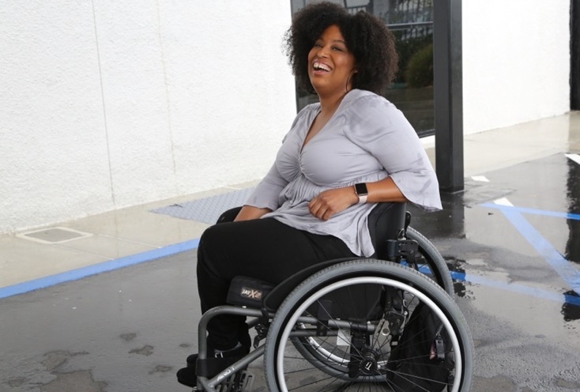

1 in 4 adults
61 Million
people in the US have a disability.*
1 in 4
adults have a disability
(physical, sensory, cognitive, mental health or other)
* Source: US Census

Slide 5
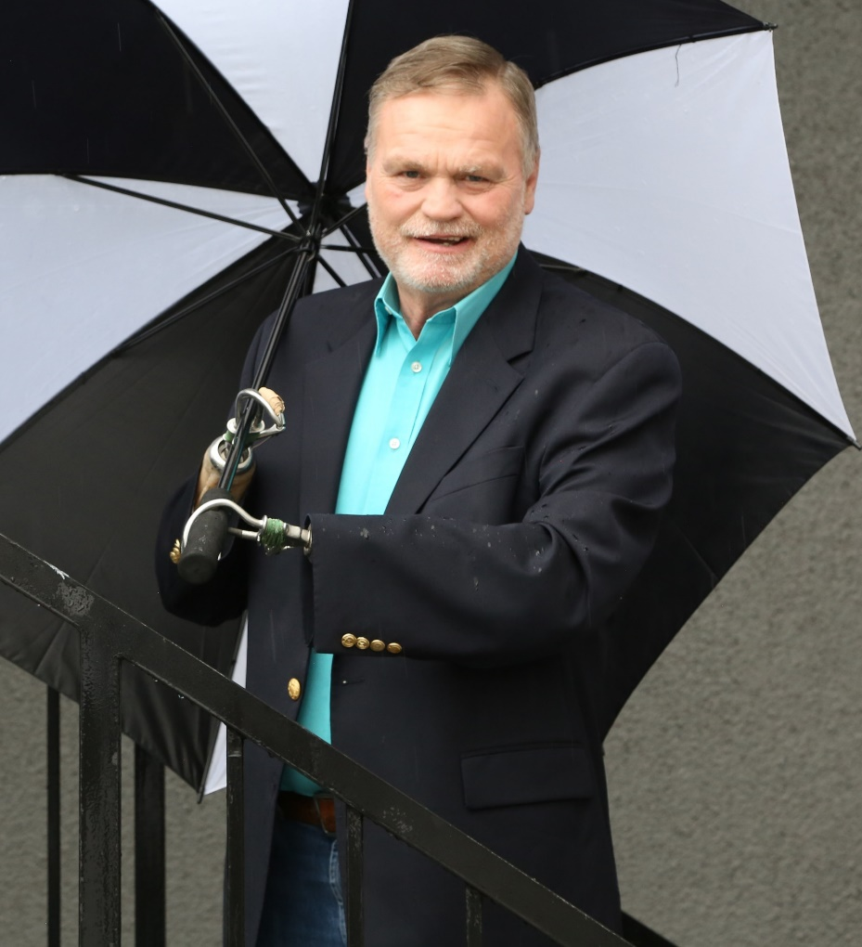
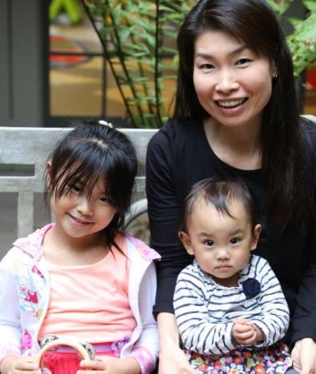
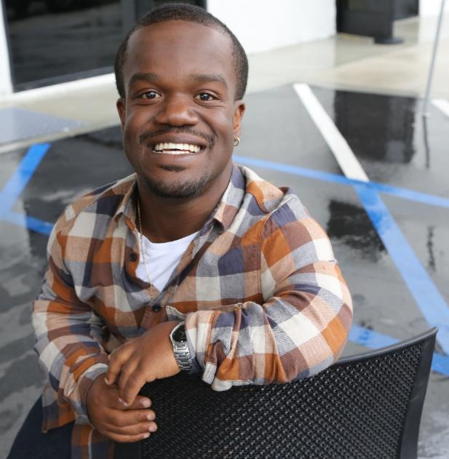
Disabilities Are….
Temporary and Permanent
Visible and Nonvisible
From Birth or Acquired Later

Slide 6
Accessibility Is Important For All
Ensuring accessibility during the planning process of an event is important; if you are planning to post a video of the event after the fact, you may need to ensure accessibility during the actual event, even if no live participants request one. This is important for several reasons:
Twenty percent of people in the U.S. are Deaf/Hard of Hearing; that is 48 million Americans.
More than 1 million people in the U.S. are blind and more than 12 million have low vision.
More than 5 million people in the U.S. are English language learners.
While not everyone knows they have one, it is likely that more than 40 million Americans have a learning disability.

Slide 7
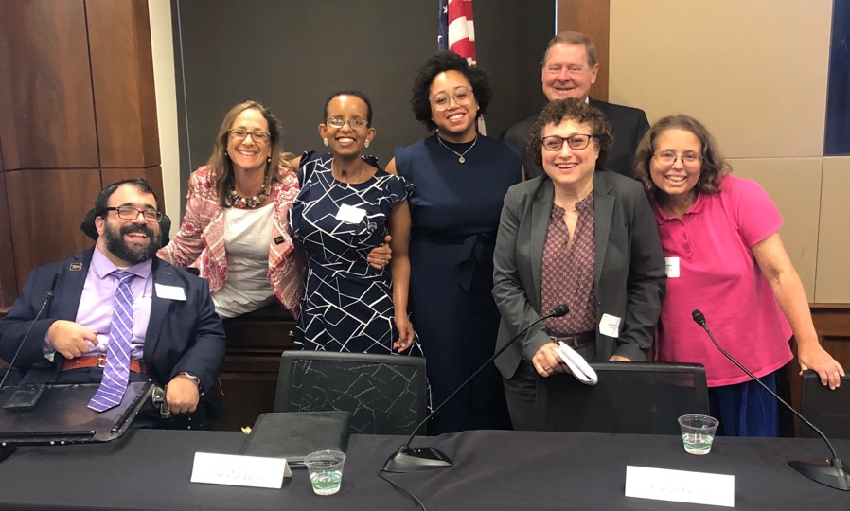
The disability market is valued at more than $1 Trillion
Opening the inclusion umbrella is the right thing to do as well as economically smart given that the disability market is valued at more than $1 trillion.
Reaching the disability / chronic illness / mental health market is win-win for companies and people with disabilities alike.
*Nielson (2016): Reaching Prevalent, Diverse Consumers with Disabilities

Slide 8

When We Think About Access…
Do we think about this?

Slide 9
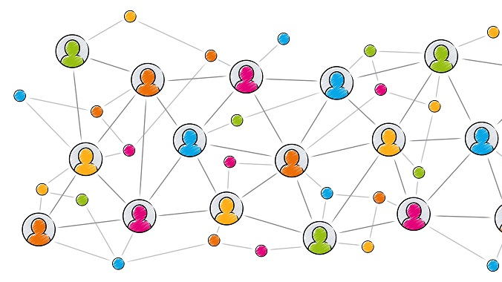
Or this?

Slide 10

Inclusion
&
Belonging

Slide 11
Words Matter

Slide 12
Talking about Disability
Say the word. “Disability” is not a bad word!
Use “nondisabled” instead of “able-bodied” or “normal.”
Don’t use euphemisms like “differently-abled” or “special needs.”
Avoid passive, victim words. Use accurate, respectful language.
  Instead of “he suffers from cerebral palsy,” use “he has cerebral palsy.”
  Instead of “confined to a wheelchair” or “wheelchair-bound,” use “wheelchair user.”
Eliminate common ableist language: Ex: Crazy
Avoid referring to “the disabled” in the same way that you would avoid referring to “the Asians,” “the Jews” or “the African-Americans.” Instead, consider using such terms as “the disability community” or “the disability activist.”
People with disabilities should not be described as “inspirational” or “courageous” just because they have a disability.

Slide 13
People-First Language vs. Identity-First Language
People-First Language (woman with a disability) puts the emphasis on the person first; followed by a description of the disability.
Identity-First Language (disabled woman) puts the emphasis on the disability.
Several U.S. disability groups have always used identity-first terms, specifically the culturally Deaf community and the autistic rights community.

Slide 14
People First vs. Identity First Language
If you are working with individuals with disabilities, ask them their preference.

Slide 15
Accessibility Starts Before the Event

Slide 16
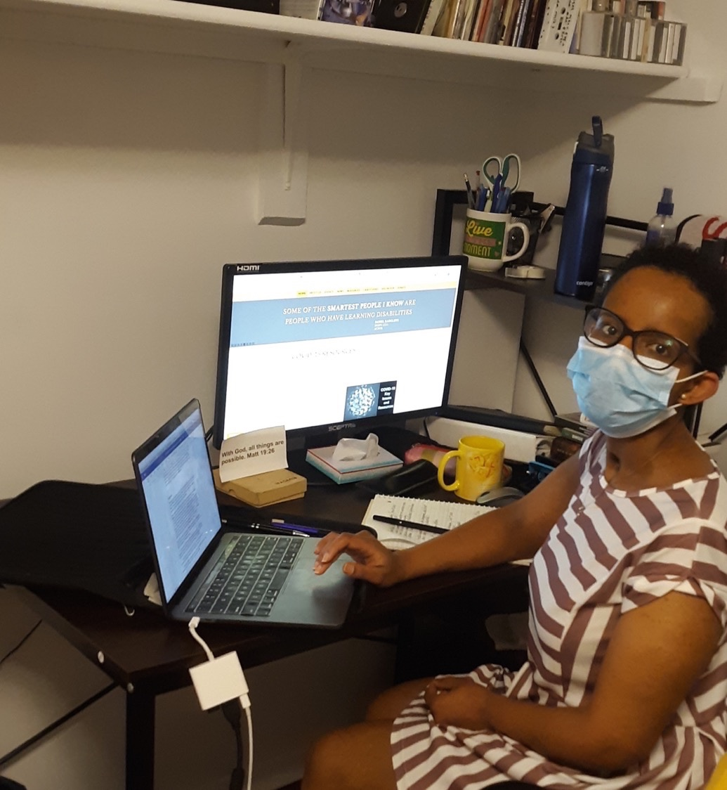
Be Intentional
It is vitally important to think through every step and every use of the event before implementing anything.
After all, it always is easier to make changes during the planning stages than after the fact.

Slide 17

Question 2
Question to Consider:
What are some of the most common accessibility challenges when planning virtual events and what are some of the solutions you’ve found to be most effective?

Slide 18
Invitation Format
Ensure images and logos have alt text (image descriptions) for people who are blind and use screen readers
Have a plain text version of the invite
Some systems, like Eventbrite are not accessible to people who use screen readers
Google Forms are accessible
User test – can someone using a screen reader access all fields on the form?

Slide 19
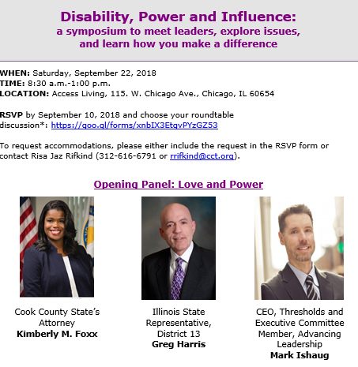
Accommodations Language
On the sign-up form, ask registrants if they need any accommodations to effectively participate in the event:
“To request accommodations, please either include the request in the RSVP form, or contact [Name of Person] at 222-222-2222 [Phone number] or xxxxxxx@yyyyyy.org [Email address]”
Be specific! List a real person!
Note: You may also choose to list accommodations you plan to offer such as CART or American Sign Language interpretation
May set a deadline of 48 hours before the event to request any accommodations

Slide 20





Information to Provide
How long the event will last and format of the event
Will participants be on video or audio for discussion or will they be more like spectators watching a presentation?
If there will be an icebreaker or questions for everyone to answer, let attendees know that ahead of time.
Encourage attendees to send questions or comments in advance (helpful to participants who may want more time to prepare their materials and to presenters to help them frame their comments)
If there will be time for live Q&A, share that information in the invitation.

Slide 21
Ensure Accessible Documents
Distribute documents or PowerPoint presentation in advance
Tips on ensuring an accessible PPT: https://support.office.com/en-us/article/make-your-powerpoint-presentations-accessible-to-people-with-disabilities-6f7772b2-2f33-4bd2-8ca7-dae3b2b3ef25
Word documents: have a text-only version for people who request one

Slide 22
During The Event:
Ensuring Everyone Can Participate Including Those Who are Blind, Have Cognitive Disabilities and/or are Nonverbal

Slide 23
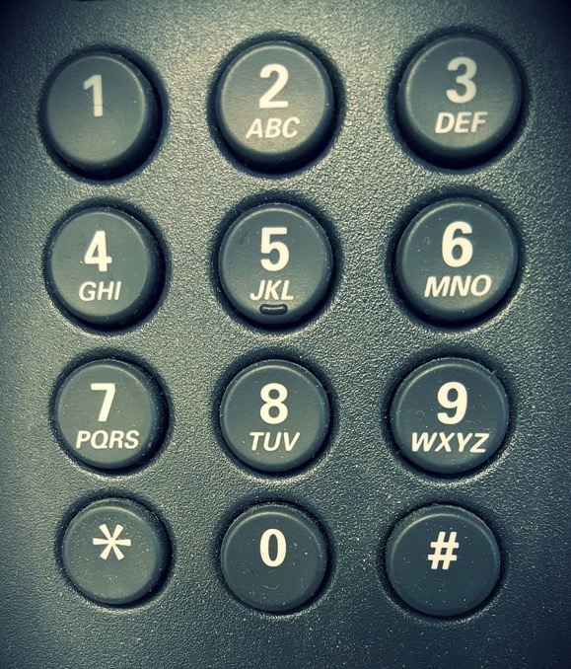
Access for All – Even if Virtual
Have accommodation for individuals who do not have access to video conferencing
Offer option for attendees to dial in by phone

Slide 24
Question 1
Question to Consider:
What are some of the most common accessibility challenges when planning in-person events and what are some of the solutions you’ve found to be most effective?

Slide 25
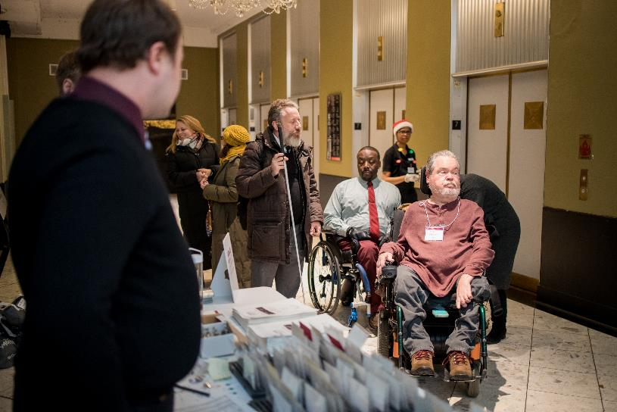
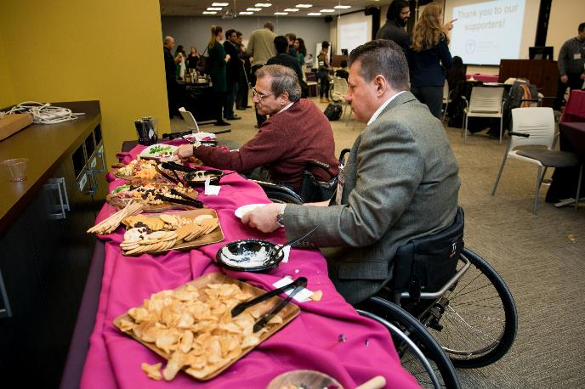
Layout: Arrival and Food
Notes:
The selection of an accessible space is critical in ensuring that our guests arrive and leave feeling welcomed.
ELEMENTS OF ACCESSIBLE VENUE
• Location should be accessible for wheelchair users and others with disabilities. Avoid stairs, steep ramps, and other physical barriers that could pose an obstacle. Accessible entrances should be in an appropriate and convenient location (for example, not through an alley or kitchen)
• The accessible entrance should be in an appropriate area not via a back area or an alley.
• Aisles between tables are wide enough for wheelchair users to navigate. Aisle should be a minimum of three feet wide when chairs are pulled out.
• The coat check and registration are accessibly located.
• Accessible bathrooms are required.
• Stage, podium, and panel should be accessible for speakers with disabilities.
• Pathways and access aisle should allow for movement throughout full space.
• Accessible seating should be available in multiple areas to achieve diverse integrated seating options.
• Warn event goers of loud noise and lights that might be flickering
Is there a quiet room?

Slide 26
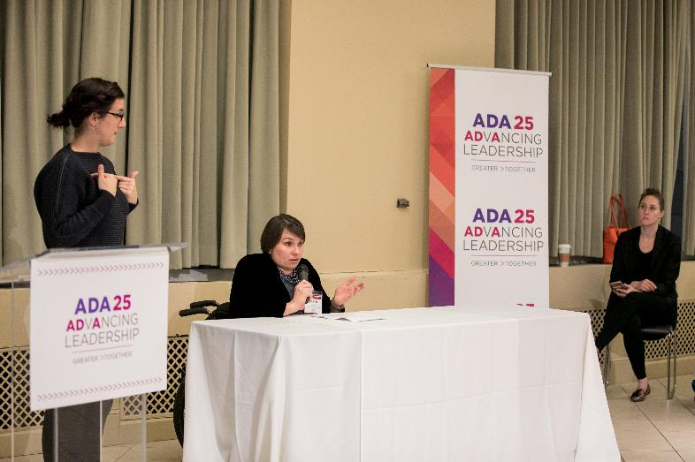
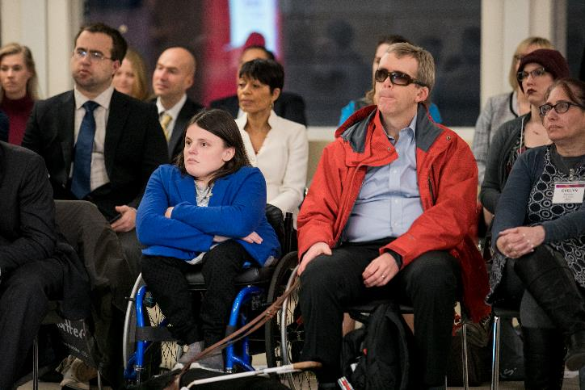
Event Experience: Speakers and Seating
Notes:
The selection of an accessible space is critical in ensuring that our guests arrive and leave feeling welcomed.
ELEMENTS OF ACCESSIBLE VENUE
• Location should be accessible for wheelchair users and others with disabilities. Avoid stairs, steep ramps, and other physical barriers that could pose an obstacle. Accessible entrances should be in an appropriate and convenient location (for example, not through an alley or kitchen)
• The accessible entrance should be in an appropriate area not via a back area or an alley.
• Aisles between tables are wide enough for wheelchair users to navigate. Aisle should be a minimum of three feet wide when chairs are pulled out.
• The coat check and registration are accessibly located.
• Accessible bathrooms are required.
• Stage, podium, and panel should be accessible for speakers with disabilities- if you can’t afford a ramp for the stage, then you can’t afford a stage
• Pathways and access aisle should allow for movement throughout full space.
• Accessible seating should be available in multiple areas to achieve diverse integrated seating options.
• Warn event goers of loud noise and lights that might be flickering
Is there a quiet room?

Slide 27
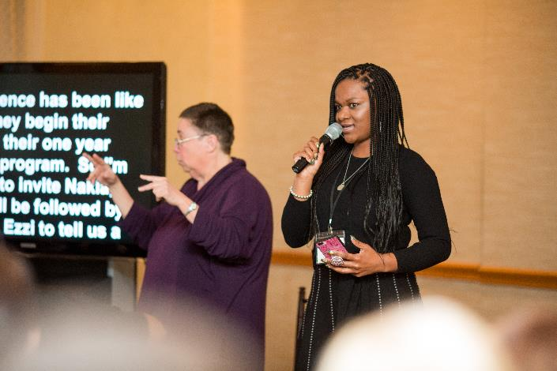
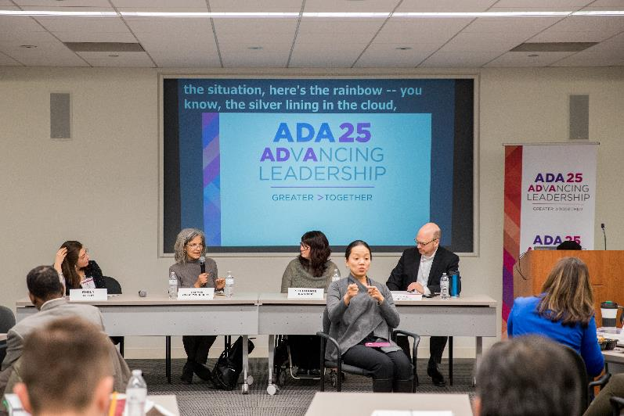
Event Experience: A/V Considerations
Notes:
ACCESSIBLE EVENT SETUP
Microphones are available in the space or have been arranged for event
Placement of CART and ASL interpreters has been planned

Slide 28
Live Audio Description
Speaker should describe what is on screen (like PowerPoints or other visual aids)
NOTE: Even if you made the PPT accessible, people will not be able to use screen readers for the PPT being shown on screen (whether virtual or in-person) – only if they are sent their own copy to use.
If video clips do not include audio description, the speaker should explain the visuals prior to showing the video
Resource on audio description: http://www.superfestfilm.com/audiodescription

Slide 29
Benefits of Live Captioning
People who are Deaf/Hard of Hearing
People who have Learning Disabilities
People whose first language is not English
Everyone – greatly eases the cognitive load of a video meeting or event

Slide 30
Communication Access Realtime Translation (CART)
Live transcriber – third-party captioning service
Provide names, proper nouns and technical vocabulary for more accurate captioning
Can be for platforms like Zoom or in-person on a separate screen or individual tablet
Note: Automatic Speech Recognition (ASR), while improving, will have more errors

Slide 31


Third-Party Captioning in Separate Browser Window

Slide 32
Benefits of ASL Interpreters
If Deaf/Hard of Hearing individuals want to fully participate, ensure ASL interpreters for active participation
For events that involve complex subject matter, technical terms, or industry-specific terminology, viewers will find that automatic captioning, and in some cases, even live-captioning solutions, struggle to maintain a reasonable minimum level of quality and legibility for the user.
Share names of speakers and materials ahead of time so interpreters can become familiar with the materials

Slide 33
Zoom: Never Spotlight an Individual During Webinars
Spotlighting a video leads to all attendees only seeing the video of the active speakers
This means that attendees are unable to view the ASL interpreter’s video
Instead, ensure gallery view
When screen sharing, ensure video gallery is set to side-by-side view so participants see the materials, individual speaking and ASL interpreter

Slide 34

Hiring a Sign Language Interpreter
Best practice to book at least two weeks prior to the event
Ensure interpreter is certified
Registry of Interpreters for the Deaf (RID) maintains a searchable directory of interpreters and their certification status: https://myaccount.rid.org/Public/Search/Member.aspx

Slide 35
Best Practices for Virtual Meetings
Each person should say their name every time they begin speaking
Any individual not speaking should be on mute and video off
Moderator manages turn-taking
For people who are nonverbal, give them an option too share thoughts if others are doing so verbally (chat box)
ASL interpreter video stays on all the time
Have 10-minute breaks every hour or so

Slide 36
After The Event:
Ensuring Accessible Videos for Websites and Social Media

Slide 37

Importance of Captions
41% of videos are incomprehensible without sound or captions.
80% of viewers react negatively to videos autoplaying with sound.
Many social media outlets autoplay videos on silent.
Important to think about this for assets on social media!

Slide 38
Subtitles vs. Captions
Subtitles only reflect what is being spoken.
Captions go a step further by also including non-spoken information including [laughter], [applause] and [music], as well as environmental sounds.
Open captions: always visible
  85% Facebook videos are watched without sound
  92% mobile users watch video with the sound off
Closed captions can be turned on/off by view on TV and social media platforms

Slide 39
YouTube
Automatic free captions similar to subtitles
Note: Speakers will not be identified, certain words will not be accurate, and there will not be any punctuation
Important: Free to edit them!
Learn more: https://support.google.com/youtube/topic/9257536?hl=en&ref_topic=9257610

Slide 40
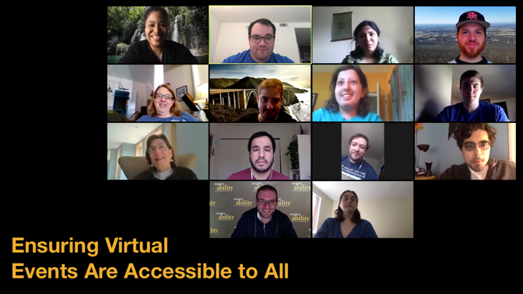
Ensuring Virtual Events Are Accessible for All Toolkit
https://www.respectability.org/accessible-virtual-events

Slide 41
Question 3
Question to Consider:
If we could make one change today in order to ensure greater accessibility for all, what would you recommend that we do vis a vis in-person events and online/virtual experiences?

Slide 42
A Note on Hybrid Events

Slide 43
Hybrid Events
If livestreaming an in-person event, think about what is in the video frame? For example, ASL interpreter
Ensure CART is working for folks both in person and watching the livestream
In-person conference followed by a virtual conference with accessible recordings

Slide 44
Remember: Don’t forget how turning virtual allowed more folks to participate as we go back to in-person events

Slide 45
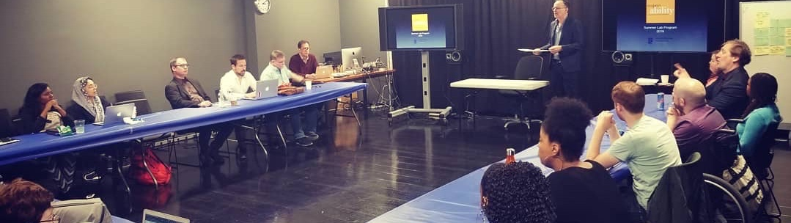

For More Information
FOR MORE INFORMATION:
Lauren Appelbaum
www.RespectAbility.org
Cell: (202) 591-0703
LaurenA@RespectAbility.org

