Slide 1
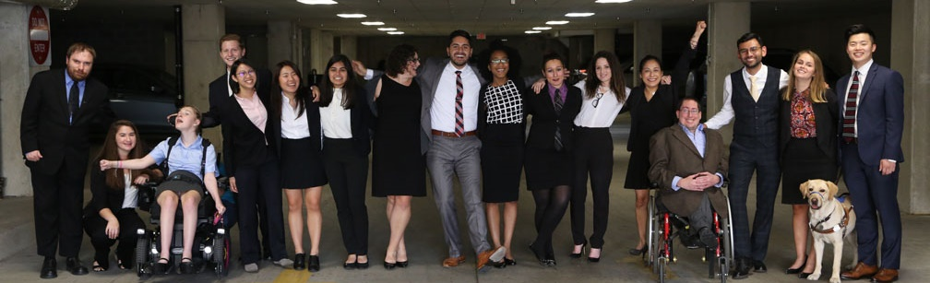

Cover
LA Workforce Comments
April 22, 2021
https://www.respectability.org/

Slide 2

Disability Statistics in California (Pre-COVID)
There are 4,131,700 Californians with disabilities.
There are 1,910,288 working-age Californians with disabilities.
Out of that number, 731,093 working-age Californians with disabilities had jobs in 2019.
California’s disability employment rate was 38.2 percent in 2019.
The employment rate for working-age Californians without disabilities was 76.4 percent in 2019.
There was a 38.1 percentage point Gap in Labor Force Participation Rates between PWDs and non-PWDs.
The poverty rate for working-age Californians with disabilities was 22.8 percent.
Gov. Gavin Newsom (D)
Source: Annual Disability Statistics Compendium: 2020 Durham, NH: Univ. of New Hampshire, Institute on Disability
https://disabilitycompendium.org/

Slide 3

Disability Statistics in Los Angeles
In total, there are 992,719 Angelenos with disabilities living in L.A. County.
There are 466,385 working-age Angelenos with disabilities living in L.A. County.
In the economic expansion prior to COVID-19, only 169,322 working-age Angelenos with disabilities had jobs.
L.A. County’s disability employment rate was only 36.3 percent in 2019.
By contrast, the employment rate for Angelenos without disabilities was 74.7 percent.
That means that there is a 38.4 percentage point gap in the labor force participation rates between Angelenos with and without disabilities.
Mayor Eric Garcetti (D)
Source: Annual Disability Statistics Compendium: 2020 Durham, NH: Univ. of New Hampshire, Institute on Disability
https://disabilitycompendium.org/

Slide 4
Recognizing Racial Disparities in California
There are 180,888 working-age African Americans with disabilities. Out of that number, only 53,874 or 29.8 percent had jobs in 2019.
Fully 28.5 percent of African Americans with disabilities live in poverty compared to 18.9 percent of African Americans without disabilities.
There are 684,515 working-age Latinx people with disabilities. Out of that number, fully 274,399 or 40.1 percent had jobs in 2019.
Fully 21 percent of Latinx people with disabilities live in poverty, compared to only 15.6 Of Latinx people without disabilities.
There are 167,672 working-age Asian Americans with disabilities. Out of that number, only 68,725 or 41 percent have jobs.
Fully 18.4 percent of Asian Americans with disabilities live in poverty compared to 9.3 percent of Asian Americans without disabilities.
SOURCE: Annual Disability Statistics Supplement: 2020. Univ. of New Hampshire, Institute on Disability.
https://disabilitycompendium.org/compendium/2020-annual-disability-statistics-supplement

Slide 5
Employment Rates for Working-Age Americans w/ & w/o Disabilities, by Race – 2019 (Pre-COVID)
SOURCE: Annual Disability Statistics Supplement: 2020. Univ. of New Hampshire, Institute on Disability.
https://disabilitycompendium.org/compendium/2020-annual-disability-statistics-supplement

Slide 6
Poverty Rates for Working-Age Americans w/ & w/o Disabilities, by Race – 2019 (Pre-COVID)
SOURCE: Annual Disability Statistics Supplement: 2020. Univ. of New Hampshire, Institute on Disability.
https://disabilitycompendium.org/compendium/2020-annual-disability-statistics-supplement

Slide 7
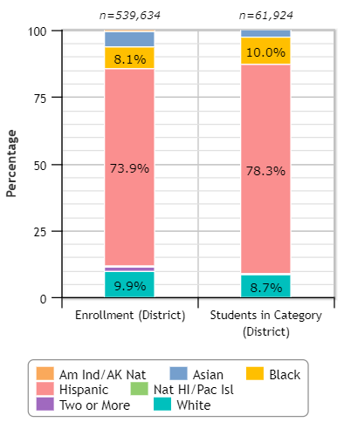
LA Unified & Students with Disabilities
78.3 percent of LAUSD’s students with disabilities are Hispanic
10 percent of LAUSD’s students with disabilities are African-American
8.7 percent of LAUSD’s students with disabilities are White
Overall, 11.5 percent of LAUSD students are students with disabilities.
Source: Civil Rights Data Collection

Slide 8
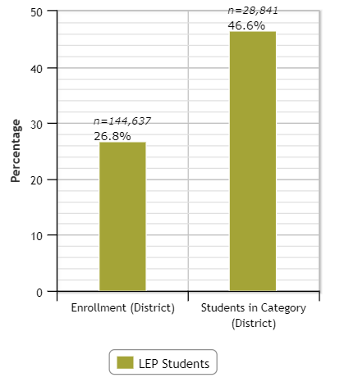
LA Unified & Students with Disabilities – LEP
Overall, 26.8 percent of LAUSD students have Limited English Proficiency (LEP)
46.6 percent of LAUSD’s students with disabilities have Limited English Proficiency (LEP)
Source: Civil Rights Data Collection: https://ocrdata.ed.gov/Page?t=d&eid=30388&syk=8&pid=2396

Slide 9
LAUSD HS Graduation Rates for Students w/ & w/o Disabilities, by Race – Class of 2018
Source: 2018-19 Four-Year Adjusted Cohort Graduation Rate Los Angeles County Report
https://dq.cde.ca.gov/dataquest/dqcensus/CohRate.aspx?agglevel=county&year=2018-19&cds=19

Slide 10
Disability by Type – SWDs in LAUSD and CA
 | Intellectual Disability | Hard of Hearing | Deaf | Speech or LanguageDisability | Visual Disability | Emotional Disturbance | Orthopedic Disability | Other health conditions | Specific Learning Disability | Deaf-Blindness | Multiple Disability | Autism | Traumatic Brain Injury (TBI)
Number of SWDs with that Disability in LAUSD | 9,655 | 2,825 | 695 | 34,621 | 843 | 4,999 | 3,020 | 24,472 | 74,623 | 25 | 1,118 | 33,834 | 289
Number of SWDs with that Disability in Calfiornia | 43,770 | 10,657 | 3,223 | 164,698 | 3,405 | 25,233 | 9,916 | 104,792 | 300,295 | 114 | 7,308 | 120,095 | 1,541
In total, there are 191,019 students with disabilities in LAUSD
There are 795,047 students with disabilities in CA’s K-12 schools.
Source: Special Education Enrollment by Ethnicity and Disability - https://bit.ly/3fCEAaD

Slide 11
Thank you!
THANK YOU!
Matan Koch, Director of RespectAbility California matank@respectability.org
Nelly Nieblas, Manager of Policy, Advocacy and Engagement nellyn@respectability.org
Philip Kahn-Pauli, Policy Director philipp@respectability.org

