Slide 1

How Disability Inclusion & Equity Can Add to Your Success
How Nonprofits Work
Erica Goldman
Tamar Davis
Michelle Friedman

Slide 2
Three Logistical Points
We have live captioning and an ASL interpreter for this webinar.
We are taking questions, so if you have something to ask our panelists, use the Q&A box on Zoom. Facebook comments are also being checked.
This webinar is being recorded and will be posted to RespectAbility’s website by early next week after captions are cleaned up.

Slide 3
Partners/Co-Promoters
Builders of Jewish Education: JKidLA, Congregation Kol Ami, Edlavitch DCJCC, Gateways: Access to Jewish Education, Hillel International, Institute on Theology and Disability, Jewish Family and Children’s Service of Greater Philadelphia, Jewish Family Service Houston, Jewish Federation of Greater MetroWest NJ – Greater MetroWest ABLE, Jewish Residential Services, JVS SoCal, JPRO Network, Keshet: For LGBTQ equality in Jewish life, Keshet, Matan, The Miracle Project, National Ramah Commission, Network of Jewish Human Service Agencies (NJHSA), Pasadena Jewish Temple & Center, SoCal Jewish News, Whole Community Inclusion at Jewish Learning Venture, The Women’s Rabbinic Network

Slide 4
Sponsored by
We want to thank our generous funders: The Jewish Community Foundation of Los Angeles and the Charles and Lynn Shusterman Family Philanthropies. Without their support, this series would not be possible.
Additionally, we want to thank The David Berg Foundation, The Beverly Foundation and The Diane & Guilford Glazer Foundation for their support of our general Jewish inclusion work.

Slide 5
Upcoming Webinars
Tuesday, June 29, 2021 – Development: Individual Prospects
Thursday, July 8, 2021 – Development: Foundations
Tuesday, July 13, 2021 – Leading at the Next Level: Working in the Jewish World
Thursday, July 15, 2021 – Effective Disability Advocacy from the Inside
Tuesday, July 20, 2021 – Accessible Events: Both In-Person and Online
Sign Up at www.respectability.org/jewish-events/

Slide 6
Why?
Including people with disabilities is something that more than 90% of Jewish organizations say they want to do.
Yet, a survey of the Jewish world shows that fewer than 15% of Jews can identify a single leader with a disability in Jewish communal life.
This series is a complement to our previous series training organizations (which is available to watch online) and is designed to introduce Jewish lay leaders with disabilities to topics and skills that will help them to lead as volunteers and professionals in nonprofit organizations.

Slide 7
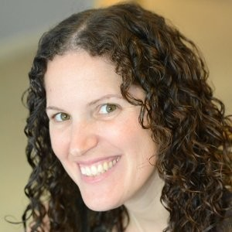
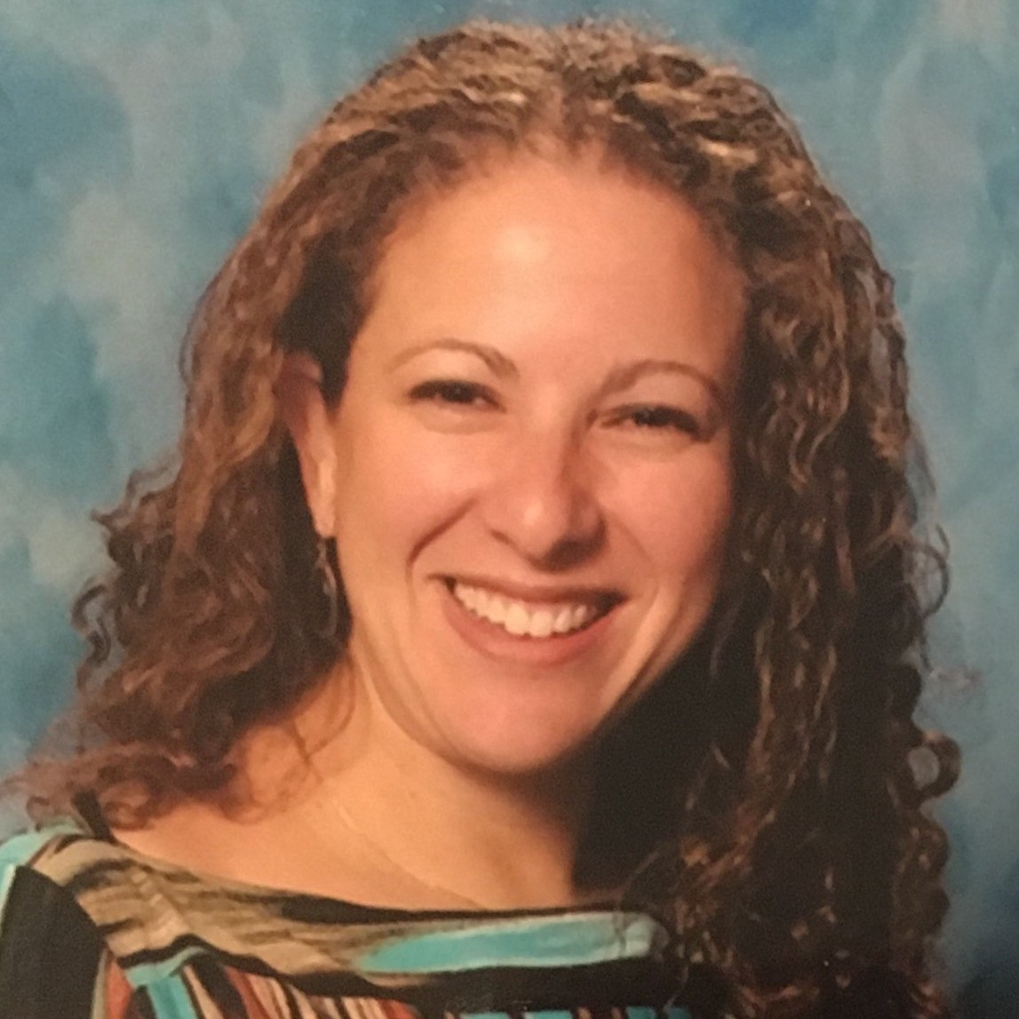
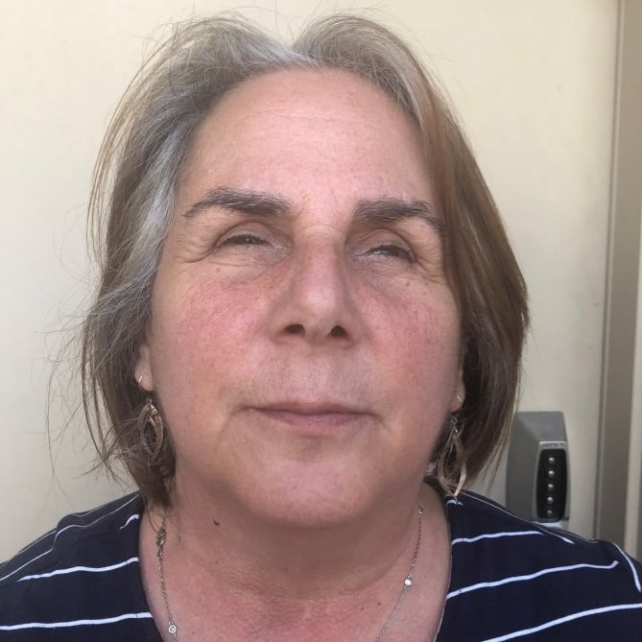
Speakers
Erica Goldman
Director of Program and Operations, JPRO Network
She/Her/Hers
Tamar Davis
CEO, Gateways: Access to Jewish Education
She/Her/Hers
Michelle Friedman
Board Chair, Keshet
She/Her/Hers

Slide 8

National Disability Speakers Bureau:
Jewish Division
For more information contact JakeS@RespectAbility.org
www.RespectAbility.org/speakers-bureau/jewish/

Slide 9
RespectAbility Jewish Inclusion Fellowship
The National Leadership Program is a virtual program, ideal for people who want to gain skills and contacts while making a positive difference for people with disabilities.
For the Jewish inclusion fellowship program in particular, we’re looking for people with an absolute passion for learning and exploring about the different inclusion resources that exist, who would also enjoy research, interaction with other organizations, and deep thought about how to make information useful.
Do you know a future Jewish professional that fits the bill? Or perhaps someone who lost their job during this pandemic and wants to be helpful during their job search? Please encourage them to learn more and apply at: https://www.respectability.org/about-us/fellowship/jewish-inclusion-fellowship/

Slide 10
Upcoming Webinars – See You Tuesday!
Tuesday, June 29, 2021 – Development: Individual Prospects
Thursday, July 8, 2021 – Development: Foundations
Tuesday, July 13, 2021 – Leading at the Next Level: Working in the Jewish World
Thursday, July 15, 2021 – Effective Disability Advocacy from the Inside
Tuesday, July 20, 2021 – Accessible Events: Both In-Person and Online
Sign Up at www.respectability.org/jewish-events/

