Slide 1
The State of Disability
Employee Engagement
Meg O’Connell, President, Global Disability Inclusion
Dr. Pete Rutigliano, Sr. Principal, Mercer
June,2021

Slide 2
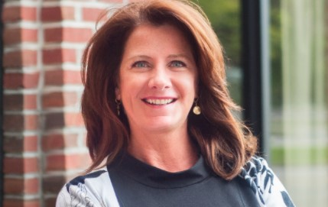
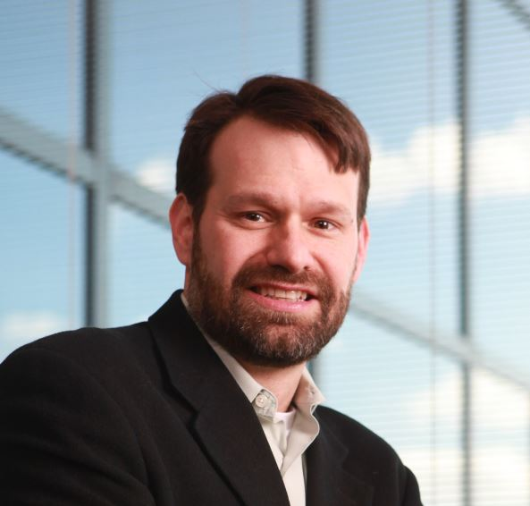
Welcome!
Meg is the CEO & Founder of Global Disability Inclusion; she is an internationally recognized disability employment and inclusion expert with over 25 years of experience in human capital management, talent acquisition, performance management, disability inclusion, employee engagement, marketing, and customer service programs. Meg and her team have worked with some of the world's most recognized brands and provides strategic program design, development, and implementation of disability employment and inclusion programs for Global 500 companies, US Federal Contractors, colleges and universities, non-profits, and foundations. Her work has received numerous accolades including the Society of Human Resource Management’s (SHRM’s) Innovative Practice Award.
Meg O’Connell
In over 25 years of external consulting, Peter has provided data analysis, interpretation, and recommendations for many organizations across a variety of industries. Peter joined Mercer in 2007; over the years since Peter has been working with client organizations to drive change through engagement surveys, onboarding surveys, exit surveys, 360 surveys, as well as other survey efforts. Peter is a trusted advisor to many Fortune 500 companies throughout North American providing insights and actionable recommendations to CEOs and other corporate executives. Additionally, Peter manages the Data Analytics Group within Mercer which, among other duties, maintains the company benchmark database. In addition to his position at Mercer, Peter is on the Corporate Advisory Board at Hofstra University. Peter is also a committee member for SIOP (Society of Industrial / Organizational Psychology). Peter maintains an active research program with over 90 publications and scholarly presentations including a consistent representation at the SIOP annual conference.
Dr. Peter Rutigliano
2

Slide 3

Diversity Equity and Inclusion are at the forefront of talent management strategies
DEI Readily Addresses:
  Race/ethnicity,
  Gender,
  Age,
  Sexual orientation
2020 brought significant challenges in the DEI space
Companies needed to re-examine efforts on race, equity, justice and opportunity
Yet, Disability is frequently left out of most DEI conversations
3

Slide 4
People with disabilities are the largest minority group – representing 15% of the global population.
More than a billion people worldwide live with some form of disability - or about 15% of the global population
In the U.S. there are 61 million people with a disability or 26% of the population
785 million (15.6%) persons 15 years and older live with a disability
95 million (5.1%) children 0–14 years live with a disability
Source:
US Census 2000 Data and Harris Report, National Organization on Disability, Open Doors Organization 2015 Market Study; World Health Survey; Global Burden of Disease
4

Slide 5
While Disability is the largest minority group, it is often left out of the broader diversity discussion
90%
Investigated gender as a diversity segment
4%
75%
Only 4% of companies investigate disability as a diversity segment
Investigated race / ethnicity as a diversity segment
Source: 2007-2015 Mercer Engagement Survey Benchmarks
5

Slide 6
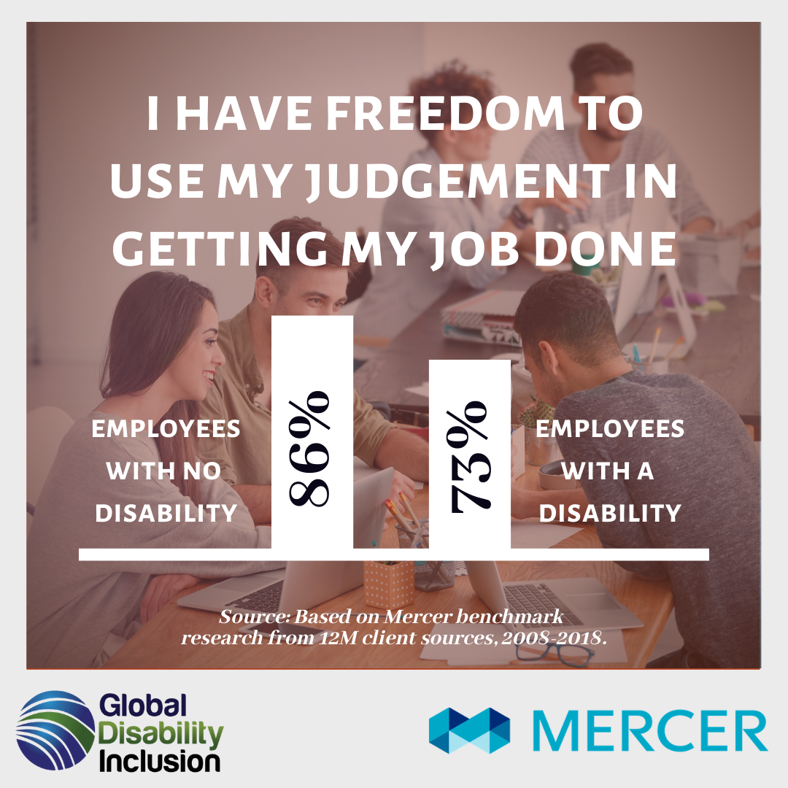
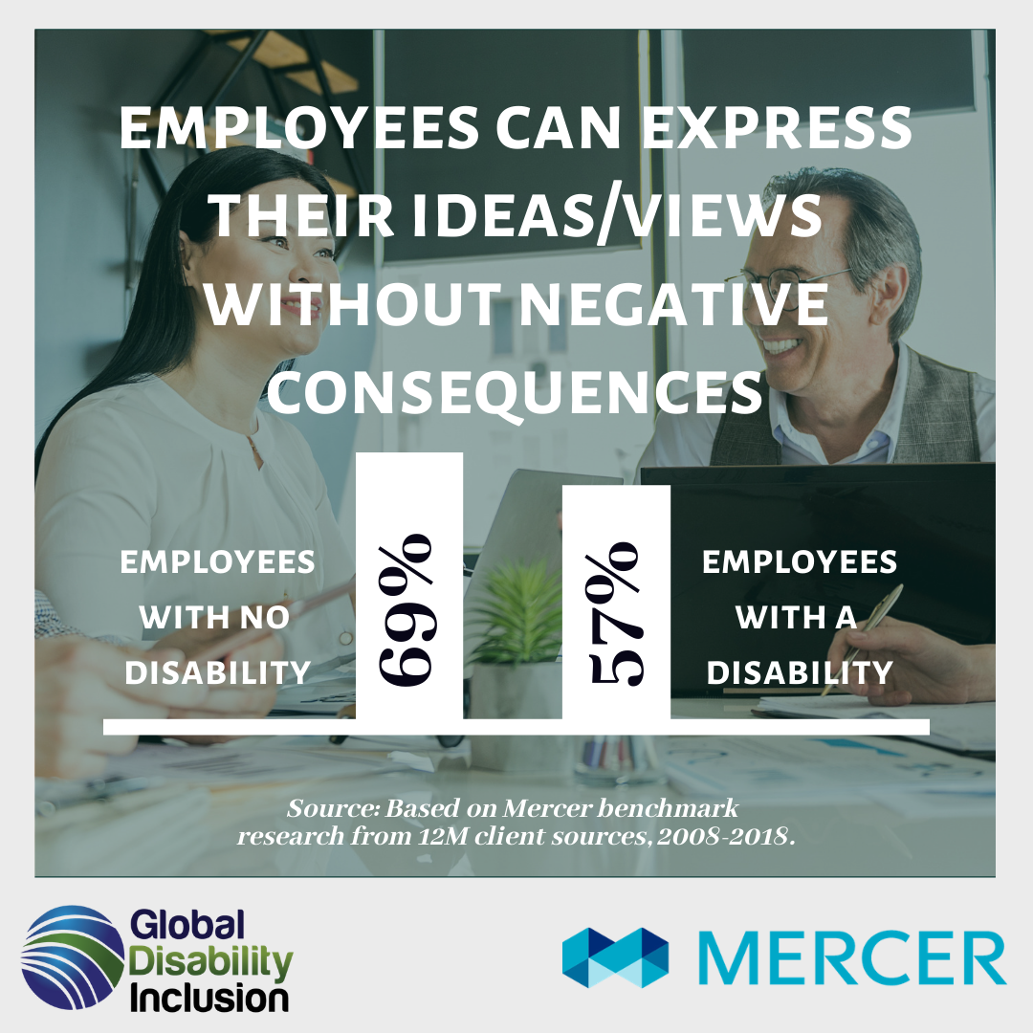
This led Mercer and Global Disability Inclusion to study 10 years of global data examining disability employee engagement
Disparities: Disabled vs. Non-Disabled
-13%
-12%
People with disabilities often feel micromanaged,
or feel a lack of trust they will make good decisions.
People with disabilities feel like there is greater risk
of consequences for sharing new ideas or opinions.
6

Slide 7
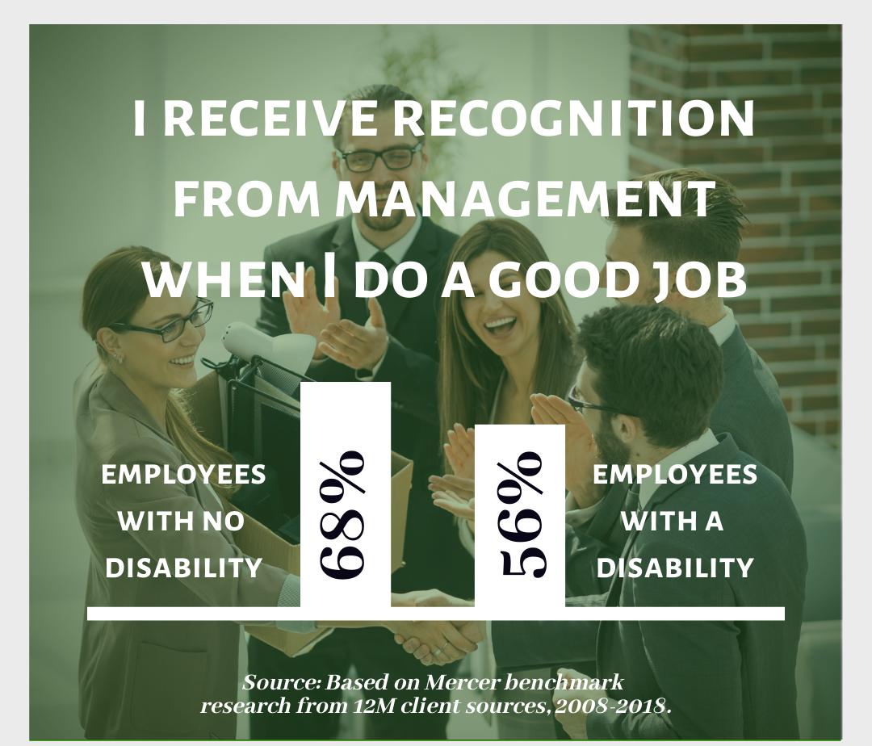
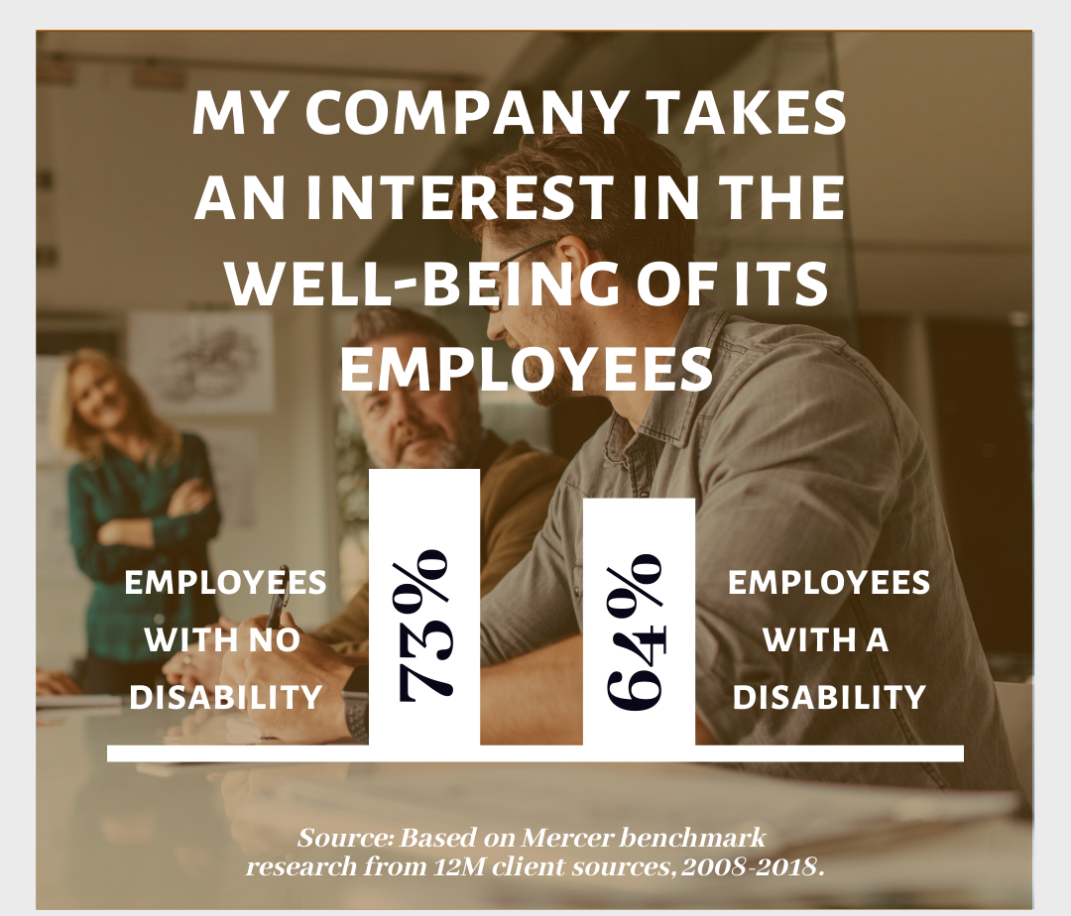
The differences between employees with disabilities and those with out disabilities is stark
Disparities: Disabled vs. Non-Disabled
-12%
-9%
A low-ranking question across the board.
But people with disabilities feel significantly
less recognized when doing a good job.
People with disabilities often feel their well- being is not
of interest to the company. This could be the “don’t ask,
don’t tell” approach until a few years ago.
7

Slide 8
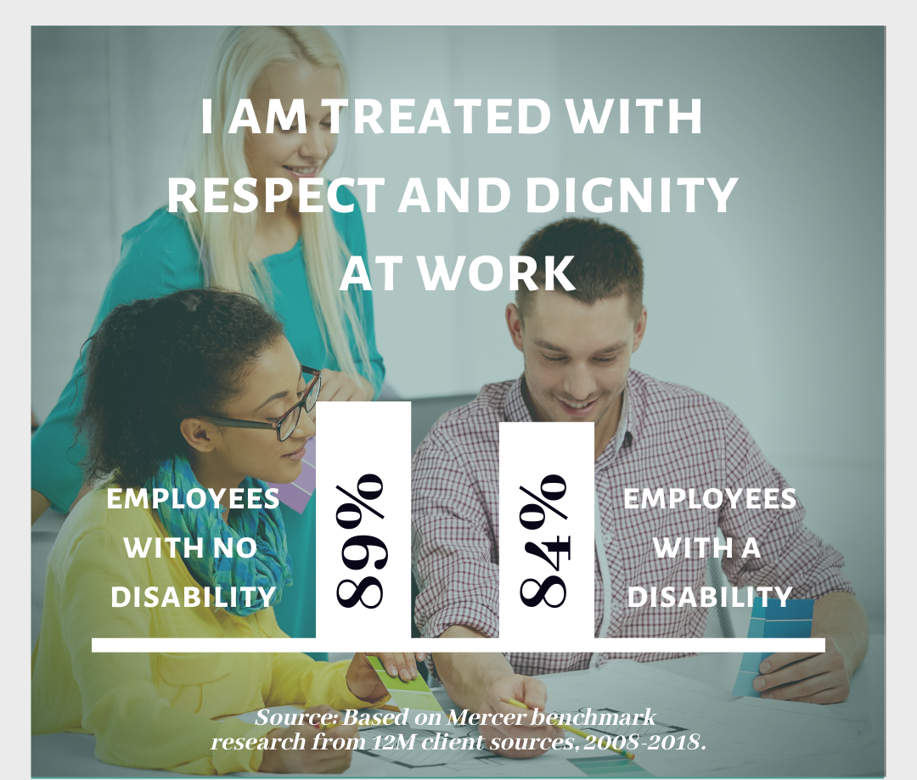
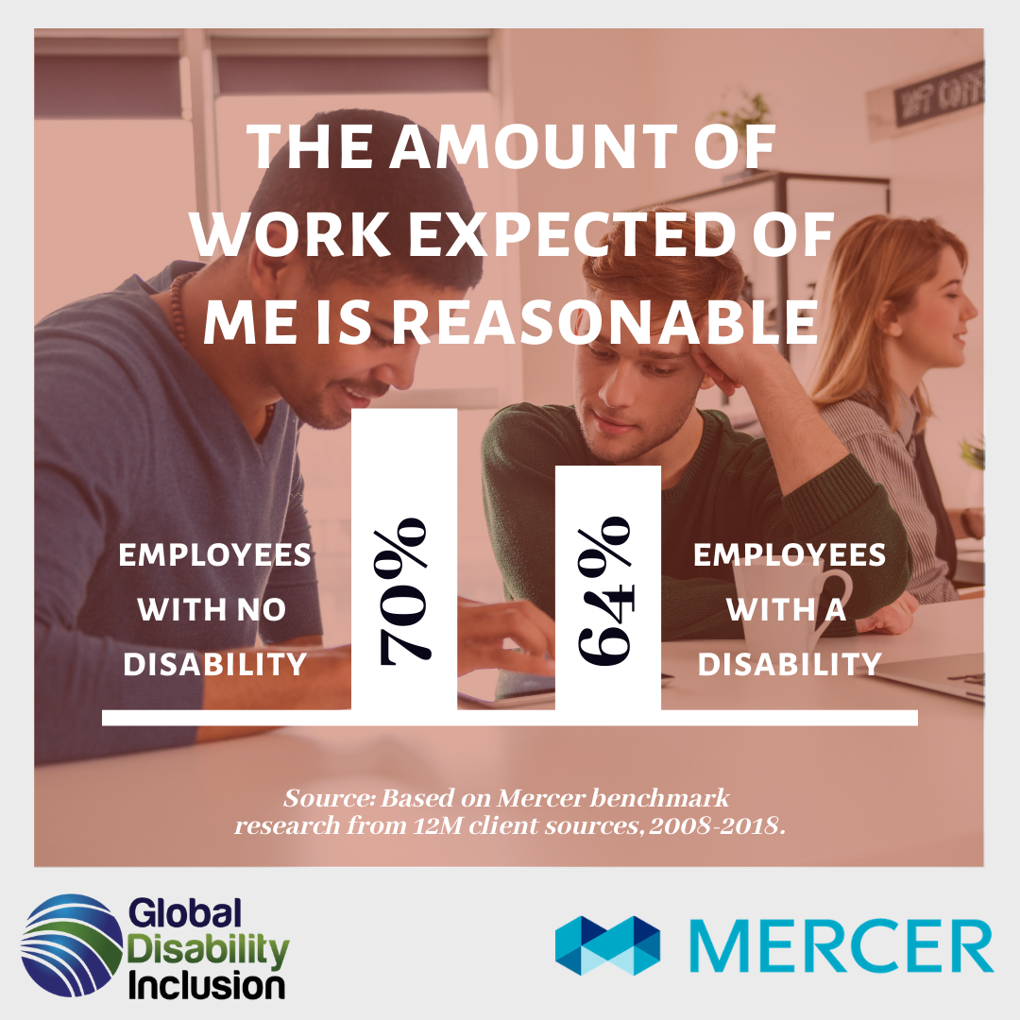
A few questions showed little differences between disabled employees and non disabled colleagues
Disparities: Disabled vs. Non-Disabled
-5%
-6%
Employees with disabilities feel they are treated
with respect with only a -5% difference. Yet, this
is still a call to action
Even though we saw employees with disabilities
Don’t feel they are allowed to make decisions about
their work, they believe their work load is reasonable.
8

Slide 9
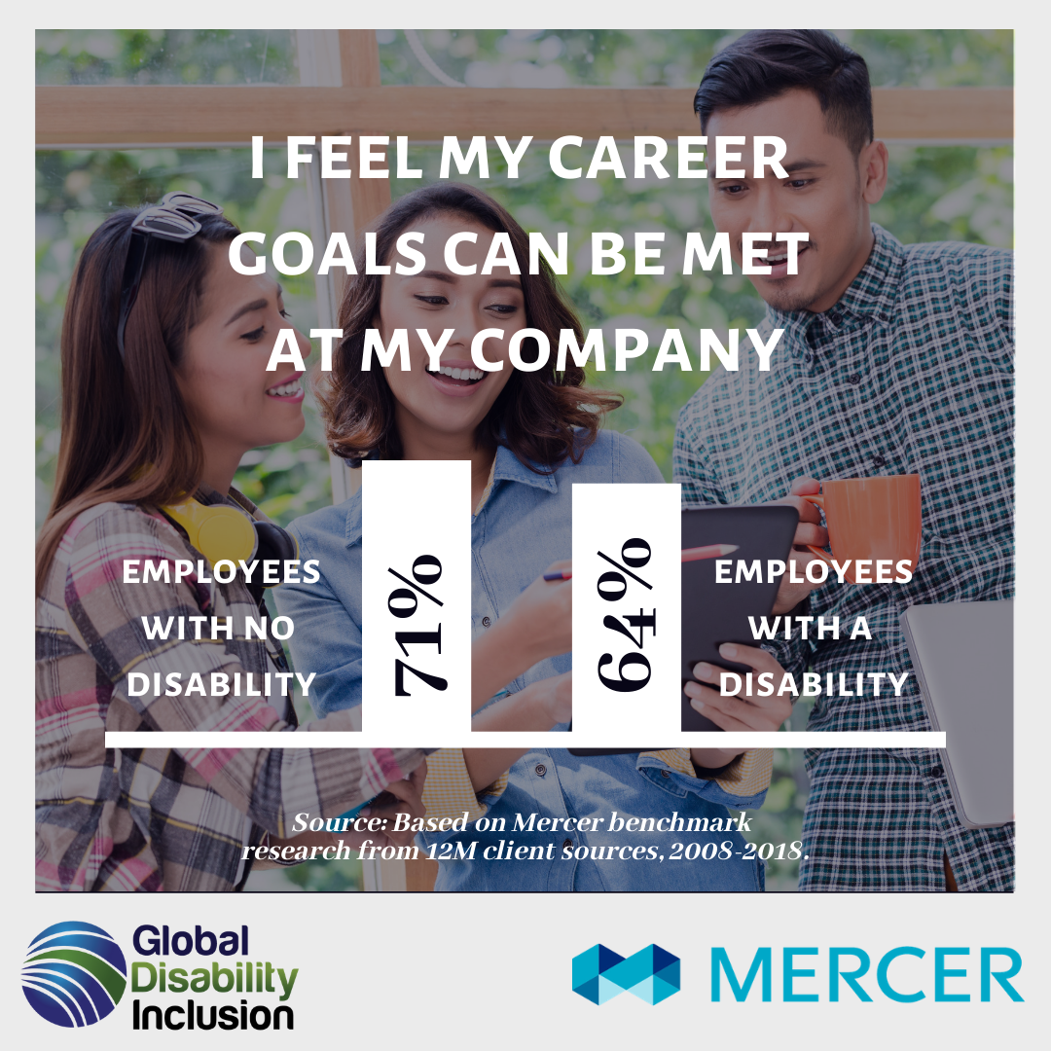
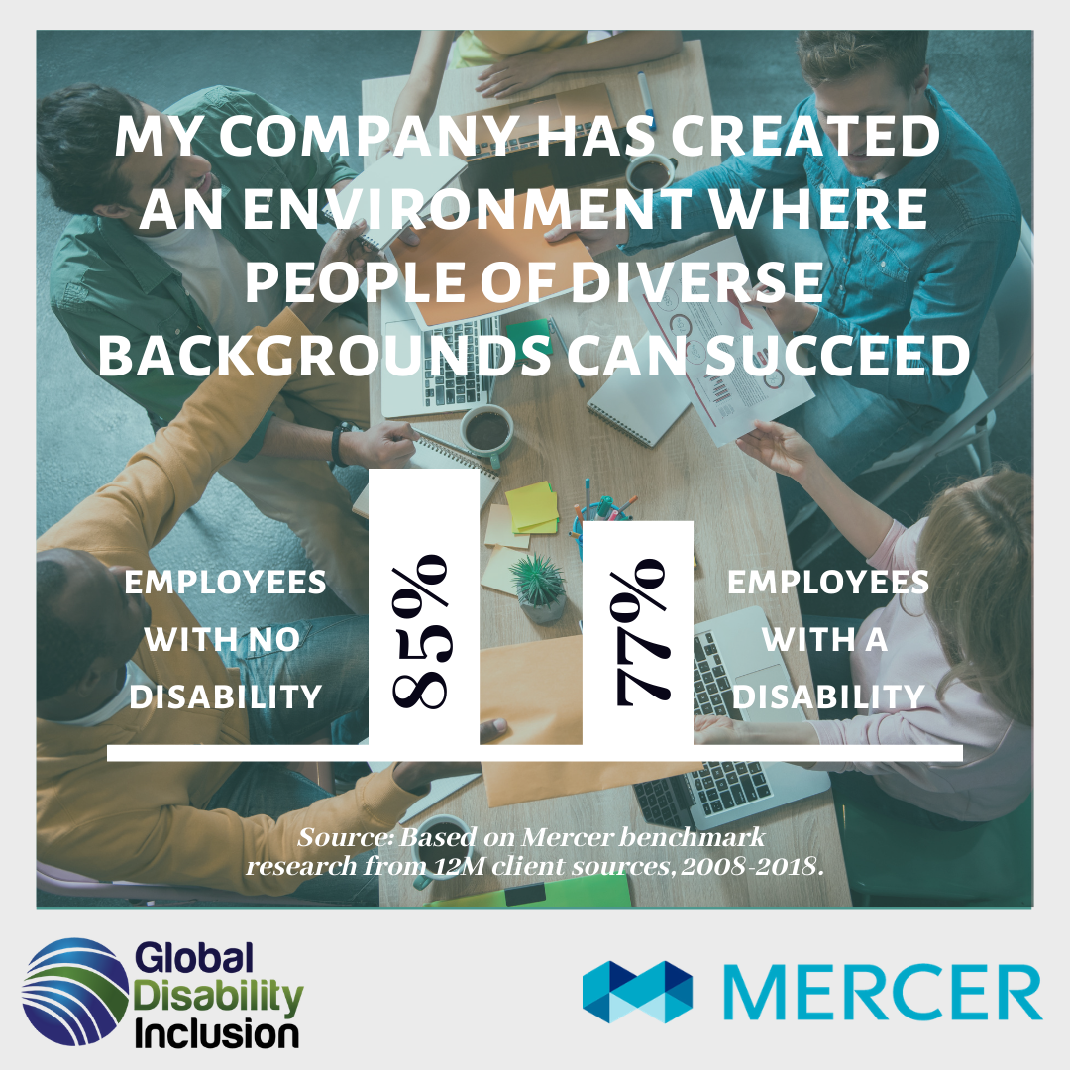
A few questions showed little differences between disabled employees and non disabled colleagues cont.
Disparities: Disabled vs. Non-Disabled
-7%
-8%
Employees with disabilities rank the ability to
achieve their career goals -7% less than their
colleagues without disabilities.
While EWD believe they are treated with respect,
they do not believe people of diverse backgrounds
can succeed.
9

Slide 10

These differences are meaningful because a call to action is only a 5% difference
Action & Opportunity
In all of Mercer’s survey data there are no real engagement differences for:
  Age
  Race
  Gender
  Sexual Orientation
Yet, disability has some of the largest differences across all engagement categories.
Companies are missing out on data from their largest diversity segment.
The opportunity to impact what is likely 15-20% of the employee population is monumental.
5%
10

Slide 11
Often perceptions exist that disabled people are less happy in general, as well as in their work experiences
Our data indicates new hires with and without disabilities are equally enthusiastic at the start of their employment experience.
There is little difference in their perceptions about inclusion, advancement opportunities and ability to contribute
Employees
However, as employee tenure increases we begin to see differences in the engagement of employees with disabilities.
This might be an indication that the climate and culture of the company do not meet the expectations; they do not feel they belong perhaps because they do not perceive an open environment for disclosure of their disability.
Culture/ Climate
11

Slide 12
The question is, can we make a difference? Absolutely.
Percent Favorable
Case Study: A company who chose to take strong position on disability actions show the progress they made in engagement in 3 short years.
12

Slide 13

What can be done? Companies must begin to investigate and understand the employee experiences of people with disabilities
Amplify Survey Dimensions:
Diversity & Equity (e.g., colleagues with disabilities are treated fairly and with respect)
Enablers/Resources (e.g., in my work group my opinion seems to count)
Climate & Culture (e.g., my company is open to disability status conversations)
Leadership (e.g., publicly senior leaders promote diversity and disability)
Achievement (e.g., I have the opportunity for advancement in my company)
Identity (e.g., I am comfortable disclosing my disability status, I am comfortable having people with disabilities disclose to me)
Disability Inclusion (e.g., accommodations, disclosure/self-id, remote work, and workplace safety etc.)
13

Slide 14

Questions, Comments, Thoughts
Questions, Comments, Thoughts

