Slide 1

How Disability Inclusion & Equity Can Add to Your Success
Development: Foundations
Dena Kaufman
David Rittberg

Slide 2
Three Logistical Points
We have live captioning and an ASL interpreter for this webinar.
We are taking questions, so if you have something to ask our speakers, use the chat box.
This webinar is being recorded and will be posted to RespectAbility’s website by early next week after captions are cleaned up.

Slide 3
Partners/Co-Promoters
Builders of Jewish Education: JKidLA, Congregation Kol Ami, Edlavitch DCJCC, Gateways: Access to Jewish Education, Hillel International, Institute on Theology and Disability, Jewish Family and Children’s Service of Greater Philadelphia, Jewish Family Service Houston, Jewish Federation of Greater MetroWest NJ – Greater MetroWest ABLE, Jewish Residential Services, JVS SoCal, JPRO Network, Keshet: For LGBTQ equality in Jewish life, Keshet, Matan, The Miracle Project, National Ramah Commission, Network of Jewish Human Service Agencies (NJHSA), Pasadena Jewish Temple & Center, SoCal Jewish News, Whole Community Inclusion at Jewish Learning Venture, The Women’s Rabbinic Network

Slide 4
Sponsored by
We want to thank our generous funders: The Jewish Community Foundation of Los Angeles and the Charles and Lynn Shusterman Family Philanthropies. Without their support, this series would not be possible.
Additionally, we want to thank The David Berg Foundation, The Beverly Foundation and The Diane & Guilford Glazer Foundation for their support of our general Jewish inclusion work.

Slide 5
Upcoming Webinars
Tuesday, July 13, 2021 – Leading at the Next Level: Working in the Jewish World
Thursday, July 15, 2021 – Effective Disability Advocacy from the Inside
Tuesday, July 20, 2021 – Accessible Events: Both In-Person and Online
Sign Up at www.respectability.org/jewish-events/

Slide 6
Why?
Including people with disabilities is something that more than 90% of Jewish organizations say they want to do.
Yet, a survey of the Jewish world shows that fewer than 15% of Jews can identify a single leader with a disability in Jewish communal life.
This series is a complement to our previous series training organizations (which is available to watch online) and is designed to introduce Jewish lay leaders with disabilities to topics and skills that will help them to lead as volunteers and professionals in nonprofit organizations.

Slide 7
Speakers
Dena Kaufman
Community Legacy Consultant
Harold Grinspoon Foundation
She/Her/Hers
David Rittberg
Senior Director, US Jewish Grantmaking
Charles and Lynn Schusterman Family Philanthropies
He/Him/His

Slide 8

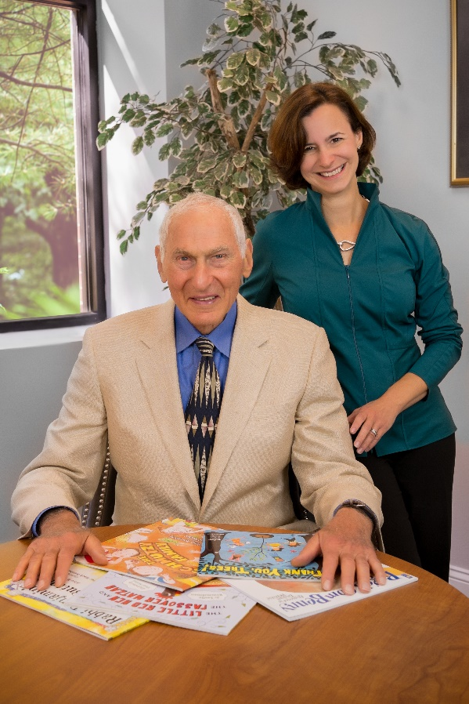


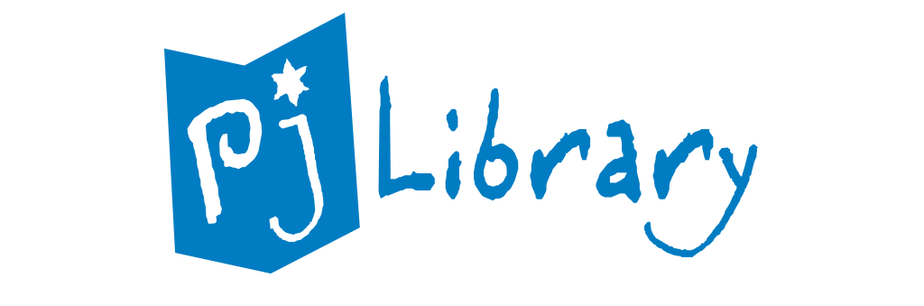
Harold Grinspoon Foundation

Slide 9

PJ Library
PJ Library sends free, award-winning books that celebrate Jewish values and culture to families with children from birth through 12 years old.
Over 28 Million books sent so far
670,000 subscribers worldwide in 7 languages
Over $78 Million spent so far

Slide 10

Voices and Visions
Voices and Visions – connecting Jewish art, thought and people
Get a free set for your organization:
https://voices-visions.org/free-set-request-form

Slide 11

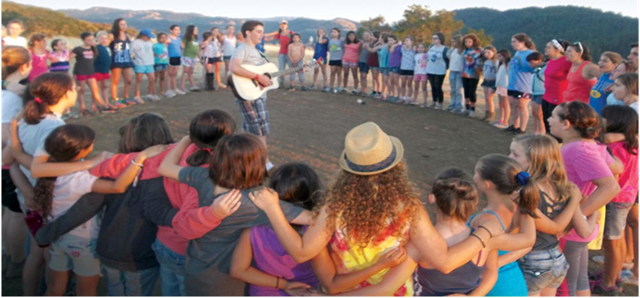
Jcamp 180
JCamp 180 develops and cultivates vibrant organizations that assure the continuity of Jewish identity, people, and culture through transformative youth experiences.
providing consulting and grants to Jewish Camps:
100 Overnight
23 Day camps

Slide 12

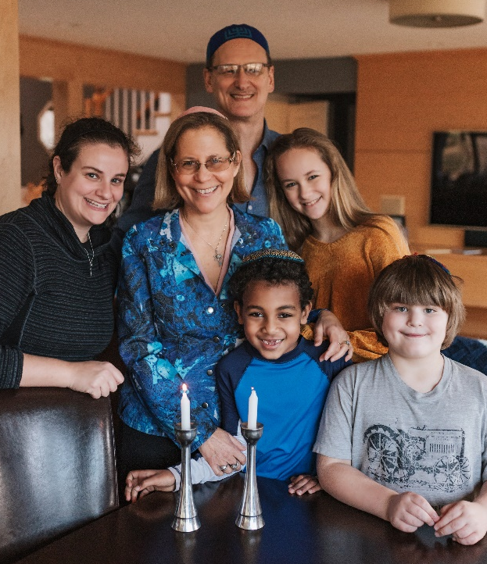
Life & Legacy
What will YOUR legacy be?
LIFE & LEGACY® working with more than 700 organizations in 72 communities to build permanent, sustainable support through permanent endowments.
Raised over $1.2 Billion
in estimated future value

Slide 13


Charles and Lynn Schusterman Family Philanthropies

Slide 14
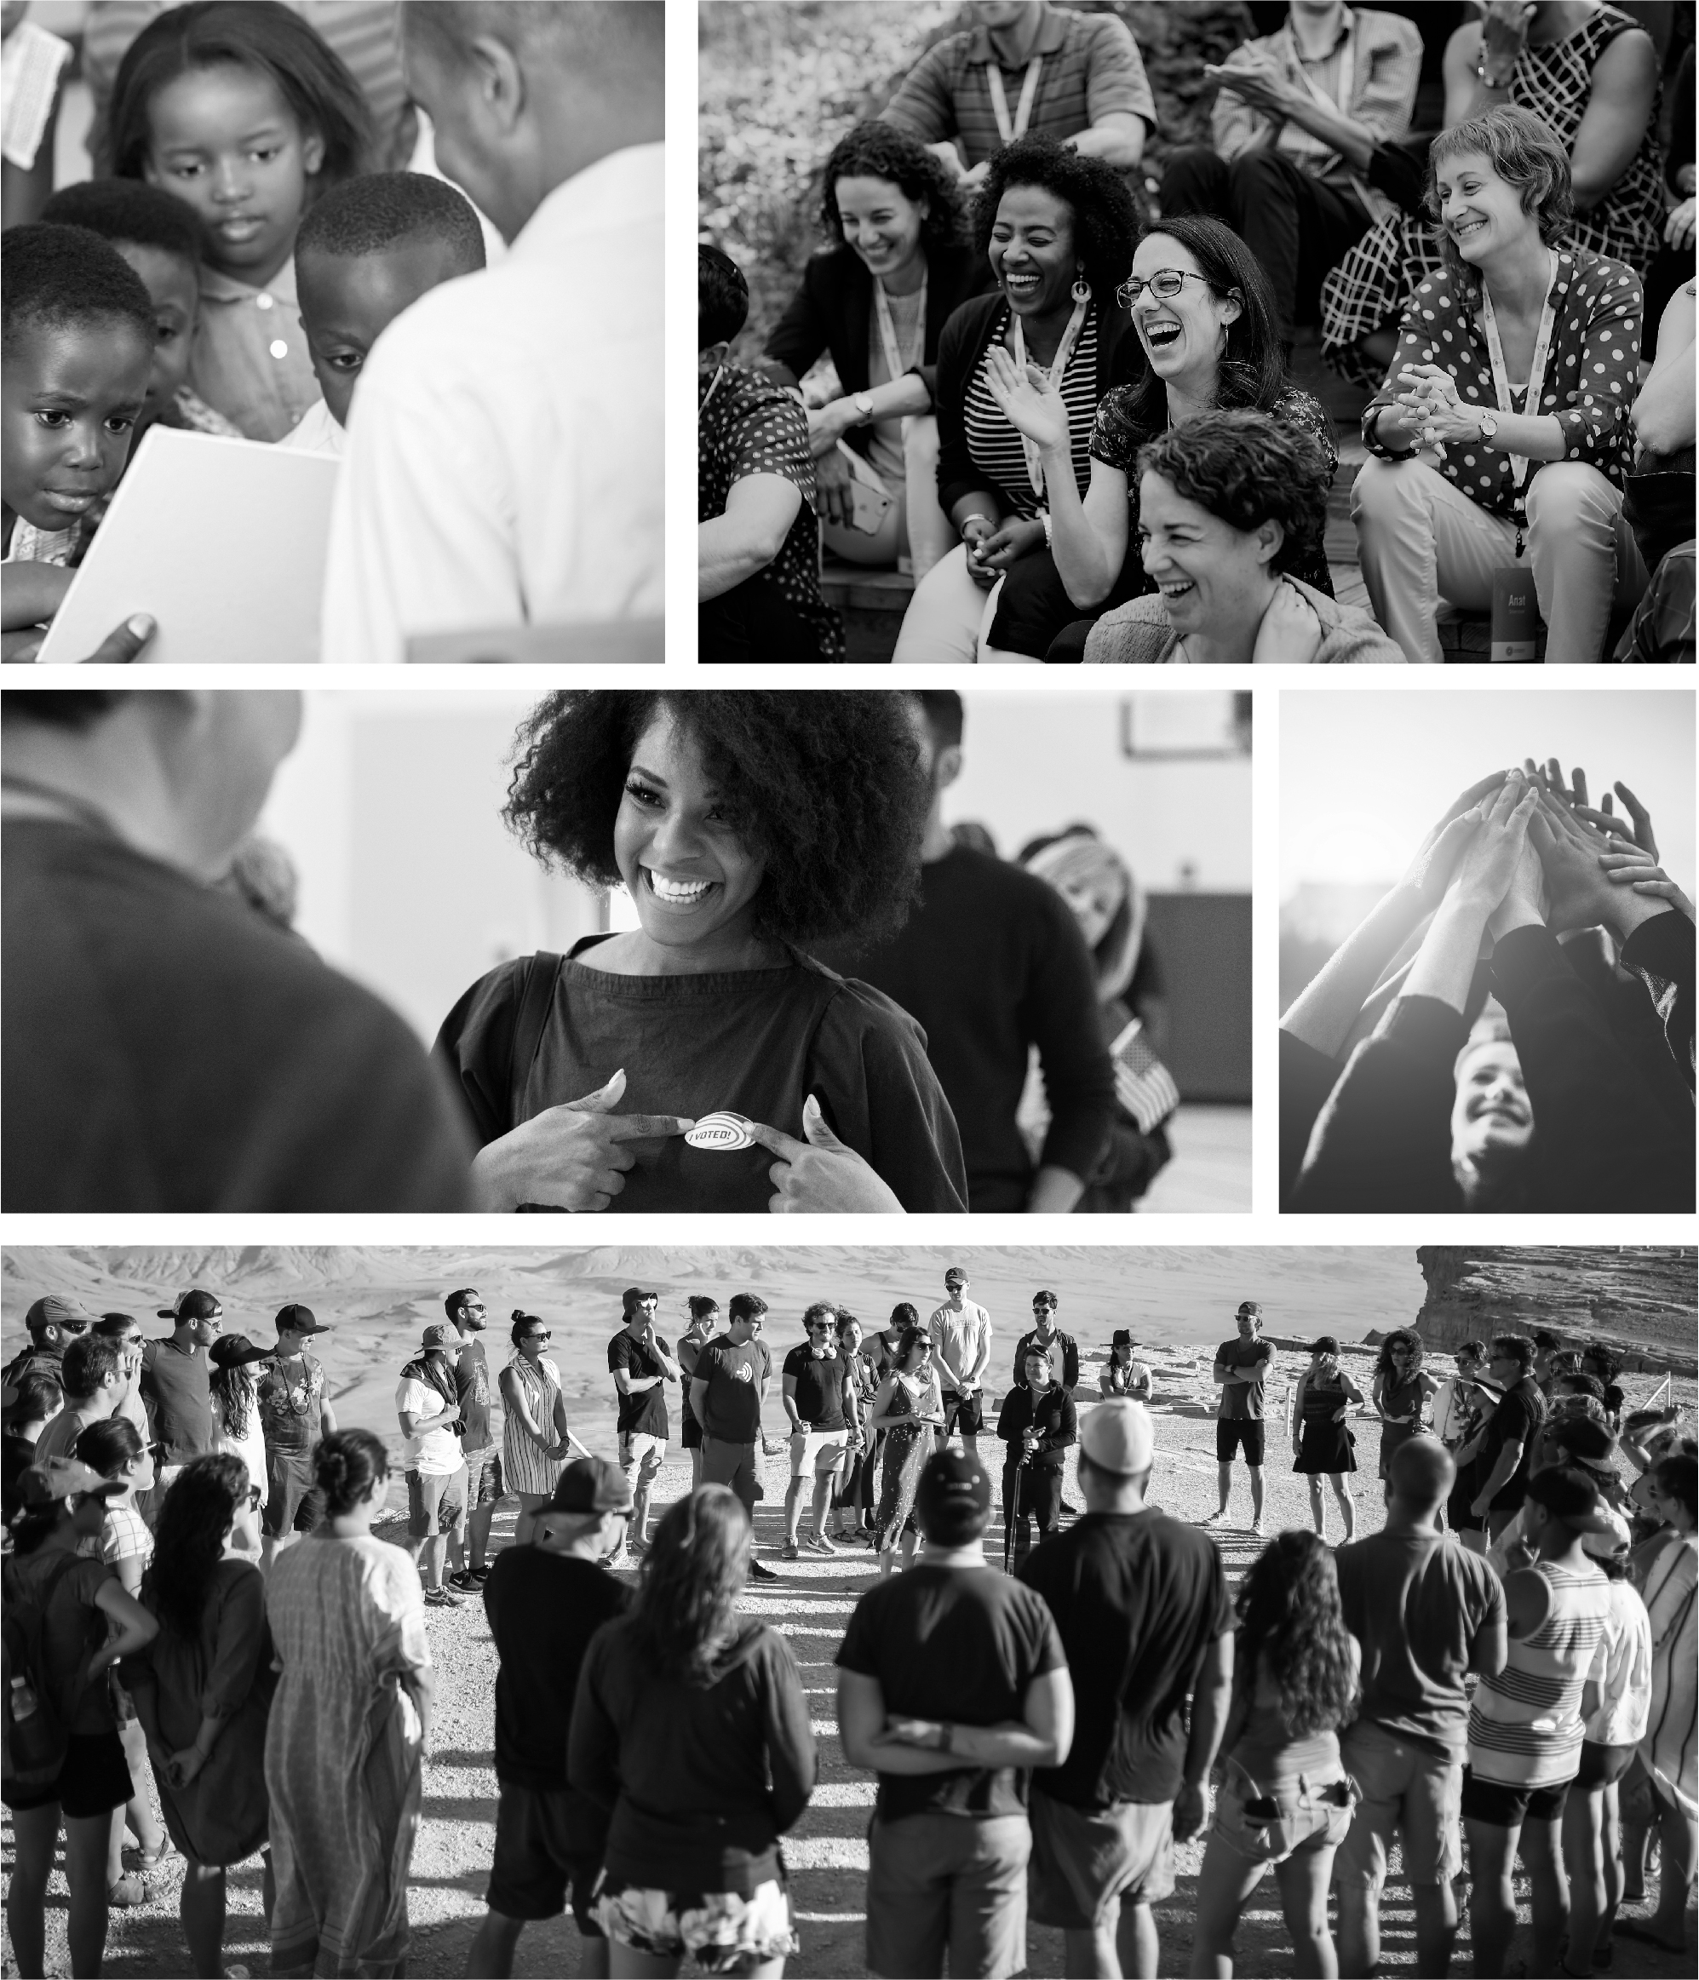
Mission
Charles and Lynn Schusterman Family Philanthropies (Schusterman) is a global organization that seeks to improve lives, strengthen communities and advance equity. Our philanthropic vision is grounded in a commitment to pursue justice, repair the world and treat all people with dignity and civility. We invest in efforts to improve public education in the United States, strengthen the Jewish people and Israel, and address the needs of marginalized individuals and communities.

Slide 15
Approach
We invest in long-term systemic change in the United States and Israel, striving for a future in which both countries live up to their highest ideals and achieve more just and inclusive societies.
We use grantmaking, program and advocacy strategies to invest in our seven portfolios: Criminal Justice, Education, Gender and Reproductive Equity, Israel, Jewish Community, Voting Rights and support for our founders’ hometown of Tulsa, OK.
We also operate three programs focused on cultivating leaders as well as their commitment to justice and connection to Israel: REALITY, ROI Community and the Schusterman Fellowship.
In 2020, the Schusterman family gave $450 million across its charitable and advocacy grantmaking, including over $150 million to COVID-19 emergency relief efforts, primarily supporting low-income individuals across the U.S. and Israel

Slide 16
Values
Our five core values inform our investments and define how we approach our work.
Equity: We seek to create a society that is more equitable, inclusive and respectful of all people.
Impact: We work toward real change by investing in organizations and leaders able to meaningfully address entrenched challenges and complex problems.
Optimism: We see possibility rather than impossibility in our work.
Humility: We recognize our grantees and partners face incredible challenges every day, and no one has all the answers.
Collaboration: We believe we can go further by working together to generate solutions

Slide 17
Values (2)
    We seek to create a society that is more equitable, inclusive and respectful of all people. We work with partners from diverse backgrounds, faiths, perspectives and orientations to challenge structural inequity and bias and to address the needs of marginalized communities in the US and Israel.
Equity
Impact
We work toward real change by investing in organizations and leaders able to meaningfully address entrenched challenges and complex problems. We recognize change takes time and base our investments in on-the-ground realities and evidence about what works.
Optimism
We see possibility rather than impossibility in our work. We invest in our relationships and honor the milestones on the road to achieving meaningful change. We bring compassion to our work and a commitment to learning from our successes and failures.
We recognize our grantees and partners face incredible challenges every day, and no one has all the answers. We strive to listen deeply, to engage with and learn from diverse perspectives and to act respectfully, from a place of purpose, not ego.
Humility
Collaboration
We believe we can go further by working together to generate solutions. We actively collaborate and build partnerships with grantees, funders and the people we serve. We constantly seek to improve and proactively share what we learn with our partners and the fields in which we work.

Slide 18
Charles and Lynn Schusterman Family Philanthropies (2)

Slide 19
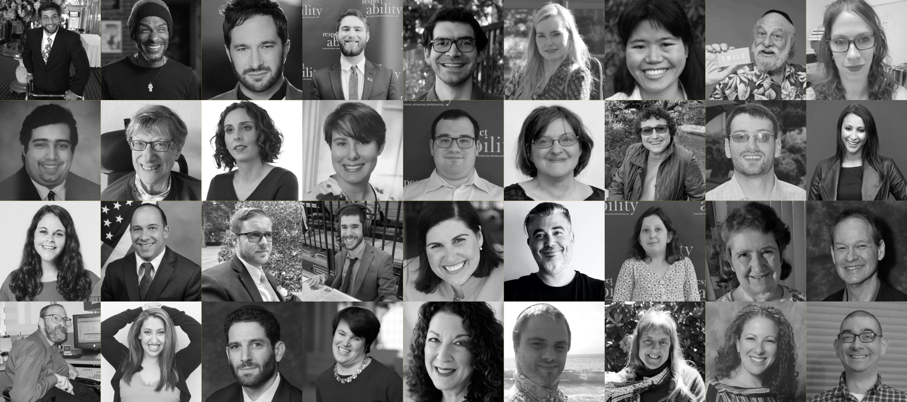
National Disability Speakers Bureau:
Jewish Division
For more information contact JakeS@RespectAbility.org
www.RespectAbility.org/speakers-bureau/jewish/

Slide 20
RespectAbility Jewish Inclusion Fellowship
The National Leadership Program is a virtual program, ideal for people who want to gain skills and contacts while making a positive difference for people with disabilities.
For the Jewish inclusion fellowship program in particular, we’re looking for people with an absolute passion for learning and exploring about the different inclusion resources that exist, who would also enjoy research, interaction with other organizations, and deep thought about how to make information useful.
Do you know a future Jewish professional that fits the bill? Or perhaps someone who lost their job during this pandemic and wants to be helpful during their job search? Please encourage them to learn more and apply at: https://www.respectability.org/about-us/fellowship/jewish-inclusion-fellowship/

Slide 21
Upcoming Webinars – See You Tuesday!
Tuesday, July 13, 2021 – Leading at the Next Level: Working in the Jewish World
Thursday, July 15, 2021 – Effective Disability Advocacy from the Inside
Tuesday, July 20, 2021 – Accessible Events: Both In-Person and Online
Sign Up at www.respectability.org/jewish-events/

