Slide 1
Disability and Voting Accessibility in the 2020 Elections Presentation for RespectAbility webinar: “The Lessons of 2020: Voting, Accessibility, and Voters with Disabilities” April 8, 2021
Dr. Lisa Schur
Dr. Douglas Kruse
Co-Directors, Program for Disability Research, Rutgers University

Slide 2
Introduction (1)
What were the voting experiences of people with disabilities in the 2020 elections?
How do these compare to the experiences of voters without disabilities?
Has there been progress in voting accessibility since 2012?
How did the COVID pandemic affect voting experiences?
To answer these and other questions, the U.S. Election Assistance Commission (EAC) asked Rutgers University to design and coordinate a national survey of voting-eligible citizens with and without disabilities following the 2020 elections.
But first, what do we know about disability and voting from prior research?

Slide 3
Background on disability and voting
Background on disability and voting
There were 38.3 million eligible voters with disabilities in the 2020 election, based on Census data
In addition, there were another 29.4 million people who did not have a disability themselves, but lived in a household with someone with a disability
In total, 67.7 million eligible voters, or 28% of the total electorate, either had a disability or lived with someone with a disability

Slide 4
Disability and voter turnout
Disability and voter turnout
There has been a stubborn disability voting gap of 6-7 points in general elections
2008 2012 2016
People without disabilities 64.5% 62.5% 62.2%
People with disabilities 57.3% 56.8% 55.9%
Disability turnout gap -7.2% -5.7% -6.3%
This gap widens when controlling for demographic factors (age, gender, race, ethnicity, education, marital status)

Slide 5
Do people with disabilities care less about elections?
No: Surveys in 2016 and 2018 showed they were more likely than people without disabilities to:
say they follow the campaign closely
say “It really matters who wins the election”, and
be “extremely interested” in the elections
(pew.org and respectability.org)

Slide 6
So why is there a disability turnout gap?
Partly explained by:
Lower resources (income and education)
Greater social isolation (more likely to live alone, less likely to be employed)
Lower belief that political system is responsive
Voting difficulties (see next slide)

Slide 7
Difficulties in voting
Difficulties in voting
U.S. GAO study: 83% of polling places in 2016 had one or more potential impediments to voting
Rutgers national household survey of 3022 citizens in 2012 found reported problems in voting at a polling place for:
30% of voters with disabilities
8% of voters without disabilities

Slide 8
Importance of voting accessibility
Importance of voting accessibility
Inaccessible polling places and voting procedures:
Make it more difficult to vote
Can have psychological effects by sending the message that people with disabilities are not welcome in the political sphere.
Analysis of the 2012 survey data finds that:
Voting difficulties predict lower perceived influence of people with disabilities in politics, and
This perception in turn predicts lower voter turnout among people with disabilities.

Slide 9
2020 Post-election Survey Description
National sample based on randomly-selected citizens eligible to vote in 2020 elections
Survey was designed to update and expand on 2012 post-election survey (also funded by EAC)
Both surveys were conducted by SSRS, a member of American Association of Public Opinion Research (AAPOR)
Disability measure was based on 6-question set used by Census Bureau, plus seventh broad question to capture other types of disability

Slide 10
Survey Description (continued)
Total sample size of all participants: 2,569
Disability Sample: 1,782
Non-disability Sample: 787
Citizens with disabilities were oversampled to get large enough sample for reliable estimates plus breakdowns by disability type and demographics
Total sample is more than twice the size of typical national phone surveys of 1000 people, so results should generalize well to disability and non-disability populations

Slide 11
Survey Report
The full report has 32 detailed statistical tables
All results use survey weights to reflect the full disability and non-disability populations.
The report notes which differences are large enough to be statistically significant (falling outside the survey’s margin of error so that we can be highly confident of a true difference in the population).
The following slides highlight some of the key results

Slide 12
Disability Characteristics in the 2020 Survey
Disability sample reflects overall U.S. disability population:
Almost half (48%) in disability sample have mobility impairments
One-fourth (24%) have cognitive impairments
One-sixth (18%) have hearing impairments
One-eighth (12%) have vision impairments
One-fourth (27%) have difficulty going outside alone
One-eighth (13%) have difficulty with self-care inside home
One-third (32%) need help in activities of daily living

Slide 13
Voter Turnout
People with disabilities voted at a 7% lower rate than people without disabilities of the same age
=> Points toward a continuing disability gap in voter turnout (found in past elections)
=> But disability turnout gap may have narrowed in 2020—will have a better sense of this when Census Bureau’s Voting and Registration Supplement dataset is released in April

Slide 14
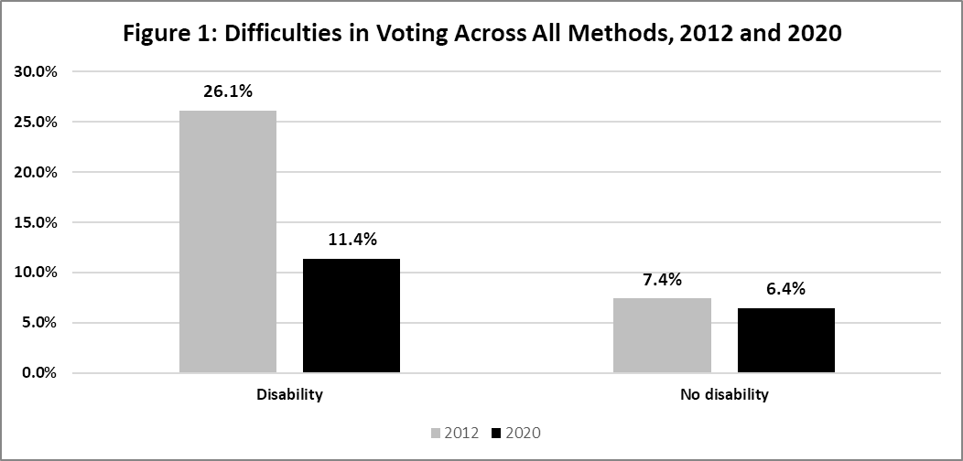
Difficulties in Voting (Report)
Difficulties in Voting
Voting difficulties among people with disabilities declined markedly from 2012 to 2020, from 26% to 11%.
About one in nine voters with disabilities reported difficulties voting in 2020. This is double the rate of people without disabilities.

Slide 15
Methods of Voting
Almost half (49%) of voters with disabilities voted at a polling place in 2020, compared to 56% of voters without disabilities
The shift to using mail ballots from 2012 to 2020 was identical for voters with and without disabilities (28 percentage point increase)
One-quarter of voters with and without disabilities (24% and 25%) voted early at a polling place
Close to three-fourths (74%) of voters with disabilities voted with a mail ballot or early in-person in 2020. This represents a significant increase from 2012 and is higher than the two-thirds (69%) of non-disabled voters who did so in 2020.

Slide 16
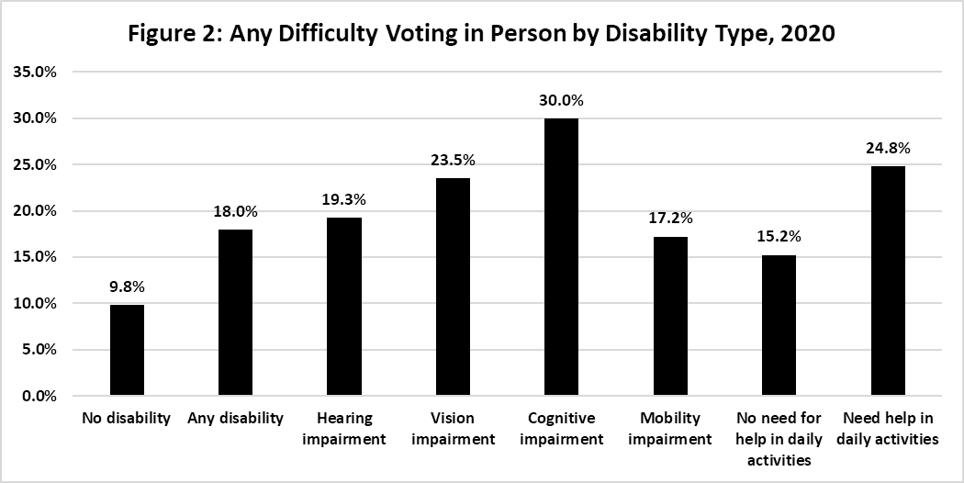
Difficulties Voting In Person (report)
Difficulties Voting in Person
Among people with disabilities who voted in person in 2020, 18% reported difficulties, compared to 10% of people without disabilities. The disability number is down from 30% in 2012.
Difficulties were most common among people with vision (30%) and cognitive (24%) impairments.

Slide 17
Are polling places more accessible in 2020?
Are polling places more accessible in 2020?
About half of the decline in difficulties voting in a polling place for people with disabilities since 2012 appears due to progress in making polling places more accessible
Biggest declines in difficulty were in:
“Difficulty reading or seeing the ballot”
“Difficulty understanding how to vote or use the voting equipment”
Also possible declines in “difficulty in finding or getting to the polling place” and “waiting in line” (but within survey’s margin of error)
The other half of the overall decline is tied to a change in composition of polling place voters, as those expecting the most difficulties switched to mail ballots

Slide 18
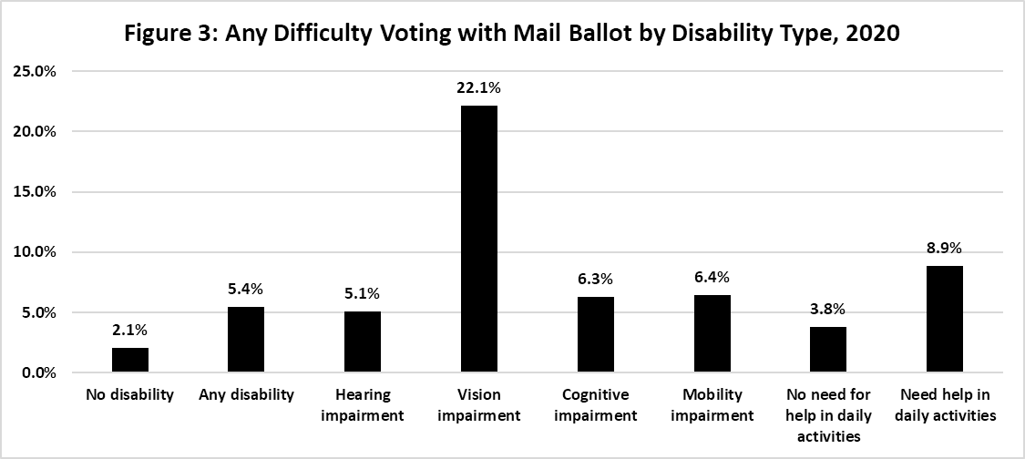
Difficulties Voting with a Mail Ballot
Among those using mail ballots, 5% of voters with disabilities had difficulty using the ballot, compared to 2% of voters without disabilities.
22% of voters with vision impairments had difficulties with a mail ballot.

Slide 19
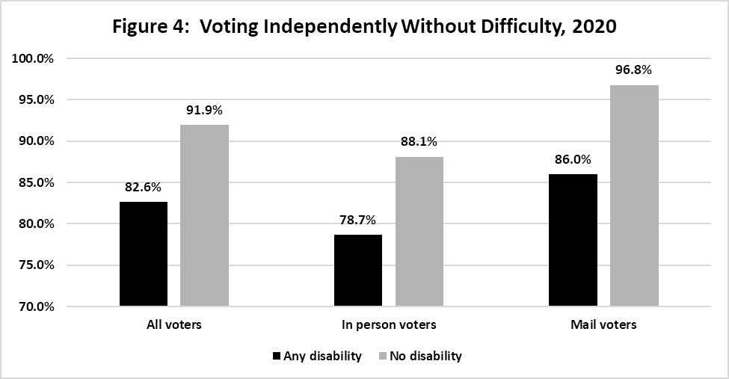
Voting Independently Without Difficulty
Among voters with disabilities, 6% of in-person voters needed assistance, and 11% of mail voters needed assistance
Five of six voters (83%) with a disability voted independently without any difficulties in 2020, compared to over nine of ten (92%) of voters without disabilities.
One in seven (14%) of voters with disabilities using a mail ballot needed assistance or encountered problems in voting, compared to only 3% of those without disabilities.

Slide 20
Perceived Treatment by Election Officials
Among in-person voters, people with disabilities were more likely to report that election officials were “very respectful” toward them (84% compared to 77% for people without disabilities)
The perceived respect from election officials, however, appeared to decline slightly from 2012 for voters both with and without disabilities (possibly due to stresses of pandemic)

Slide 21
Confidence that Vote was Accurately Counted
Two-thirds (68%) of voters with disabilities said they are highly confident their vote was accurately counted in 2020, compared to 59% of voters without disabilities
Close to one-eighth (13%) of each group said they are “not very confident” or “not at all confident” their vote was accurately counted
Results are very similar for in-person and mail voters

Slide 22
Voter Comparisons to Pre-Pandemic Experience
Voters were asked to compare the ease or difficulty of voting in 2020 to the last time they voted before the pandemic
Overall, most voters with and without disabilities (63% and 64%) said it was “about the same”
But mail voting seemed to help: among those who voted in person before the pandemic but with mail ballot in 2020, close to half of voters said it was easier in 2020 (50% of voters with disabilities and 53% of voters without disabilities).
One-fourth (23%) of voters with disabilities who voted in polling places both in 2020 and pre-pandemic said it was easier in 2020, compared to 13% of voters without disabilities (providing more evidence of increased accessibility of polling places)

Slide 23
Preference for How to Vote in Next Election
Both voters and non-voters were asked “If you wanted to vote in the next election, how would you prefer to cast your vote?”
Close to half (49%) of people with disabilities, and three-fifths (61%) of people without disabilities, would prefer voting in person inside a polling place
Next most popular was voting with a mail ballot: chosen by one-third (32%) of people with disabilities and one-fifth (19%) of people without disabilities.
Choices among remaining options did not differ significantly by disability:
About one-eighth (12-14%) chose voting fully online by personal computer or smartphone
4-5% chose filling out a ballot online and then printing and mailing it
3% chose voting by drive through or curbside.

Slide 24
Other topics covered in survey report
Relationship of disability to:
Non-voting forms of political participation
Political interest and feelings of political efficacy
Recruitment for voting
Other facilitators of voting: employment, group involvement, transportation, attending religious services, education, income

Slide 25
Conclusion
Key takeaways:
Voting accessibility for people with disabilities has improved since 2012
Despite the progress, one in nine people with disabilities encounter difficulties in voting, and they are twice as likely as those without disabilities to experience these difficulties
This points to the need for continued progress in improving accessibility, and ensuring people with disabilities can easily exercise their right to vote
We welcome any questions, and the opportunity to make these results as useful as possible for improving civic participation and access to voting.

