Slide 1
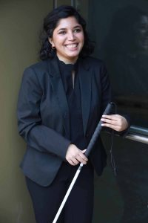
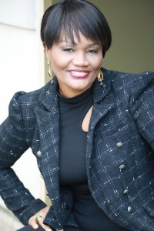
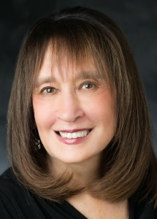
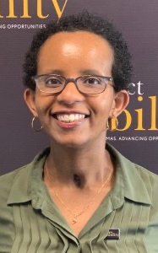
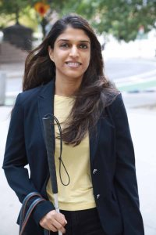


An Untold Narrative:
Immigrant Women with Disabilities
NGO Commission on the Status of Women 65th Forum
An Untold Narrative:
Immigrant Women with Disabilities
(L-R) Baksha Ali, Dr. Nelle Richardson, Laka Mitiku Negassa, MPH,
Khadija Bari and Vivian G. Bass (Moderator, center)
Director/Producer: Debbie Fink
March 22, 2021: 11:00 AM - 12:30 PM EST
Notes:
KHADIJA

Slide 2
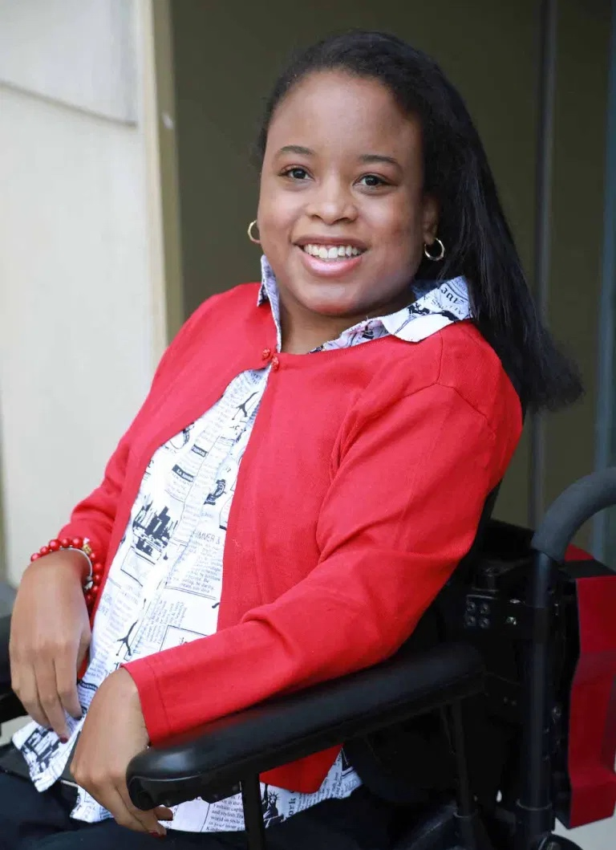
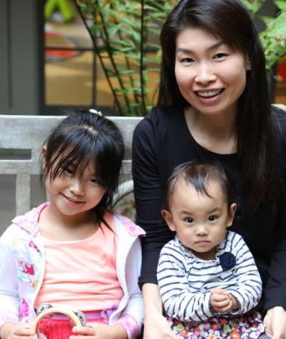
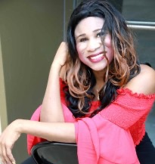
Disabilities Are….
Temporary and Permanent
Visible and Nonvisible
From Birth or Acquired Later
Notes:
KHADIJA

Slide 3
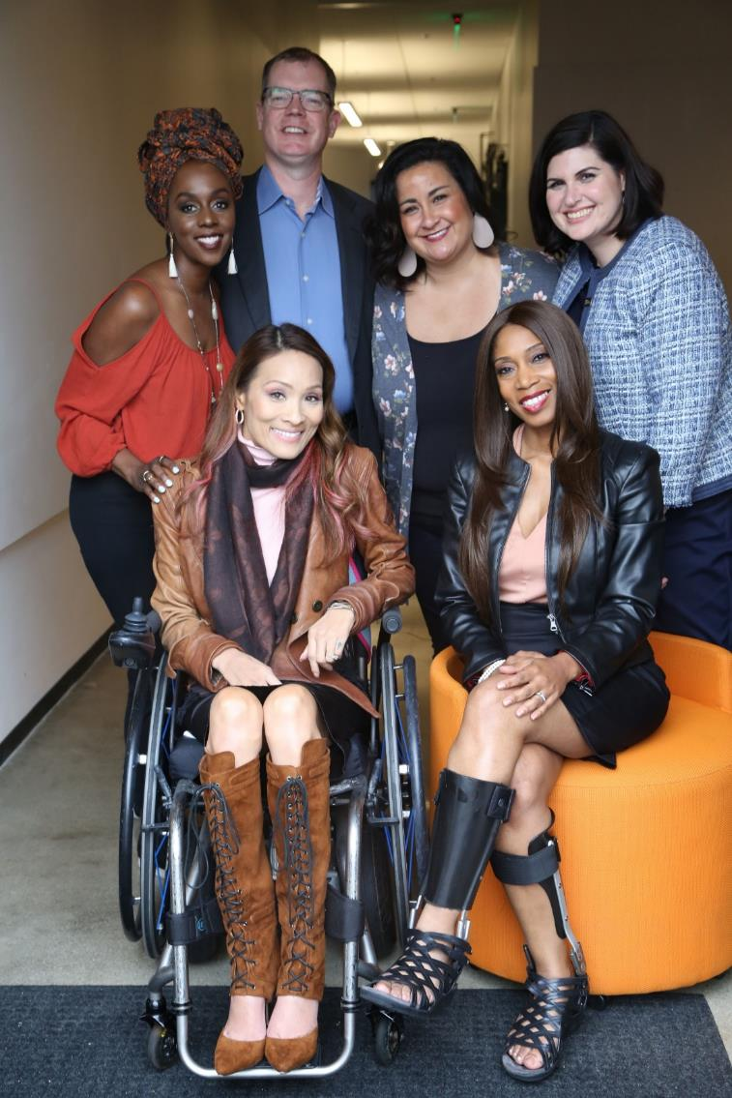

Three Facts
Anyone can join the disability community at any point due to aging, illness, accidents,
and trauma.
The disability community
is diverse.
People with disabilities from other underrepresented communities face double discrimination.
Notes:
KHADIJA

Slide 4
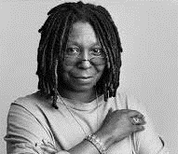
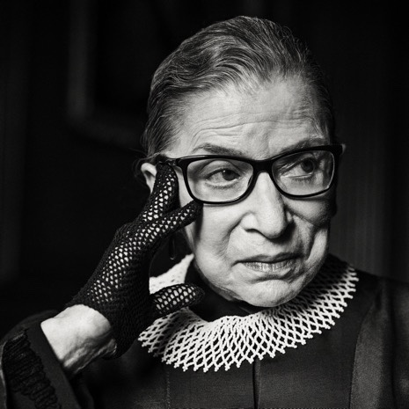
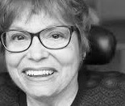
What is Disability?
According to the United States Centers for Disease Control and Prevention (CDC), disability is any condition of the body or mind that makes it more difficult for the person with the condition to do certain activities and interact with the world around them.
Photos of prominent American women with disabilities: Actor Whoopi Goldberg, Supreme Court Justice Ruth Bader Ginsburg; and Disability Activist, Judy Heumann
Notes:
KHADIJA

Slide 5

What is Disability? (continued)
According to the World Health Organization (WHO), disability has three components:
  Impairment in a person’s body structure or function or mental functioning;
  Activity limitation, such as difficulty seeing, hearing, walking, or problem solving;
  Participation restrictions in normal daily activities.
Notes:
KHADIJA

Slide 6
1 Billion People
Over 1 billion – approximately 15% –
of the global population live with a visible and/or nonvisible disability
(pre-pandemic)
Notes:
LAKA

Slide 7
Disability Around the World
The World Bank emphasizes that 20% of the world’s poorest people have some kind of disability
The WHO 2020 Report stresses the fact that people with disabilities experience:
  Poorer health outcomes;
  Have less access to education;
  Have less access to work opportunities;
  Health services are poor quality and/or under-resourced.
Notes:
LAKA

Slide 8
Women and Girls With Disabilities
Women and girls with disabilities experience exclusion and increased abuse of all types, based on gender and disability
https://www.respectability.org/speakers-bureau/women/
Notes:
DR. NELLE

Slide 9
Women and Girls with Disabilities (continued)
According to The United Nations Report, girls and women with disabilities are generally among the more vulnerable and marginalized section of society.
  Girls and women experience significant barriers to participating in social life and development;
  Women with disabilities are more likely than men with disabilities to be institutionalized; and
  Women with disabilities have barriers to accessing health services.
Notes:
DR. NELLE

Slide 10

Women with disabilities often face disproportionately high rates of gender-based violence
The United Nations Department of Economics and Social Affairs states:
Women with disabilities often face disproportionately high rates of gender-based violence, sexual abuse, neglect, maltreatment, and exploitation and discrimination.
Notes:
DR. NELLE

Slide 11

Disability Laws and Acts
According to the UN’s Department of Economic and Social Affairs:
“Disability laws and acts are instruments through which countries abolish discrimination against persons with disabilities and eliminate barriers towards the full enjoyment of their rights and their inclusion in society.”
Notes:
DR. NELLE

Slide 12
Only 121 out of 197
Out of the 197 countries or sovereign nations around the world, 121 countries have official disability rights laws
Notes:
LAKA

Slide 13

90% don’t attend school
According to UNESCO, 90% of the children with disabilities in developing countries
do not attend school.
Notes:
BAKSHA

Slide 14

Americans with Disabilities Act (ADA)
The ADA is a civil rights law that was passed by the U.S. Congress and signed off by President George H.W. Bush in 1990.
It prohibits discrimination against individuals with disabilities in all aspects of public life.
Notes:
BAKSHA

Slide 15
Americans with Disabilities Act (ADA): Title I
The ADA has five key sections:
Title I prohibits employment discrimination
Notes:
BAKSHA

Slide 16
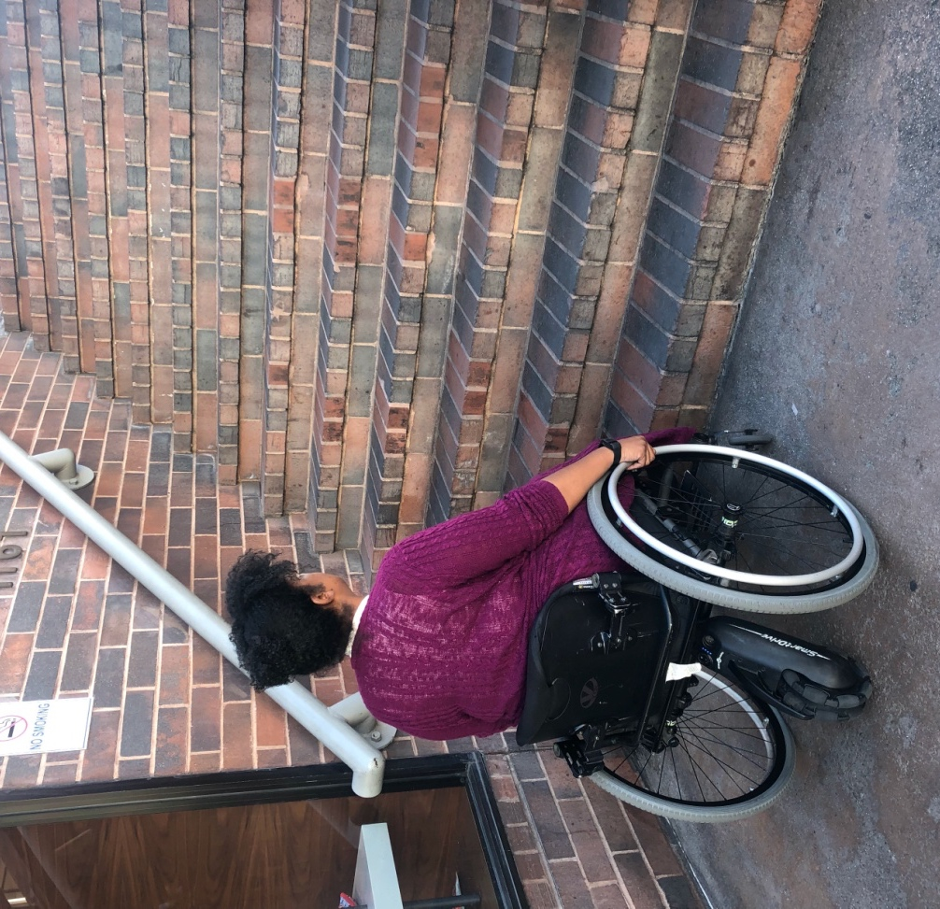
Americans with Disabilities Act (ADA): Title II
Title II addresses Public Services:
Under Title II, obligations of state and local governments, including public buildings and services, and transportation are addressed.
Notes:
BAKSHA

Slide 17

Americans with Disabilities Act (ADA): Title III
Title III concerns Public Accommodations:
That is, businesses and other organizations in the private sector providing goods and services to the general public, including web accessibility.
Watch Webinar
Notes:
BAKSHA

Slide 18
Americans with Disabilities Act (ADA): Title IV
Title IV addresses Telecommunications:
Telecommunications companies offering telephone service to the general public must have telephone relay service to individuals who use telecommunication devices for the deaf (TTYs) or similar devices.
Watch Webinar
Notes:
LAKA

Slide 19

Americans with Disabilities Act (ADA): Title V
Title V sets forth Miscellaneous provisions:
This includes a provision prohibiting either:
(a) coercing or threatening or
(b) retaliating against individuals with disabilities or those attempting to aid people with disabilities in asserting their rights under the ADA.
Watch Webinar
Notes:
LAKA

Slide 20

Thank You!
STORIES OF EMPOWERMENT
Baksha Ali
Khadija Bari
Laka Mitiku Negassa, MPH
Dr. Nelle Richardson
and Vivian Bass (moderator)
Debbie Fink, Director,
Community Outreach and Impact
Event Director/Producer
Maya Cohen-Shields, Intern/Event Manager
Community Outreach and Impact
Jake Stimell, Fellow,
Community Outreach and Impact
Notes:
KHADIJA

Slide 21
References
https://www.who.int/health-topics/disability#tab=tab_1
https://www.worldbank.org/en/topic/disability
https://www.who.int/en/news-room/fact-sheets/detail/disability-and-health
https://askjan.org/articles/The-Americans-with-Disabilities-Act-A-Brief-Overview.cfm
https://adata.org/learn-about-ada
https://dredf.org/news/publications/disability-rights-law-and-policy/the-ada-and-models-of-equality/
https://www.forbes.com/sites/andrewpulrang/2020/07/27/its-time-to-revisit-our-ada-to-do-lists/?sh=77bd88903f87
https://www.un.org/development/desa/disabilities/disability-laws-and-acts-by-country-area.html
https://www.un.org/development/desa/disabilities/resources/factsheet-on-persons-with-disabilities.html
https://www.un.org/development/desa/disabilities/resources/factsheet-on-persons-with-disabilities.html
https://www.jhsph.edu/covid-19/articles/an-unequal-response-covid-19-and-disability.html
https://www.un.org/development/desa/disabilities/issues/women-and-girls-with-disabilities.html

