Slide 1



Accessibility for All
Vivian Bass with Ollie Cantos, his triplet sons, Jennifer Mizrahi and Cal Harris.
Children around the world treated by Save A Child’s Heart.

Slide 2

1 Billion People
Over 1 billion – approximately 15% –
of the global population live with a visible and/or nonvisible disability
(pre-pandemic)

Slide 3
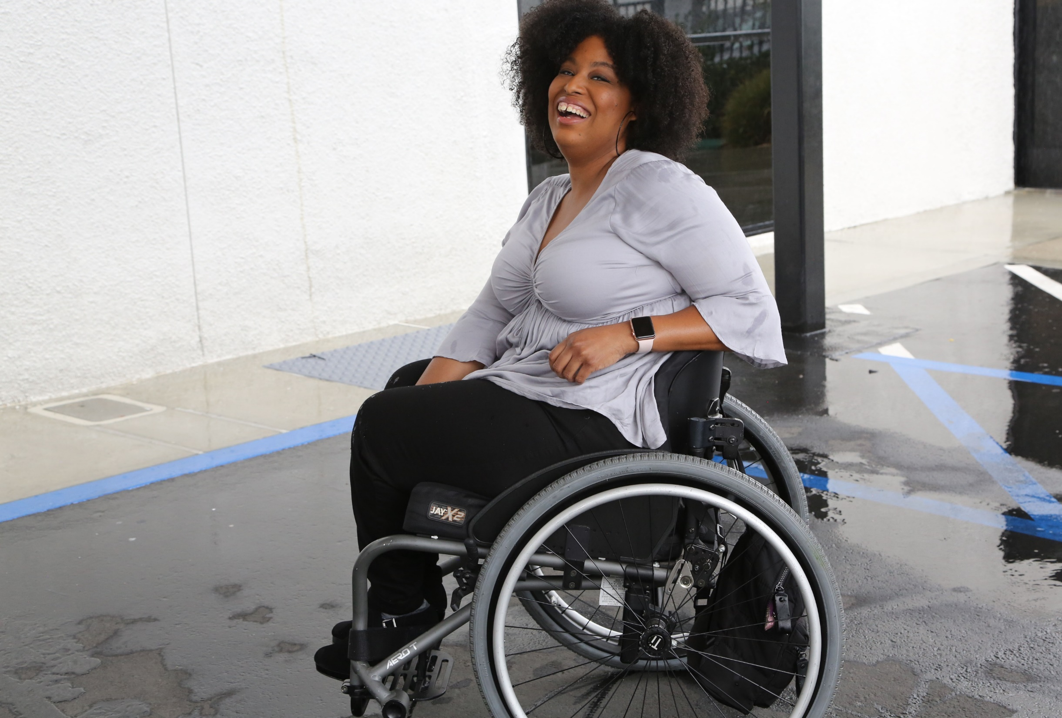

1 in 4 adults
1-in-5
people of all ages has a
disability
in the U.S.
(pre-pandemic)

Slide 4
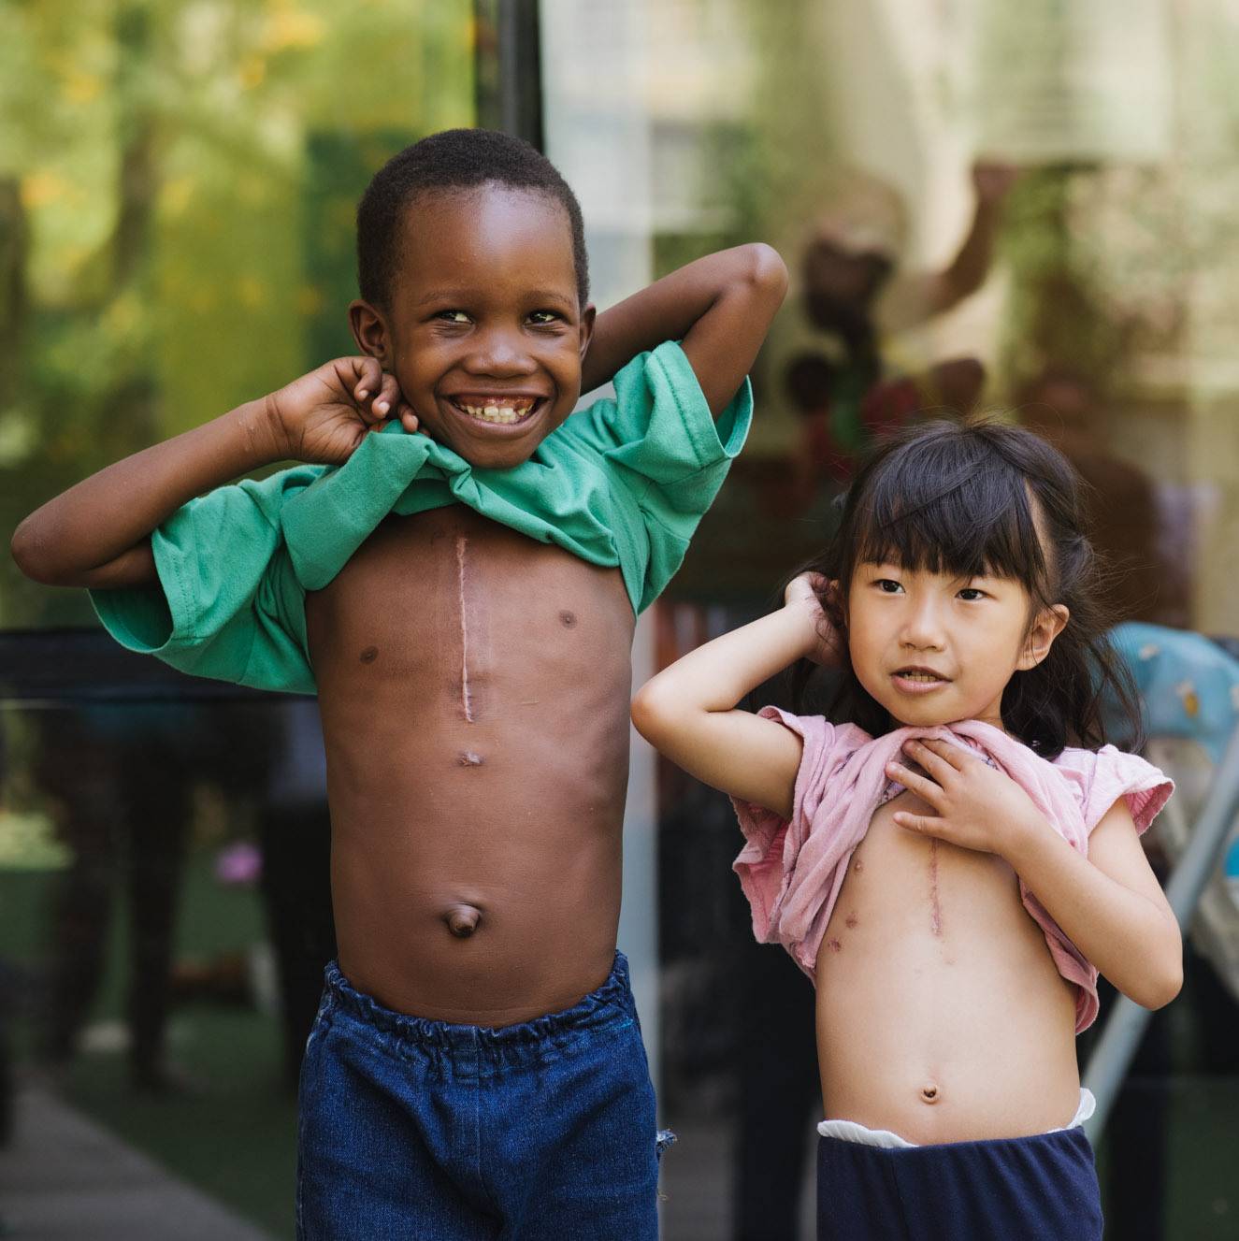
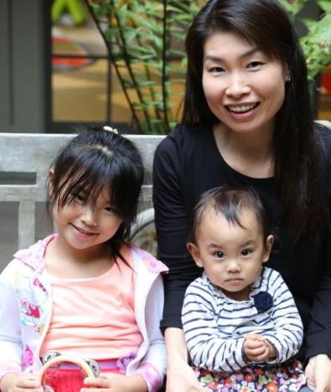
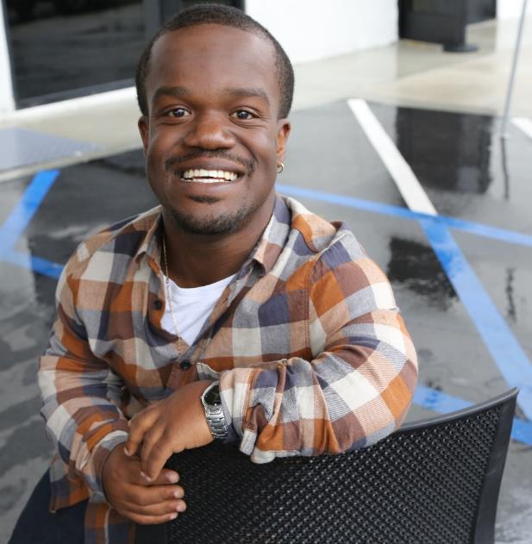
Disabilities Are….
Temporary and Permanent
Visible and Nonvisible
From Birth or Acquired Later

Slide 5


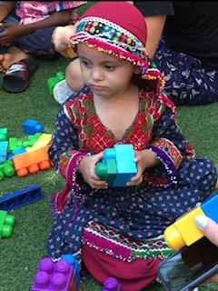
90% don’t attend school
According to UNESCO, 90% of the children with disabilities in developing countries
do not attend school.

Slide 6
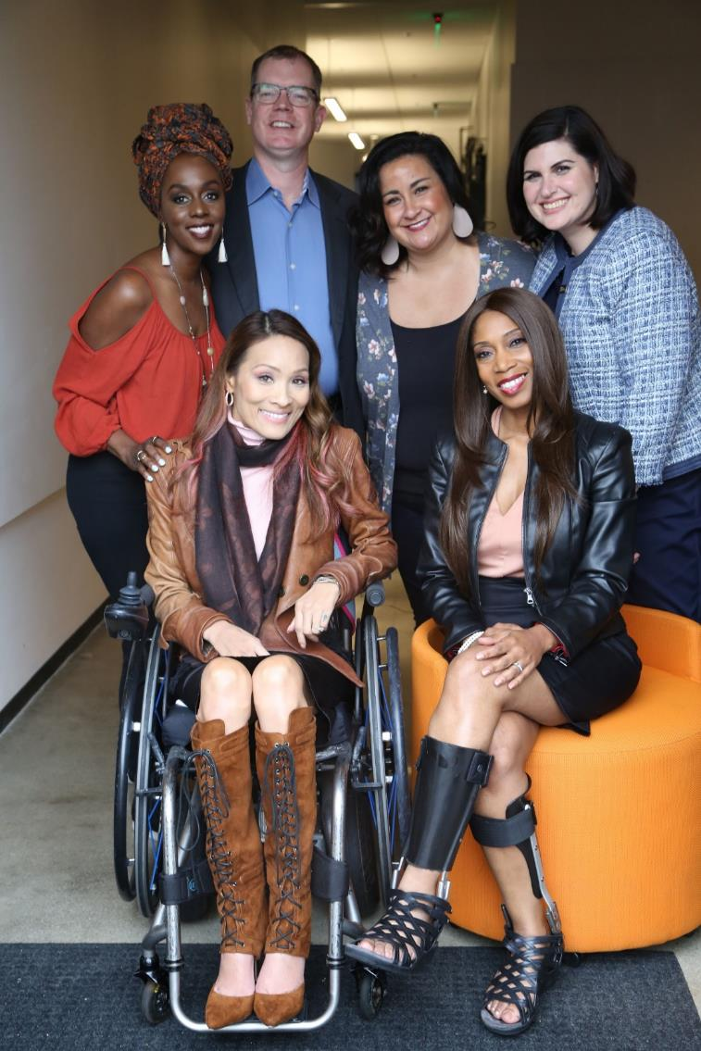
Three Facts
Anyone can join the disability community at any point.
The disability community
is diverse.
People with disabilities from other underrepresented communities face double discrimination.

Slide 7
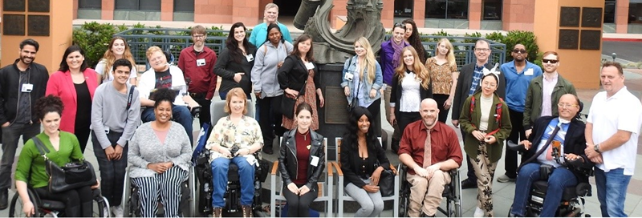
People with disabilities want opportunities
People with disabilities
want
opportunities
Just like anyone else.

Slide 8

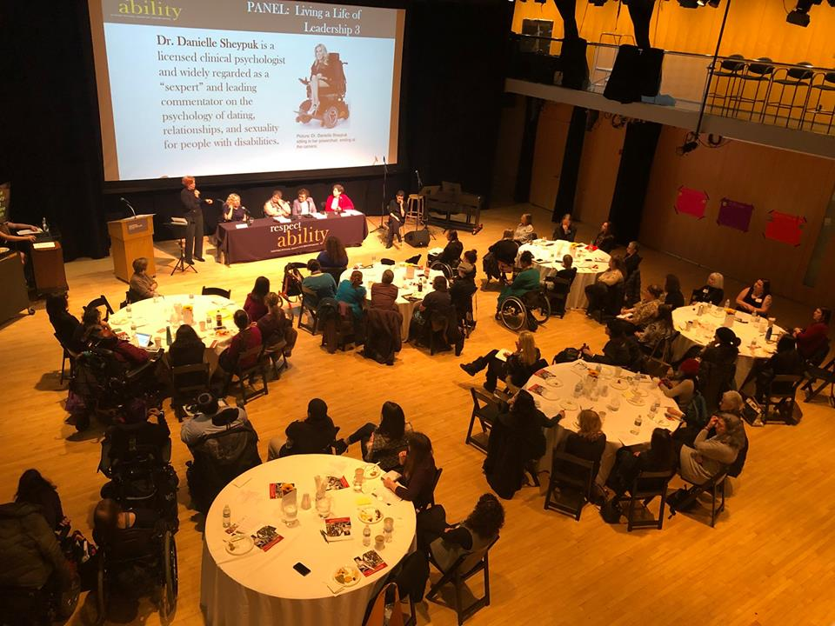
Ensuring Accessible Events: In–Person
This time will come once again . . .
At your first planning meeting, make sure to:
Ensure that your event will be held in accessible locations (more in next slide).
Make it easy and comfortable for people to request accommodations beforehand; include this phrase in every registration form:
“Do you need any accommodations to fully participate in this event?”*
Offer and provide accommodations when requested (i.e. sign language interpreters; large print handouts; live captioning; allergy-friendly food)
Assign/provide email/phone number of employee who is responsible to handle accommodations.

Slide 9
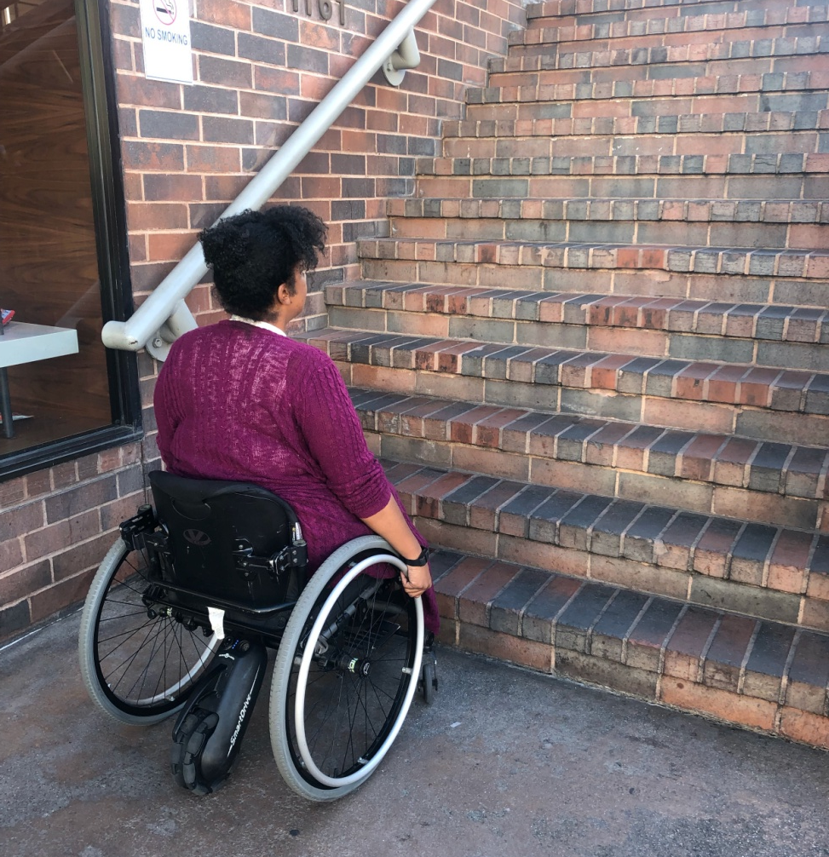
Physical Accessibility of Venue(s)
When choosing a venue, make sure that:
There is a ramp at the main entrance;
Rooms to be used do not require one or more stairs to access (unless there is an elevator);
Door entrances have a clear width for wheel-chairs that is stated in guidelines;
Elevators have different requirements;
Measuring tapes will tell you!
Bathrooms are accessible: at least one stall door must have this same clearance.
  (In the U.S.: See Americans with Disabilities Act guidelines at ADA.gov for specific requirements.)
Webinar on Ensuring Accessible Events

Slide 10

Work with people with disabilities
When planning an event, make sure to:
Include people with disabilities in the planning, and on panels and programs.
Use vendors who are or who hire people with disabilities.
Include people with visible disabilities in your marketing material.
Put captions on all videos and ensure screen reader accessibility on all documents, social media and website.
Webinar on Welcoming Lexicon, Websites and Social Media

Slide 11
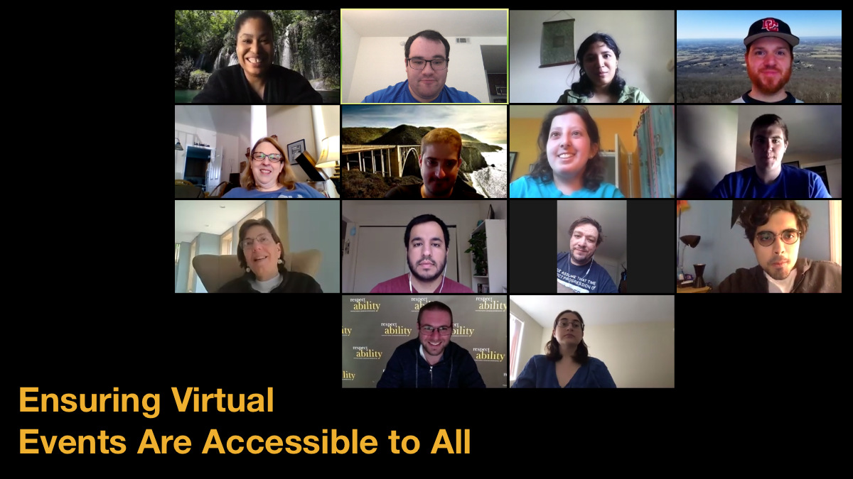
Ensuring Accessible Events: Virtual
At your first planning meeting, make sure to:
Make it easy and comfortable for people to request accommodations beforehand; include this phrase in every registration form:
“Do you need any accommodations to fully participate in this event?”*
Offer and provide accommodations when requested (i.e. sign language interpreters; accessible PPTs or other materials) – Add captions to videos; add captioning via Zoom (free!) or hire a professional
Assign/provide email/phone number of employee who is responsible to handle accommodations.
Ensure that people with disabilities are on virtual panels and programs.
Webinar on Accessible Virtual Events

Slide 12
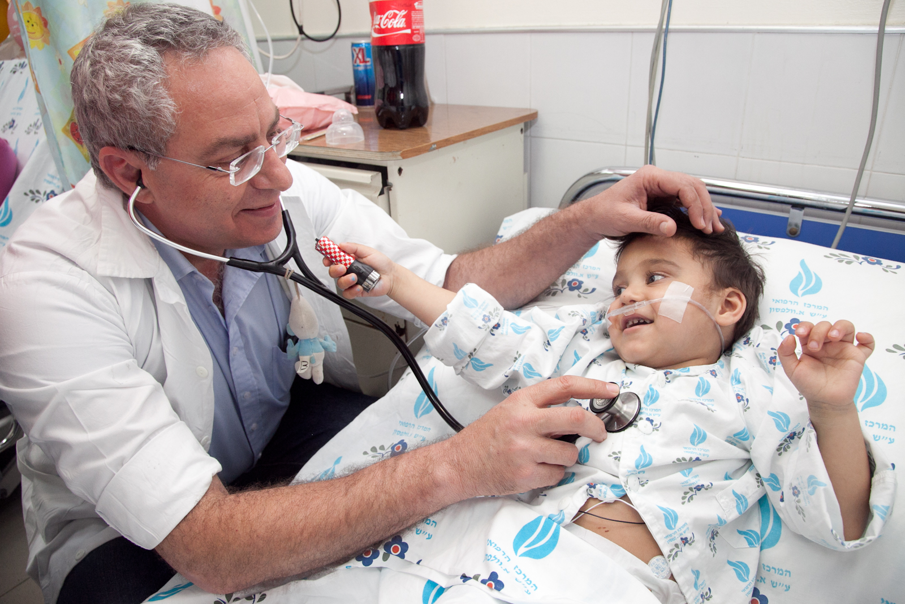
10 Tips In Disability Etiquette
One-on-One Interactions
Webinar on Disability Etiquette

Slide 13
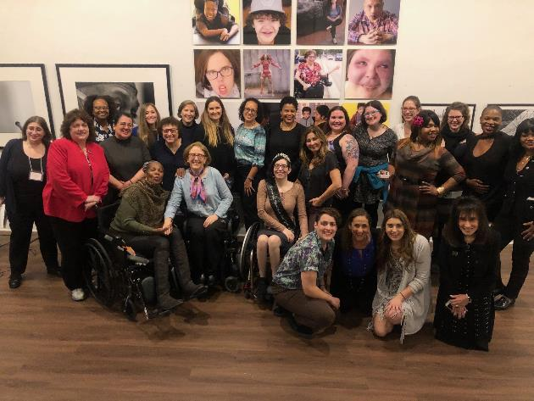
Tip #1 in Disability Etiquette:
People with disabilities are PEOPLE. The Golden Rule.
Follow The Golden Rule: Treat others the way you wish to be treated.
Acknowledge their differences as you would acknowledge anyone’s. Treat them the same.
Do not talk down to them literally or figuratively.

Slide 14

Tip #2 in Disability Etiquette: Language Matters!
Some people prefer person-first language – “person with a disability" – and others prefer identity-first language – “disabled person.” Ask the person what language they prefer and respect their preference.
Avoid outdated terms like “handicapped,” “crippled” or the “R” word.

Slide 15
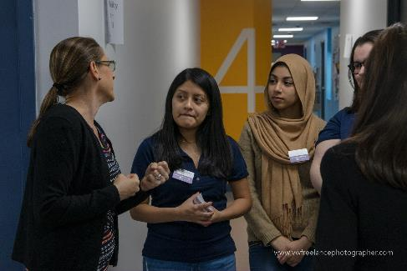
Tip #3 in Disability Etiquette: Unsure how to interact?
A-T-P! Ask the Person!
Not sure how to interact? Not sure how to refer to them or their disability?
Remember A-T-P! Ask the Person!
Just because someone has a disability, do not assume they need help:
Before offering assistance, first ask if they want it.
Respect their response, if it is “No.” Don’t ask repeatedly or qualify their response with “are you sure?”
Respect someone’s choice even if it looks like they’re struggling.
If there is a dangerous situation, help just as you would help someone without a disability.

Slide 16
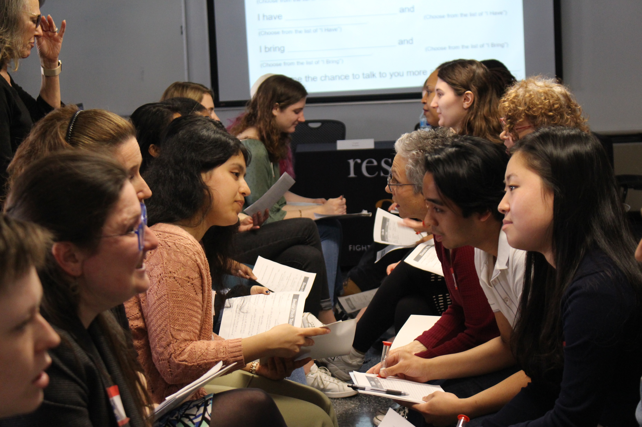
Tip #4 in Disability Etiquette: Adults with disabilities are adults. Treat them and speak to them as adults.
Do not make decisions for adults.
Do not tell them what to do or use childlike talk.
Provide them with every option you provide those without disabilities.
Use “I suggest …” or “I think …”
Read their nonverbal cues
If the option they choose presents a difficulty concerning their disability, discuss ways you could modify or adapt the choice.

Slide 17
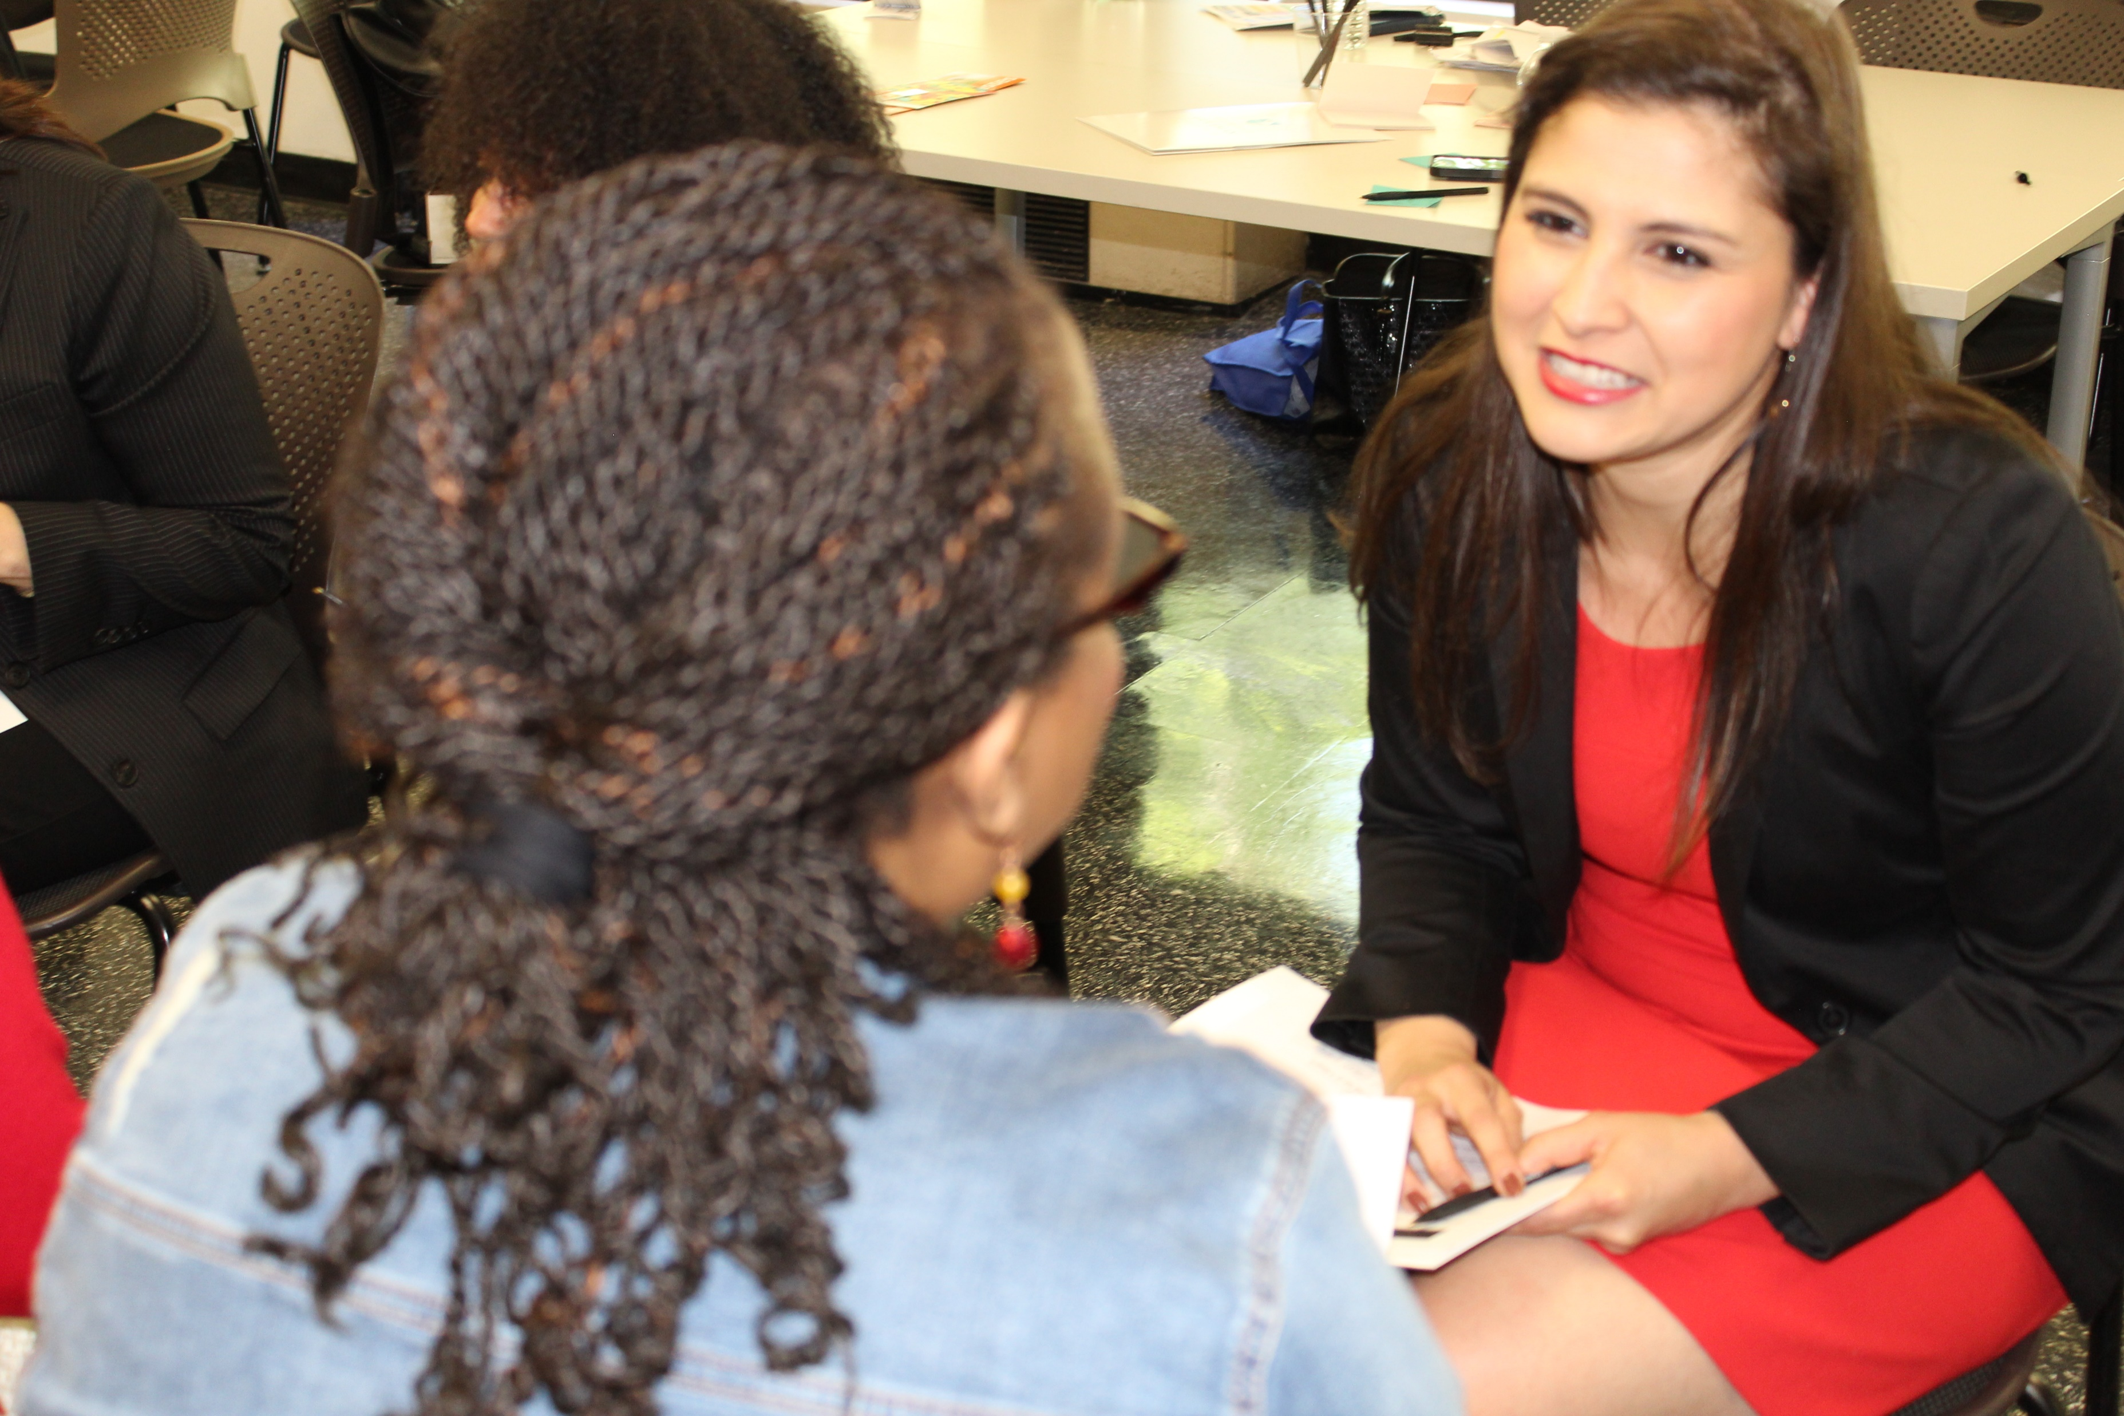
Tip #5 in Disability Etiquette: Listen attentively and patiently when talking with a person who has difficulty speaking.
Be patient and wait for the person to finish, rather than correcting, interrupting, or speaking for the person.
If necessary, ask short or close-ended questions that require short answers, a nod or shake of the head.
Never pretend to understand if you are having difficulty doing so.
Instead, repeat what you have understood and allow the person to respond. The response will clue you in and guide your understanding.

Slide 18
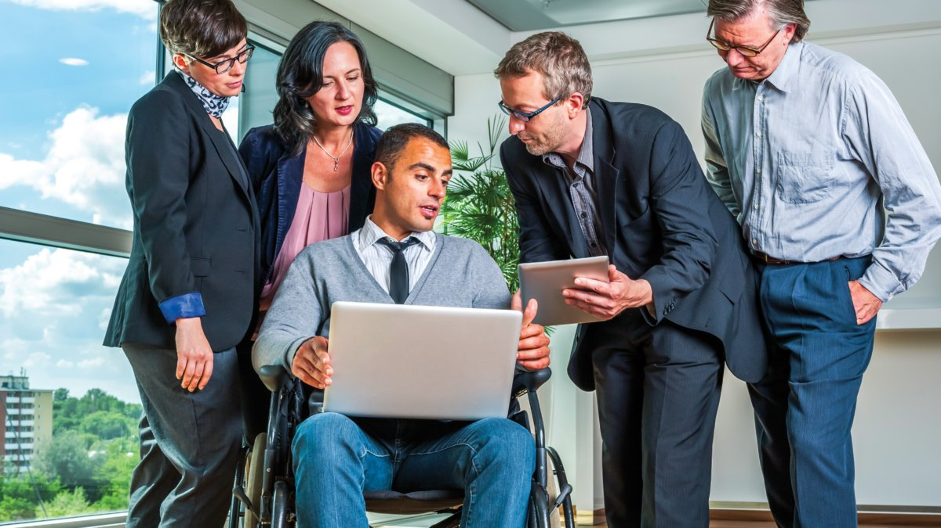
Tip #6 in Disability Etiquette: Speak directly to a person with a disability.
Look directly at the person, as you would anyone else with whom you are speaking.
Do not speak to their companion or sign language interpreter or other language interpreter.
Again, read their nonverbal cues.
A lack of immediate response does not indicate that the person can’t or won’t respond. Be patient.

Slide 19
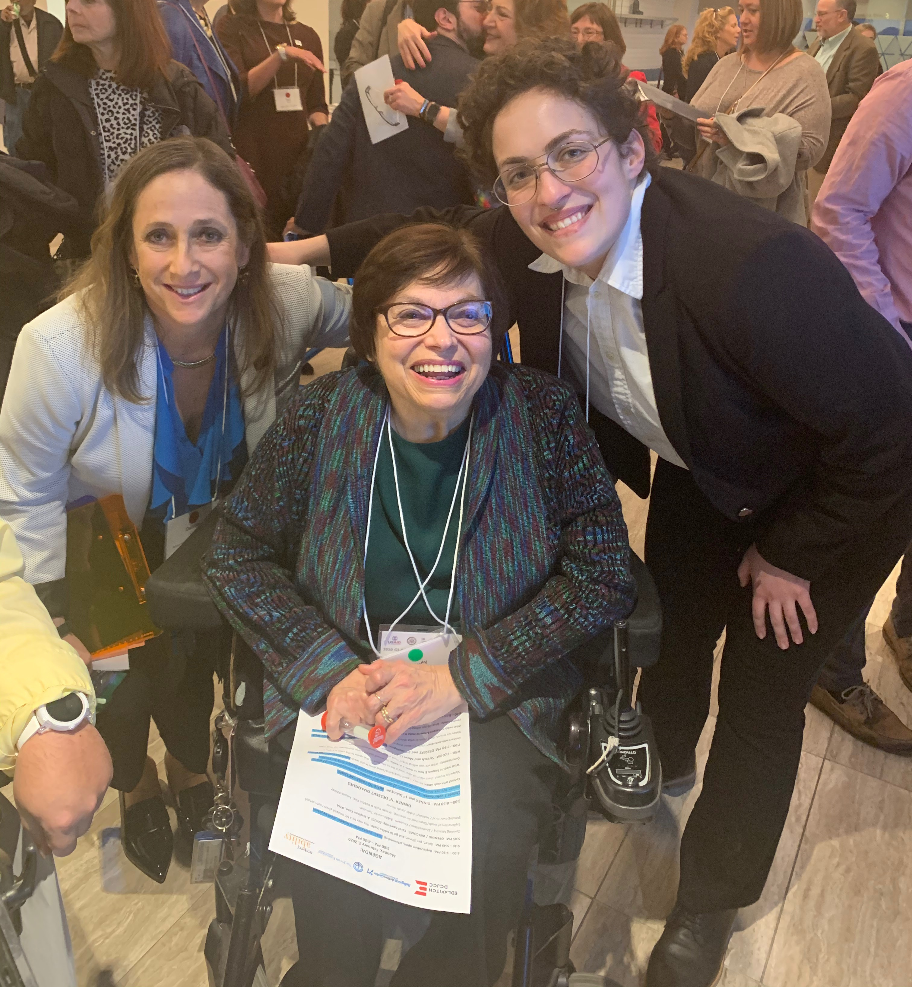
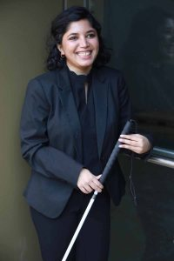
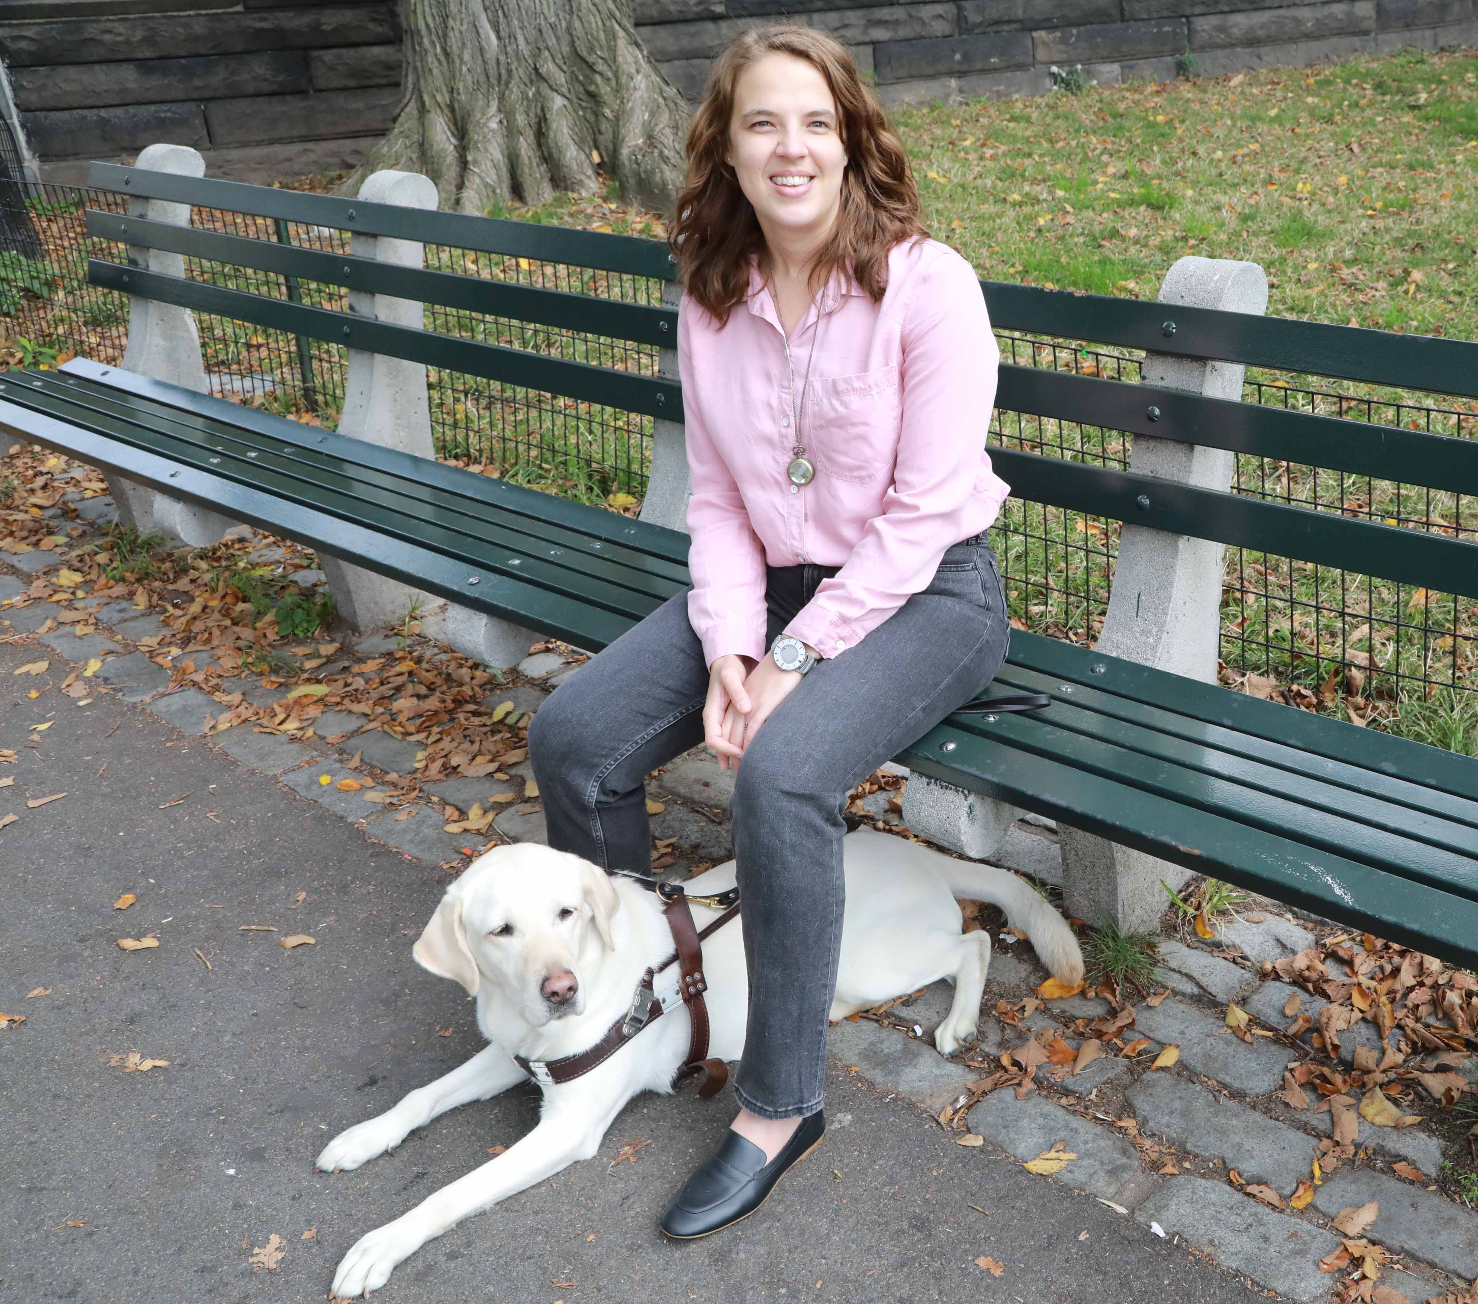
Tip #7 in Disability Etiquette: Respect Their Personal Space - Wheelchairs, scooters & canes are someone’s personal space.
If they use a wheelchair, use a chair to be eye-level if you are having a long conversation.
Do not touch or move an individual’s adaptive devices – even if they put it down or choose to leave it somewhere – without permission:
Leaning on someone’s wheelchair is like leaning on someone’s shoulder.
Putting something in someone’s carry basket is like putting something in their backpack.
It is vital that owners know where their equipment is at all times.
Service animal etiquette: Request permission from owner prior to petting a service animal.

Slide 20
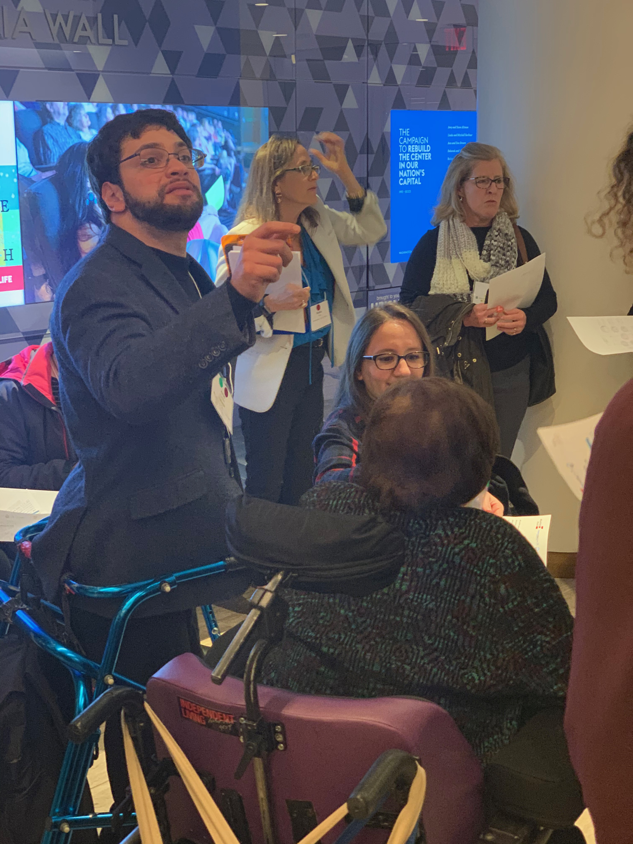
Tip #8 in Disability Etiquette:
Don’t pretend to have a disability.
Disability simulation experiences should be done for design/ navigational / educational purposes only.

Slide 21

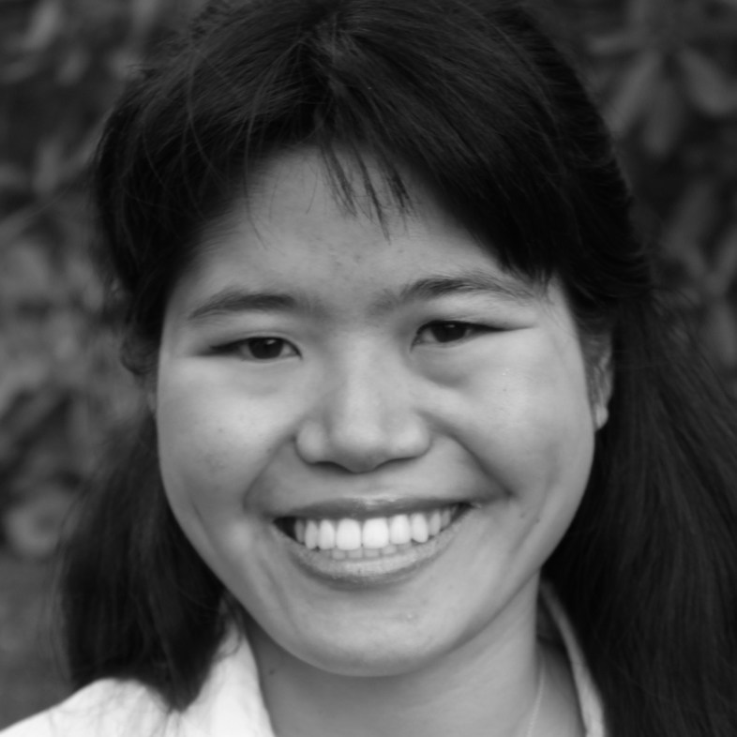
Tip #9 in Disability Etiquette: Visible and Nonvisible Disabilities – Some you can see, some you cannot
A person may make a request or act in a way that you don’t understand. That request or behavior may be disability-related.
For example, you may give seemingly simple verbal directions to someone, but the person asks you to write it down.
The person may have a learning disability that makes written communication easier – or more difficult.
Or a person may be anxious or act depressed.

Slide 22

Tip #10 in Disability Etiquette: People with mental health disabilities
– This nonvisible disability presents differently for different people.
Mental health disabilities are the pandemic’s “shadow.” People of all ages are struggling:
If you or someone you know is struggling with anxiety and/or depression, seek help. It is a sign of strength to ask for help.
Others may have trouble picking up on social cues; some may be super-sensitive.
One person may be very high energy, while someone else may appear sluggish or distant.
Treat each person as an individual.

Slide 23

Thank You!
THANK YOU!
Vivian Bass, Host
Jennifer Laszlo Mizrahi, Moderator
Ollie Cantos, Esq., Speaker
Rabbi Darby Leigh, Speaker
Dr. Donna Walton, Ed.D., Speaker
Debbie Fink, Director,
Community Outreach and Impact
Event Director/Producer
Jake Stimell, Fellow,
Community Outreach and Impact
Maya Cohen-Shields, Intern,
Community Outreach and Impact

