Slide 1
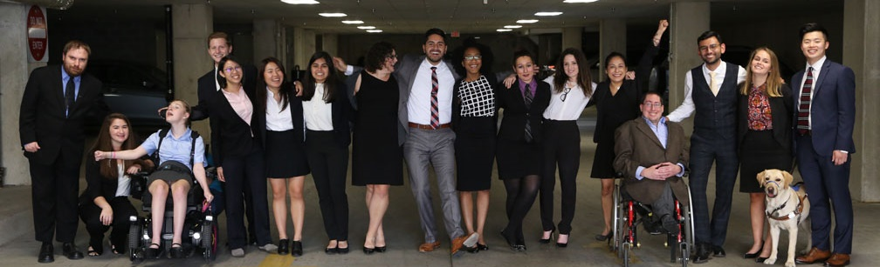

MLK Day of Service
Making Your Voices Heard: Civic Engagement Strategies for People with Disabilities in 2021 and Beyond
www.RespectAbility.org
January 18, 2021

Slide 2
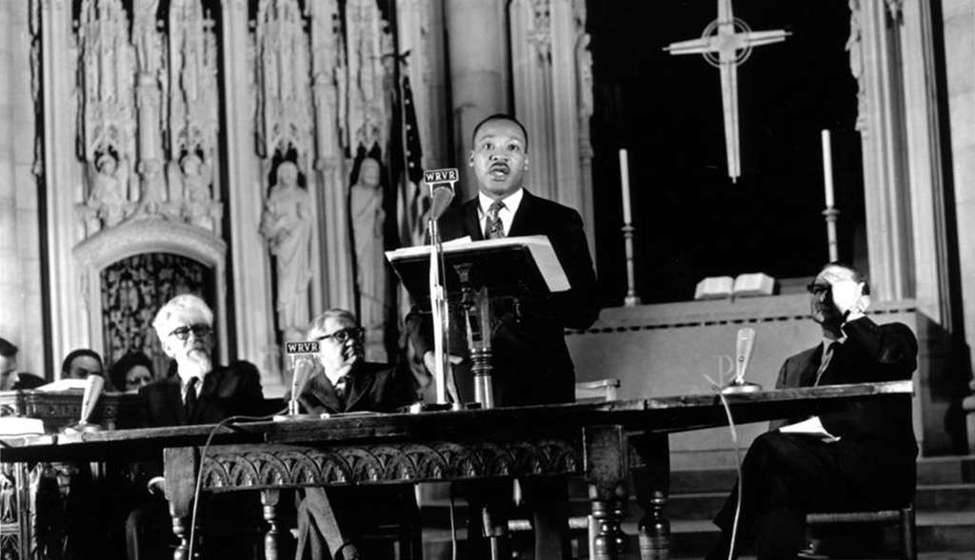
On this MLK Day of Service…
“True compassion is more than flinging a coin to a beggar; it comes to see that an edifice which produces beggars needs restructuring.”
– Martin Luther King, Jr., “A Time to Break Silence,” Riverside Church, New York City, April 4, 1967
Source: https://www.blackpast.org/african-american-history/1967-martin-luther-king-jr-beyond-vietnam-time- break-silence/

Slide 3
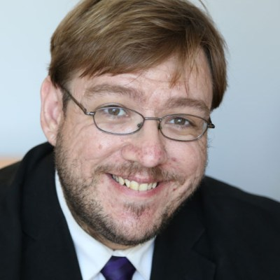
Meet your host: Philip Kahn-Pauli
Philip Kahn-Pauli is the Policy and Practices Director of RespectAbility, a nonprofit organization fighting stigmas and advancing opportunities so people with disabilities can fully participate in all aspects of community. He educates leaders at the federal and state level about best practices to expand opportunities for people with disabilities. He frequently organizes accessible webinars on best practices, which are attended by workforce boards, agencies, VR, disability organizations, public officials, artists and more – reaching a national audience of more than 2,000. Kahn-Pauli also speaks at national and regional conferences for workforce boards, agencies and professionals.
Raised by a single mother with serious chronic health issues, he is deeply committed to building a better future for people with disabilities.

Slide 4
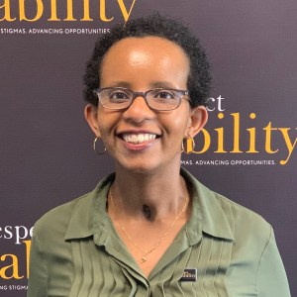
Meet your special guest: Laka Mitiku Negassa
Laka Mitiku Negassa, former Policy Fellow, National Leadership Program, Summer 2020.
Negassa recently completed her a Master’s degree in Public Health, at the George Washington University: Milken Institute School of Public Health. Negassa is interested how health policy of a country is structured and affects marginalized communities such as the disability community, including access to health care and quality of care.
Born in Ethiopia, Negassa immigrated to the United States after completing her senior year of high school. She attended the University of Maryland, Baltimore County, where she earned a Bachelor of Science, with a major in biology and minor in psychology.

Slide 5
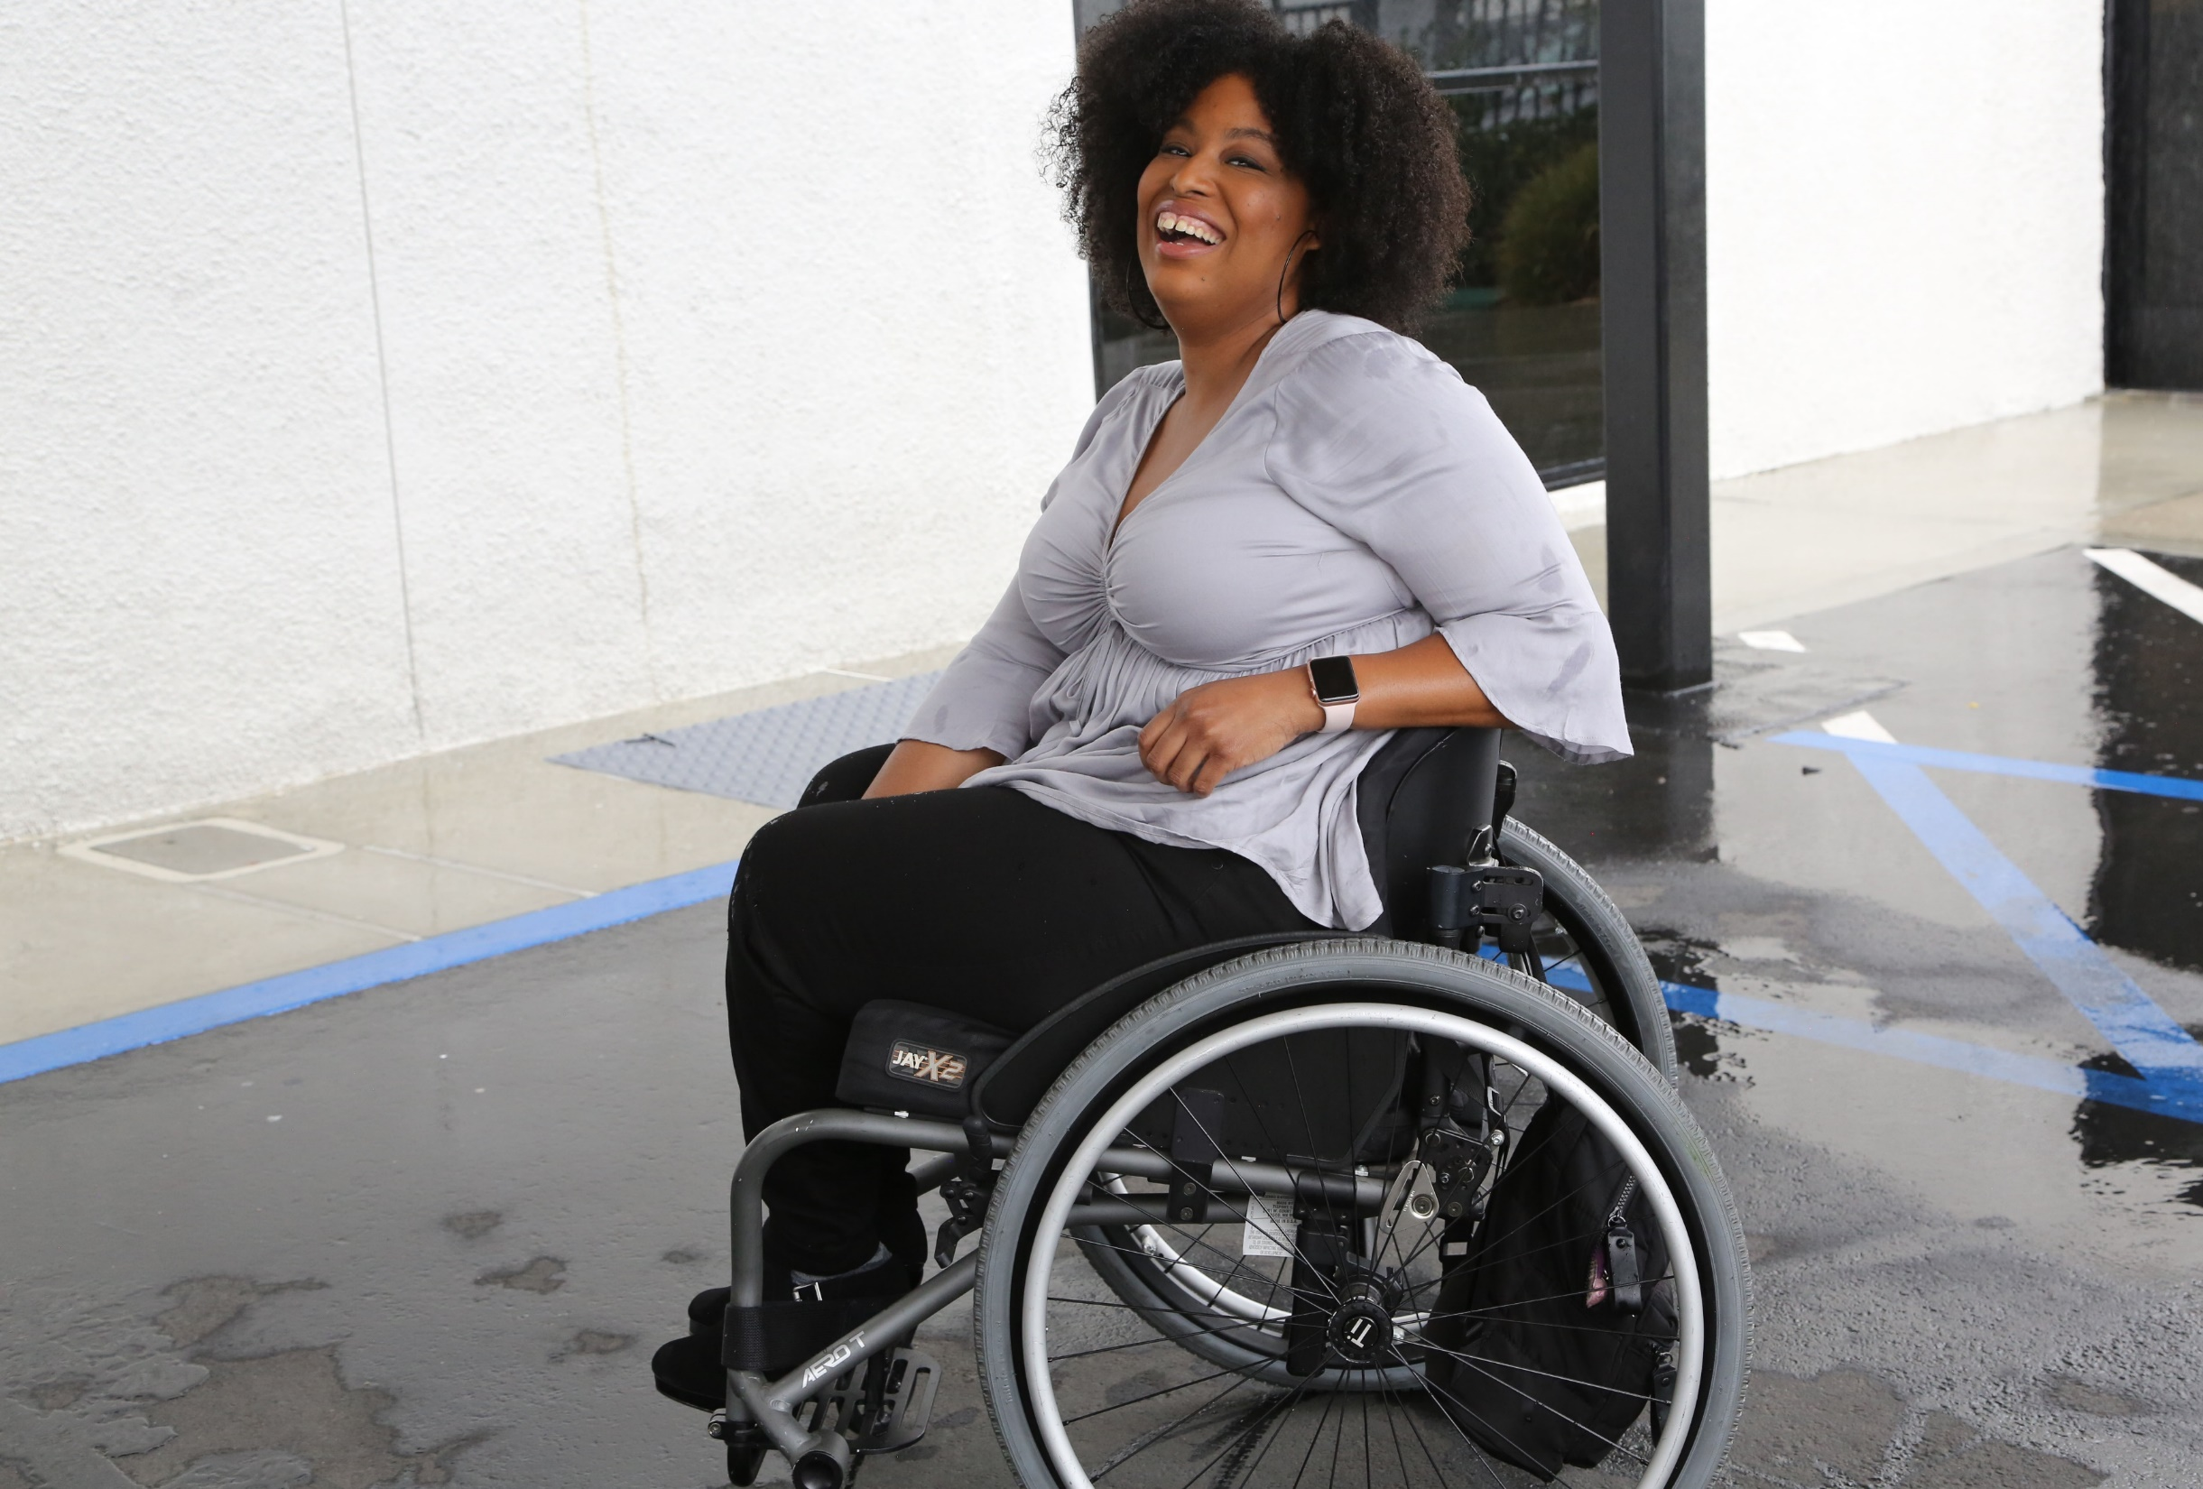

1 in 4 adults
61 million people in America have disabilities.
1-in-5
people have a disability
(physical, sensory, cognitive, mental health or other disability)

Slide 6
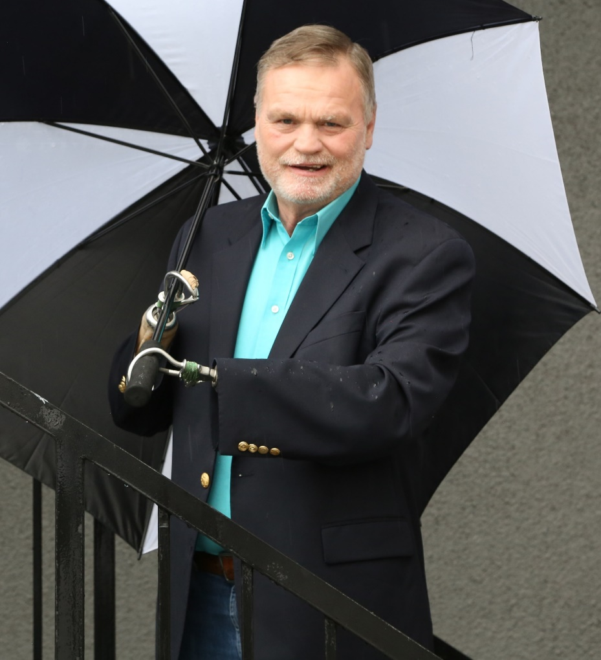
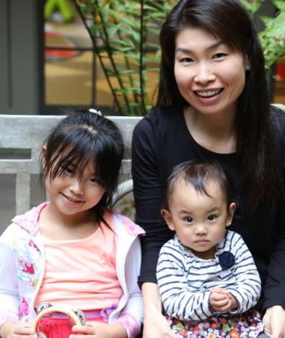
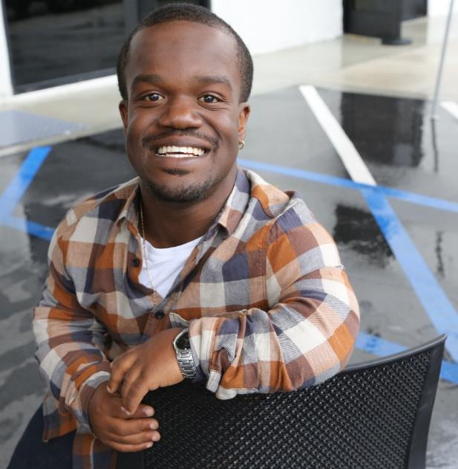
Disabilities Are….
Temporary and Permanent
Visible and Nonvisible
From Birth or Acquired Later

Slide 7
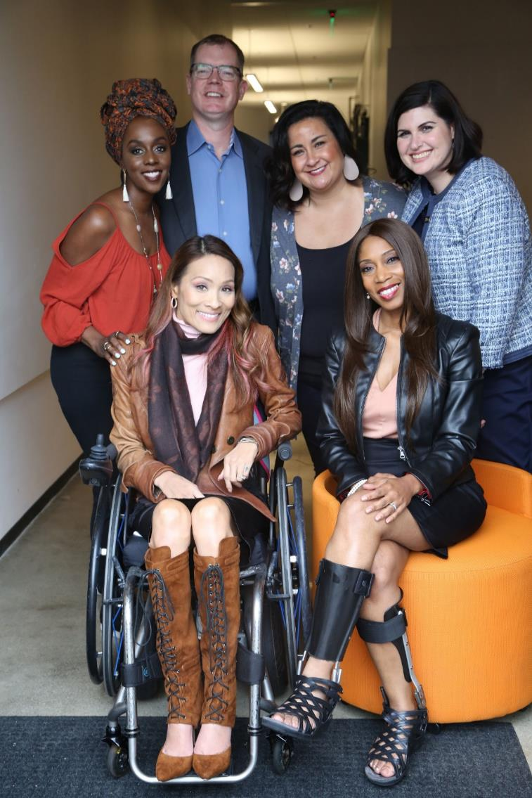
Three Facts
Anyone can join the disability community at any point.
The disability community can be cutting edge and innovative.
People with disabilities are diverse and part of all communities.

Slide 8
Intersectionality with All Communities
African Americans with Disabilities
Latinx People and Hispanics with Disabilities
Women with Disabilities
LGBTQ+ Individuals with Disabilities

Slide 9
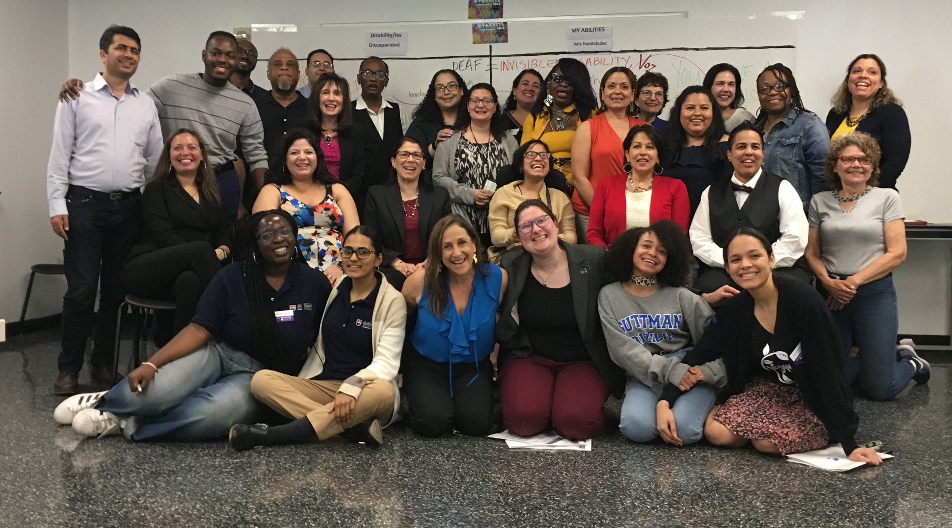
More statistics
Only 65% of people with disabilities finish high school.
Only 7% of people born with disabilities complete college.
Only 1 in 3 people with a disability have a job.

Slide 10
Laka – Question Time!
What does disability advocacy mean to you?
Why should ordinary people with disabilities get involved with disability advocacy?
Why should people write to their elected officials or write op-eds in local newspapers?
Can you tell me about your advocacy memory or experience?

Slide 11
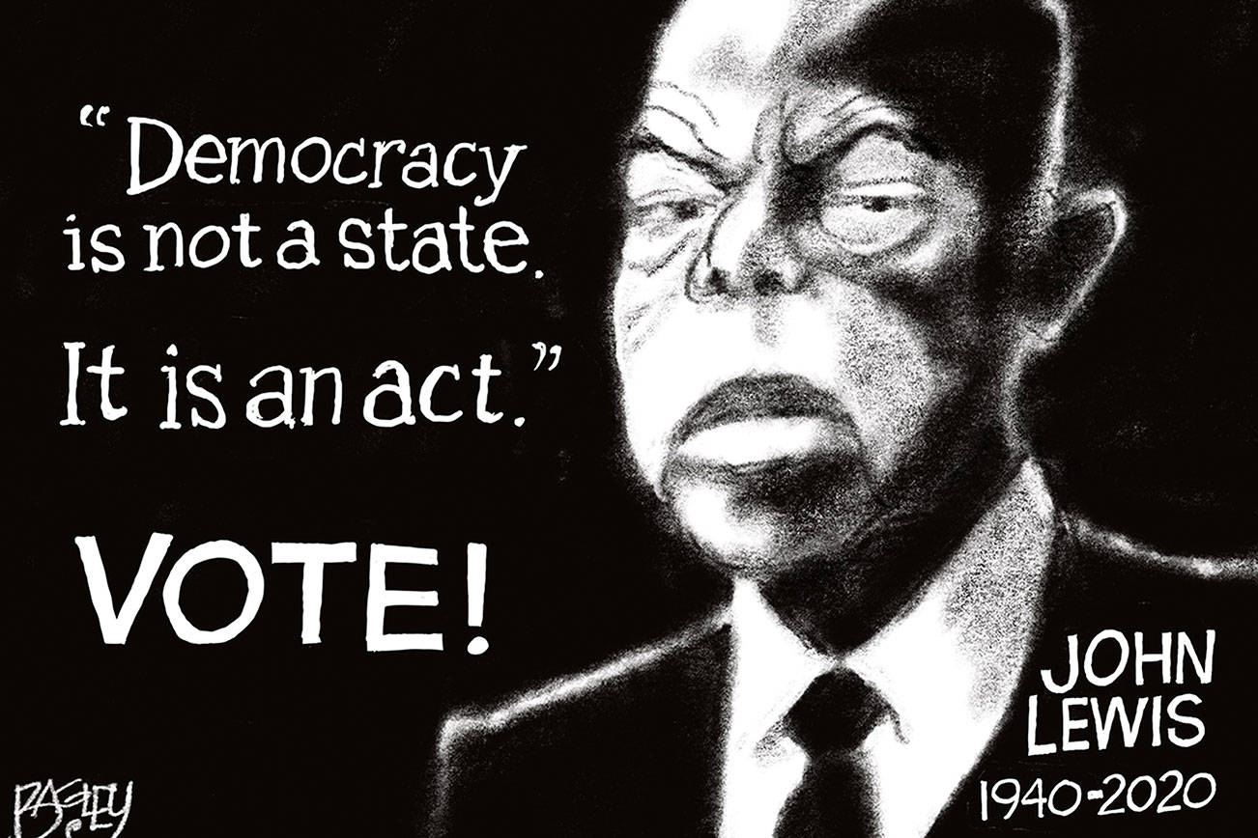
As the late John Lewis put it…
New York Times - John Lewis: Together, You Can Redeem the Soul of Our Nation – July 30th, 2020
https://www.nytimes.com/2020/07/30/opinion/john-lewis-civil-rights-america.html

Slide 12
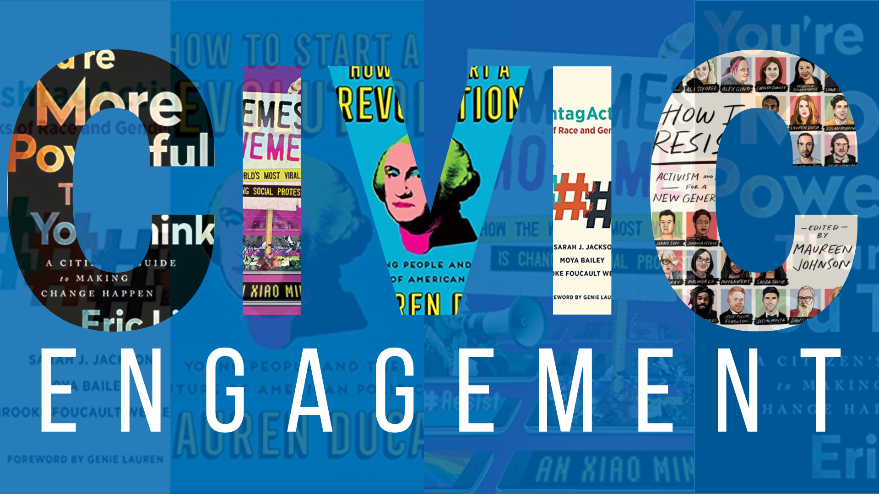
What is Civic Engagement?
Youth.gov defines Civic Engagement as: “working to make a difference in the civic life of one’s community and developing the combination of knowledge, skills, values and motivation to make that difference. It means promoting the quality of life in a community, through both political and non-political processes.”
Volunteering, national service, and service-learning are all forms of civic engagement.
Source: https://youth.gov/youth-topics/civic-engagement-and-volunteering

Slide 13
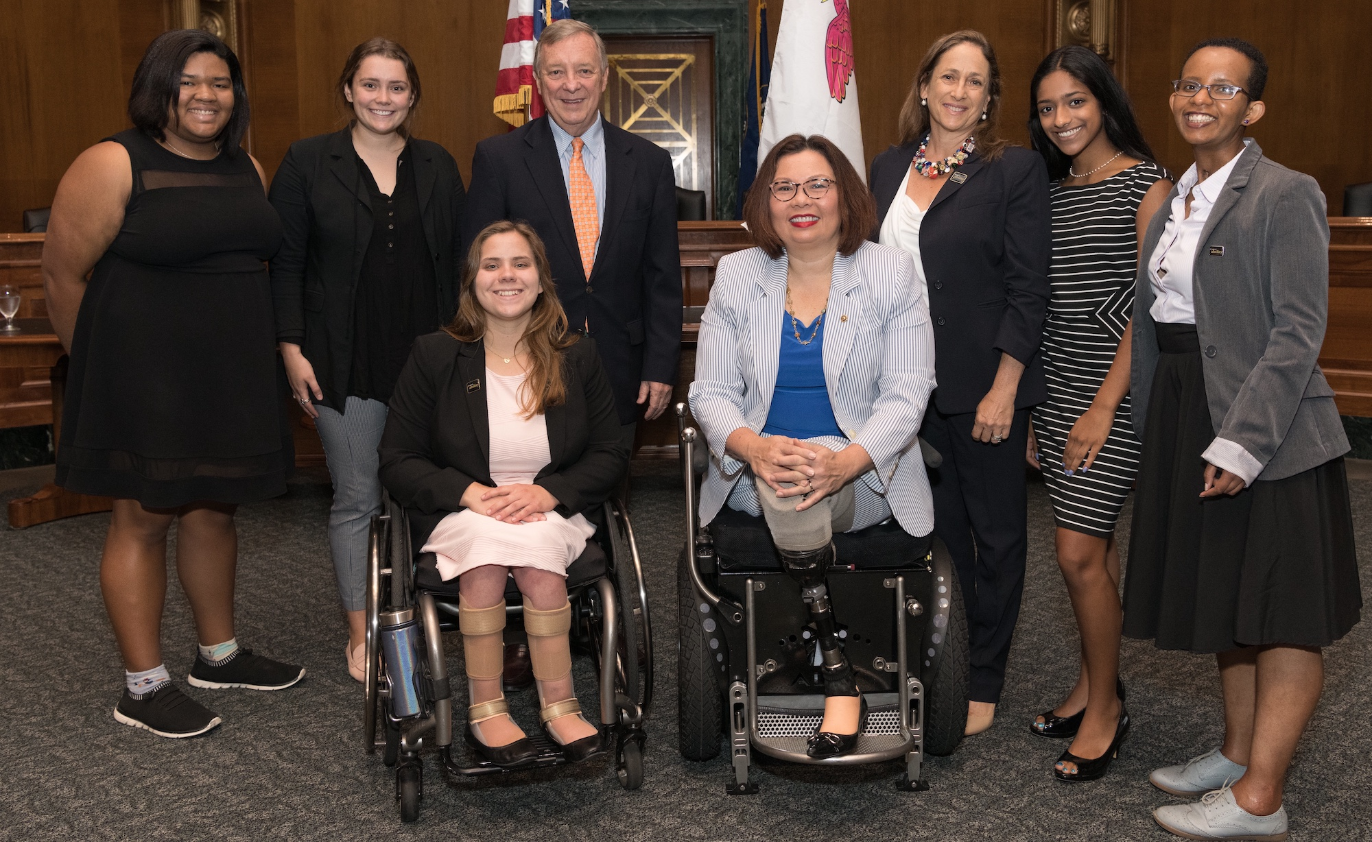
Civic Engagement Strategies for People with Disabilities
Getting involved with local, state and national elections!
Writing op-eds in your local newspapers about key issues!
Writing to your elected officials using digital advocacy tools!

Slide 14


Democracy for People with Disabilities
“All politics are local.” – Former Speaker of the House Tip O'Neill
Check out: Ballotpedia.org
Ballotpedia covers elections at the federal, state, and local levels of government.
Getting involved locally is so important!
  There are thousands of School Board elections, Municipal Government issues, and Local ballot measures where you can make your voices heard!

Slide 15
How to Contact Your Elected Officials from USA.gov
Learn how to contact your federal, state, and local elected leaders!
Local Elected Officials
  Locate your mayor by name, city, or population size.
  Find your county executive (the head of the executive branch of government in your county) by map search or your ZIP Code. The county executive may be an elected or an appointed position.
  Get contact information for your city, county, and town officials.
State Elected Officials
  Get in touch with your state governor.
  Find the names and current activities of your state legislators.
We’ll talk about connecting with your Federal Elected Officials later…

Slide 16

But what about COVID?

Slide 17
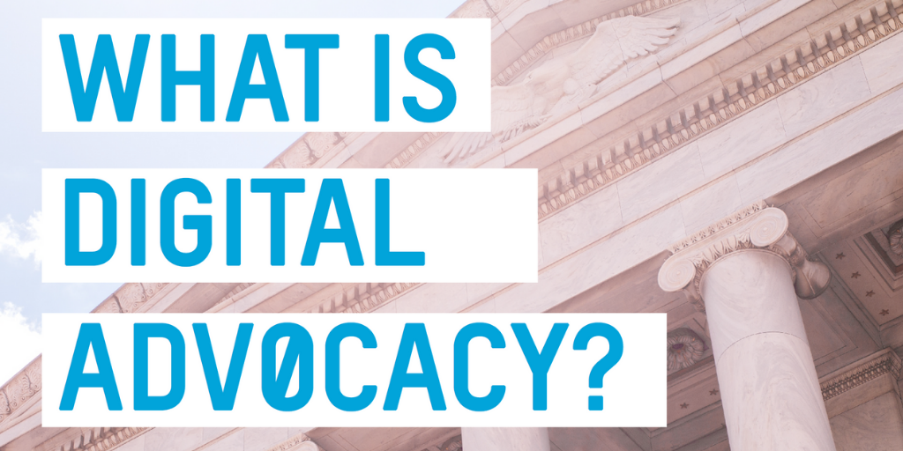
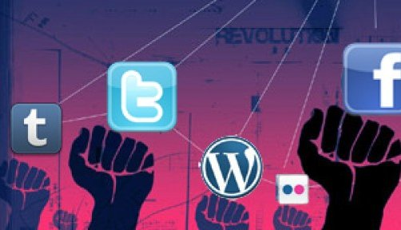
The Power of Digital Advocacy!

Slide 18
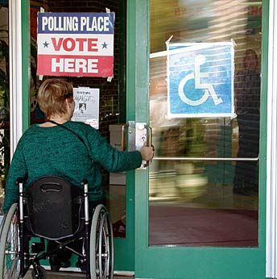
Examples of Easy Acts of Digital Advocacy!
Use social media including Facebook and Instagram advertisements
Contact state and local election officials via phone, email or social media!
Write op-eds about the challenges of voting with a disability
Share resources to help officials make more voting places accessible

Slide 19
Governors are Partners in this Work
The nation’s governors are critical partners in the continuing effort to advance job opportunities for millions of people with disabilities.
Governors drive policy, prioritize programs, and bring attention to what people with disabilities can accomplish if and when given a fair chance.
RespectAbility met with 48 governors to discuss disability employment and to advocate for best practices.
  A nonpartisan endeavor, connecting all governors to promote the idea that people with disabilities deserve the opportunity to work and achieve independence.

Slide 20
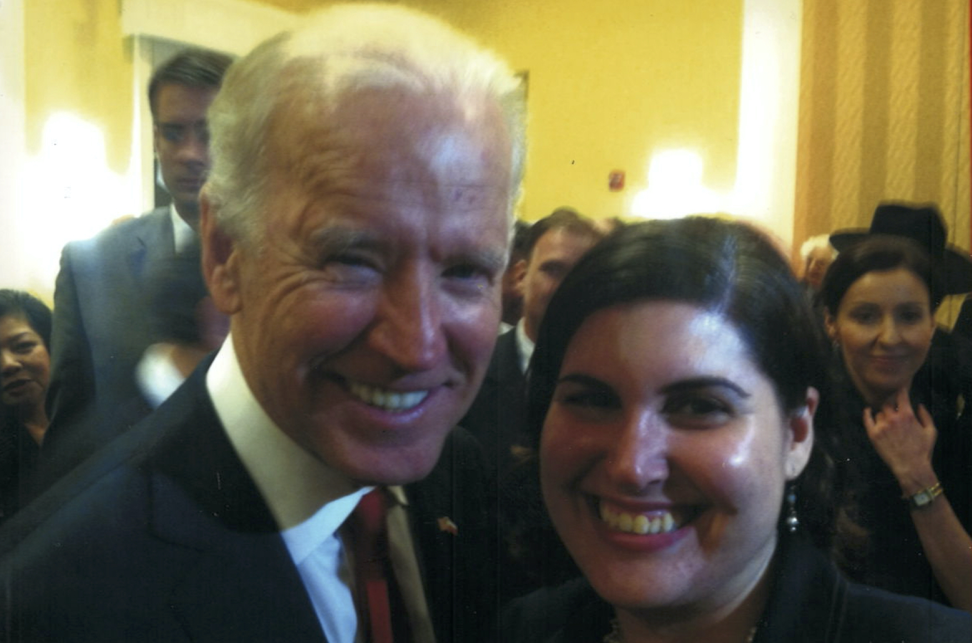
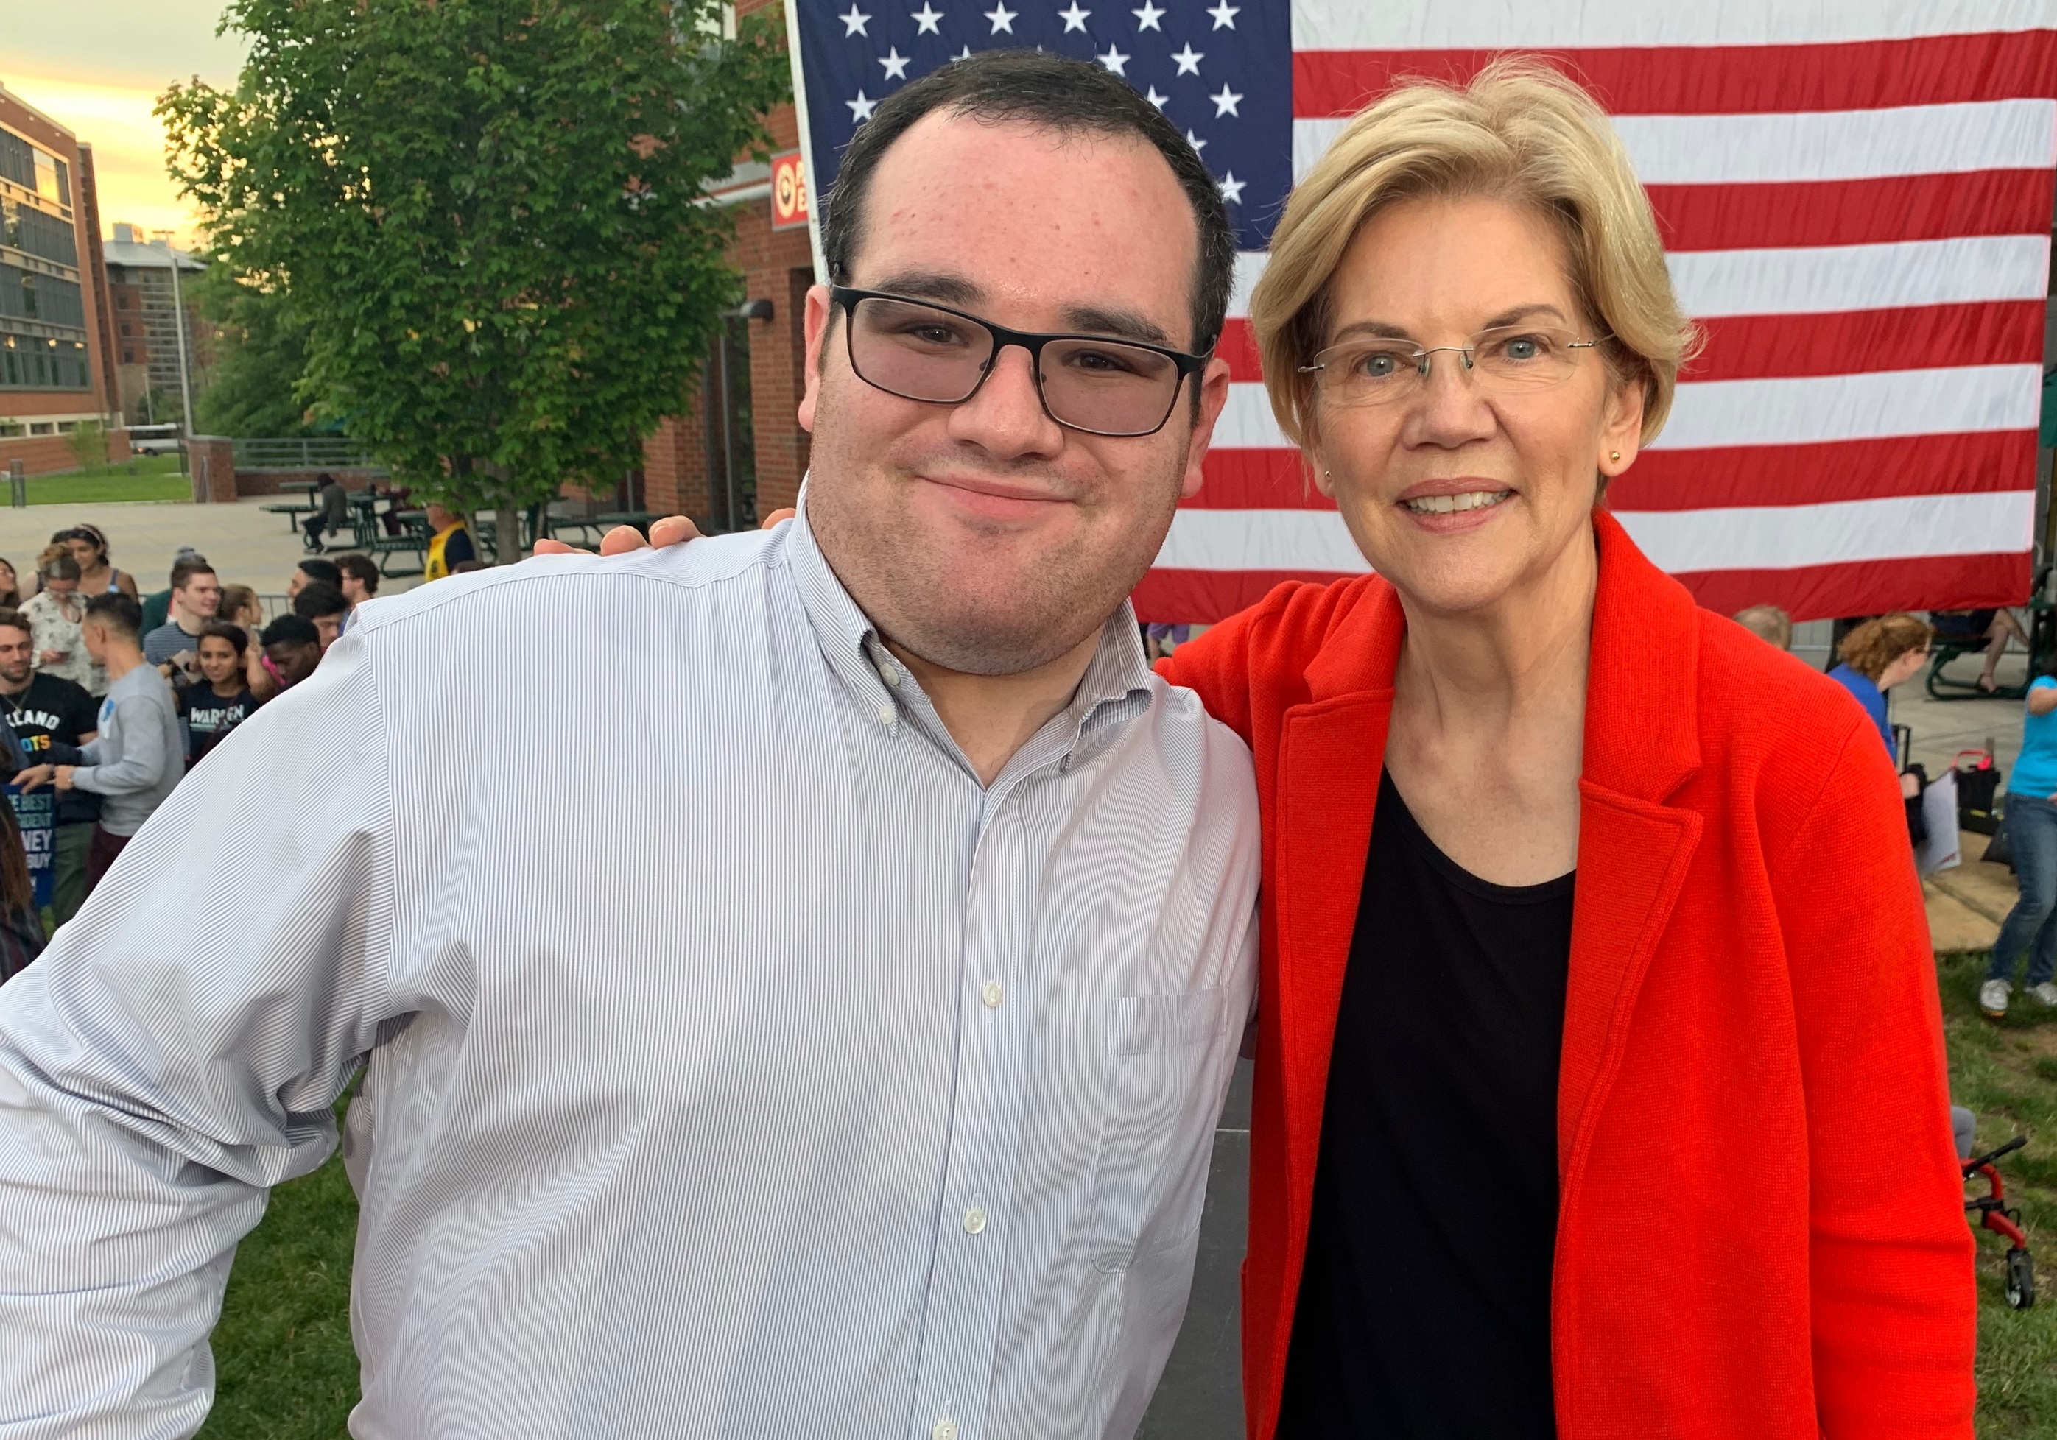
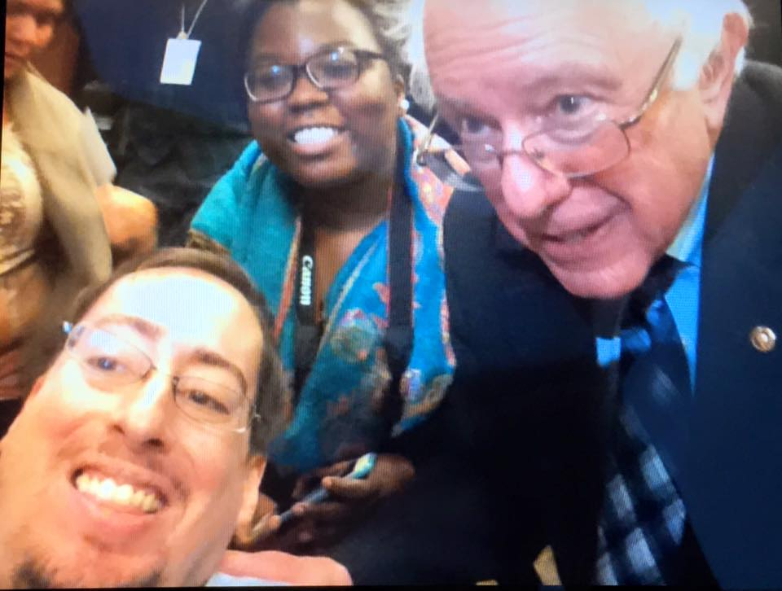
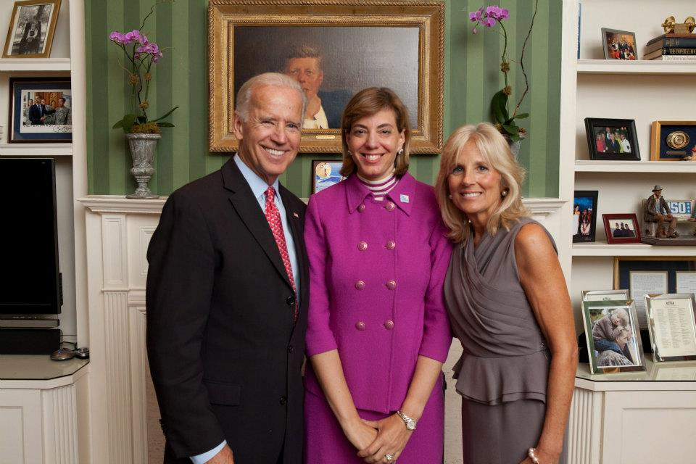
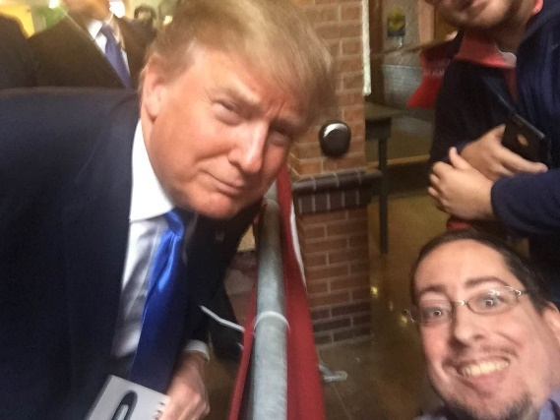
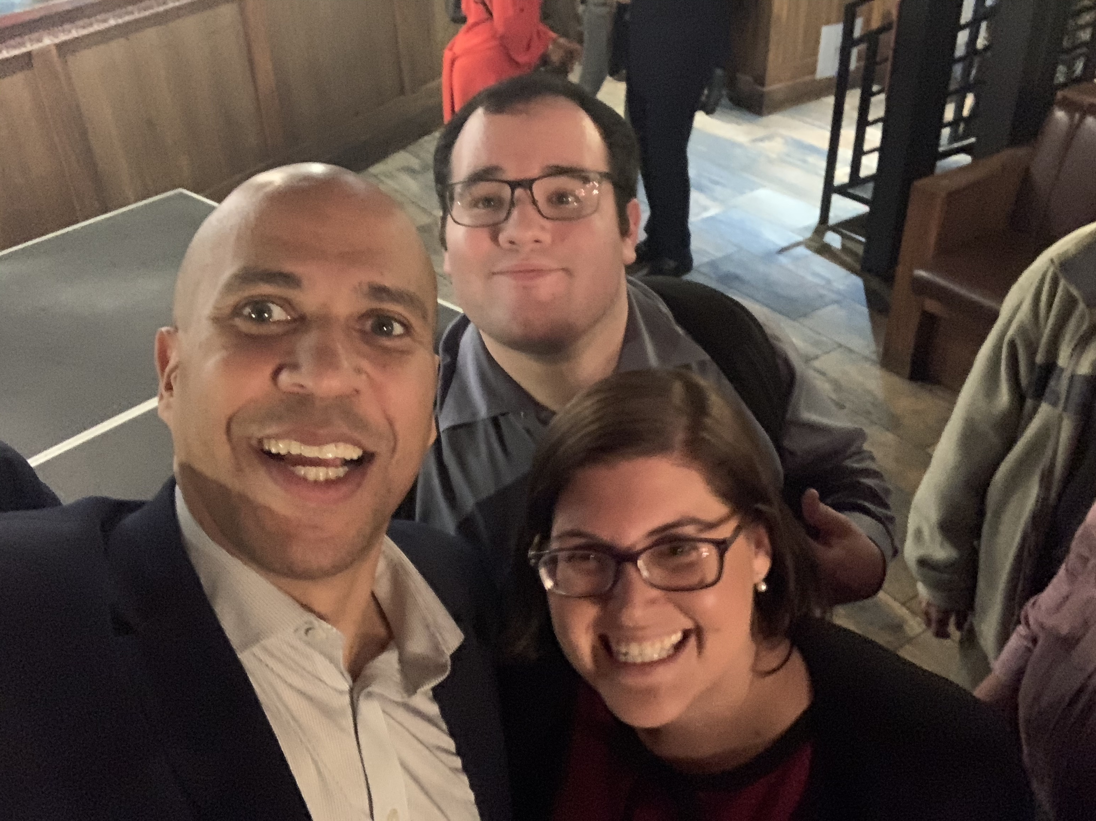
Get To Know Your Policymakers

Slide 21
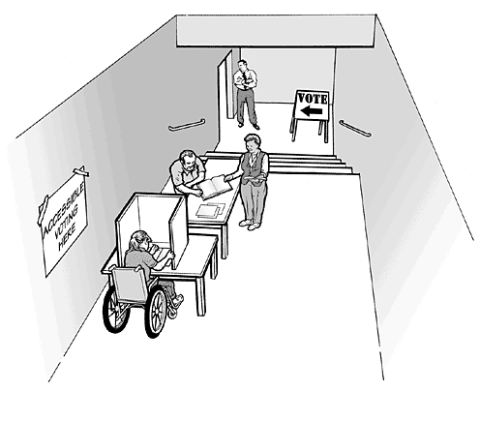
Inaccessibility Has Many Forms
Campaign events at non ADA accessible locations
Websites, ads and social media without captions and screen reader accessibility
Lack of ASL interpreters when requested at events
Lack of translations (Spanish) and too complex wording
Lack of ramp/elevator
Lack of accessibility in parking lot
Lack of accessible bathroom
Lack of Braille ballot
Inaccessible voting booths
Or when those who require assistance are judged to be not capable of voting by polling officials

Slide 22
An Advocacy Agenda for Policymakers
We want policymakers to make sure that workers with disabilities are part of plans to recover from the current economic crisis.
We want RespectAbility volunteers to virtually meet with policymakers or their staff to talk about jobs for people with disabilities.
We want policymakers to do press events at programs / projects supporting Competitive Integrated Employment for people with disabilities.
BOTTOM LINE: We want policymakers to become “champions” on education, skills and jobs for people with disabilities.

Slide 23

Now for the writing assignment!

Slide 24
Why Write Op-eds?
An opportunity to get your voice heard;
A chance to educate the public through facts and personal experiences;
An opportunity to change public opinion and improve legislation.
What should Op-eds say?
  Most people with disabilities want to work;
  Nearly three-quarters of people with disabilities want jobs and independence more than benefits;
  Hiring people with disabilities can increase company profitability and save taxpayers money.

Slide 25
What are your Media Goals?
Who specifically do you want to impact? Governor? Employers? People with Disabilities?
What do THEY read/watch?
Whose opinions do they trust?
What facts will move their brains?
What “human interest” story will win their hearts?
Picture your reader/viewer when you write or do interviews!

Slide 26
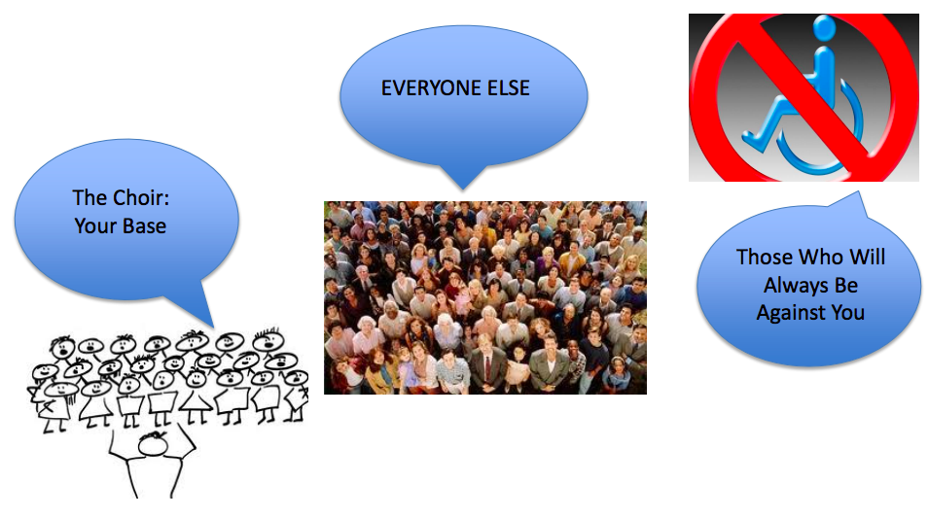
Focus on the Persuadables!

Slide 27
You Don’t Have to Be a Professional Writer or PR Expert!
Your Most Important Tools:
Your authentic experience: People will listen when you speak from your heart and true experiences
A desire to share and educate: Help people understand why your issue is important and how progress can be achieved
The facts: Do your research and be accurate

Slide 28
Tips for Interviews & Op-eds
Number One Rule: Use the “KISS” Method
KISS = Keep It Simple & Straightforward
  Don’t use jargon and technical terms
  Use your personal experience to help others understand and care
  Use facts – and double-check for accuracy
  Use “people-first” language – terms that respect people with disabilities.
  You are in a unique position to shape the public image for people with disabilities

Slide 29
Structure/Components of an Op-ed
First paragraph: Concisely introduce your topic
State your argument
Give 3 facts that support your argument
Don’t be afraid to use your personal experience
Ensure each paragraph supports your argument
Be your own critic: After each paragraph, ask yourself: “Why is this important? Why should others care?”
Link your conclusion back to your original point How long?
Typically 500 words or less! But check the guidelines!

Slide 30
Your Key Messages
Our communities are at their best when all people, including people with disabilities, have the opportunity to get skills, jobs and succeed.
People with disabilities bring unique characteristics and talents to workplaces that benefit employers and organizations. Stephen Hawking was a genius who happened to use a wheelchair. People with disabilities can work in hospitals, hotels and excel in computer programming, software development and in many other areas of information technology and other fields.

Slide 31
Your Key Messages (2)
Companies including JPMC, Starbucks and Bank of America have shown that employees with disabilities are loyal, successful and help them become more profitable. If we find the right people for the right jobs it can increase the bottom line of all sorts of companies.
Government policies that help people with disabilities get and keep jobs are a win-win because they allow people with disabilities the dignity and financial benefits of work. Those same policies also grow our economy and save taxpayer money.

Slide 32
Where to Send it?
Check out guidelines for various publications & alternative publication venues: http://www.ccmc.org/node/16179
Google your top media outlets and then do searches on their websites.
See which reporters cover disability issues at that media outlet.

Slide 33
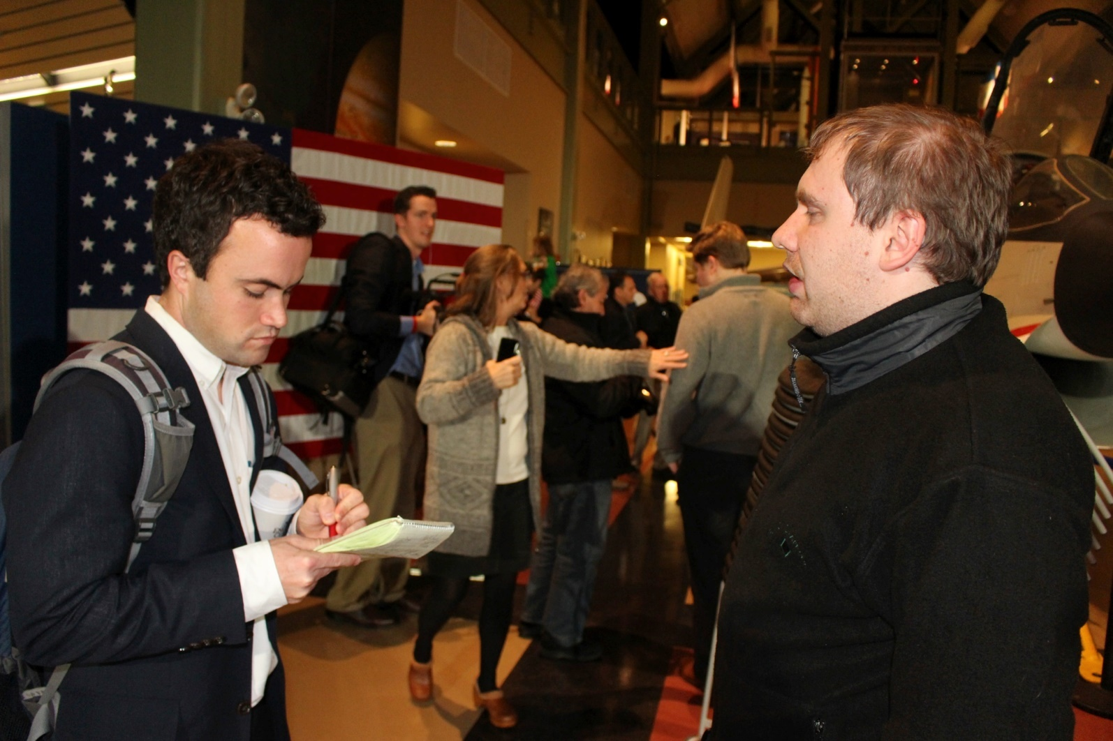
People with Disabilities Interviewed by Press
Appeared on PBS NewsHour with Judy Woodruff
Front page stories on The New York Times and The Washington Post

Slide 34
Op-eds Written by RespectAbility Volunteers
Albuquerque Journal
Savannah Now
Idaho Statemsan
The News & Observer
D5 Coalition
National Committee for Responsive Philanthropy
Nonprofit Quarterly

Slide 35
Let’s write to our elected officials now!

Slide 36
Learn more about MLK and disability issues
Independence Care System-New York – Rev. Dr. Martin Luther King and the Disability Rights Movement
Mobility Works – How Dr. Martin Luther King, Jr. Helped Shape the Disability Rights Movement
Friendship Circle – 10 Disability Awareness Lessons Learned From Dr. Martin Luther King, Jr.

Slide 37
Webinars on Civic Engagement
Los Angeles Civic Engagement Training
#ADA30 Summit: Leadership: Making A Difference for the Future
Seattle Online Session: How Disability Inclusion & Equity Can Add to Your Success
How to Write Winning Op-eds on Jobs for People with Disabilities
Advocating With Your Governor on Jobs for People with Disabilities
Free RespectAbility Volunteer Training – Education & Skills Building Engagement
Free RespectAbility Volunteer Training – Advancing Jobs for People with Disabilities

Slide 38
Equity and Access Webinar Series
Disability 101
Disability History
How to Ensure Accessible Events
How to Recruit, Accommodate and Promote People with Disabilities for Volunteer Leadership, Board Positions and Paid Employment
How to Ensure A Welcoming Lexicon and Inclusive Storytelling
How to Ensure Accessible Websites and Social Media
Premium Skills Workshop in Social Media Accessibility
How to Ensure Legal Rights and Compliance Obligations: Exploring the Rights of Employees and Participants, and the Obligations of Nonprofit Organizations Under the Law

Slide 39
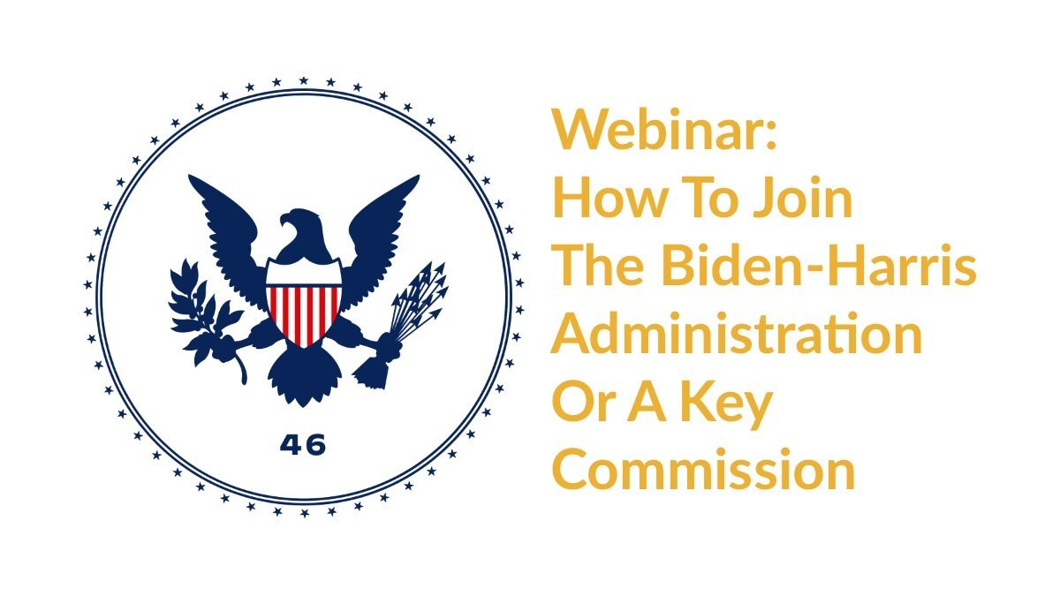
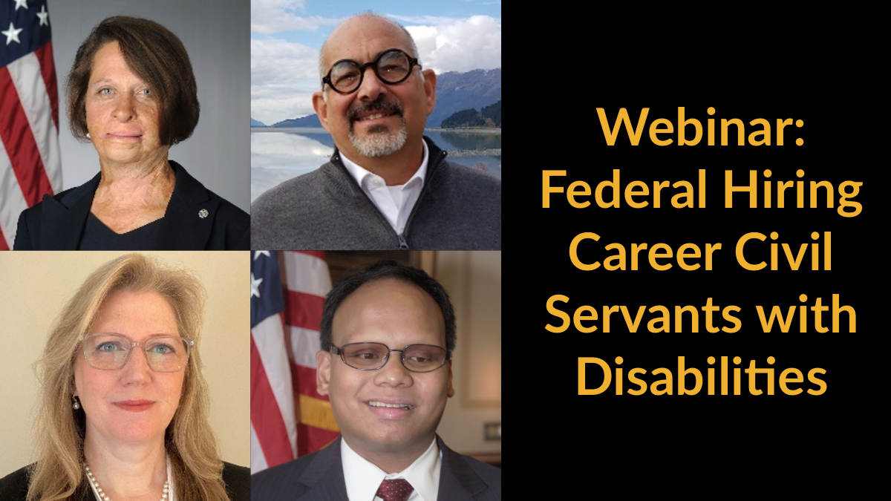
Webinars: Work in Public Service
Watch part 1
Watch part 2

Slide 40
Thank you!
THANK YOU!
Philip Kahn-Pauli
Policy and Practices Director, RespectAbility
PhilipP@RespectAbility.org
(202) 525-8755

